Slide 1


UPH Simulation with Automation Line Layout
Name : Richard Schiepek
Computer Science, University of Applied Sciences Rapperswil
Mentor : Rattagarn Vardcheeranon
Department : Tooling Software Department

Slide 2
Agenda
Objective
Requirements
Technology
Procedure
Live demonstration
Suggestion
Reflection

Slide 3

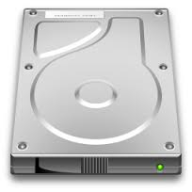
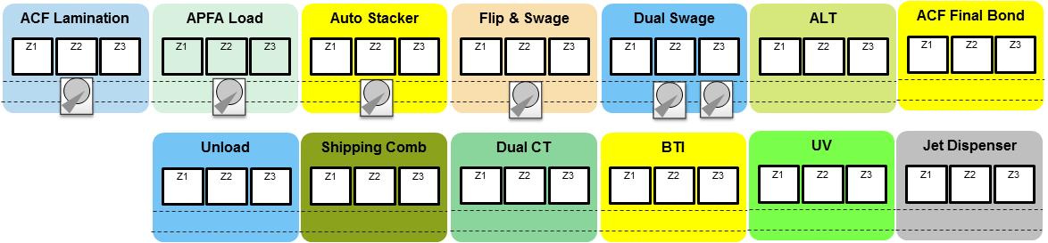
Objective
out to out
Software Simulation of an assembly line
Calculate “out to out” time and uph
Detect “traffic jam”
Validate line concept before physical implementation

Slide 4
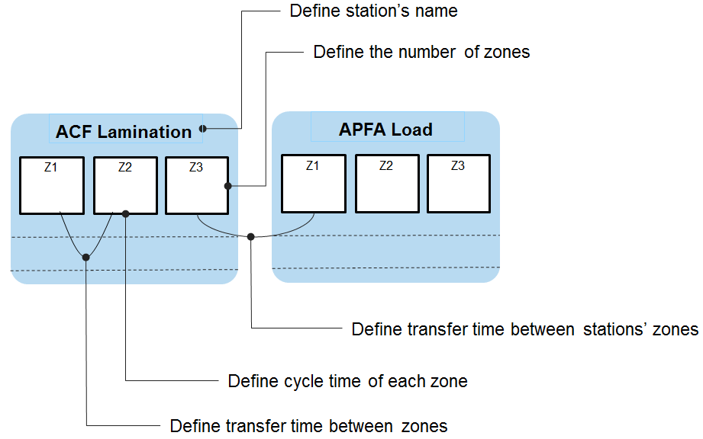
Requirements
Configure and visualize line layout
Save and load assembly lines
Run simulation step by step / rounds
Calculate uph and out to out
Dualzone / Autostacker logic

Slide 5
Requirements
1 sec
Long Tail Alignment
Stacker
Swage
Auto Stacker
Flip & Swage
Dual Swage
ALT
Zone1
2
Zone2
4
Zone3
2
Zone1
2
Zone2
10/2
Zone3
2
Zone1
10/2
Zone2
2
Zone3
10/2
Zone1
4
Zone2
5
Zone3
2
1
1
1
1
1
1
1
1
2
2
2
1/1

Slide 6
Requirements
2 sec
Long Tail Alignment
Stacker
Swage
Auto Stacker
Flip & Swage
Dual Swage
ALT
Zone1
2
Zone2
4
Zone3
2
Zone1
2
Zone2
10/2
Zone3
2
Zone1
10/2
Zone2
2
Zone3
10/2
Zone1
4
Zone2
5
Zone3
2
1
1
1
1
1
1
1
1
2
2
2
2/2

Slide 7
Requirements
3 sec
Long Tail Alignment
Stacker
Swage
Auto Stacker
Flip & Swage
Dual Swage
ALT
Zone1
2
Zone2
4
Zone3
2
Zone1
2
Zone2
10/2
Zone3
2
Zone1
10/2
Zone2
2
Zone3
10/2
Zone1
4
Zone2
5
Zone3
2
1
1
1
1
1
1
1
1
2
2
2
1/3

Slide 8
Requirements
4 sec
Long Tail Alignment
Stacker
Swage
Auto Stacker
Flip & Swage
Dual Swage
ALT
Zone1
2
Zone2
4
Zone3
2
Zone1
2
Zone2
10/2
Zone3
2
Zone1
10/2
Zone2
2
Zone3
10/2
Zone1
4
Zone2
5
Zone3
2
1
1
1
1
1
1
1
1
2
2
2
1/1
1/4

Slide 9
Requirements
5 sec
Long Tail Alignment
Stacker
Swage
Auto Stacker
Flip & Swage
Dual Swage
ALT
Zone1
2
Zone2
4
Zone3
2
Zone1
2
Zone2
10/2
Zone3
2
Zone1
10/2
Zone2
2
Zone3
10/2
Zone1
4
Zone2
5
Zone3
2
1
1
1
1
1
1
1
1
2
2
2
2/2
2/5

Slide 10
Requirements
6 sec
Long Tail Alignment
Stacker
Swage
Auto Stacker
Flip & Swage
Dual Swage
ALT
Zone1
2
Zone2
4
Zone3
2
Zone1
2
Zone2
10/2
Zone3
2
Zone1
10/2
Zone2
2
Zone3
10/2
Zone1
4
Zone2
5
Zone3
2
1
1
1
1
1
1
1
1
2
2
2
3/3
3/6

Slide 11
Requirements
7 sec
Long Tail Alignment
Stacker
Swage
Auto Stacker
Flip & Swage
Dual Swage
ALT
Zone1
2
Zone2
4
Zone3
2
Zone1
2
Zone2
10/2
Zone3
2
Zone1
10/2
Zone2
2
Zone3
10/2
Zone1
4
Zone2
5
Zone3
2
1
1
1
1
1
1
1
1
2
2
2
4/4
4/7

Slide 12
Requirements
8 sec
Long Tail Alignment
Stacker
Swage
Auto Stacker
Flip & Swage
Dual Swage
ALT
Zone1
2
Zone2
4
Zone3
2
Zone1
2
Zone2
10/2
Zone3
2
Zone1
10/2
Zone2
2
Zone3
10/2
Zone1
4
Zone2
5
Zone3
2
1
1
1
1
1
1
1
1
2
2
2
1/5
1/8

Slide 13
Requirements
9 sec
Long Tail Alignment
Stacker
Swage
Auto Stacker
Flip & Swage
Dual Swage
ALT
Zone1
2
Zone2
4
Zone3
2
Zone1
2
Zone2
10/2
Zone3
2
Zone1
10/2
Zone2
2
Zone3
10/2
Zone1
4
Zone2
5
Zone3
2
1
1
1
1
1
1
1
1
2
2
2
1/1
1/6
1/9

Slide 14
Requirements
10 sec
Long Tail Alignment
Stacker
Swage
Auto Stacker
Flip & Swage
Dual Swage
ALT
Zone1
2
Zone2
4
Zone3
2
Zone1
2
Zone2
10/2
Zone3
2
Zone1
10/2
Zone2
2
Zone3
10/2
Zone1
4
Zone2
5
Zone3
2
1
1
1
1
1
1
1
1
2
2
2
2/2
2/7
2/10

Slide 15
Requirements
11 sec
Long Tail Alignment
Stacker
Swage
Auto Stacker
Flip & Swage
Dual Swage
ALT
Zone1
2
Zone2
4
Zone3
2
Zone1
2
Zone2
10/2
Zone3
2
Zone1
10/2
Zone2
2
Zone3
10/2
Zone1
4
Zone2
5
Zone3
2
1
1
1
1
1
1
1
1
2
2
2
3/3
3/8
1/11

Slide 16
Requirements
12 sec
Long Tail Alignment
Stacker
Swage
Auto Stacker
Flip & Swage
Dual Swage
ALT
Zone1
2
Zone2
4
Zone3
2
Zone1
2
Zone2
10/2
Zone3
2
Zone1
10/2
Zone2
2
Zone3
10/2
Zone1
4
Zone2
5
Zone3
2
1
1
1
1
1
1
1
1
2
2
2
4/4
4/9
2/12

Slide 17
Requirements
13 sec
Long Tail Alignment
Stacker
Swage
Auto Stacker
Flip & Swage
Dual Swage
ALT
Zone1
2
Zone2
4
Zone3
2
Zone1
2
Zone2
10/2
Zone3
2
Zone1
10/2
Zone2
2
Zone3
10/2
Zone1
4
Zone2
5
Zone3
2
1
1
1
1
1
1
1
1
2
2
2
1/5
1/10
1/13

Slide 18
Requirements
14 sec
Long Tail Alignment
Stacker
Swage
Auto Stacker
Flip & Swage
Dual Swage
ALT
Zone1
2
Zone2
4
Zone3
2
Zone1
2
Zone2
10/2
Zone3
2
Zone1
10/2
Zone2
2
Zone3
10/2
Zone1
4
Zone2
5
Zone3
2
1
1
1
1
1
1
1
1
2
2
2
1/1
1/6
1/11
2/14

Slide 19
Requirements
15 sec
Long Tail Alignment
Stacker
Swage
Auto Stacker
Flip & Swage
Dual Swage
ALT
Zone1
2
Zone2
4
Zone3
2
Zone1
2
Zone2
10/2
Zone3
2
Zone1
10/2
Zone2
2
Zone3
10/2
Zone1
4
Zone2
5
Zone3
2
1
1
1
1
1
1
1
1
2
2
2
2/2
2/7
2/12
1/15

Slide 20
Requirements
16 sec
Long Tail Alignment
Stacker
Swage
Auto Stacker
Flip & Swage
Dual Swage
ALT
Zone1
2
Zone2
4
Zone3
2
Zone1
2
Zone2
10/2
Zone3
2
Zone1
10/2
Zone2
2
Zone3
10/2
Zone1
4
Zone2
5
Zone3
2
1
1
1
1
1
1
1
1
2
2
2
3/3
3/8
1/13
1/16

Slide 21
Requirements
17 sec
Long Tail Alignment
Stacker
Swage
Auto Stacker
Flip & Swage
Dual Swage
ALT
Zone1
2
Zone2
4
Zone3
2
Zone1
2
Zone2
10/2
Zone3
2
Zone1
10/2
Zone2
2
Zone3
10/2
Zone1
4
Zone2
5
Zone3
2
1
1
1
1
1
1
1
1
2
2
2
4/4
4/9
2/14
2/17

Slide 22
Requirements
18 sec
Long Tail Alignment
Stacker
Swage
Auto Stacker
Flip & Swage
Dual Swage
ALT
Zone1
2
Zone2
4
Zone3
2
Zone1
2
Zone2
10/2
Zone3
2
Zone1
10/2
Zone2
2
Zone3
10/2
Zone1
4
Zone2
5
Zone3
2
1
1
1
1
1
1
1
1
2
2
2
1/5
1/10
1/15
1/18

Slide 23
Requirements
19 sec
Long Tail Alignment
Stacker
Swage
Auto Stacker
Flip & Swage
Dual Swage
ALT
Zone1
2
Zone2
4
Zone3
2
Zone1
2
Zone2
10/2
Zone3
2
Zone1
10/2
Zone2
2
Zone3
10/2
Zone1
4
Zone2
5
Zone3
2
1
1
1
1
1
1
1
1
2
2
2
1/1
1/6
1/11
2/16
1/19

Slide 24
Requirements
20 sec
Long Tail Alignment
Stacker
Swage
Auto Stacker
Flip & Swage
Dual Swage
ALT
Zone1
2
Zone2
4
Zone3
2
Zone1
2
Zone2
10/2
Zone3
2
Zone1
10/2
Zone2
2
Zone3
10/2
Zone1
4
Zone2
5
Zone3
2
1
1
1
1
1
1
1
1
2
2
2
2/2
2/7
2/12
1/17
2/20

Slide 25
Requirements
21 sec
Long Tail Alignment
Stacker
Swage
Auto Stacker
Flip & Swage
Dual Swage
ALT
Zone1
2
Zone2
4
Zone3
2
Zone1
2
Zone2
10/2
Zone3
2
Zone1
10/2
Zone2
2
Zone3
10/2
Zone1
4
Zone2
5
Zone3
2
1
1
1
1
1
1
1
1
2
2
2
3/3
3/8
1/13
1/18
1/21

Slide 26
Requirements
22 sec
Long Tail Alignment
Stacker
Swage
Auto Stacker
Flip & Swage
Dual Swage
ALT
Zone1
2
Zone2
4
Zone3
2
Zone1
2
Zone2
10/2
Zone3
2
Zone1
10/2
Zone2
2
Zone3
10/2
Zone1
4
Zone2
5
Zone3
2
1
1
1
1
1
1
1
1
2
2
2
4/4
4/9
2/14
2/19
2/22

Slide 27
Requirements
23 sec
Long Tail Alignment
Stacker
Swage
Auto Stacker
Flip & Swage
Dual Swage
ALT
Zone1
2
Zone2
4
Zone3
2
Zone1
2
Zone2
10/2
Zone3
2
Zone1
10/2
Zone2
2
Zone3
10/2
Zone1
4
Zone2
5
Zone3
2
1
1
1
1
1
1
1
1
2
2
2
1/5
1/10
1/15
1/20
1/23

Slide 28
Requirements
24 sec
Long Tail Alignment
Stacker
Swage
Auto Stacker
Flip & Swage
Dual Swage
ALT
Zone1
2
Zone2
4
Zone3
2
Zone1
2
Zone2
10/2
Zone3
2
Zone1
10/2
Zone2
2
Zone3
10/2
Zone1
4
Zone2
5
Zone3
2
1
1
1
1
1
1
1
1
2
2
2
1/1
1/6
1/11
2/16
1/21
2/24

Slide 29
Requirements
25 sec
Long Tail Alignment
Stacker
Swage
Auto Stacker
Flip & Swage
Dual Swage
ALT
Zone1
2
Zone2
4
Zone3
2
Zone1
2
Zone2
10/2
Zone3
2
Zone1
10/2
Zone2
2
Zone3
10/2
Zone1
4
Zone2
5
Zone3
2
1
1
1
1
1
1
1
1
2
2
2
2/2
2/7
2/12
1/17
2/22
1/25

Slide 30
Requirements
26 sec
Long Tail Alignment
Stacker
Swage
Auto Stacker
Flip & Swage
Dual Swage
ALT
Zone1
2
Zone2
4
Zone3
2
Zone1
2
Zone2
10/2
Zone3
2
Zone1
10/2
Zone2
2
Zone3
10/2
Zone1
4
Zone2
5
Zone3
2
1
1
1
1
1
1
1
1
2
2
2
3/3
3/8
1/13
1/18
1/23
1/26

Slide 31
Requirements
27 sec
Long Tail Alignment
Stacker
Swage
Auto Stacker
Flip & Swage
Dual Swage
ALT
Zone1
2
Zone2
4
Zone3
2
Zone1
2
Zone2
10/2
Zone3
2
Zone1
10/2
Zone2
2
Zone3
10/2
Zone1
4
Zone2
5
Zone3
2
1
1
1
1
1
1
1
1
2
2
2
4/4
4/9
2/14
2/19
2/24
2/27

Slide 32
Requirements
28 sec
Long Tail Alignment
Stacker
Swage
Auto Stacker
Flip & Swage
Dual Swage
ALT
Zone1
2
Zone2
4
Zone3
2
Zone1
2
Zone2
10/2
Zone3
2
Zone1
10/2
Zone2
2
Zone3
10/2
Zone1
4
Zone2
5
Zone3
2
1
1
1
1
1
1
1
1
2
2
2
1/5
1/10
1/15
3/20
1/25
1/28

Slide 33
Requirements
29 sec
Long Tail Alignment
Stacker
Swage
Auto Stacker
Flip & Swage
Dual Swage
ALT
Zone1
2
Zone2
4
Zone3
2
Zone1
2
Zone2
10/2
Zone3
2
Zone1
10/2
Zone2
2
Zone3
10/2
Zone1
4
Zone2
5
Zone3
2
1
1
1
1
1
1
1
1
2
2
2
1/1
1/6
1/11
2/16
4/21
2/26
1/29

Slide 34
Requirements
30 sec
Long Tail Alignment
Stacker
Swage
Auto Stacker
Flip & Swage
Dual Swage
ALT
Zone1
2
Zone2
4
Zone3
2
Zone1
2
Zone2
10/2
Zone3
2
Zone1
10/2
Zone2
2
Zone3
10/2
Zone1
4
Zone2
5
Zone3
2
1
1
1
1
1
1
1
1
2
2
2
2/2
2/7
2/12
3/17
5/22
3/27
2/30

Slide 35
Requirements
31 sec
Long Tail Alignment
Stacker
Swage
Auto Stacker
Flip & Swage
Dual Swage
ALT
Zone1
2
Zone2
4
Zone3
2
Zone1
2
Zone2
10/2
Zone3
2
Zone1
10/2
Zone2
2
Zone3
10/2
Zone1
4
Zone2
5
Zone3
2
1
1
1
1
1
1
1
1
2
2
2
3/3
3/8
3/13
4/18
6/23
4/28
3/31

Slide 36
Requirements
32 sec
Long Tail Alignment
Stacker
Swage
Auto Stacker
Flip & Swage
Dual Swage
ALT
Zone1
2
Zone2
4
Zone3
2
Zone1
2
Zone2
10/2
Zone3
2
Zone1
10/2
Zone2
2
Zone3
10/2
Zone1
4
Zone2
5
Zone3
2
1
1
1
1
1
1
1
1
2
2
2
4/4
4/9
4/14
5/19
7/24
5/29
4/32

Slide 37
Requirements
33 sec
Long Tail Alignment
Stacker
Swage
Auto Stacker
Flip & Swage
Dual Swage
ALT
Zone1
2
Zone2
4
Zone3
2
Zone1
2
Zone2
10/2
Zone3
2
Zone1
10/2
Zone2
2
Zone3
10/2
Zone1
4
Zone2
5
Zone3
2
1
1
1
1
1
1
1
1
2
2
2
5/5
5/10
5/15
6/20
8/25
6/30
5/33

Slide 38



Technology
.NET
Windows Forms
WPF
Asp.NET

Slide 39
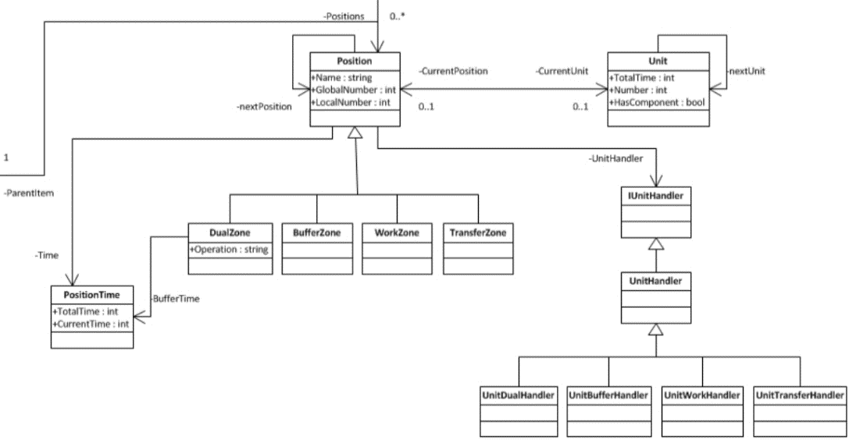
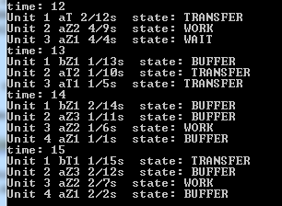
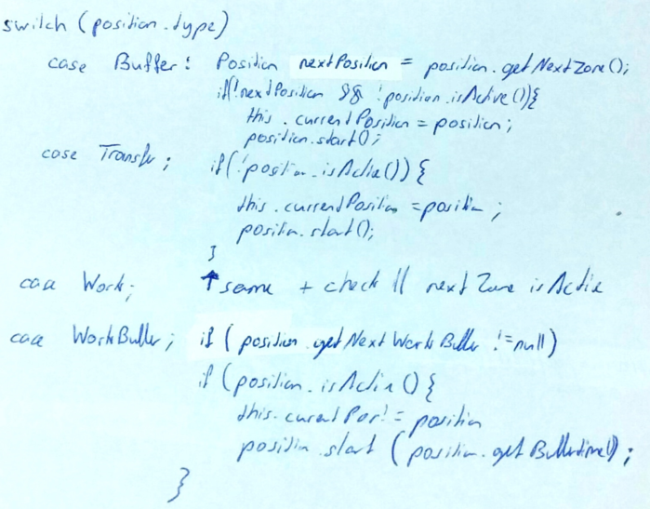
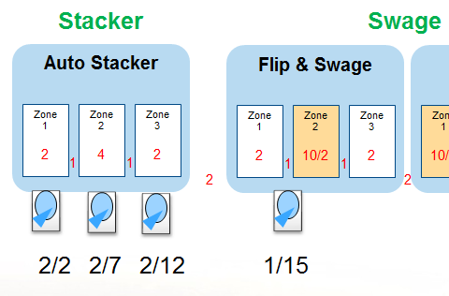
Procedure
1. UML
3. Console Application
2. Pseudo code

Slide 40
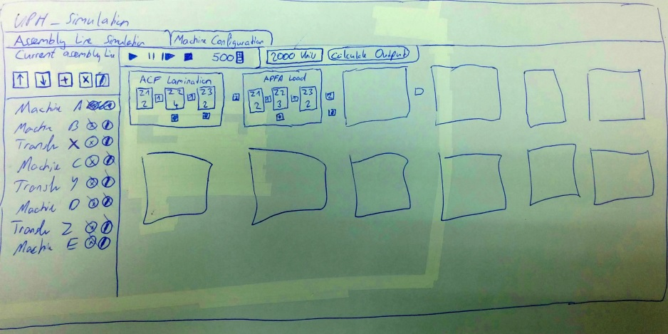
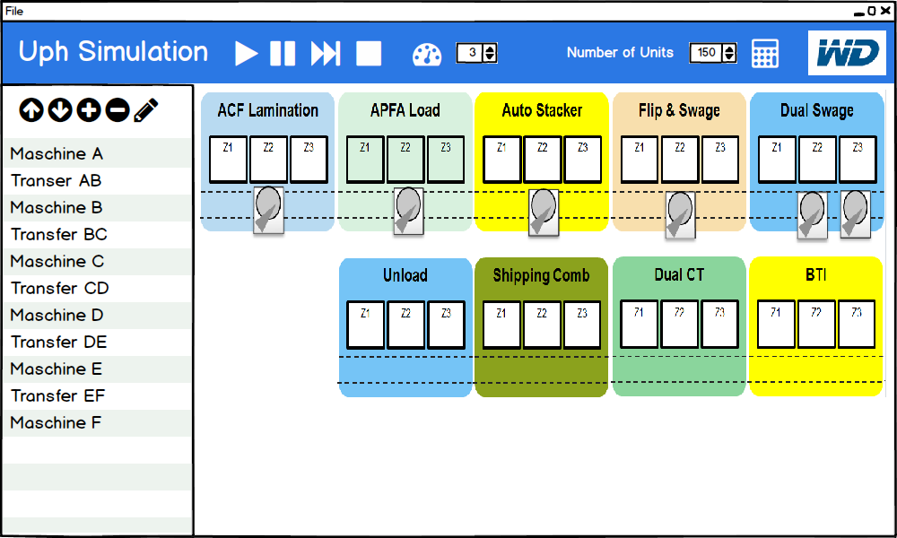
Procedure
4. Paper Prototyping / Balsamiq

Slide 41



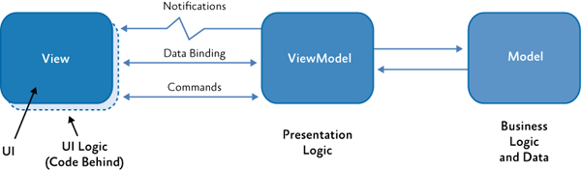
Procedure
5. Build MVVM Architecture
Notifications

Slide 42
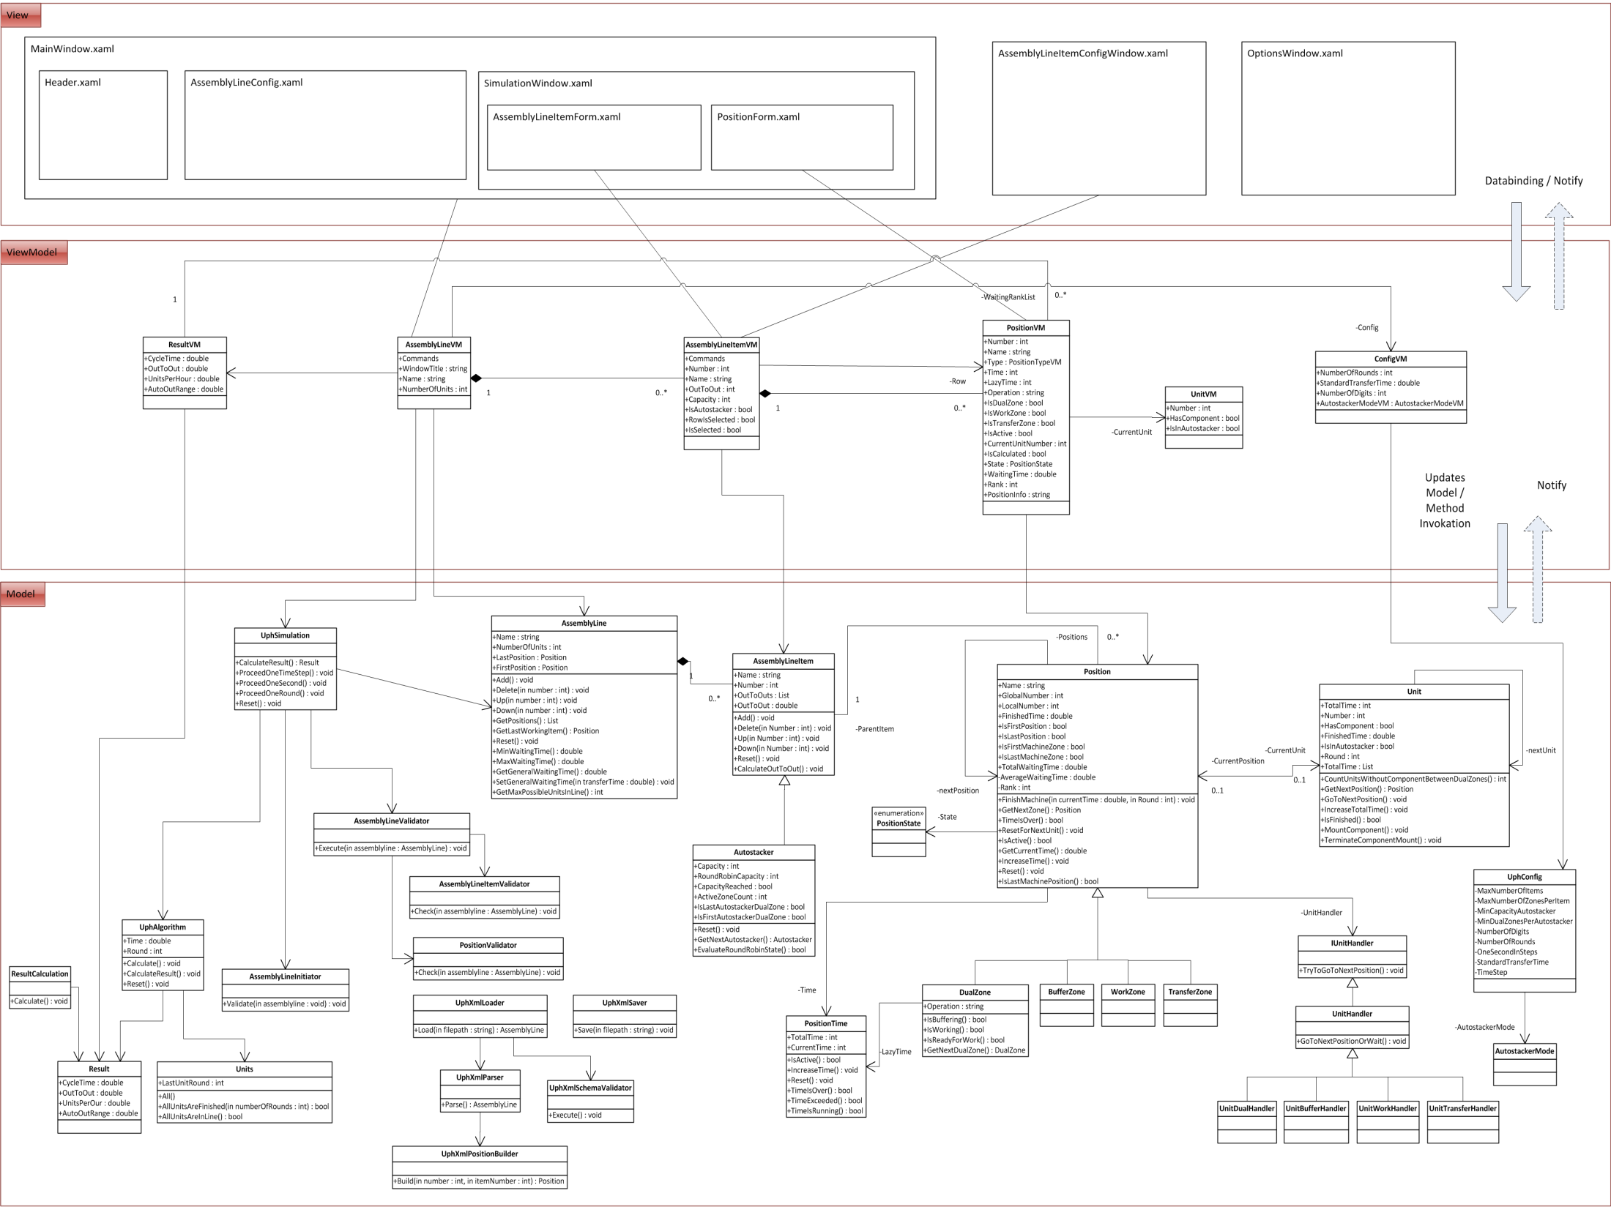
Architecture

Slide 43

Live Demonstration
UPH_Simulation.exe

Slide 44
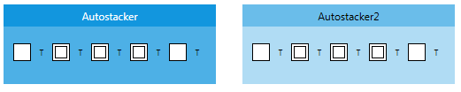
Suggestion
More than 2 autostackers
Measure transfer time
Implement random malfunction

Slide 45

Reflection
C# / XAML / WPF
Software architecture (MVVM)
UI Design
Softskills Engl. , communication, presentation

Slide 46
Q & A
Thank you.

