Slide 1

Pinoy Speak
A Trend Analysis and Contextual Lexicon System
for Informal Filipino Text
Carl Timothy E. Clemente | Concepcion L. Khan
2026 ICS Undergraduate Research Symposium
Informal Filipino NLP
FastText + Burstiness
Human Validation
Notes:
Good day everyone. I am Carl Timothy Clemente, and I will be presenting Pinoy Speak: A Trend Analysis and Contextual Lexicon System for Informal Filipino Text. This project focuses on informal Filipino and Taglish expressions that emerge online, especially slang words that are difficult to capture using static dictionaries. The main idea is to treat Filipino internet slang as dynamic linguistic data that can be collected, analyzed, validated, and presented through an educational web system.

Slide 2
Filipino internet slang changes fast
Problem Context
Problem Context
Static resources
Context-sensitive meaning
Fast trend cycles
Traditional dictionaries are slow to reflect emerging online terms.
Words like bet, solid, and awit may be ordinary or slang depending on the sentence.
Slang may emerge, peak, shift meaning, and decline quickly.
Examples of the target phenomenon
omsim
forda
lodi
dogshow
yarn
bet
solid
awit
Key issue: form alone is not enough; meaning depends on usage and context.
Notes:
Filipino users online frequently mix Filipino, English, and localized internet expressions. This produces Taglish and other informal forms that can be meaningful within a community but difficult for traditional NLP tools to understand. A static dictionary can define established words, but it cannot easily answer questions such as: when did a word start trending, how is it being used in context, and did its meaning shift? This is the gap that Pinoy Speak addresses.

Slide 3
What this study builds
Research Aim
Research Aim
Collect
Detect
Filter
public informal Filipino and Taglish text
emerging slang candidates and semantic shifts
false positives using morphology and context
Enrich
Present
Evaluate
definitions, examples, origins, and formation types
dictionary, trends, analyzer, concordance, and tutor
lexicon quality and web-app usability
Output: a deployed, application-oriented Filipino NLP system
Notes:
The objective of this study is to develop and evaluate a dynamic lexicon and trend-analysis system for informal Filipino text. In practical terms, the system collects public informal text, detects candidate slang using lexical novelty, burstiness, and semantic shift indicators, reduces false positives through contextual checks, enriches accepted entries, and makes the results usable through a deployed web application.

Slide 4
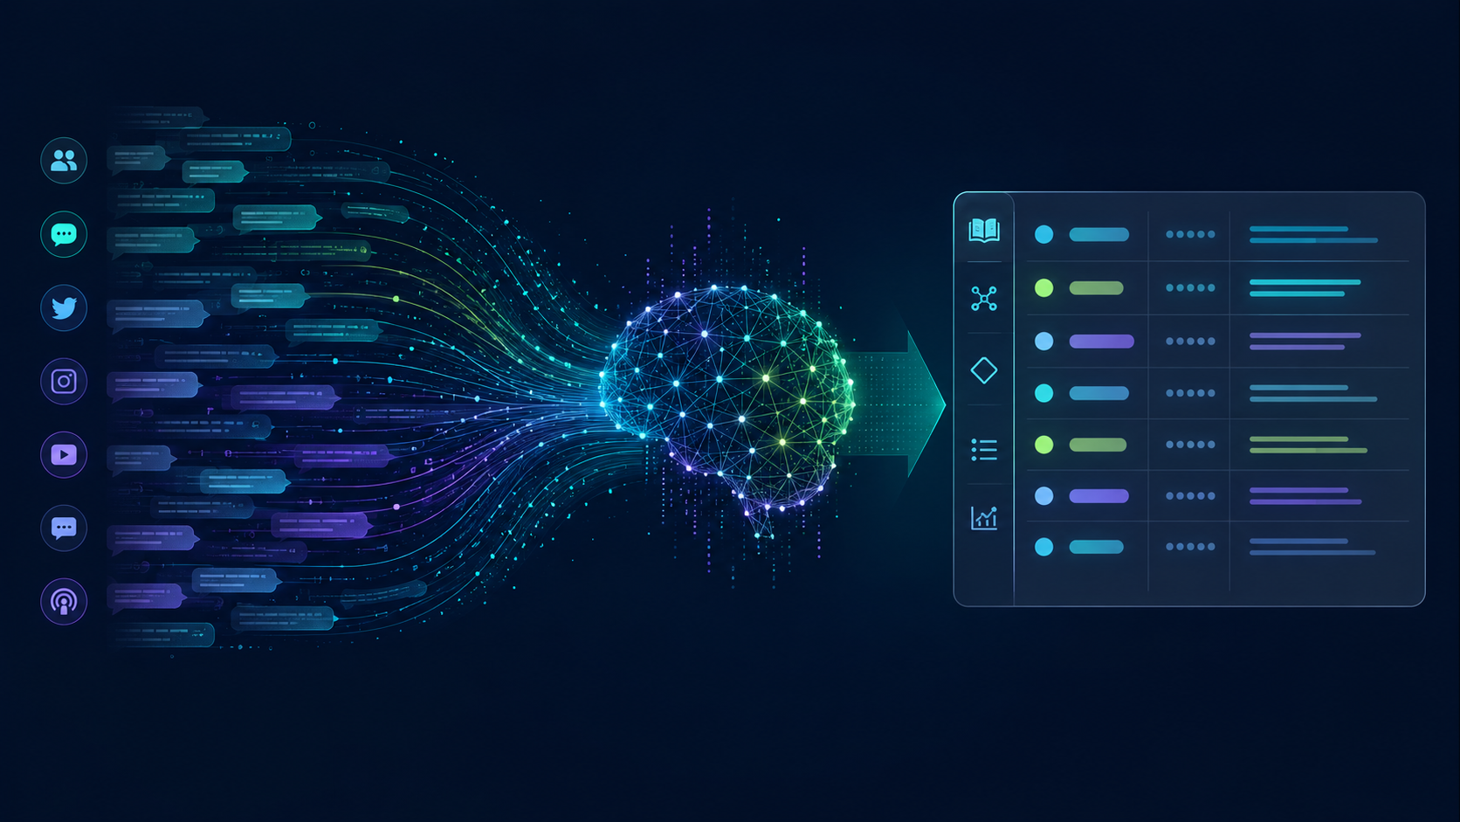
Corpus and online sources
Data Scope
Data Scope
175,481
163,372
12,075
34
archived corpus records
Reddit records
YouTube comments
chat interactions
Selected Reddit communities
Ethical boundary
r/peyups, r/ADMU, r/dlsu, r/Tomasino, r/studentsph, r/CasualPH, r/ChikaPH, r/TiktokPH, r/BPOinPH, and others
The study excludes private messages, private groups, images, audio, and video. User-identifying metadata are not displayed in dictionary entries.
Notes:
The current implementation uses public online text only. The corpus contains 175,481 archived records: 163,372 from Reddit, 12,075 from YouTube comments, and 34 chat interaction records from the deployed system. The Reddit collection focuses on 15 high-slang-density communities that represent university life, gaming, entertainment, programming, workplace experiences, and youth-oriented discourse.

Slide 5
End-to-end architecture
System Design
System Design
1
2
3
4
5
Ingest
Preprocess
Detect
Enrich
Interface
Reddit
YouTube
Chat
Tokenize
Normalize
Filter
Burstiness
Novelty
Shift
Definition
Example
Origin
Dictionary
Tutor
Trends
Backend: FastAPI + SQLite + NLP/LLM services | Frontend: Next.js + Tailwind-style responsive UI
Notes:
Pinoy Speak follows a modular full-stack architecture. Public text enters through Reddit, YouTube, and chat sources. The backend preprocesses the text, applies filtering and detection, enriches accepted terms, and then exposes the results through user-facing features such as the dashboard, dictionary, translator, concordance, and Kuya Slang tutor.

Slide 6
How candidate slang is identified
Detection Method
Detection Method
Dictionary gating
Subword novelty
FastText support
Separate ordinary known words from possible OOV candidates.
Tagalog RoBERTa tokenizer helps flag unfamiliar forms.
Character n-grams help with rare and creative spellings.
Burstiness
Semantic shift
Z(t) = frequency spike compared with historical baseline.
Known words can still be flagged when usage changes.
Novel OOV threshold: Z(t) > 2.0 | Semantic-shift threshold: Z(t) > 1.8
Notes:
The detection pipeline does not depend on a single rule. It combines dictionary gating, subword novelty signals, FastText nearest-neighbor support, burstiness scores, and semantic-shift monitoring. For novel words, the system checks whether the term looks unfamiliar and whether it is rising in use. For known words, it checks whether the word shows unusual usage patterns that may indicate a shifted meaning.

Slide 7
Reducing false positives
Context Control
Context Control
Morphological filter
Ambiguous terms
Context-window gate
Removes ordinary forms such as naka-, napaka-, nag-, and pinaka- patterns.
bet, solid, ghost, slay, sus, chika, tropa, and others require context.
Checks nearby Filipino particles: ang, ng, sa, kasi, talaga, grabe.
Example disambiguation
Not confirmed as slang
Accepted in Filipino context
“I bet this will work.”
“Bet ko itong feature, ang useful.”
Notes:
A major challenge is that not every unfamiliar word is slang, and not every dictionary word is non-slang. The system therefore uses morphological filtering and a context-window gate. Filipino affixes such as naka-, napaka-, nag-, and pinaka- are filtered to avoid treating ordinary Tagalog conjugations as slang. Ambiguous words are checked against surrounding Filipino particles and intensifiers before being accepted as slang.

Slide 8
User-facing modules
Prototype
Prototype
/
/dictionary
/tutor
Live dashboard
Searchable lexicon
Kuya Slang chatbot
/translator
/top-slang
/concordance
Taglish-to-English analyzer/translator
Slang leaderboard
Context search
Design principle: make NLP outputs understandable to Filipino users, not just visible to developers.
Notes:
The deployed system is not only a backend pipeline. It is also a usable learning interface. The main modules include a dashboard for live statistics and trends, a searchable dictionary, the Kuya Slang tutoring chatbot, a translator or analyzer, a top slang view, a concordance search, and an about page.

Slide 9
Two complementary validation layers
Evaluation
Evaluation
Lexicon validation
Usability and bug tracking
79 entries
3 ratings per item
237 item-level judgments
4 unique validators across the forms
Checked meaning, example, formation type, and final acceptability
39 total submissions
36 consented responses retained
6 modules evaluated
Ratings for usability, aesthetics, speed, accuracy, and bug occurrence
Human validation was used because slang meaning is context-sensitive and culturally grounded.
Notes:
Evaluation used two instruments. First, a lexicon validation form was used to check whether 79 dictionary entries were actually used as Filipino or Taglish slang, correctly defined, naturally exemplified, and properly classified. Each item received three ratings. Second, a web application usability and bug tracking form was used to evaluate six modules of the deployed system. This produced 36 consented usability responses from 39 submissions.

Slide 10
Lexicon validation was strongly positive
Results 1
Results 1
95.78%
4.83/5
4.75/5
87.76%
actually used as slang
definition correctness
example naturalness
final correct/acceptable
Correct/acceptable
87.76%
Needs minor revision
9.70%
Incorrect/false positive
2.53%
Priority revision terms
basic, dead, dogshow, and yarn were flagged for closer revision based on validator comments.
Notes:
The lexicon validation results were positive. Out of 237 item-level judgments, 95.78 percent marked the entries as actually used in Filipino or Taglish slang. Definition correctness averaged 4.83 out of 5, and example naturalness averaged 4.75 out of 5. The final judgment showed that 87.76 percent were correct or acceptable, while a smaller portion needed minor revision or was marked as a possible false positive.

Slide 11
Users rated the app highly
Results 2
Results 2
Dictionary
9.36
Tutor
9.33
Navigation
9.14
Analyzer
9.00
Top Slang
8.85
Dashboard
8.58
Learning outcome
Most reported bugs
86.11% learned at least one new slang word or expression.
Dashboard/Word Popularity: 6 reports; Top Slang: 4 reports.
Notes:
For the usability evaluation, the Dictionary had the highest module usability score at 9.36 out of 10, followed closely by the Tutor at 9.33. Navigation, Analyzer or Translator, Top Slang, and Dashboard also received high scores. These results suggest that users found the learning-oriented features useful and understandable.

Slide 12
What the results mean
Discussion
Discussion
1. Dynamic lexicon works
2. Human review matters
3. Learner tools are valued
The corpus and pipeline can support a living dictionary of informal Filipino text.
Validation identifies false positives, weak definitions, and formation-label issues.
Users rated Dictionary, Tutor, and Analyzer as especially usable.
Best framing for defense
Pinoy Speak is not claiming to replace linguistic experts.
It demonstrates a practical system that combines automated discovery, human validation, and interactive presentation.
Notes:
The results show that Pinoy Speak is useful, but it should be understood as a semi-automated dynamic lexicon rather than a fully automatic authority. The system can collect, prioritize, and explain candidate slang, but human validation remains important because Filipino slang is context-sensitive and culturally grounded.

Slide 13
Limitations and next improvements
Future Work
Future Work
Corpus coverage
Validation
Add more regional Filipino languages and dialectal varieties.
Use more annotators and clearer annotation guidelines.
Lexicon quality
User interface
Revise flagged terms and improve formation labels.
Improve chart controls, loading states, and dictionary navigation.
Evaluation
Add precision, recall, false-positive and false-negative rates, and inter-annotator agreement.
Immediate lexicon fixes: dogshow, yarn, basic, dead
Notes:
There are still limitations. The corpus is based on selected public online communities, so it does not represent all Filipino speakers or all regions. The usability sample is also an initial user feedback sample. For future work, the system should expand regional coverage, add more validators, improve ambiguous-word handling, add pronunciation support, improve chart interactions, and compute formal metrics such as precision, recall, false-positive rate, and inter-annotator agreement.

Slide 14
Main contribution
Conclusion
Conclusion
Technical contribution
NLP contribution
Evaluation contribution
FastAPI + Next.js system for slang detection, enrichment, and presentation.
Uses novelty, burstiness, semantic shift, and context-window disambiguation.
Combines lexicon validation and web usability testing using actual collected data.
Pinoy Speak bridges fast-changing Filipino internet language and accessible language technology.
Thank you. I am ready for your questions.
Notes:
In conclusion, Pinoy Speak shows that informal Filipino and Taglish slang can be documented through a combination of computational detection, validation, and interactive presentation. The project contributes a deployed full-stack system, a dynamic lexicon workflow, a validation-backed evaluation, and an educational tool for understanding slang in context.

Slide 15
Key references used in the study
References
References
• Bautista (2004); Poplack (1980); Thompson (2003) — code-switching and Taglish
• Bojanowski et al. (2017) — FastText subword embeddings
• Hamilton et al. (2016); Kutuzov et al. (2018); Bamler & Mandt (2017) — semantic shift
• Lewis et al. (2020) — retrieval-augmented generation
• Brooke (1996) — usability evaluation
• Ocampo & Clariño (2023) — Filipino NLP and native Filipino annotators
Notes:
This is a references and backup slide. If asked, I can explain that the study is grounded in literature on code-switching, FastText subword embeddings, semantic shift, retrieval-augmented generation, usability evaluation, and prior Filipino NLP work using human annotation.

