Slide 1
Factors Affecting Climate Change
By: Dexter Schincke

Slide 2
Statistical Question
What factors affect temperature and contribute to climate change?
Variables to look at:
Aerosols: Represents the concentration of aerosols.
CH4: Represents the concentration of methane.
MEI: A measure of the El Niño or La Niña climate pattern.
CO2: Carbon dioxide concentration - a key greenhouse gas.
Temp: Temperature

Slide 3
Outlier Detection
Z-Score Test for Outliers
Identified 13 outliers in Aerosols, CH4, MEI, CO2, and Temp.
Z-score threshold is 3 standard deviations

Slide 4

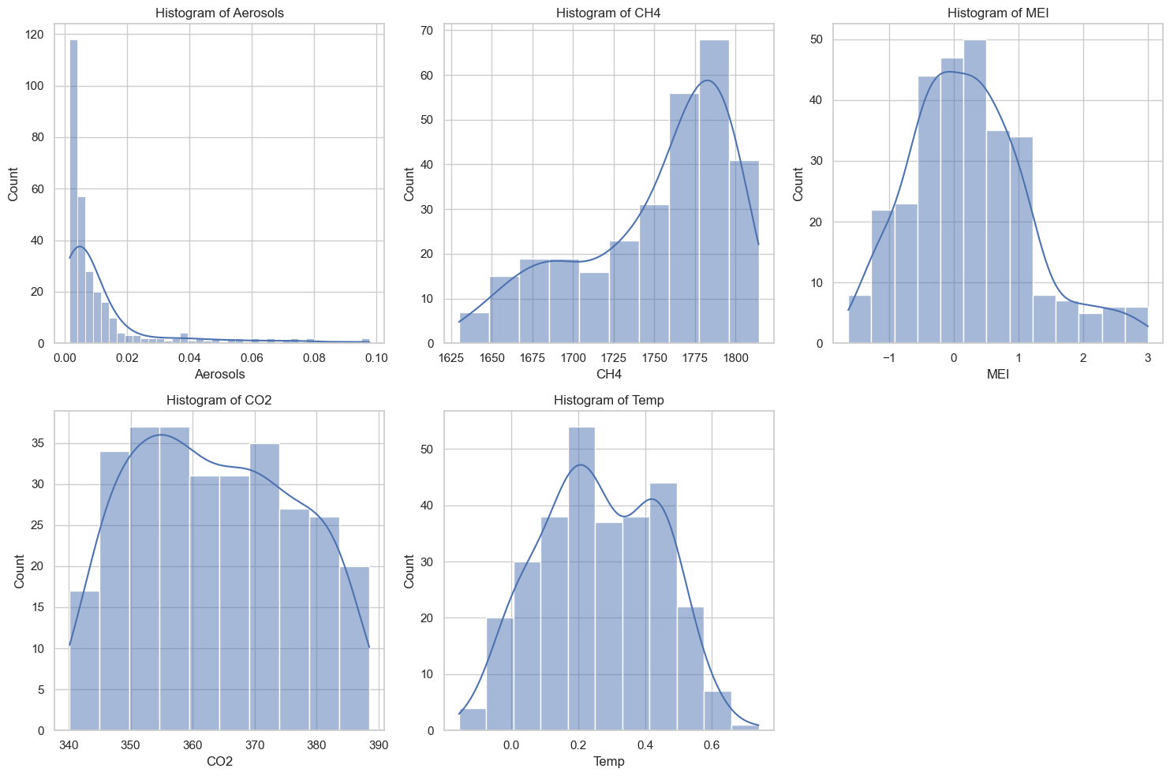
Histograms
Aerosols: Right-skewed
CH4: Left-skewed
MEI: Right-skewed
CO2: Slightly left-skewed
Temp: Slightly Bimodal

Slide 5
Descriptive Statistics
 | Mean | Mode | Standard Deviation | Skewness
Aerosols | 0.011968 | 0.0021 | 0.017635 | 2.8521
CH4 | 1750.26678 | 1666.8300 | 46.790855 | -0.8352
MEI | 0.231258 | -1.0110 | 0.919318 | 0.6046
CO2 | 363.575051 | 343.2 | 12.786030 | 0.1181
Temp | 0.264610 | 0.1760 | 0.176554 | -0.0103

Slide 6
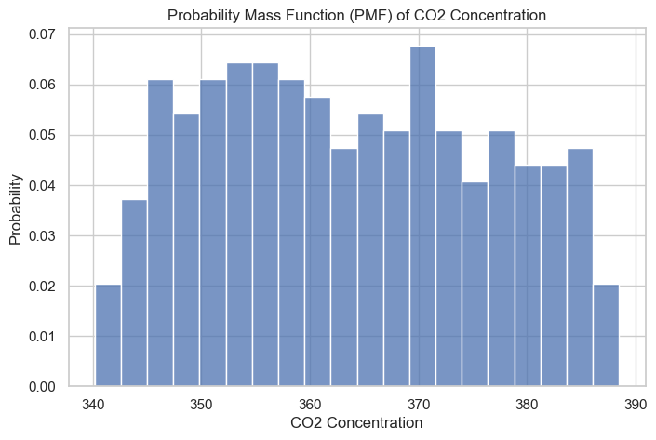
Probability Mass Function (PMF)
Higher likelihood of lower CO2 concentrations.
Gradual decrease in probability with higher concentrations.

Slide 7
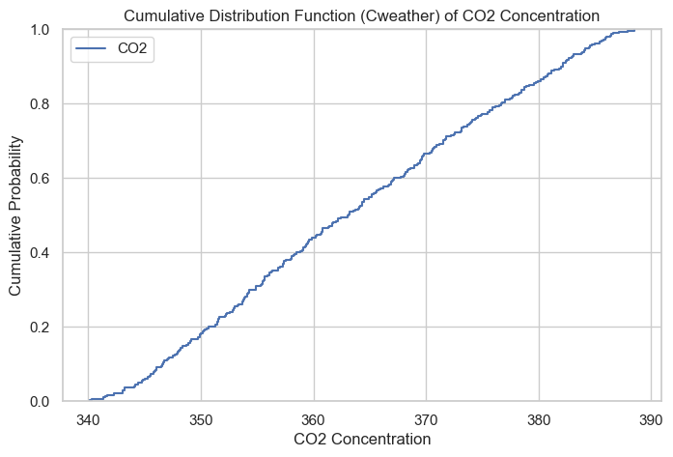
Cumulative Distribution Function (CDF)
Uniform and steady increase in cumulative probability.
Each concentration level contributes consistently.

Slide 8
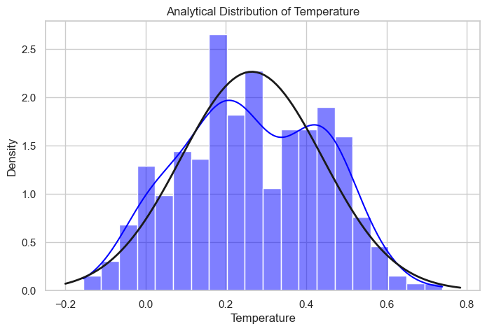
Analytical Distribution
Dual peaks in temperature distribution.
Normal distribution curve fitted to data.

Slide 9
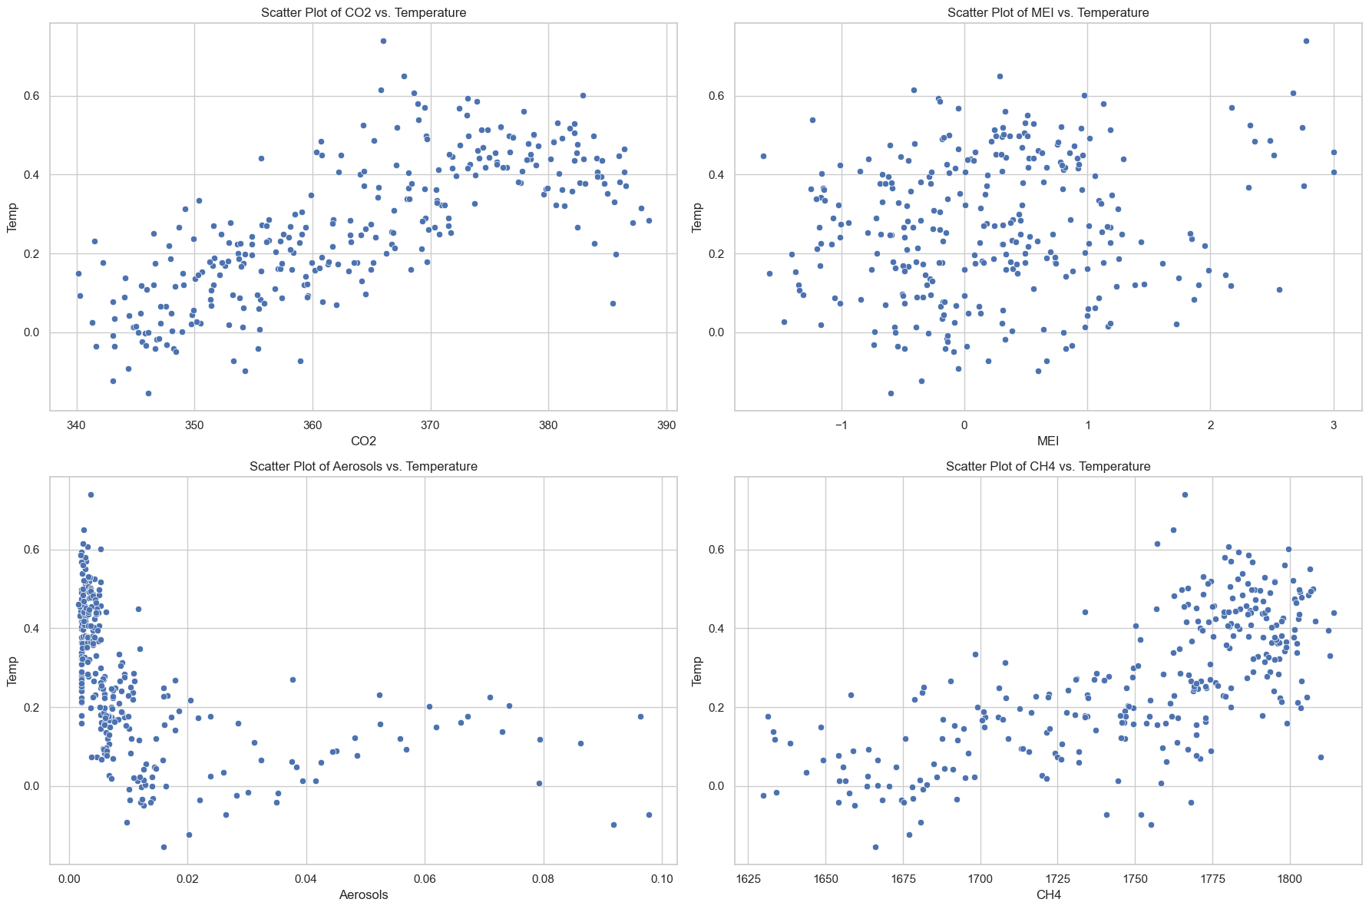
Scatter Plots
CO2 vs. Temperature: U-shaped pattern.
MEI vs. Temperature: Scattered with no clear trend.
Aerosols vs. Temperature: More aerosols may be linked to lower temperatures.
CH4 vs. Temperature: Loose line with a slight curve up.

Slide 10
Hypothesis Testing
Observed correlation: 0.7485 between CO2 and temperature.
Permutation test p-value: 0.0, highly statistically significant.
Strong evidence supporting the hypothesis of a significant correlation between CO2 concentration and temperature.
P-value of 0.0 suggests none of the 1000 permuted correlations were as extreme as the observed correlation.
Indicates that changes in CO2 concentration may be associated with temperature changes.

Slide 11
Regression Analysis
Predictors: CO2, Aerosols, MEI
R-squared: 0.670 (67% of variability explained)
F-statistic: 197.2 (p-value: 8.60e-70)
Significant impacts of CO2, Aerosols, MEI on temperature.

Slide 12
Conclusion
Key Findings:
Outliers: Detected and removed 13 outliers using the Z-score test.
Variable Distributions: Revealed varied patterns, providing insights into the dataset's characteristics.
Correlation Analysis: Strong evidence of a significant correlation (0.7485) between CO2 and temperature.
Regression Model: Multiple linear regression demonstrated significant impacts of CO2, Aerosols, and MEI on temperature (R-squared: 0.670).

