Slide 1
Predictive Analytics for NVIDIA
Dexter Schincke &
Hunter Fernandez

Slide 2
TABLE OF CONTENTS
01
02
03
OVERVIEW
PREPROCESSING
MODELING
04
CONCLUSION
Goals
Data
Preparation
EDA
Models
Results
What we learned
What we would change

Slide 3
Goals
Project Objective:
Explore the predictive power of various models on NVIDIA stock movements
Understand how tech innovations, like GPU releases, can affect the stock market.
Can we reliably predict NVIDIA stock price movement through solely stock market data?

Slide 4
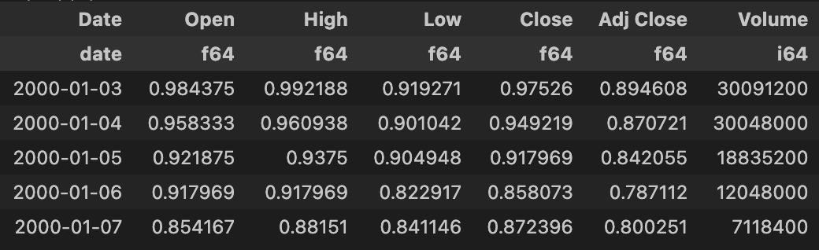
Data Overview
Historical stock data for NVIDIA (2000-2024)
Key features: Date, Open, High, Low, Close, Adjusted Close, Volume
Sourced from Kaggle, over 6,000 entries
Data Quality:
No missing values
Reliable for predictive modeling
Data Organization
Chronologically structured
Essential for temporal accuracy in models

Slide 5
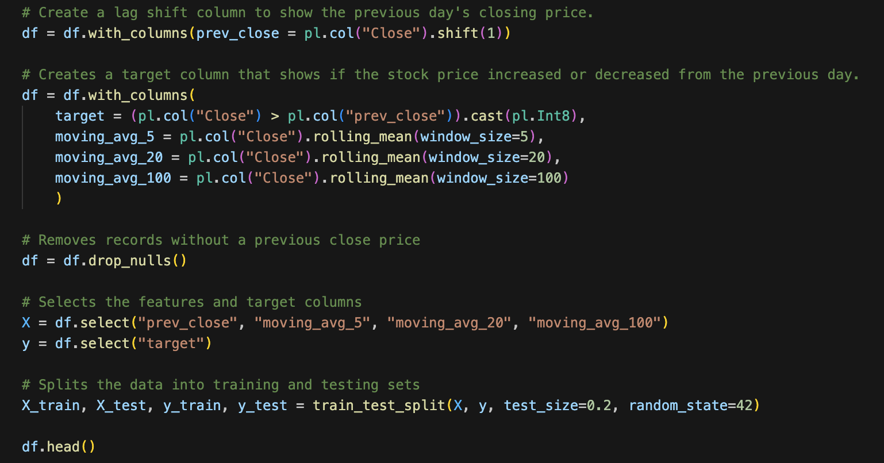
Data Preparation

Slide 6

Exploratory Data Analysis
Uncovered trends and key observations.
Spikes in trading volume around major product releases
Product Releases Impact
Examples: RTX and GTX GPU launches
Volume surges show increased investor interest
Framing for Modeling
Insights inform our approach to predicting stock movements.

Slide 7
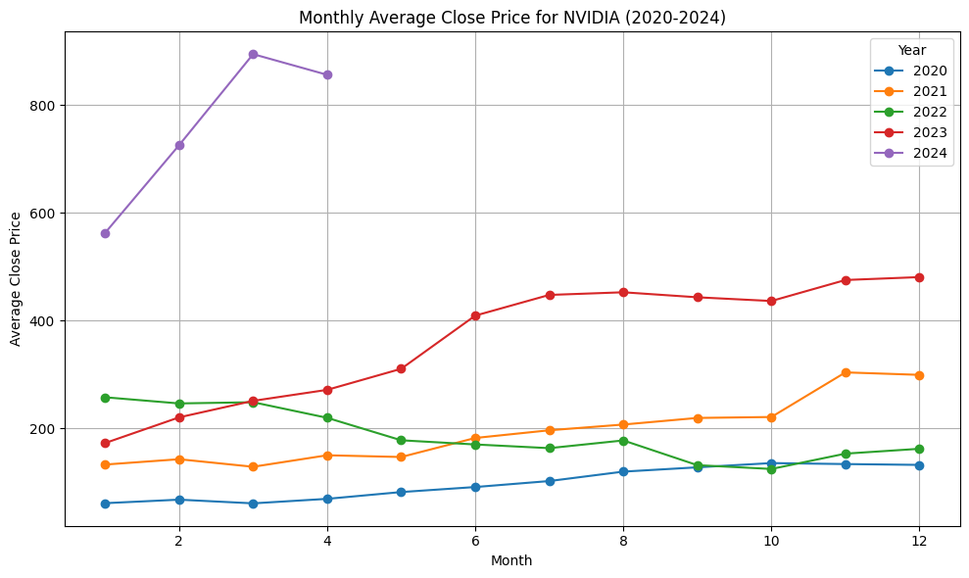

Slide 8
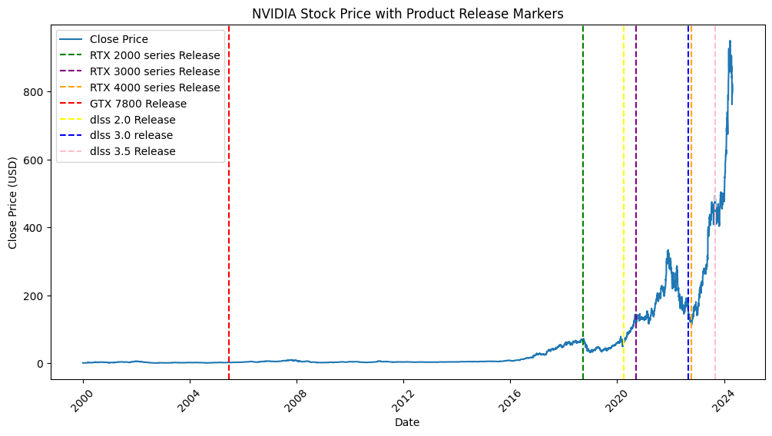

Slide 9
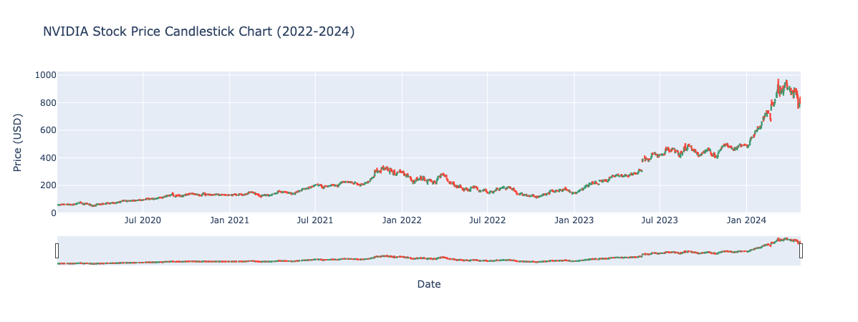

Slide 10
Model Selection
Logistic Regression
- Baseline model to use as a comparison point.
Random Forest
- Model to find non-linear relationships between features.
LSTM (Long Short-Term Memory)
- Great for capturing temporal dependencies.

Slide 11
Model Training and Testing
Data Split
Challenges
20% 80%
Overfitting in LSTM Model
Required Close monitoring during training.
Inaccurate Results at (most) times.
Test
Training
Model Tuning
Random Forest: used GridSearchCV for optimization
LSTM: Trained for ten epochs, batch size of 32

Slide 12
Evaluation Metrics
Accuracy
Precision
Recall
measured the overall correctness of predictions.
F1 Score
balanced precision and recall, offering a single metric to evaluate their trade-off.
assessed the reliability of optimistic predictions, crucial in stock market forecasting to minimize false alarms.
ROC-AUC
measured the model's ability to distinguish between price increases and decreases.
indicated the ability of the model to capture all accurate positive movements.

Slide 13
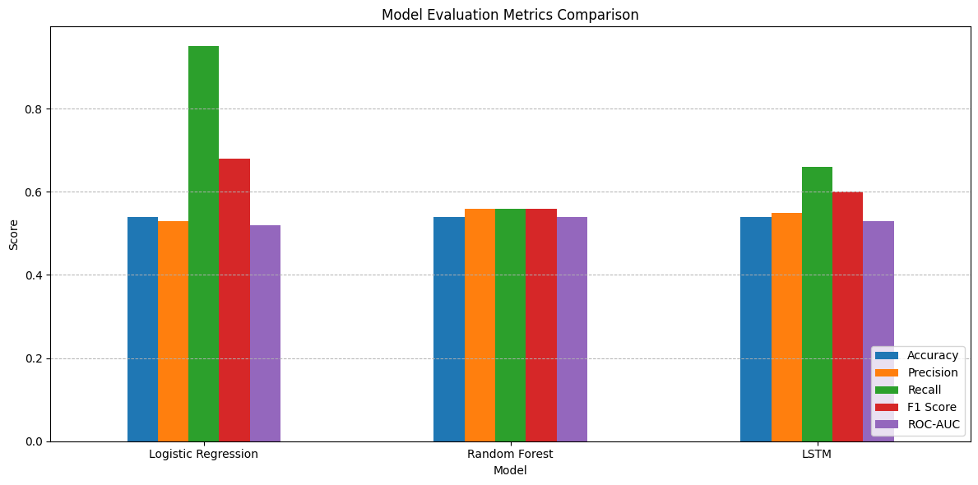
Model Results
Key Points
Logistic Regression:
54% accuracy, high recall, low precision—captures upward trends but misclassifies declines.
Random Forest:
54% accuracy, balanced precision/recall, moderate performance.
LSTM:
54% accuracy, high recall, low precision—similar to Logistic Regression, struggles with false positives.

Slide 14
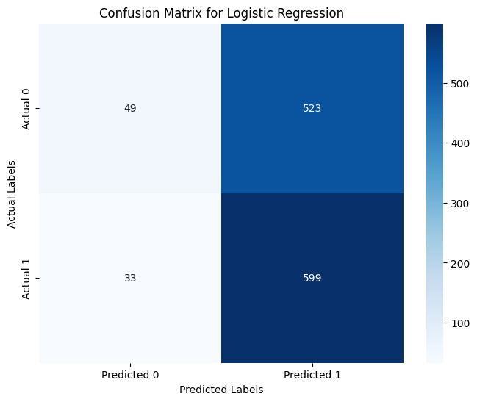

Slide 15
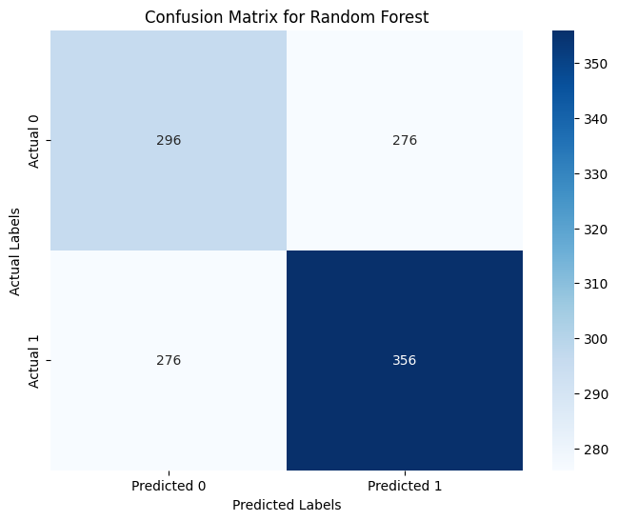

Slide 16
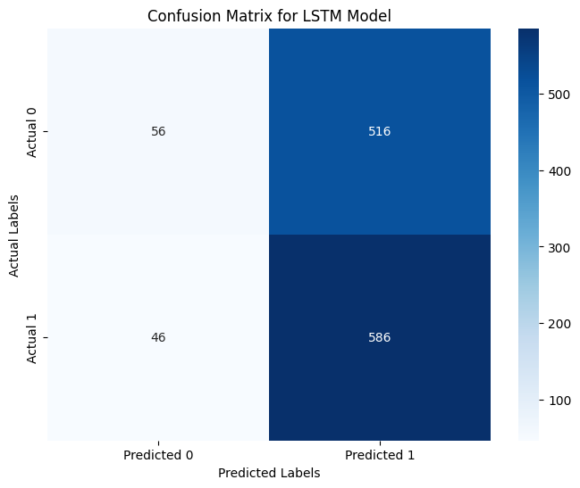

Slide 17
Result Interpretation
High Recall:
Models effectively identified price increases.
Low Precision:
Frequent false positives, misclassifying non-increase days as increases.
Moderate Accuracy:
Struggled to differentiate between price movements.
Improvement Opportunity:
Additional features, like market sentiment, could improve precision and overall performance.

Slide 18
Challenges & Limitations
Overfitting, especially with LSTM, affected performance on unseen data.
Limited features, lacking external factors, reduced accuracy.
Without adding external data will miss essential context that could improve precision

Slide 19
Ethical Considerations
Predictive models could be misused for unethical market manipulation.
Integrating external data sources requires compliance with data privacy laws.
Ensuring user data protection is essential when using sentiment analysis.
Responsible use of models is key to maintaining trust and integrity in financial forecasting.

Slide 20
Future Work
Incorporate sentiment analysis from news and social media to add qualitative data.
Include macroeconomic indicators like GDP growth, inflation, and consumer confidence for better context.
Explore advanced models like XGBoost and model stacking to enhance performance.

Slide 21
Call to Action
Use predictive models as part of a broader investment strategy.
Combine models with qualitative analysis and expert judgment.
Focus on feature engineering for improved model accuracy.
Integrate diverse data sources to enhance model utility.

Slide 22
Conclusion
Machine learning can identify stock price trends but lacks precision.
High recall achieved, but false positives limit model reliability.
Future work: Incorporate external data (e.g., market sentiment, macro indicators).
Refine models to improve prediction accuracy.
Integrate quantitative predictions with qualitative insights for better investment tools.

