Slide 1
Credit Card Fraud Detection
Author: Dexter Schincke
Institute: Bellevue University

Slide 2

Business Problem
Credit card fraud results in billions of dollars in losses annually.
As digital transactions grow, so does the sophistication of fraud schemes.
Financial institutions need robust, scalable tools to detect real-time fraudulent transactions.

Slide 3

Data Overview
Dataset: Kaggle Credit Card Fraud Detection (2023)
Features: Anonymized attributes (v1-V28), transaction amount, target variable (fraudulent/legitimate)
Key Points:
No missing values or class imbalance
Data split: 70% training, 30% testing.

Slide 4
Methods & Modeling
Preprocessing: Splitting data into training and testing sets.
Models: Logistic regression (baseline), SVC, Random Forest.
Evaluation Metrics: Accuracy, precision, recall, F1-score.

Slide 5
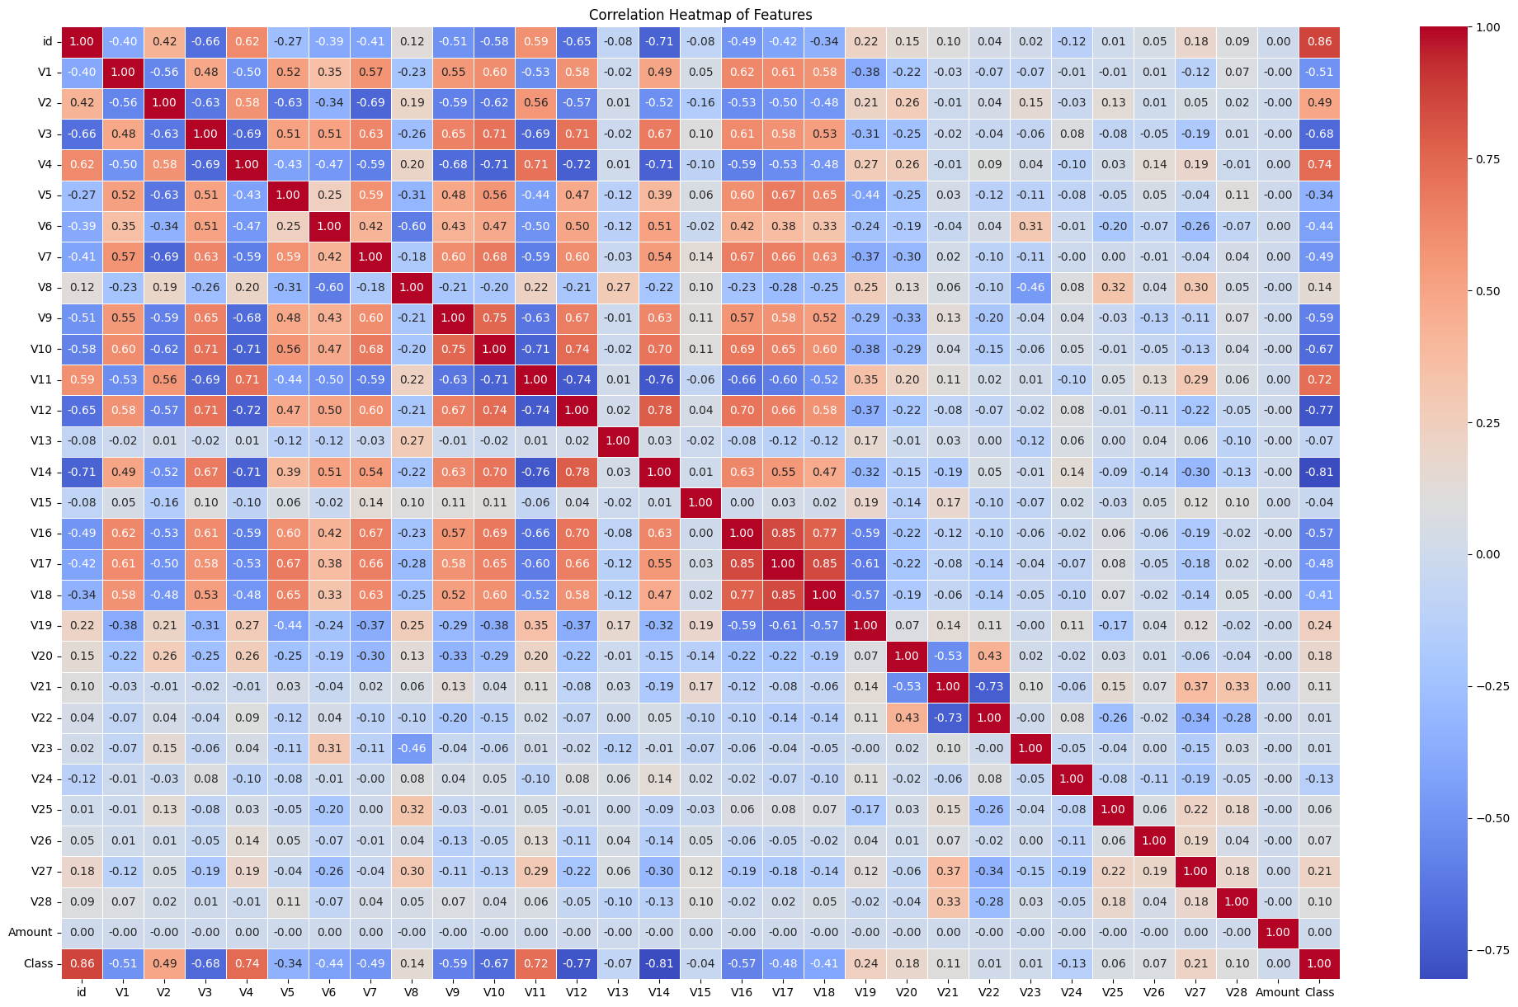
Exploratory Data Analysis (EDA)
Correlation Heatmap: Strong correlations between V1-V19.
Key insights: V1-V19 show a strong correlation; V20-V28 have weaker patterns.

Slide 6
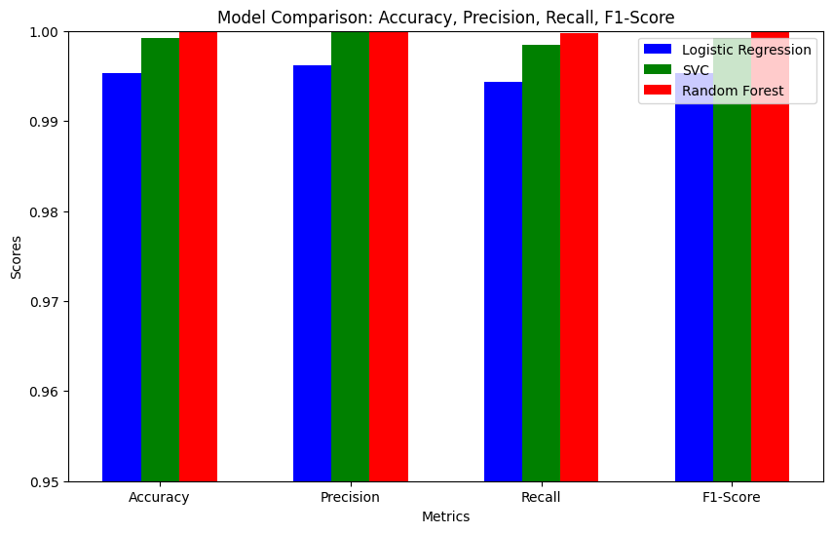
Model Evaluation
Performance Metrics: Comparison of logistic regression, SVC, and Random Forest.
Key Insights: Random Forest outperformed other models in precision, recall, and F1-score.

Slide 7
Conclusion
Key Findings: Random Forest outperforms Logistic Regression and SVC.
Key points:
High precision, recall, and F1-score
Suitable for real-world fraud detection applications.

Slide 8
Future Work & Recommendations
Explore
Explore advanced models like Gradient Boosting and deep learning.
Implement
Implement real-time fraud detection.
Update
Regularly update the training dataset.

Slide 9

Ethical Considerations
Ensure data privacy and fairness.
Avoid model biases, ensuring fairness across all demographic groups.

Slide 10
Q&A
How did you handle potential overfitting in your models?
What was the reasoning behind selecting the specific machine learning models (Logistic Regression, SVC, Random Forest)?
Can you explain the impact of feature scaling in your models, especially since some features are monetary values?
Why did you choose precision, recall, and F1-score as your evaluation metrics over others like accuracy or ROC-AUC?
What insights did the correlation heatmap provide, and how did it affect your modeling decisions?
Were there any challenges or difficulties working with anonymized features (V1-V28)?
How would you adapt your approach if the dataset was highly imbalanced?
What measures would you take to ensure the model can be deployed for fraud detection in a real-world, high-volume setting?
How do you ensure that your model is not biased or unfair to certain demographic groups?
What would you do if the model performs well on the training data but not on the testing set?

Slide 11
References
Projects/Papers:
Abueltouh, A. (2024). Credit Card Detection. Kaggle. https://www.kaggle.com/code/abdallahabuelftouh/credit-card-detection
Fatima, S. (2024). Credit card fraud detection: Achieving 99% accuracy. Kaggle. https://www.kaggle.com/code/samanfatima7/credit-card-fraud-detection-achieving-99-acc
GeeksforGeeks. (2024, September 6). ML credit card fraud detection. GeeksforGeeks. https://www.geeksforgeeks.org/ml-credit-card-fraud-detection/
Ileberi, E., Sun, Y., & Wang, Z. (2022). A machine learning-based credit card fraud detection using the GA algorithm for feature selection. Journal of Big Data, 9, 24. https://doi.org/10.1186/s40537-022-00573-8
Datasets:
Elgiriye Withana, N. (2023). Credit card fraud detection dataset 2023. Kaggle.
https://www.kaggle.com/datasets/nelgiriyewithana/credit-card-fraud-detection-dataset-2023/data

