Slide 1
Tech Salary Trends Analysis
Author: Dexter Schincke
University: Bellevue University

Slide 2

Business ProBlem
Salaries in tech vary widely by job, title, experience level, location, and remote work.
Employers need competitive salary strategies.
Job seekers need better salary negotiation insights.
Policymakers require data for equitable labor policies.

Slide 3
Background
Tech industry salaries are dynamic and influenced by many factors.
Remote work has reshaped salary structures.
The COVID-19 pandemic accelerated remote work adoption.
Understanding these trends is critical for decision-making.

Slide 4

Data Overview
Dataset Source: Kaggle (Global Tech Salaries for 2023-2024).
Key Features:
Work year, experience level, employment type, job title. Salary (USD), employee residence, remote ratio, company location, and company size
Data Quality:
No Missing values, well-structured.

Slide 5

Methods & Exploratory Data Analysis
Data Cleaning: No missing values, standardized salaries in USD.
EDA:
Histogram of salary distribution.
Boxplots for salaries by experience level.
Correlation matrix for relationships between features.

Slide 6
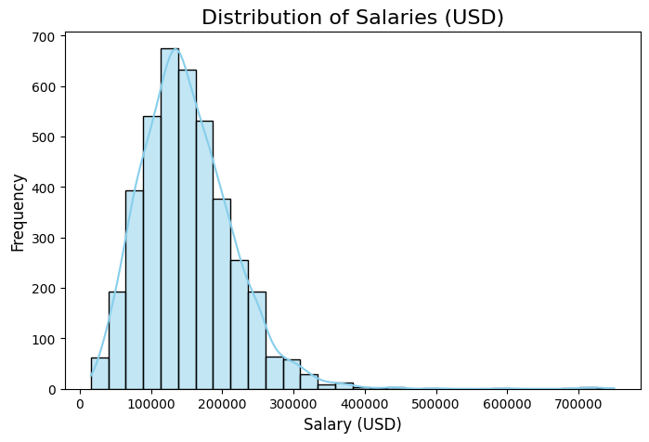

Slide 7
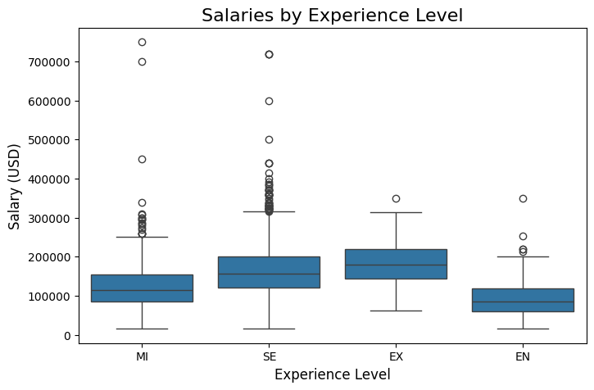
Salaries by Experience Level
Boxplot Insights:
Entry-level: ~$80,000.
Mid-level: ~$120,000.
Senior-level: ~$150,000.
Executive-level: ~$200,000.

Slide 8
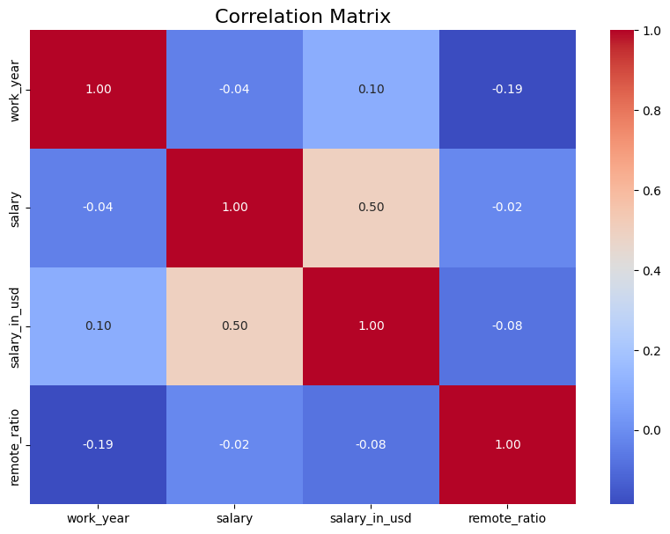
Correlation Matrix
Key Correlations:
Weak negative correlation between work year and salary.
Weak negative correlation between remote work and salary.
Weak positive correlation between salary and its USD equivalent.

Slide 9
Model Evaluation
Model Evaluation
Mean Squared Error (MSE): 1.78 billion Indicates the average deviation in salary predictions, with the model still showing significant errors.
R-squared (R²): 0.578 The model explains 57.8% of the variation in salaries, meaning over half of the salary variation is captured.
Hyperparameter Tuning
Best Model MSE (after tuning): 1.76 billion Small improvement after grid search tuning.
Best Model R-squared: 0.583 Explains 58.3% of the salary variation, showing a slight improvement.
Cross-Validation
Mean MSE (cross-validation): 1.89 billion Slightly worse than the best model, indicating some instability.
Cross-Validation Std (MSE): 436.2 million Shows variability in performance, requiring further model refinement.
Residual Analysis
Mean Absolute Error (MAE): 25,280 USD The average error in predictions is about 25,000 USD, signaling the need for better accuracy.

Slide 10
Key Insights
Experience level is the strongest salary determinant.
Remote work had a weak impact on salary.
Company size and location also showed limited influence.
High salaries are driven by seniority, not necessarily job title.

Slide 11
Limitations & Challenges
Dataset covers only 2023-2024 (short timeframe).
Possible selection bias in self-reported salaries.
Does not account for cost of living variations.
Potential overfitting in salary predictions.

Slide 12
Future Work & Recommendations
Expand dataset to include more years and companies.
Test advanced models like Gradient Boosting or Neural Networks.
Adjust for cost-of-living differences.
Create a salary prediction tool for job seekers.

Slide 13
Ethical Considerations
Ensure data privacy and anonymity.
Avoid reinforcing biases in salary predictions.
Present findings transparently.

Slide 14
Conclusion
Salaries are most influenced by experience level.
Remote work and company size had limited effects.
Future research should explore broader datasets and new models.

Slide 15
Q&A
How did you handle missing data or outliers in your dataset?
Were there any unexpected trends or insights that emerged during your analysis?
How did you ensure that your model didn’t overfit the data and remained generalizable?
What other factors, such as company culture or benefits, might influence salary that were not included in this analysis?
How confident are you that the salary trends you observed will hold true across different industries outside the tech sector?

Slide 16
Q&A Part 2
What are the average salaries for different experience levels in your dataset?
How do salaries vary by job title and location?
How do remote work and company size impact salaries in the tech industry?
Are there significant differences in salaries across regions, and how did your account for that in your analysis?
What trends can be observed over time, specifically between 2023 and 2024?

Slide 17
Sources
Abueltouh, A. (2024). Credit Card Detection. Kaggle. https://www.kaggle.com/code/abdallahabuelftouh/credit-card-detection
Fatima, S. (2024). Credit card fraud detection: Achieving 99% accuracy. Kaggle. https://www.kaggle.com/code/samanfatima7/credit-card-fraud-detection-achieving-99-acc
GeeksforGeeks. (2024, September 6). ML credit card fraud detection. GeeksforGeeks. https://www.geeksforgeeks.org/ml-credit-card-fraud-detection/
Ileberi, E., Sun, Y., & Wang, Z. (2022). A machine learning-based credit card fraud detection using the GA algorithm for feature selection. Journal of Big Data, 9, 24. https://doi.org/10.1186/s40537-022-00573-8
Elgiriye Withana, N. (2023). Credit card fraud detection dataset 2023. Kaggle.
https://www.kaggle.com/datasets/nelgiriyewithana/credit-card-fraud-detection-dataset-2023/data

