Slide 1
Heart Failure Mortality Analysis
Dexter Schincke
Bellevue University

Slide 2

Business Problem
Heart failure is a leading cause of mortality worldwide.
Early detection of high-risk patients can improve outcomes.
Machine learning can help predict mortality based on clinical and demographic factors.

Slide 3
Background & History
Advances in medical technology have improved treatment.
Traditional risk assessment methods rely on clinical expertise.
Machine learning offers an objective, data-driven alternative.

Slide 4
Dataset Explanation
The dataset contains 299 patients, 13 features, and the target variable (DEATH_EVENT)
Includes factors like age, ejection fraction, serum creatinine, and more.
No missing values; dataset is relatively small but informative.

Slide 5
Methods - EDA

Slide 6
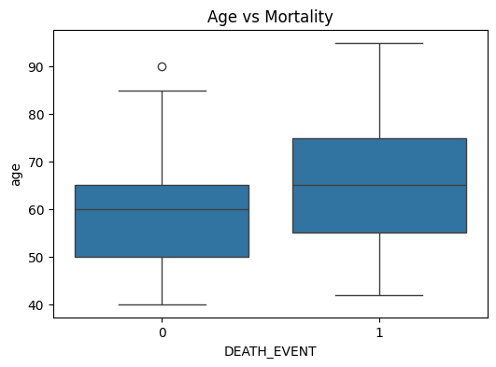
Age Vs. Mortality

Slide 7
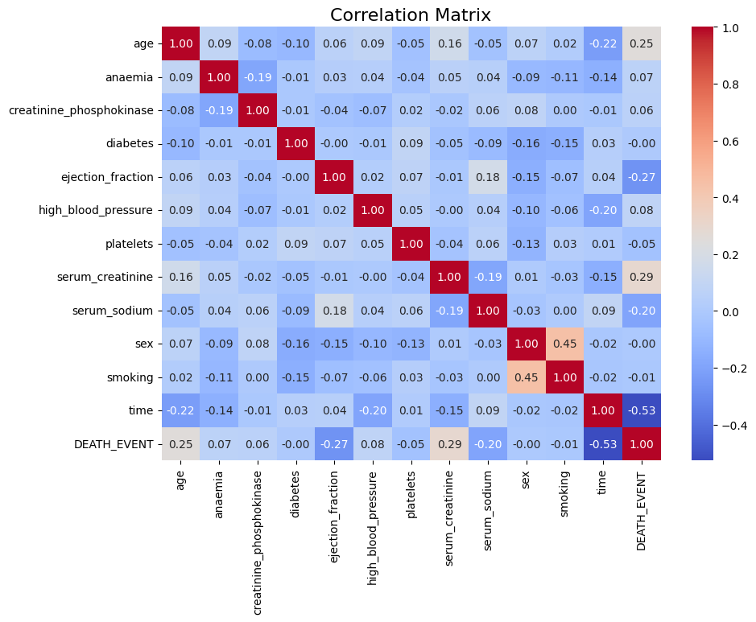
Correlation Heatmap

Slide 8
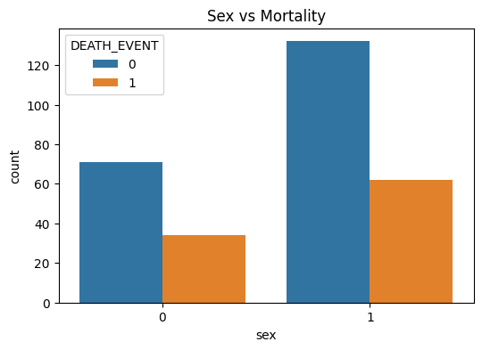
Sex vs. Mortality

Slide 9
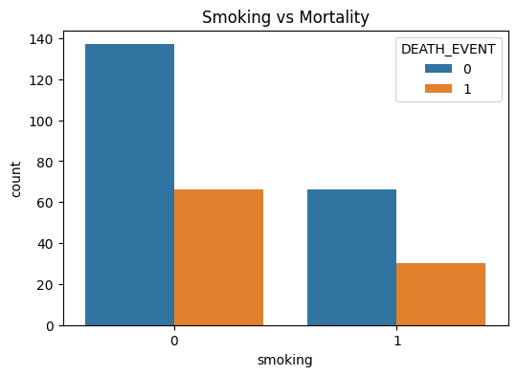
Smoking vs. Mortality

Slide 10
Methods - Modeling
Models used: Logistic Regression, Random Forest, XGBoost.
Train-test split for model evaluation.
Performance metrics: Accuracy, Precision, Recall, F1-score.

Slide 11
Analysis – Model Evaluation
Models Tested: Logistic Regression, Random Forest, XGBoost.Metrics:Logistic Regression: Accuracy (80%), Recall (56%).
Random Forest: Accuracy (75%), Recall (48%).
XGBoost: Accuracy (76%), Recall (60%) - Best Model.

Slide 12
XGBoost Performance
XGBoost: Best model for mortality prediction.
Key Stats: Recall 60%, Accuracy 76%, Precision 79%.

Slide 13
Conclusion
Key predictors of mortality: age, serum creatinine, ejection fraction.
XGBoost had the best performance for identifying high-risk patients.
Logistic Regression: high accuracy, but lower recall.
Random Forest: balanced precision and recall.

Slide 14
Assumptions
Data is complete and accurate.
Linear relationships assumed between features and mortality.
Features were relevant for predicting mortality.All patients received similar care (limited by dataset).

Slide 15
Limitations
Dataset Size: Small (299 observations), may not represent the entire population.
Missing Factors: Lack of treatment and comorbidity data.
Binary Classification Limitation: Mortality classification is too simplified.

Slide 16
Challenges
Class Imbalance: Difficulty in predicting mortality due to higher number of survivors.
Precision vs. Recall: Trade-offs in optimizing model performance.

Slide 17
Future Uses
Clinical Applications: Predict mortality risk in heart failure patients.
Further Research: Apply model to other chronic diseases (e.g., diabetes).
Model Expansion: Include treatment, genetic data, etc.

Slide 18
Recommendations
Data Quality: Gather more comprehensive patient data (e.g., treatment, lifestyle).
Class Imbalance: Use resampling techniques (e.g., SMOTE) to improve recall.
Advanced Models: Explore ensemble methods, deep learning, and cross-validation.

Slide 19
Implementation Plan
Phase 1: Integrate model into clinical decision support system (pilot).
1
Phase 2: Refine model based on feedback, add features.
2
Phase 3: Scale to more institutions, monitor performance.
3

Slide 20
Ethical Assessment
Data Privacy: Ensure data anonymization and adherence to regulations (HIPAA, GDPR).
Bias Mitigation: Ensure diverse datasets to prevent biased predictions.
Transparency: Allow healthcare professionals to understand and validate model outputs.

Slide 21
Q & A
What was the primary objective of your heart failure mortality analysis, and why is it important for healthcare professionals?
How did you address the class imbalance in your dataset, and what effect did it have on the performance of your models?
Which features were most influential in predicting mortality, and how did you determine their importance?
Why did you choose Logistic Regression, Random Forest, and XGBoost as the machine learning algorithms for this analysis?
How did you evaluate the effectiveness of each model, and which one performed best overall?

Slide 22
Q & A
What challenges did you encounter during data preprocessing, and how did you overcome them?
What role did exploratory data analysis (EDA) play in shaping your modeling approach?
How can the findings from your analysis be used to inform healthcare practices or improve patient outcomes?
What are the limitations of your model, and how could these be addressed in future work or through further data collection?
How did you ensure the ethical use of patient data throughout the project, and what considerations should be made when applying the model in real-world scenarios?

