Slide 1

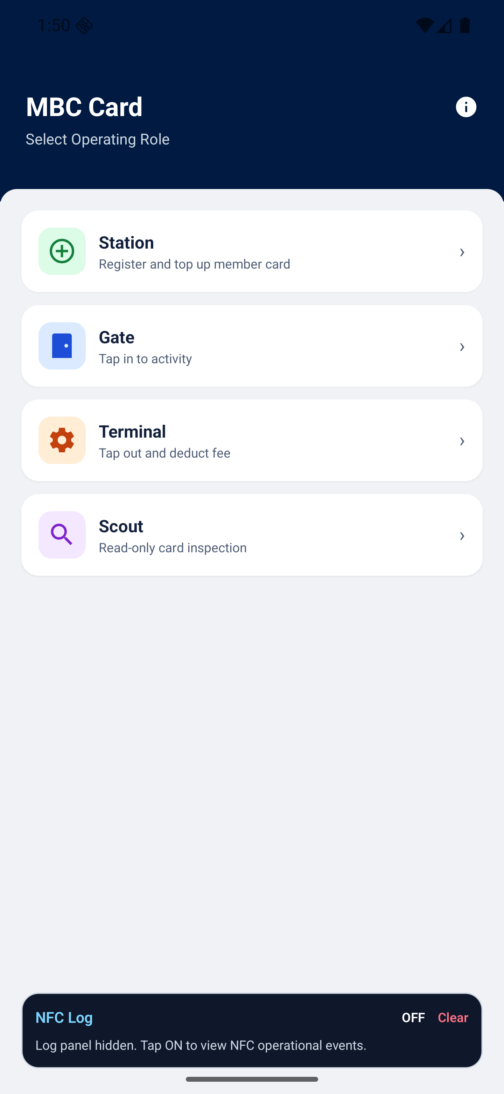

MEMBERSHIP BENEFIT CARD
Assessment presentation
MBC
One app.
Four roles.
Zero internet.
Offline-first NFC membership card for a village cooperative.
4
362B
444+
operational roles
encrypted payload
automated tests
Source: docs/PRESENTATION.md
01

Slide 2
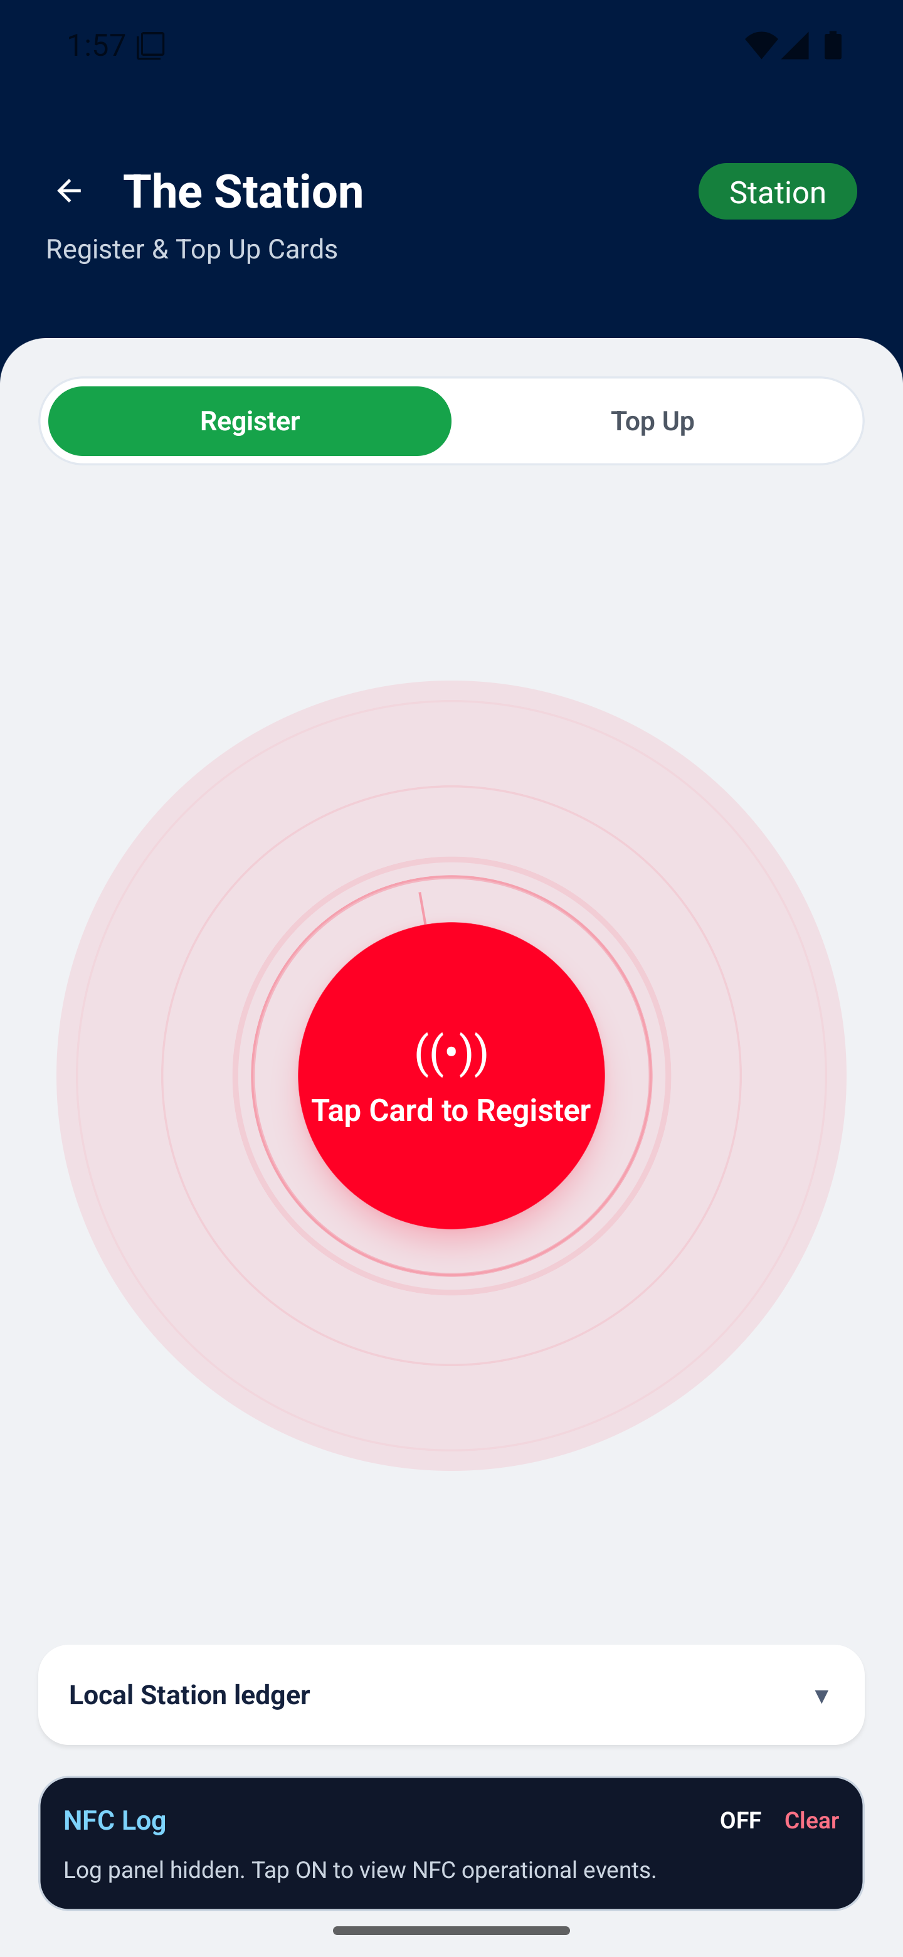
OFFLINE CORE
When internet fails, the card remains the system of record.
Phone app
NTAG215 card
SQLite ledger
reads and writes by NFC
portable member state
device-only audit trail
No backend dependency
Register, top-up, check-in, check-out, and inspect keep working with the network off.
Station
CARD = TRUTH
APP = OPERATOR
LEDGER = AUDIT
Membership Benefit Card assessment
02

Slide 3
ROLE MODEL
Four roles cover the full parking cycle without role-specific apps.
Station
Gate
Terminal
Register + top-up + ledger
Write entry timestamp
Calculate fee + deduct
Scout
Read-only inspection
One app entry point
Ledger writes only where audit matters: Station and Terminal.
Membership Benefit Card assessment
03

Slide 4
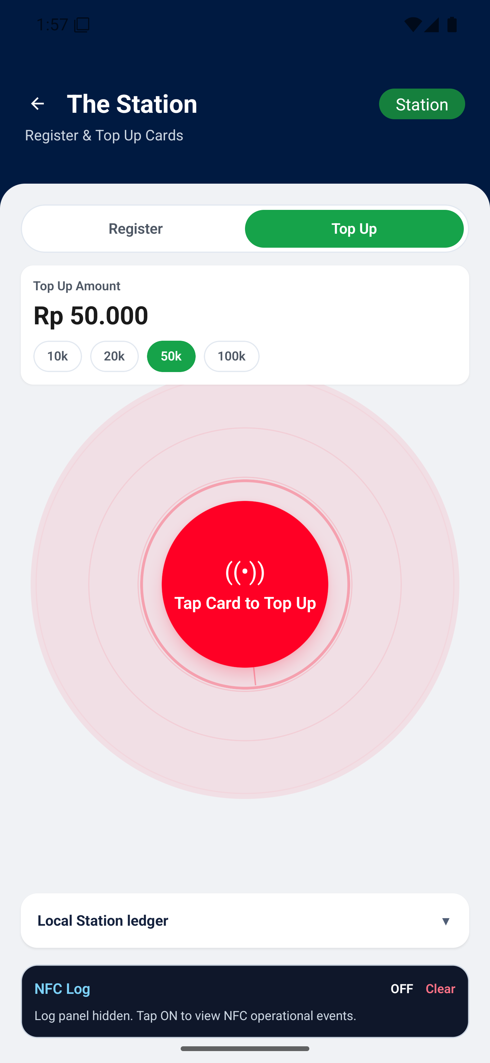
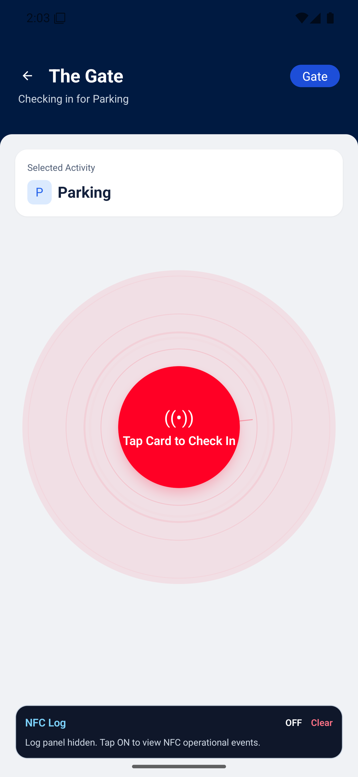
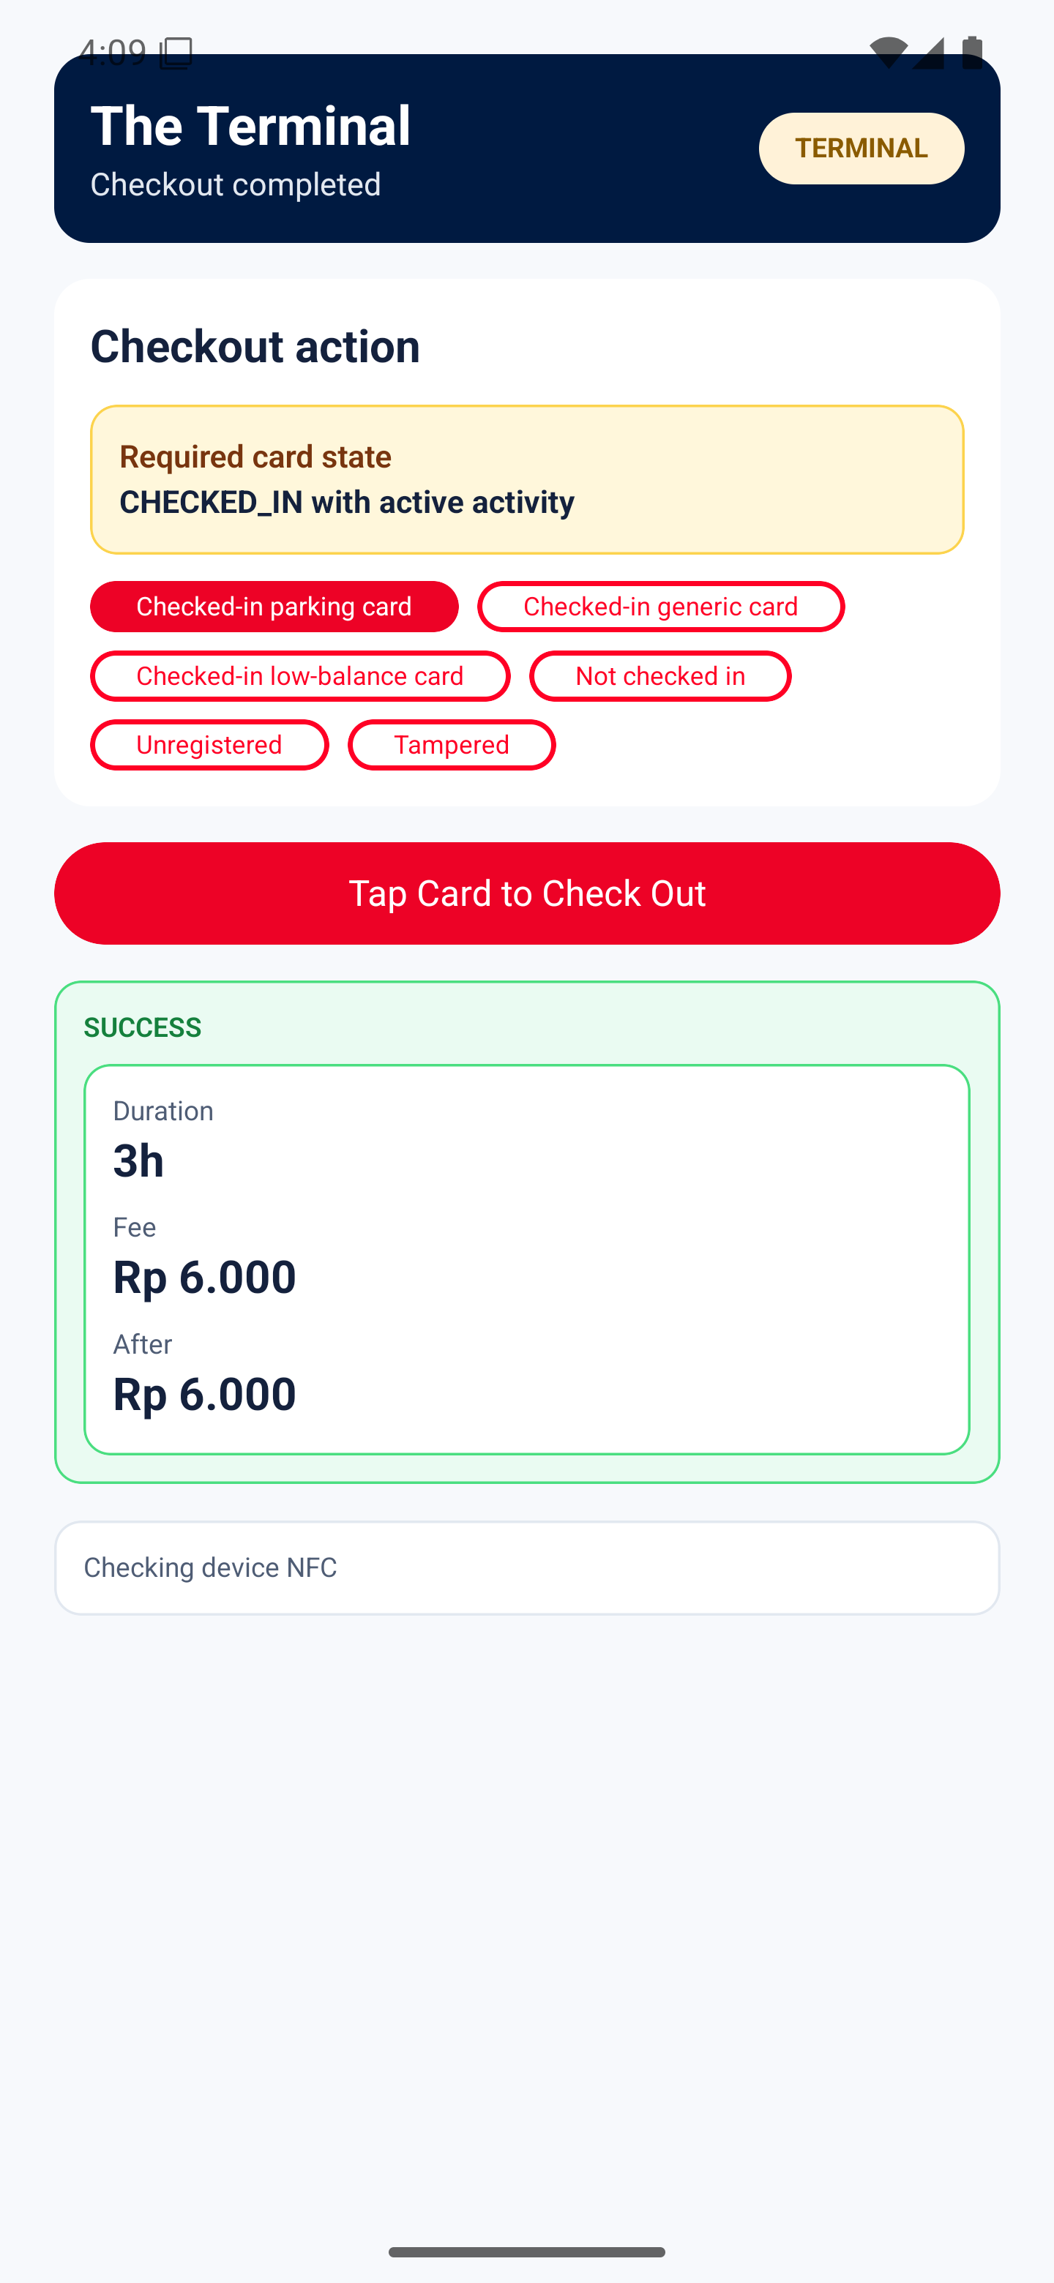
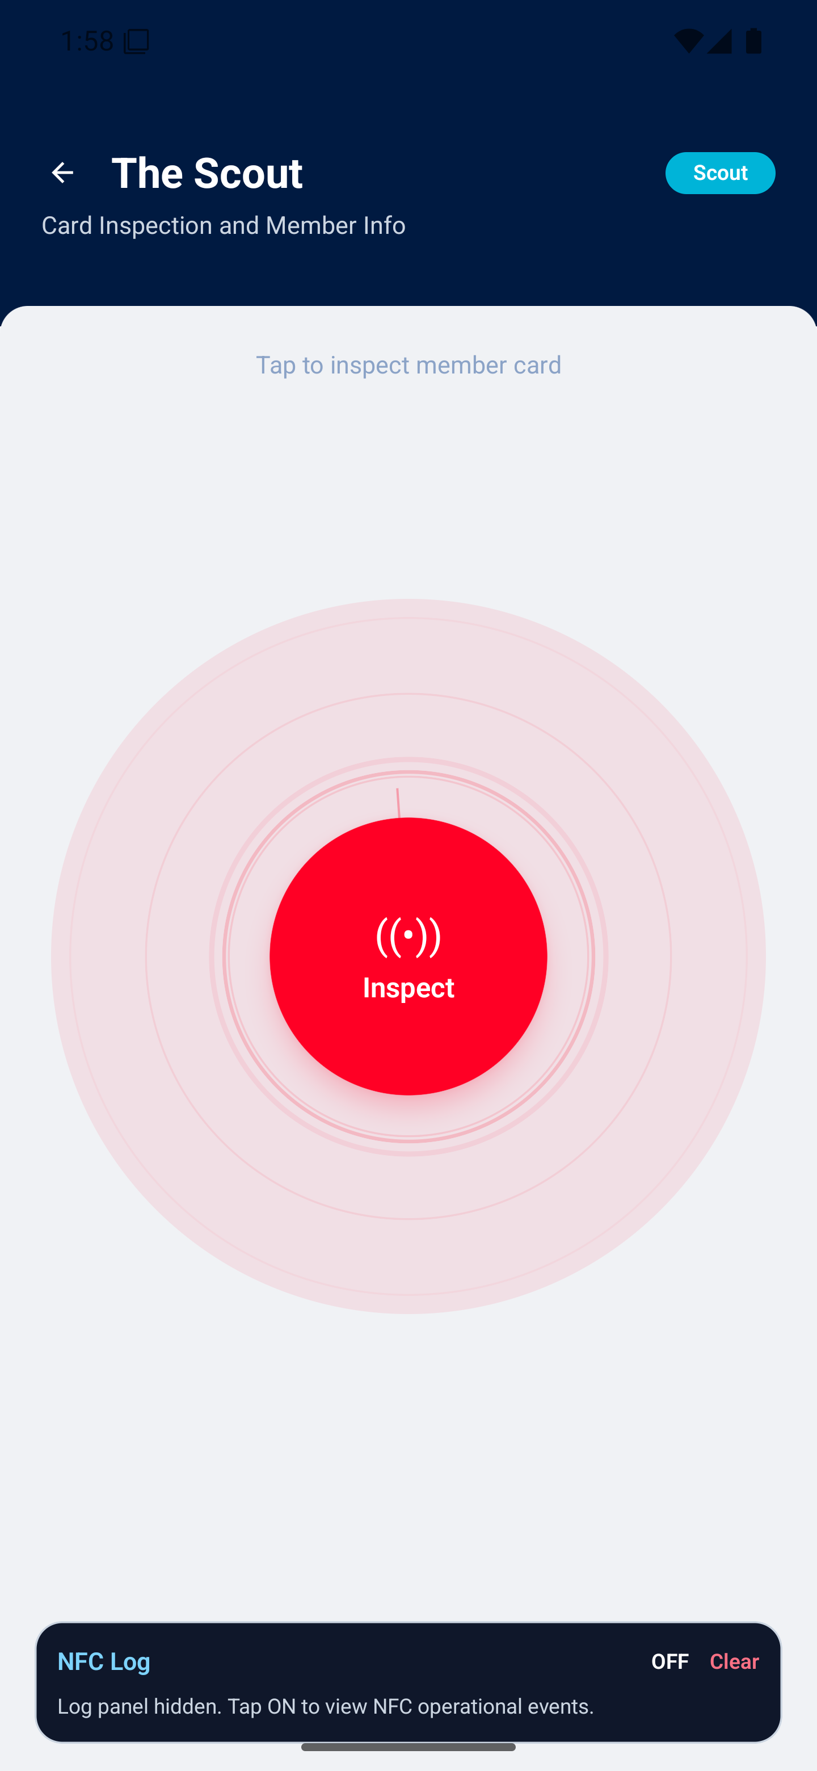

DEMO CYCLE
A complete parking demo is one NFC tap loop.
Rp 2.000 / started hour
Top-up
Check-in
Check-out
Inspect
1
2
3
4
5
6
Register
Top-up
Check-in
Check-out
Inspect
Opaque read
Membership Benefit Card assessment
04

Slide 5
SILENT SHIELD
Generic NFC readers see an opaque MBC1 payload, not member data.
Card data
Compact JSON
AES-GCM
MBC1 envelope
NTAG215
MbcCard state
small field names
fresh IV + auth tag
versioned payload
NDEF write
Generic reader
Balance edit
Replay/copy
opaque binary only
auth tag fails
fresh IV per write
Silent Shield: AES-256-GCM with MBC1 envelope
05

Slide 6
PAYLOAD PROOF
The encrypted payload fits NTAG215 with 25% headroom.
504B
362B encrypted payload
118B margin
NTAG215 raw
480B
480B usable NDEF capacity
NDEF usable
25%
MBC1
Ver
Key
Algo
IV
Auth
Ciphertext
4B
1B
1B
1B
12B
16B
var
safety margin
Membership Benefit Card assessment
06

Slide 7
ARCHITECTURE
Clean Architecture keeps business rules safe at the center.
Dependency rule
Outer code depends inward.
The domain does not know NFC, SQLite, or React Native.
Presentation
Role screens, Signal UI, Zustand stores
Application
Register, top-up, check-in, check-out, inspect
Domain
MbcCard, TariffCalculator, CardStatePolicy, interfaces
Infrastructure
NFC reader/writer, Silent Shield codec, SQLite ledger
Membership Benefit Card assessment
07

Slide 8
QUALITY PROOF
444+ tests run without NFC hardware because hardware sits behind interfaces.
444+
65
100%
0
automated tests
test suites
line coverage
audit vulnerabilities
Mock repo
Use cases
MbcCardRepository
CI without tag hardware
depend on domain interfaces
same contract in test and prod
Real repo
device validation
SonarCloud passed
A- code audit
99% thresholds
Membership Benefit Card assessment
08

Slide 9
DEPLOYMENT
Release flow blocks risky changes before Firebase distribution.
feature/*
develop
main
Firebase
implementation branch
PR-only integration
manual release
tester distribution
Unit test
Lint
Vuln scan
SonarCloud
Build APK
Jest
code style
npm audit
quality gate
main only
PR to develop: quality gate only. Manual dispatch on main: quality gate plus APK distribution.
Membership Benefit Card assessment
09

Slide 10
RELEASE READINESS
Submission is ready, with production hardening clearly scoped.
All
20/20
Production hardening
requirements traced
risks closed
HSM / secure enclave keys
Fleet key rotation
13
22
Optional backend sync
device tests pass
ADRs documented
Operator PIN/login
iOS NFC write entitlement
Validated checkout
Core MVP promise: cooperative member services continue operating offline.
Built from docs/PRESENTATION.md
10

