Slide 1

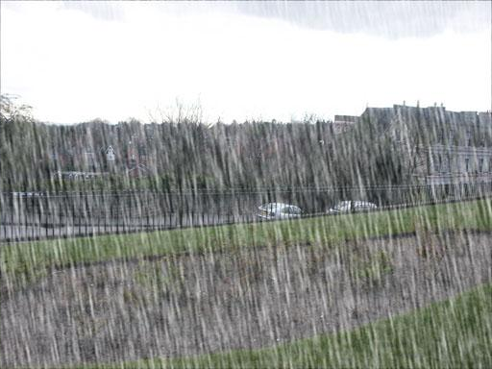
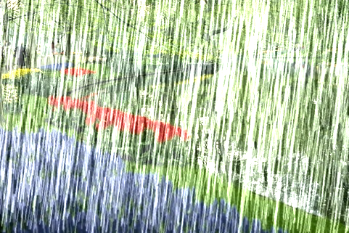



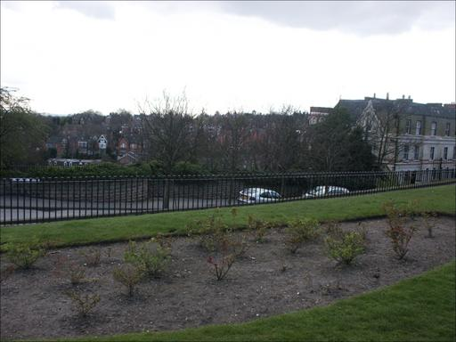




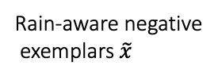

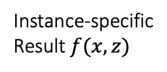




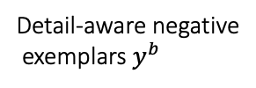

detail-aware
both-aware
rain-aware
(a) Rain density distribution
(b) Rain-/detail-aware intensities
Context-based instance-level
modulation (CoI-M)
Rain-aware
Searching rain layer bank
Rain-aware negative
exemplars $\tilde{x}$
$$E(⋅)$$
?
push
$$φ(⋅)$$
Add most dissimilar rain
Detail-aware
$$x$$
Guidance $z$
Gaussian blur
Modulated model
Detail-aware negative
exemplars $y^{b}$
$$x∈𝒟$$
$$=∪_{i=1}^{M}D_{i}$$
Rain-/detail-aware
contrastive learning
Instance-specific
Result $f(x, z)$
$$y$$
(a) An overview of the proposed CoIC
(b) Rain-/detail-aware negative exemplars generation

