Slide 1

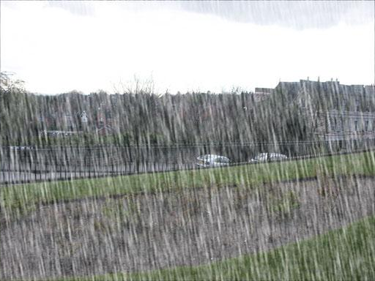



detail-aware
rain-aware
both-aware
(a) Rain density distribution
(b) Rain-/detail-aware intensities
(c) Real-world deraining w/o CoIC
(d) Real-world deraining w/ CoIC

