Slide 1

RESTest
Matthew Schlager

Slide 2
Introduction & Motivation
What is RESTest
A framework the makes use of multiple testing techniques for the testing of RESTful APIs
Why am I interested in such a tool?
Co-op experiences and increased API development
Notes:
RESTest as a complete framework which integrates multiple testing techniques beyond constraint-based testing. RESTest is open source and can be easily extended with new test case generation strategies, test data generators and test writers.
Black-box & automated
Techniques = state-of the-art techniques including fuzzing, adaptive random testing and constraint-based testing

Slide 3
RESTful (REpresentational State Transfer)
What does it mean to be RESTful?
Client-Server Architecture: Independent evolution
Statelessness: Context free
Cacheability: Defining if the data can be saved
Layered System: Implementation of layered servers

Slide 4




Problem
Testing API’s is a laborious and boring process but, its incredibly important
Authentication breaches; Venmo, Facebook, USPS, and JustDial

Slide 5
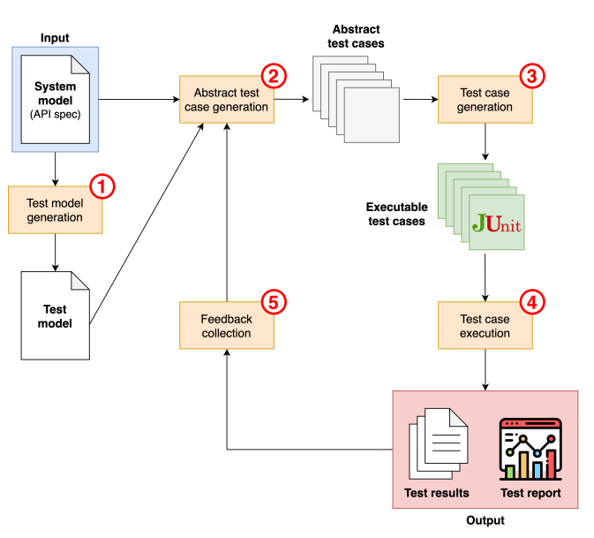
Techniques
Test Model Generation: Creating testConf.YAML from OpenAPI Specification (Swagger)
Abstract Test Case Generation: Abstract or platform-independent case generation
Test Case Generation: Abstract to executable cases (REST Assured)
Test Case Execution
Feedback Collection: Learning and making better tests (Coverage)

Slide 6
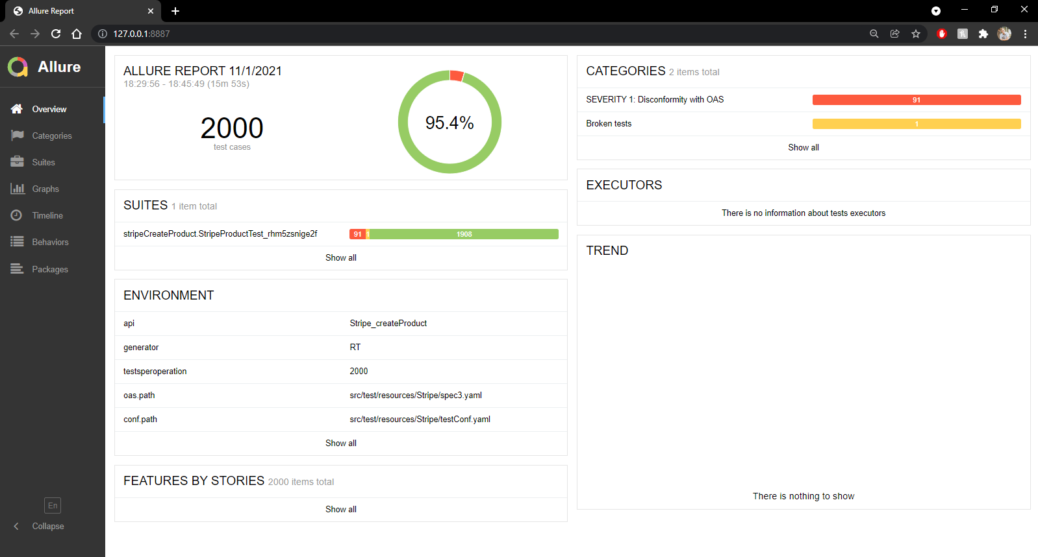
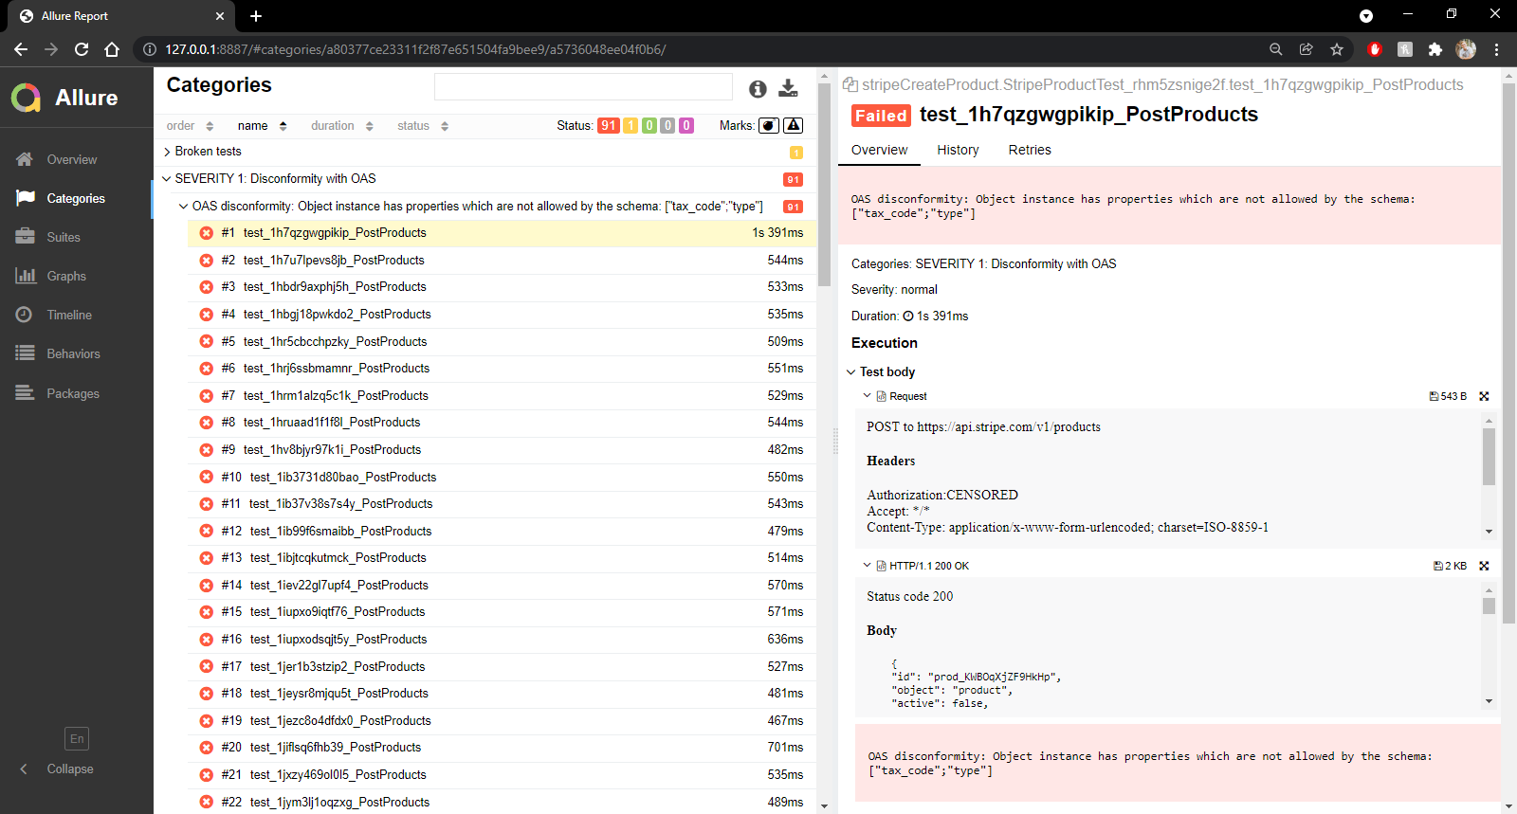
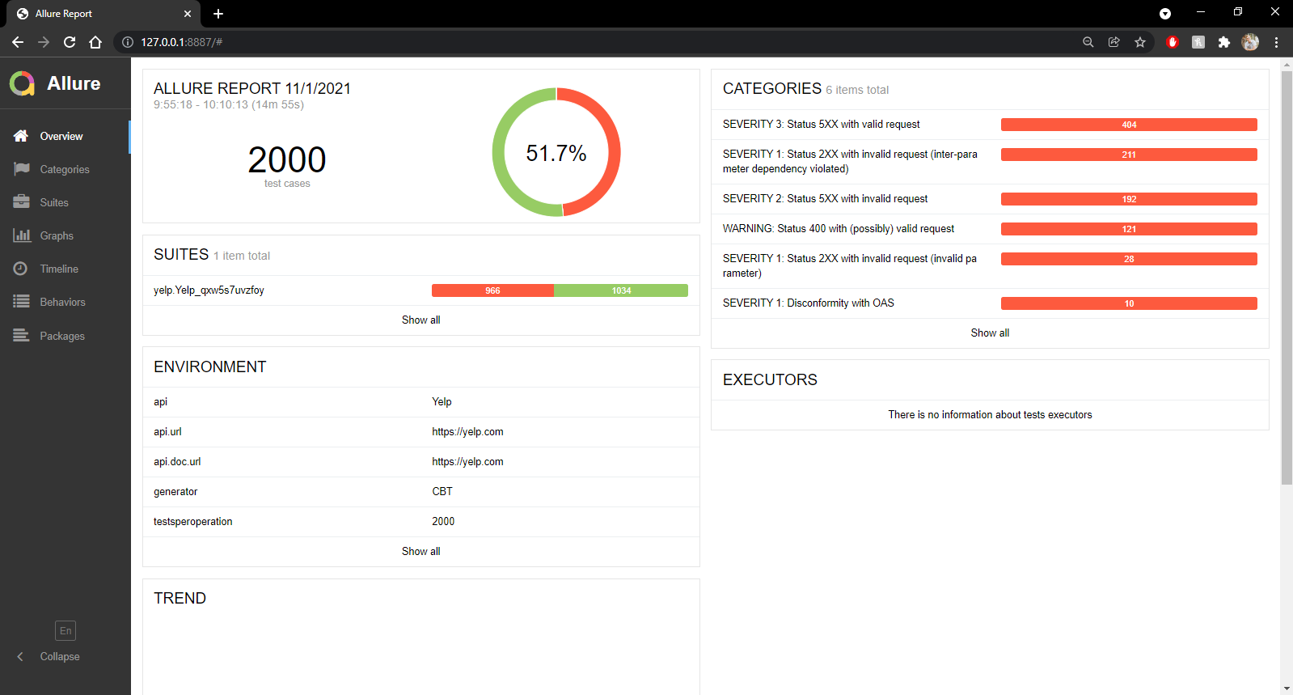
Testing

Slide 7

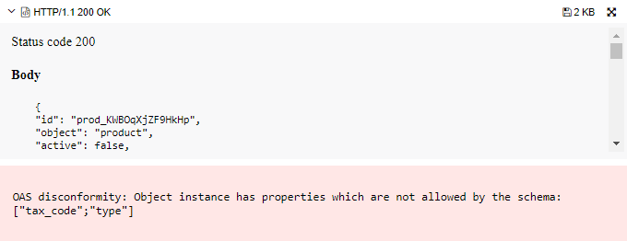
Stripe: Create Product
Where are the differences coming from?
Random based testing difference = ~5%
Constraint based testing difference = ~66%
Changes in Stripe API
Disconformity with OAS & Statues 4XX with (possibly) valid credentials

Slide 8
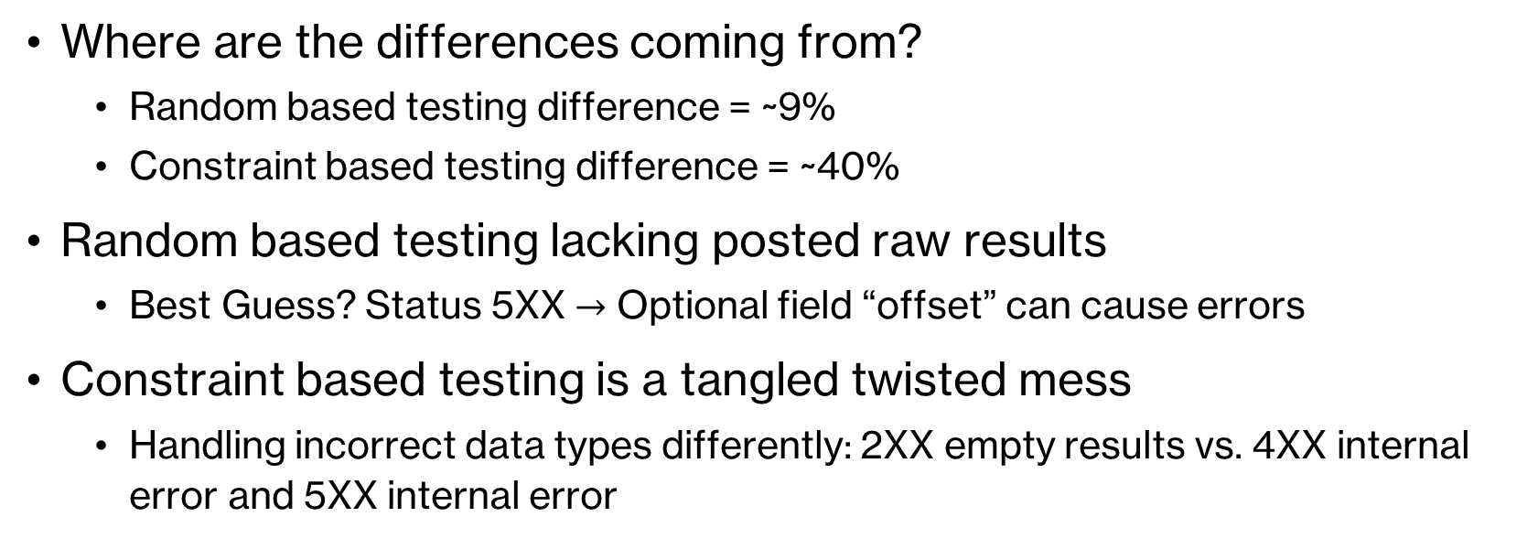
Yelp: Search Businesses
Where are the differences coming from?
Random based testing difference = ~9%
Constraint based testing difference = ~40%
Random based testing lacking posted raw results
Best Guess? Status 5XX $→$ Optional field “offset” can cause errors
Constraint based testing is a tangled twisted mess
Handling incorrect data types differently: 2XX empty results vs. 4XX internal error and 5XX internal error

Slide 9

Improvements
RESTest is not a perfect tool, what does it need to improve:
Improve Documentation
Update Benchmarking
Usefulness

Slide 10

Threats to Validity
Let's talking about everything I could have done wrong!
Lacked Information
Differences
I’m not an Expert

