Slide 1

Note: The data and information in this document is reflective of a hypothetical situation and client. This document is to be used for KPMG Virtual Internship purposes only.
Sprocket Central Pty Ltd
Data analytics approach
[Division Name] - [Engagement Manager], [Senior Consultant], [Junior Consultant]

Slide 2
Note: The data and information in this document is reflective of a hypothetical situation and client. This document is to be used for KPMG Virtual Internship purposes only.
Agenda
Introduction
Data Exploration
Model Development
Interpretation

Slide 3
Note: The data and information in this document is reflective of a hypothetical situation and client. This document is to be used for KPMG Virtual Internship purposes only.
Introduction
The problem
Who are the customer?
How old?
Financial status?
In what job industry they work?
What is the target group?
Who spent the most?
Who is the loyalist?
Who are new?
The approach
Create clusters with a k-mean model
RFM-score as variables
Define the optimal amount of clusters
Every customer get categorized
Show the top 1000 customer

Slide 4
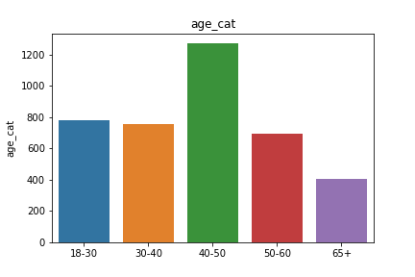
Note: The data and information in this document is reflective of a hypothetical situation and client. This document is to be used for KPMG Virtual Internship purposes only.
Data Exploration
Age distribution of the customers
Sursprinsingly the most customer are in their 40s
Second are the youngest group, but only slightly higher than the 30s and 50s
The older population is like expected the smallest group

Slide 5
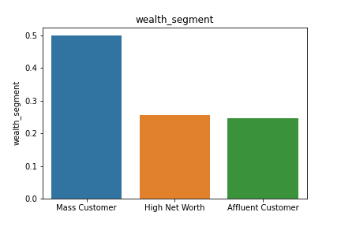
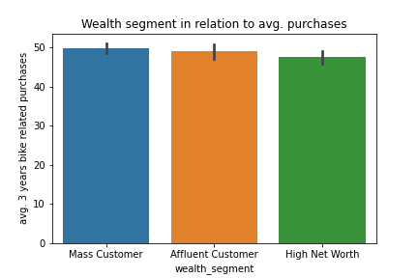
Note: The data and information in this document is reflective of a hypothetical situation and client. This document is to be used for KPMG Virtual Internship purposes only.
Data Exploration
Wealth segment distribution of the customers
Nearly the half are mass customer
On average all wealth segments purchased the same amount
So no wealth segment should be preferred over another

Slide 6
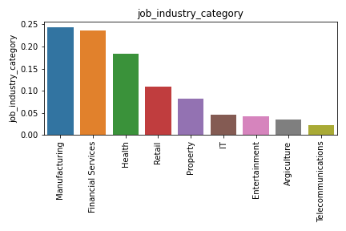
Note: The data and information in this document is reflective of a hypothetical situation and client. This document is to be used for KPMG Virtual Internship purposes only.
Data Exploration
Job industry distribution of the customers
Biggest sectors are manufacturing and financial services

Slide 7
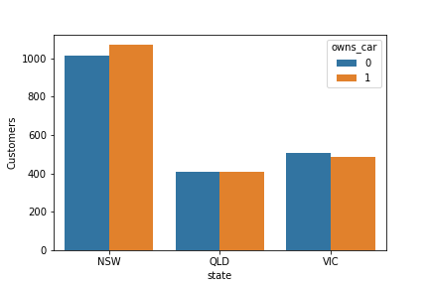
Note: The data and information in this document is reflective of a hypothetical situation and client. This document is to be used for KPMG Virtual Internship purposes only.
Data Exploration
Car distribution of the customers
Most customer are from New South Wales
People with a car are also good customer

Slide 8
Note: The data and information in this document is reflective of a hypothetical situation and client. This document is to be used for KPMG Virtual Internship purposes only.
Model Development
Feature engineering: RFM-score
Table 1: Abstract of the new data
Recency = last date from the transaction table (30.12.2017) minus the date of the last transaction
Frequency = For every cutomer_id the sum of their transactions
Monotary = = For every cutomer_id the sum of the difference between list_price and standard_cost
cutomer_id | Recencyy | Frequency | Monotary
1 | 11 | 7 | 3018.09
2 | 3 | 128 | 2226.26
3 | 8 | 102 | 3362.81
4 | 2 | 195 | 220.57
5 | 6 | 16 | 2394.94

Slide 9
Note: The data and information in this document is reflective of a hypothetical situation and client. This document is to be used for KPMG Virtual Internship purposes only.
Model Development
K-Mean Model
Based on the RFM-scores and the elbow method the optimal amount of clusters are 4
A = top customers: most recent, high frequency and spend the most
B = potential top customers: don't buy often, but bought recently and spend large amount of money
C = occasionally customers: customer don't buy often, spend small amount of money, but bought recently
D = churning out: low recency, low frequency and spend the least
Table 2: Average RFM-scores in the clusters
Clusters | Recencyy | Frequency | Monotary
A | 33.85 | 9.08 | 5945.65
B | 44.10 | 6.52 | 3569.74
C | 43.99 | 3,95 | 1816.33
D | 171.97 | 3.55 | 1823.62

Slide 10
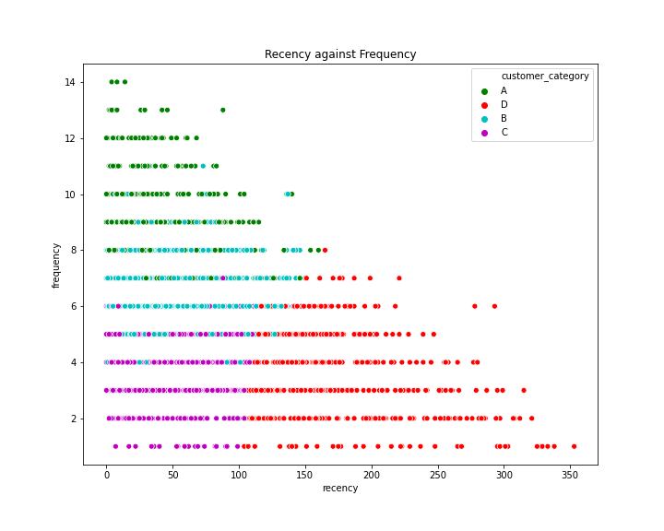
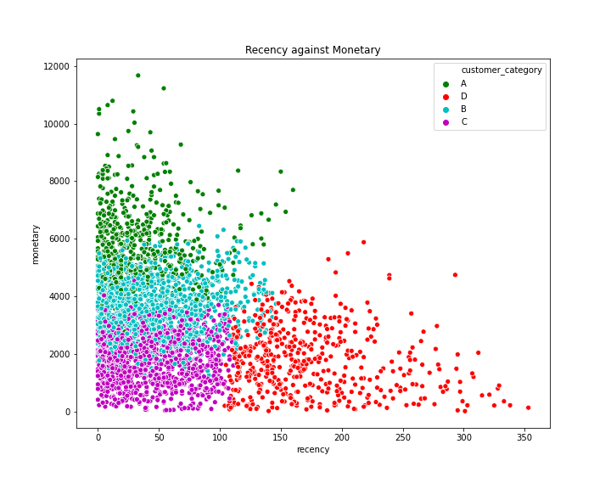
Note: The data and information in this document is reflective of a hypothetical situation and client. This document is to be used for KPMG Virtual Internship purposes only.
Model Development
Results I

Slide 11
Note: The data and information in this document is reflective of a hypothetical situation and client. This document is to be used for KPMG Virtual Internship purposes only.
Model Development
Results II
Table 3: Cluster distribution
Clusters | Number of customers | Cumulative | Customer selection
A | 547 | 547 | 547
B | 1324 | 1871 | 453
C | 1106 | 2977 | 0
D | 517 | 3494 | 0
The top 1000 customers are in cluster A and B

Slide 12
Note: The data and information in this document is reflective of a hypothetical situation and client. This document is to be used for KPMG Virtual Internship purposes only.
Interpretation
Interpretation of the clusters
Table 4: customer distribution based on the clusters
Clusters | Gender | Past 3 years bike purchases | Owns car | tenure | age | Property valuation
A | 0.54 | 47.28 | 0.49 | 10.60 | 42.35 | 7.64
B | 0.52 | 49.35 | 0.50 | 10.57 | 42.75 | 7.55
C | 0.51 | 49.30 | 0.52 | 10.72 | 42.59 | 7.41
D | 0.50 | 49.00 | 0.48 | 10.88 | 42.70 | 7.59
All features are very similar
No attribute stand out, which indicates that he/she will be a top customer

Slide 13
Note: The data and information in this document is reflective of a hypothetical situation and client. This document is to be used for KPMG Virtual Internship purposes only.
Interpretation
Conclusion
We separated the customer into 4 categories based of their transactions
Based of the new customer list we could not make a prediction, which would be a good customer
So, the goal should be to concentrate on the old customer to hold them and try to convert them into the higher category

Slide 14
Note: The data and information in this document is reflective of a hypothetical situation and client. This document is to be used for KPMG Virtual Internship purposes only.
Appendix

Slide 15
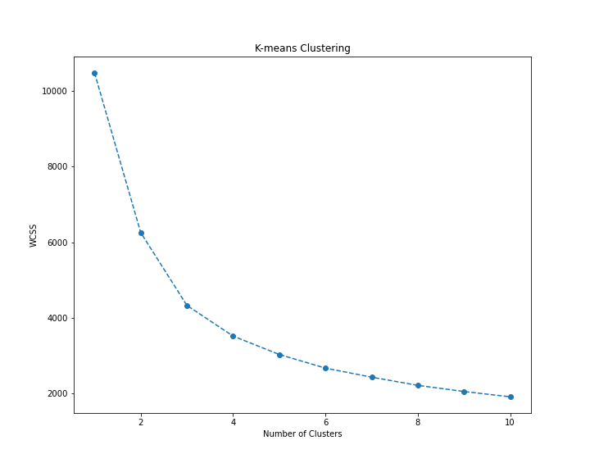
Note: The data and information in this document is reflective of a hypothetical situation and client. This document is to be used for KPMG Virtual Internship purposes only.
Appendix
Elbow method

