Slide 1
Nod+/+ and Nod-/- comparison through AOM/DSS model – untreated with antibiotics

Slide 2
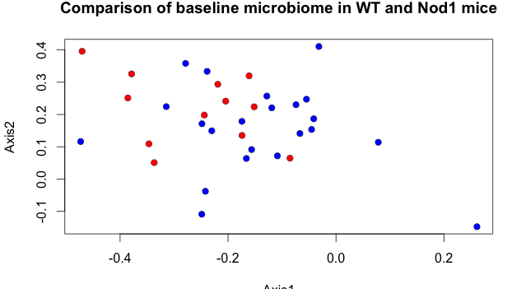
Microbiomes do not cluster separately before AOM/DSS treatment
Notes:
Red = nod1, blue = WT

Slide 3
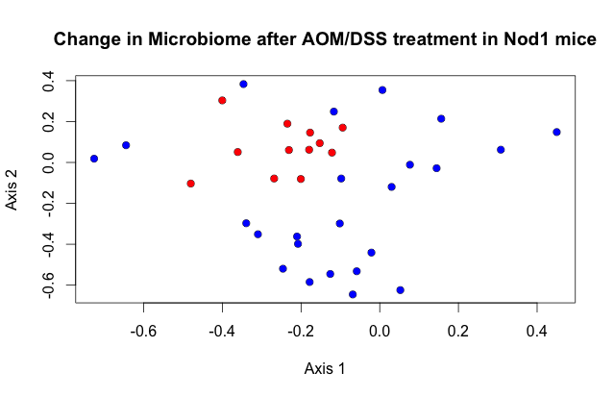
Microbiome does not change significantly after AOM/DSS treatment like it does in WT
Notes:
Red= before, blue = after (DSS3)
NMDs was made with nod1 data only

Slide 4
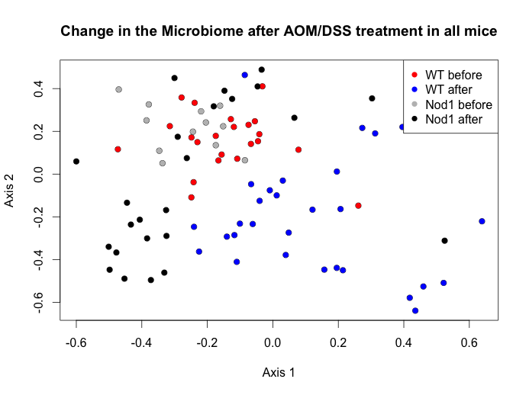
Notes:
Nod1 seems to stay more in the same place while WT changes more

Slide 5
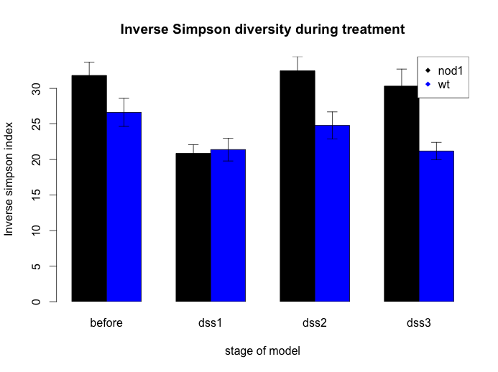
Notes:
WT diversity decreases and stays low throughout model, but nod1 seems to go back up
I wonder if the same species are coming back or if these are new species

Slide 6
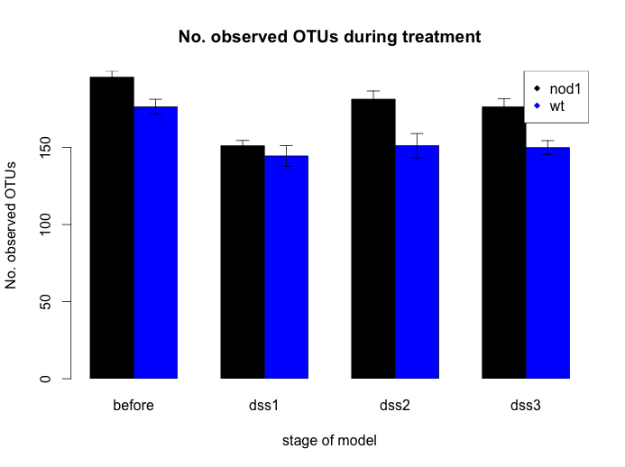

Slide 7
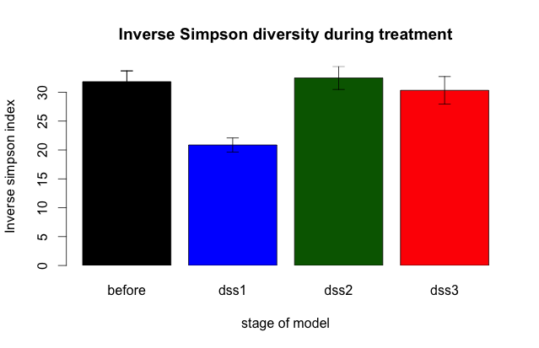
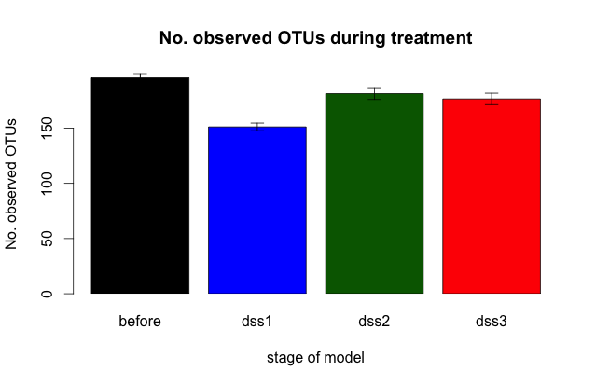
Notes:
Both the number of OTUs and the alpha diversity go down after initiation of the model but then go back up

