Slide 1
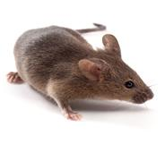
15% PEG 3350
Euthanize
Euthanize
15% PEG 3350
15% PEG 3350
Day:
-15
-10
-5
-1
0
4
6
10
30
Clindamycin: 10mg/kg (N=20)
5-days of 15% PEG 3350 in drinking water (N=21)
5-day PEG 3350 + Clind. (N=9)
5-day PEG 3350 + 10-day recovery (N=12)
Clind.
IP
Gavage 10⁵ spores C. difficile 630
Notes:
Fig. 1
Clindamycin: 10mg/kg (N = 21)
5-days of 15% PEG 3350 in drinking water (N = 21)
5-day PEG 3350 + Clind. (N = 9)
5-day PEG 3350 + 10-day recovery (N = 12)

