Slide 1
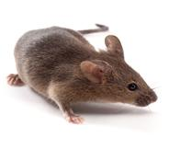
Groups
Clindamycin: 10mg/kg (N = 6)
1-day of 15% PEG 3350 in drinking water (N = 6)
1-day PEG 3350 + 1-day recovery (N = 6)
+ C. difficile
Euthanize
PEG
PEG
Day:
-2
-3
-1
0
1
2
4
6
8
10
Snap freeze stool
Collect stool daily to monitor C. difficile CFU
Clind.
IP
Gavage 10⁵ spores C. difficile 630
Notes:
Used all female mice
C Group started on D-15, M1 Started Day -11,
6 mice per group

