Slide 1
Incorporating make into a data analysis workflow
(just how weird are my kids?)
Pat Schloss (@PatSchloss)
http://github.com/pschloss/make_tutorial

Slide 2
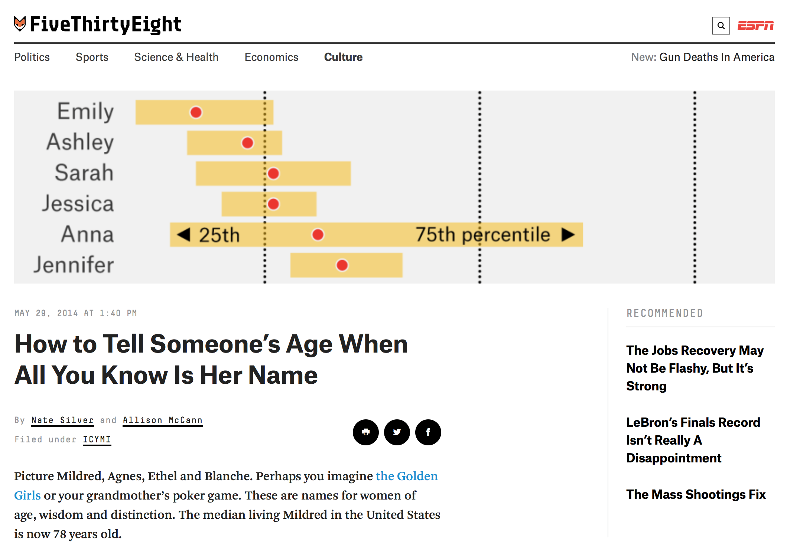
http://fivethirtyeight.com/features/how-to-tell-someones-age-when-all-you-know-is-her-name/

Slide 3
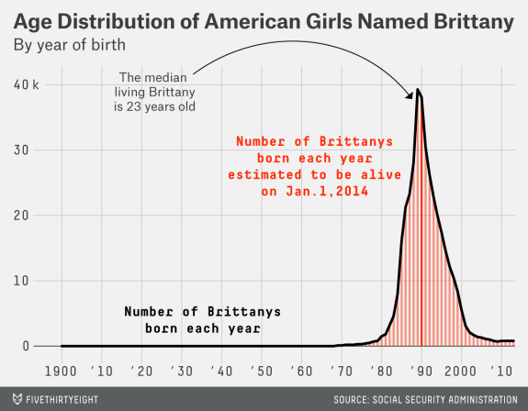

Slide 4
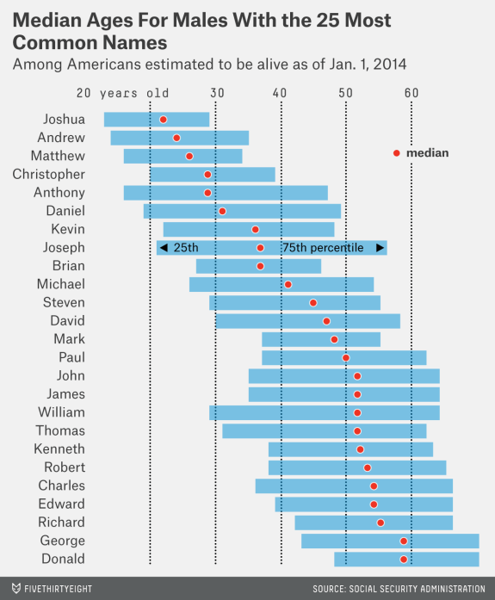

Slide 5
Reactions…
What about my kids’ names?
This would be cool as a Shiny app
This was done in 2013, what about 2016?
What if we had similar data from Canada?
Can I replicate their analysis?

Slide 6
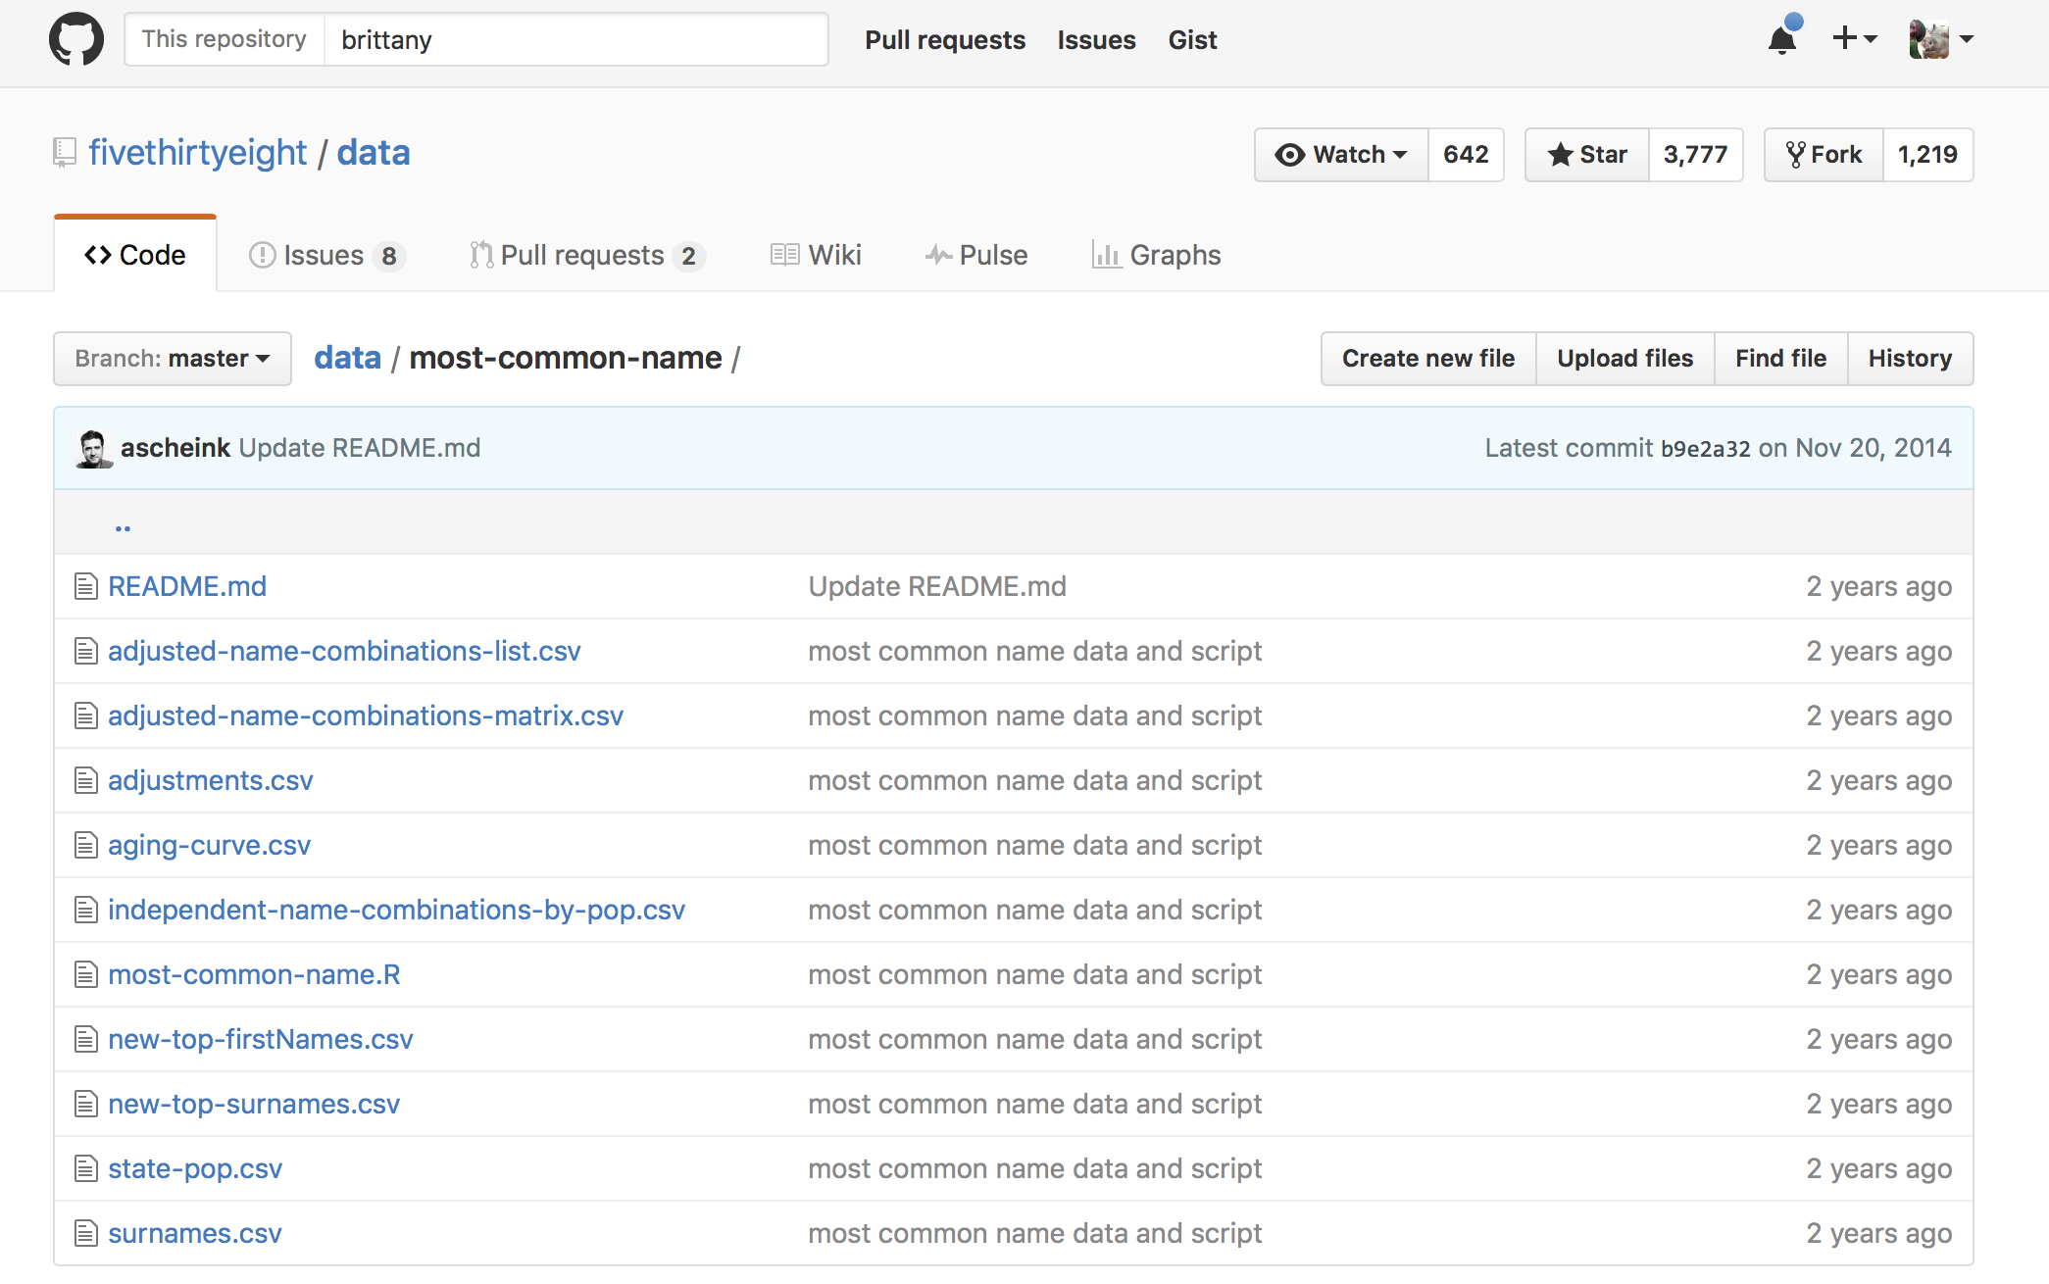
Kudos to Five Thirty Eight, but…
Notes:
R! Open science!
Poor organization
Script doesn’t produce plots – is actually for a different question (what’ s the most common name?)

Slide 7
My general approach: IRL
I know that I will repeat various steps in an analysis multiple times
The end product is a data-heavy paper written in Rmd
Each step of the analysis may be slow
There are a lot of steps
Analysis run on an HPC, so it needs to be scripted
Want to make it possible for others (including me!) to replicate what I’ve done

Slide 8
Various approaches…
A single batch script file
kntir caching
GNU make
Numerous knock offs
Notes:
Show current single batch script file
Discuss shortcomings of batch file and knitr caching

Slide 9
History of make
Developed by Stuart Feldman in 1977 as a Bell Labs summer intern
The goal was to have a tool for compiling software
Don’t want to recompile an entire program for every change, so only compile what changed and what depends on that change
People generally hate make – hence the knock offs
Hard to do much better!
http://swcarpentry.github.io/make-novice/

Slide 10
Fundamentals of make - DAG
Mortality data
interpolate_mortality.R
YOB files
YOB files
YOB files
YOB files
alive_2016_annual.csv
get_total_and_living_name_counts.R
concatenate_files.R
total_and_living_name_counts.csv
all_names.csv
plot_functions.R
family_report.html
family_report.Rmd

Slide 11
Holy Grail
$ git clone git@github.com:pschloss/make_tutorial.git
$ cd make_tutorial
$ make clean; make family_report.html
… and it just works (for you too!)

Slide 12
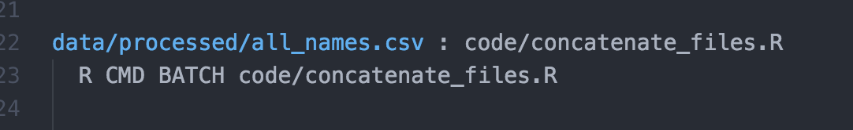
Rules
Target(s)
Dependency(ies)
Command(s)
– note you must use a tab!
$ make data/processed/all_names.csv
Notes:
At this point show how to convert existing batch file into a Makefile and run “make family_report.html”

Slide 13
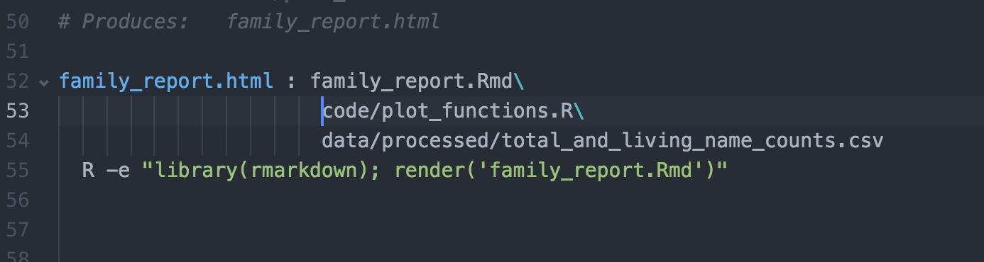
List of dependencies

Slide 14
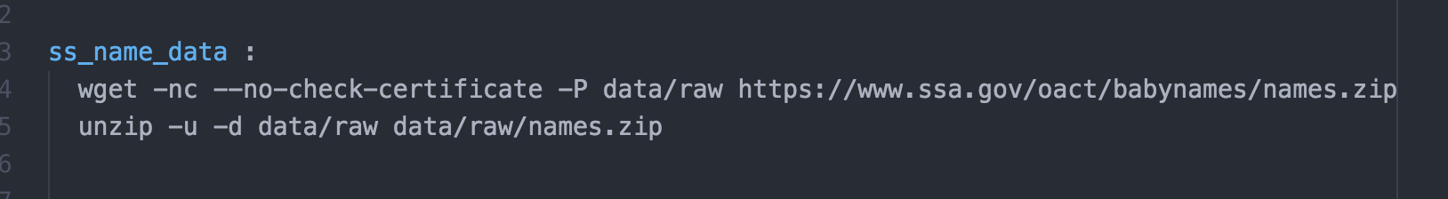
Multiple commands per rule

Slide 15
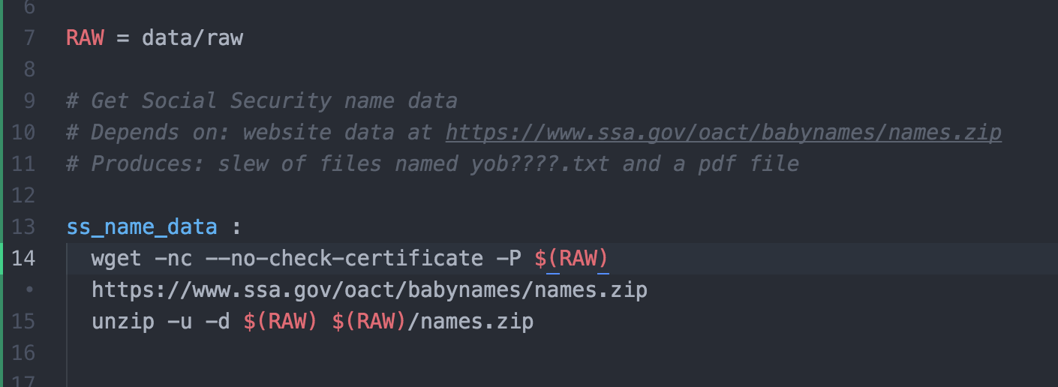
User-defined variables
Want to keep code DRY/simple to maintain

Slide 16
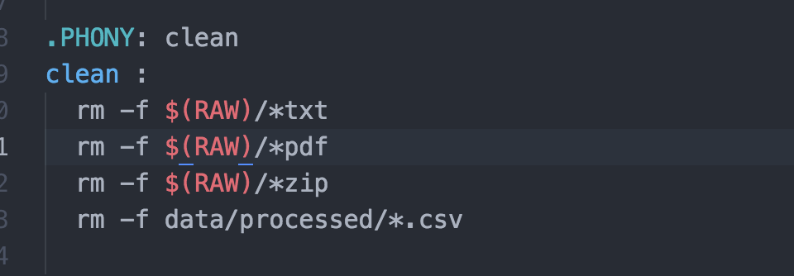
PHONY! (targets)

Slide 17
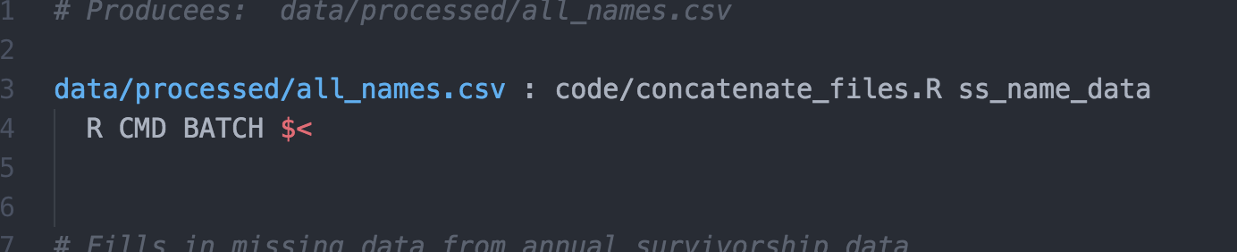
Automatic variables
$@: the target
$^: all dependencies for current rule
$<: first dependency
$*: pattern match

Slide 18
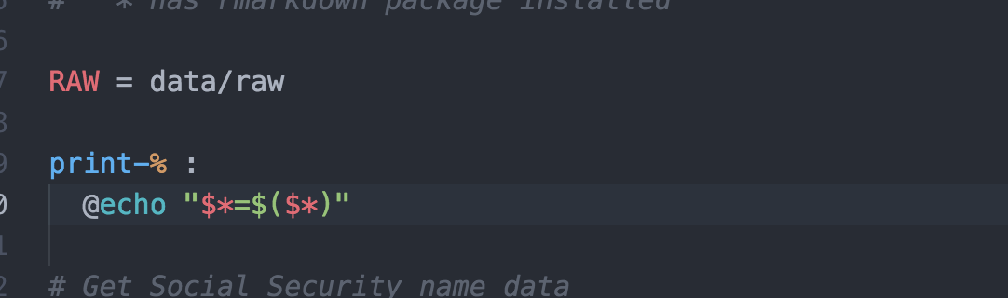
Pattern matching
Weird example (sorry!)…
make print-RAW

Slide 19
Functions
What are we missing here?

Slide 20
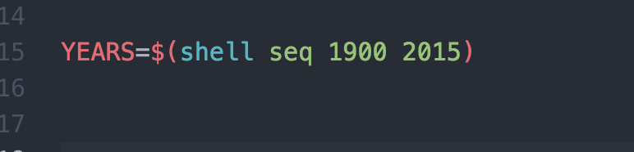
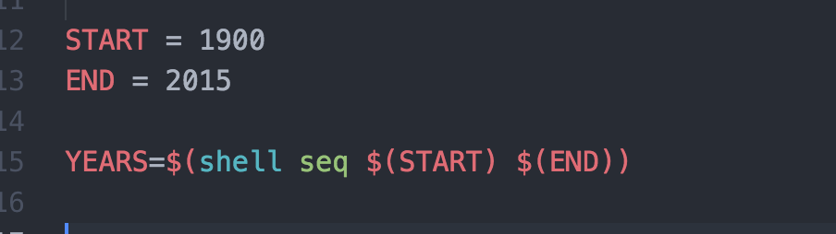
Bash commands
or…
Notes:
Try make print-YEARS

Slide 21
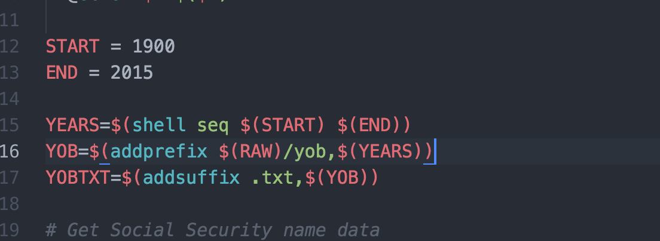
make commands

Slide 22
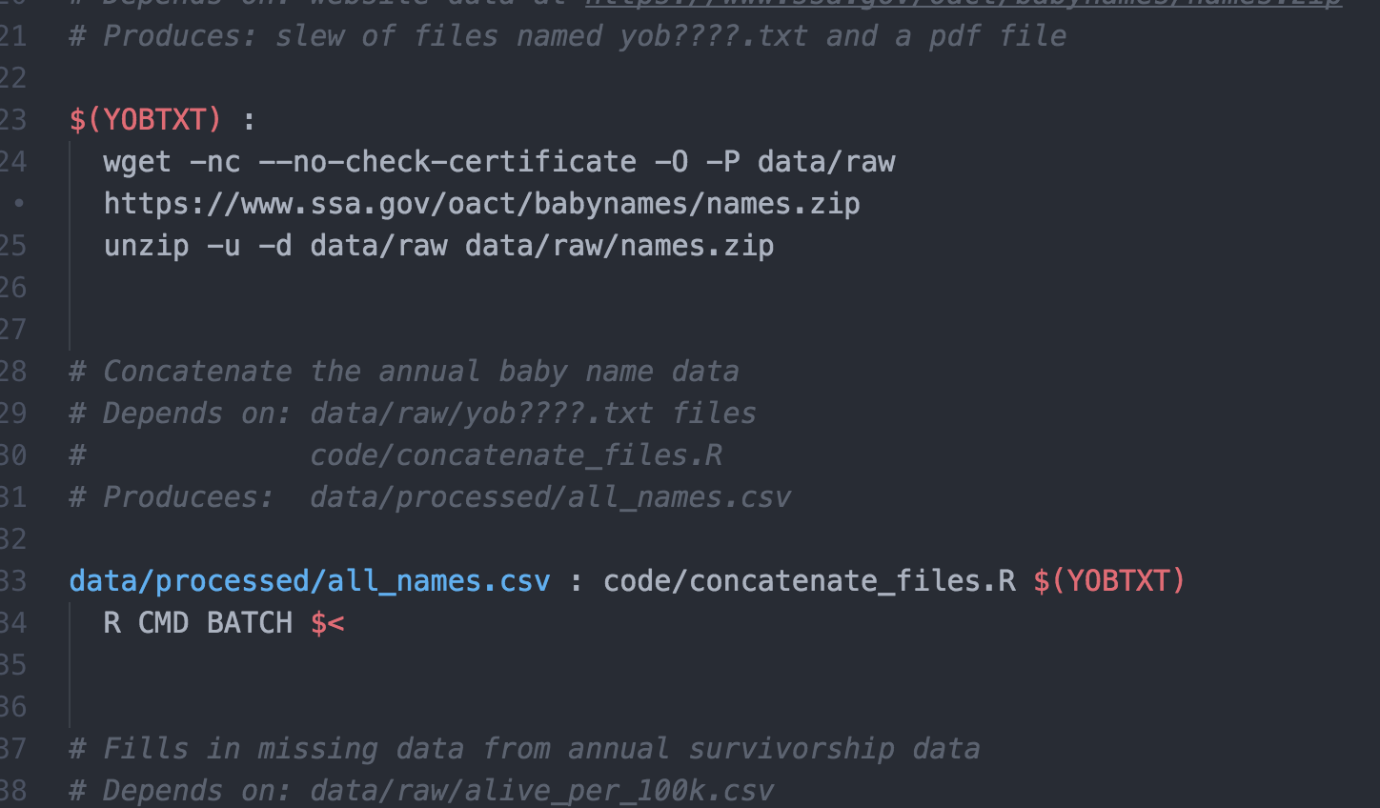
Updating our first rules…

Slide 23
Other commands
make -n target: What commands will be run to build the target?
make -d target: What dependencies need to be fulfilled to build the target?
make –j N target: Use N processors to build target
make: Build first rule in Makefile
make –f my_makefile: Use my_makefile in place of Makefile

Slide 24
Resources
Software carpentry:
http://swcarpentry.github.io/make-novice/
GNU make:
https://www.gnu.org/software/make/manual/
StackOverflow

Slide 25
Holy Grail
$ git clone git@github.com:pschloss/make_tutorial.git
$ cd make_tutorial
$ make clean; make family_report.html
… and it just works (for you too!)

