Slide 1


FOR KNOWLEDGE PARTNERS AND ENTERPRISE TEAMS
Your academy.
Your team's proof of competence.
Chronopoli, the Global Knowledge City for the digital economy, hosted by Dubai Blockchain Center
AI
Digital assets
Governance
Compliance/AML
Financial-crime investigation
Risk & trust
Emerging tech
Founding Partner and pilot-cohort programme · Pre-launch · September 2026
Real Open edX grades and reports today; team-admin console and evidence pack come with the pilot
DESIGN PROTOTYPE
Backdrop: landing page, not yet deployed
Illustrative mock data · Tether is a partner-roadmap target only; no agreement implied · all other organisations and people are fictitious
01
Notes:
TALK TRACK: Thank you for the time. In 20 minutes I'll show you two things. For a Knowledge Partner: how you get your own academy that educates your market and feeds you talent. For an enterprise team: how you train and certify staff and prove it to a supervisor. Every screen is labelled as real Open edX, a real Chronopoli template render, a real extension or a design prototype, and slide 6 shows the build status of every deliverable on one page. The architecture in one picture is the Octopus Model on slide 4: Chronopoli is the head, your academy is a tentacle. We're pre-launch and looking for Founding Partners and pilot teams. BEFORE ANY MEETING WITH A REAL STABLECOIN ISSUER OR ITS COMPETITOR: say up front that the Tether academy in this deck is an illustrative example built without Tether's involvement, and that no partnership exists. OBJECTION: 'Is this live?' ANSWER: Not yet. The feature code is written and the core Open edX runs. There's a six-sprint go-live plan, and that's why founding partners get to shape what launches first.

Slide 2



WHO IT IS FOR
Built for two buyers
The organisations that shape the digital economy, and the teams that have to operate inside it
For Knowledge Partners
ONE CITY
For Enterprise Teams
CHRON-AI
Protocols & stablecoin issuers · Analytics & investigation vendors
AI companies · Universities & think tanks · Banks
CHRON-DA
Banks · VASPs & exchanges · Regulators' & FIU teams
Law enforcement · Corporates & treasury
WHAT THEY WANT
CHRON-GOV
WHAT THEY WANT
Educate your market
Policy insight
Close competence gaps
Own the standard
Revenue from content
CHRON-COMP
One training record
Build a talent pool
Evidence for supervisors and audit
UNIVERSITIES AND THINK TANKS ALSO WANT
CHRON-INV
Grow people into roles
Co-certified executive education
CHRON-RISK
ALSO FOR REGULATORS' AND FIU TEAMS
Research round tables with practitioners and regulators
CHRON-INV: tracing for FIUs and law enforcement
A route to industry for graduates
CHRON-ET
CHRON-GOV: policy and supervision for regulators
Seven Knowledge Districts · four learning layers: L1 Entry · L2 Professional · L3 Institutional / Advanced Practitioner · L4 Influence / Live cohort
Partner roadmap targets (not signed): Founding: Ripple, Chainalysis, Cardano, Hedera · Strategic: Tether, Polygon, Chainlink, Fireblocks · Investigation: TRM Labs, Elliptic · AI: Microsoft AI, Google AI · Institutional: BUiD (MOU in progress), universities, banks. Targets only; no partnership, endorsement or agreement is implied.
02
Notes:
TALK TRACK: Two buyers, one platform. Partners bring the expertise and the brand; enterprises bring the learners and the budget. Both sit in the same seven districts and four layers, so a bank's compliance team and a stablecoin issuer's academy meet in the Compliance District. Ask early which column the room is in and route the talk. PARTNER TALK: 1-13 and 18-29 (backup 30 on request). ENTERPRISE TALK: 1-6, 11, 14-23, 25-29 (skip 24; on 21 and 22 speak only to the team-subscription rows; on 23 use the data-access panel; on 25 use the enterprise lane). INSTITUTIONS (universities, think tanks): 1-10, 13, 18-23, 25-29 (skip 12 and 24; 30 only if asked). The roadmap line names organisations we are approaching or want to approach; none is signed. The Octopus Model (slide 4) and the traction slide (slide 20) name the targets from the master papers, with their exact status. Before a meeting with a competitor of a named target, decide whether to show those two slides. OBJECTION: 'Are these partners on board?' ANSWER: No. Dubai Blockchain Center is the confirmed anchor and the BUiD MOU is in progress; no partner is signed. The offer is about being a founder, not joining a crowd. OBJECTION: 'We already have an LMS.' ANSWER: For internal policy training, keep it. Chronopoli is for specialist digital-economy content and credentials, and the standard Open edX reports export as CSV to whatever system you use.

Slide 3




THE PROBLEM
The digital economy has a structural knowledge gap
No one connects AI, blockchain, compliance and forensics in one trusted, neutral place
Fragmentation
Slides 7-9, 14
Speed mismatch
Slides 8, 13
AI governance, blockchain, AML/CFT and forensics sit in silos: webinars, conference sessions and vendor decks, with no path by role and no single record.
MiCA changes, FATF updates, a new exploit creates a new typology. Universities take 18 months to update a curriculum, training firms 6; the market moves daily.
We deliver: seven districts, partner tracks and role-based pathways (P1–P3, E1)
We deliver: your experts author in Studio; round tables become drafts within hours (P2, P8)
Fake credentials
Slides 9-10, 16
No neutral convener
Slides 4, 13
A certificate says someone sat in a room; it tells no employer or regulator what they know today, and 'who was trained?' is answered with a spreadsheet.
Nobody puts a protocol, a regulator, an investigator and a researcher in one room and turns the conversation into institutional knowledge.
We deliver: badges on real grades (P3), grade reports (E3), badge-gated jobs (P4)
We deliver: closed-door round tables with a Partner Intelligence Report (P8)
Slide numbers show where each answer is proven
03
Notes:
TALK TRACK: The digital economy has a structural knowledge gap, and both buyers feel it in the same four ways. Fragmentation: AI governance, blockchain, AML/CFT and forensics live in silos, so nobody gets a path by role or a single record. Speed mismatch is the killer fact: universities take 18 months to update a curriculum and training firms 6, while MiCA, FATF guidance and crime typologies change every month. Fake credentials: a certificate proves attendance, not competence, and when a regulator or internal audit asks who was trained, the answer is a spreadsheet. No neutral convener: nobody puts a protocol, a regulator, an investigator and a researcher in one room and turns the conversation into institutional knowledge. Let the buyer pick the problem that hurts most, then jump to that proof slide. For partners it's usually the pipeline and owning the standard; for VASPs and banks it's proof for the supervisor; for universities it's reach into practice. Be precise on credentials: what exists today is the real Open edX grade report (slide 16); the one-click evidence pack is designed with pilot teams (slide 17). The 18- and 6-month figures come from our master papers; don't quote market sizes in a sales meeting. Instead ask: how long did your last evidence request take to answer? OBJECTION: 'Our vendor already gives us certificates.' ANSWER: A certificate from one course isn't a role-based pathway or a grade record. We show both, with the pass mark, per employee.

Slide 4

THE SOLUTION
Chronopoli: the Octopus Model
Chronopoli is the head. Every company, institution and knowledge partner is a tentacle.
Ripple Academy
TRM Labs
WHAT YOUR ACADEMY KEEPS
Company academy · target
Knowledge partner · target
Your brand on your own subdomain (slide 7)
Your courses, pathways and co-issued badges (slides 8-9)
Your talent pipeline and open roles (slide 10)
Your dashboard and 70% of sales (slide 12)
Chainalysis Academy
Fireblocks
Company academy · target
CHRONOPOLI
Knowledge partner · target
WHAT FLOWS THROUGH THE HEAD
AI · credentials
community · pipeline
AI tutor and district community (slide 11)
Open Badges 2.0 credentials (slide 9)
Round tables with five outputs, one human approves (slide 13)
Team seats, grades and evidence (slides 14-17)
BUiD
Regulators / FIUs
University · MOU in progress
Institutions · target
Each partner keeps its own identity, content and certification; the AI, credentialing, community and intelligence flow through Chronopoli.
Tentacle names are the master papers’ examples: targets, not agreements. Status: slide 20.
04
Notes:
TALK TRACK: Here's the architecture. Chronopoli is the head. Every company that joins is a tentacle: its own brand, its own courses, its own certification pathway. But the AI, the credentials, the community intelligence and the automation pipeline all flow through the centre. Your academy gets network effects it could never build alone, and the city becomes more valuable with every academy added. If you are in person, sketch the octopus on paper. The names on the tentacles are the master papers' examples, not partners: DBCC is the confirmed anchor, the BUiD MOU is in progress, Ripple is being pitched and Chainalysis is engaging; the others are targets. The product tour shows a tentacle with an illustrative Tether academy. OBJECTION: 'So we become part of your brand?' ANSWER: Your academy carries your name, content and signatory; 'Powered by Chronopoli' and the co-issued badge are the link to the city.

Slide 5


PRODUCT
Three pillars, one platform
Every feature serves the network effect: more partners → more content → smarter AI → more value
Symposia
Company Academies
Open Knowledge
Community Intelligence Engine
The Tentacle Model
AI Tutor + Digital Twins
Live round tables, human-moderated, under the Chatham House Rule (designed for AWS IVS)
Opinion papers drafted in 3 hours
LinkedIn and Instagram content, one human approves (TikTok: roadmap)
Partner Intelligence Reports per session
Branded sub-academies on your own subdomain
Custom learning pathways and a badge system
Open Badges 2.0 credentials, co-issued with you
Talent pipeline: badges matched to your open roles
AI tutor grounded in platform content, citing its sources
Digital Twin: an expert’s documents become an AI avatar, with consent
Open course marketplace, 70/30 revenue split
Compounds with every new piece of content
01
02
03
SHOWN IN THIS DECK
SHOWN IN THIS DECK
SHOWN IN THIS DECK
Slide 13
Slides 7, 9-10, 12
Slides 11-12, 30
Shared platform core: Open edX courseware and Studio, batch enrolment, gradebook and grade reports for enterprise teams (slides 8, 14-17)
05
Notes:
TALK TRACK: Three pillars, one platform. Symposia is the community intelligence engine: closed-door round tables that become papers, posts and a Partner Intelligence Report. Company Academies is the tentacle model: your branded academy with pathways, badges and a talent pipeline. Open Knowledge is the AI tutor, digital twins and the open course marketplace with its 70/30 split. Every feature serves the network effect: more partners bring more content, which makes the AI smarter, which brings more value to every academy. Each proof slide carries its pillar in a label next to the kicker. Be precise on two points: publishing needs one human approval, and TikTok is on the roadmap, not in the code. Enterprise teams mostly use the shared platform core: seats, cohorts, grades and reports.

Slide 6
THE OFFER · BUILD STATUS
What you get, and what is built today
Two tracks, one city · 5-question onboarding routes each learner to a home district and layer
FOR KNOWLEDGE PARTNERS
FOR ENTERPRISE TEAMS
P1
Your academy under your name
CODE IN REPO
GO-LIVE ITEM
E1
Batch enrolment and company cohort
RUNNING
Name, pathways, jobs per tenant in code · go-live item: colours and logo, subdomain lookup · slide 7
Stock Open edX that ran in our test instance · slide 14
P2
Authoring and certificates in Open edX Studio
RUNNING
E2
Gradebook, per-employee progress
RUNNING
Stock Studio that ran in our test instance · slide 8
Stock Open edX that ran in our test instance · slide 15
P3
Pathways ending in a co-issued Open Badges 2.0 badge
CODE IN REPO
E3
Grade reports as CSV
RUNNING
Co-issued with your academy; your criteria; hosted verification: go-live item · slide 9
For your regulator or internal audit · slide 16
P4
Badge-gated job postings: your talent pipeline
CODE IN REPO
E4
Team-admin console, evidence pack
DESIGN
Candidate consent gate: go-live item · slide 10
Coming with the pilot; seat data model in code · slide 17
P5
AI tutor on your content, plus community
RUNNING
CODE IN REPO
District community running · AI tutor in code; your course knowledge base is built in the pilot · slide 11
BUILD STATUS CHIPS
P6
Partner analytics and weekly e-mail report
CODE IN REPO
GO-LIVE ITEM
RUNNING
Stock Open edX or extension that ran in our test instance
Analytics and weekly job in code · dashboard page: go-live item · slide 12
CODE IN REPO
Our code exists and renders on test data; not deployed
P7
70% of course sales via Stripe Connect
CODE IN REPO
GO-LIVE ITEM
GO-LIVE ITEM
Change not yet built; scheduled before go-live
Split logic in code · payouts page and Stripe onboarding: go-live items · slide 12
DESIGN
Page designed, not yet built
P8
Round tables with a Partner Intelligence Report
CODE IN REPO
Five outputs, one human approves · attribution removal: go-live item · slide 13
SCREEN LABELS ON THE PROOF SLIDES
P9
Digital-twin masterclass, with expert consent
DESIGN
REAL CHRONOPOLI TEMPLATE RENDER
REAL EXTENSION
Roadmap: last milestone · backup slide 30
REAL OPEN EDX SCREEN
DESIGN PROTOTYPE
Illustrative mock data · Tether is a partner-roadmap target only; no agreement implied · all other organisations and people are fictitious
06
Notes:
TALK TRACK: This is the whole offer on one page, and the status of each piece. Left is what a partner owns, right is what a team buys. The coloured chip says what exists: green is running software you'll see on real screens, gold is our code rendered on test data, grey is design or a go-live item. Say it before the buyer finds it: most of the partner experience is written code that isn't deployed yet, and several manager-facing pages are still design. The parts that carry your data (Studio, enrolment, grades and reports) are running stock Open edX. Each tag is a proof slide, and the tag sits in the corner of that slide. OBJECTION: 'So most of this is vapour?' ANSWER: No. It's written code with a six-sprint go-live plan, and the chips show exactly which items are still design. That's what Founding Partners and pilot teams help shape. OBJECTION: 'What does it cost?' ANSWER: Slide 21: Company Academies $25K–$150K a year, team seats $1,500 a year ($125 a month), 70/30 on course sales; slide 22 shows the packages. The three pillars behind the P and E lines are on slide 5.

Slide 7
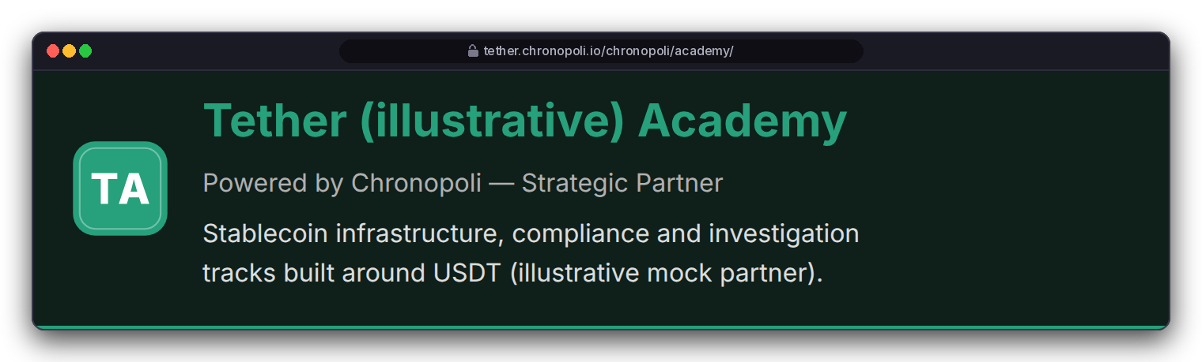
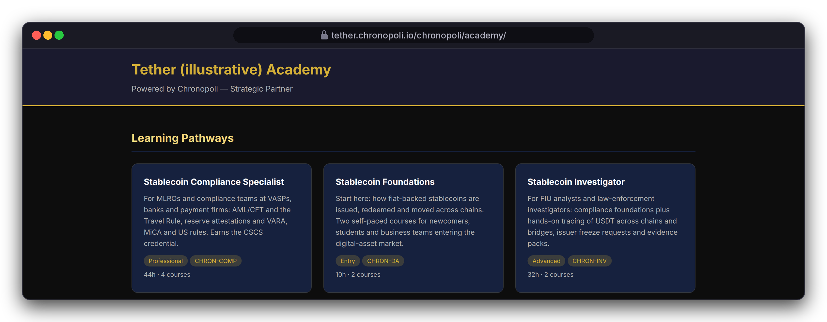
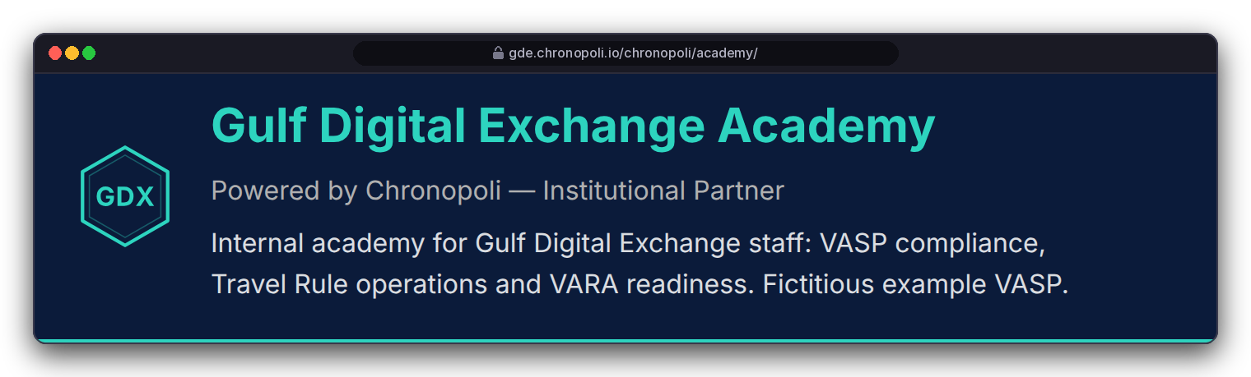
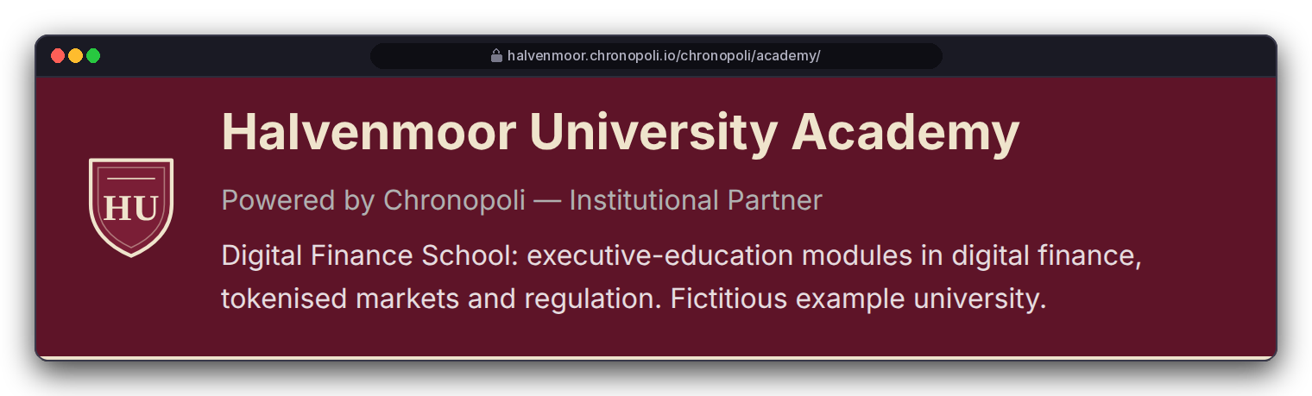
FOR KNOWLEDGE PARTNERS · PROOF
PILLAR 02 · COMPANY ACADEMIES
P1
Your academy, under your name, inside the city
One template, three tenants: a stablecoin academy, a VASP's internal academy and a university school
WITH THE GO-LIVE PATCH
Your brand
TODAY
As shipped: same template, fixed gold and navy
tether.chronopoli.io (planned)
gde.chronopoli.io (planned)
REAL CHRONOPOLI TEMPLATE RENDER
Today: the shipped template, Tether (illustrative) tenant
halvenmoor.chronopoli.io (planned)
DESIGN PROTOTYPE
Today: each academy renders its own partner's name, pathways and jobs
At go-live: colours, logo and tagline from your partner record (template-only patch: 17 lines added, 3 changed); the <partner>.chronopoli.io lookup is a go-live item, today by slug
Staff-only academies, such as a VASP's internal school: access model set in the partner agreement
Proposed brand patch to academy/home.html, not shipped · real academy view and data · marks generated, not real logos
Illustrative mock data · Tether is a partner-roadmap target only; no agreement implied · all other organisations and people are fictitious
07
Notes:
TALK TRACK: This is the outcome a partner buys: your own school, under your name, inside the city. Three very different tenants on one template: a protocol educates its market, an exchange trains its own staff, a university runs executive-education modules. Point to the inset first: that's the shipped template today, and the name, pathways and jobs already change per tenant. The big picture is the same page with a small, template-only brand patch that is scheduled for go-live, so it's labelled a prototype. Subdomain lookup is also on the go-live list; today the partner is resolved by slug. OBJECTION: 'Can we use our own domain, like academy.ourbrand.com?' ANSWER: The model is <partner>.chronopoli.io. A custom domain isn't in the code, so treat it as a request for the partner agreement. OBJECTION: 'Is my internal academy private?' ANSWER: Access for staff-only academies is set in the partner agreement; don't promise a login gate beyond that. OBJECTION: 'Can we drop Chronopoli entirely?' ANSWER: The academy says 'Powered by Chronopoli' and the badge is co-issued; that's part of the model. This is the Company Academies pillar: your tentacle of the Octopus Model (slide 4).

Slide 8
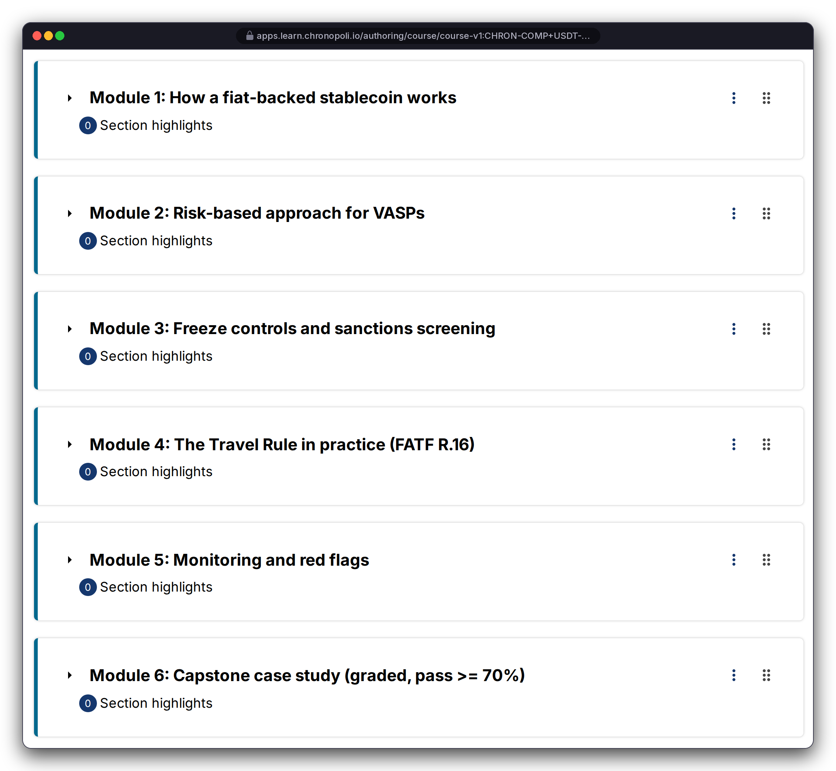
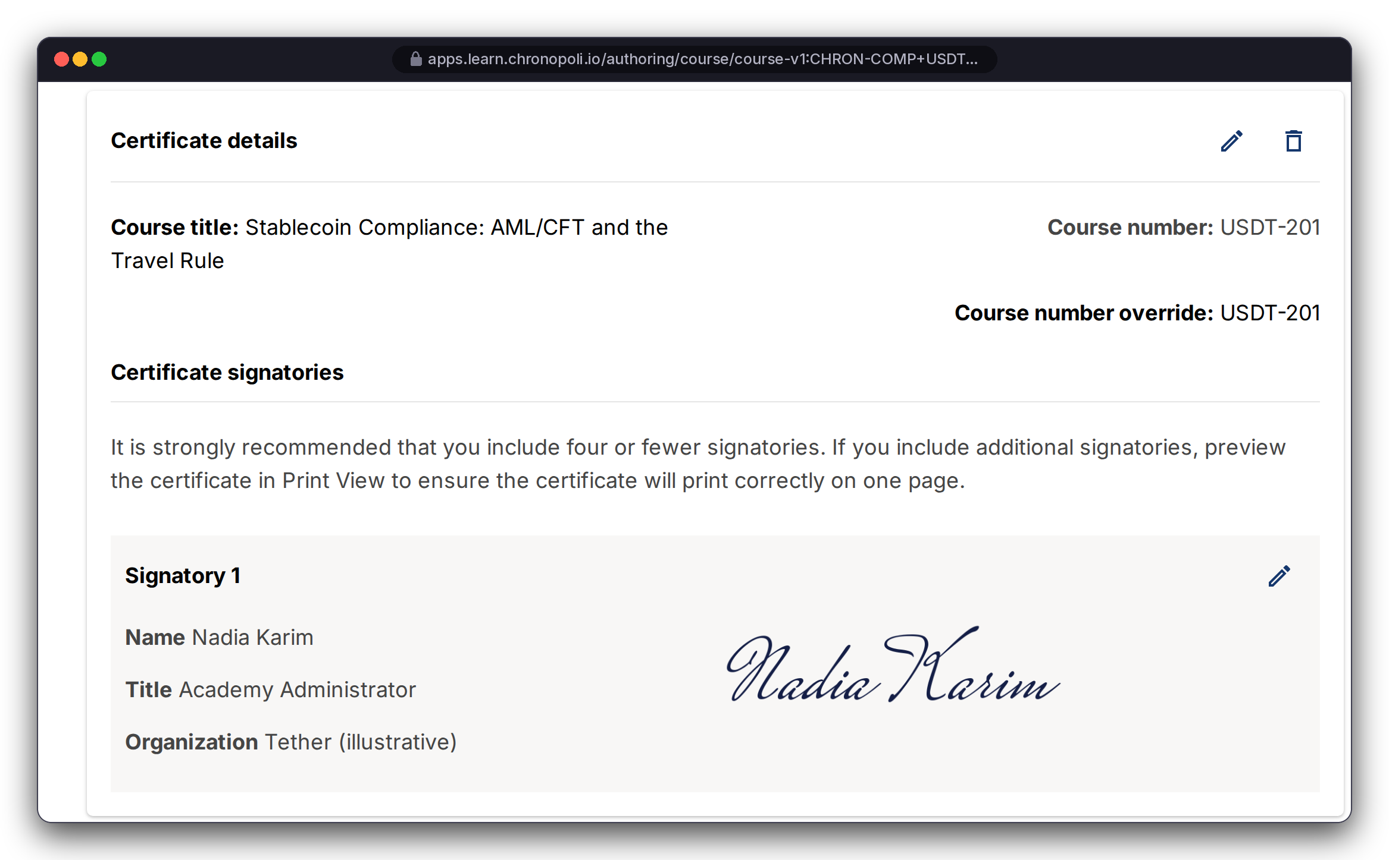
FOR KNOWLEDGE PARTNERS · PROOF
PLATFORM CORE
P2
Bring your content: author and certify in standard Open edX Studio
Your course team uses the authoring tool universities use: nothing proprietary to learn, nothing to rebuild
In Studio: outline, rich-text units, schedule and grading (USDT‑201: pass mark 70%; weighting: knowledge checks 40%, capstone 60%)
Certificate: configured on the verified track with your signatory; activated at launch
Your content stays yours: no fork of Open edX, standard Studio export; licence scope, term and exit are set in the partner agreement
REAL OPEN EDX SCREEN
REAL OPEN EDX SCREEN
Left: USDT-201 outline, six modules
Right: certificate details; configured, not activated
Course Authoring MFE, Tutor 22 · URL bar shows the planned domain; captured on our Tutor 22 test instance · signatory Nadia Karim, Academy Administrator, Tether (illustrative) · mock course, fictitious signatory
Illustrative mock data · Tether is a partner-roadmap target only; no agreement implied · all other organisations and people are fictitious
08
Notes:
TALK TRACK: Partners worry that content production is the expensive part. Here it's familiar tooling: the demo courses were built and imported through this toolchain. If you already have Open edX or similar course material, onboarding means import and QA, not a software project. The strip at the bottom shows the depth of one course: six modules down to a graded capstone. The certificate carries your signatory; it's configured but not activated, so on real screens we say 'certificate eligible', not 'issued'. OBJECTION: 'Who owns the content?' ANSWER: You author it; it exports as standard Open edX content; what licence Chronopoli gets, for how long and what happens on exit are set in the partner agreement. Don't promise a specific licence model. OBJECTION: 'We don't have instructional designers.' ANSWER: You bring subject-matter experts. Content QA with the Chronopoli team is a fixed step in the onboarding plan (slide 25). Don't promise a content-production service; its scope and price are set in the partner agreement.

Slide 9


FOR KNOWLEDGE PARTNERS · PROOF
PILLAR 02 · COMPANY ACADEMIES
P3
Credentials that carry your name
Pathways of ordered courses end in an Open Badges 2.0 badge co-issued by Chronopoli and your academy
Stablecoin Compliance Specialist: 4 courses, 44 h, ending in the Certified Stablecoin Compliance Specialist (CSCS) badge
Criteria you set: the courses, the 70% pass mark, the capstone; progress is read from Open edX grades, so a pathway is complete only when its courses are passed
Open Badges 2.0 format, portable beyond Chronopoli; hosted public verification of badge IDs is a go-live item
THREE PATHWAYS IN THE ILLUSTRATIVE ACADEMY
REAL CHRONOPOLI TEMPLATE RENDER
REAL CHRONOPOLI TEMPLATE RENDER
Stablecoin Foundations
2 courses · 10 h
Left: CSCS pathway, 100% complete (progress from a stub of the Open edX grades API)
Right: CSCS badge page as seen by the earner (fictitious learner)
Stablecoin Compliance Specialist
4 courses · 44 h
Repo views and templates in a test harness · the on-screen 'verifiable' wording refers to the planned hosted verification, not yet live · Tether (illustrative)
Stablecoin Investigator
2 courses · 32 h
Illustrative mock data · Tether is a partner-roadmap target only; no agreement implied · all other organisations and people are fictitious
09
Notes:
TALK TRACK: For a partner, this is standard-setting. You define what a competent stablecoin compliance officer knows, and the credential carries your academy's name next to Chronopoli's. For enterprises, it's the same badge their people earn. Badges follow the open Open Badges 2.0 format, so they aren't locked to our platform. Today's assertions use internal urn:uuid IDs; hosted public verification is a go-live item, so don't promise third-party verification. FOR UNIVERSITIES: co-issued means your academy's name is on the badge under criteria you set; academic credit, if any, is granted by your institution under your own quality assurance, not by the platform. OBJECTION: 'Will regulators recognise this badge?' ANSWER: We don't claim regulatory accreditation. The badge shows what it proves: the courses, the 70% pass mark and the capstone, and the underlying grade evidence is on slide 16. OBJECTION: 'Who sets the criteria?' ANSWER: You do, with our instructional team.

Slide 10
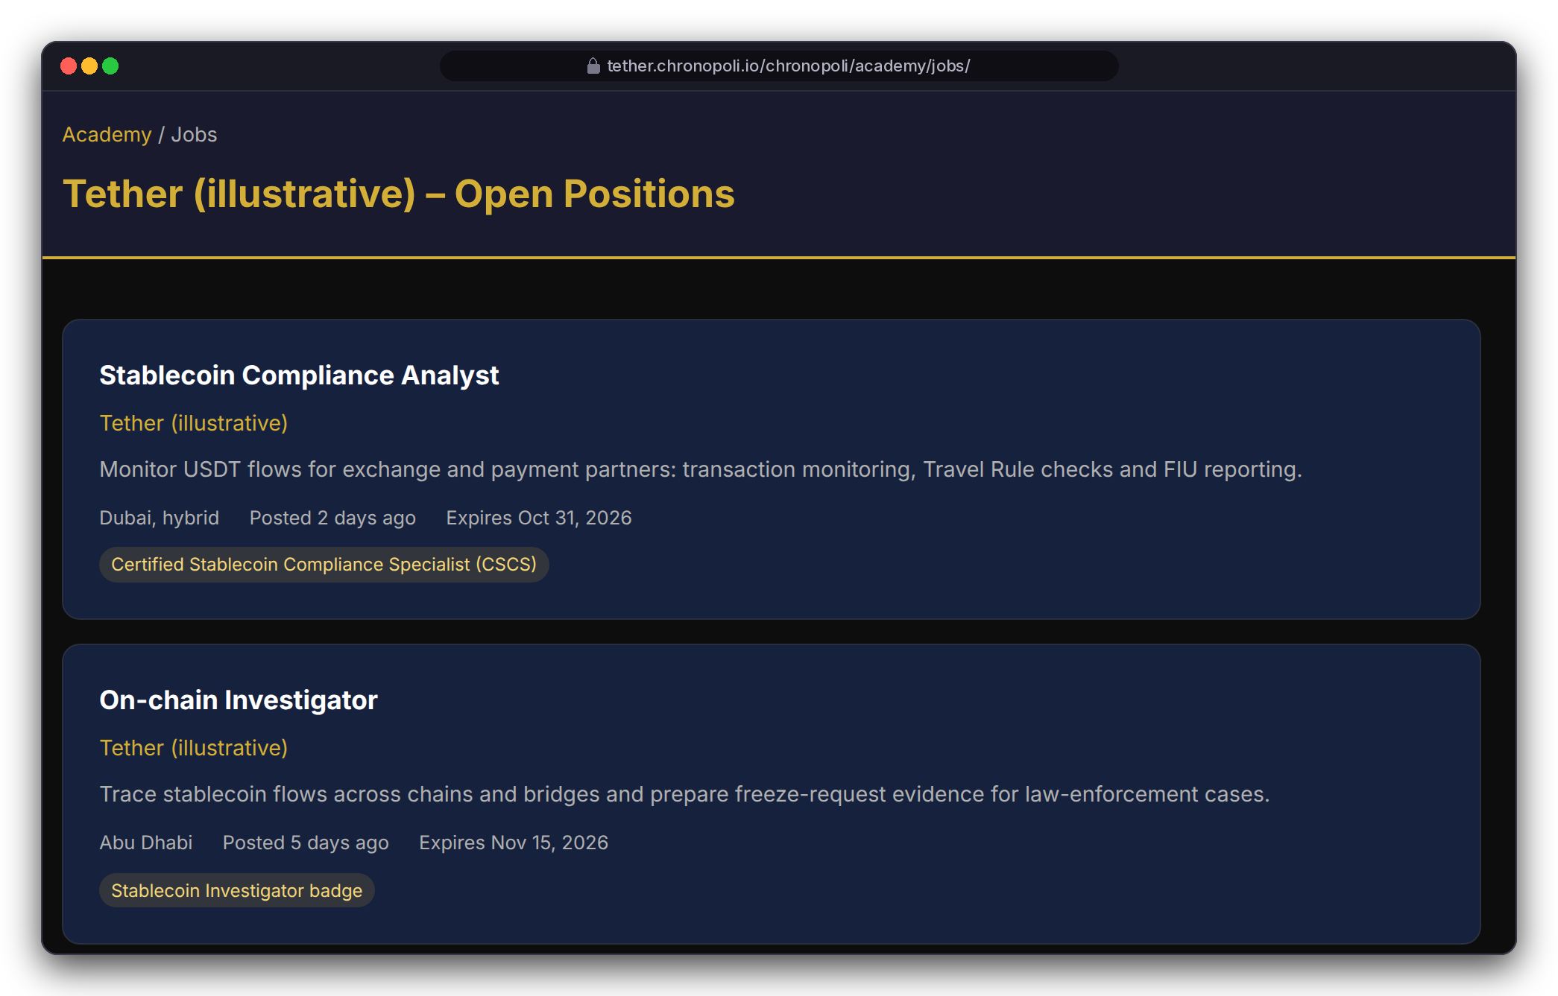
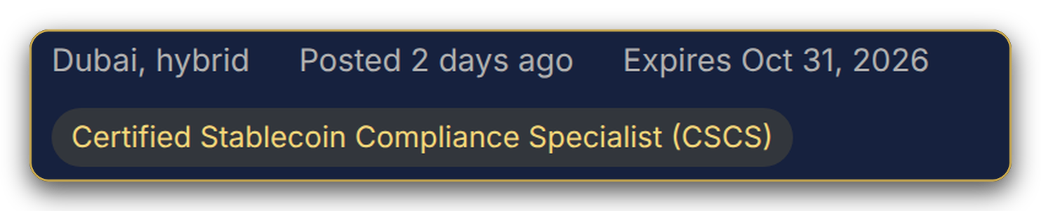




FOR KNOWLEDGE PARTNERS · PROOF
PILLAR 02 · COMPANY ACADEMIES
P4
From pathway to hire: a talent pipeline you own
Job postings in your academy require your badge, so applicants arrive pre-qualified on your curriculum
Each posting names the badge it requires (CSCS, Stablecoin Investigator, Stablecoin Foundations)
At go-live: when a learner applies and gives explicit consent, a credential snapshot goes to your HR notification address. No consent, no data
Works for partners hiring into their ecosystem, universities placing graduates, and enterprises growing people internally
37
applications across the 4 postings, Q3 2026 (illustrative mock data)
THE PIPELINE, END TO END
REAL CHRONOPOLI TEMPLATE RENDER
Pathway
Badge
Posting
Consent
Your HR
Academy job board, first 2 of 4 postings; gold frame: zoom of the first badge chip · Tether (illustrative), mock roles · consent gate: go-live requirement, not yet in code
go-live gate
Illustrative mock data · Tether is a partner-roadmap target only; no agreement implied · all other organisations and people are fictitious
10
Notes:
TALK TRACK: This is the slide partners remember. Education turns into recruiting: you stop paying to find people and start growing them to your own standard. The mock data shows 37 applications across four postings in one quarter; that's illustrative, showing the mechanics. Be clear on status: the job board and application flow are written code; the explicit candidate consent gate is a go-live requirement, and the pipeline does not switch on without it. FOR UNIVERSITIES: present this as graduate placement. Who is data controller for applicant data is set in the partner agreement. OBJECTION: 'Privacy: we can't receive candidate data without consent.' ANSWER: Agreed. No consent, no data. The target hosting region is AWS me-central-1 (UAE).

Slide 11
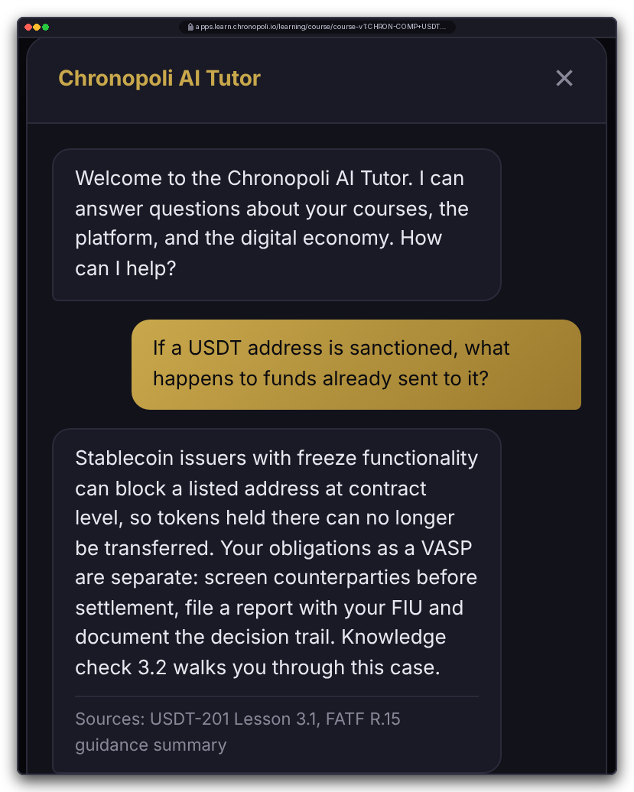
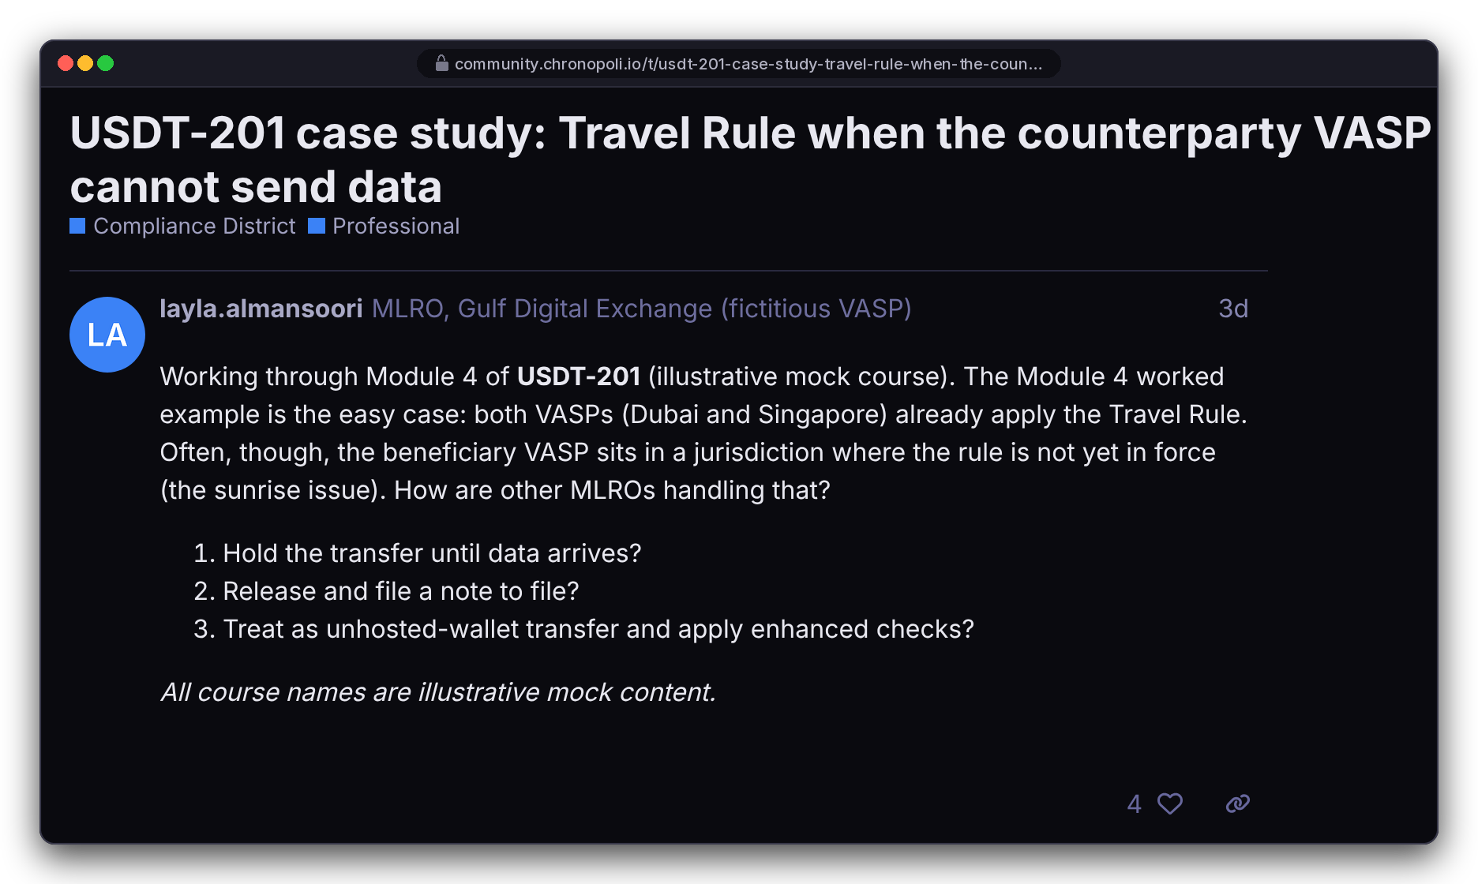
FOR KNOWLEDGE PARTNERS · PROOF
PILLAR 03 · OPEN KNOWLEDGE
P5
Learners stay engaged: an AI tutor on your content, and a community per district
Designed to answer from your course material and cite its sources; district forums connect MLROs, investigators and regulators
AI tutor: Claude on Amazon Bedrock with a Knowledge Base built from your courses; it shows its sources and is a learning aid, not advice
Go-live: knowledge base, access policy and data handling for learner questions are in the AI & data sprint
Community: Discourse with one category per district, single sign-on from the LMS, course-linked threads
For partners: questions and threads show what your market is struggling with
DESIGN PROTOTYPE
REAL EXTENSION
Left: the real tutor widget (our code) on a mock lesson page; the answer is scripted demo copy, Bedrock stubbed
Right: Discourse with the Chronopoli theme; a mock USDT-201 case-study thread, fictitious people
Illustrative mock data · Tether is a partner-roadmap target only; no agreement implied · all other organisations and people are fictitious
11
Notes:
TALK TRACK: Completion is where training programmes fail. Two things keep learners moving: an answer at the moment they're stuck, and peers doing the same job. The tutor is designed to answer from your indexed content and name its sources, here USDT-201 Lesson 3.1 and a FATF R.15 guidance summary. Say it clearly: the answer on screen is scripted because Bedrock was stubbed for the demo; the knowledge-base index, its access policy and how learner questions are logged and retained are in the AI & data sprint. The community on the right is real Discourse that ran. In the enterprise talk, this slide shows what your staff get as learners. OBJECTION: 'Where do our staff's questions go? Are they used for training?' ANSWER: Data handling for tutor questions is a go-live item in the AI & data sprint; we make no model-training guarantee beyond what's built. OBJECTION: 'What if the AI gives wrong compliance advice in our name?' ANSWER: It's labelled a learning aid, not advice; it cites sources so the learner can check them, and it's scoped to course content. This is the AI Tutor of the Open Knowledge pillar; it compounds with every approved round-table output. If a partner asks whether its content feeds a tutor other academies use: which content enters the shared knowledge base is the per-partner scoping of the AI & data sprint, set in the partner agreement (moats, slide 19).

Slide 12
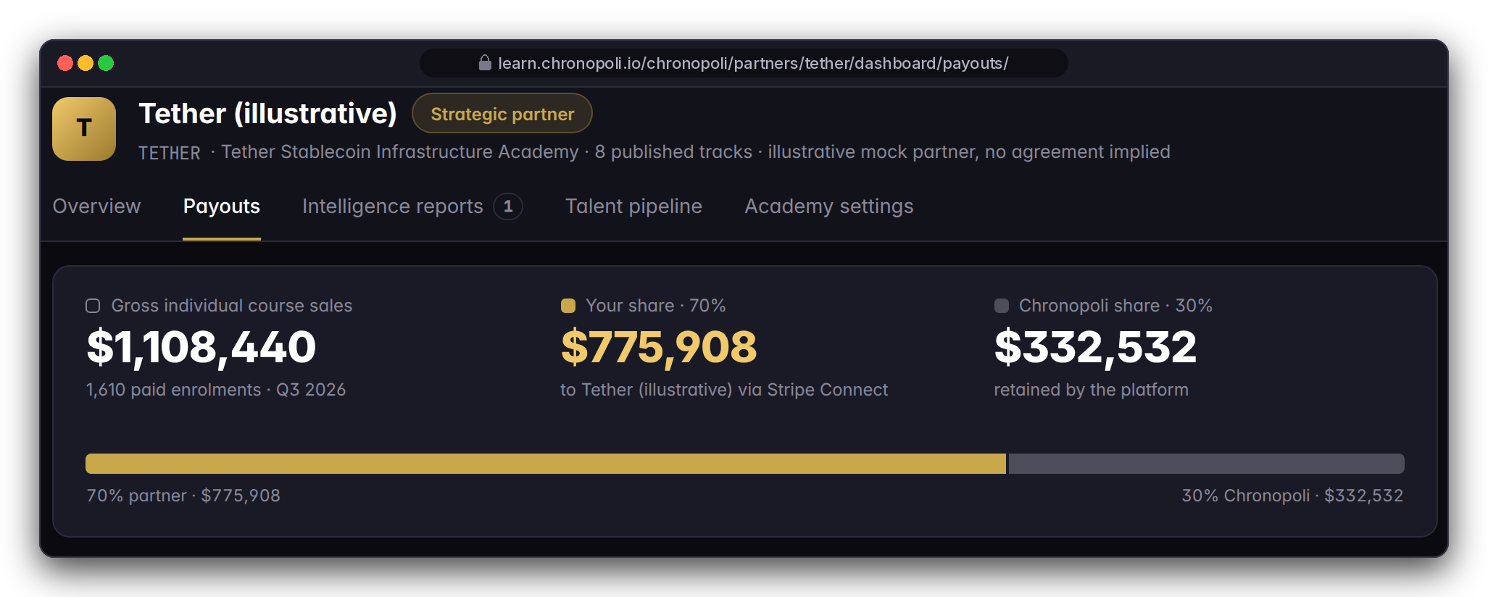
FOR KNOWLEDGE PARTNERS · PROOF
PILLAR 02 · COMPANY ACADEMIES
P6 · P7
Your dashboard and your 70% split
See what your academy does every week, and keep 70% of every partner-course sale
ENROLMENTS
COMPLETIONS
BADGES
JOB APPLICATIONS
OPERATING VIEW · ILLUSTRATIVE QUARTER
4,812
1,937
1,244
37
Tether (illustrative) demo data, Q3 2026, not real traction; the quarter's dollar figures are explained once, on slide 24
+18% QoQ
40.3% completion rate
Weekly e-mail report (Amazon SES): new enrolments, completions, badges, job applications and revenue. Analytics and the weekly job are code; the dashboard page is a go-live item
70/30 split at checkout: Stripe Checkout and Stripe Connect, split logic in code. Connect onboarding and the payouts page: go-live items. Refunds and payout status: Commerce sprint. Tax treatment: set in the partner agreement
Same dashboard for an institutional academy; KPIs shown are an illustrative stablecoin scenario
DESIGN PROTOTYPE
Partner dashboard, Payouts tab: the 70/30 split of the illustrative quarter · page not yet built; analytics, weekly e-mail job and 70/30 payout logic exist in code
Illustrative mock data · Tether is a partner-roadmap target only; no agreement implied · all other organisations and people are fictitious
12
Notes:
TALK TRACK: Partners fund education and rarely know what it achieved. The left page answers it: who enrolled, who finished, who earned your badge and who applied for your jobs, and the Monday e-mail means leadership sees it without logging in. The right page is the economic core: the split is applied at checkout, so there's no invoicing and no quarterly reconciliation argument. Status: the analytics, the weekly e-mail job and the 70/30 split logic are code; both pages and the Stripe Connect onboarding screens are go-live items. Every number is illustrative, a model of one academy; we'll walk through the money once, on slide 24. OBJECTION: 'Refunds, chargebacks, VAT, payout timing?' ANSWER: Refund handling and payout status are in the Commerce sprint; timing follows Stripe Connect; tax treatment is set in the partner agreement. OBJECTION: 'Does 70/30 also apply to team licences?' ANSWER: Team-licence revenue sharing isn't defined in the code, so it's set in the partner agreement. OBJECTION: 'Can we get the raw data?' ANSWER: Course-level data comes from the standard Open edX CSV reports (slide 16); learner-level sharing follows the access model on slide 23.

Slide 13
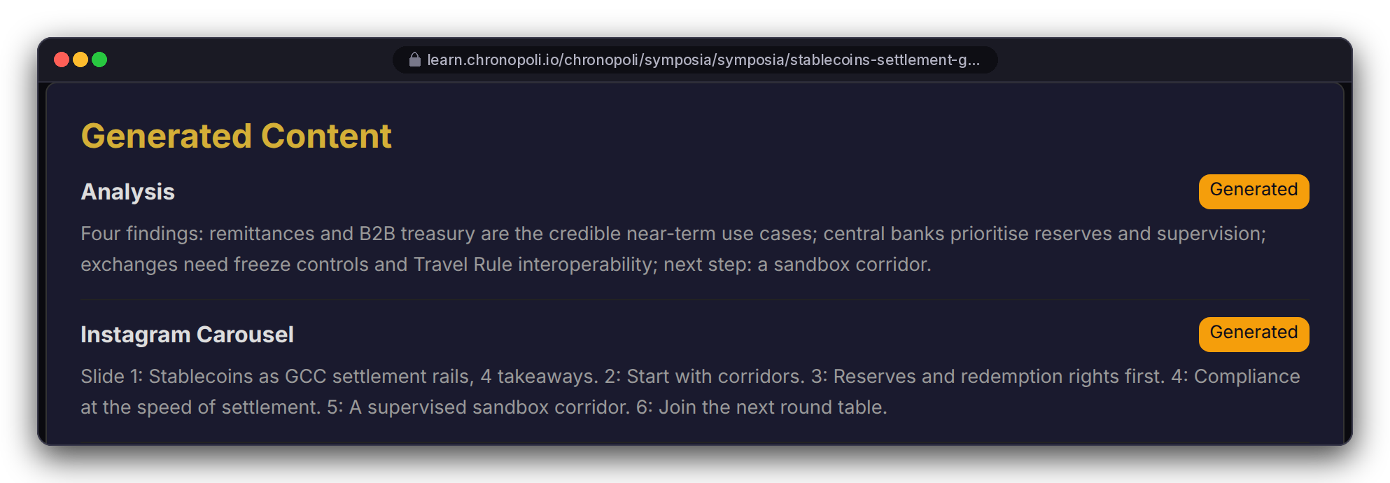
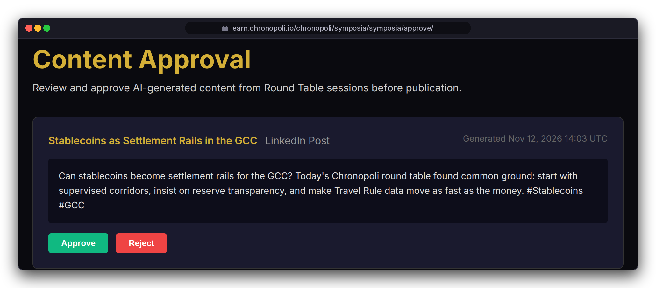

FOR KNOWLEDGE PARTNERS · PROOF
PILLAR 01 · SYMPOSIA
P8
Five outputs in 3 hours, one human approves
Sponsor or co-convene a closed-door round table: opinion paper, LinkedIn posts, Instagram carousel, Partner Intelligence Report and an AI-tutor update
IVS stream (designed)
Transcribe
Claude on Bedrock
Analysis + 4 drafts
One human approves
Publish + AI-tutor update
REAL CHRONOPOLI TEMPLATE RENDER
Left: 2 of 6 generated items, mock output texts · IVS client in code, not yet run live
REAL CHRONOPOLI TEMPLATE RENDER
Sponsor sign-off on sponsor-branded outputs, and for institutions the rights to transcripts, faculty publication and ethics review: set in the partner agreement
The sponsoring partner receives the Partner Intelligence Report: themes relevant to you and suggested follow-ups for your tracks
Right: staff approval queue, one card · session, people and sponsor illustrative
Attribution: named quotes can print today; removal is a go-live fix, and until then one human (Chronopoli staff) approves every output
Illustrative mock data · Tether is a partner-roadmap target only; no agreement implied · all other organisations and people are fictitious
13
Notes:
TALK TRACK: For many partners this is worth more than courses. You convene regulators, banks and exchanges behind closed doors, and you leave with five outputs in about 3 hours: an opinion paper, LinkedIn posts, an Instagram carousel, a Partner Intelligence Report on what the market thinks, and, once approved, an update to the AI tutor's knowledge base. One human approves everything, in about 10 minutes. Say that 3 hours and 10 minutes are design targets, and that TikTok is on the roadmap, not in the code. This is the Symposia pillar, the community intelligence engine. The attribution caveat is on the slide on purpose: sessions run under the Chatham House Rule, but the current opinion-paper template can print attributed quotes and participant names, and the analysis step extracts named key quotes. Removing attribution is a go-live fix; until then the one-human approve/reject step is the safeguard. The queue approves or rejects; it doesn't edit, and the approver is Chronopoli staff, not the partner, so sponsor sign-off is an agreement item. Streaming: there is an IVS client in the code, but no session has been streamed live yet. FOR UNIVERSITIES: position this as a research round table you co-convene; publication rights, ownership of transcripts and ethics review are set in the partner agreement. Don't claim co-moderator rights; the queue is staff-only. OBJECTION: 'What does sponsorship cost?' ANSWER: Set in the partner agreement. OBJECTION: 'Will AI misquote our panellists?' ANSWER: Every output waits in the approval queue, and one human can reject it.
On the slide as the pill row (moved here for space): Pipeline: Amazon Transcribe → Claude on Amazon Bedrock → transcript, an analysis and four drafts (opinion paper, LinkedIn post, Instagram carousel, Partner Intelligence Report); once approved, the outputs also update the AI tutor's knowledge base
Attribution: today the opinion-paper template can print named quotes and participant names; attribution removal is a go-live fix, and until then one human (Chronopoli staff) approves or rejects every output
Session shown: 'Stablecoins as Settlement Rails in the GCC'.

Slide 14
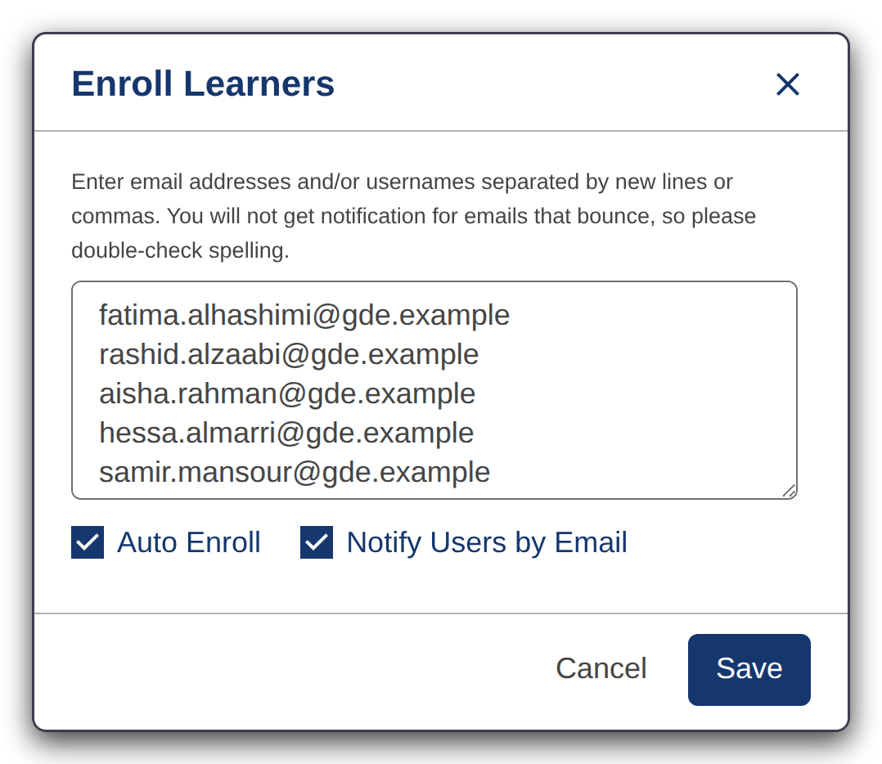
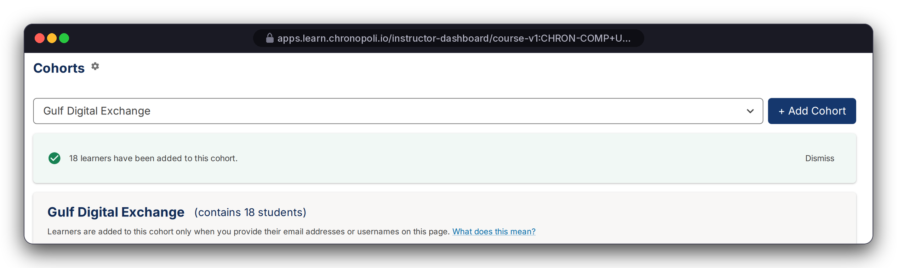
FOR ENTERPRISE TEAMS · PROOF
PLATFORM CORE
E1
Enrol a whole team in one paste, then group them as your company
Enterprise track, in real Open edX: batch enrolment, then a company cohort for reporting
25
seats licensed
18
seats assigned
17
pasted in one go
18
in the cohort: the 17 + Layla (MLRO, alias domain)
REAL OPEN EDX SCREEN
Right: Instructor Dashboard > Cohorts, cropped to the cohort panel
REAL OPEN EDX SCREEN
URL bars show the planned domain; captured on our Tutor 22 test instance · seeded test cohort; grades from test learners answering in the browser, no overrides (slides 14-16) · textarea sized to five full lines for display · Gulf Digital Exchange and its staff are fictitious
Left: 'Enroll Learners' with the 17 @gde.example addresses, just before Save
Paste the e-mail addresses, tick Auto Enroll and Notify, save: 17 Gulf Digital Exchange employees enrolled in USDT-201; Layla, the MLRO, was already enrolled on her alias domain, making 18
One manual cohort, 'Gulf Digital Exchange', holds all 18 seat holders, so every report can filter to your company; a CSV upload also assigns cohorts
Stock enrolment uses the default track; our team moves your staff to the verified track in the pilot, automated in the team-admin console (E4)
Illustrative mock data · Tether is a partner-roadmap target only; no agreement implied · all other organisations and people are fictitious
14
Notes:
TALK TRACK: Now for the enterprise buyer. Everything on this and the next two slides is real Open edX that ran. A 25-seat team licence has 18 people assigned: 17 new employees plus Layla, the MLRO, who was already enrolled. That's why the paste shows 17 and the cohort 18. The third line is deliberate: the stock dialog enrols people on the default track, so for this demo we moved the 17 to the verified track in the admin shell. In the pilot our team does that step for you; the team-admin console automates it. OBJECTION: 'Do our staff need to create accounts first?' ANSWER: No. With Auto Enroll they're enrolled when they activate with that address. OBJECTION: 'How much admin work is this for us?' ANSWER: In the pilot you send a seat list; our team runs enrolment, track and cohort. In the master pricing this is a Corporate Team Subscription: $1,500 per seat per year, the same as the $125 per seat per month list price in the code (slide 21).

Slide 15
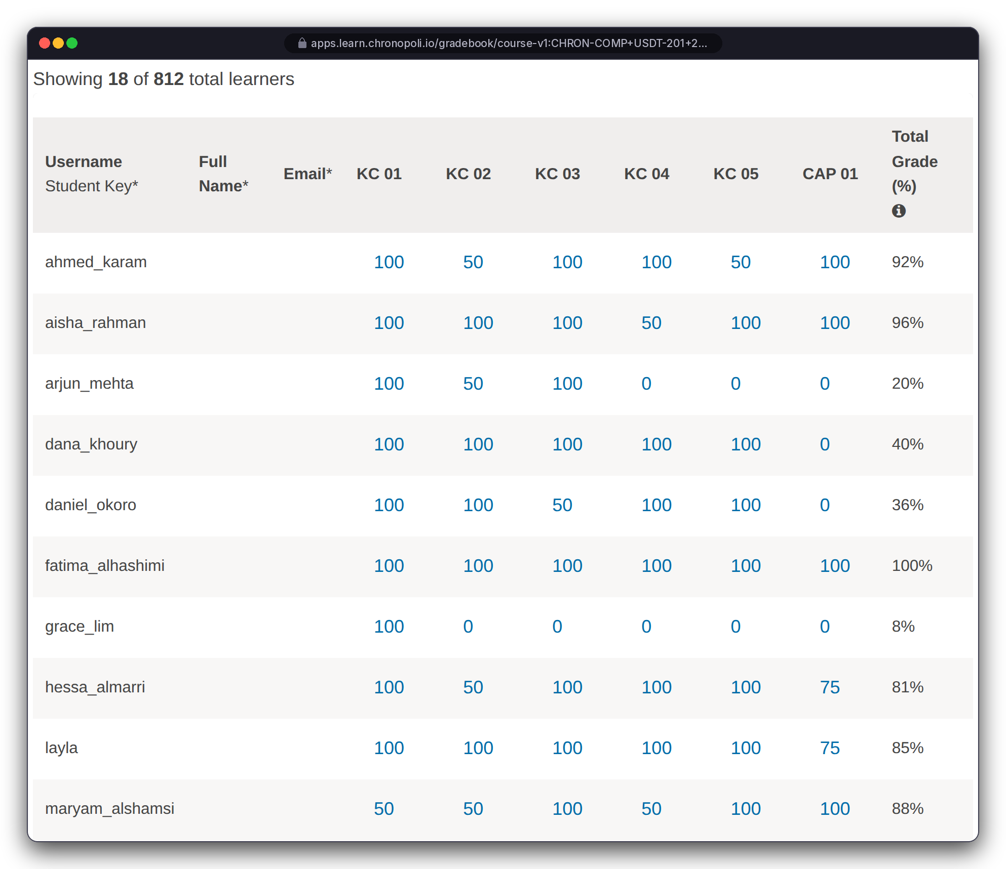
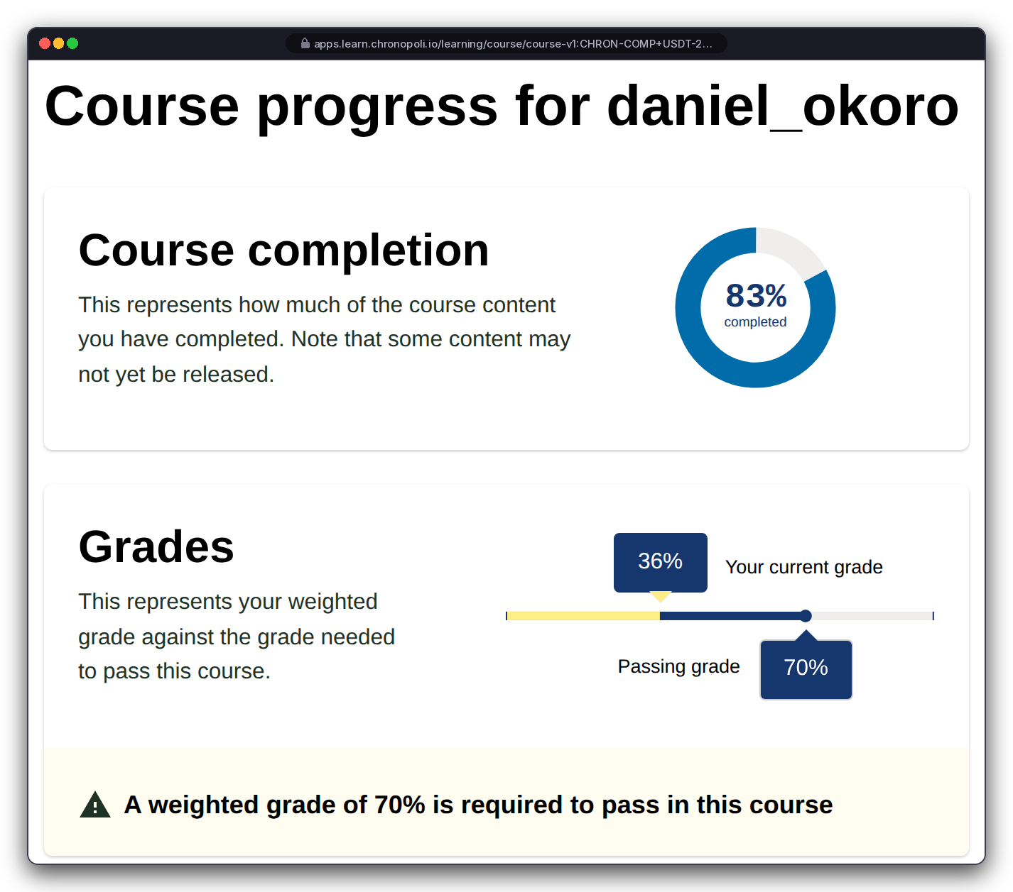

FOR ENTERPRISE TEAMS · PROOF
PLATFORM CORE
E2
See who is on track, and who needs help
Gradebook filtered to your cohort, and the staff view of any employee's progress against the 70% pass mark
Your cohort, 18 learners, with every knowledge check, the capstone and the total: from 100% down to 0% (not started); 9 of 18 at or above the 70% pass mark
Open one employee to see completion (83%) against grade (36%): capstone not yet attempted, so you know who to nudge
Who sees this: the gradebook is a course-staff view across all companies in the course. In the pilot only Chronopoli staff hold the course-staff role, and your team admin receives cohort-filtered views and reports; company-scoped admin access is part of the team-admin console (slide 17)
Tutor 22 test instance, narrower browser width; URL bars show the planned domain · scroll box expanded, tooltip colours restored (display only) · seeded cohort; grades from test learners, no overrides · fictitious people
REAL OPEN EDX SCREEN
Left: gradebook, cohort 'Gulf Digital Exchange' (18 of 812 learners), first 10 of the 18 rows
REAL OPEN EDX SCREEN
Right: staff view of daniel_okoro
Illustrative mock data · Tether is a partner-roadmap target only; no agreement implied · all other organisations and people are fictitious
15
Notes:
TALK TRACK: These grades are genuine. Each test learner worked through the course in a browser, one attempt per question, some wrong on purpose, with no overrides. The manager's question is 'who needs help?', and this answers it in one view. You set the pass mark and weights in Studio: here 70%, knowledge checks 40%, capstone 60%. Address data access before they ask: '18 of 812' means this staff view covers everyone in the course, including other companies. That's why in the pilot only our staff hold that role and you get cohort-filtered views; slide 23 shows the full access model. OBJECTION: 'Can we trust auto-graded checks for regulatory training?' ANSWER: The report shows every component and the capstone, not just a completion tick, and you set the thresholds. OBJECTION: 'Our team leads won't log in to an instructor dashboard.' ANSWER: Fair. The simpler team-admin console on slide 17 comes with the pilot.

Slide 16
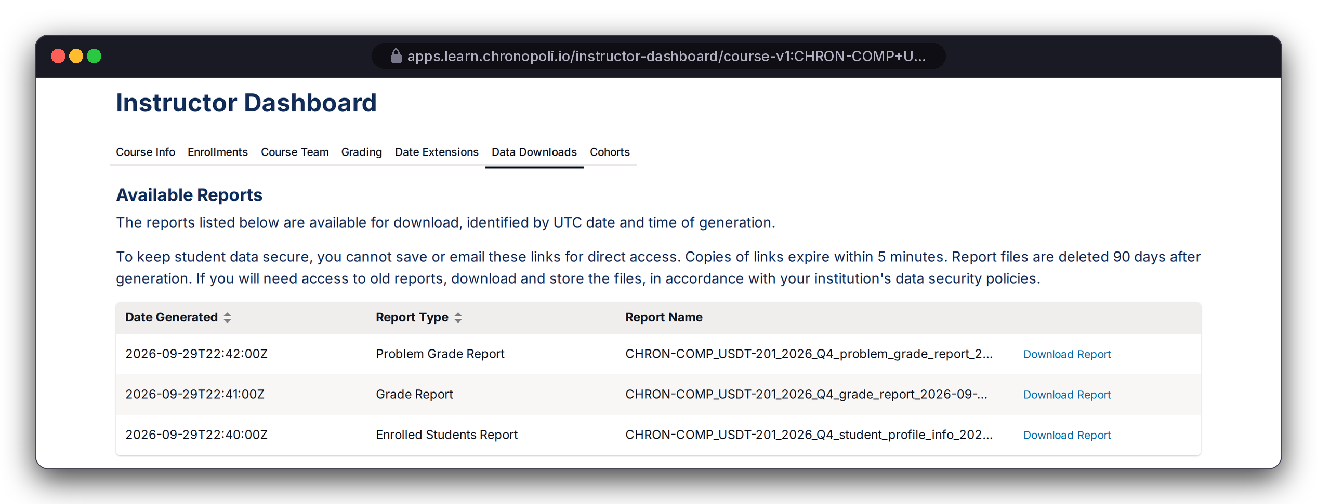
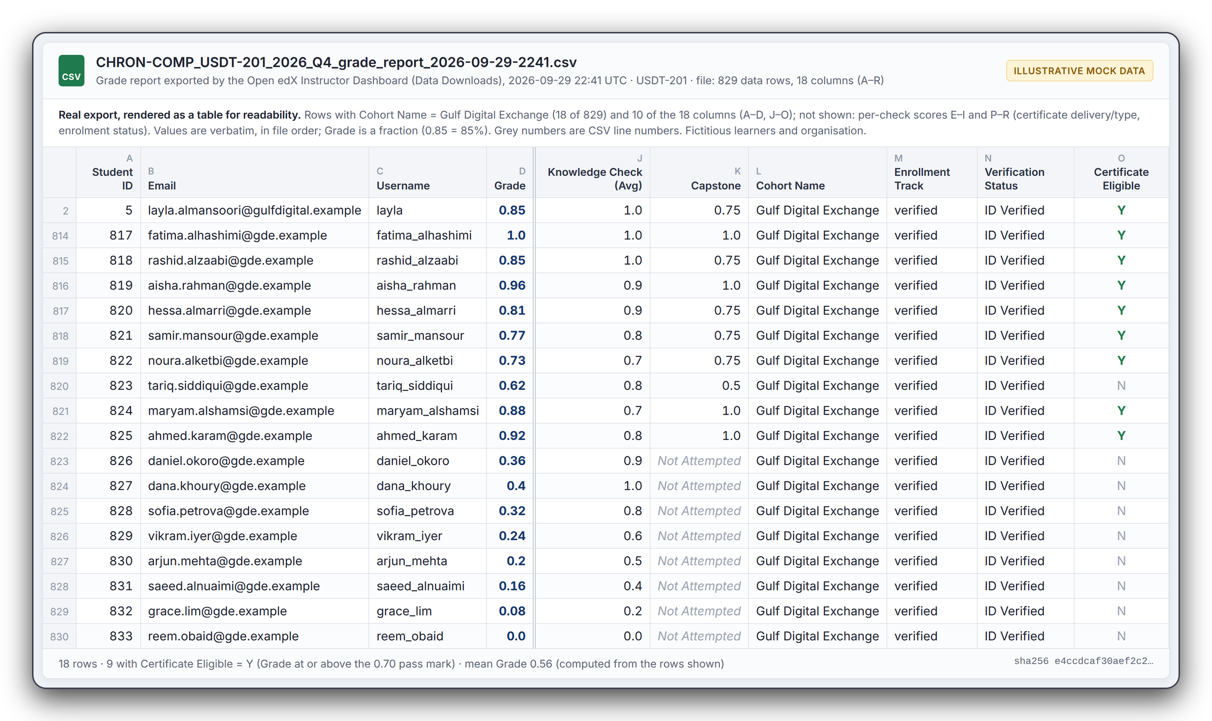
FOR ENTERPRISE TEAMS · PROOF
PLATFORM CORE
E3
Training evidence in a standard, system-generated format
Standard Open edX Data Downloads produce a course-wide grade report; your cohort's rows (Cohort Name = Gulf Digital Exchange) are handed to you as a CSV
REAL OPEN EDX SCREEN
Left: Instructor Dashboard > Data Downloads, reports generated on demand, timestamped in UTC
Per employee: grade, knowledge checks, capstone, cohort, track, verification status, certificate eligibility
Verification status column: 'ID Verified' is the stock Open edX value, set manually by staff in the test instance; no ID check or proctoring performed
Go-live item: report files are in a public media bucket today; making them private and access-controlled is a Secure-sprint fix, and pilot reports are delivered by the Chronopoli team, not by public link
REAL OPEN EDX EXPORT, RENDERED AS A TABLE
Right: the 18 Gulf Digital Exchange rows of the 829-row grade-report CSV · 10 of 18 columns, values verbatim · 9 certificate-eligible, mean grade 0.56 · certificates not activated · Tutor 22 test instance · fictitious people
Illustrative mock data · Tether is a partner-roadmap target only; no agreement implied · all other organisations and people are fictitious
16
Notes:
TALK TRACK: This is the answer to 'show me who was trained'. It's a system-generated file from the LMS itself: who, which course, what grade, against which pass mark. Be precise: Open edX produces one file for the whole course; we filter it to your cohort's rows and hand those to you. Nine of eighteen are eligible; the other nine are visible too, which is what an auditor wants to see. Say the storage point yourself: today report files sit in a public media bucket, one of the open critical findings; it's fixed in the Secure sprint, and until then we deliver pilot reports directly. OBJECTION: 'Is this accepted by VARA or our regulator?' ANSWER: We don't claim regulatory acceptance. We provide the underlying evidence in a standard format, and your compliance function decides how to present it. OBJECTION: 'Who actually sat the test?' ANSWER: Identity is the learner's SSO or e-mail account; we don't claim proctoring or ID verification. The 'ID Verified' value here was set manually in the test instance. OBJECTION: 'Where is this data stored?' ANSWER: The target is AWS me-central-1 (UAE).
Caption detail (moved here for space): 829 CSV rows = 812 enrolled learners + 17 unenrolled test placeholders; Layla's row uses her alias domain gulfdigital.example; not activated, so 'eligible', not 'issued'; the left URL bar shows the planned domain.

Slide 17
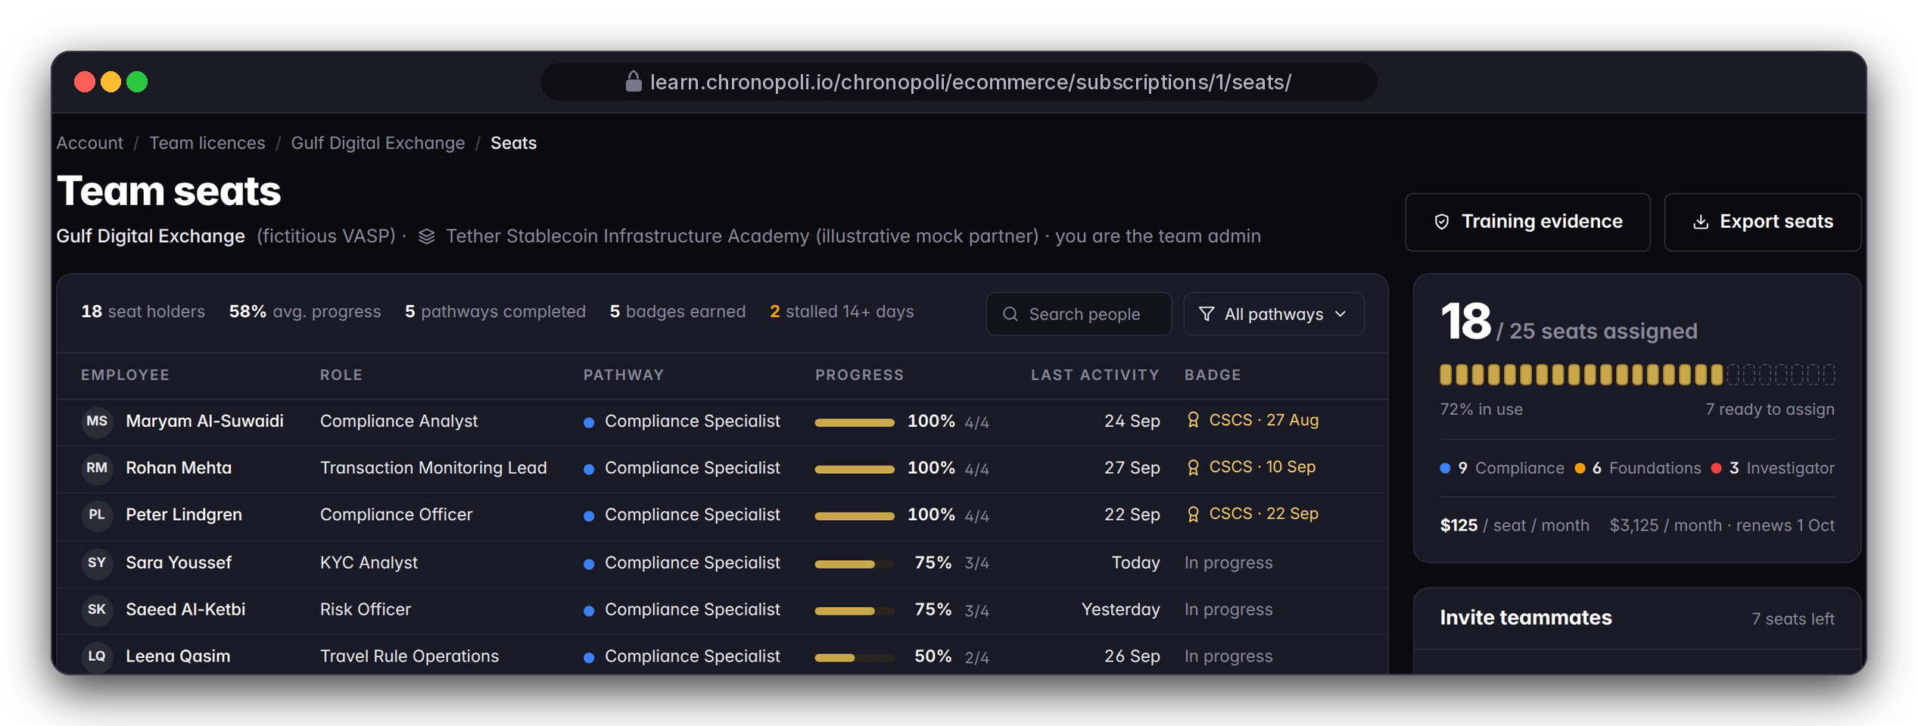
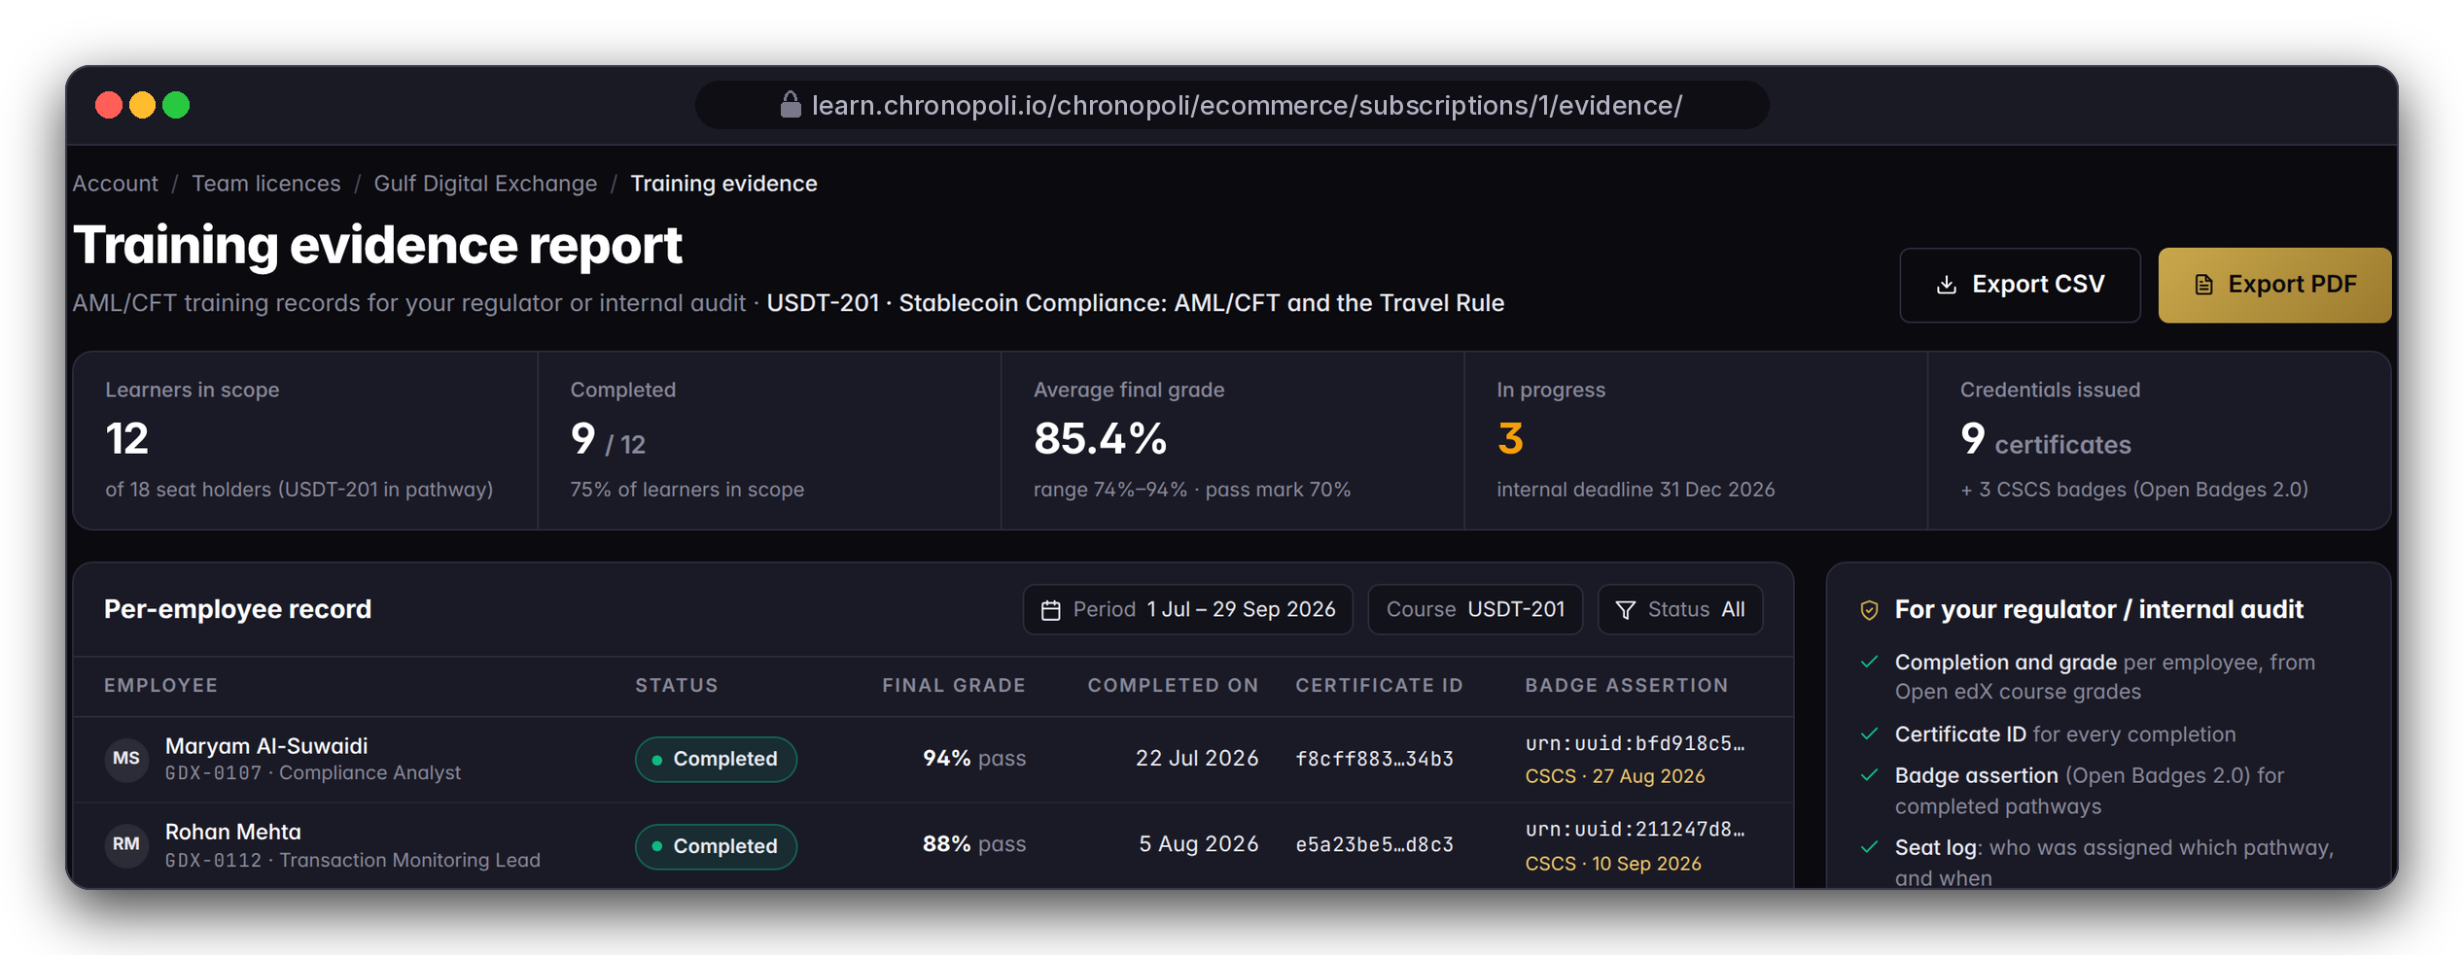
FOR ENTERPRISE TEAMS · COMING WITH THE PILOT
PLATFORM CORE
E4
Coming with the pilot: your team-admin console
Seats, invitations and a one-click evidence report, designed with our first pilot teams
DESIGN PROTOTYPE
Left: team seats, Gulf Digital Exchange (fictitious)
DESIGN PROTOTYPE
Right: training evidence report for USDT‑201
Not yet built: seat assignment, invites, domain join, CSV/PDF export; the team subscription and seat count exist · sample roster, not the slides 14-16 cohort
Team seats: 25 licensed seats × $125 = $3,125/month (18 assigned), with progress, last activity and badge per employee, and stalled learners flagged
Invite by e-mail, or let staff on your verified domain request a seat, with your approval
Training evidence report: USDT-201, 12 learners in scope (scope chosen by the team admin in this sample), 9 completed (75%), average grade 85.4%, with certificate and badge IDs and CSV/PDF export
Evidence-pack contents (fields, timestamps, sign-off) are co-designed with pilot teams
Illustrative mock data · Tether is a partner-roadmap target only; no agreement implied · all other organisations and people are fictitious
17
Notes:
TALK TRACK: Slides 14-16 are what exists. This is where it's going, and it's why we want pilot teams: you tell us what your MLRO and your auditor need on this page. The team-licence data model (seats and seats used) exists in the code, and billing is on licensed seats; these pages turn it into a console. Numbers here come from a separate sample roster, so they won't match the cohort on the previous slides; don't compare them. OBJECTION: 'Why are only 12 in scope?' ANSWER: In this sample the team admin scoped the report to the USDT-201 group; the rest of the seat holders are on other pathways or not assigned to this course. OBJECTION: 'Why buy before it exists?' ANSWER: A pilot team trains on the same stock Open edX engine shown on slides 14-16, with reports delivered by our team, and the console is designed with you. OBJECTION: 'Can we move seats when people leave?' ANSWER: That's the design: the team admin reassigns seats. OBJECTION: 'Can our regulator verify the badge ID online?' ANSWER: Not yet. Hosted verification is a go-live item.

Slide 18



COMPETITIVE LANDSCAPE
We are not a better Coursera
A categorically different architecture: the first neutral Knowledge City for the digital economy
FEATURE
COURSERA / LINKEDIN
ACAMS / ICA
VENDOR ACADEMIES
CHRONOPOLI
SHOWN ON
AI-generated content pipeline
Slide 13
Live round tables + automatic opinion papers
Slide 13
Digital Twin expert system
Slide 30
Seven cross-sector Knowledge Districts
Slide 2
Verified Open Badges 2.0 credentials
Slide 9
Automated talent pipeline
Slide 10
Partner Intelligence Reports
Slide 13
Curriculum updates in under 48 h
Slides 8, 13
Neutral cross-sector positioning
Slide 4
yes
partial
no
Competitor ratings: Chronopoli master papers. Chronopoli column: built in code, going live with the six-sprint plan; build status per item on slide 6. The 48-hour update and hosted badge verification are go-live targets.
18
Notes:
TALK TRACK: We are not a better Coursera; we are a different architecture. Coursera and LinkedIn Learning sell content, ACAMS and ICA sell certification, vendor academies teach their own product. None of them has the pipeline, the round tables, digital twins, cross-sector districts or neutral positioning. For a buyer that means one place for your market, your staff and your regulator's view, rather than three vendors. The competitor ratings are from our master papers. The Chronopoli column means built in code and shown in this deck; it goes live with the six-sprint plan, and the build status of each item is on the offer slide. The 48-hour update is a design target. OBJECTION: 'We already use ACAMS.' ANSWER: Keep it for the certification; Chronopoli adds the stablecoin, AI and on-chain depth, your own academy and the grade evidence per employee.

Slide 19




WHY IT COMPOUNDS
Four self-reinforcing moats
Each moat strengthens the other three, and each one works in your favour as a partner or a team
Proprietary Knowledge Moat
Partner Lock-in Moat
Every round table, opinion paper and masterclass feeds the AI tutor. After 12 months no external AI, not ChatGPT, not Gemini, has access to this knowledge base. It compounds like interest.
When a partner builds its academy inside Chronopoli, its credential history, talent pipeline and community are embedded there and grow every year.
For you: Your learners get answers grounded in your district's sessions.
For you: Your academy gains value every year, and exit stays open.
In this deck: slides 11, 13
In this deck: slides 7, 10, 23
Network Effects Moat
Cost Structure Moat
More partners → more round tables → more knowledge → more users → more employer demand → more partners: a two-sided flywheel in a high-value niche.
$374 a month of AWS infrastructure to start, zero licensing, an open-source stack with no fork of Open edX. SaaS competitors cannot undercut this without operating at a loss.
For you: Each new partner brings learners and employers to your district.
For you: No third-party licence fees are built into your price.
In this deck: slides 2, 4
In this deck: slides 21, 26
19
Notes:
TALK TRACK: Four moats, and each one works for you. The knowledge moat: every round table, paper and masterclass feeds the AI tutor, so your learners get answers grounded in your district's own sessions, which no external AI has. Partner lock-in, in your favour: your credential history, talent pipeline and community grow inside your academy every year, and the exit stays open with a standard Open edX export and your badge records. Network effects: every new partner brings learners, experts and employers into your district. Cost structure: $374 a month of AWS to start and zero licensing, so there are no third-party licence fees built into your price. Don't promise a price freeze; prices are set in the partner agreement or pilot order. OBJECTION: 'Does our content train a tutor that our competitors' learners use?' ANSWER: The master papers describe one tutor grounded in all platform content; which of your courses and round-table outputs enter the shared knowledge base, and which stay scoped to your academy, is the per-partner scoping of the AI & data sprint and is set in the partner agreement.

Slide 20




TRACTION & VALIDATION
Code-complete. First partners engaged.
Code-complete across 15 development phases: 90 requirements, 100% mapped; not yet deployed
PLATFORM STATUS
DONE
AWS DEPLOYMENT
NEXT
DBCC PARTNERSHIP
DONE
Code-complete
Terraform-ready
Confirmed
15 GSD phases · 90 requirements · 0 unmapped
17 Terraform files · me-central-1 (UAE) · go-live after the six sprints (slide 25)
Anchor institutional partner · 500+ company network
BUiD ACADEMIC
IN PROGRESS
TARGET: RIPPLE
TARGET
TARGET: CHAINALYSIS
TARGET
MOU in progress
Pitching
Engaging
Maria Papadaki · 30 CPD credits/year recognition
$150K Founding Academy · talent pipeline
$150K Founding Academy · Investigation District
Statuses as in the master papers; nothing with Ripple or Chainalysis is signed. Code-complete means the feature code is written: the go-live items and design pages on slide 6 are built in the six sprints and the pilot. The Tether academy in this deck is illustrative.
20
Notes:
TALK TRACK: Say the statuses exactly as they are. The platform is code-complete: 15 development phases, 90 requirements, none unmapped. Code-complete means the feature code is written; the go-live items and design pages on the offer slide are built in the six sprints and the pilot. It is Terraform-ready for me-central-1 but not deployed. Dubai Blockchain Center is the confirmed anchor, with a network of more than 500 companies. The BUiD academic MOU is in progress, with 30 CPD credits a year as the recognition target. Ripple is being pitched and Chainalysis is engaging, each as a $150K Founding Academy target. Nothing with Ripple or Chainalysis is signed. BEFORE A MEETING WITH A COMPETITOR OF RIPPLE OR CHAINALYSIS: decide whether to show this slide; it names them. OBJECTION: 'Who else has signed?' ANSWER: Nobody yet; that's why the founding seats are open.

Slide 21
COMMERCIAL TERMS
Companies pay. Students benefit.
B2B-first: Company Academy fees and team seats fund the city; learners get the credentials
REVENUE STREAM | WHAT IT COVERS | PRICE
Company Academies | Your branded academy: pathways, badges, jobs, dashboard | $25K–$150K / yr
Corporate Team Subscriptions | Seats for an enterprise team | $1,500 / seat / yr
Individual Subscriptions | A single professional learner | $490–$1,490 / yr
Open Marketplace | Partner and creator course sales | 70% creator · 30% Chronopoli
Certification | Each certificate issued | $15 / certificate
TWO PRICING VIEWS
Commercial model (left): annual academy fees and subscriptions.
In the product (slides 12, 22, 24): per-course layer prices from $0 to $8,000 for single purchases, seats at $125 a month (= $1,500 a year), 70/30 split at checkout.
EXAMPLE: A FOUNDING ACADEMY, PER YEAR
$150K
Your academy, trained staff and regulators, co-issued credentials, candidates for your hiring team and a Partner Intelligence Report per round table. One recruiter placement: about $20K.
Source: Chronopoli master papers (March 2026). Where your academy sits in the range, term and exclusivity: partner agreement; seats: pilot order.
21
Notes:
TALK TRACK: Companies pay, students benefit. The model is B2B-first: Company Academy fees and team seats fund the city before a single student pays. A Company Academy costs $25K to $150K a year depending on scope; a Founding Academy, for example, is $150K a year. For that you get your academy, trained staff and regulators, co-issued credentials, qualified candidates sent to your hiring team and a Partner Intelligence Report per round table. Compare that with about $20,000 for a single recruiter placement. Enterprise teams pay $1,500 per seat per year, which is the $125 a month list price in the code. Individual subscriptions run from $490 to $1,490 a year, marketplace course sales split 70/30 in the creator's favour, and a certificate costs $15. Whether the $15 certificate fee is included in team seats or charged per certificate is set in the pilot order; don't promise either. The right-hand box shows the second pricing view, the one already in the code: per-course layer prices, seats and the 70/30 split. Where your academy sits in the range, the term and any exclusivity are set in the partner agreement. Don't quote revenue projections in a sales meeting.

Slide 22




PACKAGES
Packages: four partner tiers and a team licence
Every partner tier runs on the same platform capabilities. The tier describes your role in the city and what we ask of you
PACKAGE | WHO IT IS FOR | WHAT YOU GET | WHAT WE ASK OF YOU
Founding Partner | First anchor partners who co-design the city | Academy + subdomain, flagship tracks, pathways + co-issued badges, badge-gated jobs, dashboard + weekly report, 70/30 payouts, first round tables, masterclass option | A Founding Academy fee (example: $150K/yr), co-design time in the pilot cohort, a flagship track, the first round table in your district
Strategic Partner | Protocols and issuers with multi-district curricula | Same capabilities, multi-district tracks, round-table sponsorship | An academy fee ($25K–$150K/yr), a multi-district curriculum
Content Partner | Analytics, investigation, AI and specialist training firms | Partner tracks and pathways in the relevant district, dashboard, 70/30 payouts, round-table sponsorship | An academy fee ($25K–$150K/yr), tracks in one district
Institutional Partner | Universities, think tanks, banks | Academy for students or staff, pathways + badges, Studio authoring, co-convened research round tables | An academy fee ($25K–$150K/yr), SMEs for one track, a research lead, a cohort
Enterprise team licence | Banks, VASPs, regulators' and FIU teams, corporates | Seats, batch enrolment, cohort, gradebook, grade reports, verified-track certificates; team-admin console and evidence pack with the pilot | Seats at $1,500/seat/yr ($125/month), a team admin, a seat list, a pathway choice
Team licence: $1,500 per seat per year = $125 per seat per month (list; master pricing and the platform default in code) · billed on licensed seats, not assigned seats · example: 25 seats = $3,125/month ($37,500/year at list) · catalogue scope per seat, minimum term and pilot length set in the pilot order
Fixed in code: 70/30 split on partner-course sales; seat list price $125/seat/month.
Single-course price guidance by layer (partners set their own prices): L1 $0‑149 · L2 $299‑799 · L3 $999‑2,499 · L4 $3,000‑8,000.
Company Academy fee: $25K–$150K/yr by scope (Founding Academy example: $150K/yr, slide 21); tier placement in the range: partner agreement.
Illustrative mock data · Tether is a partner-roadmap target only; no agreement implied · all other organisations and people are fictitious
22
Notes:
TALK TRACK: Tiers describe the depth of partnership and what we ask of you, not a paywall on features. Everyone gets the academy, the credentials, the pipeline and the 70/30 split. Founding Partners give the most (co-design time, a flagship track, the first round table) and get the most influence. The prices follow the master commercial terms on slide 21: Company Academies $25K–$150K a year by scope, with a Founding Academy at $150K a year as the example, and team seats at $1,500 a year, which is the $125 a month list price fixed in code together with the 70/30 split. Where a tier sits in the academy range, term, exclusivity and content rights are in one place: the partner agreement. ENTERPRISE TALK: point only to the gold row. You pay for licensed seats, not assigned ones; the example is 25 seats at list, $3,125 a month. What a seat unlocks (catalogue scope), the minimum term and the pilot length go in the pilot order. OBJECTION: 'What does a Founding Partnership cost?' ANSWER: A Founding Academy is $150K a year in our master pricing; the exact scope is co-designed, and term and exclusivity are set in the partner agreement. OBJECTION: 'Why choose Founding over Content?' ANSWER: Influence: flagship tracks, the first round tables and a co-design seat. The ask is higher too. OBJECTION: 'Is $125 fixed?' ANSWER: It's the list price; volume and multi-year terms are on request.
Also on the slide in earlier versions (moved here for space):
- Beyond the academy fee: round-table sponsorship, term, district exclusivity and content rights are set in the partner agreement; whether an institutional MOU uses the fee or other terms is set there too.
- Team-licence access to partner-priced courses and any team-licence revenue share: set in the partner agreement / pilot order.
- Tier is a label on the partner record and does not gate features in code; the emphasis per tier is our proposal.

Slide 23










GOVERNANCE · IP · DATA ACCESS
Who controls what: governance, IP and data access
Our proposed model. Each point is confirmed in the partner agreement or pilot order
Governance and IP
Who sees your employees' data
For partners and institutions
For enterprise teams
PROPOSED · CONFIRMED IN THE PARTNER AGREEMENT
PROPOSED · CONFIRMED IN THE PILOT ORDER
Contracting party: named in the partner agreement
Your team admin
Your cohort only (cohort-filtered reports in the pilot; company-scoped console in a later release)
You control your course content, badge criteria and certificate signatory; Chronopoli controls the platform and the approval of AI-generated outputs
A partner academy
Course-level aggregates; learner-level data only with candidate consent (go-live requirement)
Content IP stays with the author; the licence to Chronopoli (scope, term) is set in the partner agreement
Chronopoli staff
Operator access to all data; in the pilot they hold the course-staff role
Exit: standard Open edX course export plus the badge records issued under your academy
Pilot environment, and the learner data allowed in it (for example pseudonymous usernames until the Secure sprint is complete), are set in the pilot order
Research outputs from round tables follow the agreement's publication and attribution clause
Illustrative mock data · Tether is a partner-roadmap target only; no agreement implied · all other organisations and people are fictitious
23
Notes:
TALK TRACK: This is the page legal, the academic senate and the data-protection officer ask for. Left, for partners and institutions: you control content, criteria and signatory; we run the platform and approve AI outputs; your IP stays yours, the licence is in the agreement, and on exit you take a standard export and your badge records. Right, for enterprise teams: who can see your staff's grades. Your admin sees your cohort, a partner academy sees aggregates unless a learner consents, and Chronopoli staff operate the platform. The pilot environment and the kind of learner data allowed in it are written into the pilot order; until the Secure sprint is done we recommend pseudonymous usernames. Every line here is a proposal, not a signed term. OBJECTION: 'Do you have an academic advisory board?' ANSWER: Not today, and we don't claim one. OBJECTION: 'Do you offer a DPA and a retention period?' ANSWER: Data-processing terms are set in the pilot order or partner agreement; we don't quote a retention period on a slide.

Slide 24
ILLUSTRATIVE ECONOMICS · A MODEL, NOT A FORECAST
Illustrative economics: per course, per quarter, per team licence
Fictitious Tether (illustrative) scenario showing the mechanics. Not a forecast, not traction.
PER 100 USDT-201
QUARTER GROSS
PARTNER 70%
TEAM LICENCE
$41,930
$1,108,440
$775,908
$3,125/mo
partner 70% of $59,900
8 courses, Q3 2026
of gross
25 seats × $125
Unit view: per 100 paid USDT-201 enrolments at $599 → $59,900 gross → $41,930 partner (70%) · $17,970 platform (30%)
Illustrative quarter (Q3 2026): 8 courses (USDT-101 to 401) · 4,812 enrolments · $1,108,440 gross individual sales → $775,908 partner (70%) · $332,532 platform (30%)
Depth pays: L3/L4 courses bring about 50% of gross from about 17% of paid enrolments; the free USDT-101 is the funnel (2,140 enrolments). Institutions may run L1 courses at $0; the model then works on reach, not revenue
Team licence, Gulf Digital Exchange (fictitious): 25 seats × $125 = $3,125/month ($37,500/year at list); not included in the partner figures, sharing set in the partner agreement
Not modelled: your expert time, content production and the annual Company Academy fee ($25K–$150K; slide 21)
Free · 2,140 enrolments · the funnel
$40k
$17k Chronopoli
$218k
$93k Chronopoli
$73k
$31k Chronopoli
$59k
$25k Chronopoli
$147k
$63k Chronopoli
$82k
$35k Chronopoli
$158k
$68k Chronopoli
ILLUSTRATIVE MOCK DATA
Fictitious Tether (USDT) academy, Gulf Digital Exchange licence · no partnership or traction implied · paid enrolments × list price
Illustrative mock data · Tether is a partner-roadmap target only; no agreement implied · all other organisations and people are fictitious
24
Notes:
TALK TRACK: Say it plainly: this is a model, not a result. We're pre-launch, and nobody has earned this money. Start with the unit line, because it's the one you can apply to your own funnel: every hundred paid seats on a $599 professional course is $41,930 to you. The quarter shows the lever: a free entry course fills the funnel, and professional and institutional courses carry the revenue. So a partner's best investment is one strong L3 course and a live L4 cohort, not ten entry videos. The last line matters: your expert time, content production and your annual Company Academy fee (slide 21) aren't in this model. OBJECTION: 'Where did 4,812 enrolments come from?' ANSWER: It's mock data built to demonstrate the dashboard and the split, not a forecast. In the workshop we run the same model with your own audience size and price points. OBJECTION: 'A 40% completion rate seems high.' ANSWER: It's an assumption in the mock, not a benchmark, and we don't promise a rate.

Slide 25
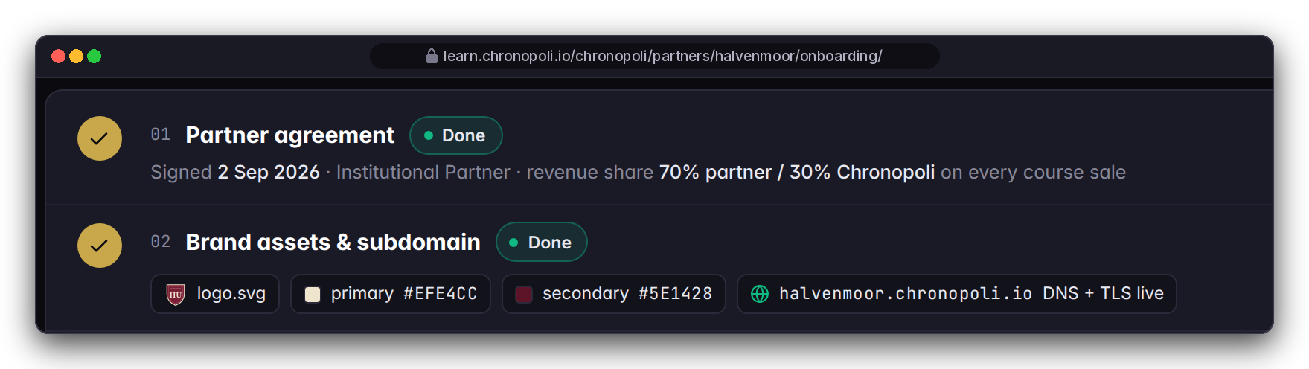

ONBOARDING · 90 DAYS FROM KICK-OFF
How onboarding works: your first 90 days
Day 0 = the kick-off date set in your partner agreement or pilot order. Content work runs in staging while the platform completes its go-live sprints
DAYS 0-30 · AGREE AND SET UP
DAYS 31-60 · BUILD
DAYS 61-90 · LAUNCH-READY
Knowledge Partner
Agreement, tier and districts · brand assets and subdomain · Stripe Connect account · HR notification e-mail · SMEs named
First track in Studio · grading policy and certificate · pathway and badge criteria · content QA with the Chronopoli team · first round-table topic
Academy preview in staging · job postings drafted · soft launch to your own audience
Enterprise team
Licence and seat list · roster and cohort · team admin named
Pathway choice · pilot cohort starts · first module completions tracked in the gradebook
First grade report reviewed with your team admin · environment and learner data: per pilot order
Platform go-live gate: after sprint 6 (Boot, Secure, Commerce, Pipeline, AI & data, Launch); no calendar date committed
Where learners come from: your own channels first; in the city, the 5-question onboarding routes new learners to your district, plus community and round tables. No audience size is promised
Your effort: an executive sponsor, one academy admin (or team admin), SMEs to author or review each module, one content-QA cycle per track; time agreed in the workshop
DESIGN PROTOTYPE
MOCK SCHEDULE · FICTITIOUS HALVENMOOR UNIVERSITY
Steps 01-02, not yet built · dates are a fictitious university's mock plan, not our commitment
Illustrative mock data · Tether is a partner-roadmap target only; no agreement implied · all other organisations and people are fictitious
25
Notes:
TALK TRACK: This is the project plan in one picture. Two lanes: partners on top, enterprise teams below, both counting from our kick-off. Answer reach before they ask: you bring your audience first; inside the city the 5-question onboarding sends new learners to your district, and the district community and round tables keep them. We don't promise audience numbers. Your effort: a sponsor, one admin, experts per module and one QA cycle; we estimate hours together in the workshop, not on a slide. The fictitious university on screen has two of six steps done, five of six experts confirmed and its first track 57% built. The dates on screen are that fictitious example's mock plan; we don't commit to a calendar go-live. ENTERPRISE: the pilot environment and what learner data may go into it are written into the pilot order; until the Secure sprint is done we recommend pseudonymous usernames. OBJECTION: 'So when are we live?' ANSWER: After the six sprints, and we'll give you a date once sprint length is fixed. Your content, brand and pathways will be ready in staging, so you launch on day one of go-live.

Slide 26







TRUST BY DESIGN
Trust by design
Commitments built into the product and the go-live plan. These are design commitments, not certifications
Human approval
IN THE PRODUCT
Chatham House
GO-LIVE ITEM
Expert consent
GO-LIVE ITEM
One human approves or rejects every AI-generated round-table output before it is published
Chatham House Rule sessions; removing attribution from outputs is a go-live fix
No voice or avatar twin without the expert's written consent (go-live requirement)
Candidate consent
GO-LIVE ITEM
Open standards
IN THE PRODUCT
No fork
IN THE PRODUCT
No credential snapshot goes to partner HR without it (go-live requirement)
Open Badges 2.0 credentials; standard Open edX grade reports as CSV
Upstream Open edX via Tutor 22; upgrades arrive through the normal channel
AWS UAE region
GO-LIVE ITEM
Private reports
GO-LIVE ITEM
Scoped AI tutor
GO-LIVE ITEM
Target: me-central-1, Terraform-managed; least privilege in the Secure sprint
Learner grade files move out of today's public media bucket in the Secure sprint
Answers cite sources, labelled a learning aid; per-partner scoping in the AI & data sprint
We hold no security certifications today. A technical review logged 37 findings (6 critical, 18 high, 13 medium): 8 fixed, 3 partly fixed, 26 open, including 5 of the 6 critical items (one is the public media bucket above); 22 of the 26 are scheduled in the six sprints. Summary available on request.
Services named in this deck: AWS (incl. Bedrock, SES, IVS, Transcribe, Textract), Stripe, Discourse; ElevenLabs and HeyGen only for consented twins. Data-processing terms are set in the pilot order or partner agreement.
Illustrative mock data · Tether is a partner-roadmap target only; no agreement implied · all other organisations and people are fictitious
26
Notes:
TALK TRACK: Regulators and banks buy trust first. Each tile is either in the product (the approval queue, Open Badges, standard reports, no fork) or a named go-live commitment (consent gates, attribution removal, private report storage, least privilege, tutor scoping). We're open about status: a technical review logged 37 findings, 6 critical, 18 high and 13 medium. Eight are fixed and three partly fixed; 26 are open, including five critical ones, and one of those is learner grade files in a public media bucket. Of the 26 open, 22 are scheduled in the six sprints and the rest are still being planned. We'd rather tell you than have you find it in due diligence. The second line lists every outside service this deck mentions, so your procurement team has the list. OBJECTION: 'Are you ISO 27001 or SOC 2 certified?' ANSWER: No, and we don't claim it; we're pre-launch. We can share the review summary and the Secure sprint scope, and we'll answer your vendor due-diligence questionnaire against the plan.

Slide 27
OBJECTIONS
Questions buyers ask
Short answers; details in the partner agreement, the pilot order or on request
Is it live?
Will a regulator accept the evidence?
Support, SLA, term and exit?
Pre-launch; six sprints to go-live; join as Founding Partner / pilot
Grade reports and Open Badges records as evidence; no regulator recognition claimed
Set in the pilot order / agreement; no SLA claimed; export + badge records on exit
What does it cost?
Can the partner see our staff's grades?
Academic credit? Language?
Academies $25K–$150K/yr; seats $1,500/yr ($125/month); 70/30 on course sales
Aggregates only; learner-level needs consent (go-live requirement)
Granted by your institution, not the platform. English at launch; other languages on request
Who owns the content, and is it exclusive?
Learner data and contact?
Research use of round tables?
Standard, exportable Open edX content; rights and exclusivity in the partner agreement
Consent + partner access model (Secure sprint); set in the agreement
Publication and attribution in the agreement; no automatic anonymity today
Can we use our brand?
Where does data live?
Who else is in?
Name, pathways, jobs today; colours, logo, subdomain before go-live
AWS me-central-1 target; Secure sprint
DBCC is the confirmed anchor; no partner signed (slide 20); Tether screens are illustrative
Illustrative mock data · Tether is a partner-roadmap target only; no agreement implied · all other organisations and people are fictitious
27
Notes:
TALK TRACK: Use this as the objection-handling slide. Invite the hardest question; if it isn't here, write it down and answer in writing. Never improvise a date, a fee, an SLA or a certification: the right answer is 'set in the partner agreement', 'set in the pilot order' or 'on request'. We don't list roadmap names on this slide: the exact statuses are on slide 20 (DBCC confirmed anchor, BUiD MOU in progress, Ripple pitching, Chainalysis engaging). If asked, say no partner is signed. OBJECTION: 'Why commit before launch?' ANSWER: Founders set the first curricula and badge standards in their districts, host the first round tables and have their academy ready on launch day. The risk is bounded: a scoped agreement and a 90-day plan. OBJECTION: 'What happens if Chronopoli slips or doesn't launch?' ANSWER: Your content is standard Open edX that you authored and can export, badges follow an open standard, and go-live is gated on the six sprints, not a marketing date.

Slide 28


NEXT STEP
Two ways to start
Hosted by Dubai Blockchain Center: help build the place where the digital economy learns
FOR KNOWLEDGE PARTNERS
FOR ENTERPRISE TEAMS
Founding Partner workshop
Pilot for 25 seats
Half a day, terms on request: choose your districts, first track and pathway, badge criteria and first round-table topic, and leave with your 90-day plan. Institutions: the workshop also drafts the governance, IP and research terms for your committee
Run one cohort on a pathway co-selected in the workshop from the courses available at pilot start, then review the first grade report together
25 seats at $1,500/seat/yr list
Term and catalogue in the pilot order
Districts + first track
Pathway + badge criteria
First round-table topic
Batch enrolment + cohort
Standard Open edX grade reports
Your 90-day plan
Institutions: governance, IP and research terms draft
Co-design the team-admin console
Next step: agree a workshop or pilot date, and name your sponsor and academy admin, or your team admin
Contact: partners@chronopoli.io · chronopoli.io/partners
Your account lead is named in the cover e-mail
Pre-launch · no go-live date committed · terms in the agreement or pilot order
Illustrative mock data · Tether is a partner-roadmap target only; no agreement implied · all other organisations and people are fictitious
28
Notes:
TALK TRACK: Close on one concrete next step, not on features. For a partner it's the workshop: it costs a morning and produces a plan they own; for a university it also produces the draft governance, IP and research terms the committee will ask for. For an enterprise team it's the 25-seat pilot, which matches the licence you've seen throughout; the term, the catalogue and the pathway go in the pilot order, and the pathway is chosen from what's available at pilot start. The pilot is priced at the list rate, $1,500 per seat per year ($125 a month). Which of the two fits you, and who else should be in the room? Then close on the statement on slide 29. Don't quote a discount or pilot price beyond the list price; workshop terms and anything else are on request. Leave behind the deck, the sample evidence CSV and, if asked, the technical review summary. RELEASE BLOCKER: don't send the deck externally until DBCC has filled in the contact block. OBJECTION: 'We'll wait until you're live.' ANSWER: You can, but Founding Partners set the curriculum and badge standards for their district and host the first round tables, and those seats go to the partners who start now. OBJECTION: 'We need to take this internally first.' ANSWER: Of course. The workshop is the easiest way to give your stakeholders a concrete scope to decide on.
RELEASE BLOCKER: partners@chronopoli.io and chronopoli.io/partners in the Contact box are placeholders; Dubai Blockchain Center confirms the live address before any external use of this deck. The account lead is named in the cover e-mail that sends this deck.

Slide 29
Chronopoli is not a better Coursera.
Not a smarter university.
It is a completely new architecture
where credentials are verifiable, content is AI-generated and regulation-linked, companies fund learning instead of students, and the degree is replaced by a dynamic professional record that follows you for life.
EMAIL
PLATFORM
HOSTED
ANCHOR
partners@chronopoli.io
learn.chronopoli.io (at go-live)
AWS UAE · me-central-1
Dubai Blockchain Center
Pre-launch · September 2026 · © Chronopoli / Dubai Blockchain Center
29
Notes:
TALK TRACK: Chronopoli is not a better Coursera, and not a smarter university. It is a new architecture: credentials are verifiable, content is AI-generated and linked to regulation, companies fund learning instead of students, and the degree is replaced by a professional record that follows you for life. Pause, then hand over the contact details and the leave-behind. RELEASE BLOCKER: the e-mail and platform addresses are placeholders until Dubai Blockchain Center confirms them; learn.chronopoli.io is live only after go-live.

Slide 30
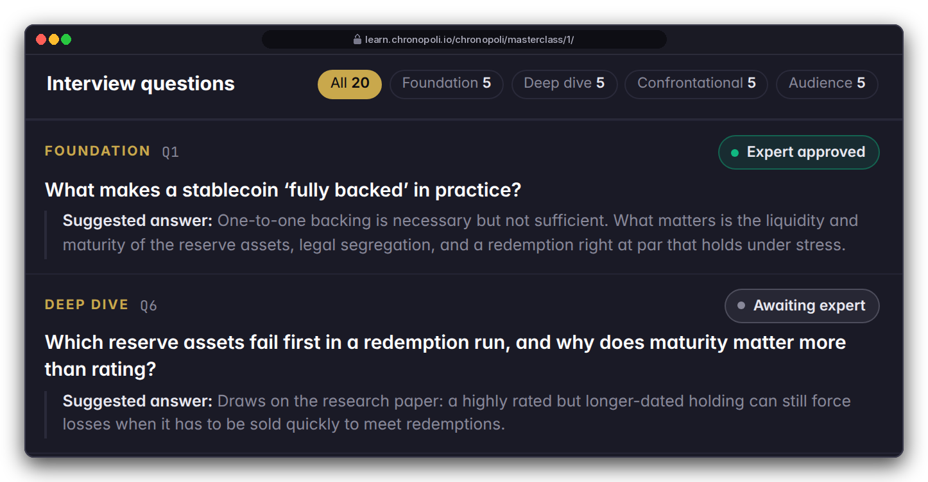
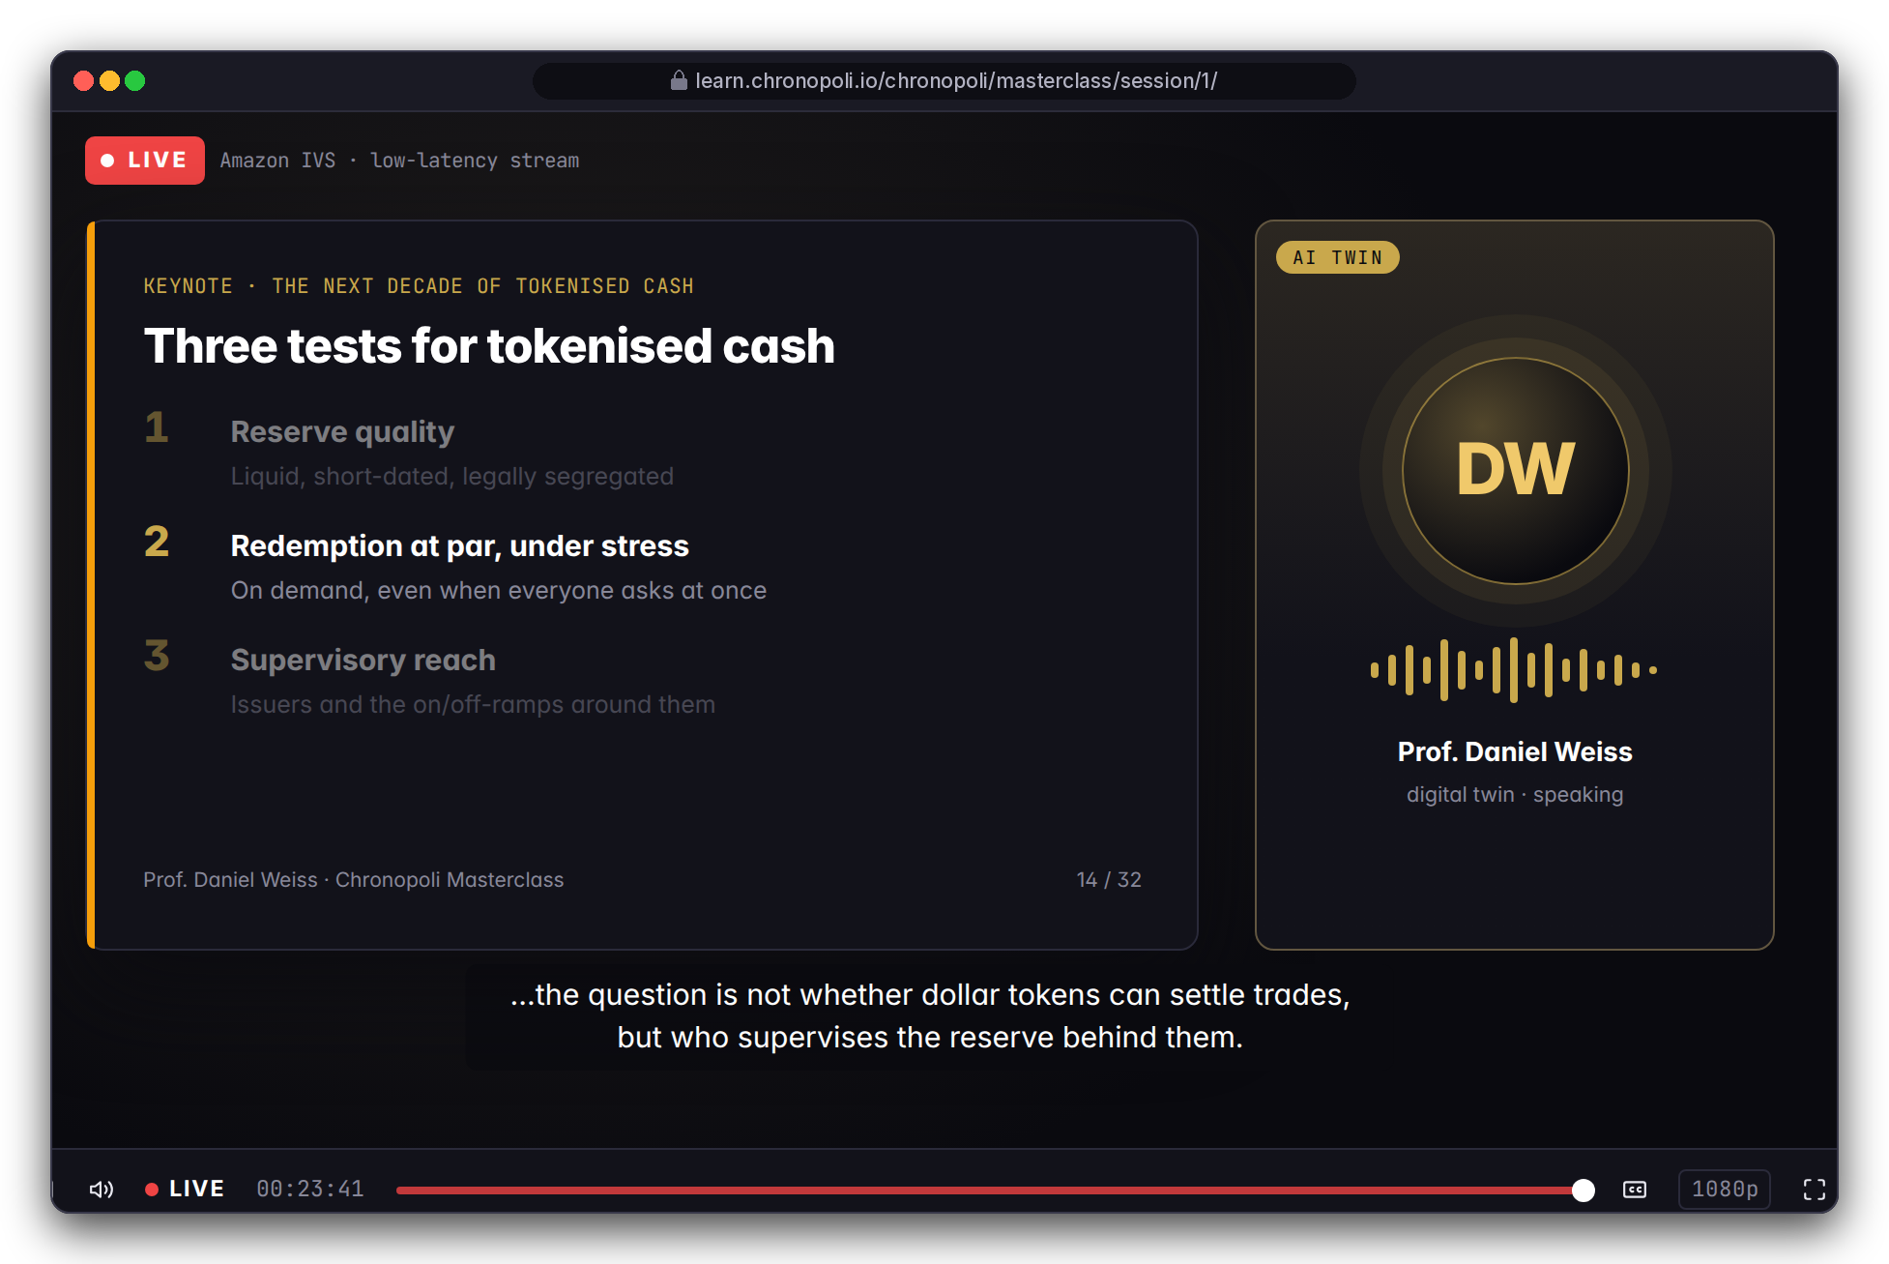
APPENDIX · ROADMAP MILESTONE 7 · ON REQUEST
PILLAR 03 · OPEN KNOWLEDGE
Scale your best expert with a digital-twin masterclass
Your expert's publications become an interview-style masterclass, only with the expert's written consent
DESIGN PROTOTYPE
Right: live masterclass session design on Amazon IVS
Publications are processed with Amazon Textract; Claude drafts interview questions at four levels: foundation, deep dive, confrontational, audience
The expert reviews and approves the questions and suggested answers, and sets what's in and out of scope
Voice (ElevenLabs) and avatar (HeyGen) only with written consent; consent, review and withdrawal are go-live requirements, not yet in code; sessions designed for Amazon IVS
DESIGN PROTOTYPE
Left: first 2 of 20 interview questions drafted for Prof. Daniel Weiss's twin, awaiting expert review
Templates not yet built · the expert is fictitious
Illustrative mock data · Tether is a partner-roadmap target only; no agreement implied · all other organisations and people are fictitious
30
Notes:
BACKUP SLIDE, show only if asked. TALK TRACK: Your best people can't be in every room. A twin lets a chief economist or head of investigations run an L4-style masterclass without flying in, and the expert stays in control of the content. Be precise about status: this is the last roadmap milestone; the pages are prototypes; consent, review and withdrawal are design rules and go-live requirements, not features in the code today. Likeness and voice rights, and withdrawal when an expert leaves, are set in the expert's consent and the partner agreement. For a university audience treat this as optional; academic freedom and likeness rights make it the most sensitive item. OBJECTION: 'Our expert won't want a deepfake.' ANSWER: Then there's no voice or avatar. The same document analysis and question bank can support a live session with the real expert. OBJECTION: 'Reputation risk if the twin says something wrong?' ANSWER: It works from the expert's own documents, with approved questions and marked out-of-scope topics, and the expert signs off before it goes live.

