Slide 1

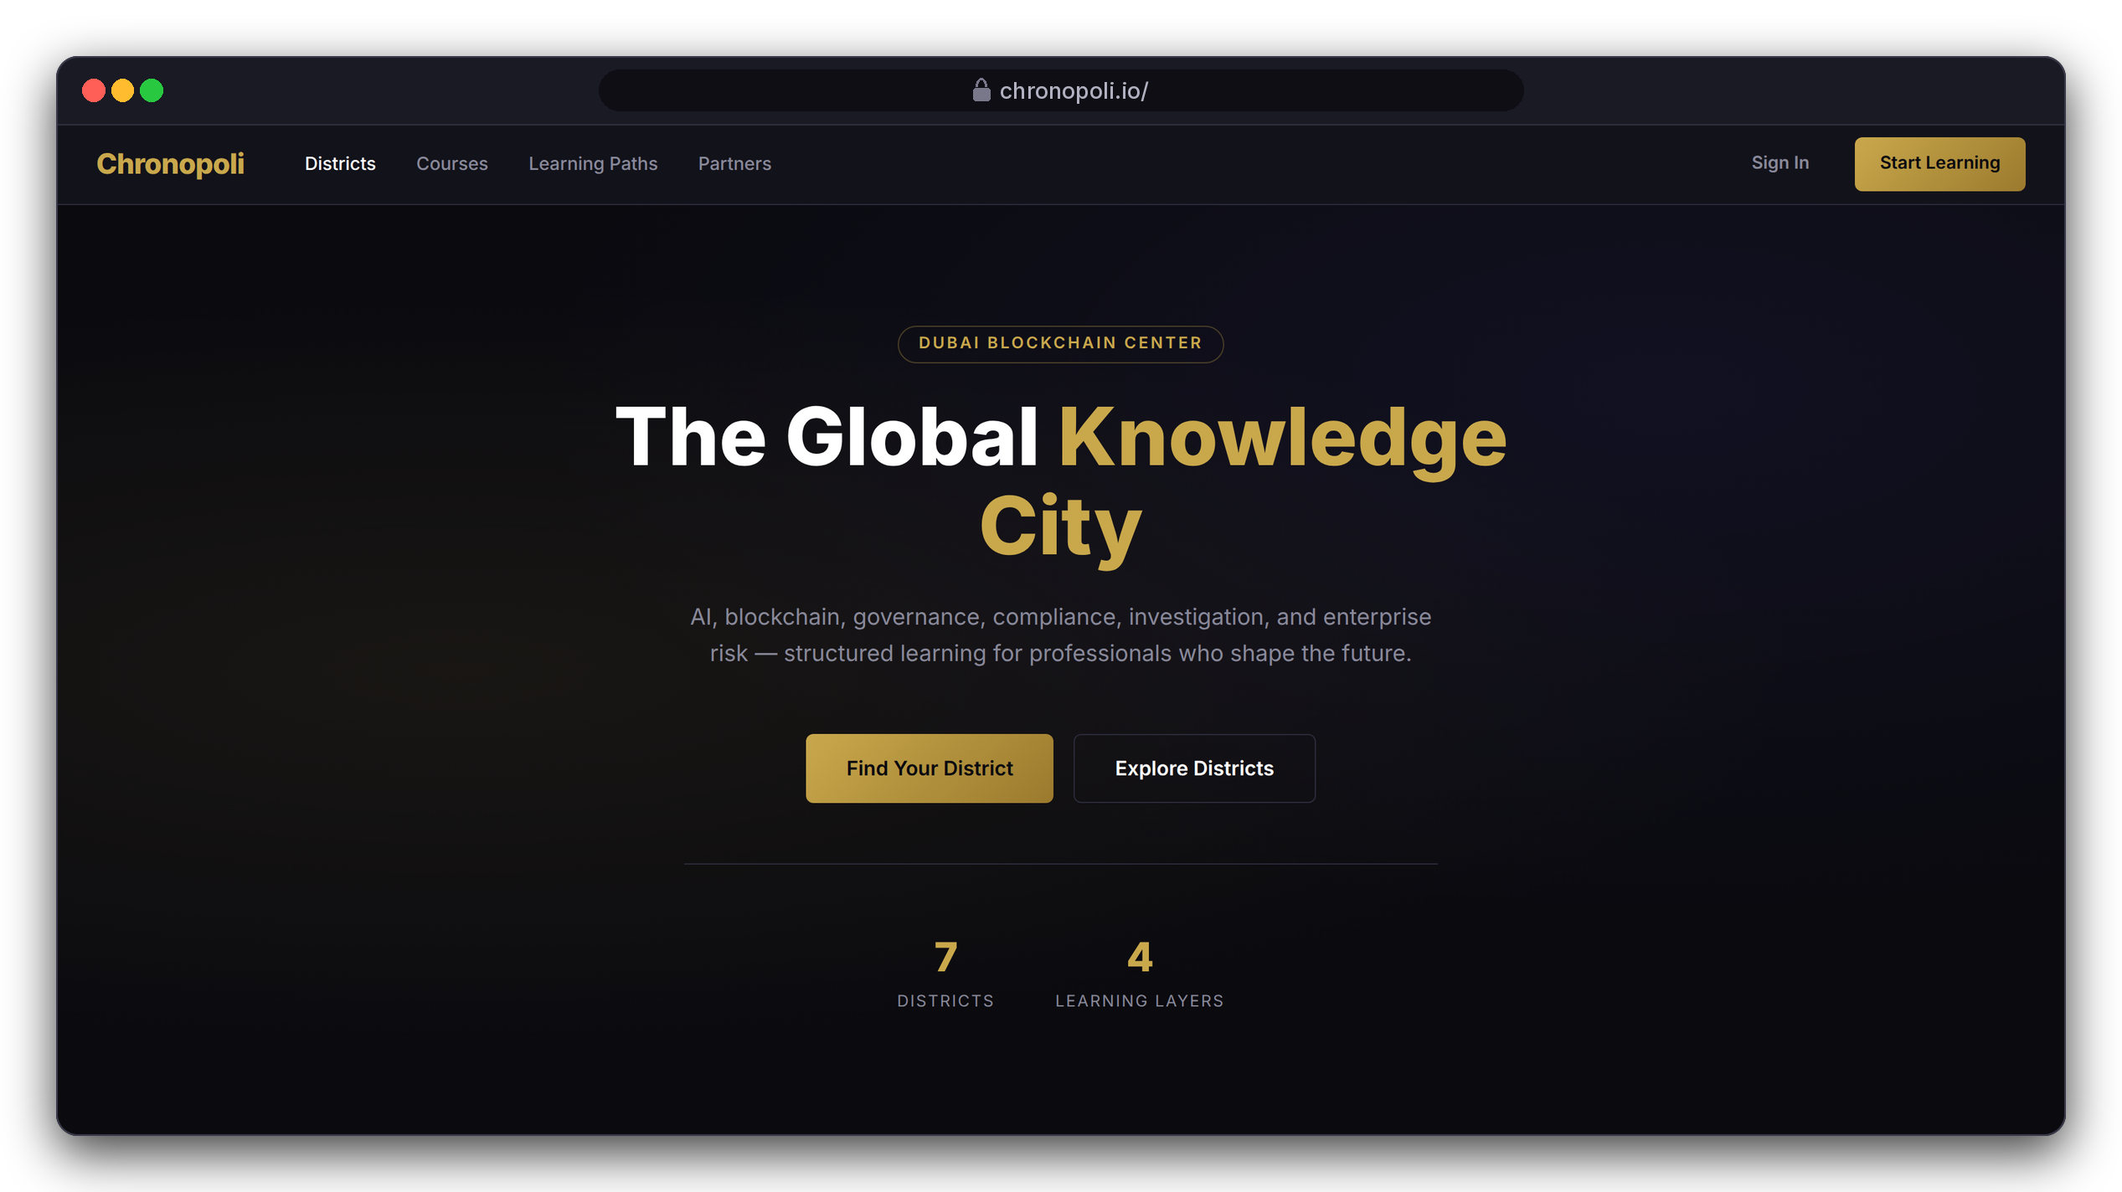

INVESTOR & PARTNER PRESENTATION
Chronopoli
The Global Knowledge City for the digital economy,
hosted by Dubai Blockchain Center
AI · Digital assets · Governance · Compliance · Financial-crime investigation · Enterprise risk
Built on Open edX (Tutor 22) on AWS · September 2026
The product tour uses an illustrative Tether (USDT) academy: fictitious mock data, no partnership implied
DESIGN PROTOTYPE
Landing-page preview (not yet deployed)
Illustrative mock data · Tether is a partner-roadmap target only; no agreement implied
01
Notes:
Chronopoli is one platform where regulators, financial intelligence units, banks, exchanges, enterprises, founders and students learn the digital economy, hosted by Dubai Blockchain Center. Every screen in this deck is either real software or a clearly labelled prototype. The running example, a Tether academy, is fictitious demo data: Tether is a roadmap target, not a partner.

Slide 2





THE PROBLEM
The people who police, regulate and build the digital economy learn it in fragments
Regulators, FIUs, banks, VASPs, founders and students face the same topics, with no shared place to learn them
Scattered and one-size
Weak credentials
Lost insight
No measurement
Vendor webinars, generic MOOCs and conferences, and nothing routes a minister, an MLRO or an investigator to the depth their role needs
A certificate tells an employer or supervisor little about what someone can do, and rarely leads to a job
Closed-door policy dialogue is seldom captured, published or reused
Protocols and vendors fund education without knowing who learned what
OUR ANSWER
OUR ANSWER
OUR ANSWER
OUR ANSWER
Districts, layers and onboarding
Open Badges linked to partner roles
Round tables and the content pipeline
Partner dashboard
Slides 3, 6
Slide 12
Slides 17, 18
Slide 16
02
Notes:
Keep this slide qualitative; we don't quote market sizes. Use one concrete picture: an exchange's MLRO whose team must understand the Travel Rule, sanctions freezes and stablecoin reserves within weeks, and who today pieces that together from webinars and PDFs. Each of the four problems has an answer later in the tour: districts and layers, badges linked to jobs, round tables with a publishing pipeline, and the partner dashboard.

Slide 3
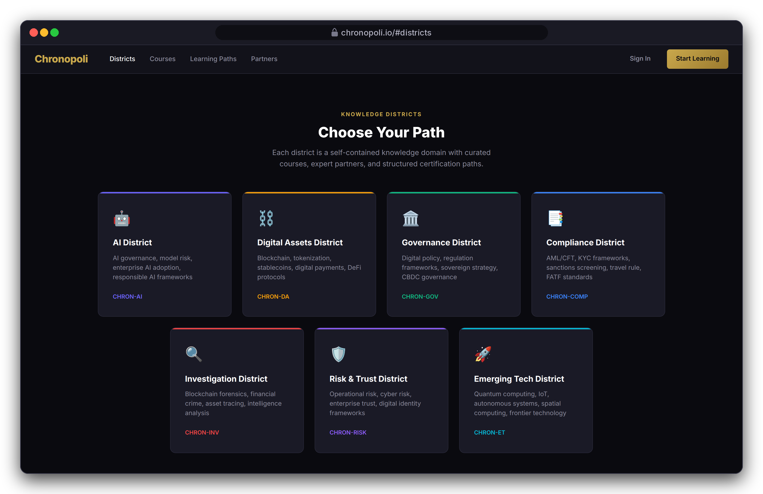
THE CITY
One city, seven districts, four layers
Every course sits in a Knowledge District and a learning layer, so every learner and partner knows where they belong
7 Knowledge Districts = 7 Open edX organisations: AI, Digital Assets, Governance, Compliance, Investigation, Risk & Trust, Emerging Tech
4 learning layers set depth and price (below)
Partners publish tracks into several districts and can run their own academy on a partner subdomain
One account for courses and community
LEARNING LAYERS: DEPTH AND PRICE RISE TOGETHER
L3
L4
L2
Institutional
Influence
L1
Professional
$999-2,499
$3,000-8,000
Entry
$299-799
$0-149
DESIGN PROTOTYPE
Landing-page preview of the seven districts (not yet deployed)
03
Notes:
Chronopoli isn't a course catalogue; it's a city map. A district is where a topic lives, and a layer is how deep you go. Every district is an Open edX organisation, so the structure sits in the LMS itself, not just in marketing. The same grid organises the community forums on slide 13. Internal, not for the audience: the repo's preview page still says six districts, shows a '50+ Partners' stat and a 'Trusted by' strip naming roadmap partners. This capture uses corrected copy, and the page must be fixed before anything goes public.

Slide 4
PRODUCT TOUR
Product tour: one learner, end to end
Layla Al-Mansoori, MLRO at Gulf Digital Exchange (fictitious VASP), earns a stablecoin compliance credential
1
2
3
4
5
6
7
8
9
Discover
Onboarding
Partner academy
Enrol & pay
Learn
AI tutor
Pass & pathway
Badge to job
Community & video
One catalogue, one sign-up
Routed in 5 questions
Pick a pathway
Stripe Checkout
Lessons and graded checks
Cited answers inside the lesson
Grades roll up to the pathway
Open Badge, matched to a job
Discourse forums, Opencast video
Slide 5
Slide 6
Slide 7
Slide 8
Slide 9
Slide 10
Slide 11
Slide 12
Slide 13
Then the partner side (slides 15-22)
Author 15
›
Measure 16
›
Convene 17
›
Publish 18
›
Masterclass 19
›
Earn 20-22
THE CAST (ALL FICTITIOUS)
WHAT EACH SCREEN IS
LA
Layla Al-Mansoori slides 6-13, 17, 19-21
REAL OPEN EDX SCREEN
Captured from a running stock Tutor 22.0.2 install
MLRO, Gulf Digital Exchange (fictitious VASP)
NK
Nadia Karim slides 16, 21-22
REAL CHRONOPOLI TEMPLATE RENDER
Our repo code, rendered in a test harness
Academy administrator, partner side (fictitious)
DESIGN PROTOTYPE
A page that is still to be built
AH
Dr. Amira Haddad slides 17-19
REAL EXTENSION
Opencast 20.4 and Discourse 3.5, running for real
Round-table moderator, Governance District (fictitious)
Illustrative mock data · Tether is a partner-roadmap target only; no agreement implied
04
Notes:
We follow one person, Layla, through every function, and then the partner behind her course. Three fictitious people carry the story: Layla the learner, Nadia who runs the partner academy, and Dr. Amira Haddad who moderates round tables. Four labels tell you what each screen is. A real Open edX screen came from a running Tutor 22 install. A Chronopoli template render is our repo code rendered in a test harness. A design prototype is a page still to be built. Opencast and Discourse screens are real extension systems. Her course runs from 1 September 2026, and her badge is issued on 18 September.

Slide 5
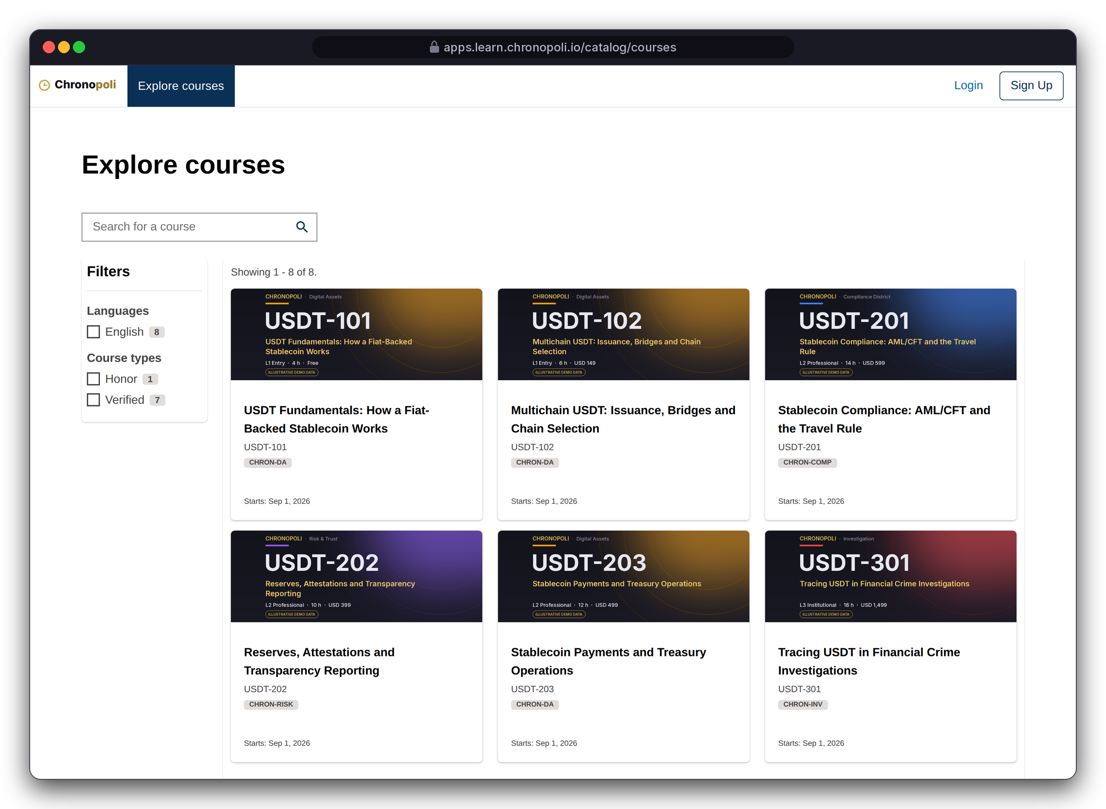
PRODUCT TOUR · STEP 1 OF 9 · DISCOVER
Persona: a visitor before sign-up
Discover: one catalogue across every district
Search and filter every track; each card shows district, layer, effort and price
Search and filters: full-text search on a real Open edX catalogue
Layer and price on every card: USDT-101 is free (L1), USDT-301 costs USD 1,499 (L3)
Sign up once: the same account signs in to the district community through Chronopoli's Discourse SSO
ALL EIGHT DEMO TRACKS (ILLUSTRATIVE)
USDT-101 L1
Free
USDT-102 L1
$149
USDT-201 L2
$599
USDT-202 L2
$399
USDT-203 L2
$499
USDT-301 L3
$1,499
USDT-302 L3
$1,299
USDT-401 L4
$4,500
REAL OPEN EDX SCREEN
Catalogue, Tutor 22.0.2 · first 6 of 8 demo courses
Illustrative mock data · Tether is a partner-roadmap target only; no agreement implied
05
Notes:
This is stock Open edX with Chronopoli settings: we didn't build a catalogue, we got one. These real Open edX screens still use the default theme with the Chronopoli name and a demo wordmark, not yet the dark/gold theme. The district filter was switched off in the demo because the stock catalogue shows raw org codes; the district still appears on every card. The frame shows the first two rows; the list on the right gives all eight demo tracks.

Slide 6
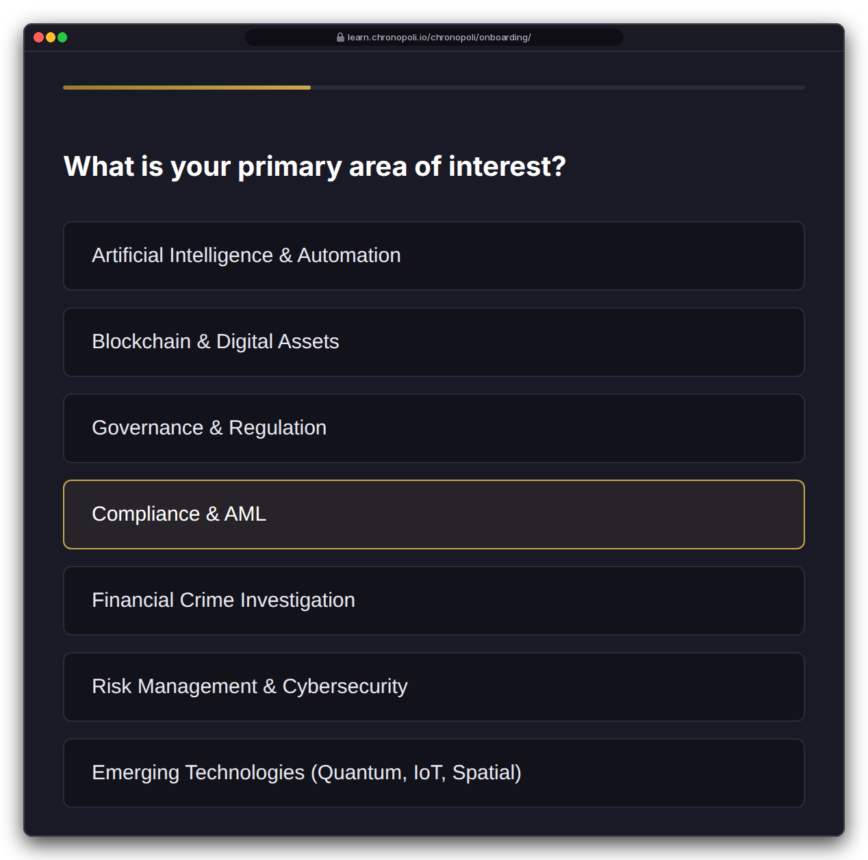
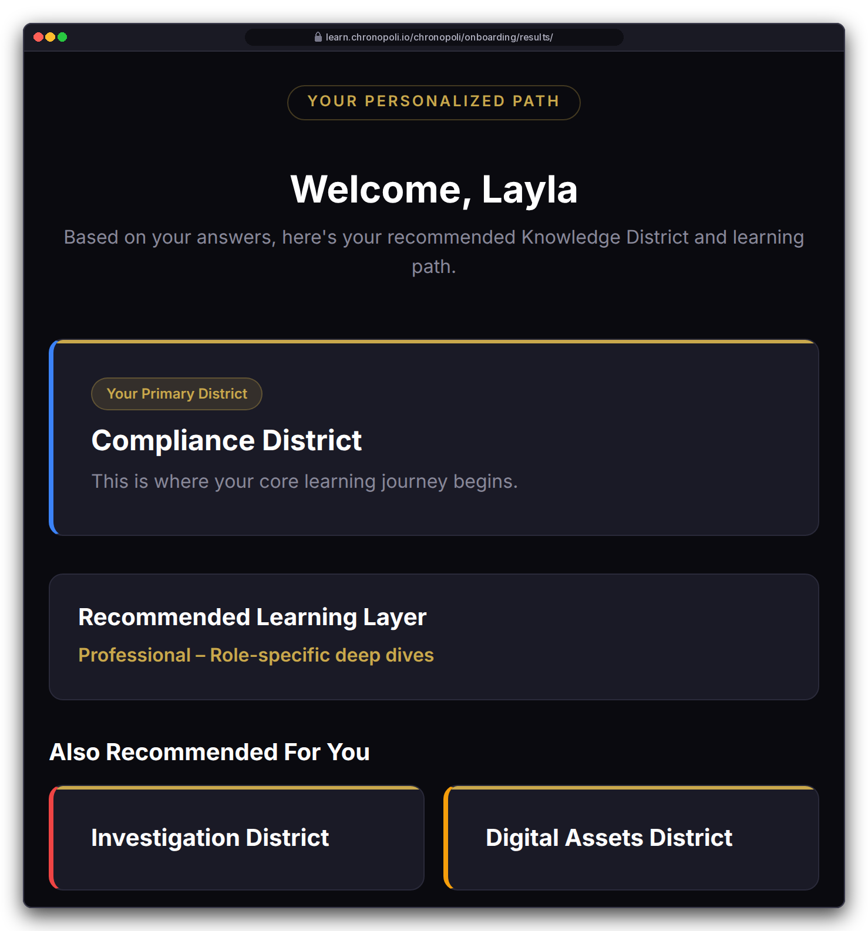
PRODUCT TOUR · STEP 2 OF 9 · ONBOARDING
Persona: Layla Al-Mansoori, MLRO (fictitious)
Onboarding: five questions, a personal map of the city
Role, focus, experience, goal and urgency give every learner a home district, two neighbouring districts and a starting layer
Layla answers: crypto exchange · Compliance & AML · experienced · certificate · within weeks
Result: Compliance District at L2 Professional, with Investigation and Digital Assets as neighbours
Rule-based and explainable: the home district follows her own focus choice; role and experience set the layer
Reused by the AI tutor: stored in her profile to set depth and examples
REAL CHRONOPOLI TEMPLATE RENDER
REAL CHRONOPOLI TEMPLATE RENDER
Question 2 of 5, rendered from the repo in a test harness
Routing result: home district, layer, neighbours
Illustrative mock data · Tether is a partner-roadmap target only; no agreement implied
06
Notes:
The recommendation isn't mocked: Layla's answers went through the repo's real routing function. Call it onboarding, not AI: today the routing is deterministic rules, which also makes it easy to explain. The AI comes in on slide 10, where the tutor reuses this profile. Because the home district follows the learner's own focus choice, an FIU investigator who picks financial-crime investigation lands in Investigation, and a ministry adviser who picks governance lands in Governance. Before go-live, these templates must render through Open edX's Mako engine (R-9), and answers must be checked against the allowed options (R-33).

Slide 7
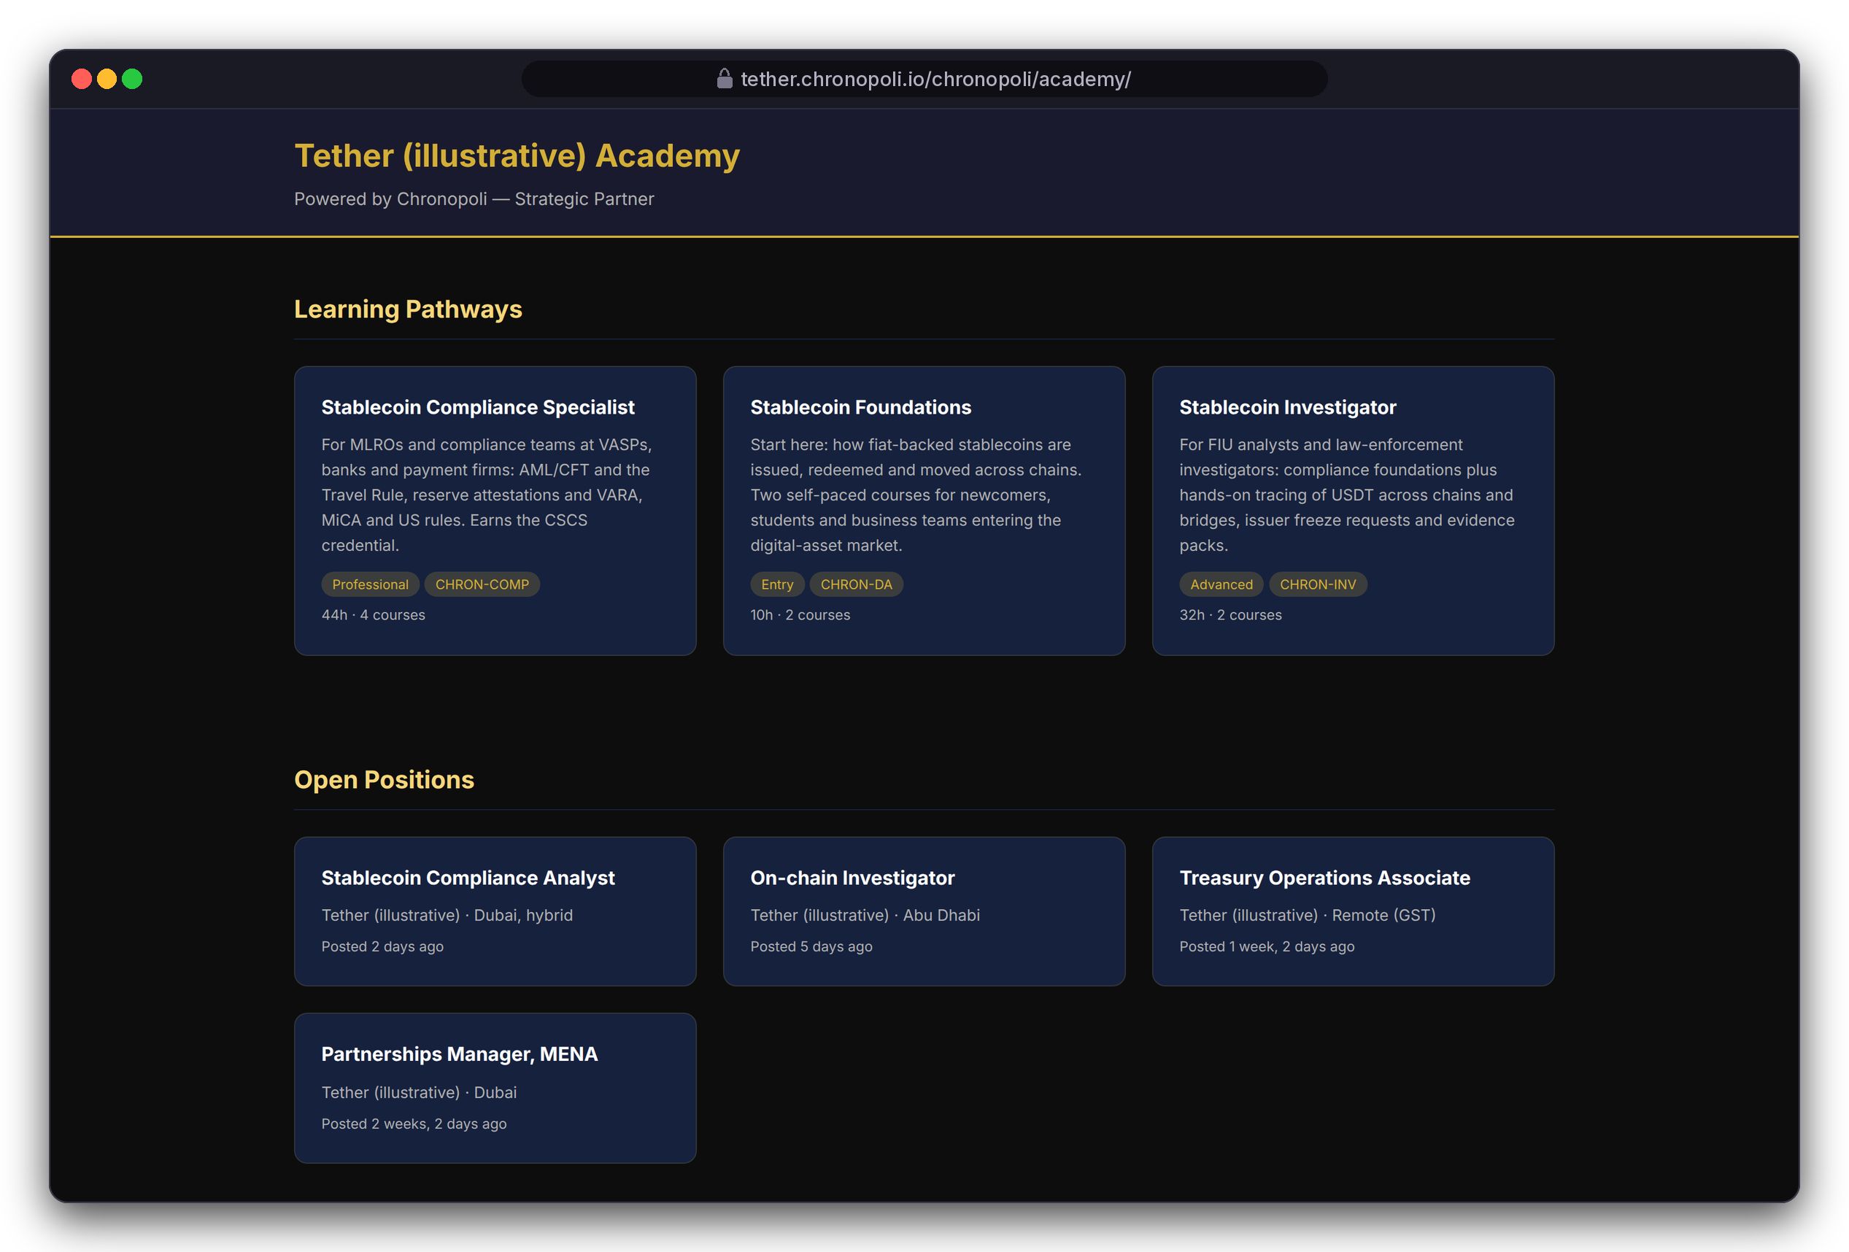
PRODUCT TOUR · STEP 3 OF 9 · PARTNER ACADEMY
Persona: Layla browsing
Partner academy: a partner's own school inside the city
Pathways that end in a co-branded badge, next to the partner's open roles, on the partner's own subdomain
3 pathways: Stablecoin Compliance Specialist (4 courses, 44 h), Foundations (2 courses, 10 h), Investigator (2 courses, 32 h)
District catalogues: courses stay in their districts, so a partner track also shows up there
Talent pipeline: open positions sit next to the learning
REAL CHRONOPOLI TEMPLATE RENDER
Academy home on tether.chronopoli.io (partner colour and logo not yet applied)
Illustrative mock data · Tether is a partner-roadmap target only; no agreement implied
07
Notes:
The partner admin, Nadia Karim (fictitious), sets this up in the Django admin: partner record, subdomain, pathways, badges and jobs. Two honest caveats. The template doesn't yet apply the partner's brand colour or logo. And the subdomain middleware isn't registered in the Tutor plugin yet (R-23, sprint 6); the test harness switched it on.

Slide 8
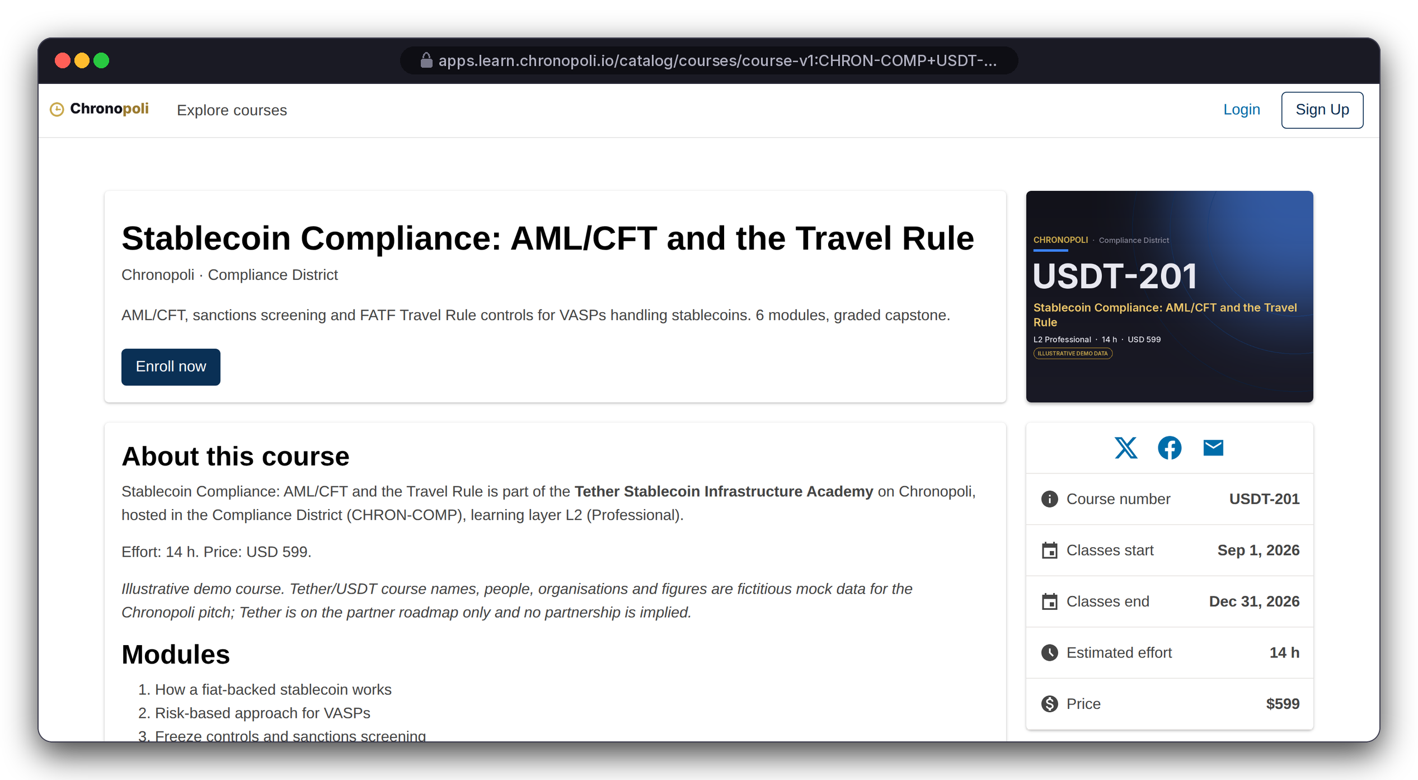
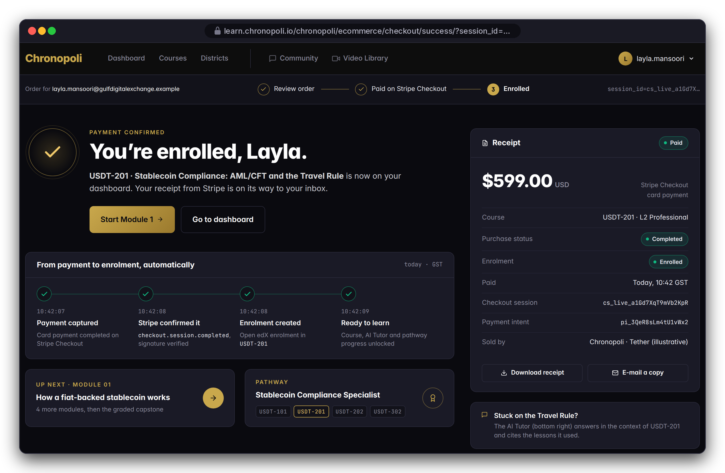
PRODUCT TOUR · STEP 4 OF 9 · ENROL & PAY
Persona: Layla · Illustrative mock data
Enrol and pay in one checkout
The learning layer sets the price, Stripe Checkout takes the payment, and a signed webhook enrols the learner
REAL OPEN EDX SCREEN
Course page with price
Layer sets the price: USDT-201, L2 Professional, $599 on the real Open edX course page
Hosted checkout: Stripe takes the card; Chronopoli never sees card details
Signed webhook: enrols her once and records the partner's 70% payout
DESIGN PROTOTYPE
Payment confirmed and auto-enrolment (template not yet built)
Illustrative mock data · Tether is a partner-roadmap target only; no agreement implied
08
Notes:
The course page and price are live Open edX. The confirmation page is a prototype because its template is missing (R-10). The checkout routing bug is fixed (R-11). Still open for the Commerce sprint: making Open edX itself enforce payment through paid course modes (R-12), and handling refunds and webhook edge cases (R-14).

Slide 9
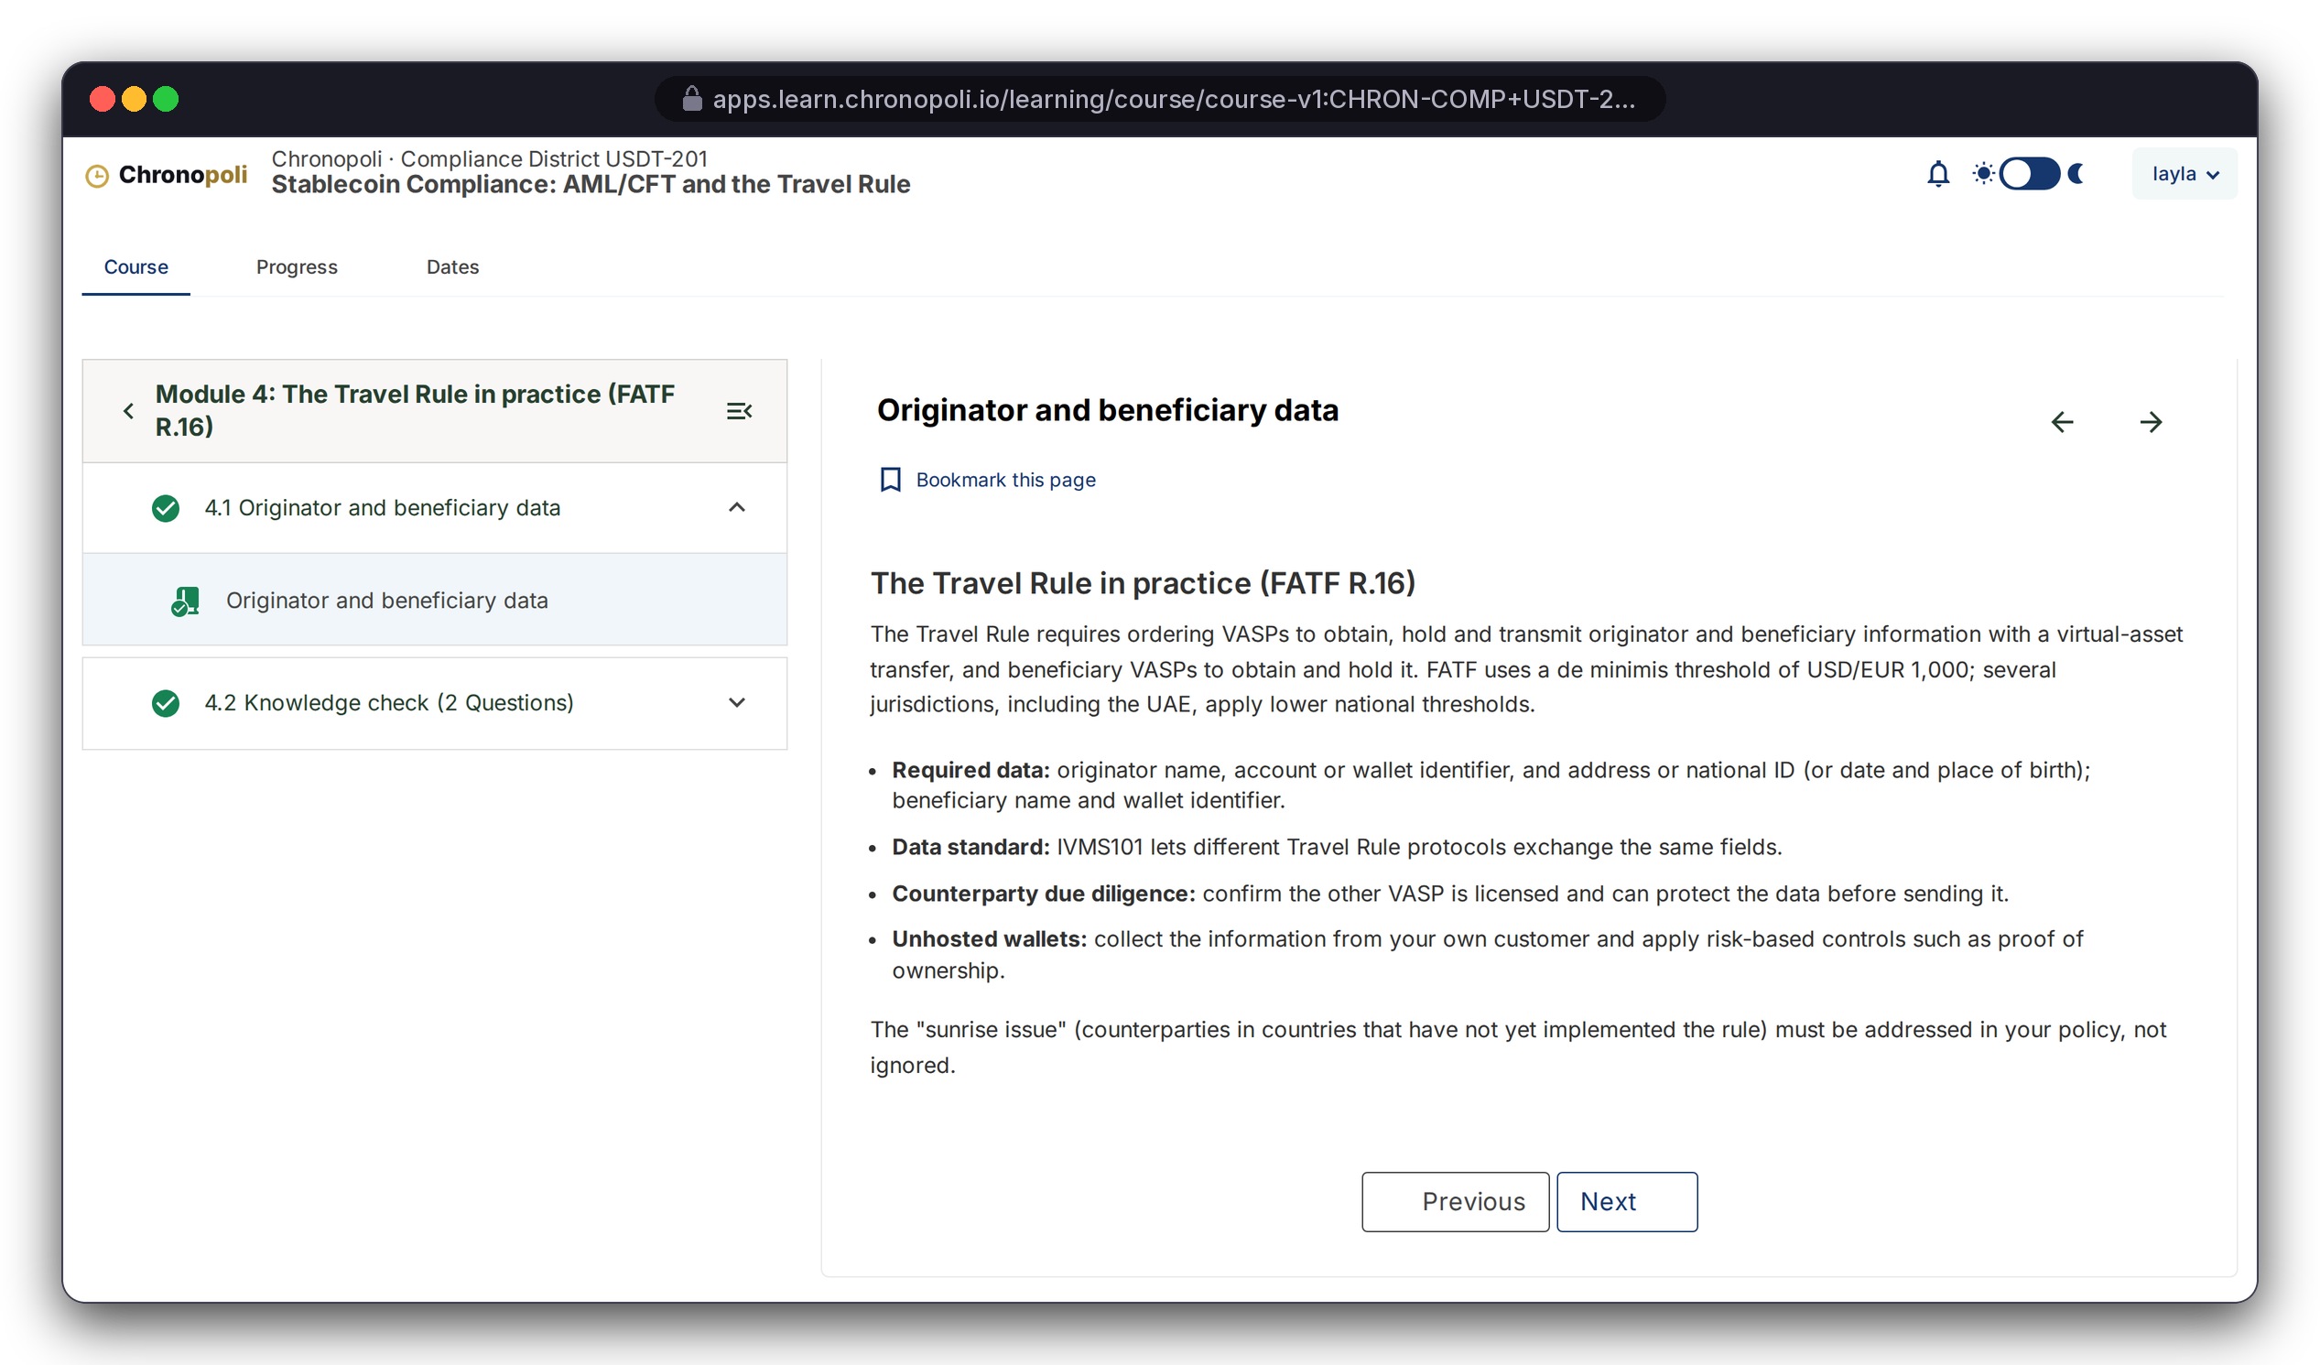
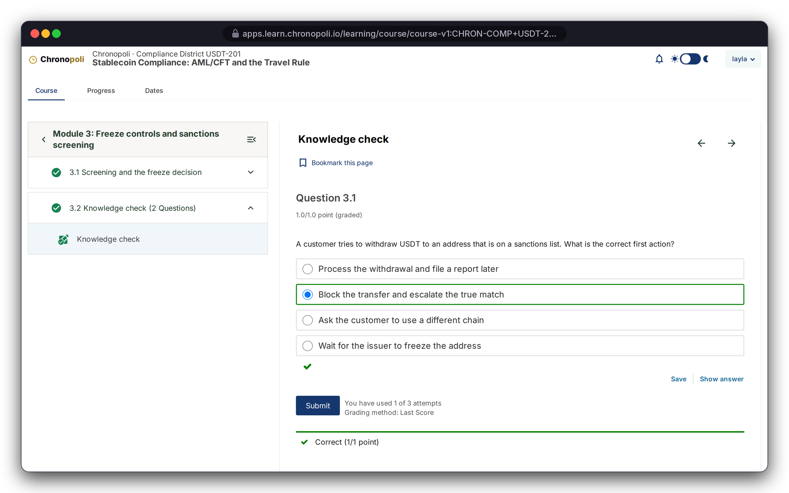
PRODUCT TOUR · STEP 5 OF 9 · LEARN
Persona: Layla · Illustrative mock course content
Learn on a proven LMS: lessons and auto-graded checks
Real Open edX courseware: completion tracking, graded problems, attempts and feedback out of the box
REAL OPEN EDX SCREEN
REAL OPEN EDX SCREEN
Learning MFE · lesson 4.1, the Travel Rule in practice
Knowledge check 3.2 · Question 3.1 correct, 1 of 3 attempts used
USDT-201: six modules, ending in a graded capstone
Instant grading: attempts are tracked (1 of 3 used)
Illustrative mock data · Tether is a partner-roadmap target only; no agreement implied
09
Notes:
Layla worked through the course in a real browser session; these aren't mock-ups. This is the no-fork advantage in practice: world-class courseware, grading and progress tracking that Open edX maintains for us. Our engineering goes into what sits around it.

Slide 10
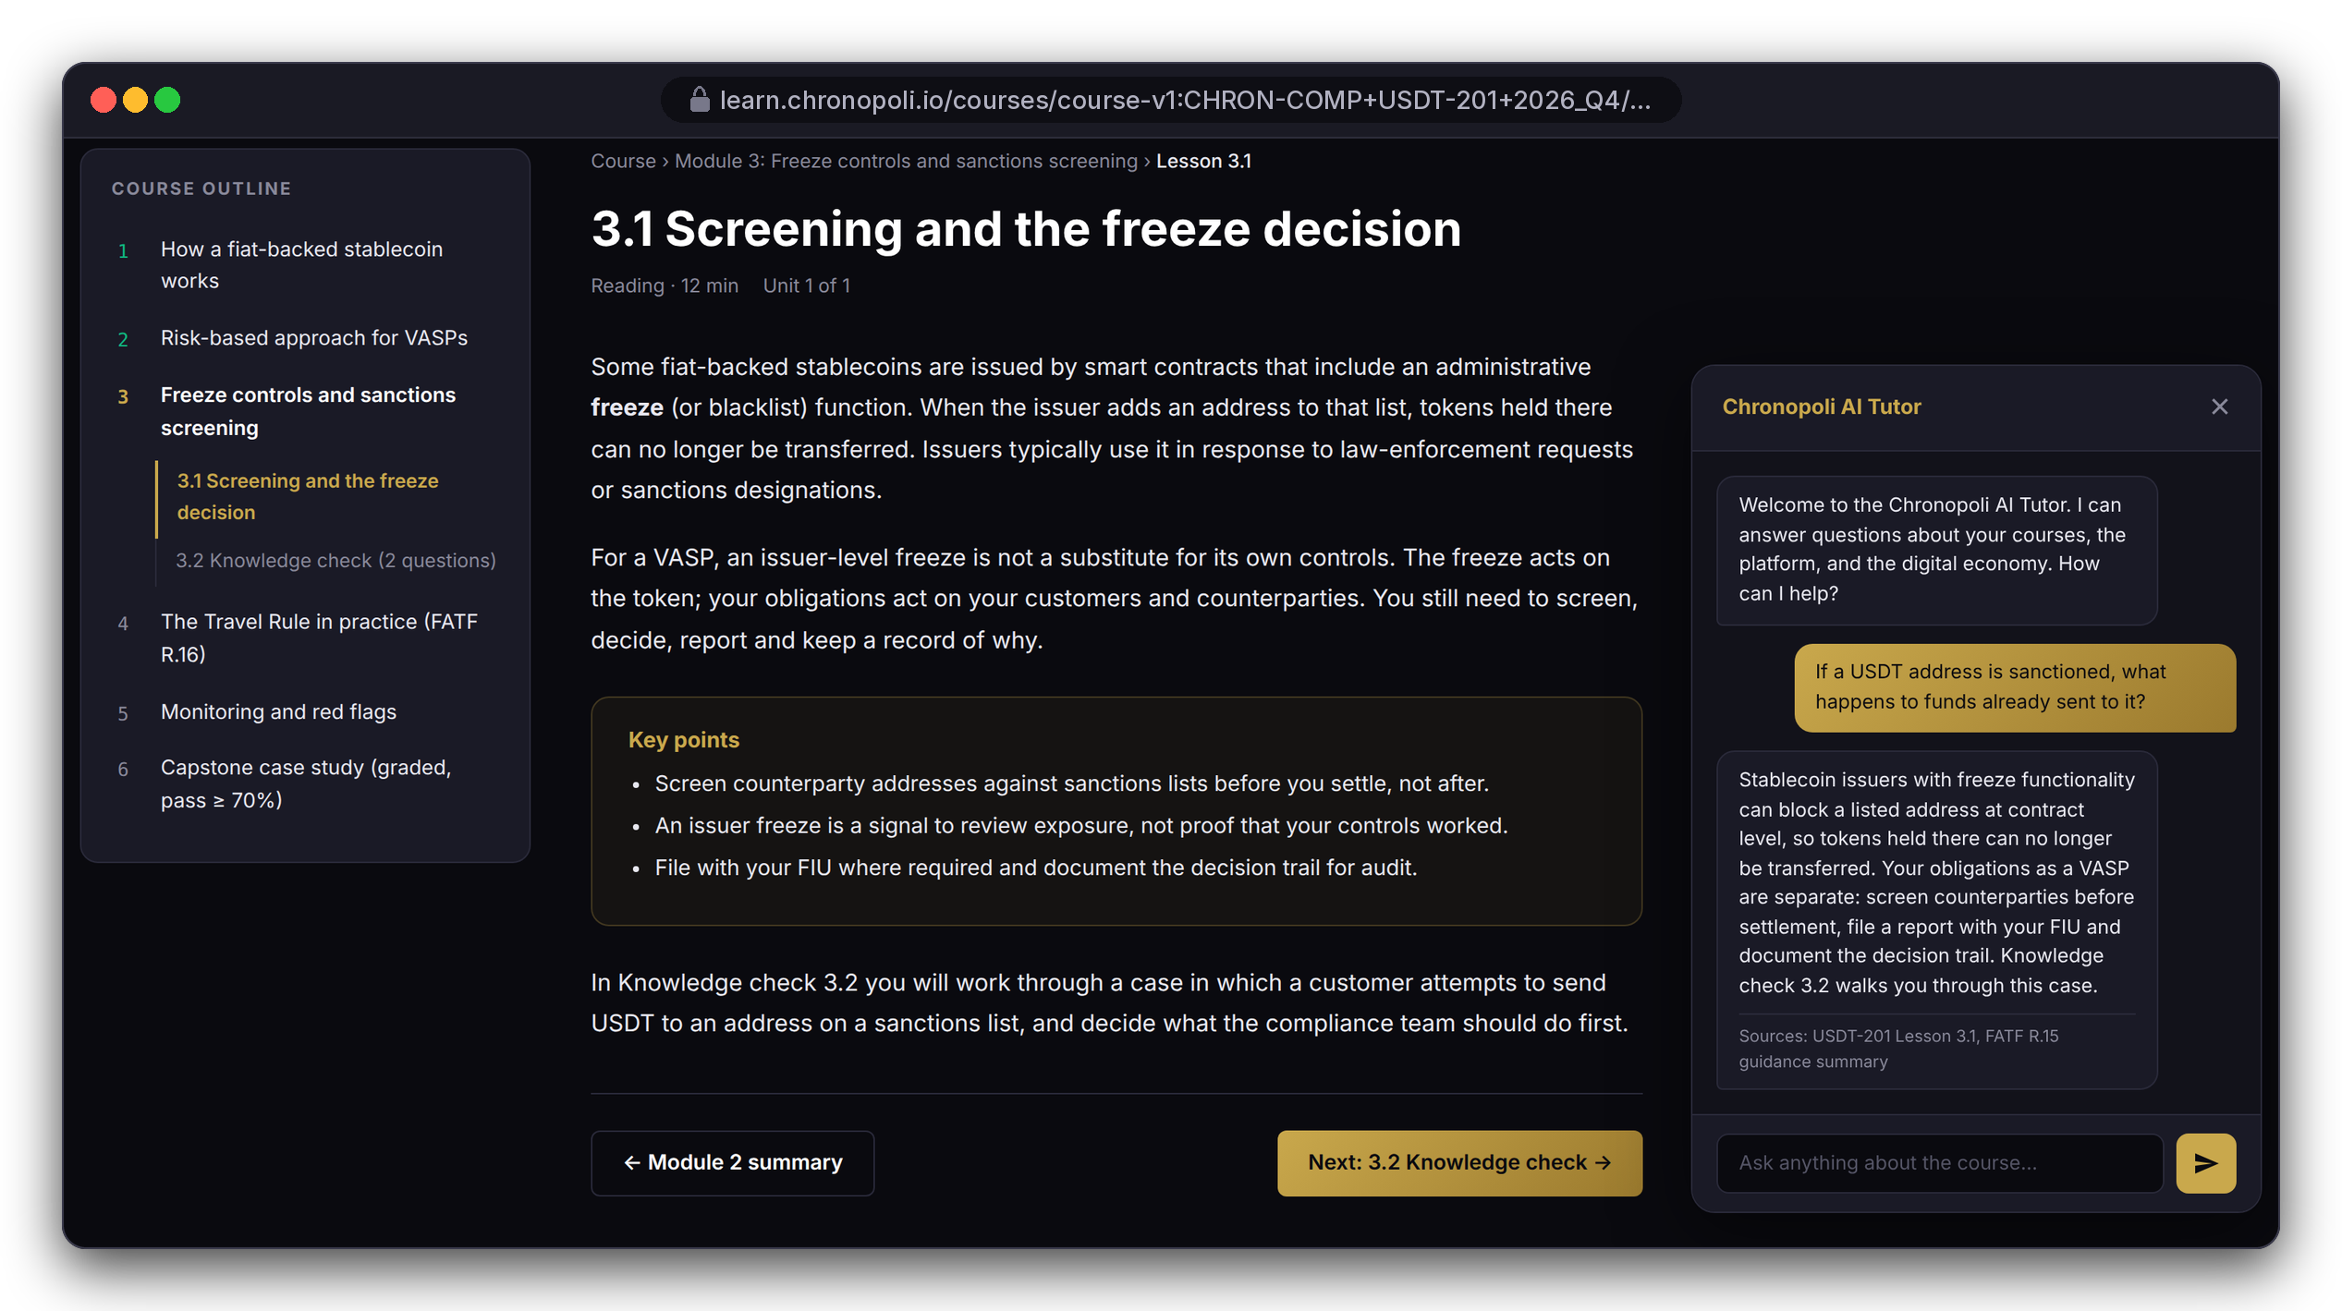
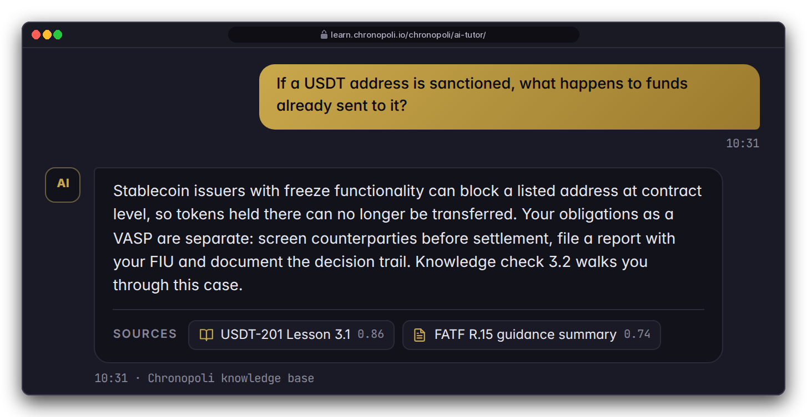
PRODUCT TOUR · STEP 6 OF 9 · AI TUTOR
Persona: Layla during USDT-201 Module 3
An AI tutor that cites its sources
Claude on Amazon Bedrock answers inside the lesson, from the Chronopoli knowledge base, and shows its sources
DESIGN PROTOTYPE
Tutor history (not yet built)
In Module 3: Layla asks what happens to funds already sent to a sanctioned USDT address
Cited answer: grounded in USDT-201 Lesson 3.1 and the FATF R.15 summary, at her L2 depth
A learning aid: not legal or compliance advice
DESIGN PROTOTYPE
Real widget, mock lesson, scripted answer (Bedrock stubbed) · dark/gold = target theme
Illustrative mock data · Tether is a partner-roadmap target only; no agreement implied
10
Notes:
The widget, the Chronopoli header and the chat view that streams the answer are real repo code, and that view built a system prompt personalised to Layla. The two Bedrock calls were stubbed in the harness, so the answer text is scripted demo copy, not live model output; say so if asked. This is our platform moat (milestone M6): tutoring grounded in partner courses and round-table papers. The review fixed the history bug that broke the tutor after about six questions (R-15) and the knowledge-base IAM permissions (R-16). Still open for sprint 5: the knowledge-base index and access policy (R-18) and per-user quotas (R-32). Check on staging that the widget appears inside the new Learning MFE. The dark/gold look is the target Chronopoli theme; the real Open edX screens on slide 9 still use the stock theme, and both show the same Module 3 outline.

Slide 11
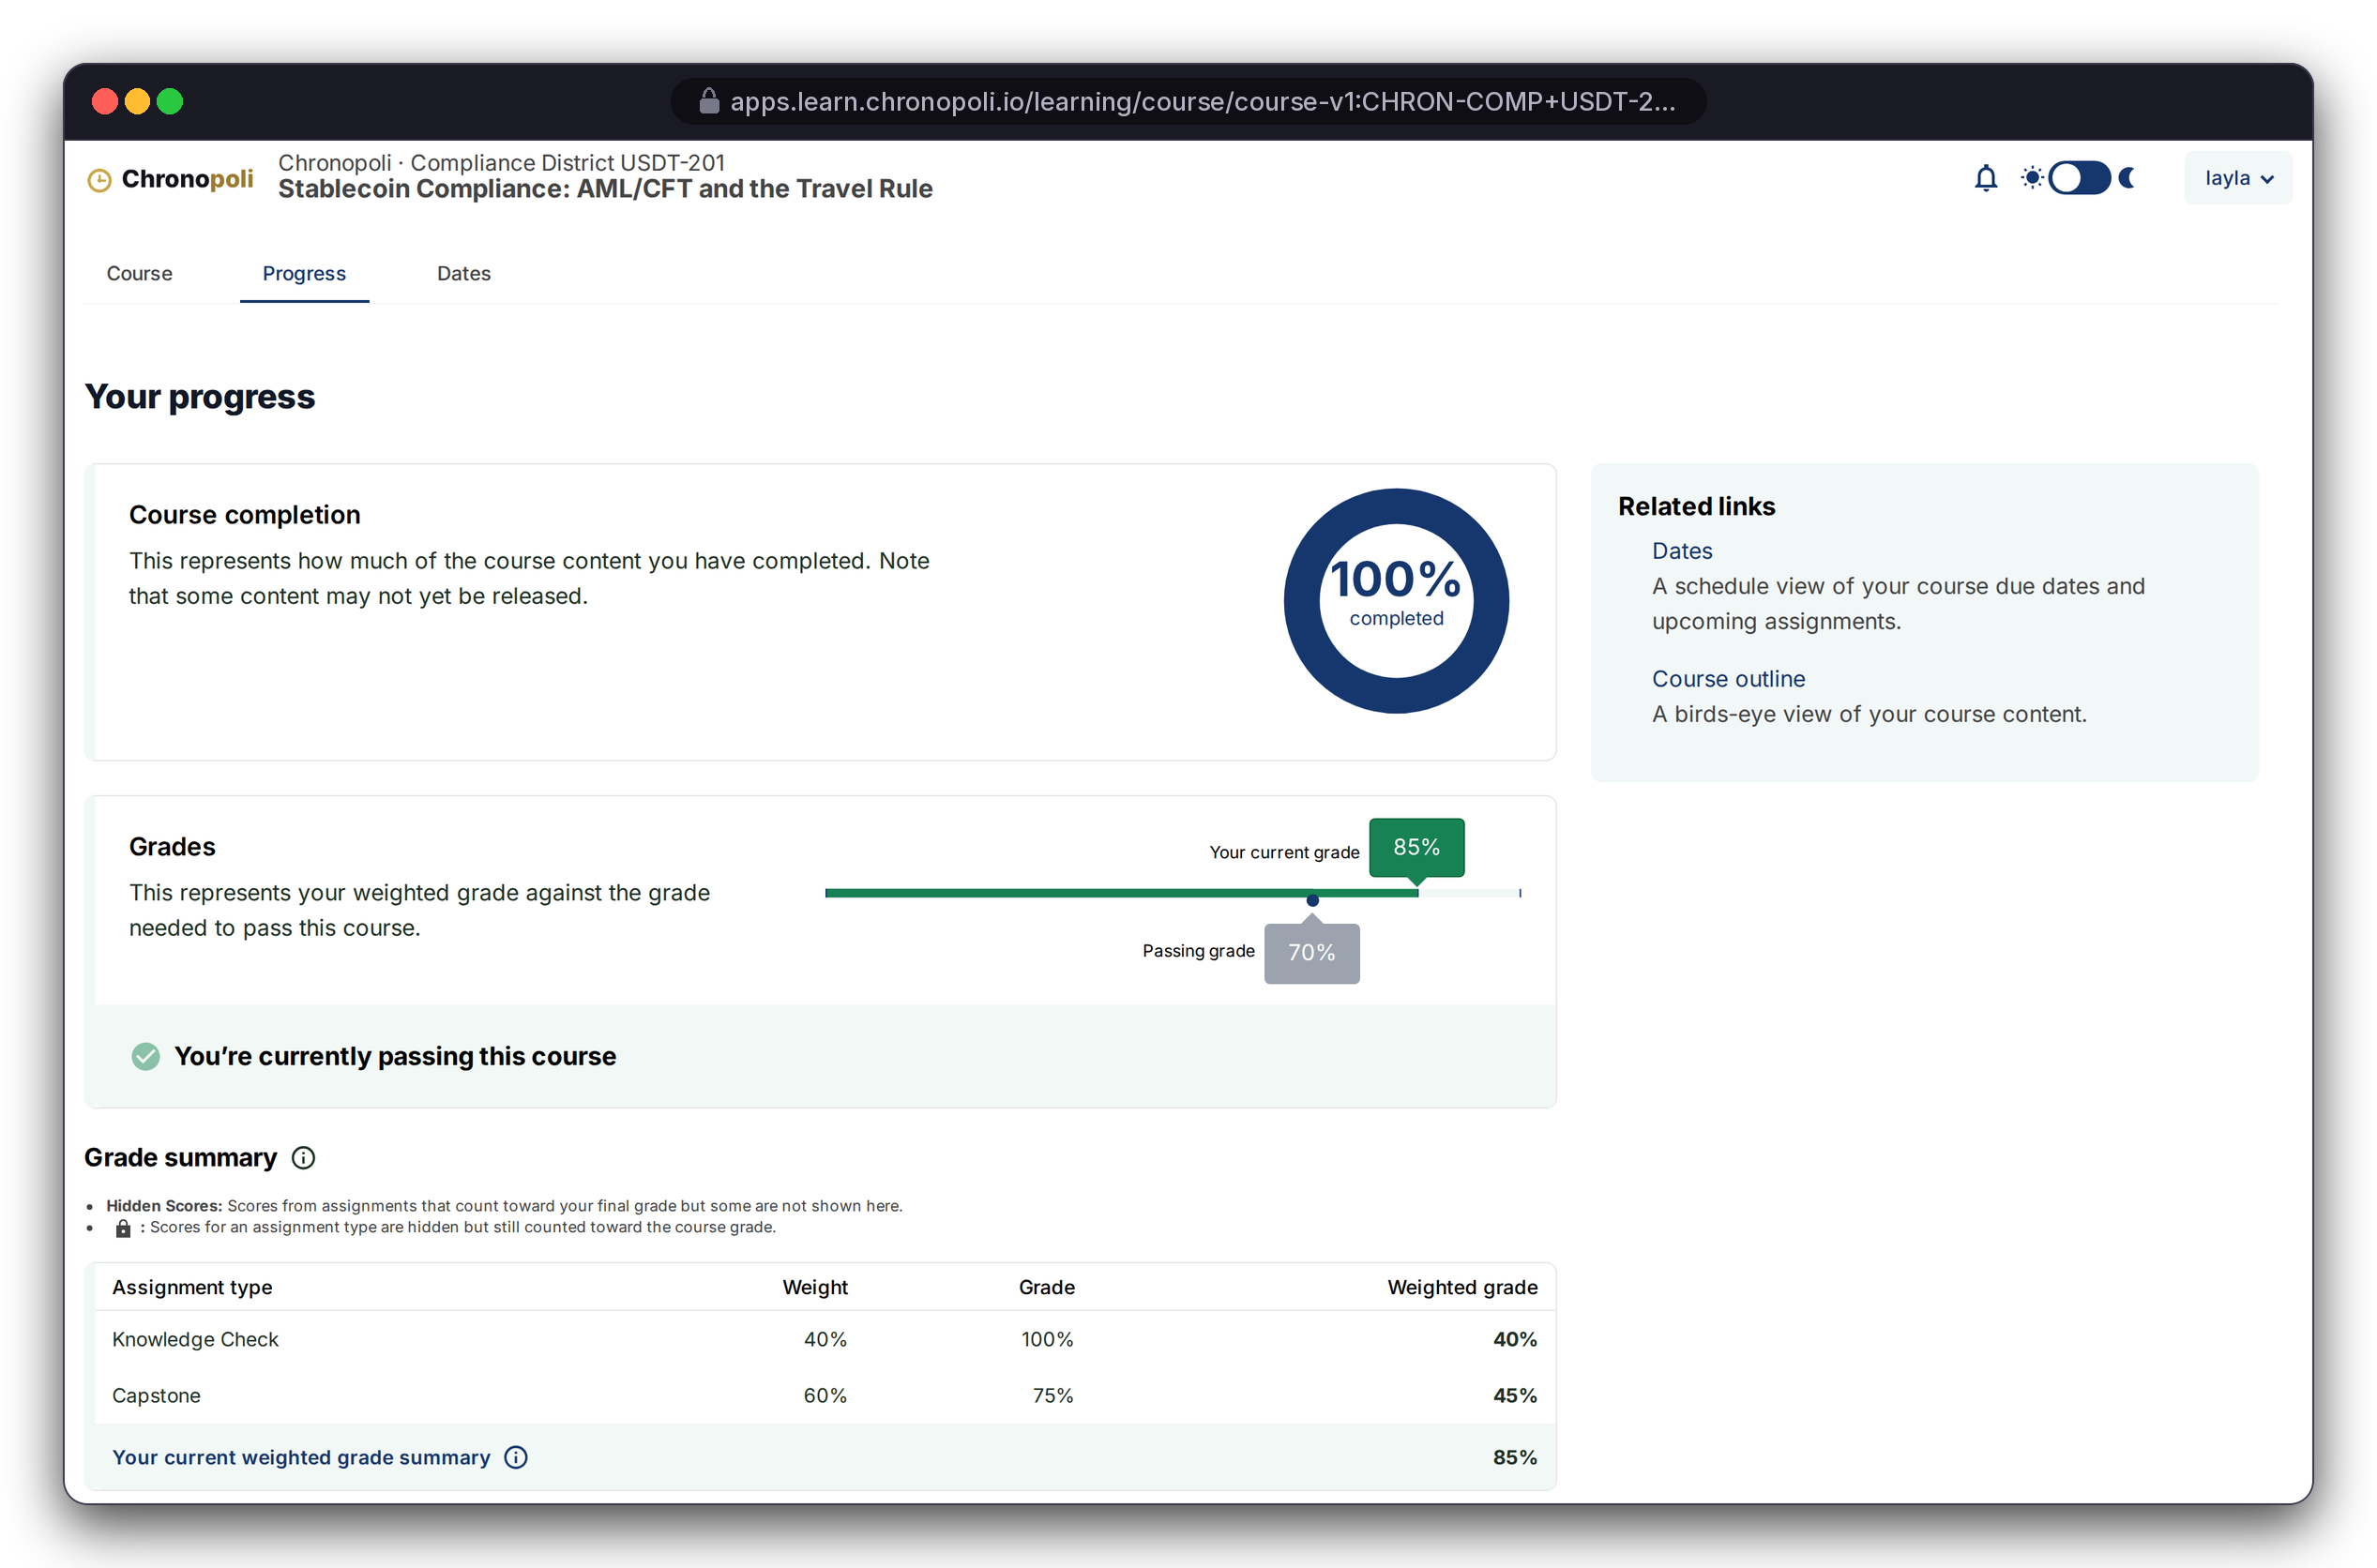
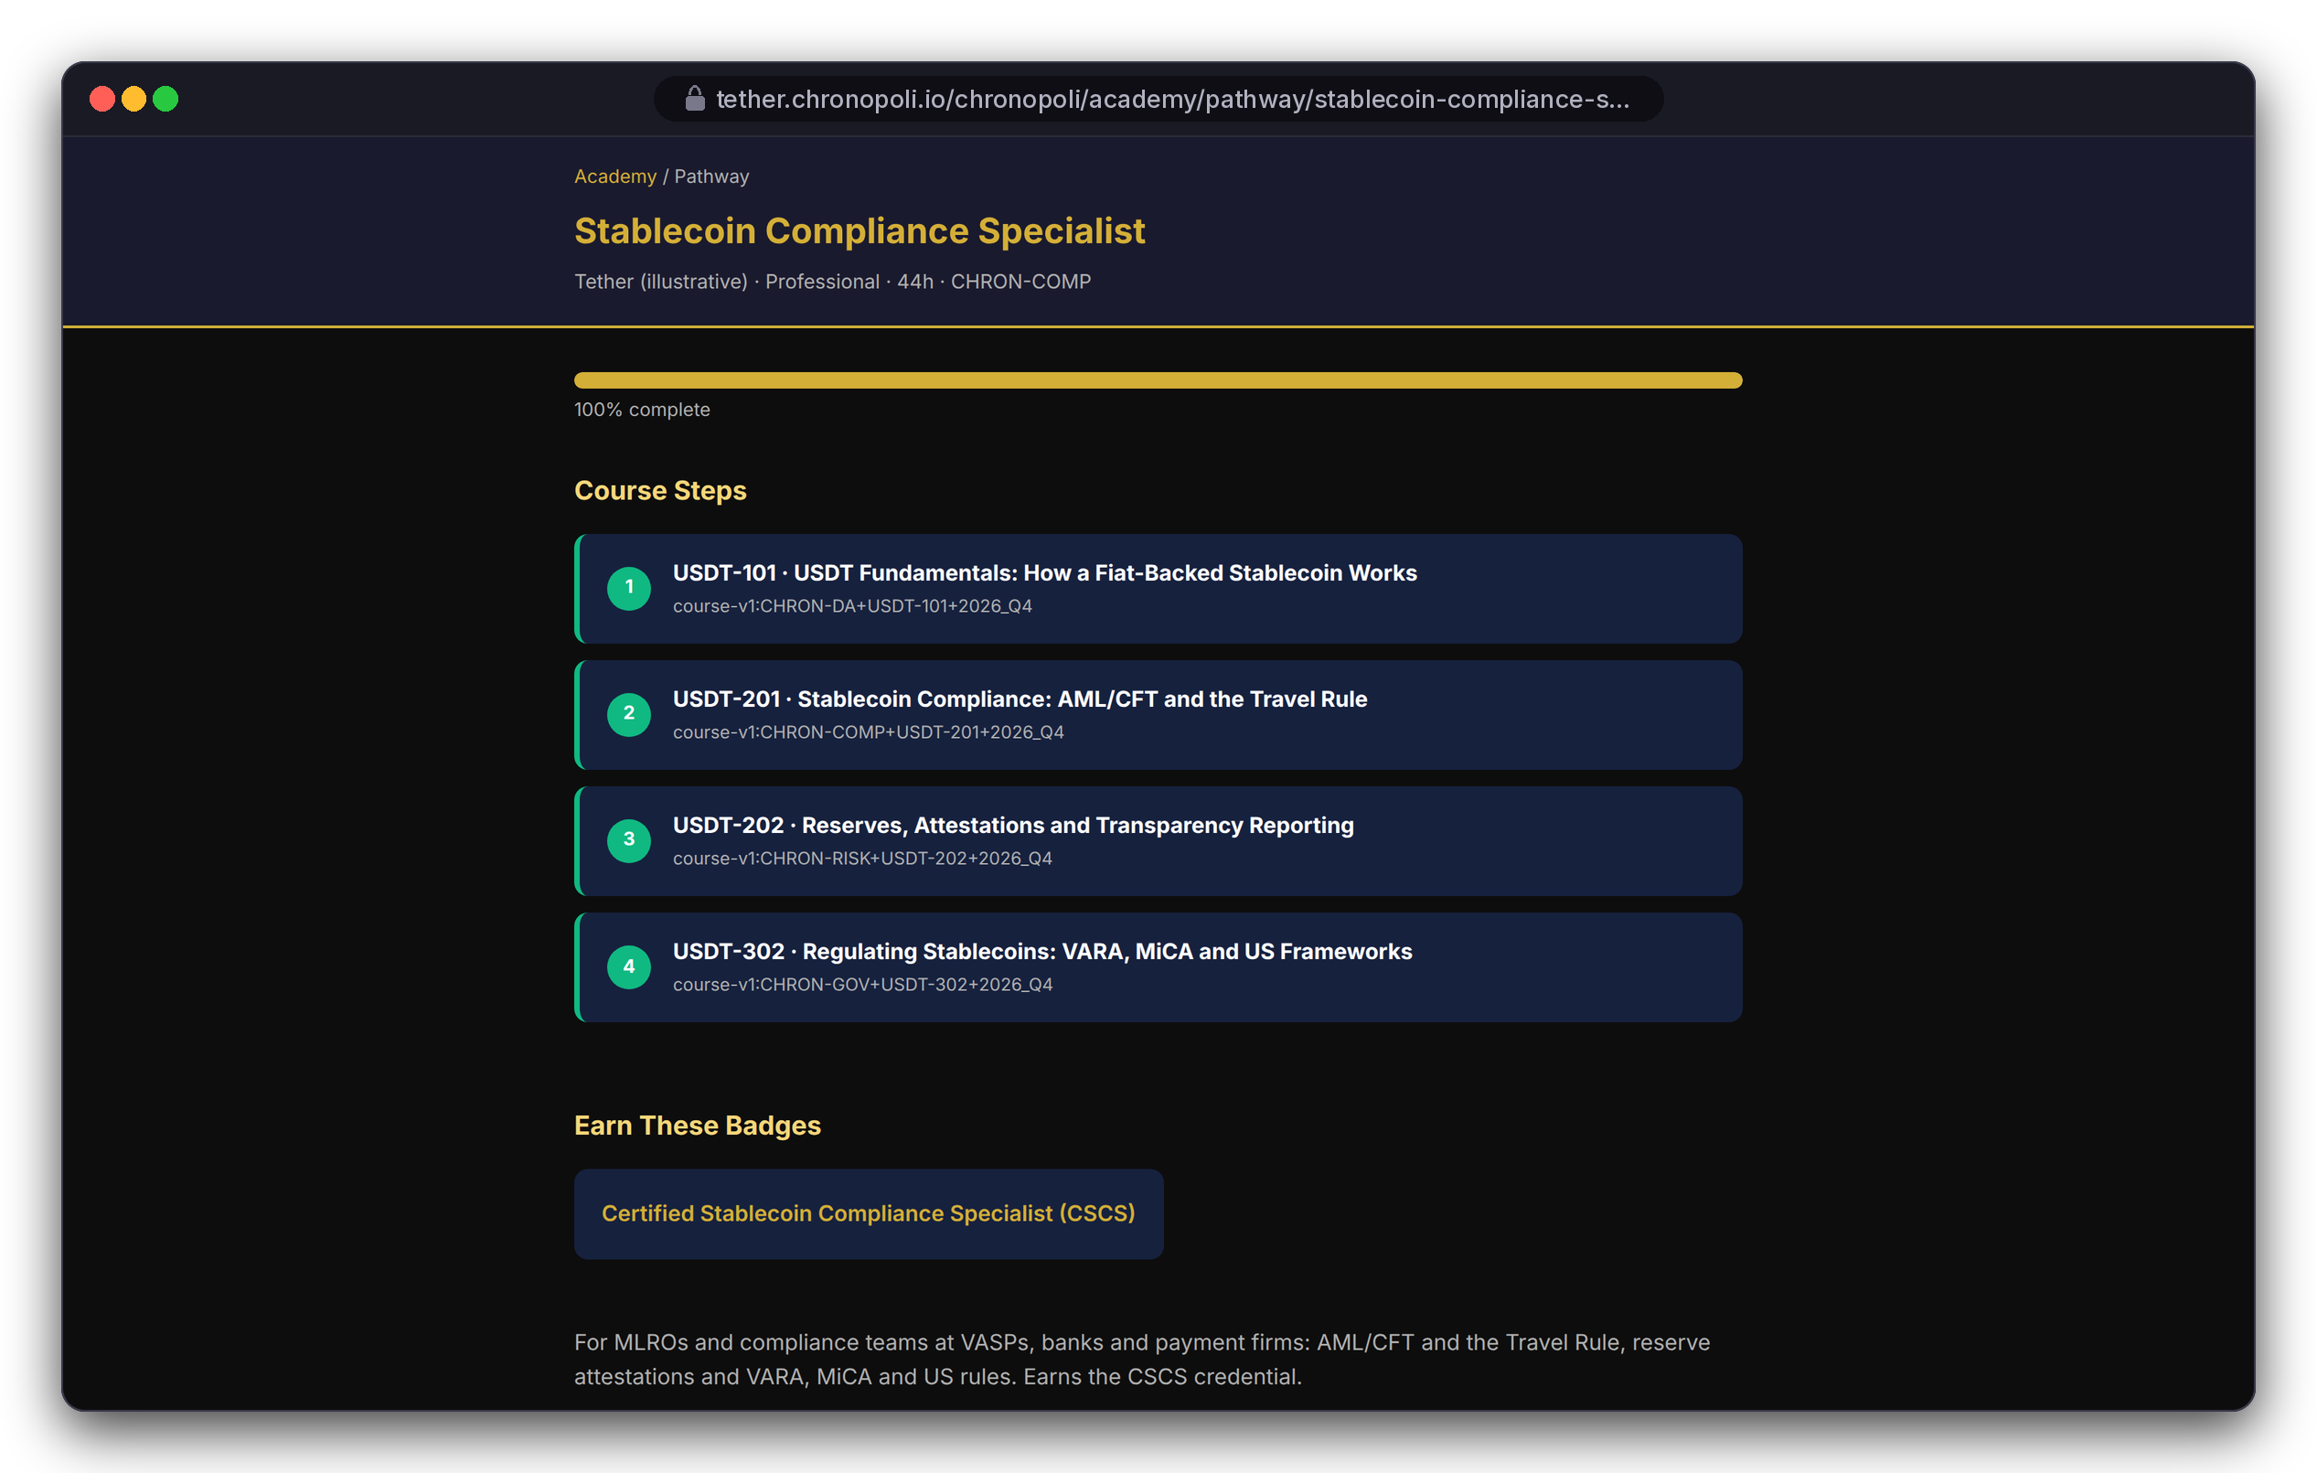
PRODUCT TOUR · STEP 7 OF 9 · PASS & PATHWAY
Persona: Layla
Pass, then watch the pathway fill up
Open edX grades each course; the academy reads those grades to track the whole pathway
REAL OPEN EDX SCREEN
Progress page
REAL CHRONOPOLI TEMPLATE RENDER
Pathway page (grades API stubbed)
USDT-201 complete: 85% against a 70% pass mark (checks 40% + capstone 60%)
Pathway: four required courses in four districts, all passed
One source of truth: the pathway reads Open edX grades; no parallel grade book
Illustrative mock data · Tether is a partner-roadmap target only; no agreement implied
11
Notes:
Layla answered one capstone question wrong on purpose, so the 85% is a grade Open edX computed from her submitted answers. The pathway spans Digital Assets, Compliance, Risk & Trust and Governance. That's the city idea: one credential built from several districts. In the harness the grades call is a stub; in production it reads the Open edX grades API.

Slide 12

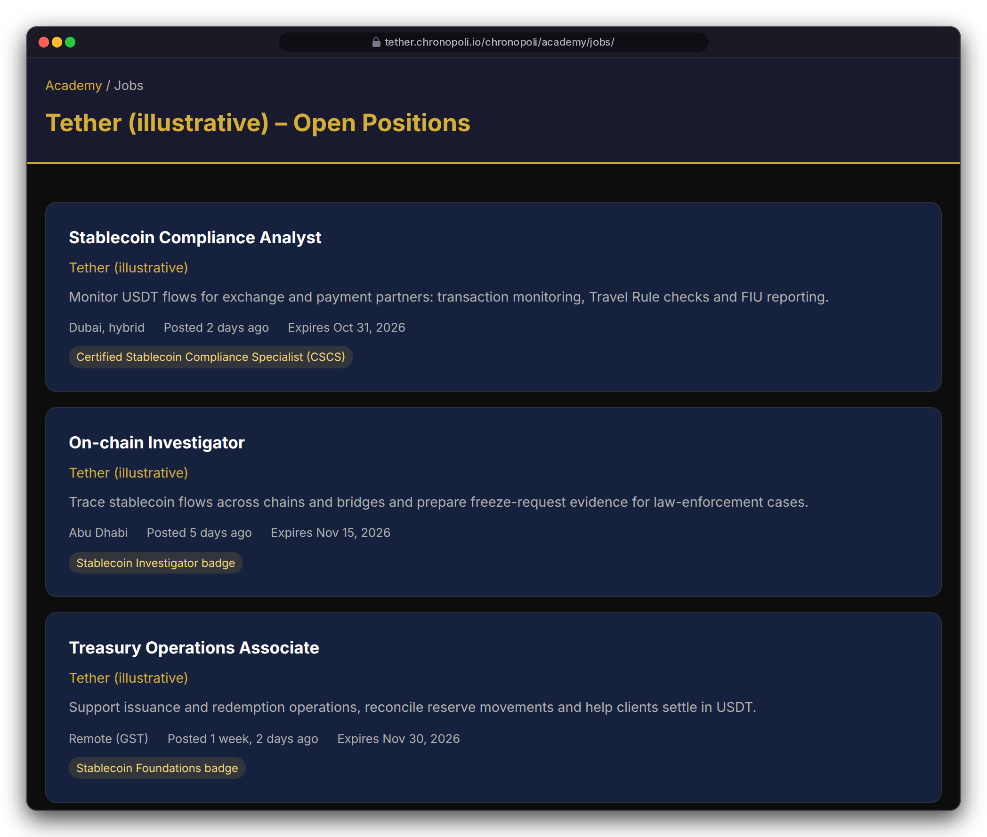
PRODUCT TOUR · STEP 8 OF 9 · BADGE TO JOB
Persona: Layla
From credential to career
Finishing a pathway issues a verifiable Open Badge, and partners can require that badge for open roles
CSCS badge: Open Badges 2.0, readable by badge wallets and HR systems
Roles can require a badge: the Stablecoin Compliance Analyst role (Dubai, hybrid) asks for CSCS
Consent first: learners opt in before partners see their badges (a go-live requirement)
REAL CHRONOPOLI TEMPLATE RENDER
REAL CHRONOPOLI TEMPLATE RENDER
CSCS badge earned by Layla on 18 Sep 2026
Partner job board · Tether (illustrative) roles are fictitious
Illustrative mock data · Tether is a partner-roadmap target only; no agreement implied
12
Notes:
The pitch to partners: you don't just educate the market, you hire from it. The badge was awarded with the repo's own award function. Two fixes are needed before this is automatic and compliant: the auto-badge trigger on certificate creation (R-22), and explicit opt-in before learners are auto-applied to jobs (R-37, UAE data-protection risk, sprint 2).

Slide 13
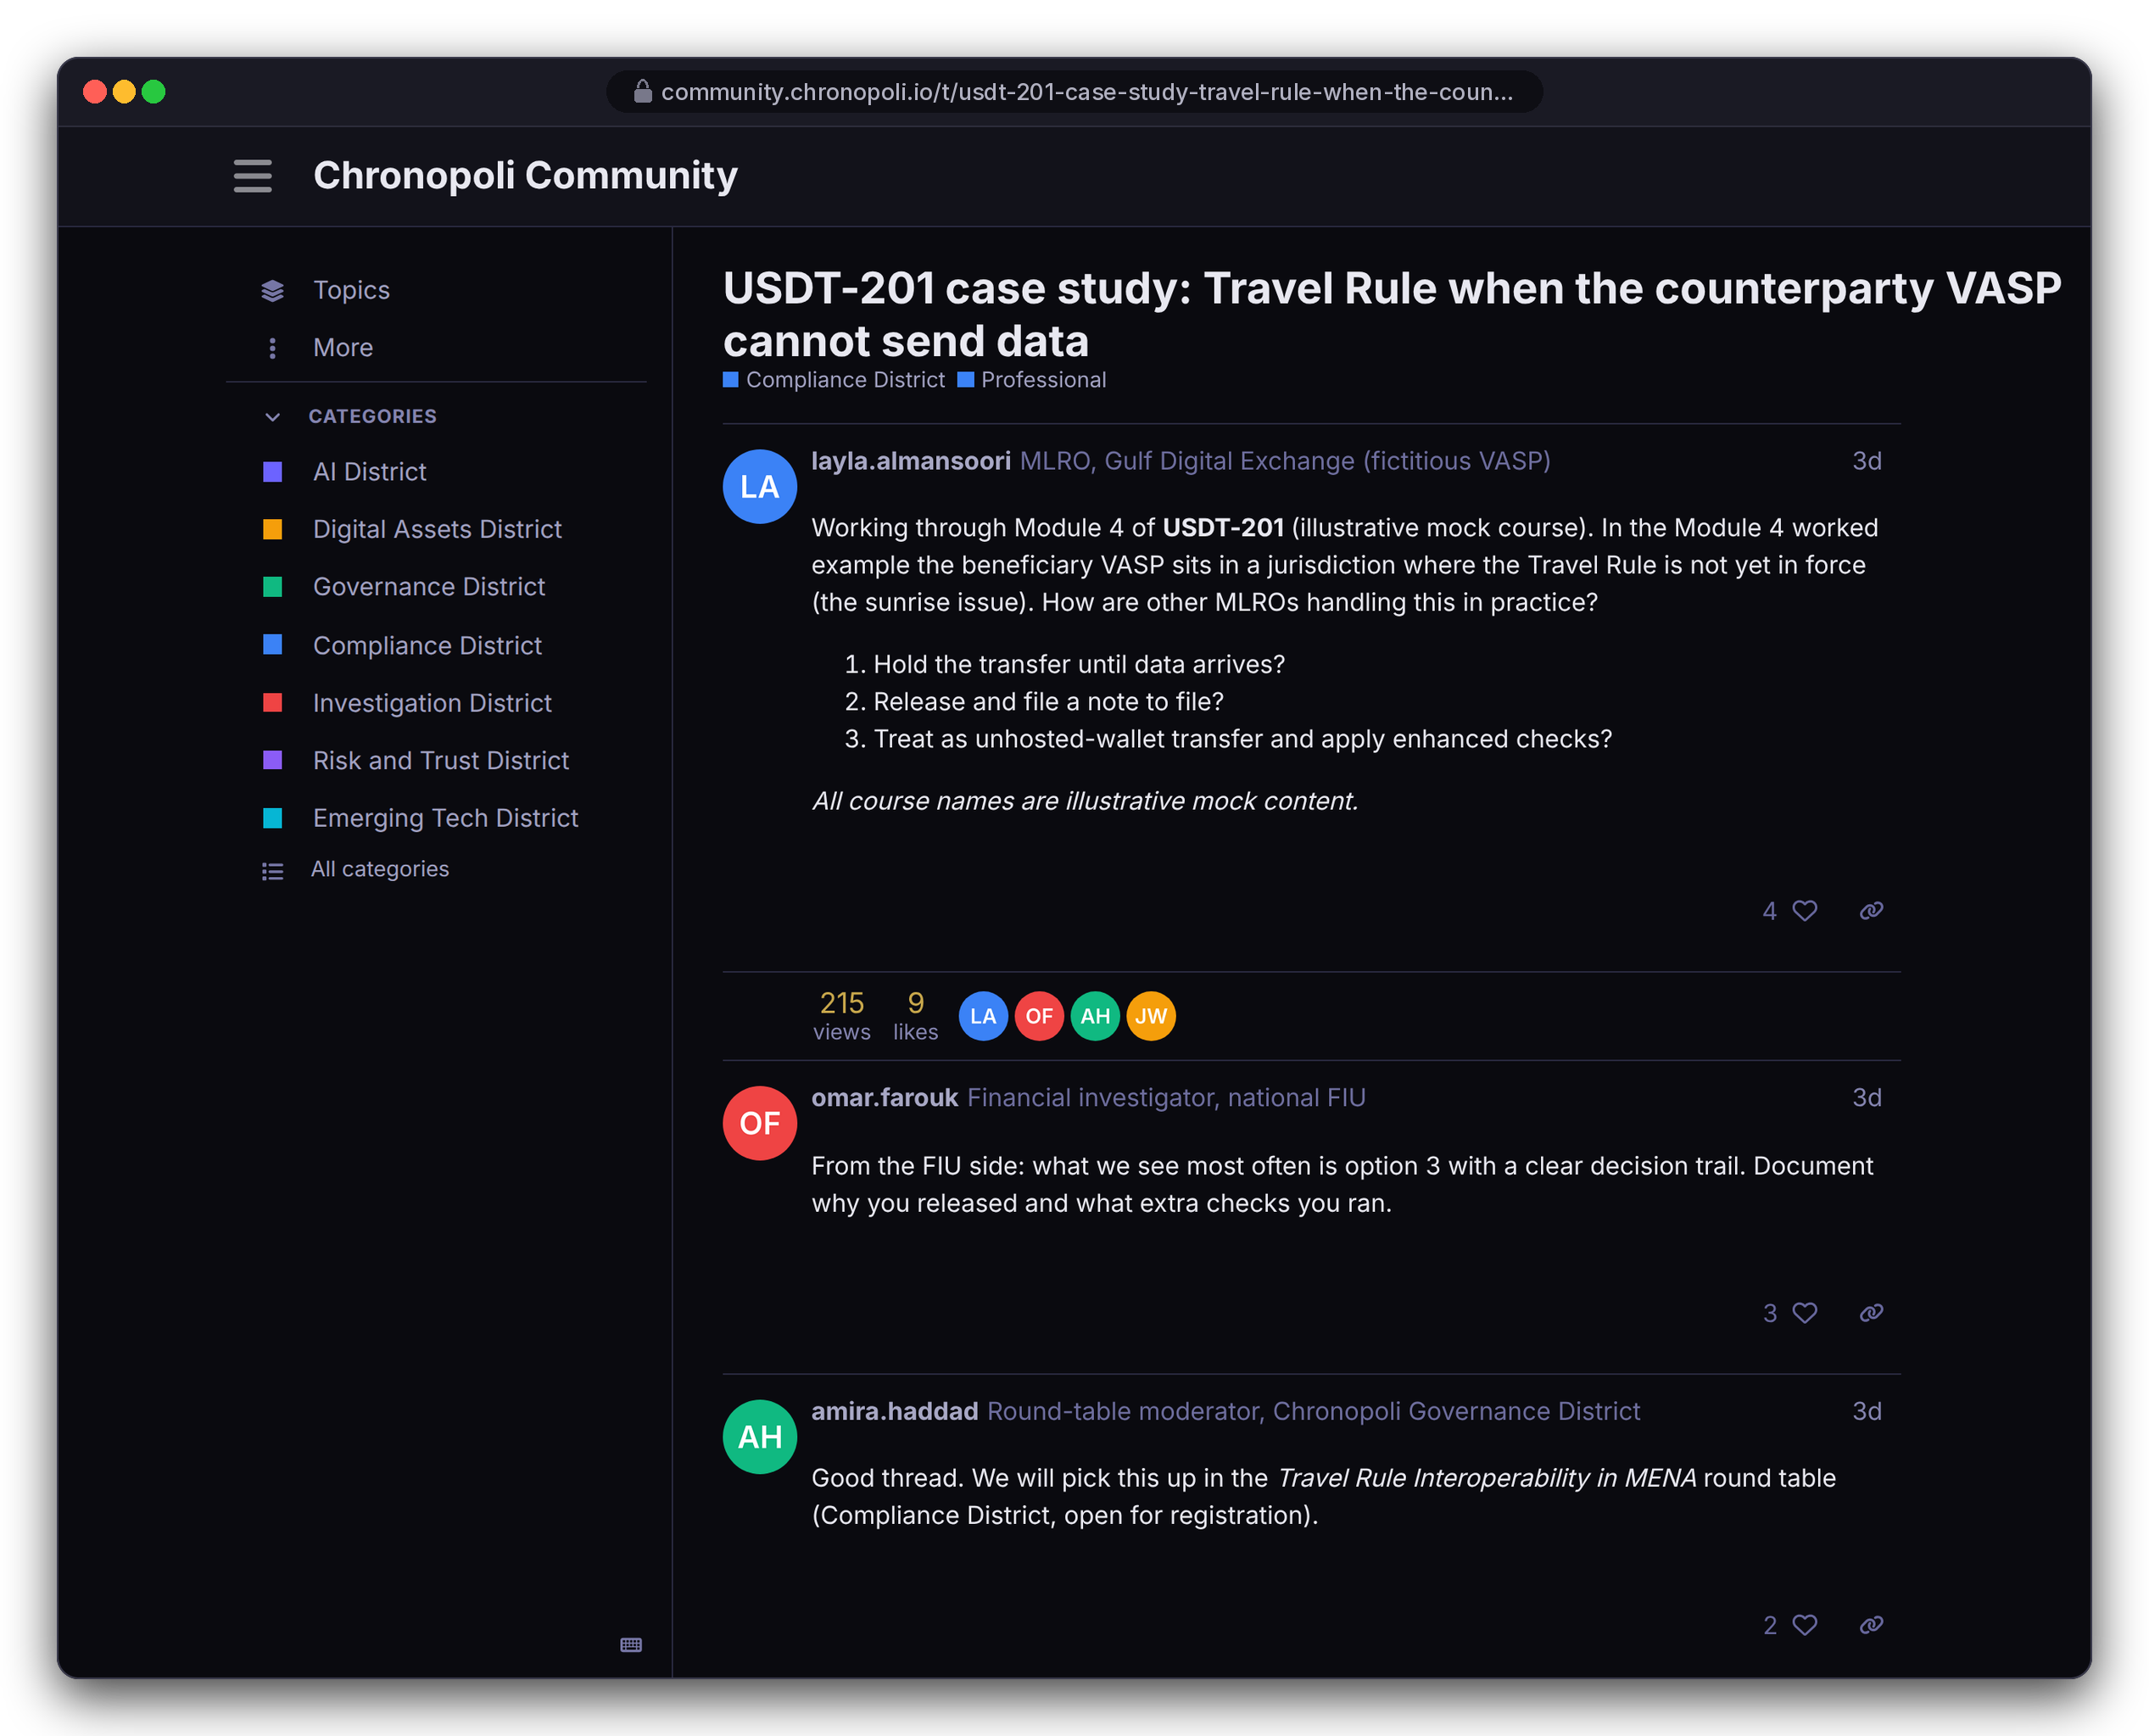
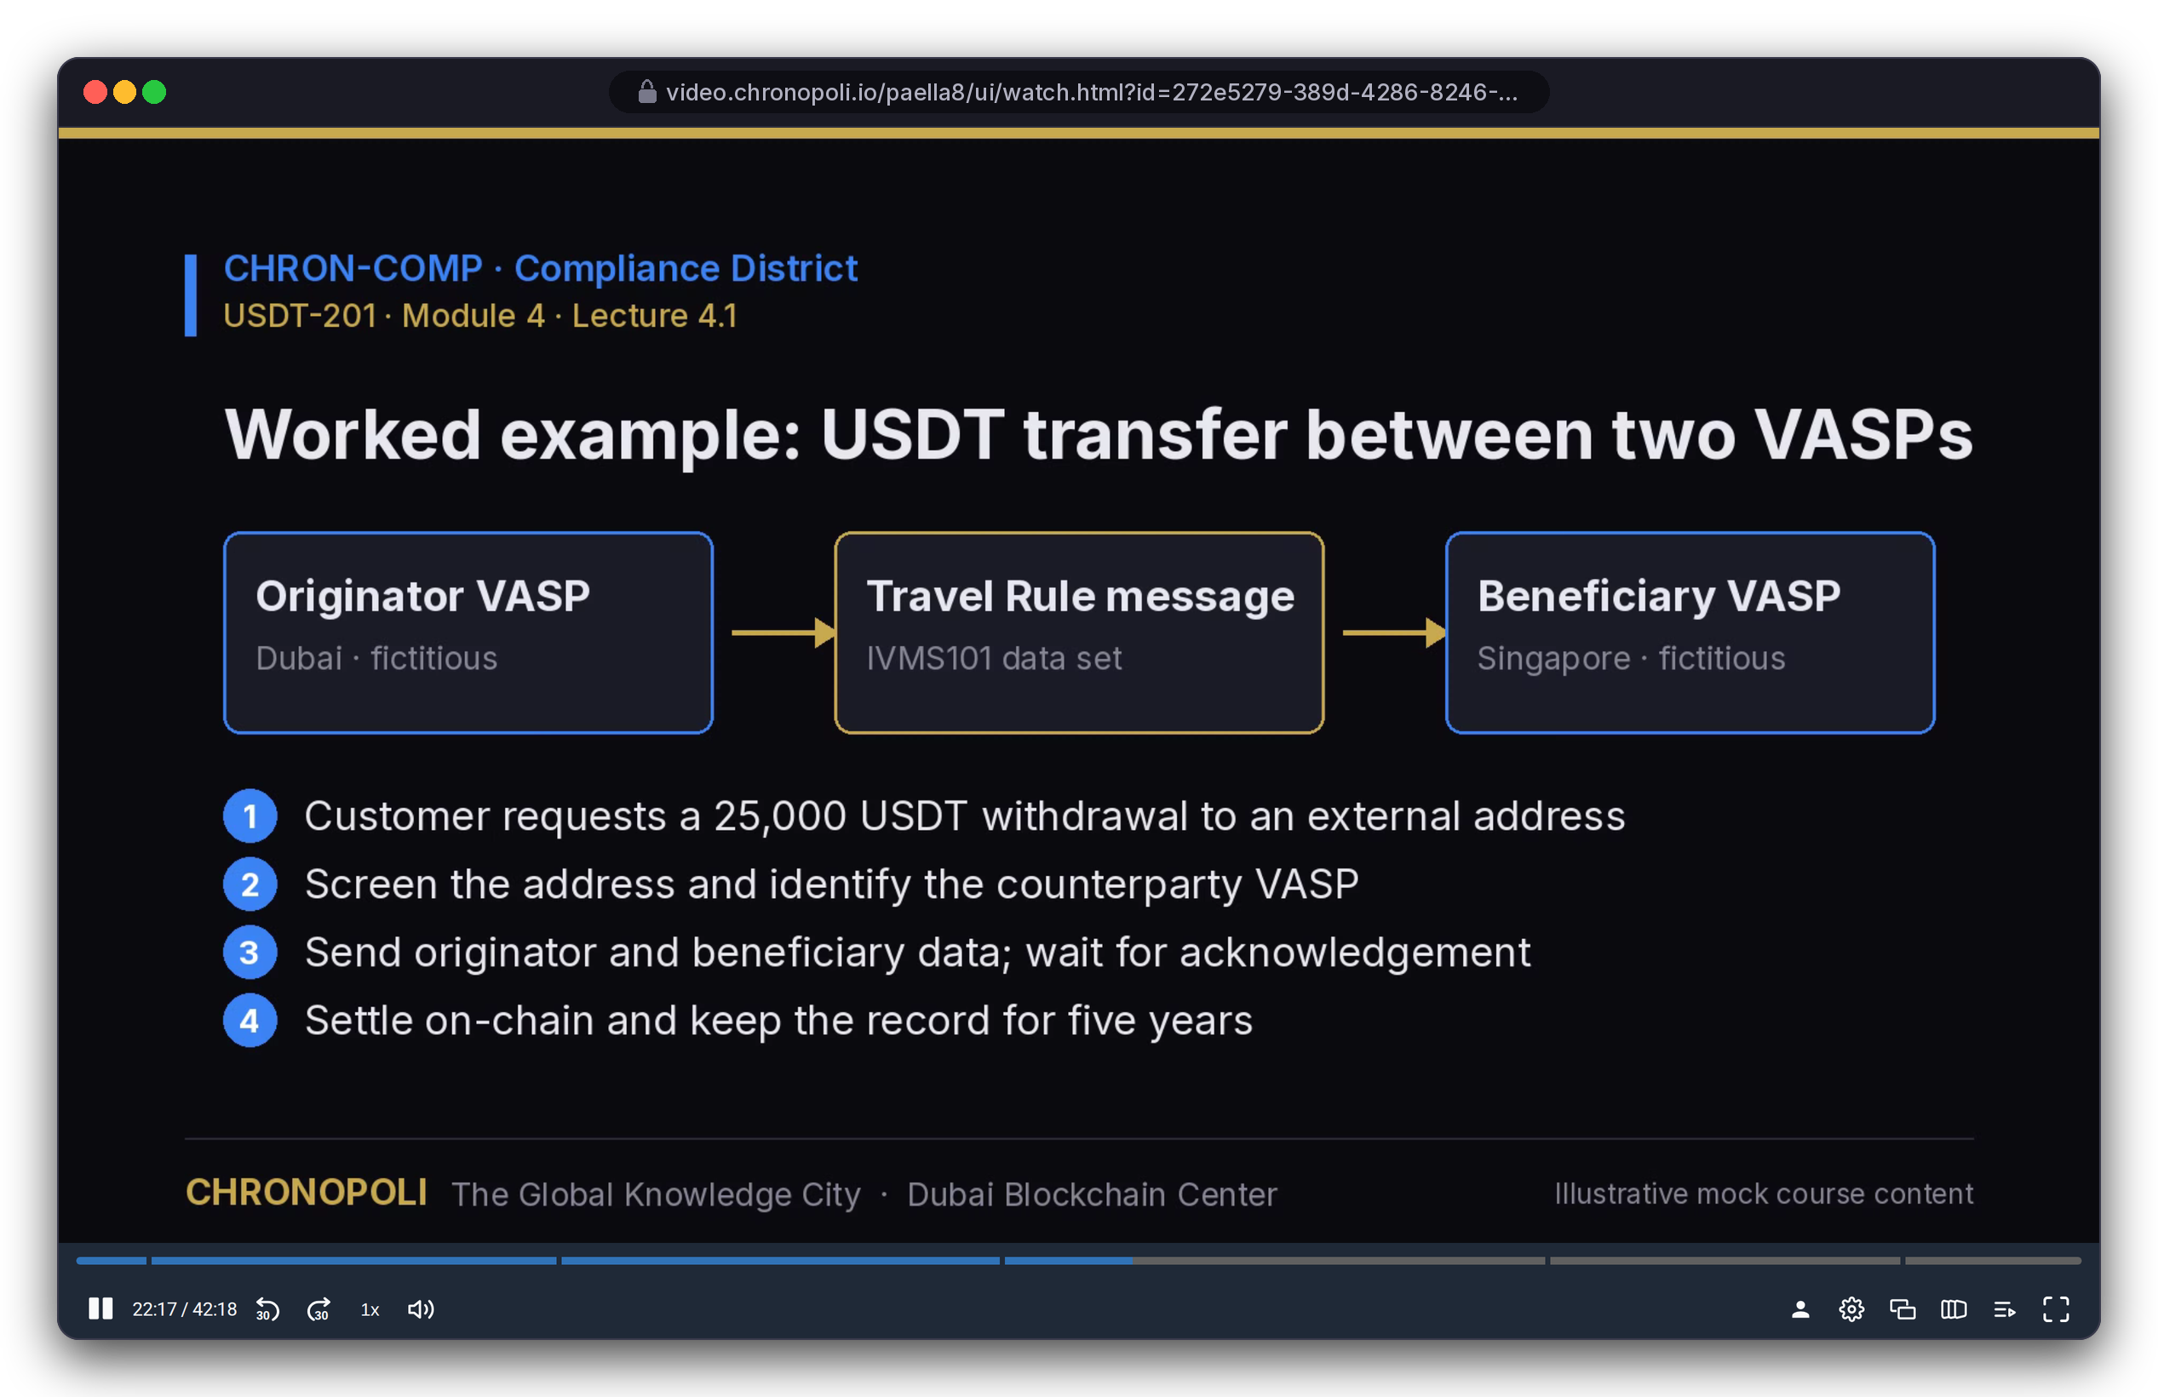
PRODUCT TOUR · STEP 9 OF 9 · COMMUNITY & VIDEO
Persona: Layla during USDT-201 · Illustrative mock content
Community and video, in district colours
District forums on Discourse and lecture video on Opencast: both real, both running in our stack
REAL EXTENSION
Discourse 3.5 · Travel Rule thread
REAL EXTENSION
Opencast 20.4 · Paella player, lecture 4.1
Community: a forum per district, joined via SSO; an MLRO asks, an FIU investigator answers
Video: Opencast records lectures, Paella adds a slide index; Presenton decks are not shown
Illustrative mock data · Tether is a partner-roadmap target only; no agreement implied
13
Notes:
Both systems ran for real in Docker for these captures, with seeded content. The thread and the lecture are about the same Module 4 worked example, so course, video and community connect. Presenton couldn't be captured because its image download was blocked in the capture environment, so we don't show a screen for it. Keeping the SSO secret in sync between Tutor and Discourse is still open (R-28).

Slide 14





PART 2
The partner side: why organisations pay
Author, run, measure and earn from an academy, plus round tables and expert masterclasses that no catalogue offers
Authoring in Studio
Slide 15
NEW PERSONAS (FICTITIOUS)
Partner dashboard and weekly reports
Slide 16
NK
Nadia Karim
Academy administrator (fictitious)
Round tables and the AI content pipeline
Slides 17-18
Digital-twin masterclasses
Slide 19
AH
Dr. Amira Haddad
Round-table moderator (fictitious)
Business model, licences and payouts
Slides 20-23
Illustrative mock data · Tether is a partner-roadmap target only; no agreement implied
14
Notes:
We switch personas here: Nadia Karim runs the partner academy, and Dr. Amira Haddad moderates round tables. Both are fictitious. From now on, the question is what a partner gets for its money.

Slide 15
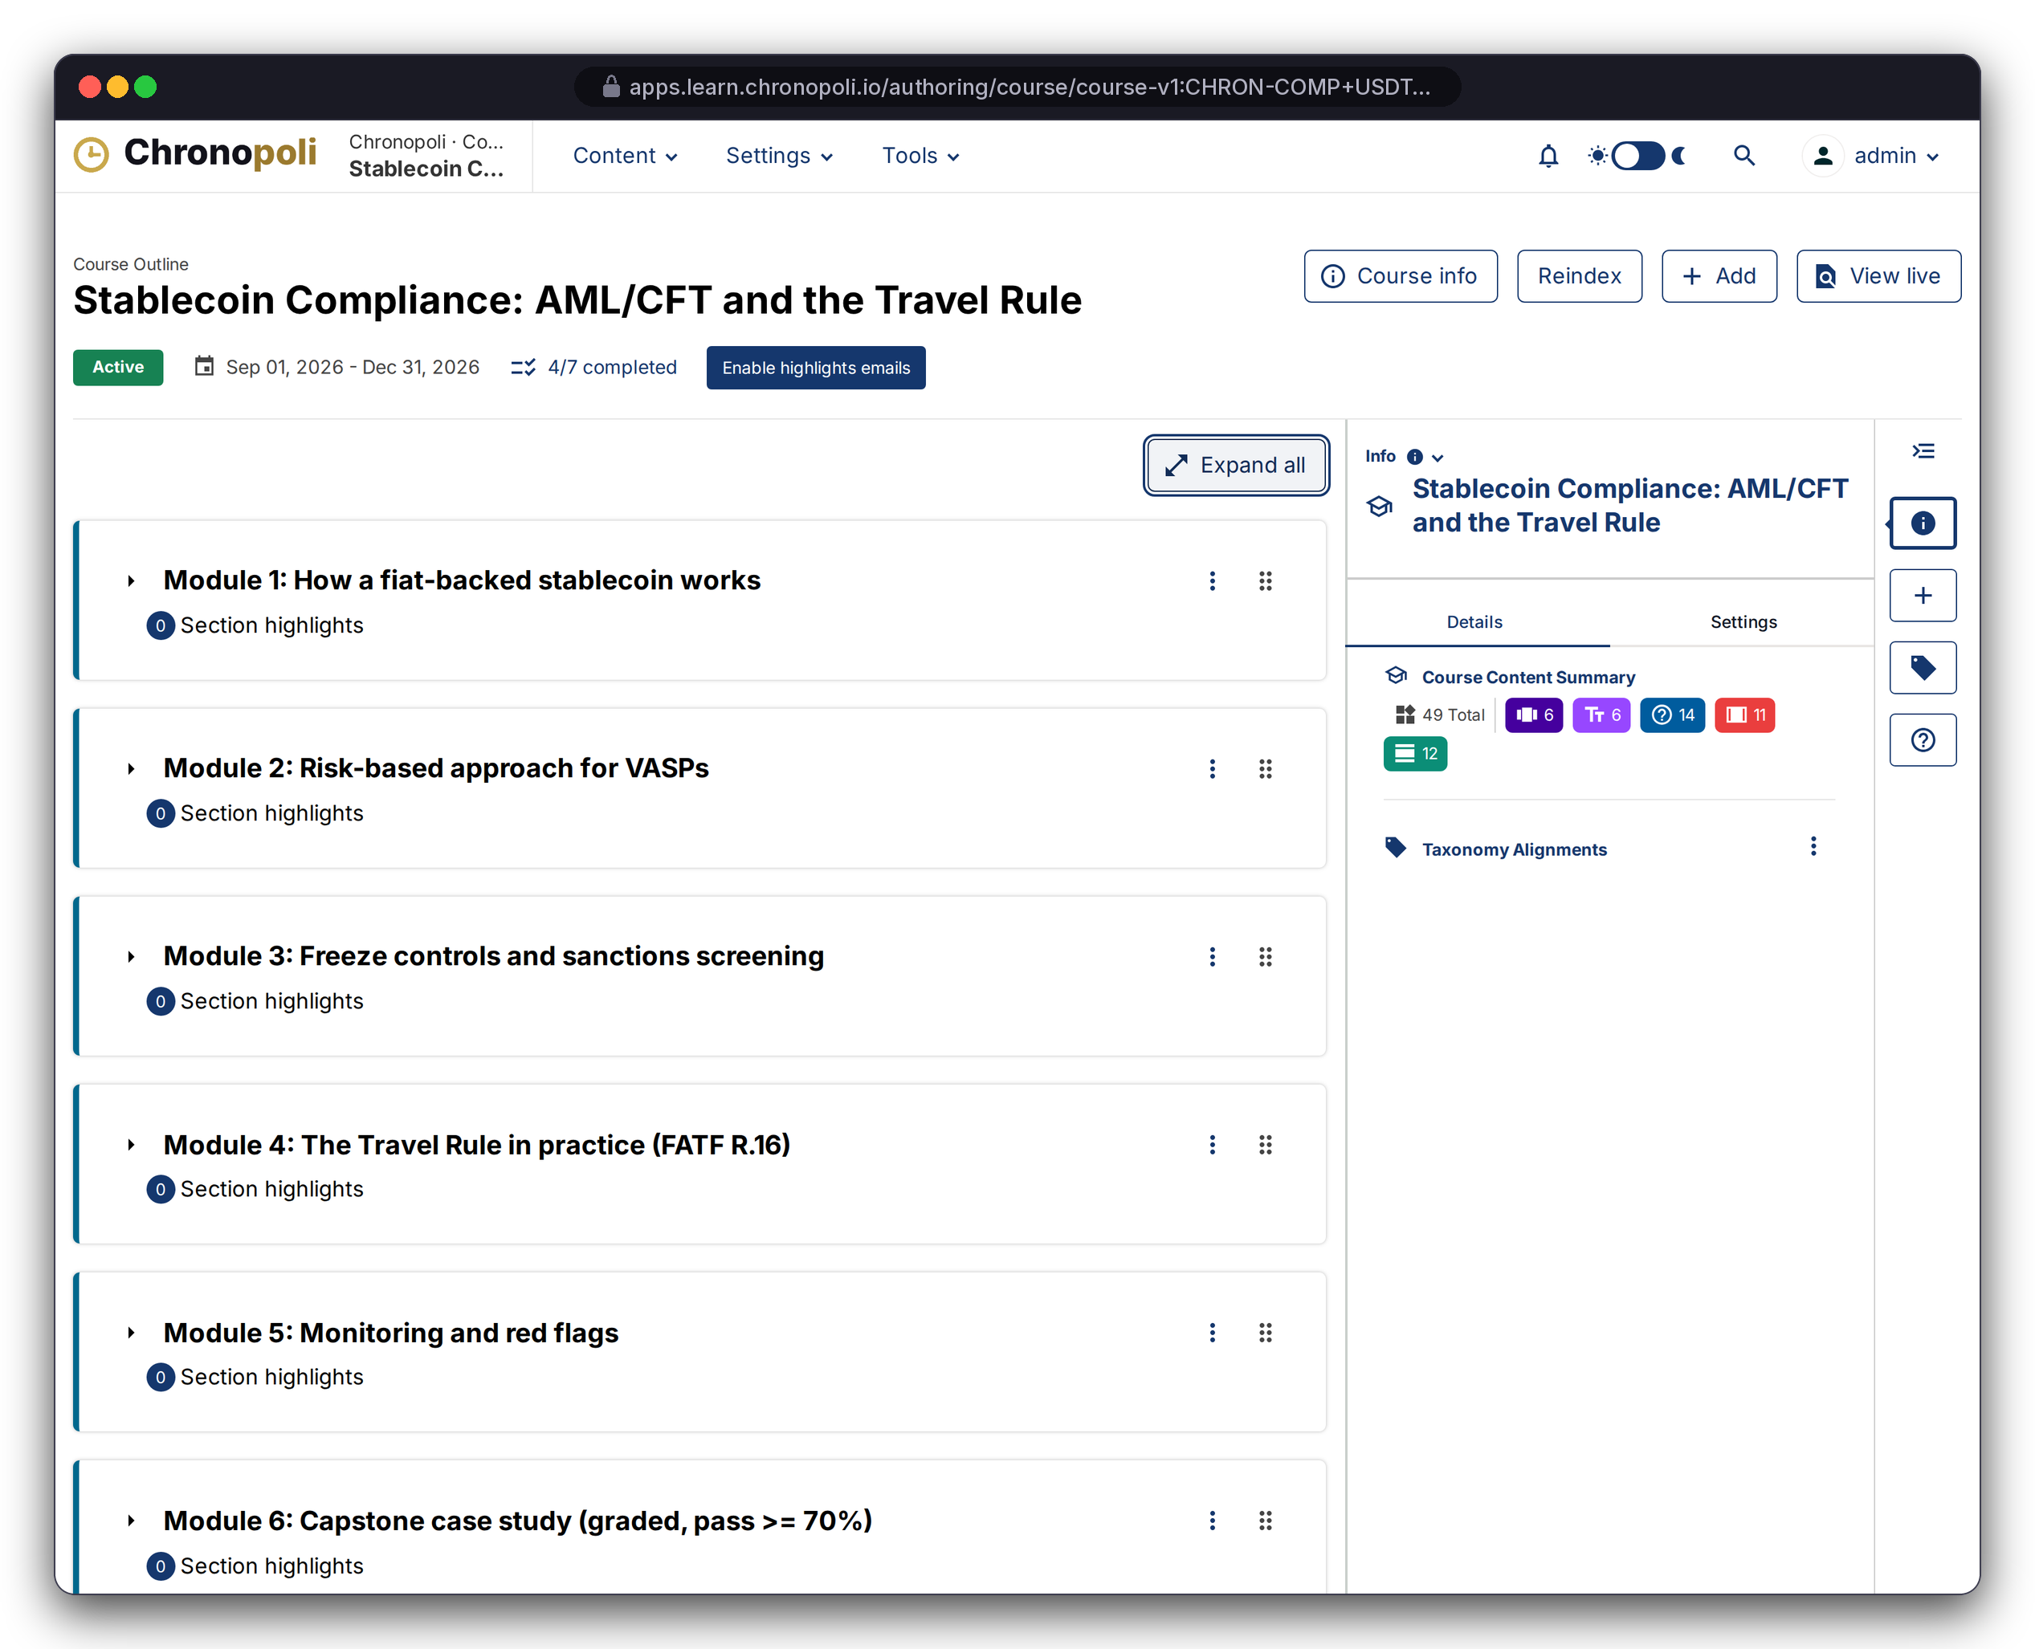
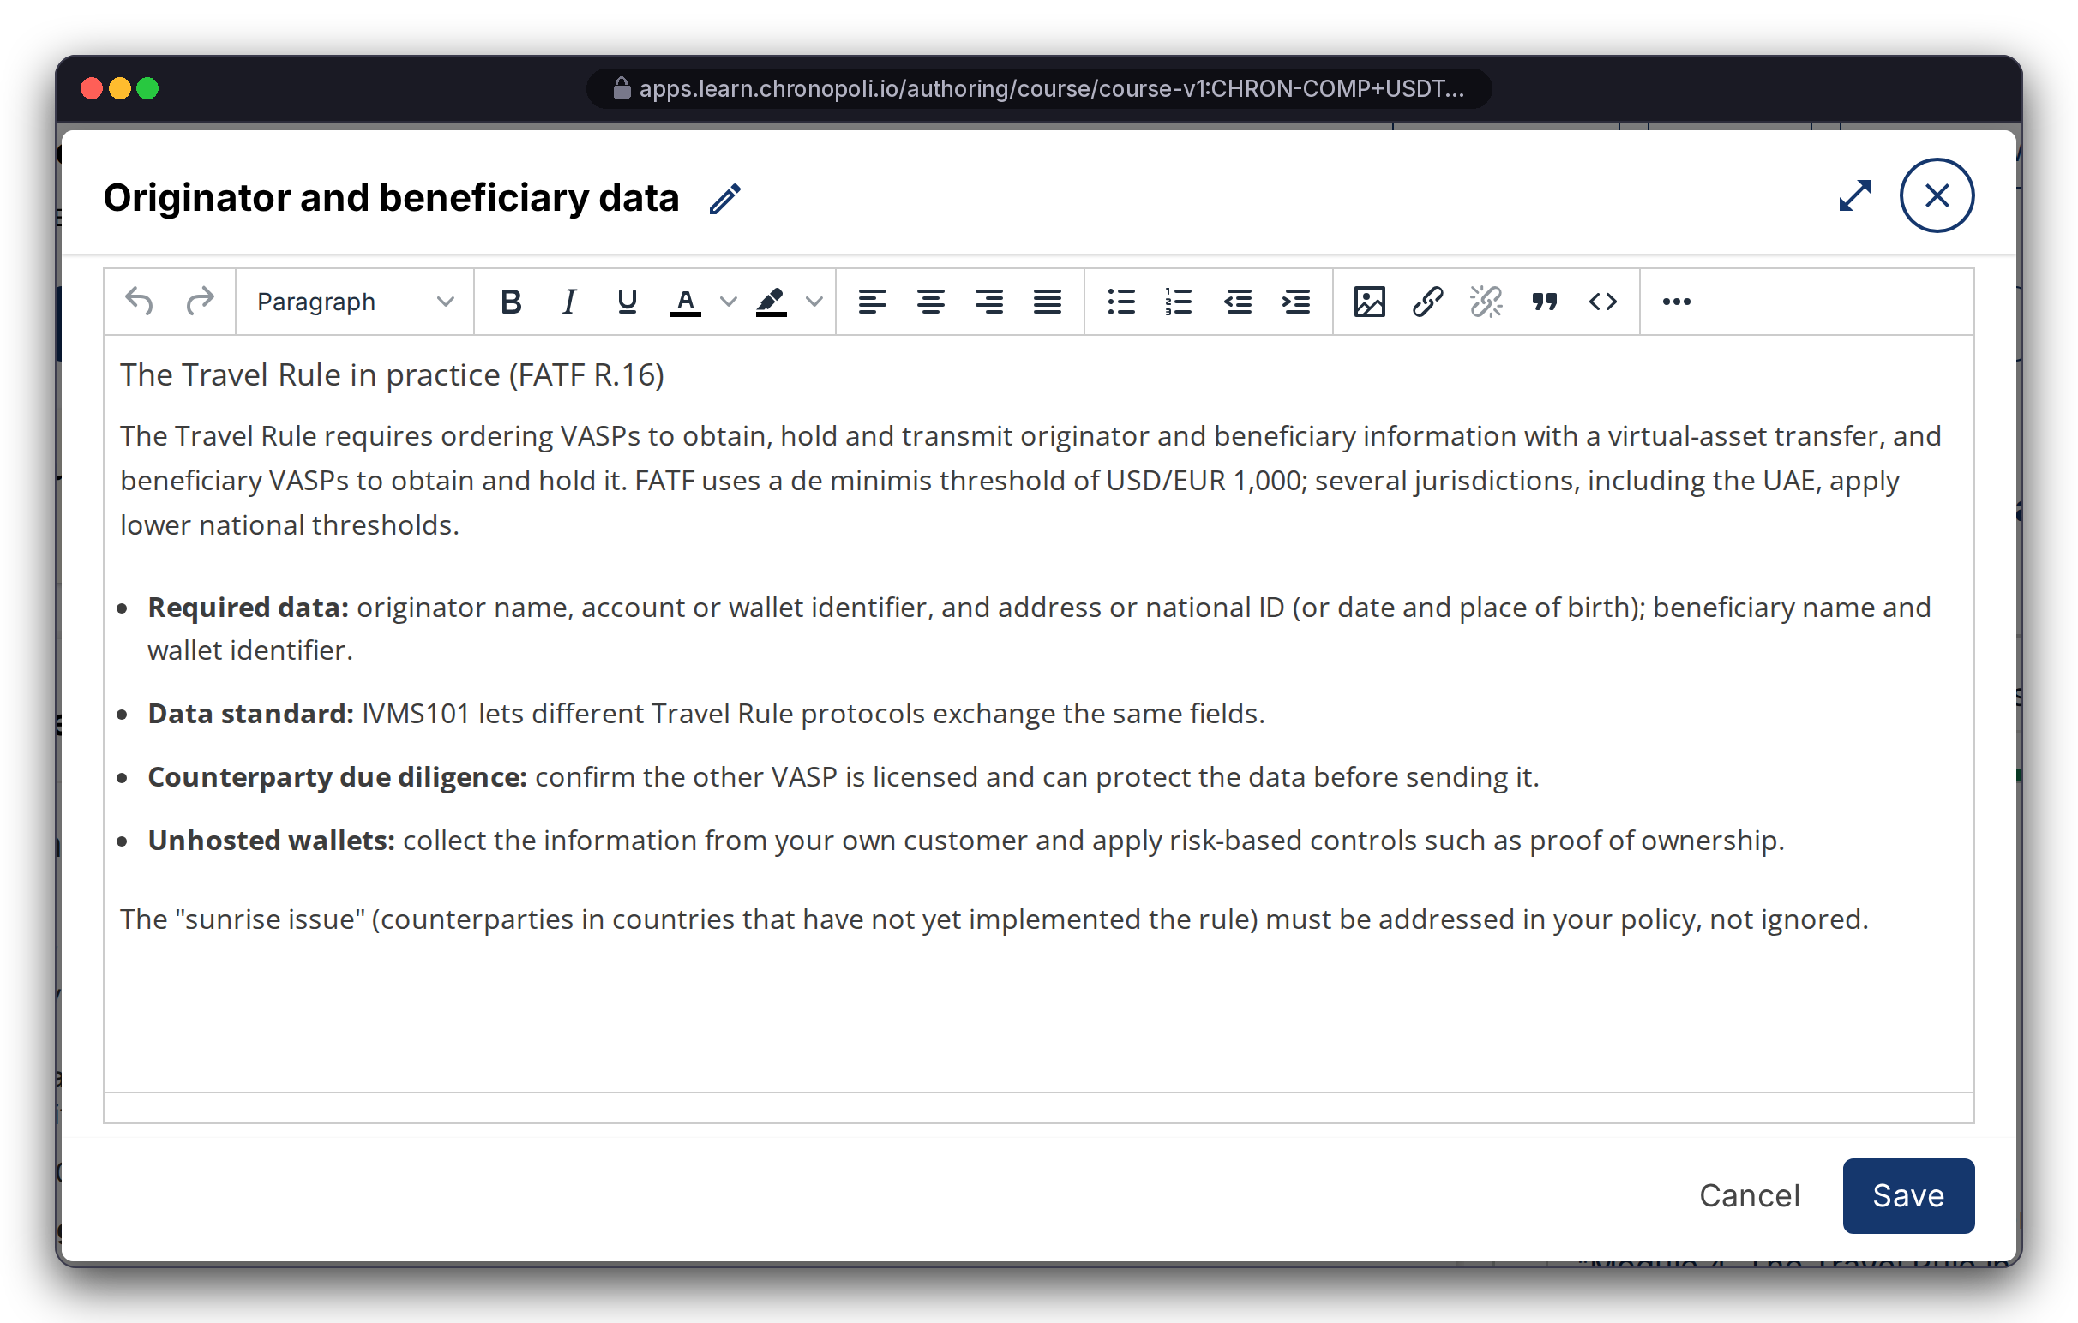
PARTNER SIDE · AUTHOR
Persona: course team (admin account)
Partners author on Open edX Studio: nothing to rebuild
Course outline, rich-text editing, scheduling and grading policies come straight from upstream Open edX
REAL OPEN EDX SCREEN
USDT-201 outline, 6 modules
REAL OPEN EDX SCREEN
Rich-text editor, lesson 4.1
District orgs: courses are built under e.g. CHRON-COMP, then linked to an academy
Straight from Studio: outline, editor, dates and grading
No fork: every upgrade improves authoring at no cost
Illustrative mock data · Tether is a partner-roadmap target only; no agreement implied
15
Notes:
Partners already know this kind of tool, and Open edX runs it at global scale. All eight demo courses were built and imported through this toolchain, so onboarding a partner's content means importing a course, not starting a software project. Pathways, badges and job postings are then set up in the academy admin.

Slide 16
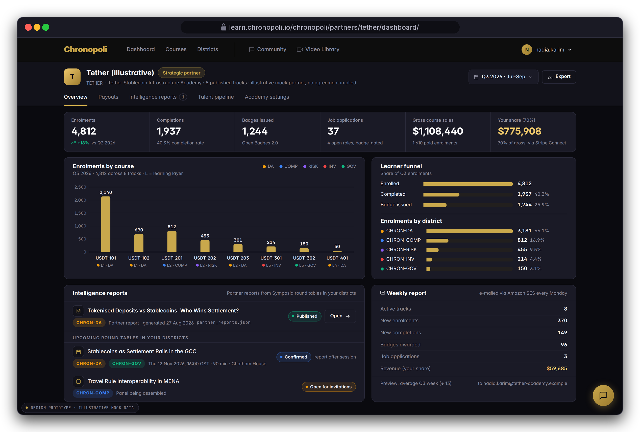
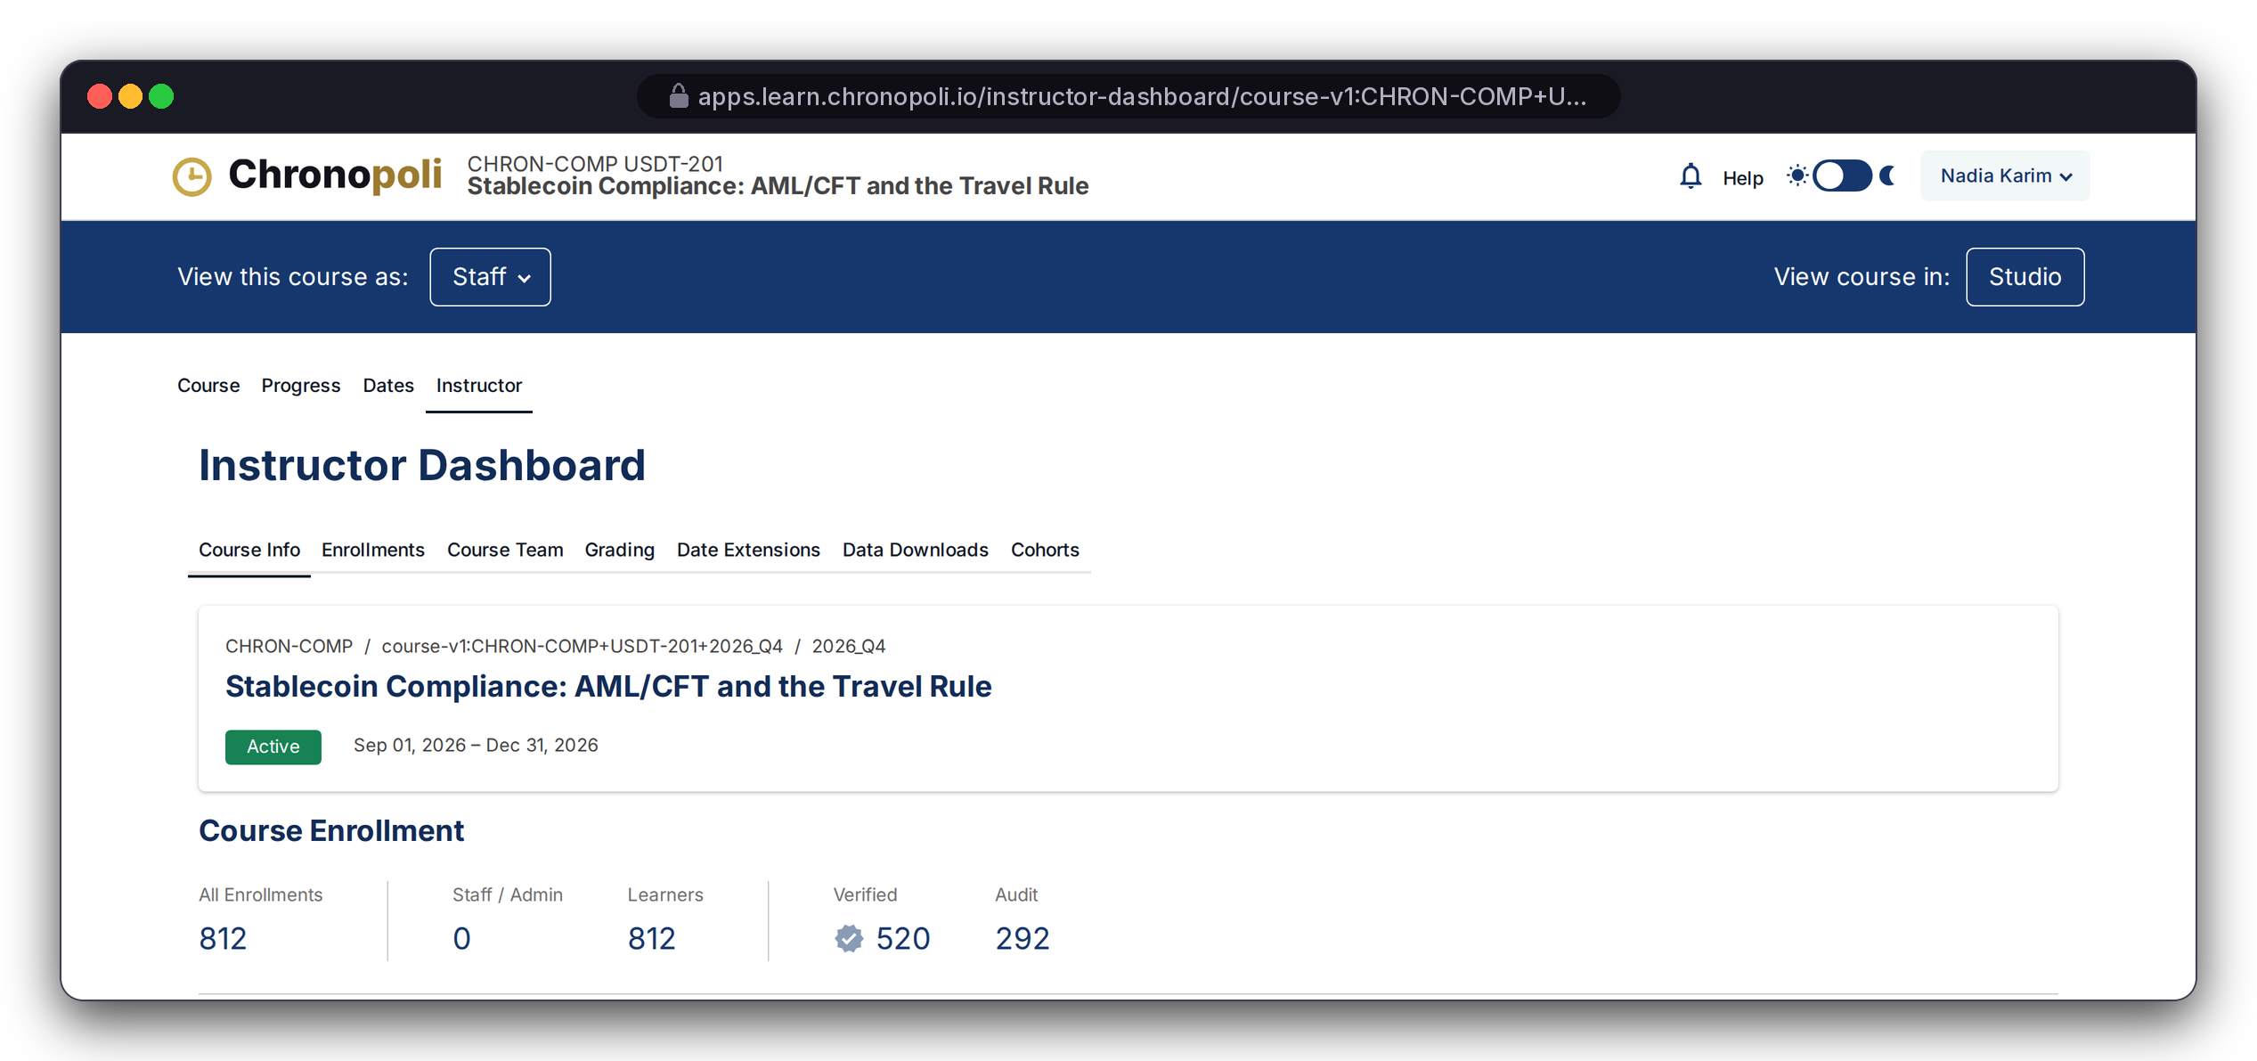
PARTNER SIDE · MEASURE
Persona: Nadia Karim, academy admin (fictitious)
A live cockpit for every partner
Enrolments, completions, badges, revenue and intelligence reports, plus a weekly e-mail summary
REAL OPEN EDX SCREEN
Instructor dashboard
KPIs: tiles, enrolments by course and district, a learner funnel
Intelligence reports: from round tables in the partner's districts
Weekly summary: via Amazon SES, plus a JSON API
From Open edX: USDT-201 shows 812 enrolled, 520 verified (paid)
DESIGN PROTOTYPE
Partner dashboard (template not yet built) · Illustrative Tether demo KPIs
Illustrative mock data · Tether is a partner-roadmap target only; no agreement implied
16
Notes:
The counts on the right come from 811 bulk-created demo accounts plus Layla, sized to match the scenario. If asked about the other 292: in the demo they are audit (unpaid) enrolments, and the scenario counts only verified enrolments as sales. The review added the weekly-report task (R-7, fixed), though Tutor still needs a scheduler process. Before go-live: a proper partner-user access model (R-26), reports scoped to each partner (R-25, partly fixed), the dashboard template itself (R-10), and the completion-rate calculation, which the analytics code doesn't fill in yet.

Slide 17
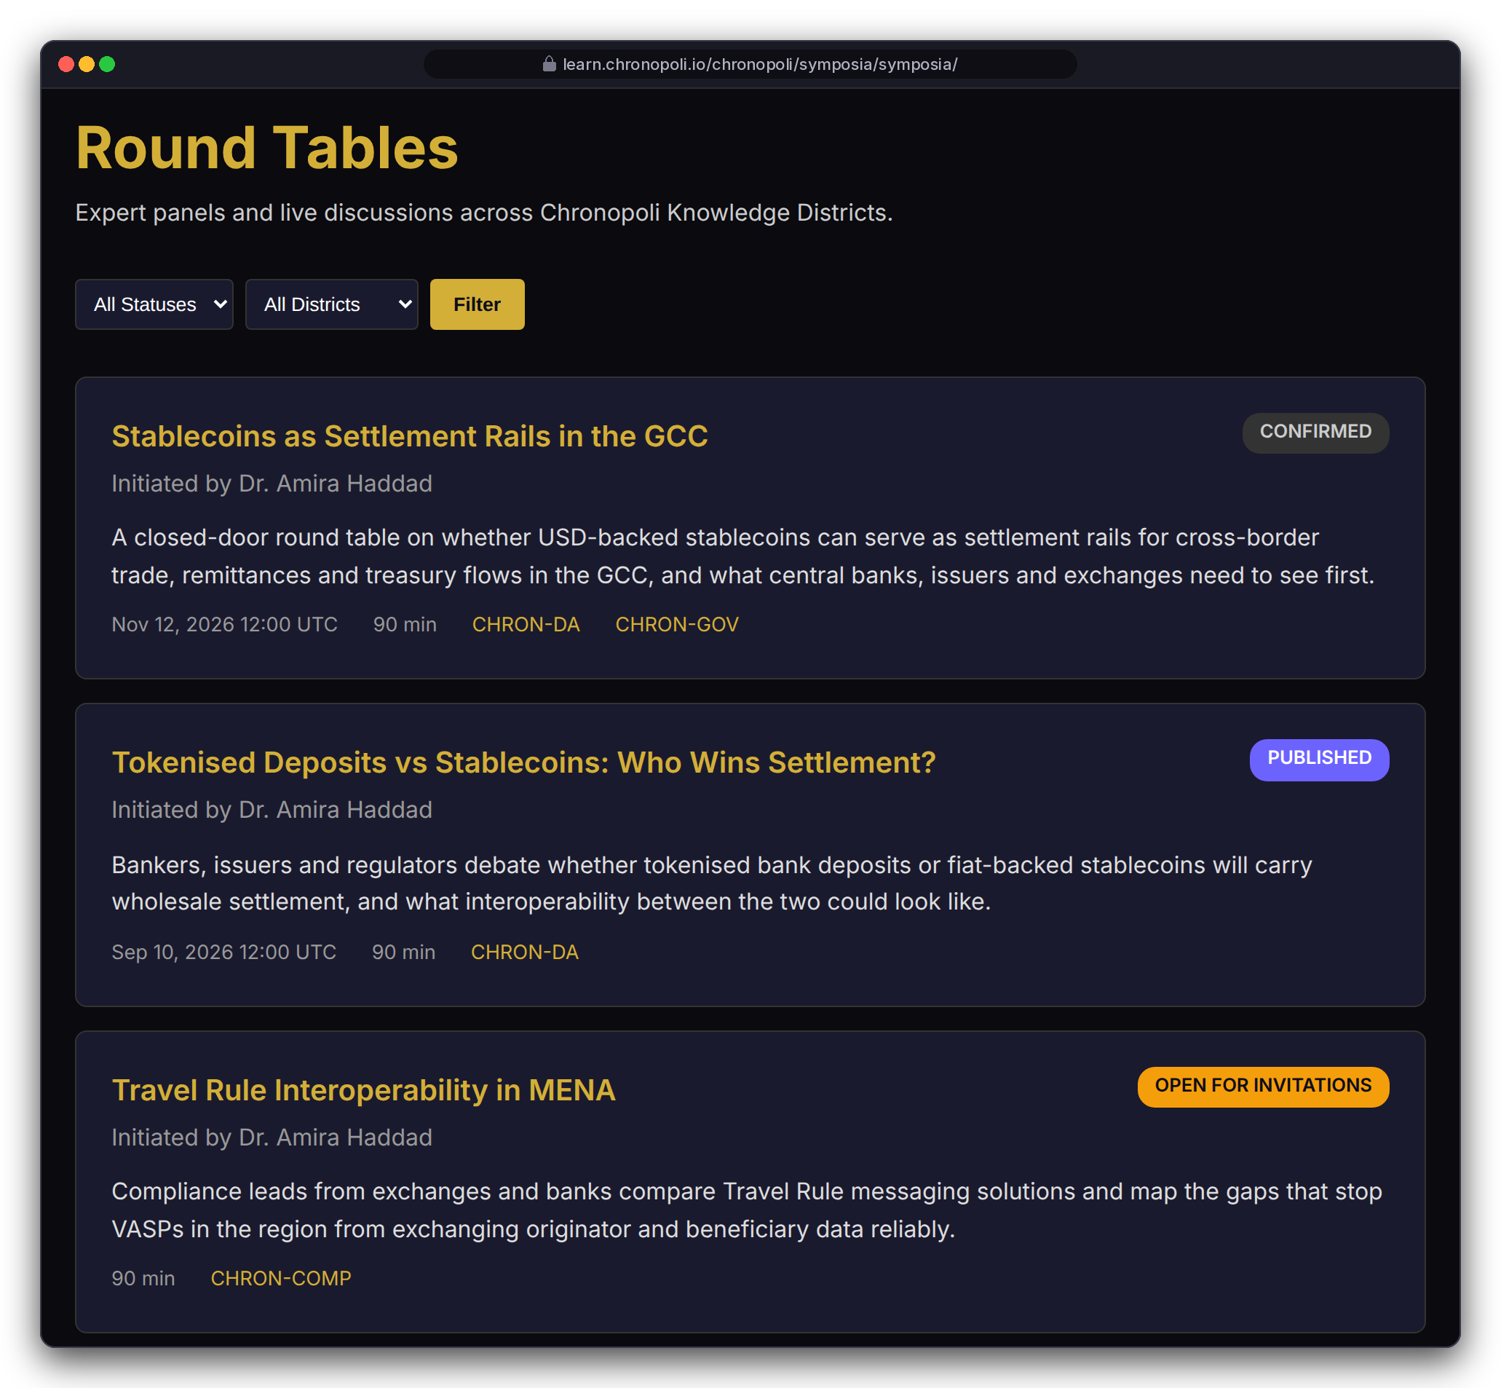
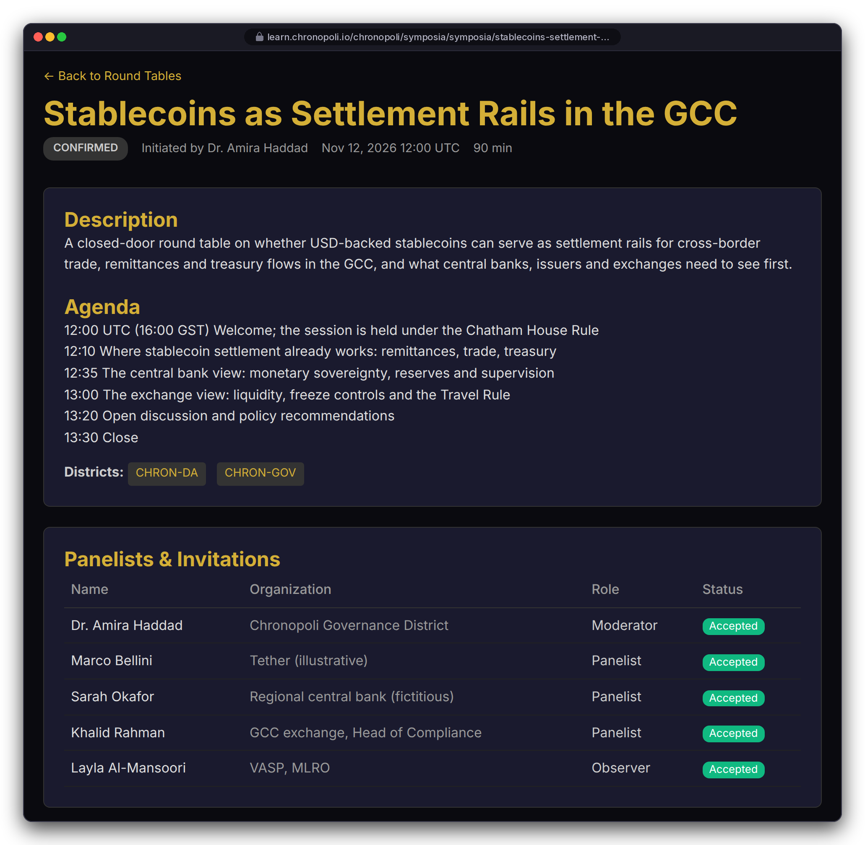
PARTNER SIDE · CONVENE
Persona: Layla as observer · Panelists and organisations are fictitious
Symposia: closed-door round tables as a product
Curated expert panels under the Chatham House Rule, streamed live on AWS IVS and tied to districts
Lifecycle: draft, open for invitations, confirmed, live, processing, published
Invitations: secure and expiring, with moderator, panelist and observer roles
Partner report: the sponsoring partner receives one after every session
REAL CHRONOPOLI TEMPLATE RENDER
REAL CHRONOPOLI TEMPLATE RENDER
Round-table list
Agenda and panel · Thu 12 Nov 2026, 12:00 UTC (16:00 GST)
Illustrative mock data · Tether is a partner-roadmap target only; no agreement implied
17
Notes:
This is the commercial differentiator (milestone M4). Putting an issuer, a central bank, an exchange and a regulator-facing moderator in one room is something no MOOC can sell. The round-table templates print times in UTC, so the agenda is written in UTC too: 12:00 UTC is 16:00 in Dubai. Open for the Pipeline sprint: the IVS recording configuration and the pipeline start (R-24).

Slide 18
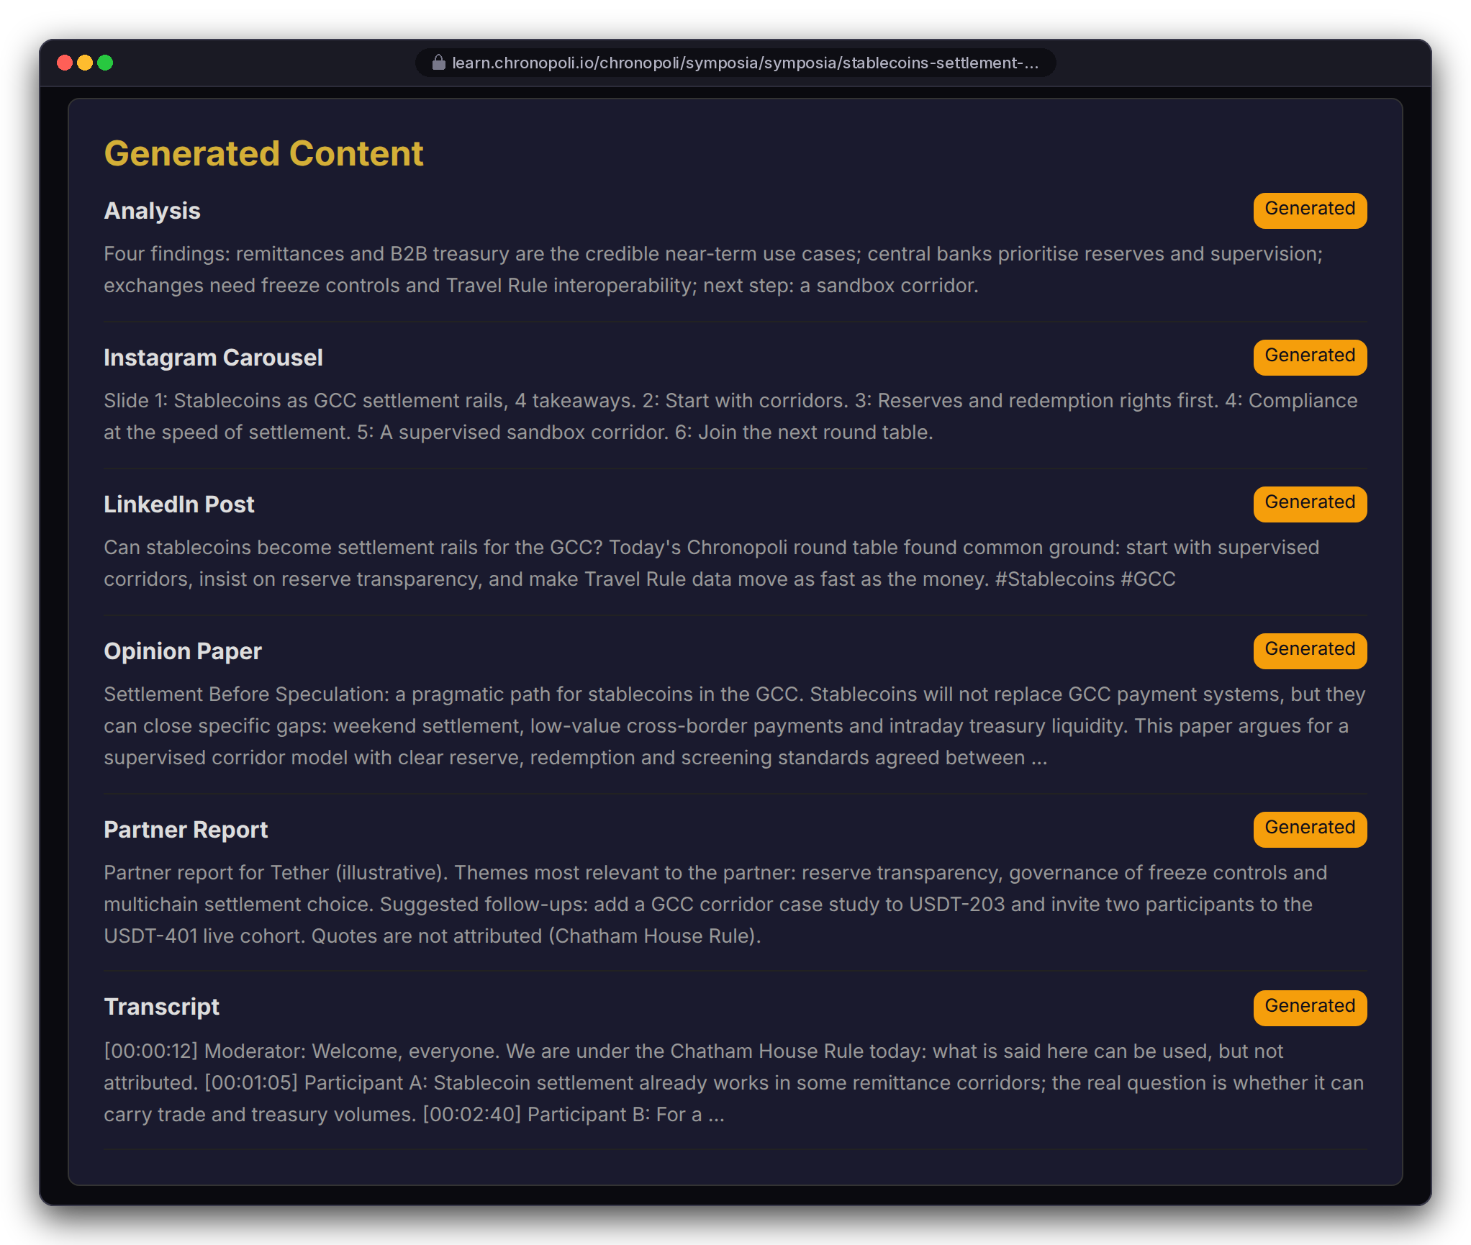
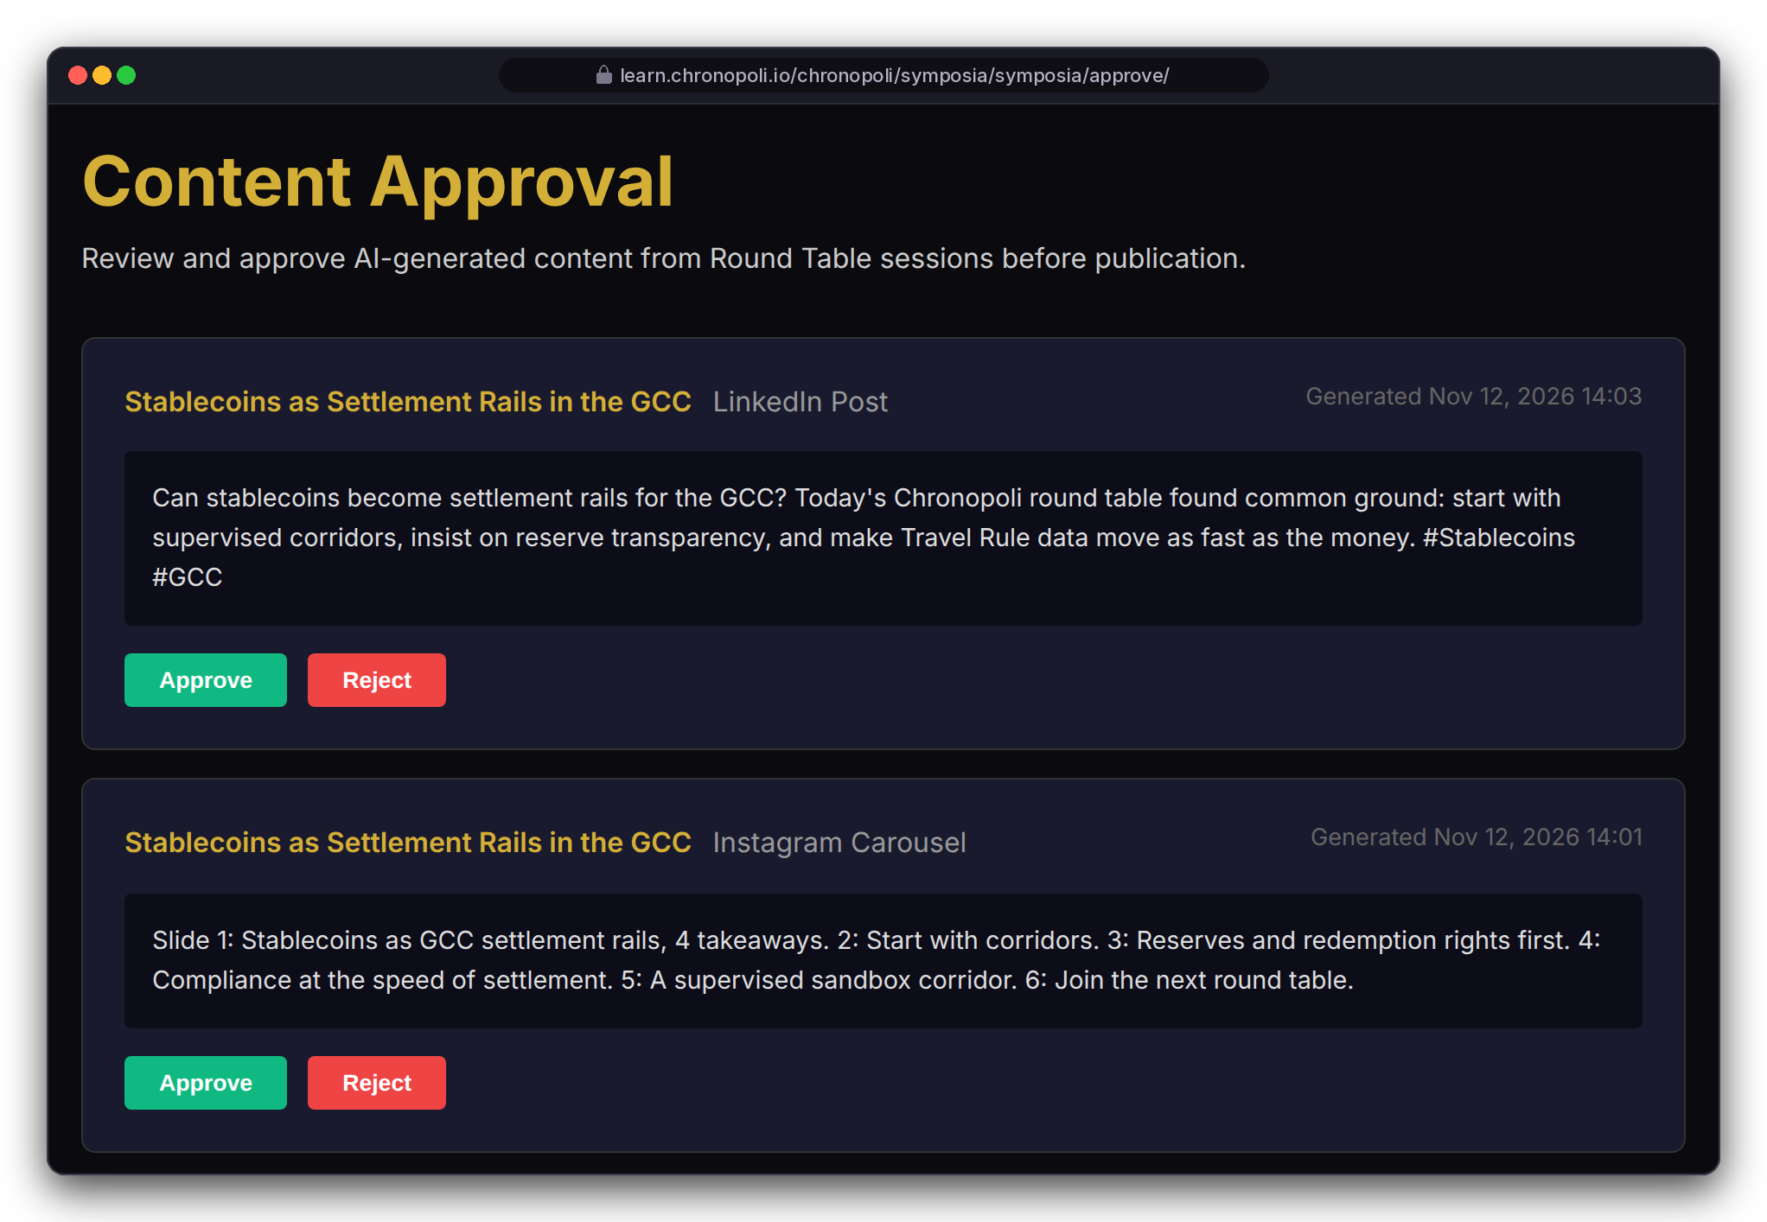
PARTNER SIDE · PUBLISH
Persona: Dr. Amira Haddad, moderator (fictitious) · Mock output texts
One session, six outputs, each approved by a person
After the stream: Transcribe, then Claude on Bedrock, then an opinion paper, LinkedIn post, Instagram carousel and partner report
PIPELINE (AWS)
IVS recording to S3
EventBridge
Step Functions
Amazon Transcribe
Claude analysis on Bedrock
4 parallel generators
SQS approval queue
Moderator approval
REAL CHRONOPOLI TEMPLATE RENDER
REAL CHRONOPOLI TEMPLATE RENDER
Generated content awaiting approval
Staff approval queue
Pipeline: 8 Lambdas run when the IVS recording ends
Sponsor report: feeds the partner's dashboard
Moderator approval: nothing auto-publishes
Illustrative mock data · Tether is a partner-roadmap target only; no agreement implied
18
Notes:
Be clear: these output texts are mock copy written for the demo and shown in the real templates. The pipeline hasn't processed a real session yet. The transcript-polling bug is fixed (R-3). Open for the Pipeline sprint: mapping the IVS event and producing an MP4 (R-4), the approval hand-off (R-5), and a container Lambda for the PDF paper (R-20). Don't promise anonymity yet. Today the analysis prompt extracts named quotes and the paper template prints them with a participant list, so Chatham House anonymisation must be built in before the first real session. One 90-minute session becomes a paper, social content and a sponsor report.

Slide 19
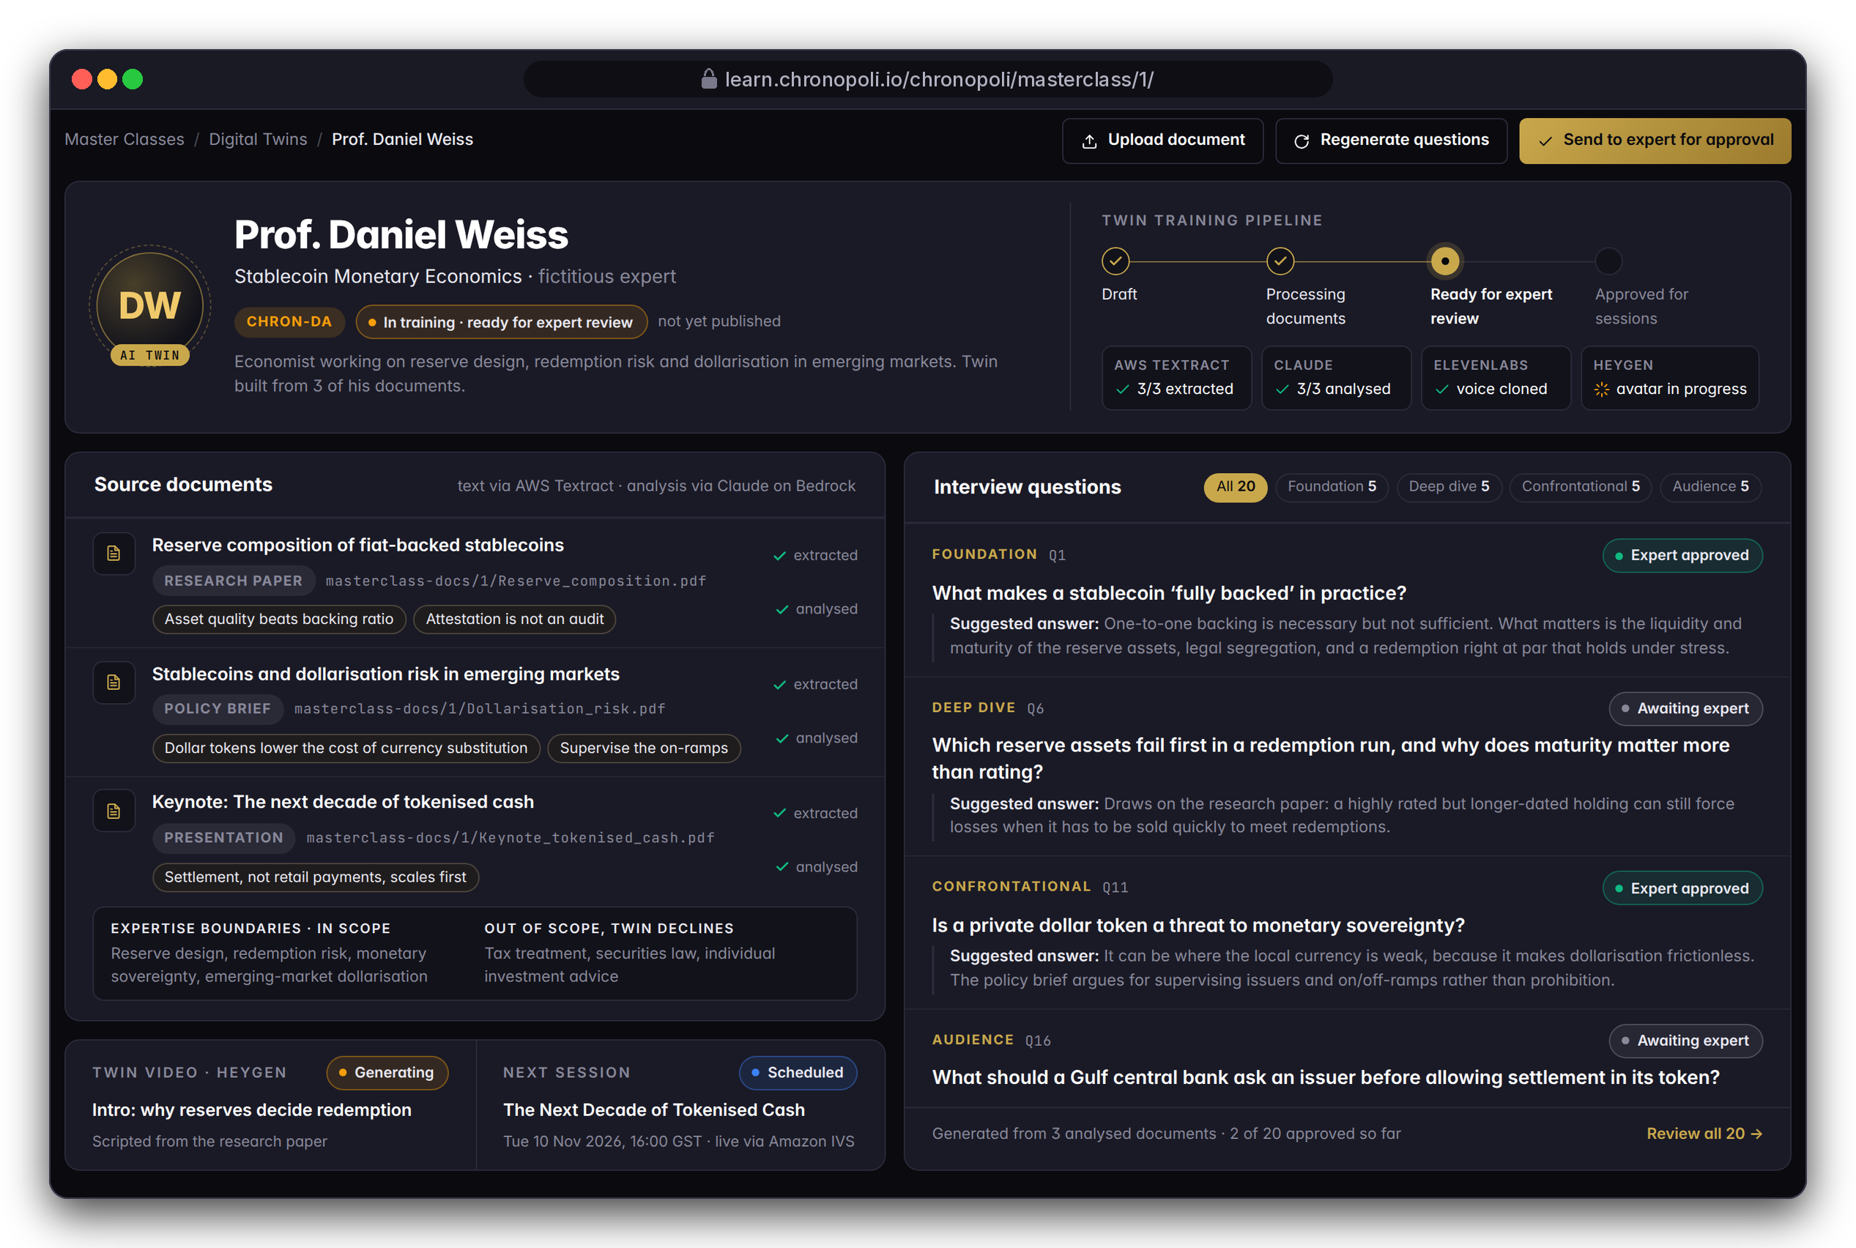
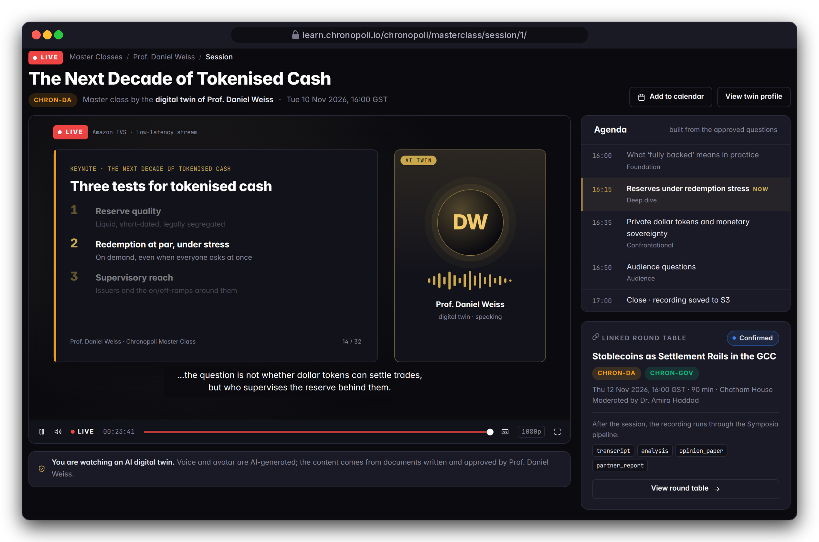
PARTNER SIDE · MASTERCLASS
Personas: Dr. Amira Haddad (staff), Layla (viewer) · The expert is fictitious
Digital-twin masterclasses: scale an expert, with consent
An AI twin built from the expert's own published work, which prepares questions for the expert to approve and can teach live
DESIGN PROTOTYPE
Twin staff view (template not yet built)
DESIGN PROTOTYPE
Live masterclass, 10 Nov 2026 (template not yet built)
Built from the expert's own work: Textract and Claude map positions; the expert approves every question
Live with consent: voice and avatar stream on IVS with an AI disclosure; written consent gates go-live
Illustrative mock data · Tether is a partner-roadmap target only; no agreement implied
19
Notes:
The models and service integrations are in the code, including expert approval of each question. The pages are prototypes because the masterclass templates are missing (R-10). Consent is a design rule, not yet code: before any voice is cloned we need a recorded written consent, and a publish check so that no twin goes live without the expert's approval (R-30, sprint 5, together with a real upload view and asynchronous Textract for multi-page PDFs). The expert must be able to withdraw the twin at any time.

Slide 20
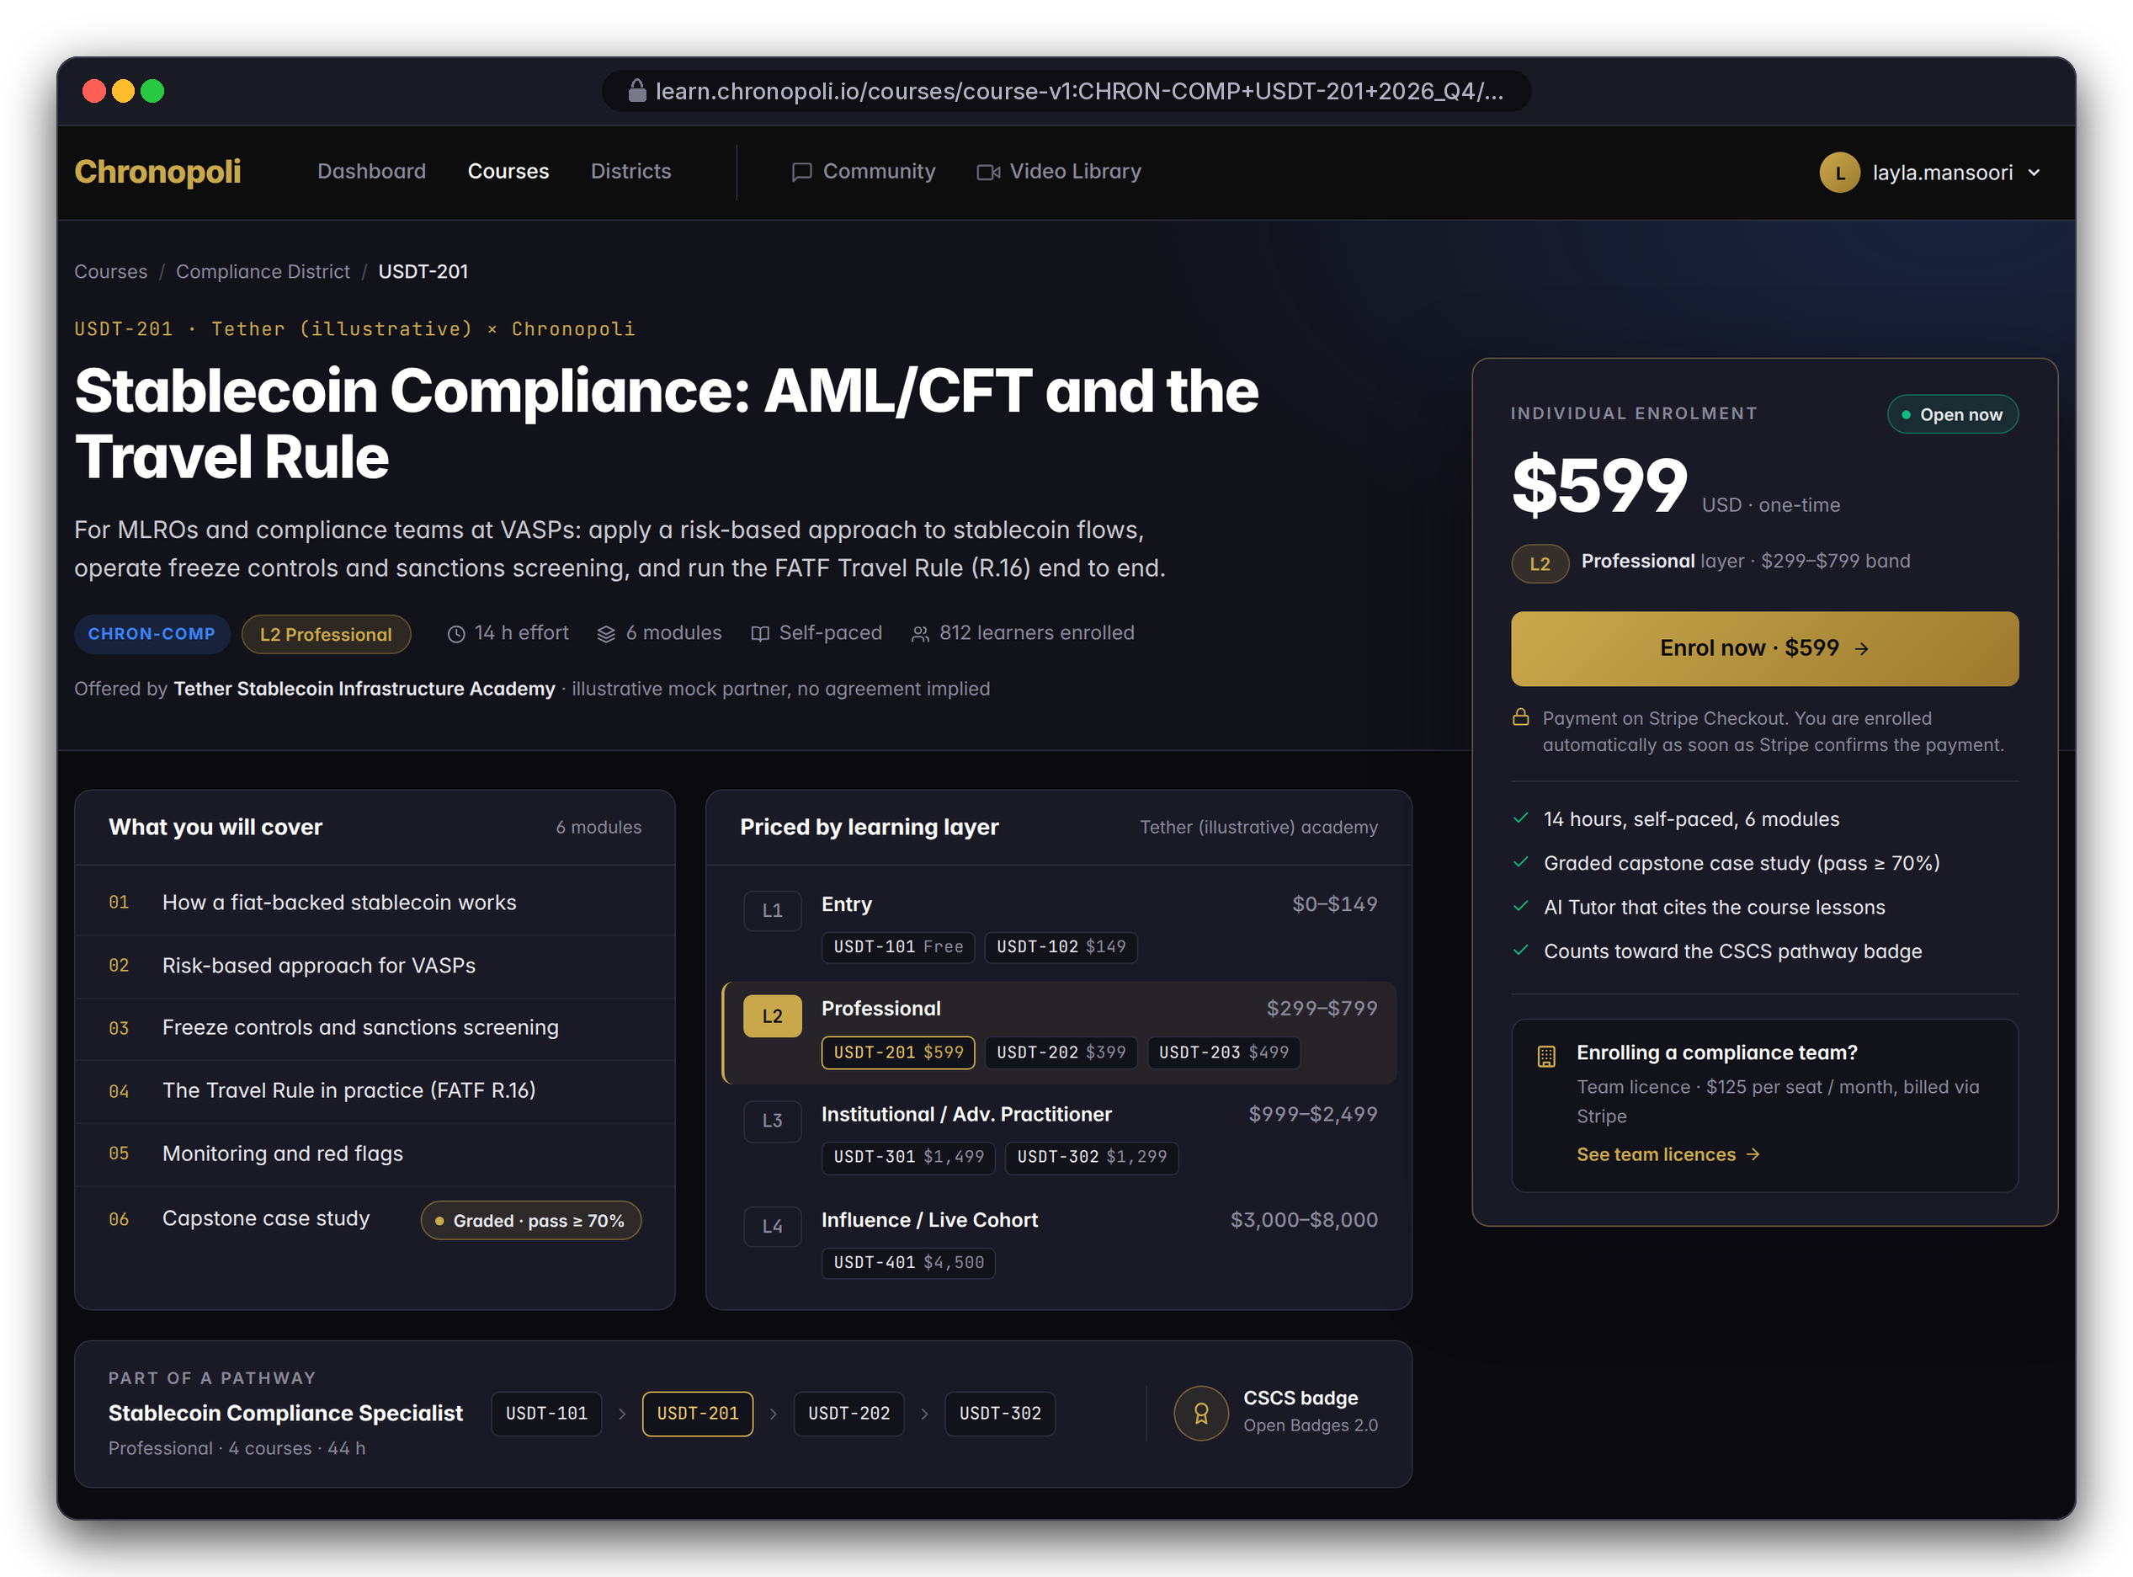
PARTNER SIDE · EARN
Persona: Layla · Illustrative mock data
Business model: four ways the city earns
Revenue follows learning depth, team size and partner reach
INDIVIDUAL ENROLMENTS
TEAM LICENCES
$0 - $8,000
$125 / seat / month
L1 Entry: $0 - 149
L2 Professional: $299 - 799
L3 Institutional: $999 - 2,499
L4 Influence: $3,000 - 8,000
For compliance and investigation teams: employers license seats for a whole team
PARTNER REVENUE SHARE
LIVE FORMATS & TIERS
70 / 30
L4 · Symposia · Masterclasses
Every partner-course sale splits at checkout, paid out via Stripe Connect
L4 cohorts, round tables, masterclasses; the tier (slide 27) sets benefits
DESIGN PROTOTYPE
USDT-201 course page with the L1-L4 price ladder (not yet built)
Illustrative mock data · Tether is a partner-roadmap target only; no agreement implied
20
Notes:
There are four revenue lines, and the mechanics for the first three are in the e-commerce code. The price ladder puts a whole academy on one screen, from a free USDT-101 to a $4,500 live cohort in Dubai. Tier fees aren't set yet, so don't quote any. The model's strength is that partners bring content and audience, and Chronopoli takes 30% of every partner sale without producing the course. Internal: the L1 price label in the code still reads $49-$149 and must be aligned to the $0-149 band.

Slide 21
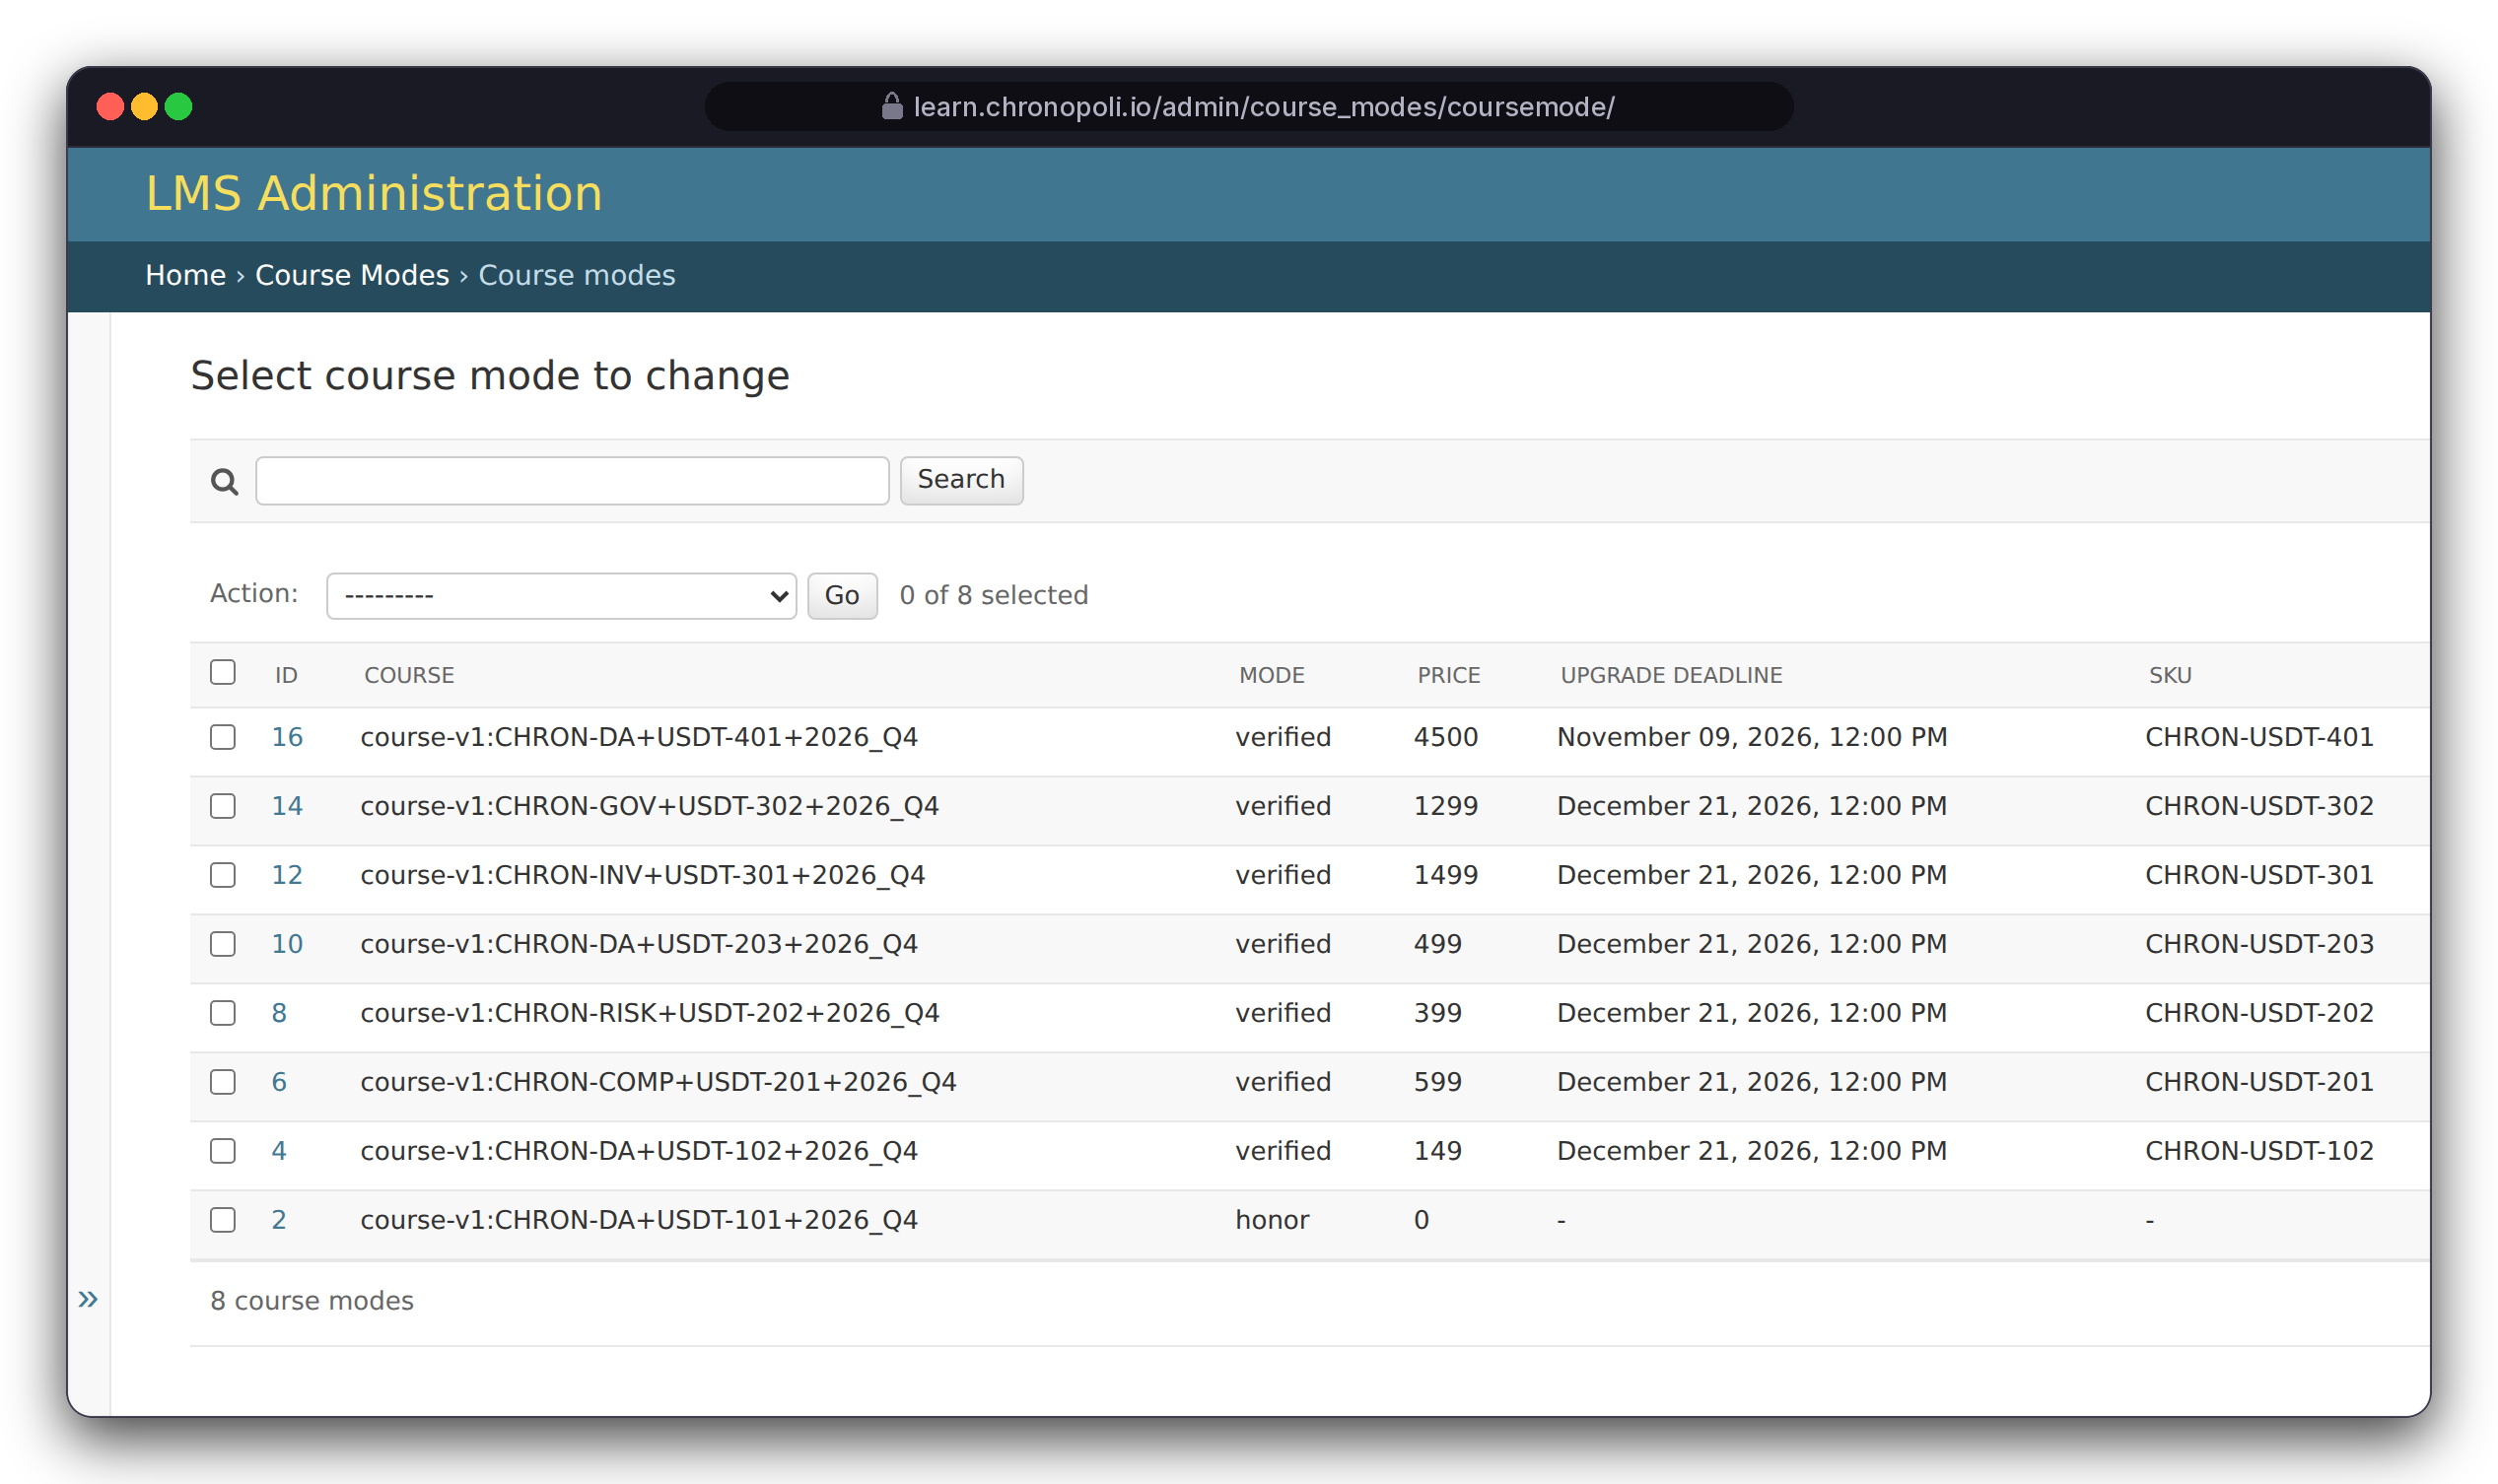
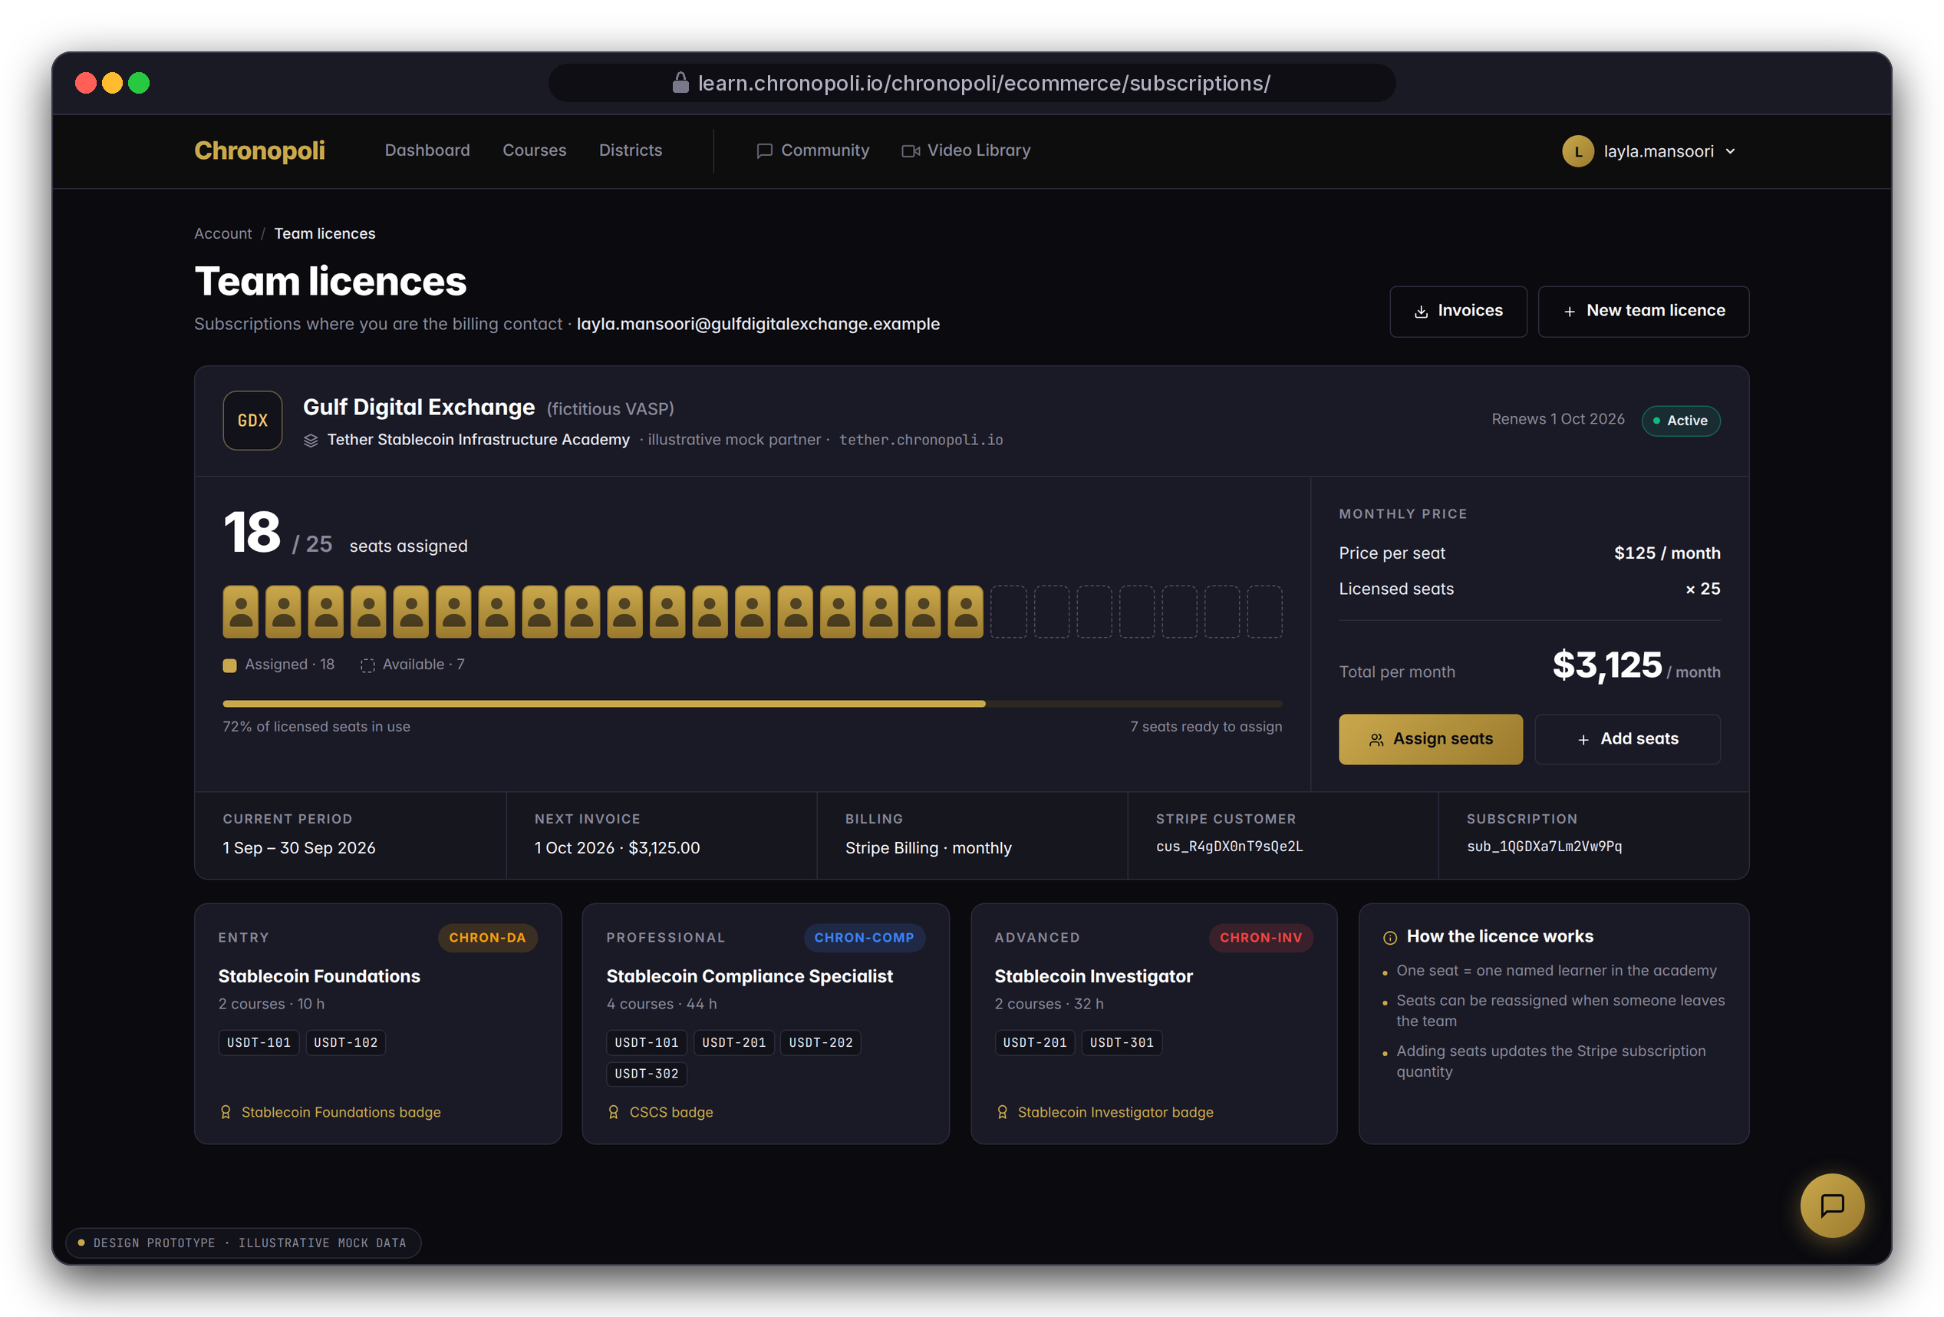
PARTNER SIDE · EARN
Personas: Nadia Karim in the admin (left), Layla as billing contact (right)
Prices live in Open edX; companies buy seats
Every course run carries its price as an Open edX course mode, and employers license seats for whole teams
REAL OPEN EDX SCREEN
Back-office course modes and prices
DESIGN PROTOTYPE
Team licence page (template missing, R-10)
Course modes: from USD 0 (USDT-101) to 4,500 (USDT-401)
Next: the same paid modes let Open edX enforce payment (R-12)
Gulf Digital Exchange: 25 seats × $125 = $3,125 a month
Illustrative mock data · Tether is a partner-roadmap target only; no agreement implied
21
Notes:
Two ways to sell. Individuals buy course by course, and the prices on the left are live Open edX configuration, not a mock-up. Employers buy seats: Gulf Digital Exchange licenses 25 seats and has assigned 18. The licence page is a prototype. Two things to resolve in the Commerce sprint: the subscription code bills yearly while the price list is monthly, and seat assignment is only a counter today.

Slide 22
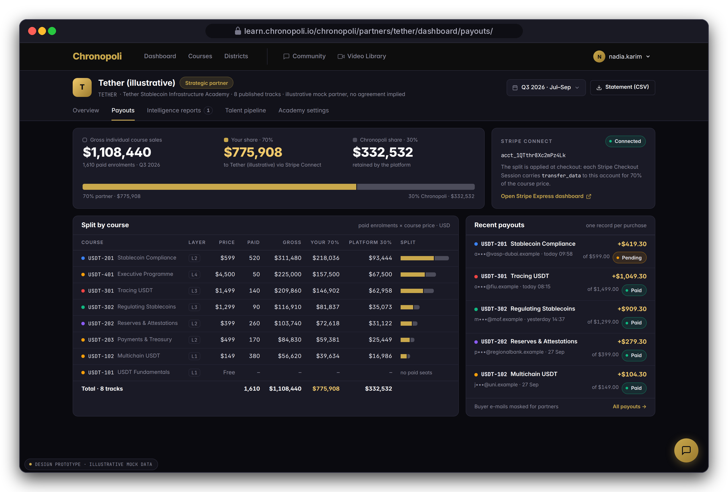
PARTNER SIDE · EARN
Persona: Nadia Karim · Illustrative Tether demo data
70% of every partner-course sale goes to the partner, automatically
Stripe Connect splits each checkout at the moment of payment
Illustrative Q3: $1,108,440 gross from 1,610 paid enrolments
$775,908
$332,532
to the partner (70%)
to Chronopoli (30%)
One payout record per purchase, split by course; buyer emails are masked for partners
DESIGN PROTOTYPE
Partner payouts view (not yet built) · Illustrative Tether demo data
Illustrative mock data · Tether is a partner-roadmap target only; no agreement implied
22
Notes:
The split is in the checkout code: each Stripe Checkout Session carries a transfer of 70 percent to the partner's Connect account, and the webhook writes a payout record. The gross counts individual purchases only; team-licence revenue comes on top. Still open for the Commerce sprint: payout status is never set to 'paid' yet (R-13, partly fixed).

Slide 23
ILLUSTRATIVE SCENARIO · ONE ACADEMY
What one academy could look like (illustrative)
Fictitious Tether scenario, Q3 2026: demo numbers that show the mechanics, not traction
ENROLMENTS
COMPLETIONS
4,812
1,937
+18% QoQ
40.3% completion rate
BADGES ISSUED
PARTNER SHARE
1,244
$775,908
Gross: $1,108,440 individual sales · $775,908 partner (70%) · $332,532 platform (30%)
Depth pays: L3/L4 courses bring about 50% of gross from about 17% of paid enrolments
Not included: team-licence revenue
USDT-101 is free: 2,140 enrolments, $0 revenue (the funnel)
ILLUSTRATIVE MOCK DATA
Source: illustrative scenario, paid enrolments × list price · segments under $20k unlabelled
Fictitious Tether (USDT) academy; no partnership or real traction implied
Illustrative mock data · Tether is a partner-roadmap target only; no agreement implied
23
Notes:
Say it plainly: this is a model of one academy, not reported revenue. Three things to take from it. First, the free USDT-101 is the funnel, with 2,140 enrolments or 44% of the total. Second, 50 live-cohort seats bring $225,000, about 72% of what 520 buyers of the flagship L2 course bring. Third, the platform keeps $332,532 without producing a single course.

Slide 24







TECHNOLOGY
Technology: Open edX at the core, AWS around it, no fork
Tutor 22 (Verawood), a Chronopoli Tutor plugin and 8 Django apps; upstream updates arrive with 'tutor upgrade'
Edge
Route53 (5 subdomains + wildcard) · CloudFront · ACM/TLS · Amazon SES
AWS SERVICES
LMS core
Open edX LMS, Studio and MFEs on Tutor 22 · Celery workers · Caddy
UPSTREAM, UNFORKED
Chronopoli apps
onboarding · partners · discourse_sso · ecommerce · symposia · academy · ai_tutor · masterclass
OUR CODE
AI & media
Bedrock (Claude Sonnet 4.6 + Knowledge Base) · Transcribe · Textract · IVS
AWS SERVICES
Pipeline
EventBridge, then Step Functions, 8 Python 3.13 Lambdas and an SQS approval queue
AWS SERVERLESS
Data
RDS MySQL 8.4 · Redis · MongoDB · S3 (media, static, backups, knowledge)
AWS MANAGED
Extensions
Discourse 3.5 · Opencast 20.4 · Presenton, behind nginx
SELF-HOSTED
Ops
Terraform · GitHub Actions · me-central-1 · EC2 ~USD 430/mo → EKS USD 600-2,000/mo
INFRA AS CODE
24
Notes:
Why the no-fork decision matters to an investor: we maintain only our plugin, apps and theme, and Open edX security fixes and features arrive through 'tutor upgrade'. The real Open edX screens in this deck ran on a stock Tutor 22.0.2 install built from prebuilt images. Hosting in the UAE region keeps regulated learners' data close to home. Costs start small and scale with traffic.

Slide 25
STATUS · HONEST VIEW
Where we are: code complete, not yet live
A September 2026 technical review of the full codebase found 37 verified issues, and fixing has begun
37
8 + 3
15
16
verified findings
fixed + partly fixed
update commits
stack updates
Each one confirmed by reading the code or running a check
26 open: the six sprints close 22 of them and finish all 3 partly fixed
On the review branch, e.g. the Bedrock model swap, the tutor history fix and the Terraform stack refresh
Tutor 22 (Verawood)
MySQL 8.4 · Ubuntu 24.04
Python 3.13 Lambdas
Claude Sonnet 4.6
Pinned Opencast and Presenton
● 6 critical ● 18 high ● 13 medium
● 8 fixed ● 3 partly ● 26 open
Not live yet: all feature code is written; the platform isn't deployed
Biggest blocker: packaging the Django apps as edx-platform plugins so Open edX loads and routes them (R-1, R-2)
What the screens in this deck are: real Open edX that ran, real Chronopoli templates rendered in a test harness, design prototypes for pages still to be built, and real Opencast and Discourse
25
Notes:
We would rather show this than have you find it in due diligence. Five critical items are open: packaging (R-1), routing (R-2), IVS event mapping (R-4), the approval hand-off (R-5), and a public media bucket that also holds learner grade files (R-6). One critical item (R-3) is fixed. Four open items still need a sprint: the auto-badge trigger (R-22), the Discourse SSO secret sync (R-28), onboarding answer validation (R-33) and the configure-tutor script (R-34). Three urgent upgrades are done: the retired Claude model is replaced, MySQL moved from 8.0 to 8.4 to avoid extended-support fees, and the plugin's cap on an end-of-life Tutor release is lifted.

Slide 26

GO-LIVE PLAN · ORDER OF WORK, NOT DATES
Chips: review findings · gold = partly fixed, finished in that sprint
Road to go-live: six sprints
Each sprint closes a named set of review findings, then terraform apply and the first partner academy
1
2
3
4
5
6
Boot
Secure
Commerce
Pipeline
AI & data
Launch
Package the apps as edx-platform plugins; fix routing, templates and init
Private media and exports, least-privilege IAM, partner access model, consent
Paid course modes, refunds, payout status, webhook hardening
IVS recording, event mapping, task tokens, container Lambda for PDFs
Knowledge-base index and access policy, embeddings region, quotas
CloudFront DNS origin, wildcard academies, CI migrations, AWS provider 6.x
R-1
R-2
R-9
R-6
R-17
R-25
R-12
R-13
R-14
R-4
R-5
R-20
R-18
R-30
R-32
R-19
R-23
R-35
R-10
R-31
R-26
R-29
R-37
R-24
R-36
After sprint 6: M1 terraform apply + EC2, then the first partner academy goes live
MILESTONES: M1 GOES LIVE, THEN THE FEATURE ROLL-OUT
M1
terraform apply + EC2
M2
CHRON-ET district
M3
E-commerce
M4
Symposia (commercial differentiator)
M5
Company academies
M6
AI tutor (platform moat)
M7
Digital twin + partner dashboard
26
Notes:
The slide shows the order of work, not dates, because sprint length isn't fixed yet. Sprint 1 unlocks everything else: once the apps load inside Open edX, every template render in this deck becomes a live page. After M1, features roll out as milestones: e-commerce, round tables, company academies, the AI tutor, then digital twins with the partner dashboard. Two upgrades are held back to sprint 6 on purpose: AWS provider 6.x, which needs a reviewed terraform plan, and Claude Sonnet 5.5, which needs Lambda changes and a check that it is available in the region.

Slide 27



PARTNER ROADMAP · TARGETS, NOT AGREEMENTS
Partner roadmap: who we want to build with
Target partners by tier. These are roadmap targets; no agreements are signed.
TIER
TARGET PARTNERS (NOT SIGNED)
WHAT THE TIER GETS
Founding
Ripple, Cardano, Hedera
Flagship tracks, co-hosted symposia, a seat on the curriculum board
Strategic
Tether, Polygon, Chainlink
Branded academy, pathways and badges, talent pipeline
Content / Investigation
Chainalysis, TRM Labs, Elliptic
Specialist courses inside a district
AI
Microsoft AI, Google AI
AI District content
Institutional
Universities, think tanks, banks
Co-certification and research round tables
Names are roadmap targets only. No partnership, endorsement or agreement is implied.
27
Notes:
Sequence: founding partners come first, because they shape the curricula and co-host the first round tables. Strategic academies like the Tether example follow once company academies are live (milestone M5). Content and AI partners deepen individual districts. Institutions give the credentials weight with regulators and employers.

Slide 28


THE ASK
Become a founding Knowledge Partner
Help build the place where the digital economy learns, hosted by Dubai Blockchain Center
Founding partners
Pilot institutions
Investors
Co-design a flagship track or an academy around the roles you hire for, co-host the first round tables, sit on the curriculum board
Regulators, FIUs, banks and VASPs for the first team-licence cohorts, with feedback on L2-L3 content
Fund the six-sprint go-live and the first partner academies
Next step: a working session to choose your district, first track and first round table
28
Notes:
Close on the ask, not on features. The product exists as code and as the screens you've seen; what's missing is go-live engineering and the first founding partners. There's deliberately no funding figure on the slide; give the amount verbally, and only once DBCC has confirmed it. Offer the user guide and technical review booklet as the leave-behind.

