Slide 1

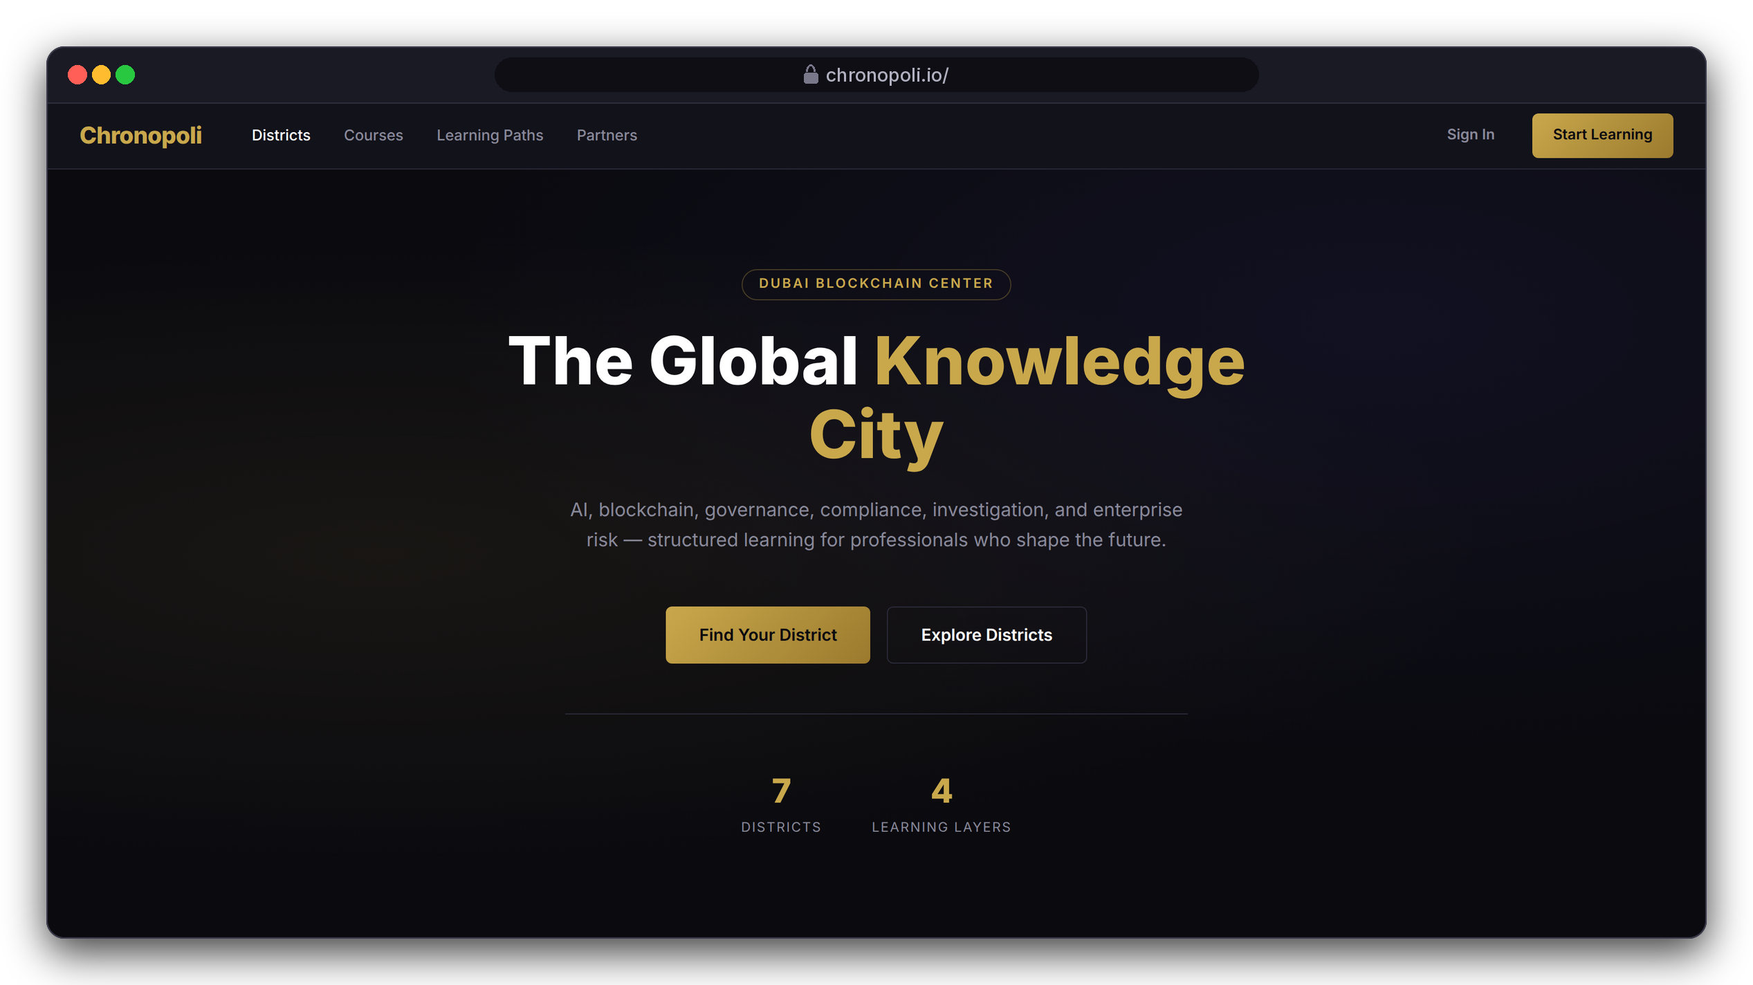

INVESTOR & PARTNER PRESENTATION
Chronopoli
The Global Knowledge City for the digital economy,
hosted by Dubai Blockchain Center
AI-Native Knowledge Infrastructure ·
Community Intelligence Engine · Verified Credentials
AI · Digital assets · Governance · Compliance ·
Financial-crime investigation · Risk & trust · Emerging tech
Built on Open edX (Tutor 22), designed for AWS · September 2026
DESIGN PROTOTYPE
Landing-page preview (not yet deployed)
The product tour uses an illustrative Tether (USDT) academy: fictitious mock data, no partnership implied
Illustrative mock data · Tether is a partner-roadmap target only; no agreement implied
01
Notes:
Chronopoli is one platform where regulators, financial intelligence units, banks, exchanges, enterprises, founders and students learn the digital economy, hosted by Dubai Blockchain Center. Every screen in this deck is either real software or a clearly labelled prototype. The running example, a Tether academy, is fictitious demo data: Tether is a roadmap target, not a partner.

Slide 2





THE PROBLEM
The digital economy has a structural knowledge gap
No one connects AI, blockchain, compliance and forensics in one trusted, neutral place
Fragmentation
Speed Mismatch
Fake Credentials
No Neutral Convener
AI governance, blockchain, AML/CFT, forensics and regulatory knowledge sit in silos; no single platform connects them
MiCA and FATF change, DeFi exploits create new typologies. Universities take 18 months to update, training firms 6; the market moves daily
A certificate says you sat in a room. It tells no employer what you know today, in context, for your jurisdiction
Nobody puts an issuer, a UAE regulator, a forensics analyst and a researcher in one room and turns that into institutional knowledge
OUR ANSWER
OUR ANSWER
OUR ANSWER
OUR ANSWER
Seven districts, four layers, one onboarding
Updates in under 48 h: Studio + pipeline
Open Badges 2.0 linked to partner roles
Symposia: round tables that publish
Slides 3, 8
Slides 17, 20
Slide 14
Slides 19, 20
02
Notes:
These are the four problems from the master investor deck. The speed mismatch is the killer fact: MiCA, FATF guidance and new crypto typologies change monthly, universities take 18 months to update a curriculum and the big certification bodies about 6. Every compliance officer in the room has felt this. Use one concrete picture: an exchange’s MLRO whose team must understand the Travel Rule, sanctions freezes and stablecoin reserves within weeks, and who today pieces that together from webinars and PDFs. Each problem has an answer that the product tour shows on real screens; the numbers under each answer are the slides. The <48-hour update is a design target of Studio authoring plus the round-table pipeline, not a measured result yet.

Slide 3
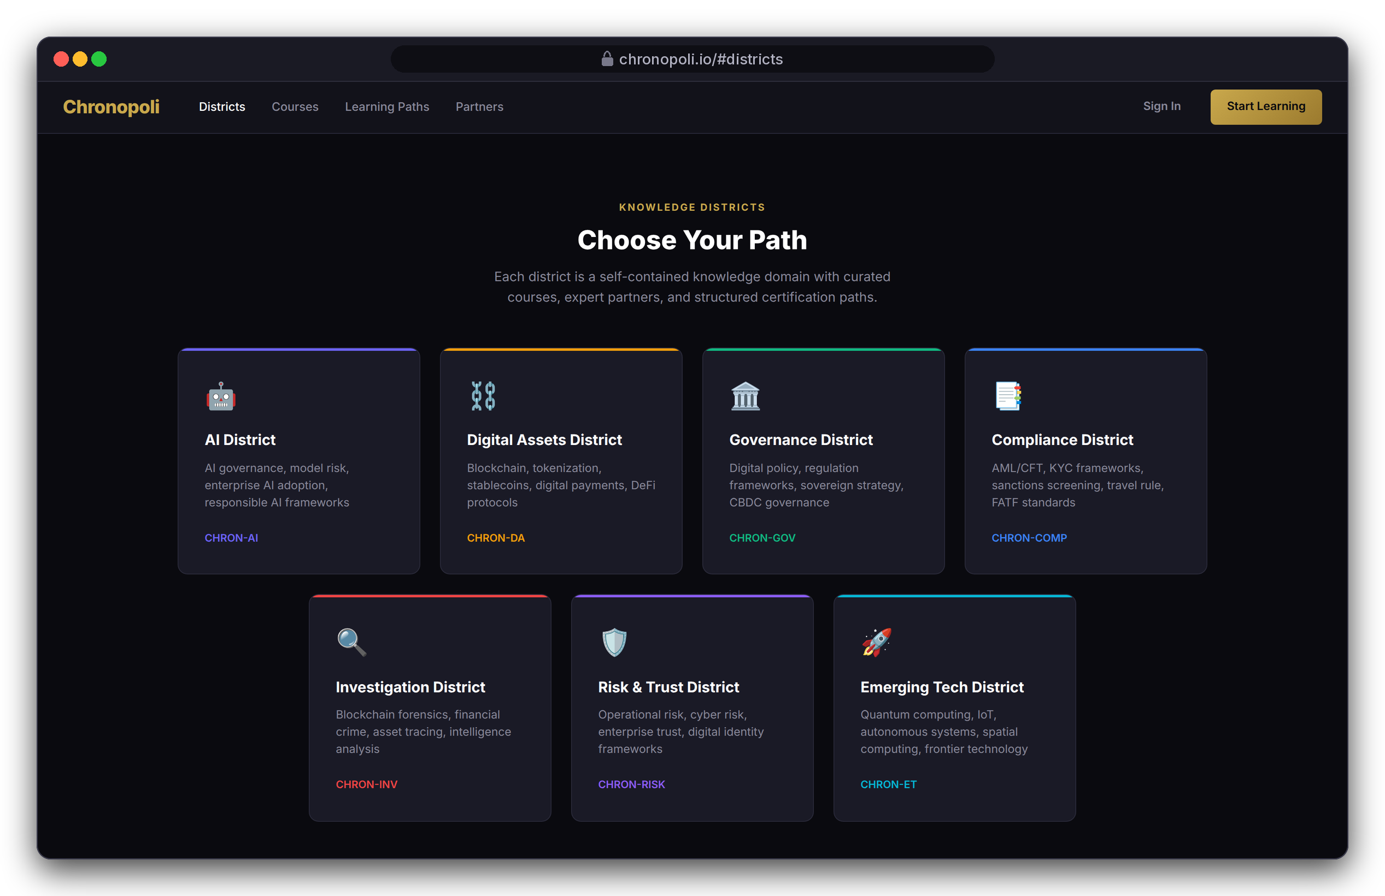
THE CITY
One city, seven districts, four layers
Every course sits in a Knowledge District and a learning layer, so every learner and partner knows where they belong
7 Knowledge Districts = 7 Open edX organisations: AI, Digital Assets, Governance, Compliance, Investigation, Risk & Trust, Emerging Tech
4 learning layers set depth and price (below)
Partners publish tracks into several districts and can run their own academy on a partner subdomain
One account for courses and community
LEARNING LAYERS: DEPTH AND PRICE RISE TOGETHER
L3
L4
L2
Institutional
Influence
L1
Professional
$999–$2,499
$3,000–$8,000
Entry
$299–$799
$0–$149
DESIGN PROTOTYPE
Landing-page preview of the seven districts (not yet deployed)
03
Notes:
Chronopoli isn't a course catalogue; it's a city map. A district is where a topic lives, and a layer is how deep you go. Every district is an Open edX organisation, so the structure sits in the LMS itself, not just in marketing. The same grid organises the community forums on slide 15. Internal, not for the audience: the repo's preview page still says six districts, shows a '50+ Partners' stat and a 'Trusted by' strip naming roadmap partners. This capture uses corrected copy, and the page must be fixed before anything goes public.

Slide 4

THE SOLUTION
Chronopoli: the Octopus Model
Chronopoli is the head. Every company, institution and knowledge partner is a tentacle.
Ripple Academy
TRM Labs
WHAT EACH TENTACLE KEEPS
Company academy · target
Knowledge partner · target
Own brand on its own subdomain (slide 9)
Own courses, pathways, badges (slides 13-14)
Own talent pipeline and open roles (slide 14)
Chainalysis Academy
Fireblocks
WHAT FLOWS THROUGH THE HEAD
Company academy · target
CHRONOPOLI
Knowledge partner · target
AI tutor on all platform content (slide 12)
Verified Open Badges 2.0 (slide 14)
District community and round tables (slides 15, 19)
Five-output pipeline and Partner Intelligence Reports (slide 20)
AI · credentials
community · pipeline
BUiD
Regulators / FIUs
University · MOU in progress
Institutions · target
Each partner keeps its own identity, content and certification; the AI, credentialing, community and intelligence flow through Chronopoli.
Tentacle names are the master deck’s examples: targets, not agreements. Status: slide 29.
04
Notes:
Here is the architecture. Chronopoli is the head. Every company that joins is a tentacle: its own brand, its own courses, its own certification pathway. But the AI, the credentials, the community intelligence and the automation pipeline all flow through the centre. The tentacle gets network effects it could never build alone; the head becomes more valuable with every tentacle added. That is a two-sided market with natural lock-in on both sides. If you are in person, sketch the octopus on paper. The names on the tentacles are the master deck’s examples: DBCC is the confirmed anchor, the BUiD MOU is in progress, Ripple and Chainalysis are being pitched and engaged, the others are targets. The product tour shows a tentacle with an illustrative Tether academy.

Slide 5

PRODUCT
Three pillars, one platform
Every feature serves the network effect: more partners → more content → smarter AI → more value
Symposia
Company Academies
Open Knowledge
Community Intelligence Engine
The Tentacle Model
AI Tutor + Digital Twins
Live round tables under the Chatham House Rule, streamed on AWS IVS
Automated opinion papers in 3 hours
LinkedIn and Instagram content, one human approves (TikTok: roadmap)
Partner Intelligence Reports per session
Branded sub-academies on a partner subdomain
Custom learning pathways and a badge system
Open Badges 2.0 verified credentials
Talent pipeline: badges matched to partner roles
AI Tutor grounded in all platform content
Digital Twin: an expert’s documents become an AI avatar, with consent
Open course marketplace, 70/30 revenue split
Compounds with every new piece of content
01
02
03
IN THE PRODUCT TOUR
IN THE PRODUCT TOUR
IN THE PRODUCT TOUR
Slides 19-20
Slides 9, 13-14, 18
Slides 7, 10, 12, 21
Shared platform core: onboarding, Open edX courseware and Studio, Discourse forums and Opencast video (slides 8, 11, 15, 17)
05
Notes:
Three pillars, one platform. Symposia is the community intelligence engine: round tables that become papers, posts and partner reports. Company Academies is the tentacle model: branded academies with pathways, verified badges and a talent pipeline. Open Knowledge is the AI tutor, digital twins and the open course marketplace. Every feature serves the network effect: more partners bring more content, which makes the AI smarter, which brings more value. Each product-tour slide carries its pillar in a label next to the step, so you can see every pillar on real screens. Be precise on two points: publishing needs one human approval, and TikTok is on the roadmap, not in the code.

Slide 6
PRODUCT TOUR
Product tour: one learner, end to end
Layla Al-Mansoori, MLRO at Gulf Digital Exchange (fictitious VASP), earns a stablecoin compliance credential
1
2
3
4
5
6
7
8
9
Discover
Onboarding
Partner academy
Enrol & pay
Learn
AI tutor
Pass & pathway
Badge to job
Community & video
One catalogue, one sign-up
Routed in 5 questions
Pick a pathway
Stripe Checkout
Lessons and graded checks
Cited answers inside the lesson
Grades roll up to the pathway
Open Badge, matched to a job
Discourse forums, Opencast video
Slide 7
Slide 8
Slide 9
Slide 10
Slide 11
Slide 12
Slide 13
Slide 14
Slide 15
Open Knowledge
Platform core
Company Academies
Open Knowledge
Platform core
Open Knowledge
Company Academies
Company Academies
Platform core
Then the partner side (slides 17-27)
Author 17
›
Measure 18
›
Convene 19
›
Publish 20
›
Masterclass 21
›
Earn 23-27
THE CAST (ALL FICTITIOUS)
WHAT EACH SCREEN IS
LA
Layla Al-Mansoori slides 8-15, 19, 21, 24-25
REAL OPEN EDX SCREEN
Captured from a running stock Tutor 22.0.2 install
MLRO, Gulf Digital Exchange (fictitious VASP)
REAL CHRONOPOLI TEMPLATE RENDER
Our repo code, rendered in a test harness
NK
Nadia Karim slides 18, 25-26
Academy administrator, partner side (fictitious)
DESIGN PROTOTYPE
A page that is still to be built
AH
Dr. Amira Haddad slides 19-21
REAL EXTENSION
Opencast 20.4 and Discourse 3.5, running for real
Round-table moderator, Governance District (fictitious)
Illustrative mock data · Tether is a partner-roadmap target only; no agreement implied
06
Notes:
We follow one person, Layla, through every function, and then the partner behind her course. Three fictitious people carry the story: Layla the learner, Nadia who runs the partner academy, and Dr. Amira Haddad who moderates round tables. Four labels tell you what each screen is. A real Open edX screen came from a running Tutor 22 install. A Chronopoli template render is our repo code rendered in a test harness. A design prototype is a page still to be built. Opencast and Discourse screens are real extension systems. Every step also carries its pillar (slide 5): Symposia, Company Academies, Open Knowledge, or the shared platform core. Her course runs from 1 September 2026, and her badge is issued on 18 September.

Slide 7
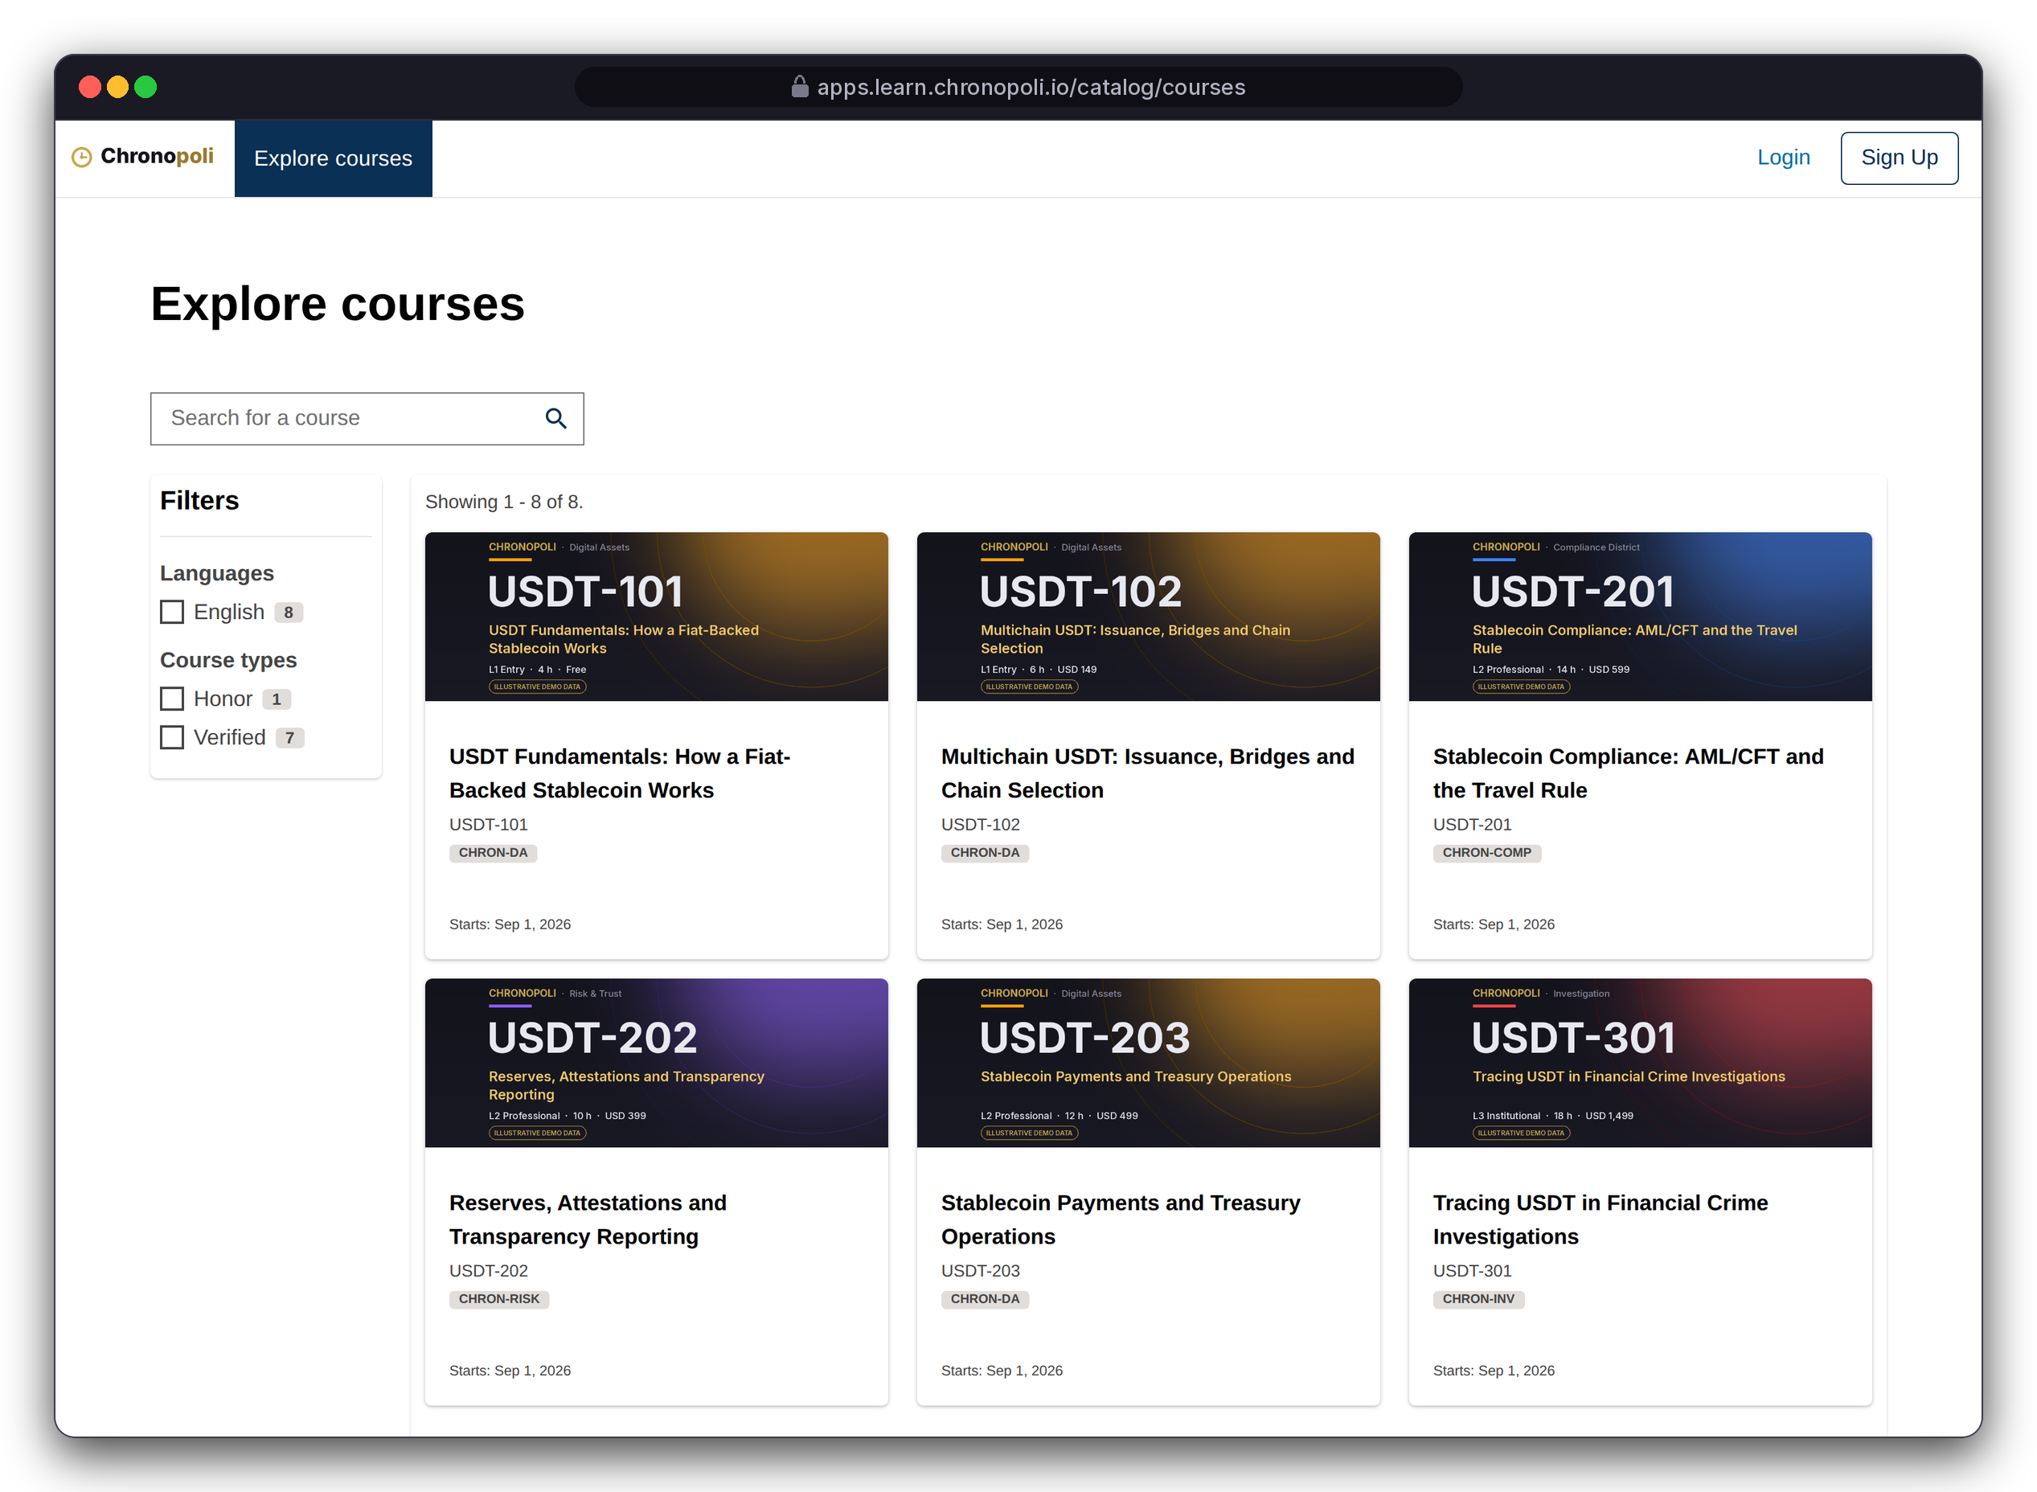

PRODUCT TOUR · STEP 1 OF 9 · DISCOVER
PILLAR 03 · OPEN KNOWLEDGE
Persona: a visitor before sign-up
Discover: one catalogue across every district
Search and filter every track; each card shows district, layer, effort and price
Search and filters: full-text search on a real Open edX catalogue
Sign up once: one account also signs in to the district forums (Discourse SSO)
ZOOM ON THE SAME SCREEN: ONE CARD IMAGE
On every card image: district, layer, effort and price
ALL EIGHT DEMO TRACKS (ILLUSTRATIVE)
USDT-101
USDT-102
USDT-201
USDT-202
L1 Free
L1 $149
L2 $599
L2 $399
USDT-203
USDT-301
USDT-302
USDT-401
REAL OPEN EDX SCREEN
Catalogue, Tutor 22.0.2 · first 6 of 8 demo courses
L2 $499
L3 $1,499
L3 $1,299
L4 $4,500
Illustrative mock data · Tether is a partner-roadmap target only; no agreement implied
07
Notes:
This is stock Open edX with Chronopoli settings: we didn't build a catalogue, we got one. These real Open edX screens still use the default theme with the Chronopoli name and a demo wordmark, not yet the dark/gold theme. The district filter was switched off in the demo because the stock catalogue shows raw org codes; the district still appears on every card. The frame shows the first two rows; the zoom is the USDT-301 card image from the same screen, and the list on the right gives all eight demo tracks: USDT-101 is free (L1), USDT-301 costs $1,499 (L3).

Slide 8
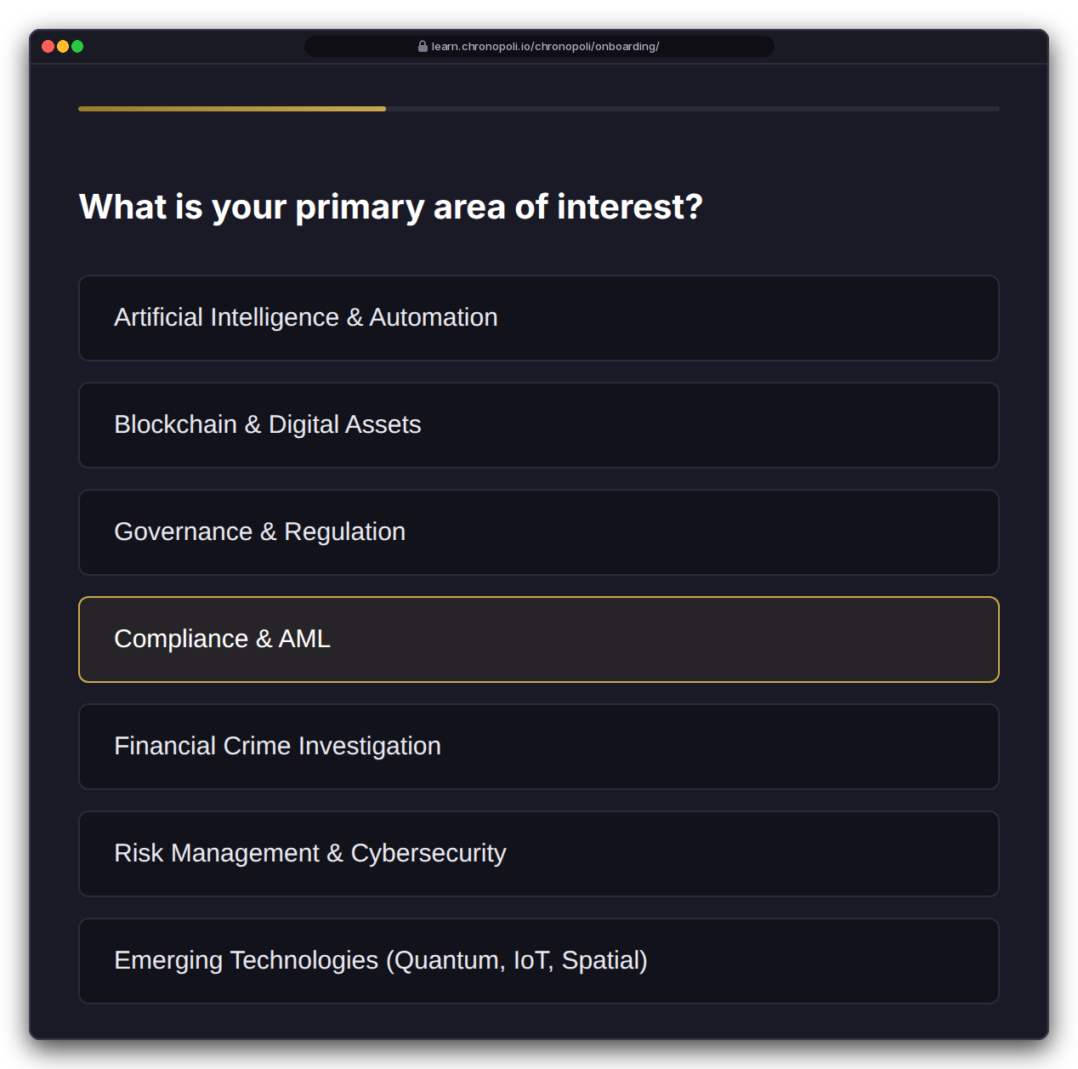
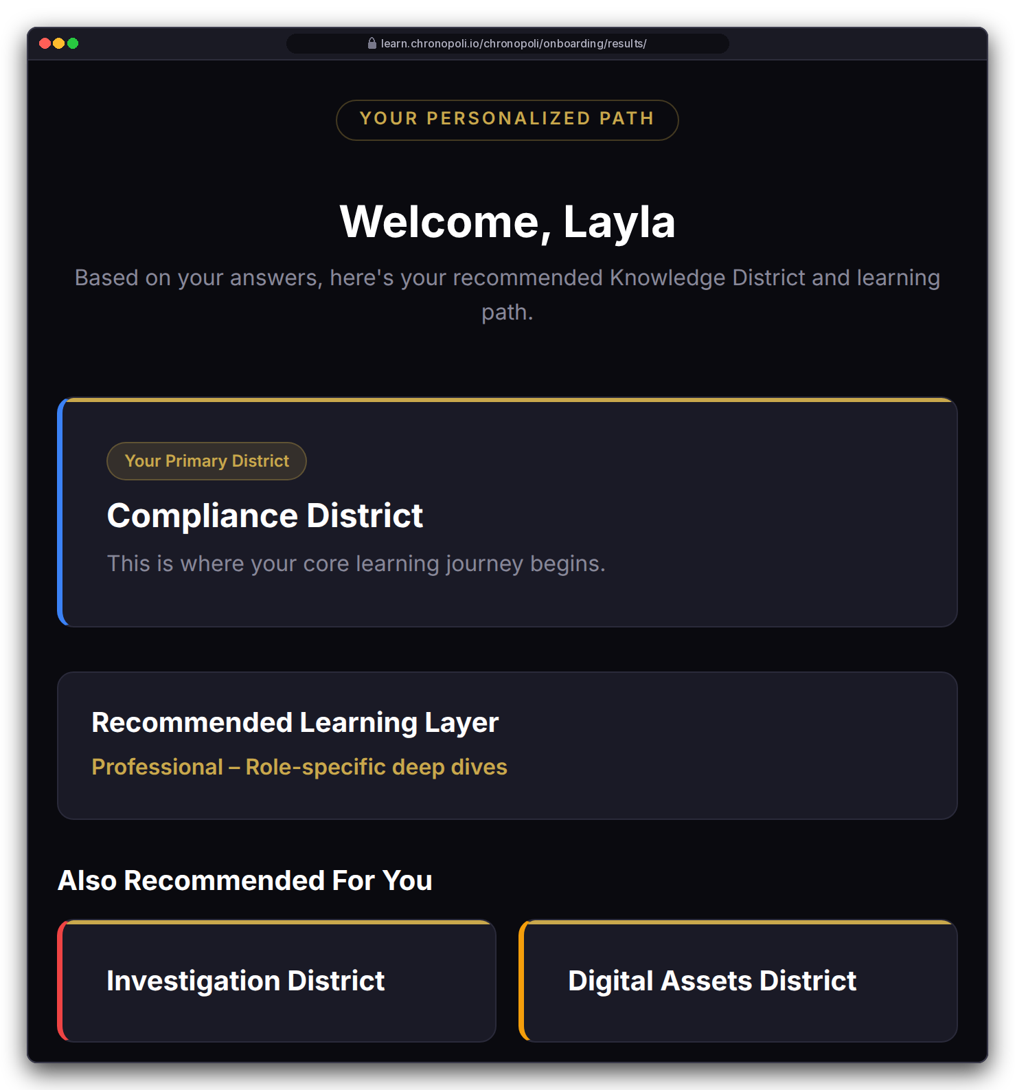
PRODUCT TOUR · STEP 2 OF 9 · ONBOARDING
PLATFORM CORE
Persona: Layla Al-Mansoori, MLRO (fictitious)
Onboarding: five questions, a personal map of the city
Focus picks the home district and its two neighbours; role and experience set the starting layer
Layla answers: crypto exchange · Compliance & AML · experienced · certificate · within weeks
Result: Compliance District at L2 Professional, with Investigation and Digital Assets as neighbours
Rule-based and explainable: the home district follows her own focus choice; role and experience set the layer
Reused by the AI tutor: stored in her profile to set depth and examples
REAL CHRONOPOLI TEMPLATE RENDER
Question 2 of 5
REAL CHRONOPOLI TEMPLATE RENDER
Routing result
Illustrative mock data · Tether is a partner-roadmap target only; no agreement implied
08
Notes:
The recommendation isn't mocked: Layla's answers went through the repo's real routing function. Call it onboarding, not AI: today the routing is deterministic rules, which also makes it easy to explain. The AI comes in on slide 12, where the tutor reuses this profile. Because the home district follows the learner's own focus choice, an FIU investigator who picks financial-crime investigation lands in Investigation, and a ministry adviser who picks governance lands in Governance. Before go-live, these templates must render through Open edX's Mako engine (R-9), and answers must be checked against the allowed options (R-33).

Slide 9
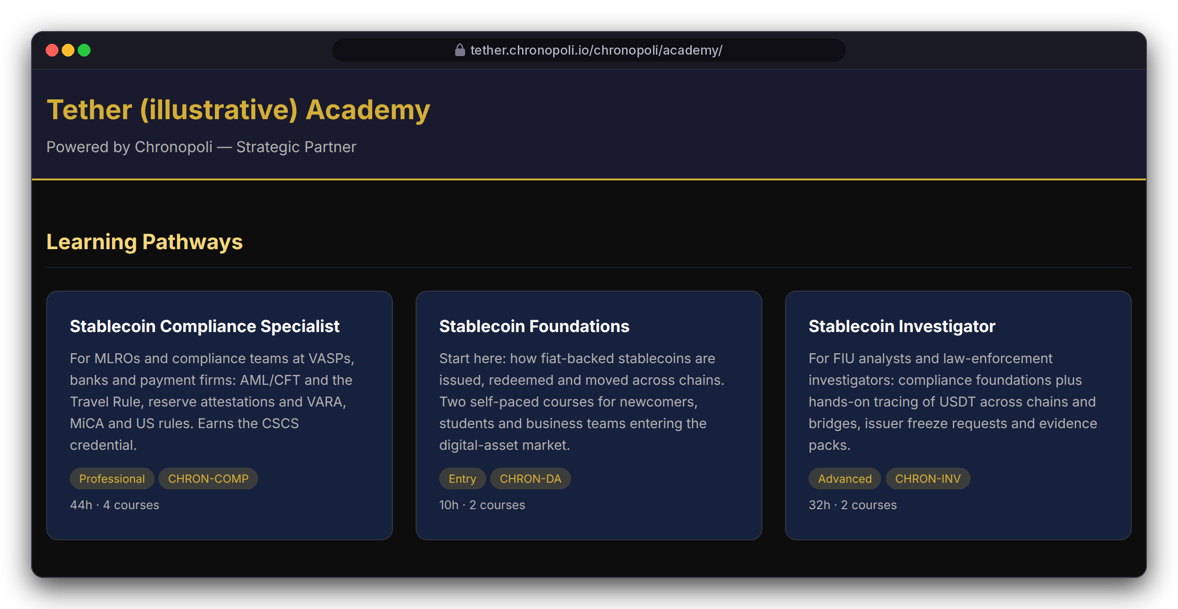
PRODUCT TOUR · STEP 3 OF 9 · PARTNER ACADEMY
PILLAR 02 · COMPANY ACADEMIES
Persona: Layla browsing
Partner academy: a partner's own school inside the city
Pathways that end in a co-branded badge, next to the partner's open roles, on the partner's own subdomain
3 pathways: Stablecoin Compliance Specialist (4 courses, 44 h), Foundations (2 courses, 10 h), Investigator (2 courses, 32 h)
District catalogues: courses stay in their districts, so a partner track also shows up there
Talent pipeline: the partner's open roles sit on the same page, below the pathways (slide 14)
REAL CHRONOPOLI TEMPLATE RENDER
Academy home, top of the page (partner colour and logo not yet applied)
Illustrative mock data · Tether is a partner-roadmap target only; no agreement implied
09
Notes:
The partner admin, Nadia Karim (fictitious), sets this up in the Django admin: partner record, subdomain, pathways, badges and jobs. Two honest caveats. The template doesn't yet apply the partner's brand colour or logo. And the subdomain middleware isn't registered in the Tutor plugin yet (R-23, sprint 6); the test harness switched it on. The frame shows the top of the academy page; the open roles follow further down the same page, and slide 14 shows the job board. This is the Company Academies pillar, the tentacle of the Octopus Model (slide 4).

Slide 10
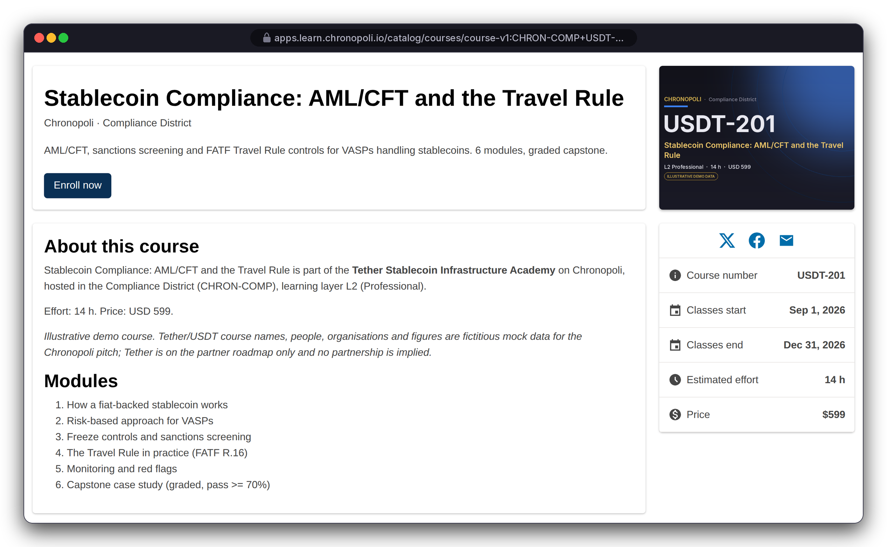
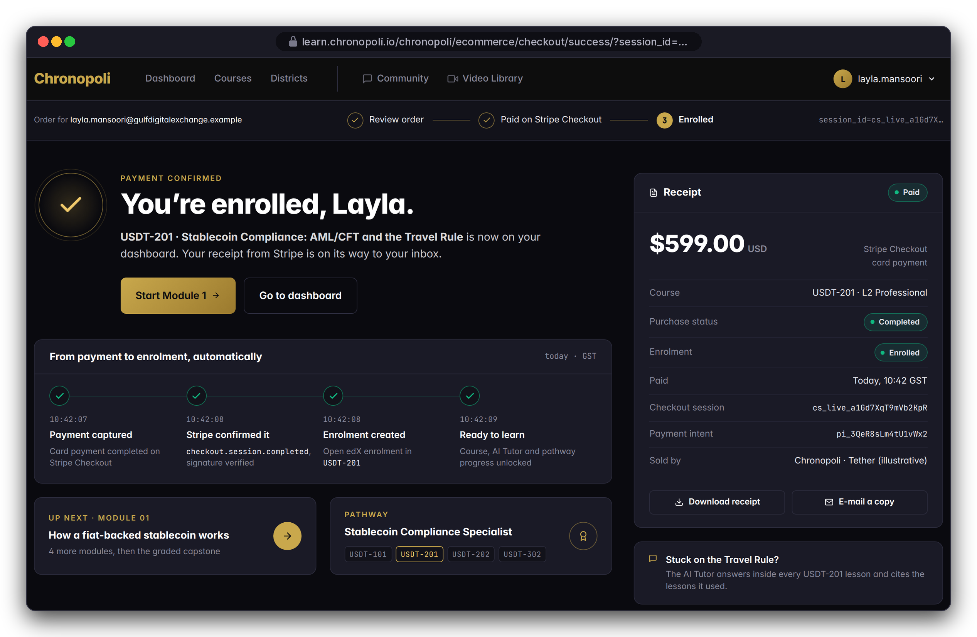
PRODUCT TOUR · STEP 4 OF 9 · ENROL & PAY
PILLAR 03 · OPEN KNOWLEDGE
Persona: Layla · Illustrative mock data
Enrol and pay in one checkout
The learning layer sets the price, Stripe Checkout takes the payment, and a signed webhook enrols the learner
REAL OPEN EDX SCREEN
Course page with price
DESIGN PROTOTYPE
Payment confirmed, auto-enrolled (not yet built)
Layer sets the price: L2 Professional, $599
Hosted checkout: card data stays with Stripe
Signed webhook: enrols her once, logs the 70% payout
Illustrative mock data · Tether is a partner-roadmap target only; no agreement implied
10
Notes:
The course page and price are live Open edX: USDT-201, L2 Professional, $599, and Chronopoli never sees card details because Stripe hosts the checkout. The confirmation page is a prototype because its template is missing (R-10). The checkout routing bug is fixed (R-11). Still open for the Commerce sprint: making Open edX itself enforce payment through paid course modes (R-12), and handling refunds and webhook edge cases (R-14).

Slide 11
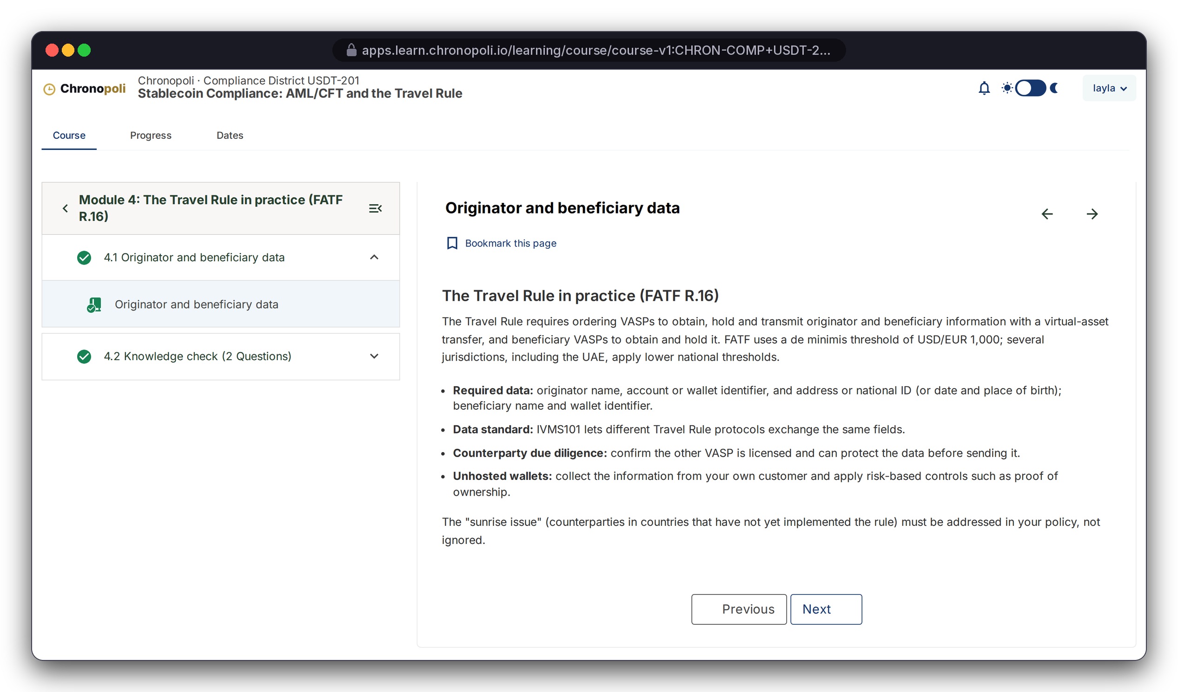
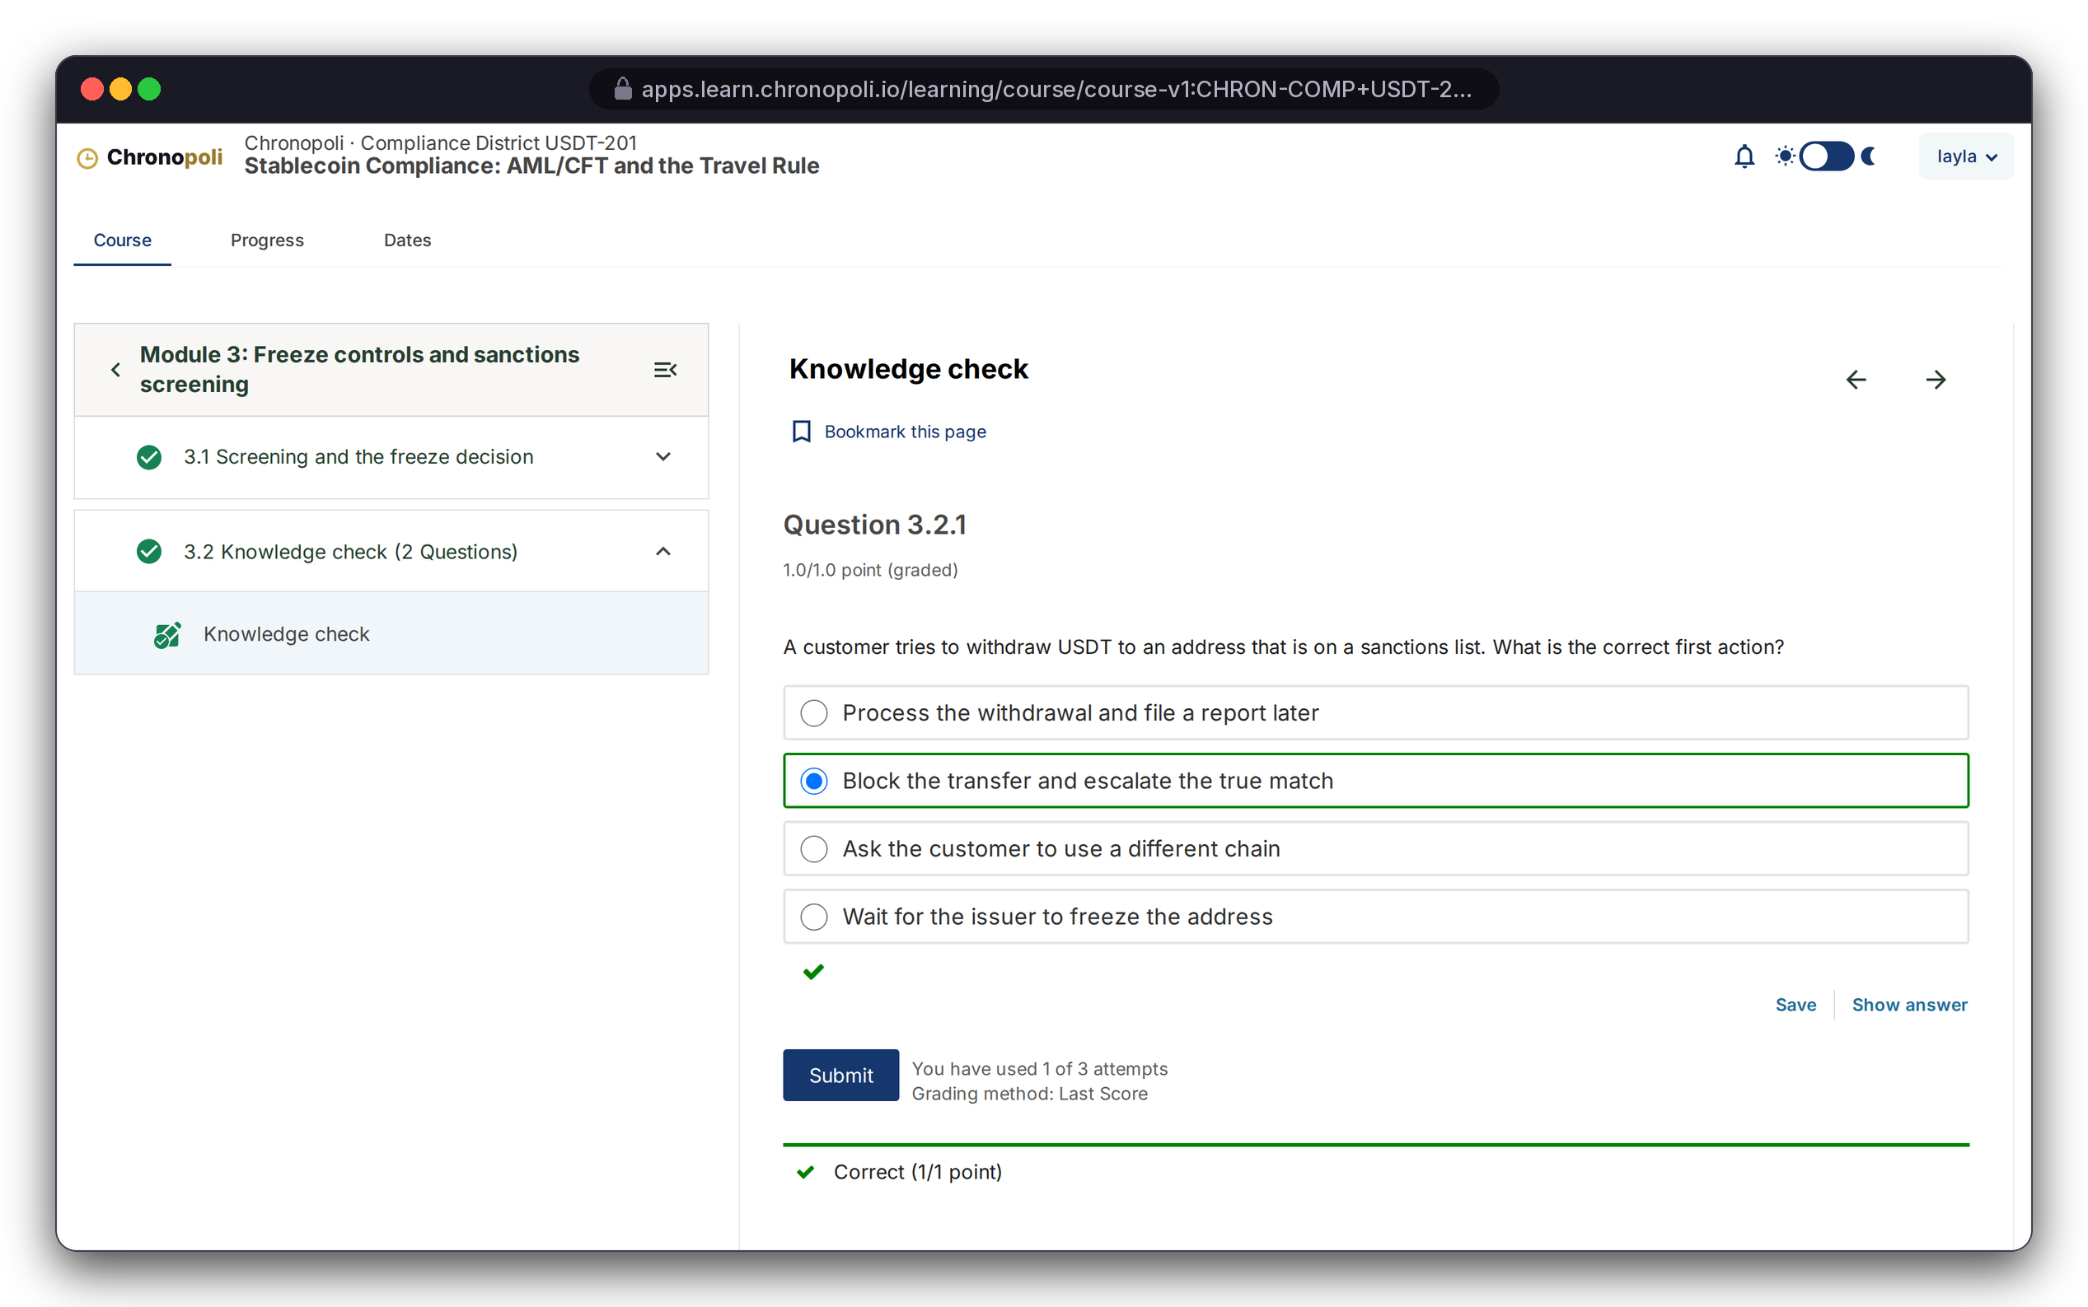
PRODUCT TOUR · STEP 5 OF 9 · LEARN
PLATFORM CORE
Persona: Layla · Illustrative mock course content
Learn on a proven LMS: lessons and auto-graded checks
Real Open edX courseware: completion tracking, graded problems, attempts and feedback out of the box
REAL OPEN EDX SCREEN
Learning MFE · lesson 4.1, the Travel Rule in practice
REAL OPEN EDX SCREEN
Knowledge check 3.2 · correct on attempt 1 of 3
USDT-201: six modules, ending in a graded capstone
Instant grading: attempts are tracked (1 of 3 used)
Illustrative mock data · Tether is a partner-roadmap target only; no agreement implied
11
Notes:
Layla worked through the course in a real browser session; these aren't mock-ups. This is the no-fork advantage in practice: world-class courseware, grading and progress tracking that Open edX maintains for us. Our engineering goes into what sits around it.

Slide 12
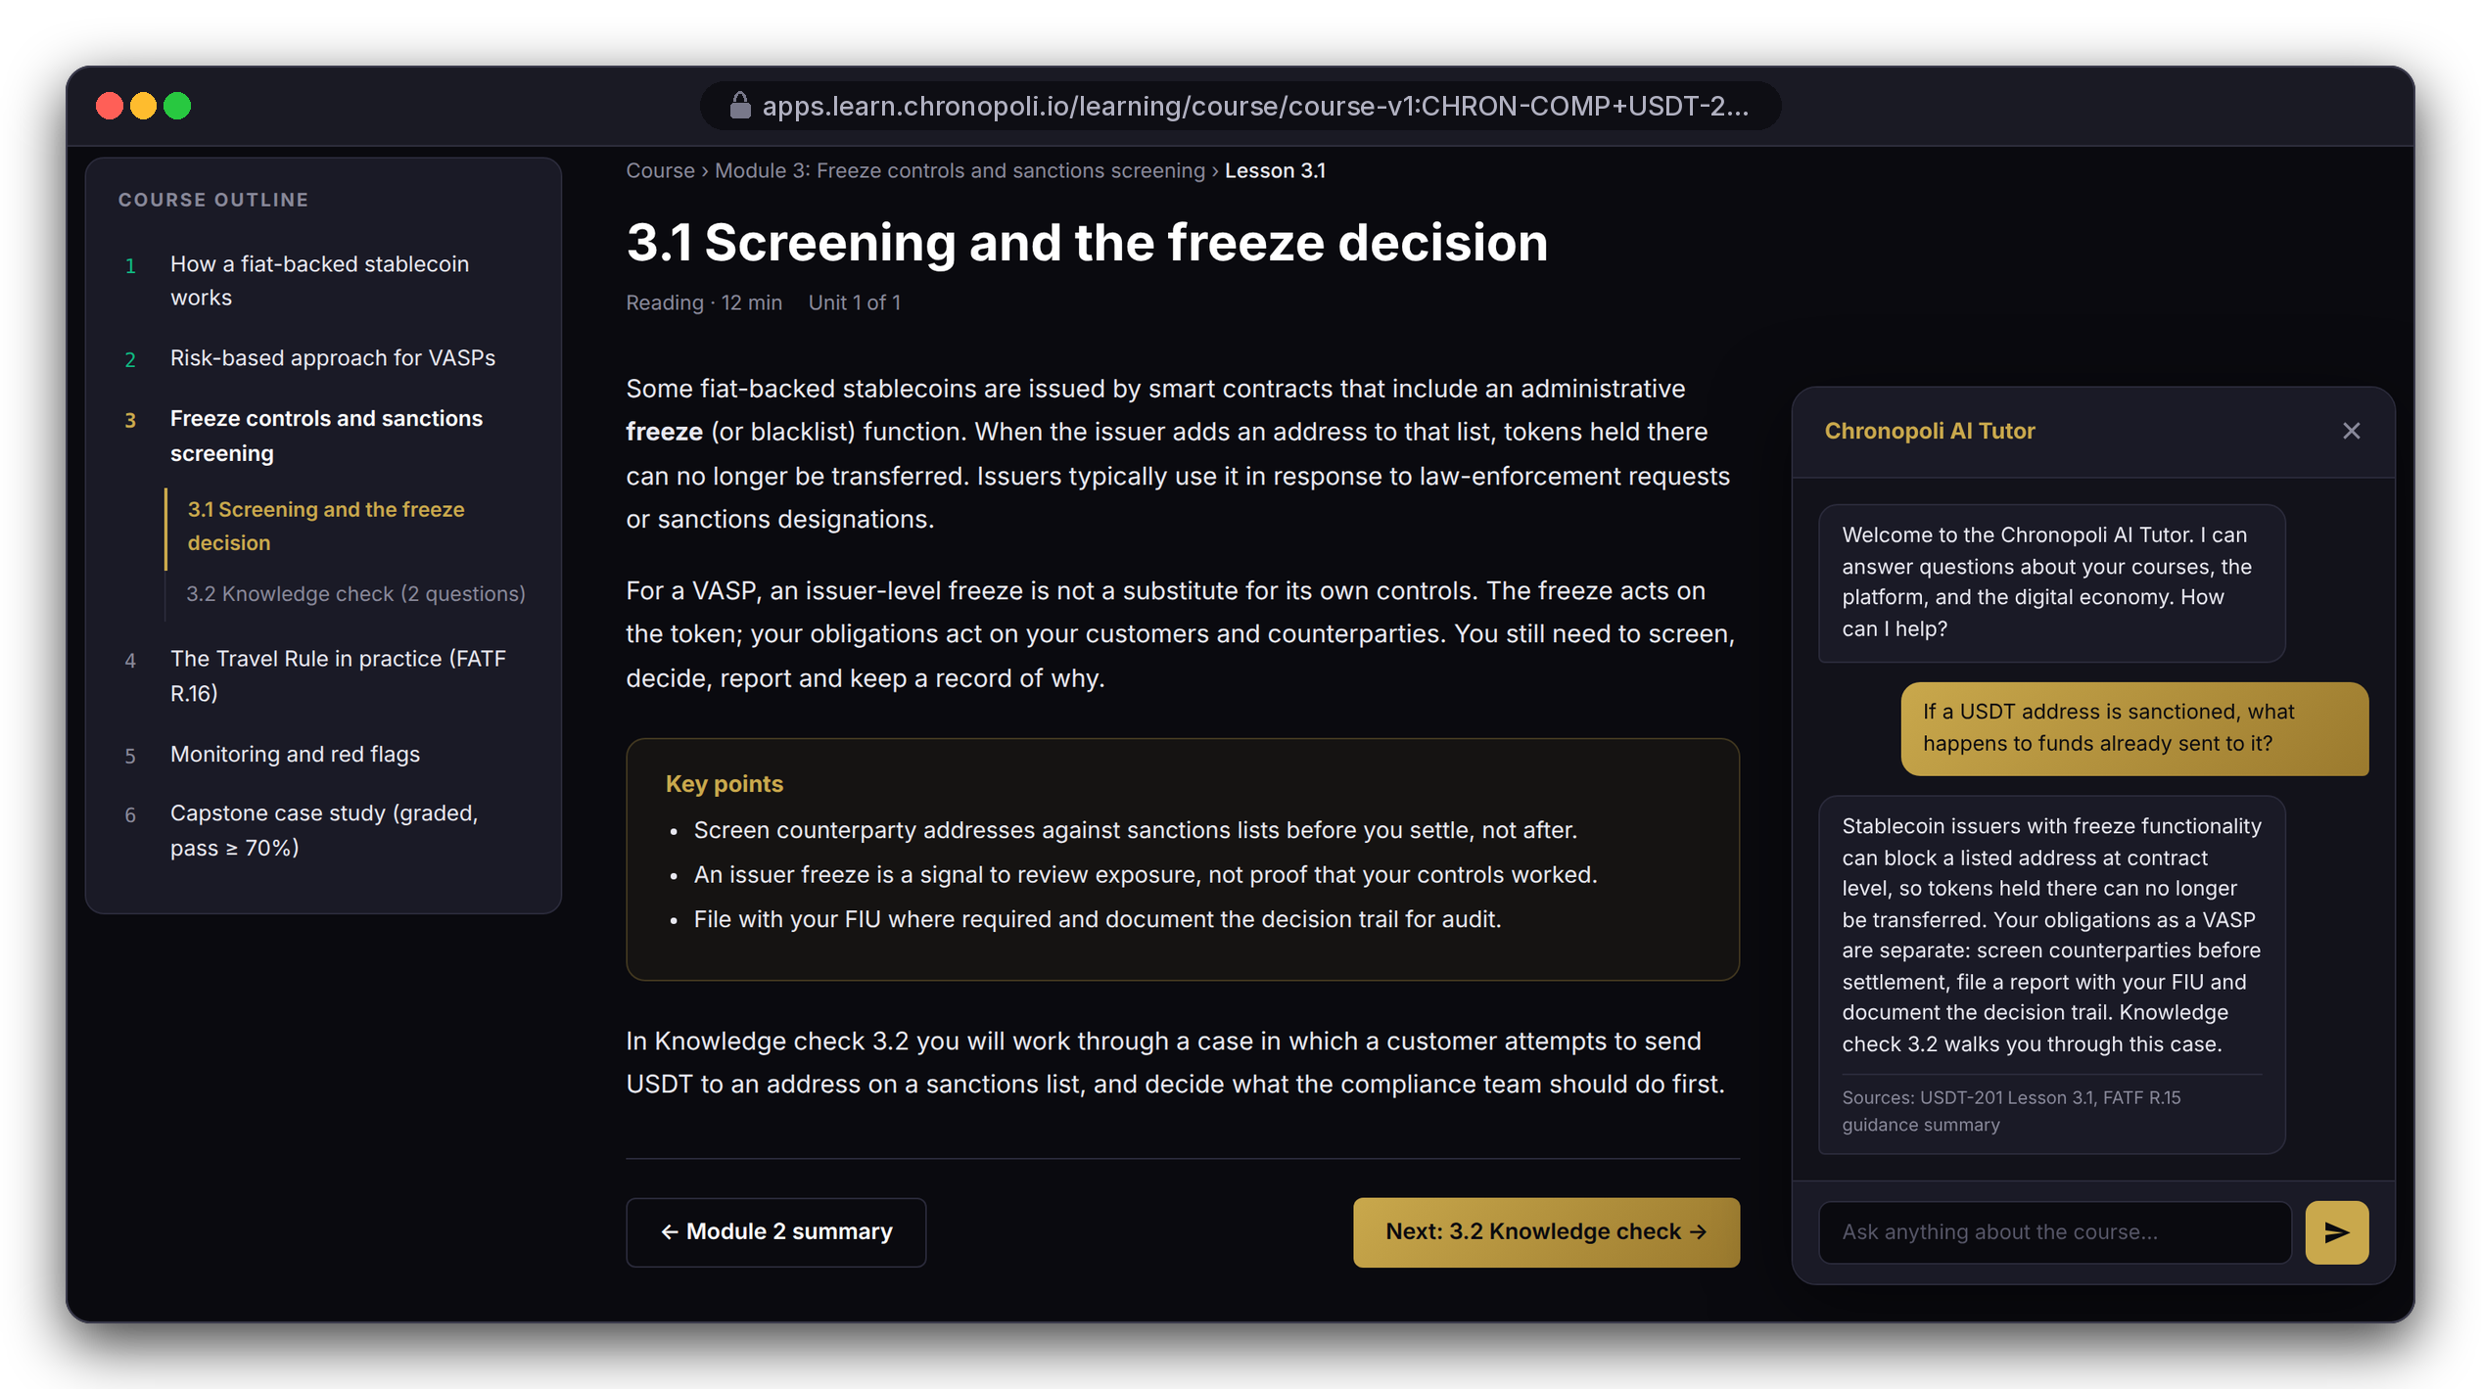
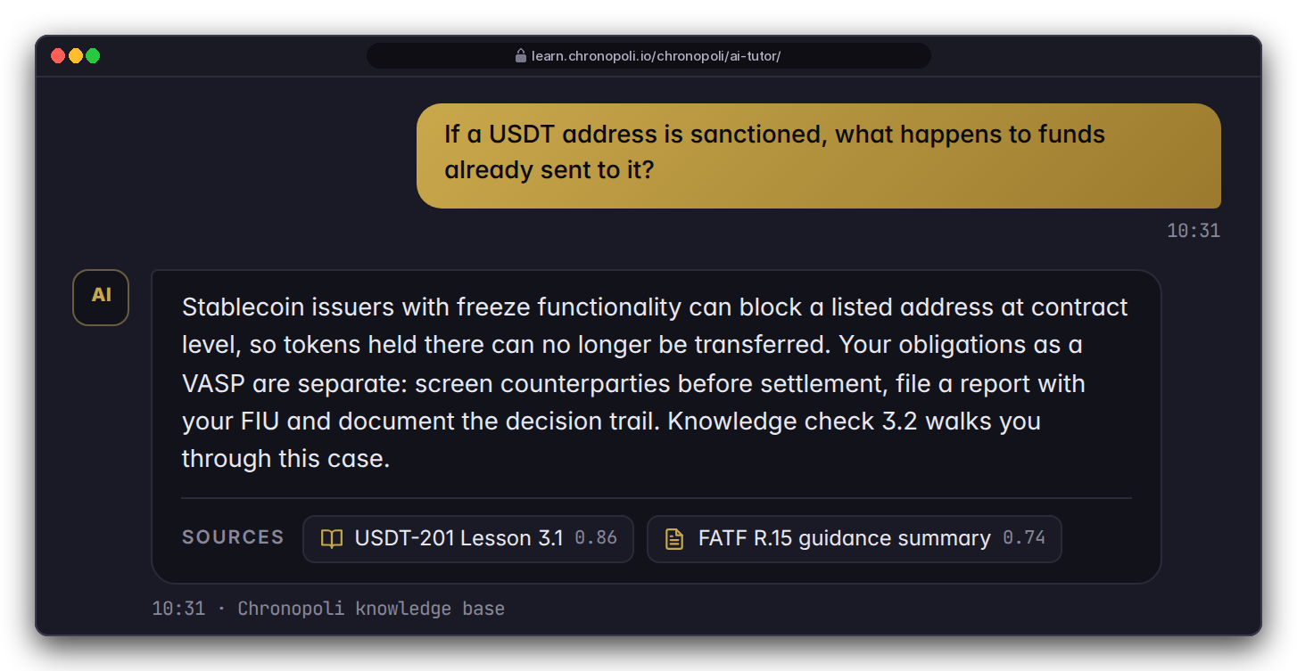
PRODUCT TOUR · STEP 6 OF 9 · AI TUTOR
PILLAR 03 · OPEN KNOWLEDGE
Persona: Layla, Module 3 · Mock lesson, target theme
An AI tutor that cites its sources
Claude on Amazon Bedrock answers inside the lesson, from the Chronopoli knowledge base, and shows its sources
DESIGN PROTOTYPE
Tutor history (not yet built)
In Module 3: Layla asks what happens to funds already sent to a sanctioned USDT address
Cited answer: grounded in USDT-201 Lesson 3.1 and the FATF R.15 summary, at her L2 depth
A learning aid: not legal or compliance advice
DESIGN PROTOTYPE
The repo's real tutor widget on a prototype lesson page · scripted answer, Bedrock stubbed
Illustrative mock data · Tether is a partner-roadmap target only; no agreement implied
12
Notes:
The widget, the Chronopoli header and the chat view that streams the answer are real repo code, and that view built a system prompt personalised to Layla. The two Bedrock calls were stubbed in the harness, so the answer text is scripted demo copy, not live model output; say so if asked. This is our platform moat (milestone M6): tutoring grounded in partner courses and round-table papers. The review fixed the history bug that broke the tutor after about six questions (R-15) and the knowledge-base IAM permissions (R-16). Still open for sprint 5: the knowledge-base index and access policy (R-18) and per-user quotas (R-32). Check on staging that the widget appears inside the new Learning MFE. The dark/gold look is the target Chronopoli theme; the real Open edX screens on slide 11 still use the stock theme, and both show the same Module 3 outline. This is the AI Tutor of the Open Knowledge pillar.

Slide 13
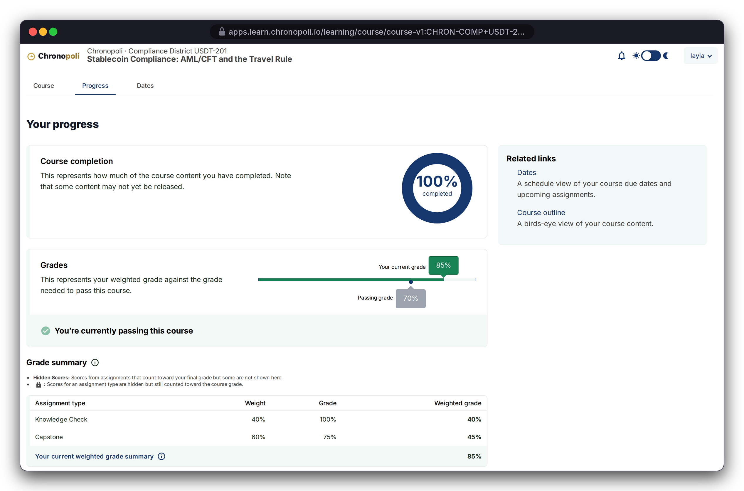

PRODUCT TOUR · STEP 7 OF 9 · PASS & PATHWAY
PILLAR 02 · COMPANY ACADEMIES
Persona: Layla · Grades API stubbed
Pass, then watch the pathway fill up
Open edX grades each course; the academy reads those grades to track the whole pathway
REAL OPEN EDX SCREEN
Progress page
REAL CHRONOPOLI TEMPLATE RENDER
Pathway page
USDT-201 complete: 85% against a 70% pass mark (weights: knowledge checks 40%, capstone 60%)
Pathway: four required courses in four districts, all passed; no parallel grade book
Illustrative mock data · Tether is a partner-roadmap target only; no agreement implied
13
Notes:
Layla answered one capstone question wrong on purpose, so the 85% is a grade Open edX computed from her submitted answers. The pathway spans Digital Assets, Compliance, Risk & Trust and Governance. That's the city idea: one credential built from several districts. In the harness the grades call is a stub; in production it reads the Open edX grades API.

Slide 14

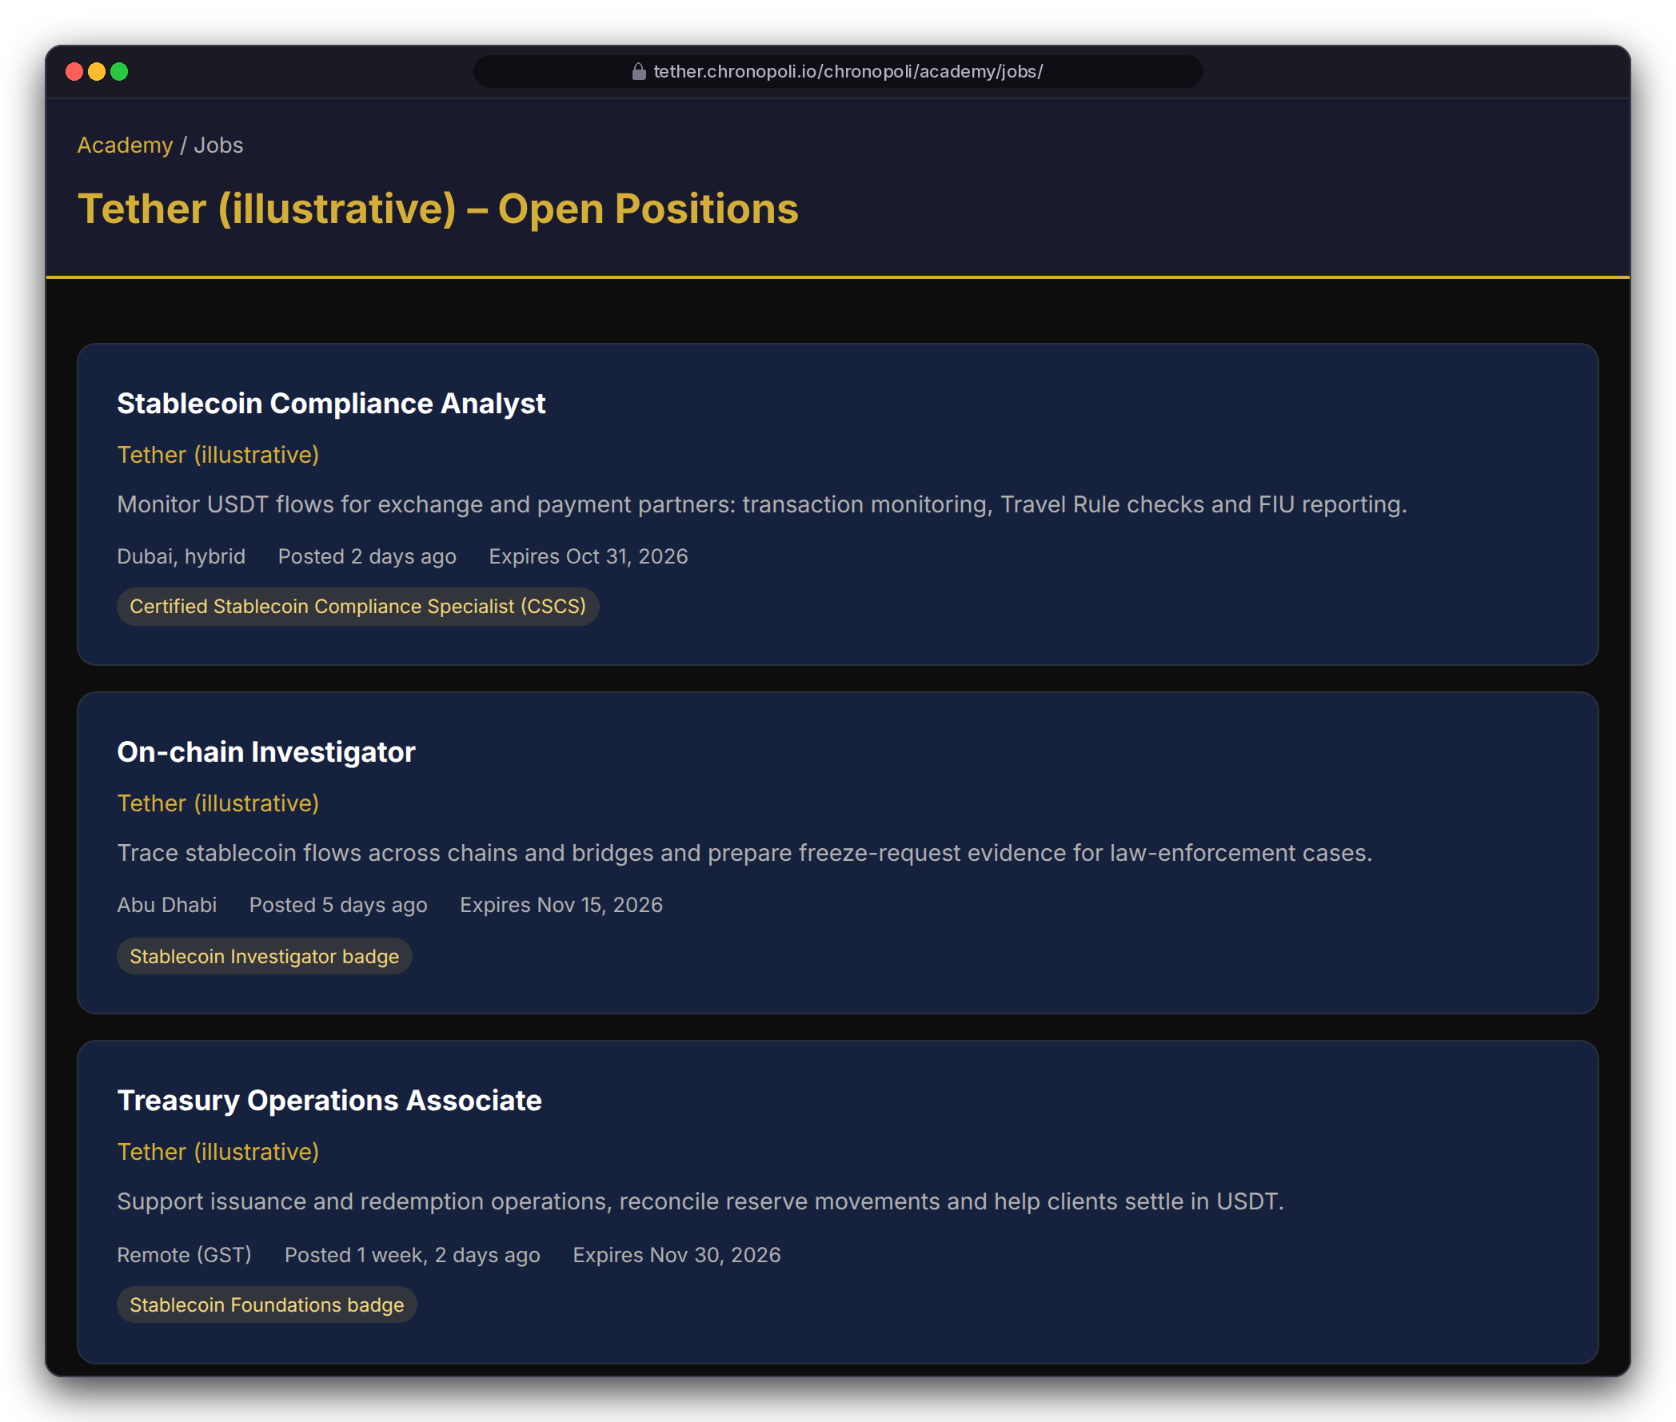
PRODUCT TOUR · STEP 8 OF 9 · BADGE TO JOB
PILLAR 02 · COMPANY ACADEMIES
Persona: Layla · Fictitious roles
From credential to career
Finishing a pathway issues a verifiable Open Badge, and partners can require that badge for open roles
CSCS badge: Open Badges 2.0, readable by badge wallets and HR systems
Roles can require a badge: the Stablecoin Compliance Analyst role (Dubai, hybrid) asks for CSCS
Consent first: learners opt in before partners see their badges (a go-live requirement)
REAL CHRONOPOLI TEMPLATE RENDER
CSCS badge
REAL CHRONOPOLI TEMPLATE RENDER
Partner job board
Illustrative mock data · Tether is a partner-roadmap target only; no agreement implied
14
Notes:
The pitch to partners: you don't just educate the market, you hire from it. The badge was awarded with the repo's own award function. Two fixes are needed before this is automatic and compliant: the auto-badge trigger on certificate creation (R-22), and explicit opt-in before learners are auto-applied to jobs (R-37, UAE data-protection risk, sprint 2).

Slide 15
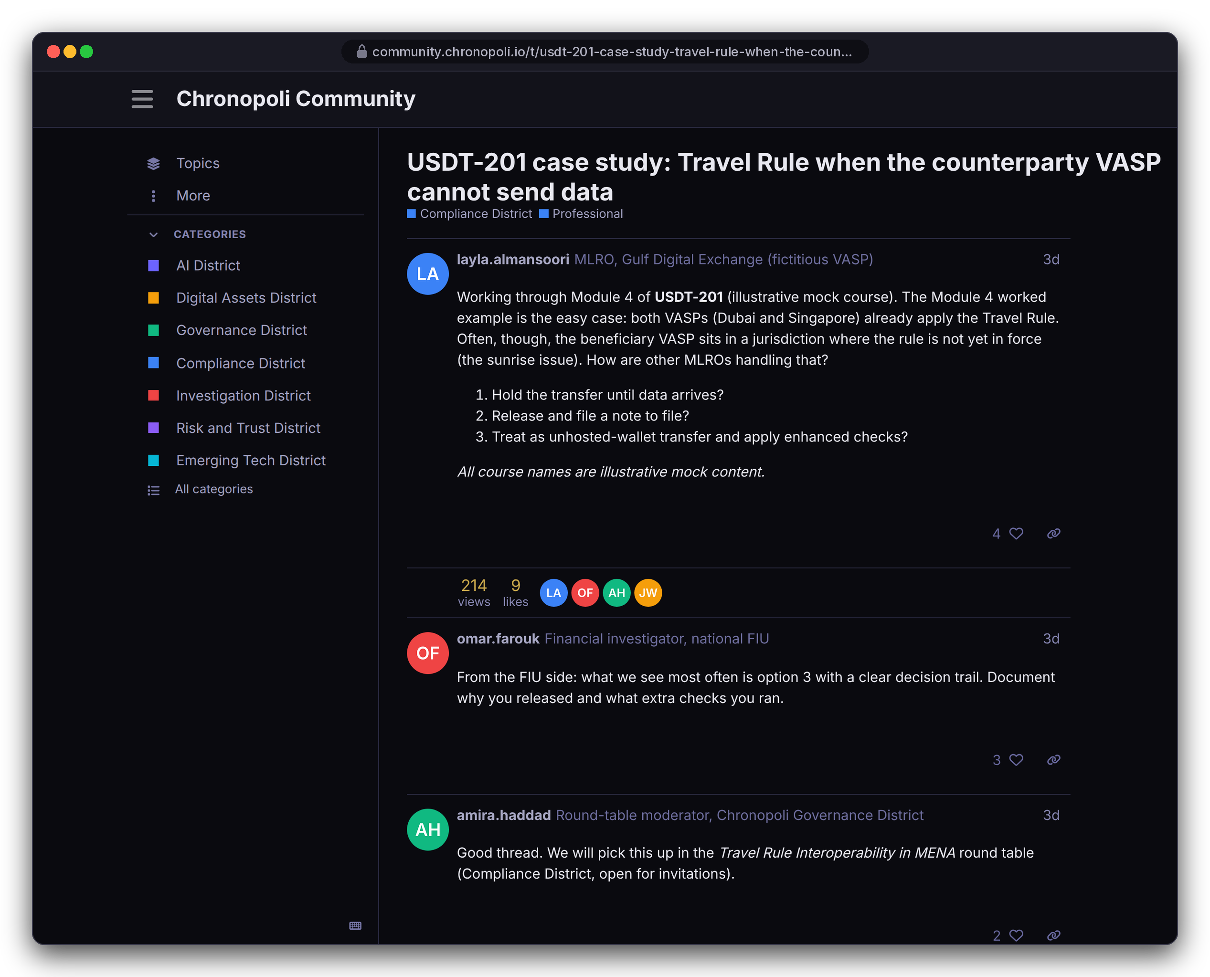
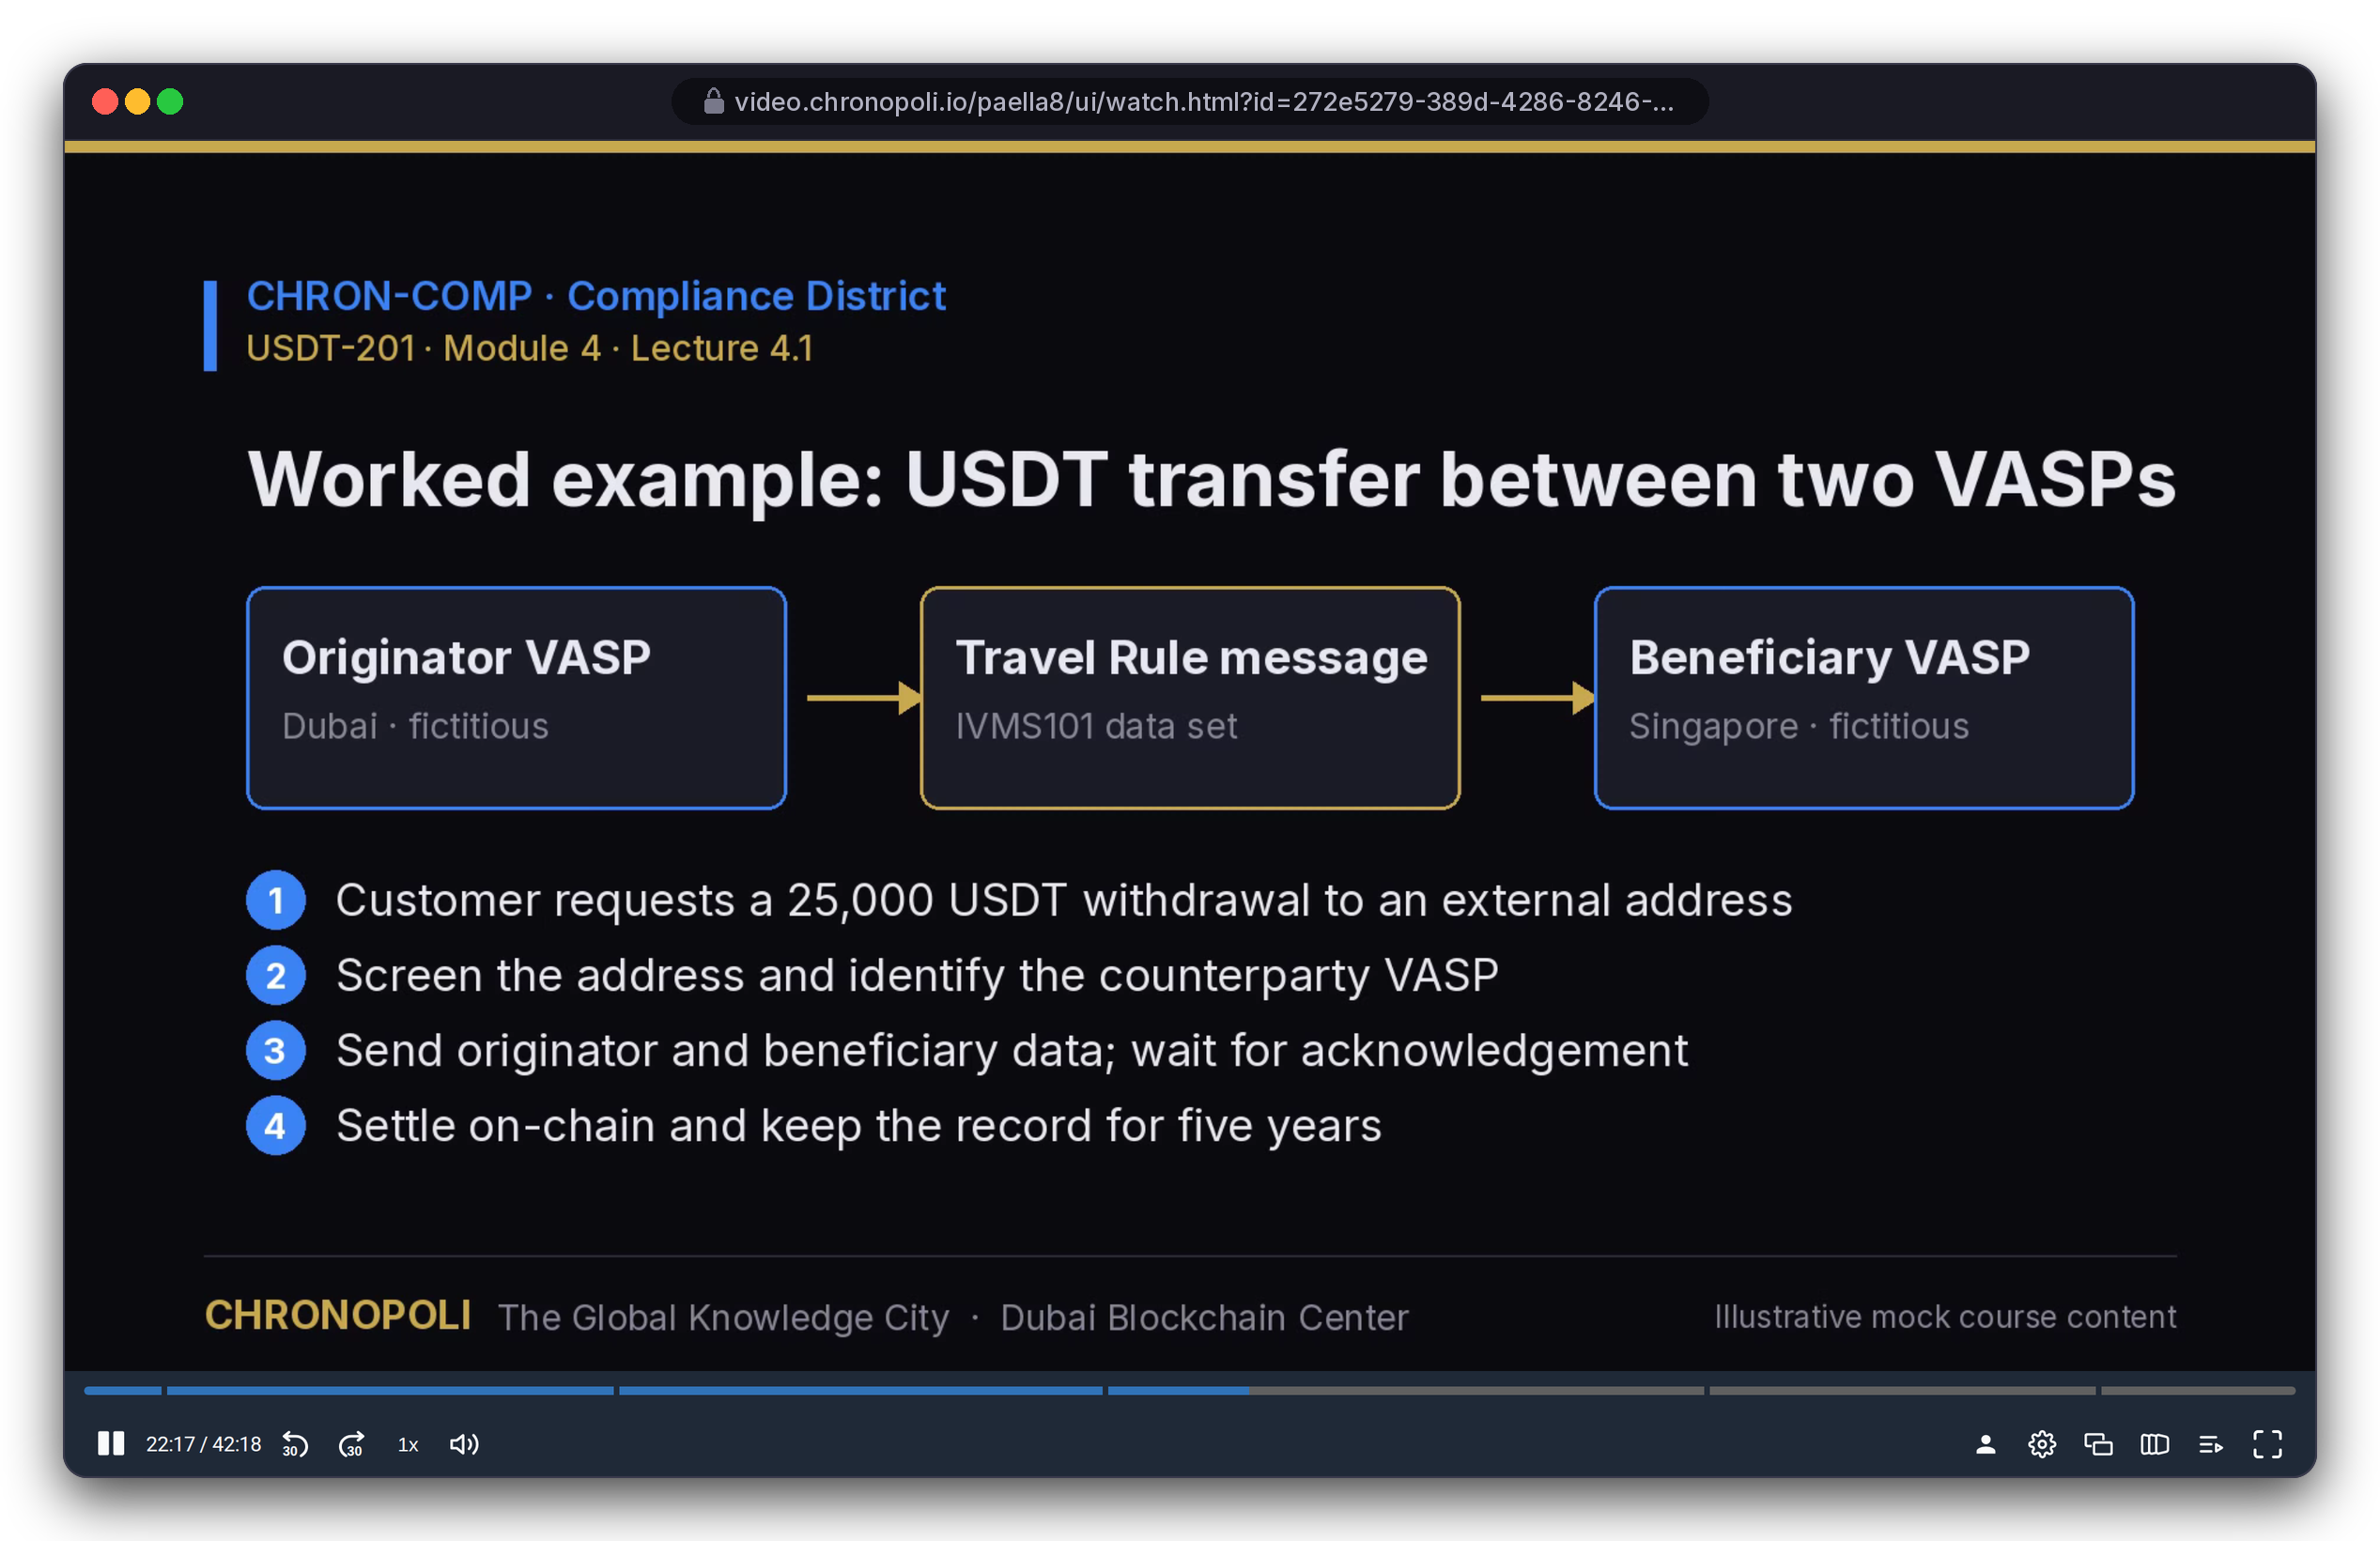
PRODUCT TOUR · STEP 9 OF 9 · COMMUNITY & VIDEO
PLATFORM CORE
Persona: Layla during USDT-201 · Illustrative mock content
Community and video, in district colours
District forums on Discourse and lecture video on Opencast: both real, both running in our stack
REAL EXTENSION
Discourse 3.5 · Travel Rule thread
REAL EXTENSION
Opencast 20.4 · Paella player, lecture 4.1
Community: a forum per district, joined via SSO; an MLRO asks, an FIU investigator answers
Video: Opencast records lectures; Paella adds a slide index so learners jump to any slide
Illustrative mock data · Tether is a partner-roadmap target only; no agreement implied
15
Notes:
Both systems ran for real in Docker for these captures, with seeded content. The thread starts from the Module 4 worked example in the lecture, where both VASPs already apply the Travel Rule, and asks about the harder sunrise case, so course, video and community connect. Presenton couldn't be captured because its image download was blocked in the capture environment, so we don't show a screen for it. Keeping the SSO secret in sync between Tutor and Discourse is still open (R-28).

Slide 16




PART 2
The partner side: why organisations pay
Author, run, measure and earn from an academy, plus round tables and expert masterclasses that no catalogue offers
Authoring in Studio
Slide 17
NEW PERSONAS (FICTITIOUS)
Partner dashboard and weekly reports
Slide 18
NK
Nadia Karim
Academy administrator (fictitious)
Symposia: round tables and the five-output pipeline
Slides 19-20
Open Knowledge: Digital Twin masterclasses
Slide 21
AH
Dr. Amira Haddad
Round-table moderator (fictitious)
Market, business model, licences and payouts
Slides 22-27
Financials, traction, team, plan and the ask
Slides 28-40
Illustrative mock data · Tether is a partner-roadmap target only; no agreement implied
16
Notes:
We switch personas here: Nadia Karim runs the partner academy, and Dr. Amira Haddad moderates round tables. Both are fictitious. From now on, the question is what a partner gets for its money.

Slide 17
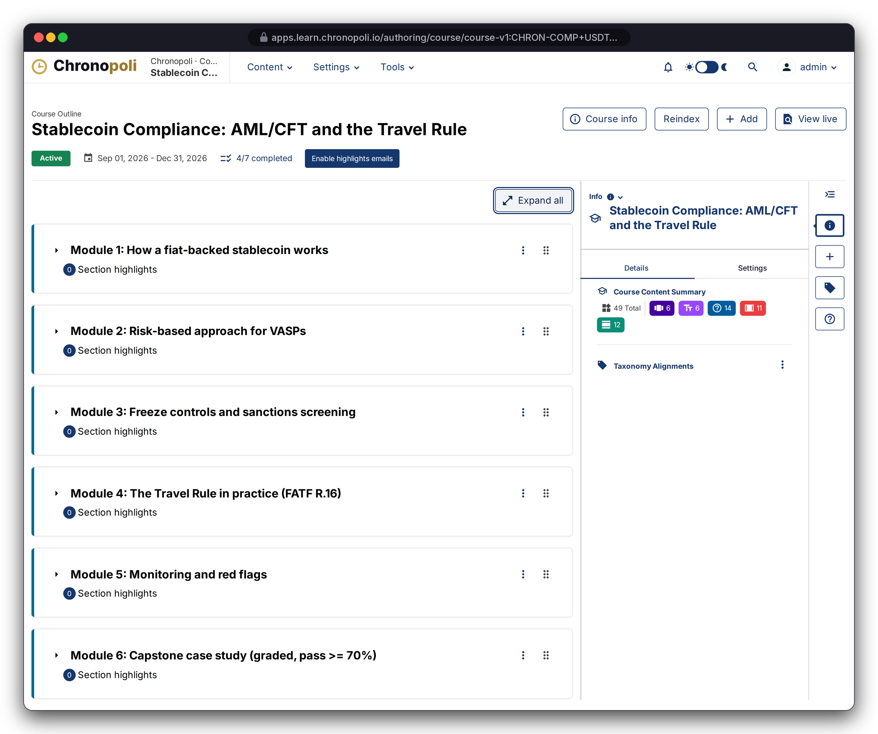
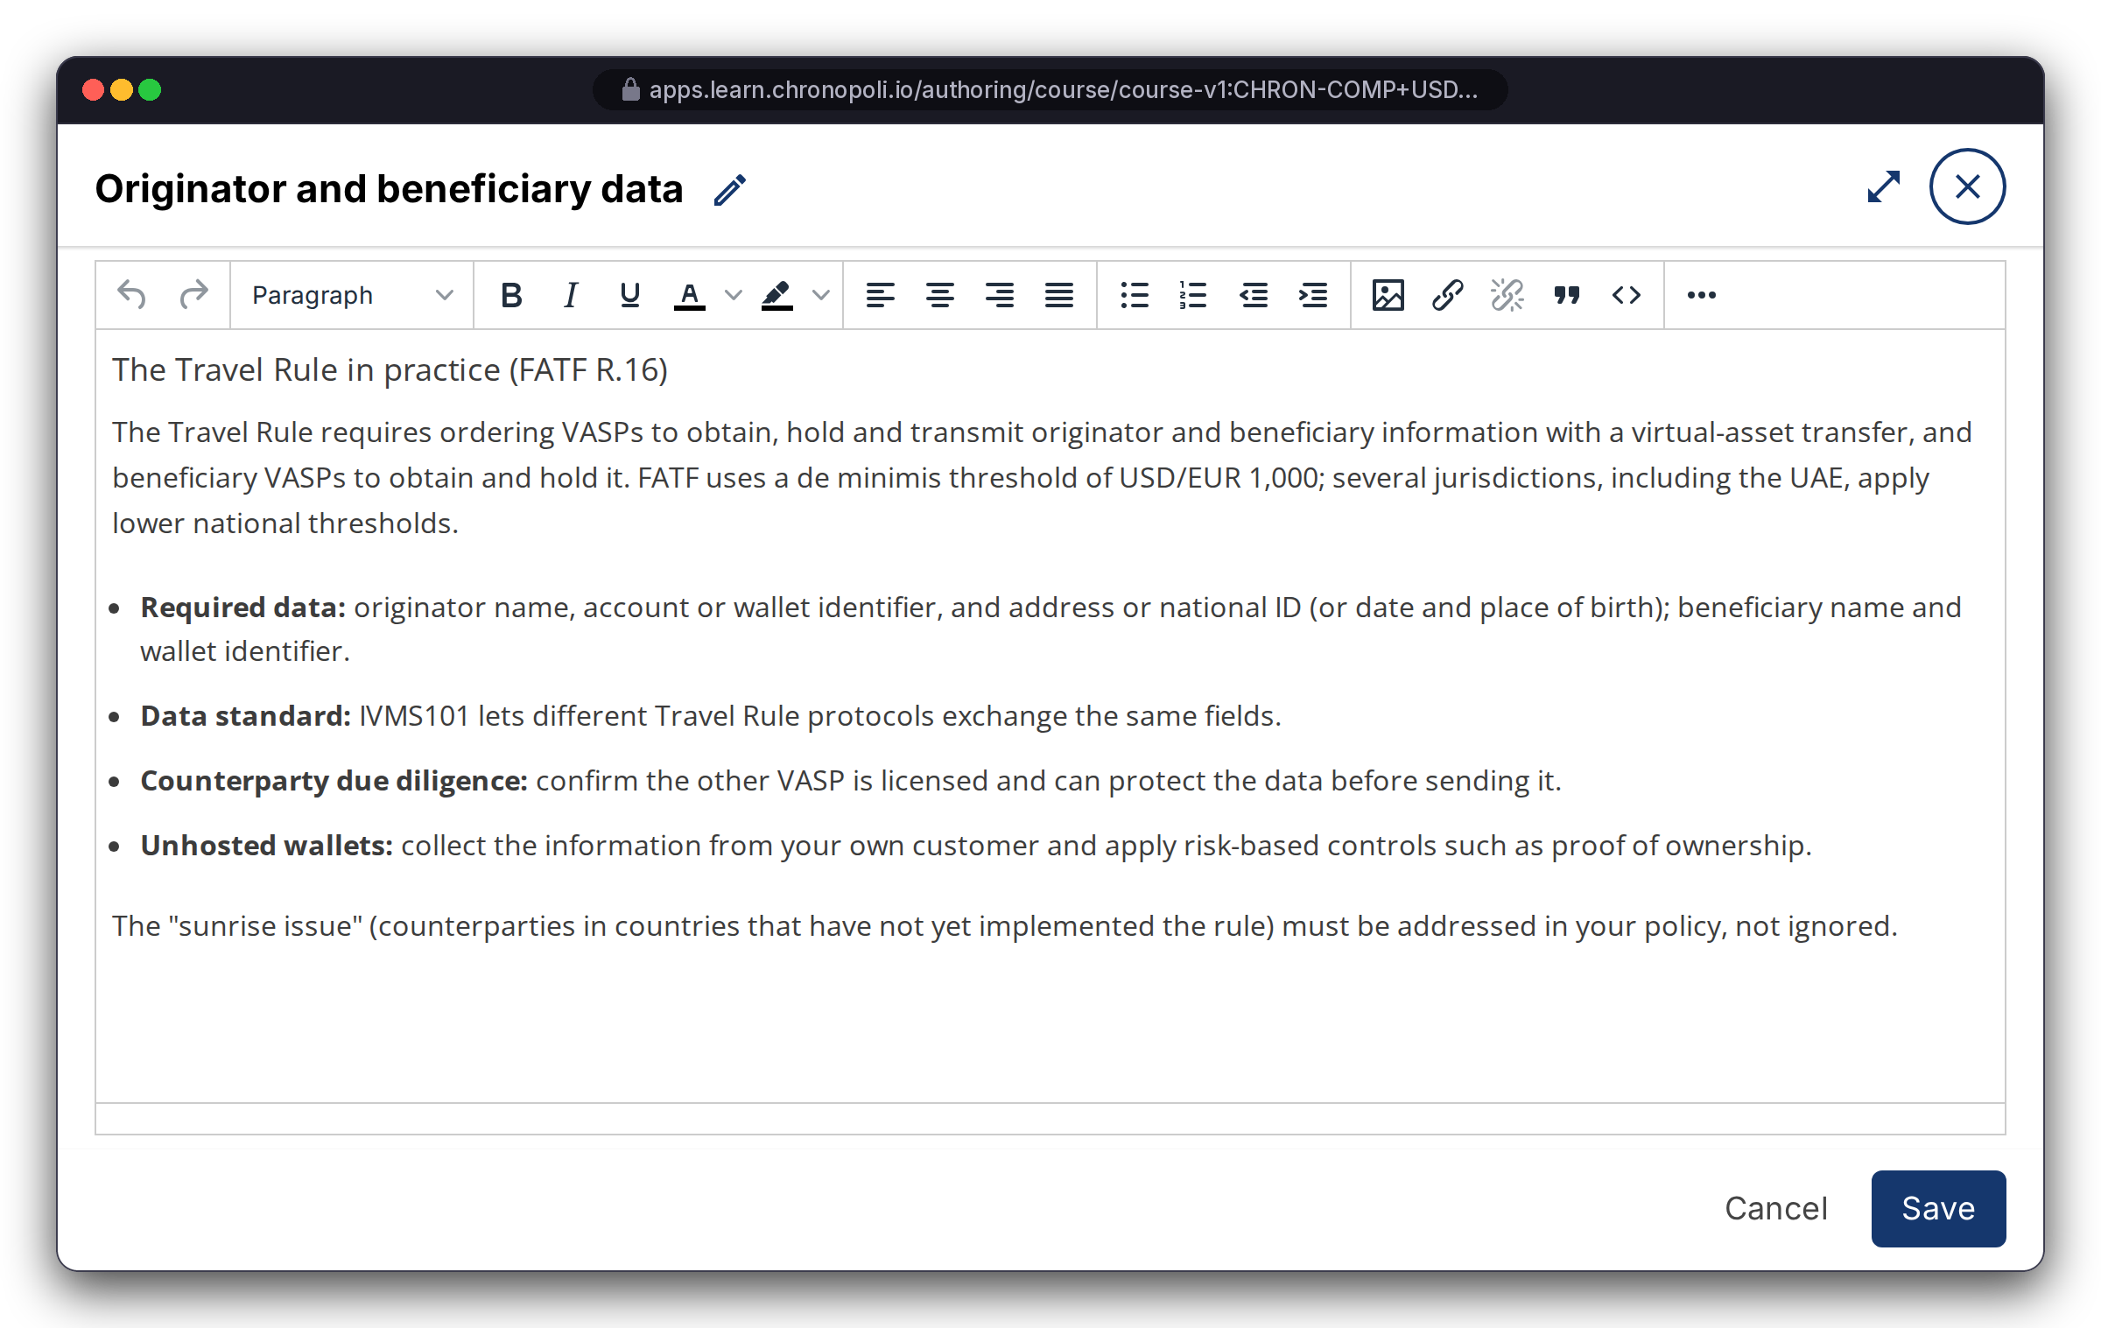
PARTNER SIDE · AUTHOR
PLATFORM CORE
Persona: course team (admin account)
Partners author on Open edX Studio: nothing to rebuild
Course outline, rich-text editing, scheduling and grading policies come straight from upstream Open edX
REAL OPEN EDX SCREEN
USDT-201 outline, 6 modules
REAL OPEN EDX SCREEN
Rich-text editor, lesson 4.1
District orgs: courses are built under e.g. CHRON-COMP, then linked to an academy
Straight from Studio: outline, editor, dates and grading
No fork: every upgrade improves authoring at no cost
Illustrative mock data · Tether is a partner-roadmap target only; no agreement implied
17
Notes:
Partners already know this kind of tool, and Open edX runs it at global scale. All eight demo courses were built and imported through this toolchain, so onboarding a partner's content means importing a course, not starting a software project. Pathways, badges and job postings are then set up in the academy admin.

Slide 18
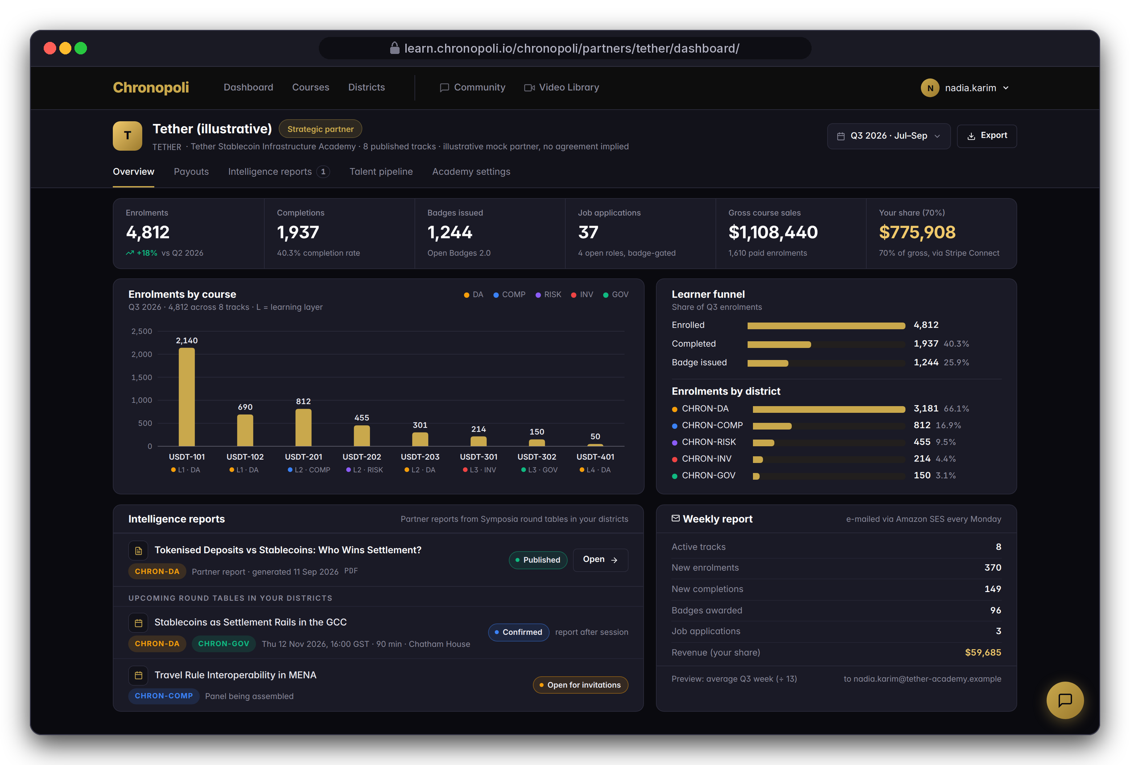
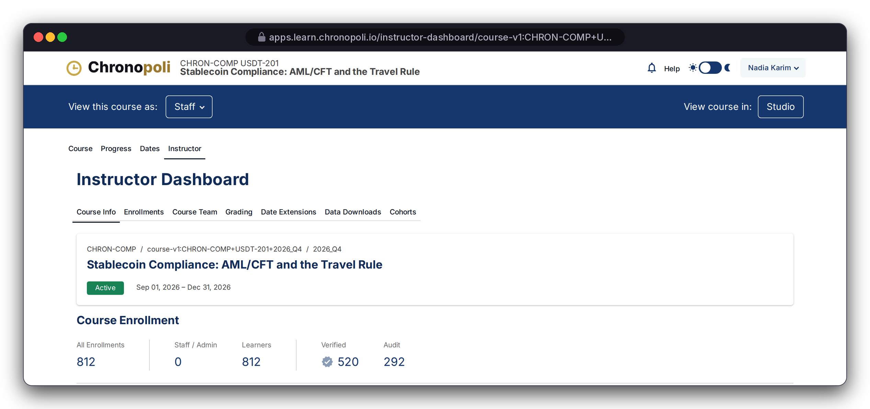
PARTNER SIDE · MEASURE
PILLAR 02 · COMPANY ACADEMIES
Persona: Nadia Karim, academy admin (fictitious)
A live cockpit for every partner
Enrolments, completions, badges, revenue and intelligence reports, plus a weekly e-mail summary
REAL OPEN EDX SCREEN
Instructor dashboard
KPIs: enrolments by course and district, learner funnel
Partner Intelligence Reports: from its districts’ round tables
Weekly summary: via Amazon SES, plus a JSON API
From Open edX: USDT-201 shows 812 enrolled, 520 verified (paid)
DESIGN PROTOTYPE
Partner dashboard (template not yet built) · Illustrative mock KPIs
Illustrative mock data · Tether is a partner-roadmap target only; no agreement implied
18
Notes:
The counts on the right come from 811 bulk-created demo accounts plus Layla, sized to match the scenario. If asked about the other 292: in the demo they are audit (unpaid) enrolments, and the scenario counts only verified enrolments as sales. The review added the weekly-report task (R-7, fixed), though Tutor still needs a scheduler process. Before go-live: a proper partner-user access model (R-26), reports scoped to each partner (R-25, partly fixed), the dashboard template itself (R-10), and the completion-rate calculation, which the analytics code doesn't fill in yet.

Slide 19
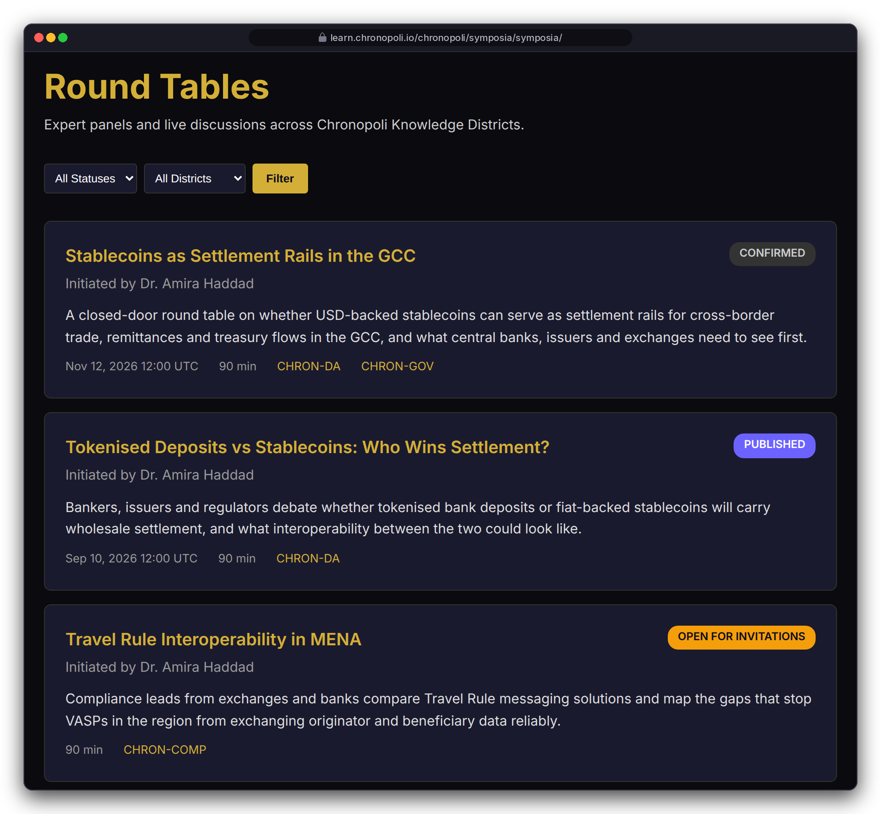
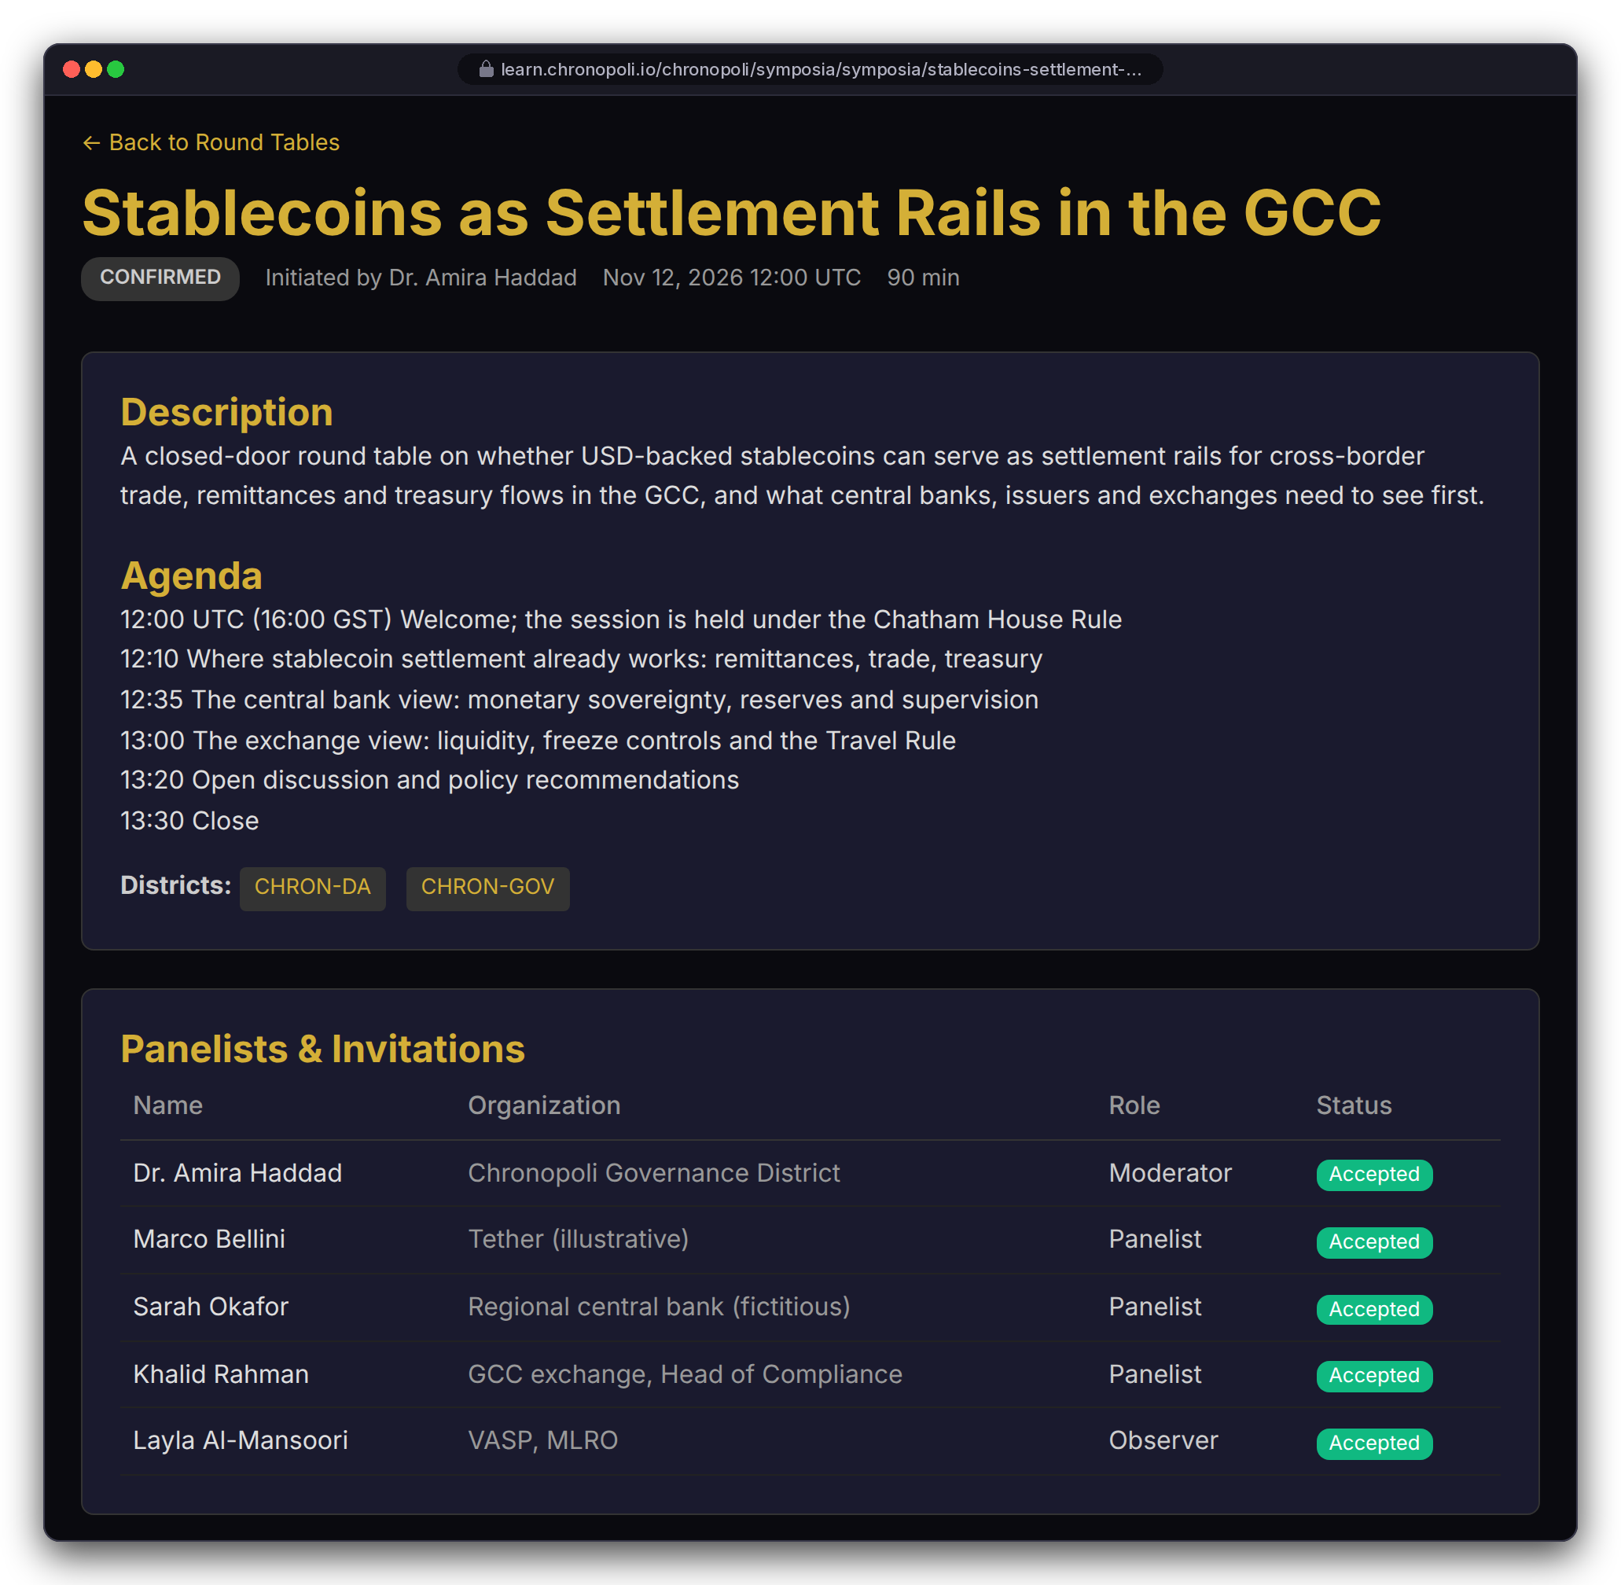
PARTNER SIDE · CONVENE
PILLAR 01 · SYMPOSIA
Persona: Layla as observer · 12 Nov 2026, 16:00 GST (12:00 UTC) · Fictitious panel
Symposia: closed-door round tables as a product
Curated expert panels under the Chatham House Rule, streamed live on AWS IVS and tied to districts
Lifecycle: draft, open for invitations, confirmed, live, processing, published
Invitations: secure and expiring, with moderator, panelist and observer roles
Partner Intelligence Report: the sponsor receives one after every session
REAL CHRONOPOLI TEMPLATE RENDER
Round-table list
REAL CHRONOPOLI TEMPLATE RENDER
Agenda and panel
Illustrative mock data · Tether is a partner-roadmap target only; no agreement implied
19
Notes:
This is the commercial differentiator (milestone M4). Putting an issuer, a central bank, an exchange and a regulator-facing moderator in one room is something no MOOC can sell. The round-table templates print times in UTC, so the agenda is written in UTC too: 12:00 UTC is 16:00 in Dubai. Open for the Pipeline sprint: the IVS recording configuration and the pipeline start (R-24).

Slide 20
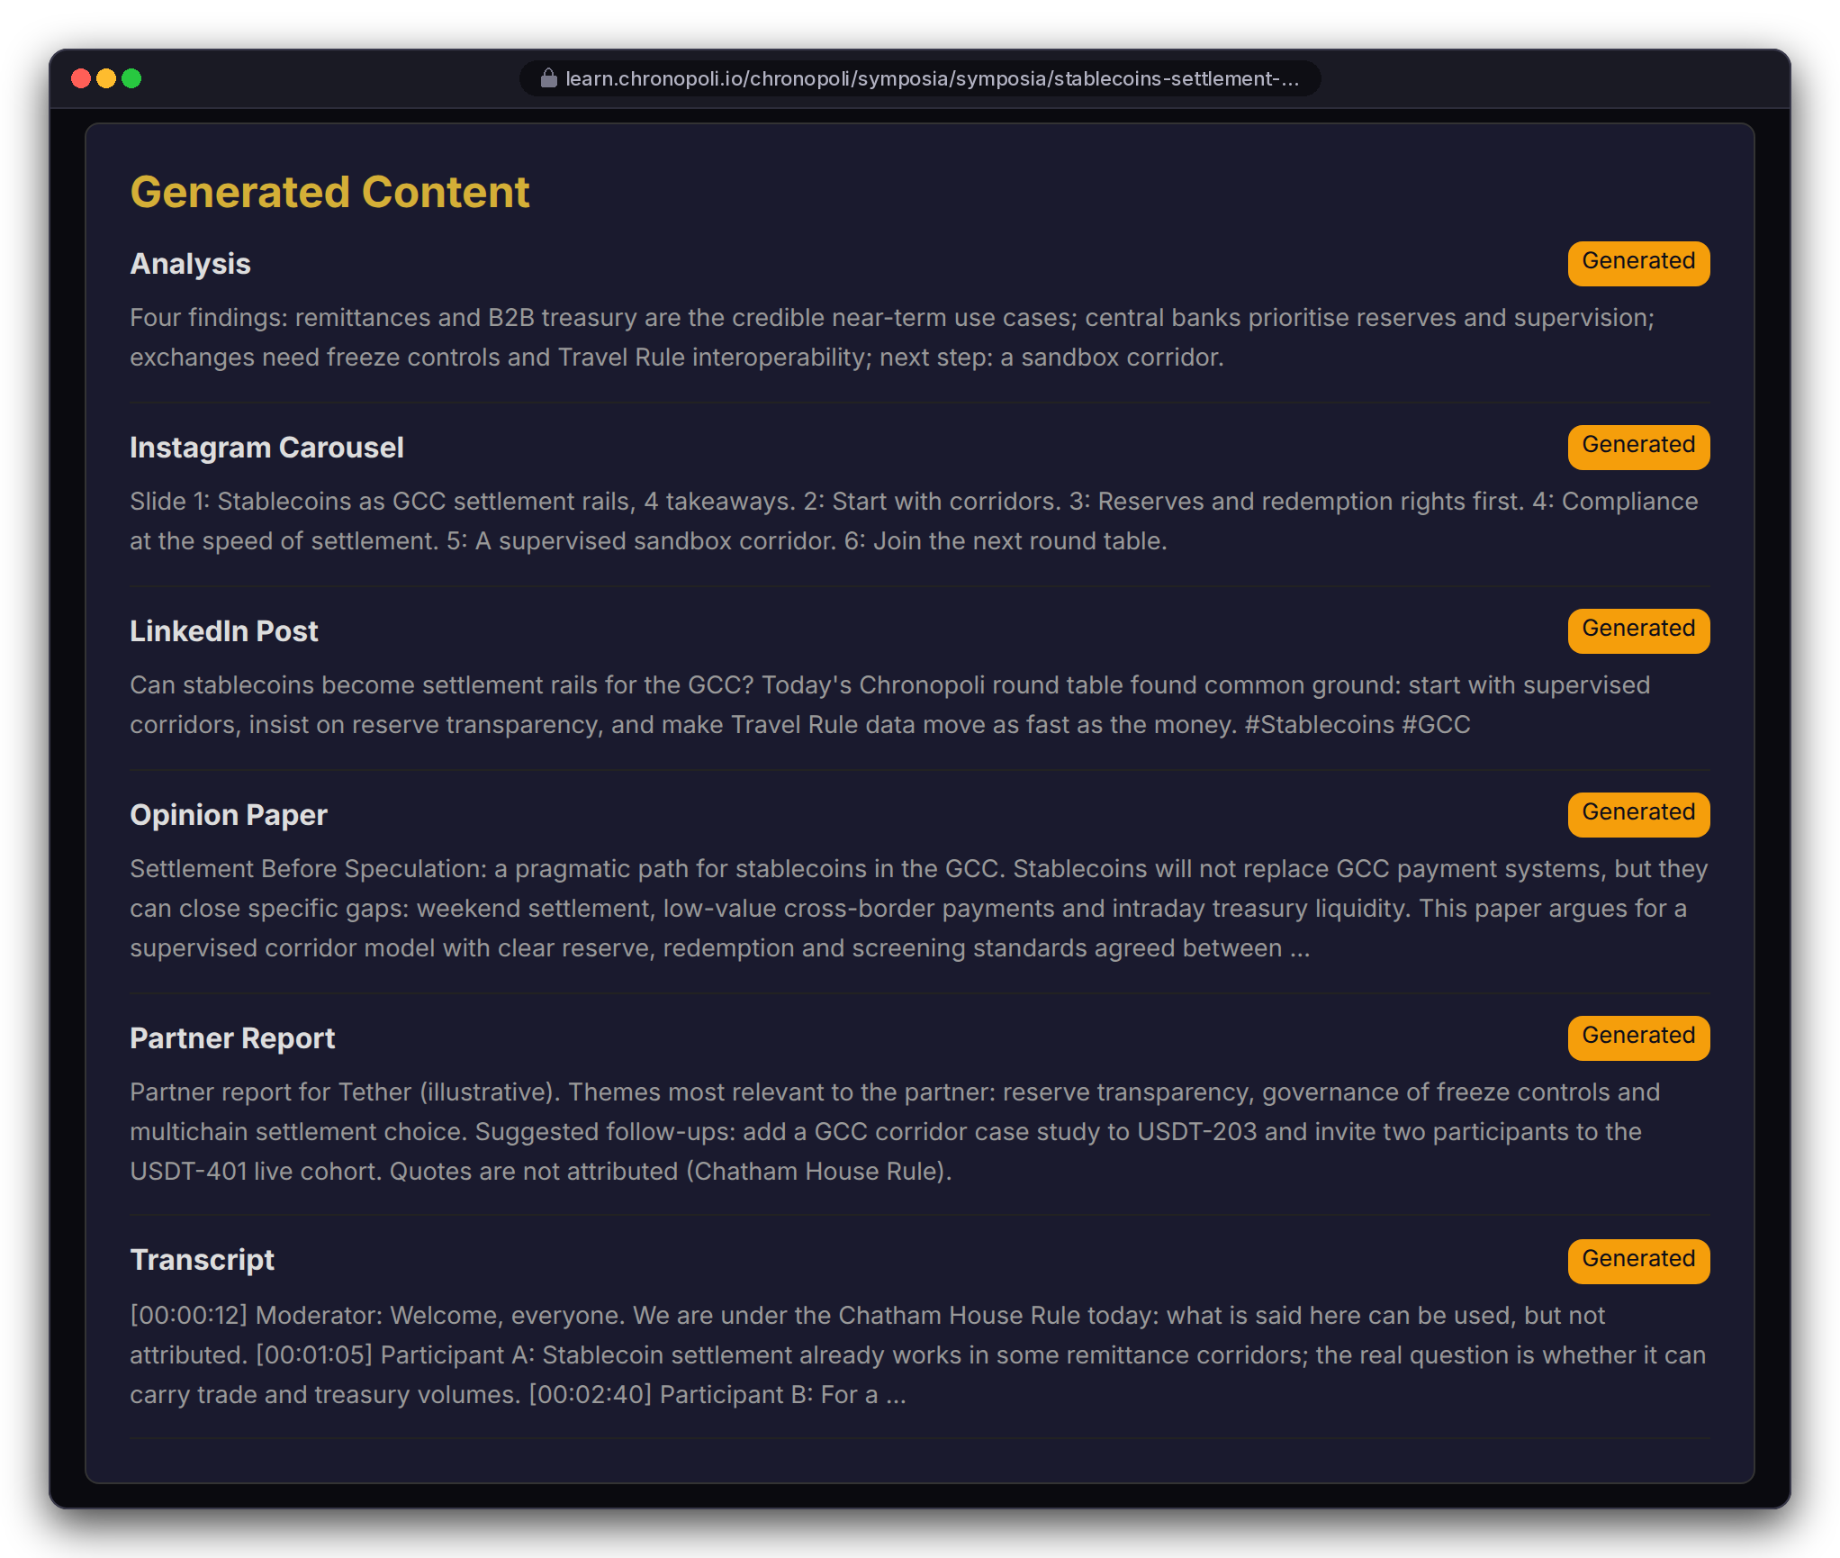
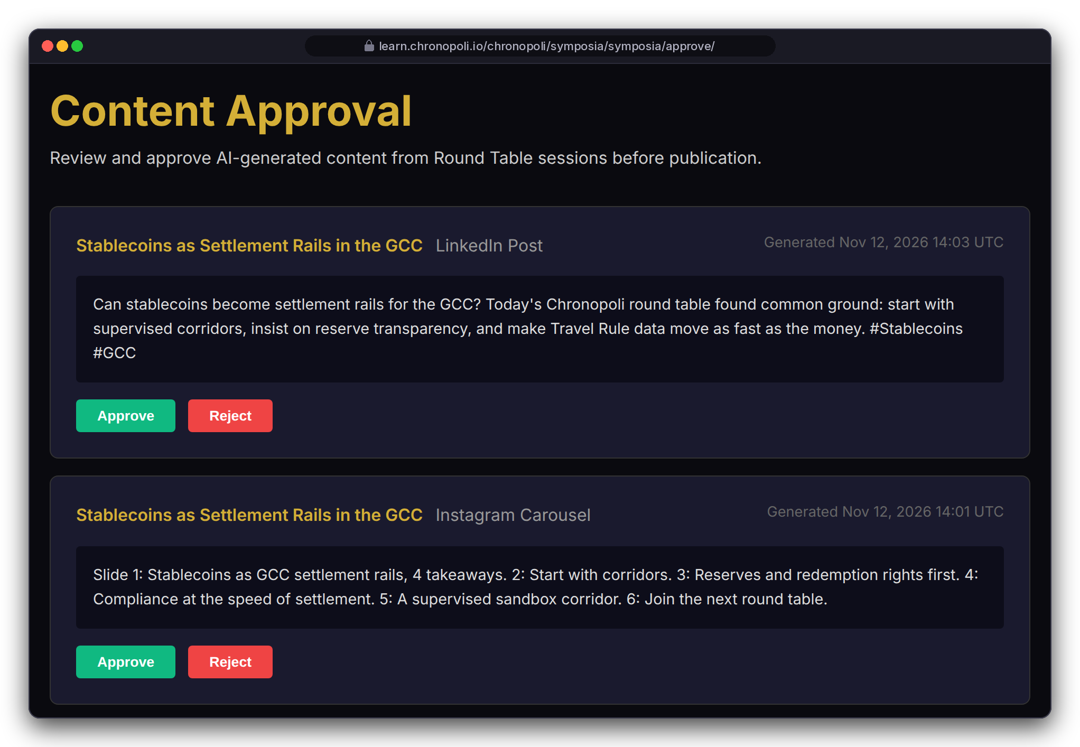
PARTNER SIDE · PUBLISH
PILLAR 01 · SYMPOSIA
Persona: Dr. Amira Haddad, moderator (fictitious) · Mock output texts
Five outputs in 3 hours, one human approves
From one round table: opinion paper, LinkedIn posts, Instagram carousel, partner report, AI-tutor update
PIPELINE STEPS (AWS)
IVS recording to S3
EventBridge
Step Functions
Amazon Transcribe
Claude analysis on Bedrock
4 parallel generators
SQS approval queue
One human approves
REAL CHRONOPOLI TEMPLATE RENDER
Outputs
REAL CHRONOPOLI TEMPLATE RENDER
Approvals
Pipeline: Step Functions runs 8 Lambda functions
Five outputs: these four, plus an AI-tutor update once approved
One human approves (~10 min): nothing auto-publishes; Chatham House anonymisation is a go-live requirement
Illustrative mock data · Tether is a partner-roadmap target only; no agreement implied
20
Notes:
Be clear: these output texts are mock copy written for the demo and shown in the real templates. The pipeline hasn't processed a real session yet. The transcript-polling bug is fixed (R-3). Open for the Pipeline sprint: mapping the IVS event and producing an MP4 (R-4), the approval hand-off (R-5), and a container Lambda for the PDF paper (R-20). Don't promise anonymity yet. Today the analysis prompt extracts named quotes and the paper template prints them with a participant list, so Chatham House anonymisation must be built in before the first real session. One round table becomes five outputs: the opinion paper, a LinkedIn post per participant, an Instagram carousel, the Partner Intelligence Report for the sponsor and, once approved, an update to the AI tutor’s knowledge base. The screen also lists the transcript and the analysis, the two intermediate products. The master papers’ “3 hours” and “10 minutes” are design targets: the pipeline has not processed a real session yet. TikTok is on the roadmap, not in the code. The approval queue prints UTC: 14:03 UTC is 18:03 in Dubai, about half an hour after the 16:00-17:30 GST session ends. (The harness copy of the approval template adds the UTC label that the detail page already prints; the same one-word fix belongs in the repo.)

Slide 21
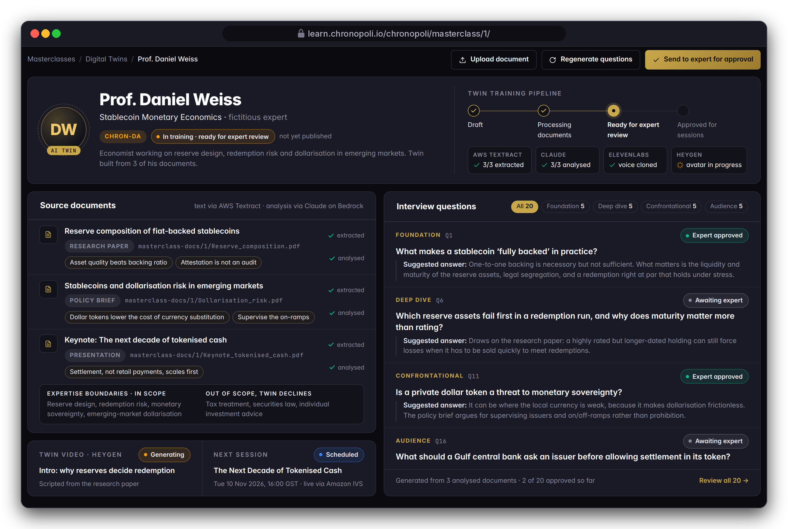
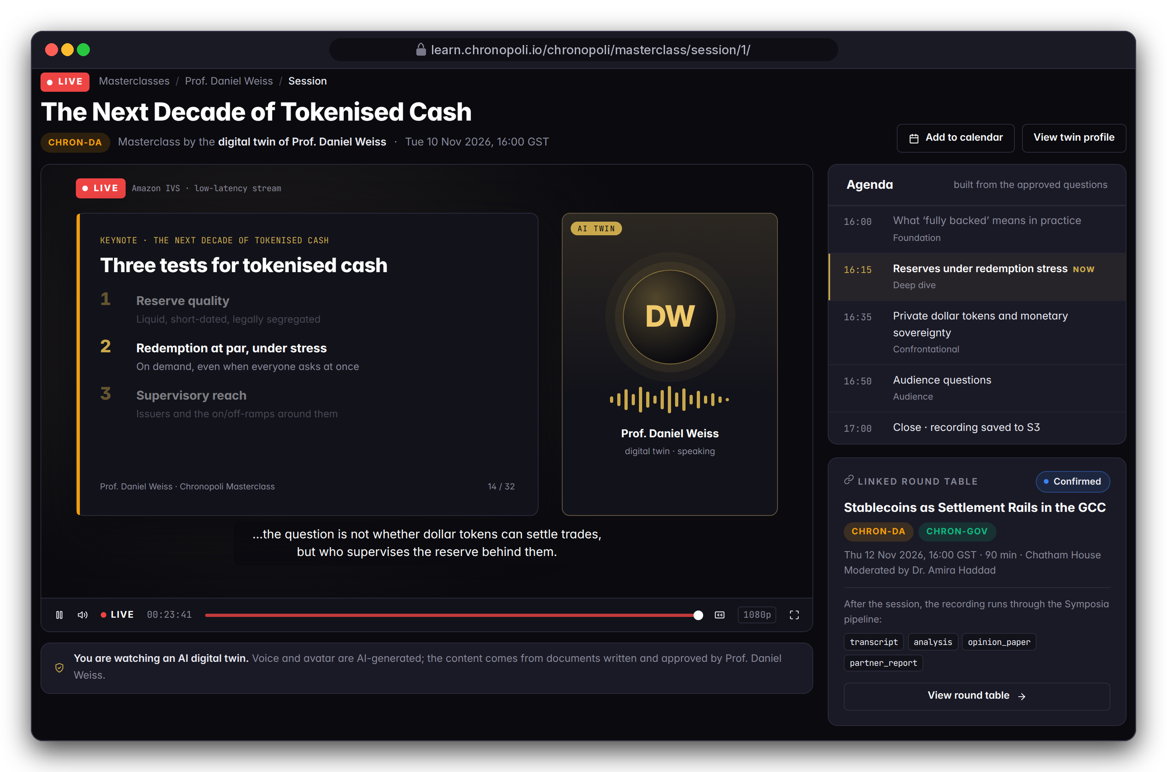
PARTNER SIDE · MASTERCLASS
PILLAR 03 · OPEN KNOWLEDGE
Personas: Dr. Amira Haddad (staff), Layla (viewer) · The expert is fictitious
Digital-twin masterclasses: scale an expert, with consent
An AI twin built from the expert's own published work, which prepares questions for the expert to approve and can teach live
DESIGN PROTOTYPE
Twin staff view (template not yet built)
DESIGN PROTOTYPE
Live masterclass, 10 Nov 2026 (template not yet built)
Built from the expert's own work: Textract and Claude map positions; the expert approves every question
Live with consent: AI-disclosed voice and avatar; written expert consent (a go-live requirement)
Illustrative mock data · Tether is a partner-roadmap target only; no agreement implied
21
Notes:
The models and service integrations are in the code, including expert approval of each question. The pages are prototypes because the masterclass templates are missing (R-10). Consent is a design rule, not yet code: before any voice is cloned we need a recorded written consent, and a publish check so that no twin goes live without the expert's approval (R-30, sprint 5, together with a real upload view and asynchronous Textract for multi-page PDFs). The expert must be able to withdraw the twin at any time.

Slide 22
MARKET OPPORTUNITY · INVESTOR VIEW
$45B total addressable market
Five fast-growing markets, connected for the first time by one platform
TAM
$45B
Professional digital-economy training
SAM
$8.5B
MENA + Europe, enterprise
SOM
$9.6M
Year 3
Source: Chronopoli Master Document estimates (March 2026), not independently verified. The segments overlap, so the TAM is not their sum.
22
Notes:
The market numbers are the Chronopoli Master Document estimates; we have not had them independently verified, so say that if asked. The TAM is professional digital-economy training, $45B; the serviceable market is enterprise training in MENA and Europe, $8.5B; the obtainable share is $9.6M by Year 3, the same figure as the Year 3 revenue projection. The five segments overlap and are not additive, which is why corporate L&D alone is larger than the TAM. The point of the slide is growth: AI-governance training and digital-assets education grow at 42% and 35% a year, and nobody connects them.

Slide 23
BUSINESS MODEL
Companies pay. Students benefit.
B2B-first: Company Academy fees fund the ecosystem before a single student pays
REVENUE STREAM | YEAR 1 | YEAR 3 | PRICING
Company Academies | $825K | $2.4M | $25K–$150K / yr
Corporate Team Subs | $480K | $2.4M | $1,500 / seat / yr
Individual Subscriptions | $280K | $2.8M | $490–$1,490 / yr
Open Marketplace (30%) | $100K | $750K | Creator 70%
Certification Fees | $30K | $240K | $15 / cert
Summit + Research | — | $1.0M | From Year 2
TOTAL REVENUE | $1.72M | $9.59M | 67.5% EBITDA (Y1)
TWO PRICING VIEWS
Commercial model (left): annual academy fees and subscriptions, as counted in the projections.
In the product (slides 24-26): per-course layer prices from $0 to $8,000 for single purchases, seats at $125 a month (= $1,500 a year), 70/30 split at checkout.
A FOUNDING ACADEMY, PER YEAR
$150K
Trained staff and regulators, verified credentials, candidates sent to its hiring team, and Intelligence Reports. One recruiter placement costs about $20K.
Source: Chronopoli Master Document projections (March 2026).
23
Notes:
The business model is B2B-first: companies fund everything. A Founding Academy costs $150,000 a year. For that the partner gets trained staff and trained regulators, verified credentials, qualified candidates sent directly to its hiring team, and a Partner Intelligence Report every time its name comes up in a round table. Compare that with about $20,000 for a single recruiter placement. Before a single student pays, the Company Academies alone bring $825,000 in Year 1. These are Master Document projections. The next slides show the second pricing view, the one already in the code: per-course layer prices, seats and the 70/30 split.

Slide 24
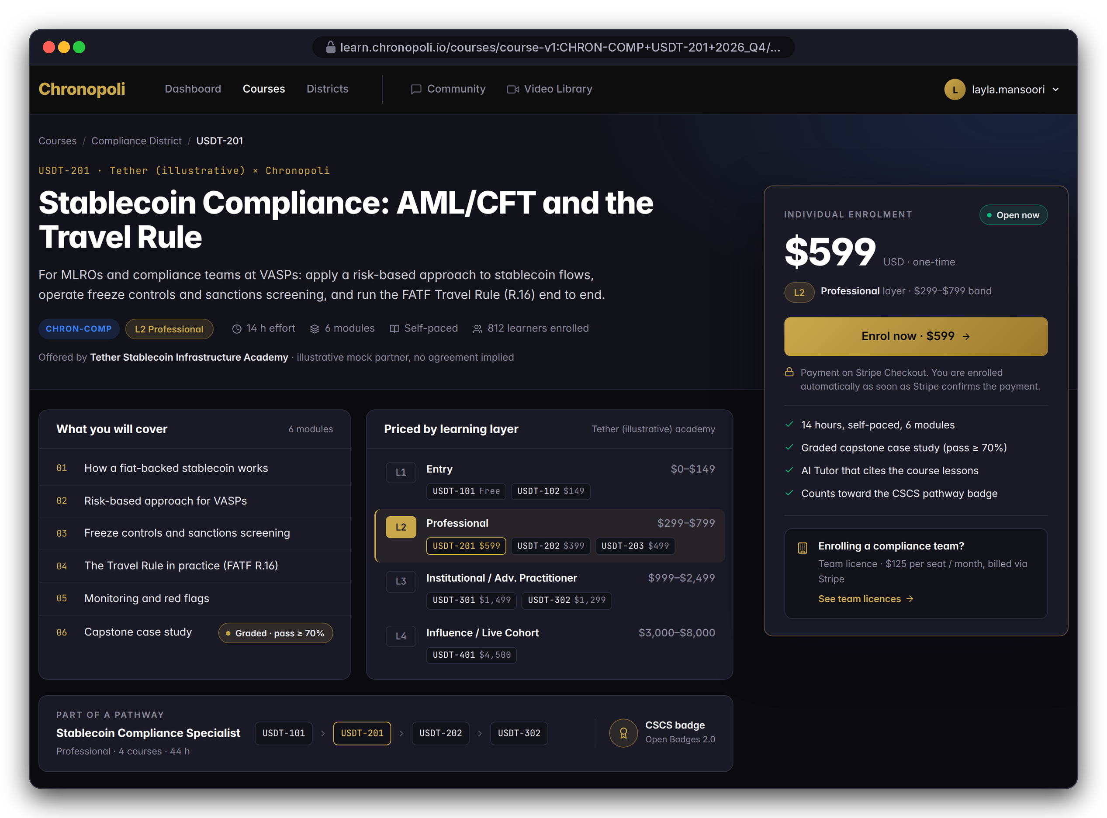
PARTNER SIDE · EARN
Persona: Layla Al-Mansoori · Illustrative mock data
In the product: how each price is charged
Layer prices for single purchases, seats for teams, 70/30 on partner courses; academy fees and subscriptions: slide 23
SINGLE-COURSE PURCHASE
CORPORATE TEAM SUBS
$0–$2,499
$1,500 / seat / yr
L1 Entry: $0–$149
L2 Professional: $299–$799
L3 Institutional: $999–$2,499
$125 per seat per month; employers license seats for compliance and investigation teams
MARKETPLACE SPLIT
L4 LIVE FORMATS & TIERS
70 / 30
$3,000–$8,000
Every partner-course sale splits at checkout, creator 70%, paid out via Stripe Connect
Influence cohorts, round tables and masterclasses; the partner tier (slide 37) sets the benefits
DESIGN PROTOTYPE
USDT-201 page with the L1-L4 price ladder (not yet built)
Illustrative mock data · Tether is a partner-roadmap target only; no agreement implied
24
Notes:
There are four mechanics, and the first three are in the e-commerce code. The price ladder puts a whole academy on one screen, from a free USDT-101 to a $4,500 live cohort in Dubai. This is the second pricing view: the commercial model on slide 23 (academy fees, subscriptions) is what the master projections count; these are the mechanics that already exist in the e-commerce code. The $1,500 per seat per year there is the $125 per seat per month here. Company Academy fees follow the master pricing ($25K–$150K a year); what each partner tier gets within that range isn't set yet. The model's strength is that partners bring content and audience, and Chronopoli takes 30% of every partner sale without producing the course. Internal: the L1 price label in the code still reads $49-$149 and must be aligned to the $0-149 band.

Slide 25
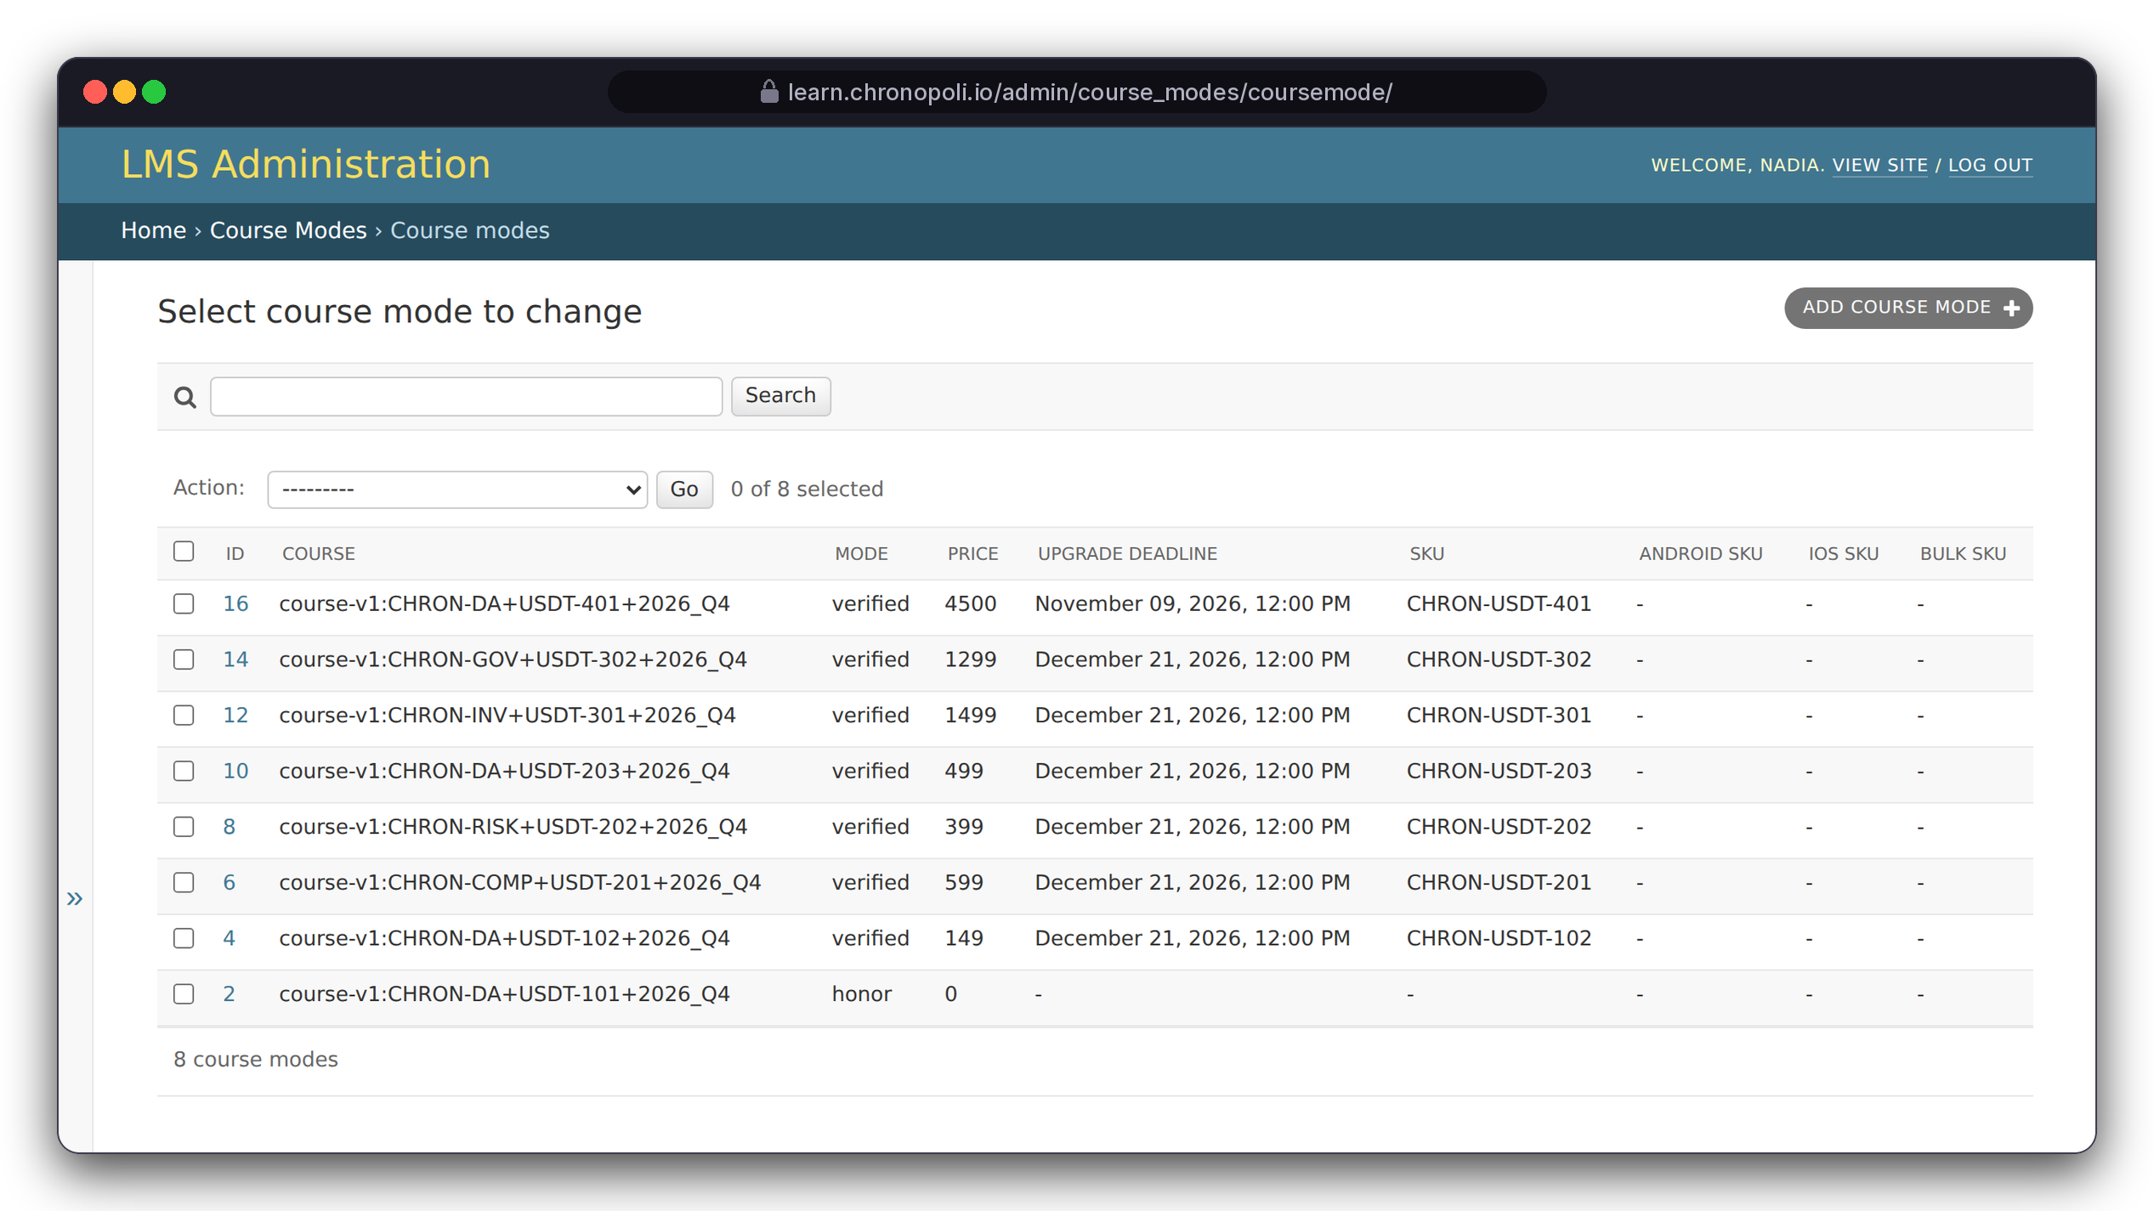
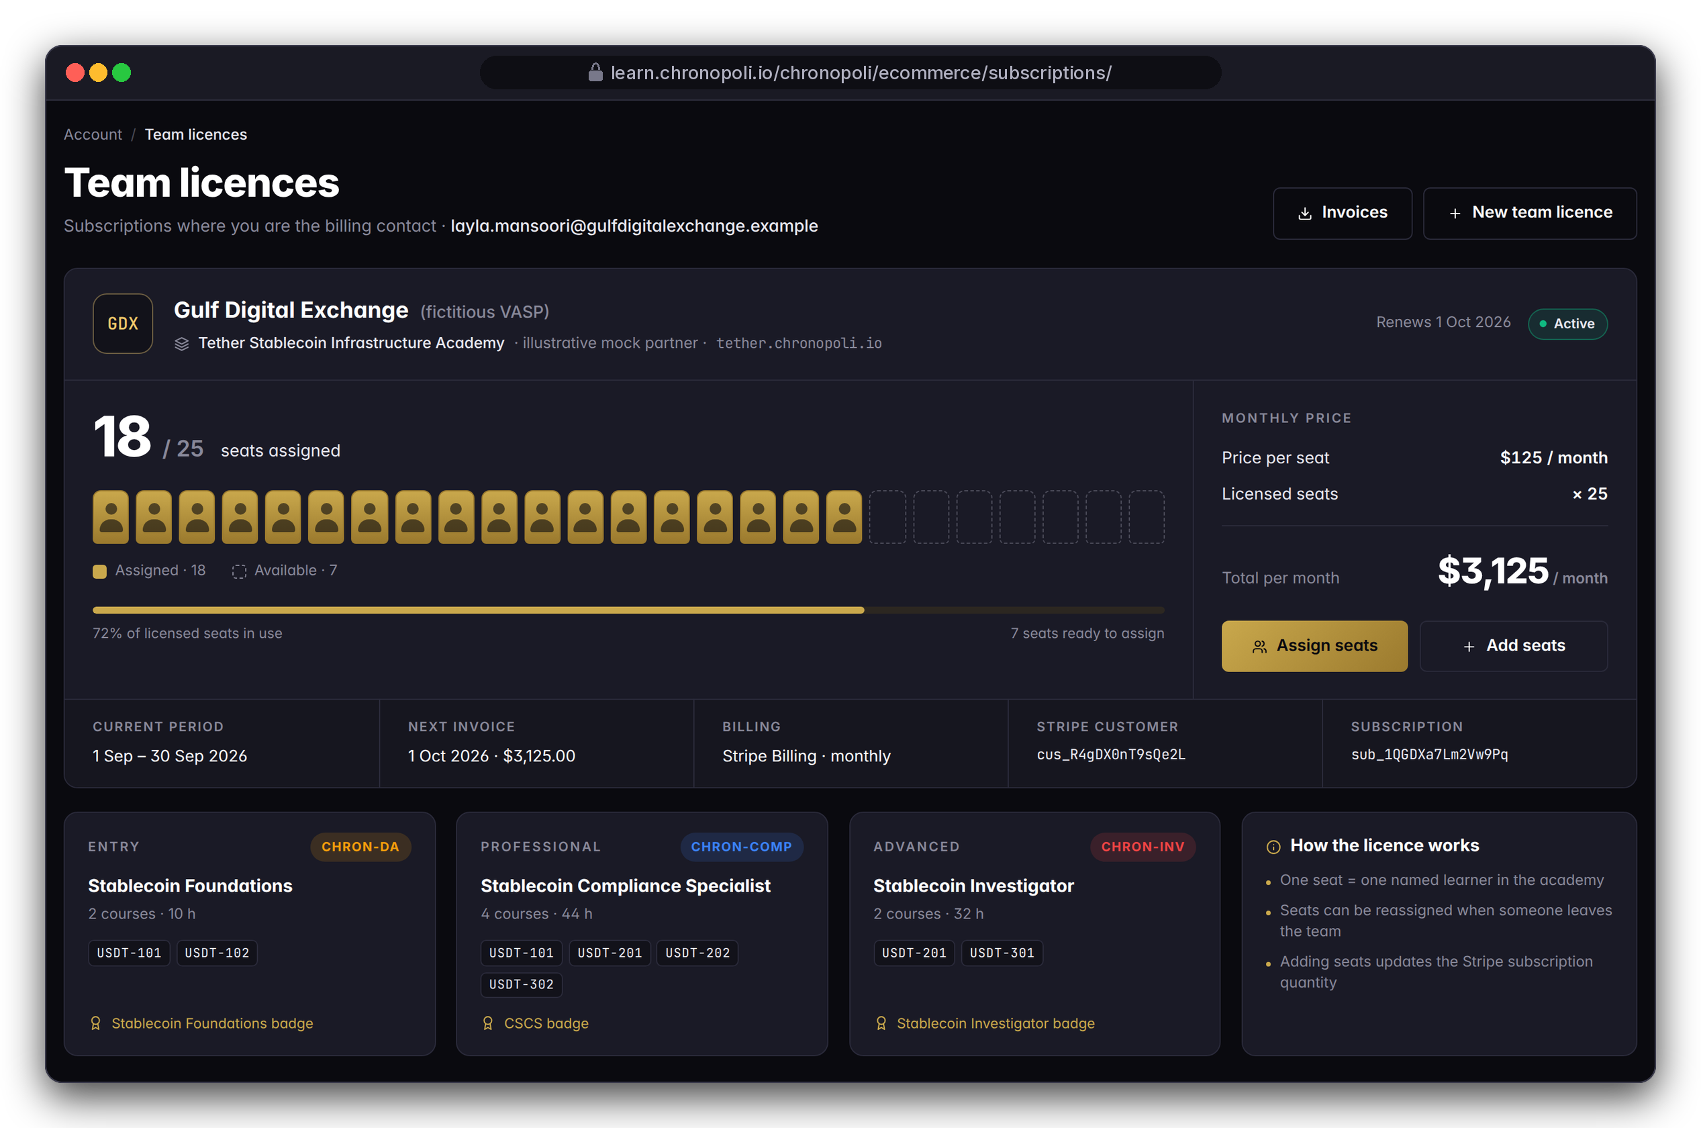
PARTNER SIDE · EARN
Personas: Nadia Karim in the admin (left), Layla as billing contact (right)
Prices sit in Open edX; companies buy seats
Every course run carries its price as an Open edX course mode, and employers license seats for whole teams
REAL OPEN EDX SCREEN
Back-office course modes and prices
DESIGN PROTOTYPE
Team licence page (not yet built)
Course modes: from $0 (USDT-101) to $4,500 (USDT-401)
Next: the same paid modes let Open edX enforce payment (R-12)
Gulf Digital Exchange: 25 seats × $125 = $3,125 a month
Illustrative mock data · Tether is a partner-roadmap target only; no agreement implied
25
Notes:
Two ways to sell. Individuals buy course by course, and the prices on the left are live Open edX configuration, not a mock-up. Employers buy seats: Gulf Digital Exchange licenses 25 seats and has assigned 18. The licence page is a prototype: its template is one of the missing templates (review finding R-10). Two things to resolve in the Commerce sprint: the subscription code bills yearly while the price list is monthly, and seat assignment is only a counter today.

Slide 26
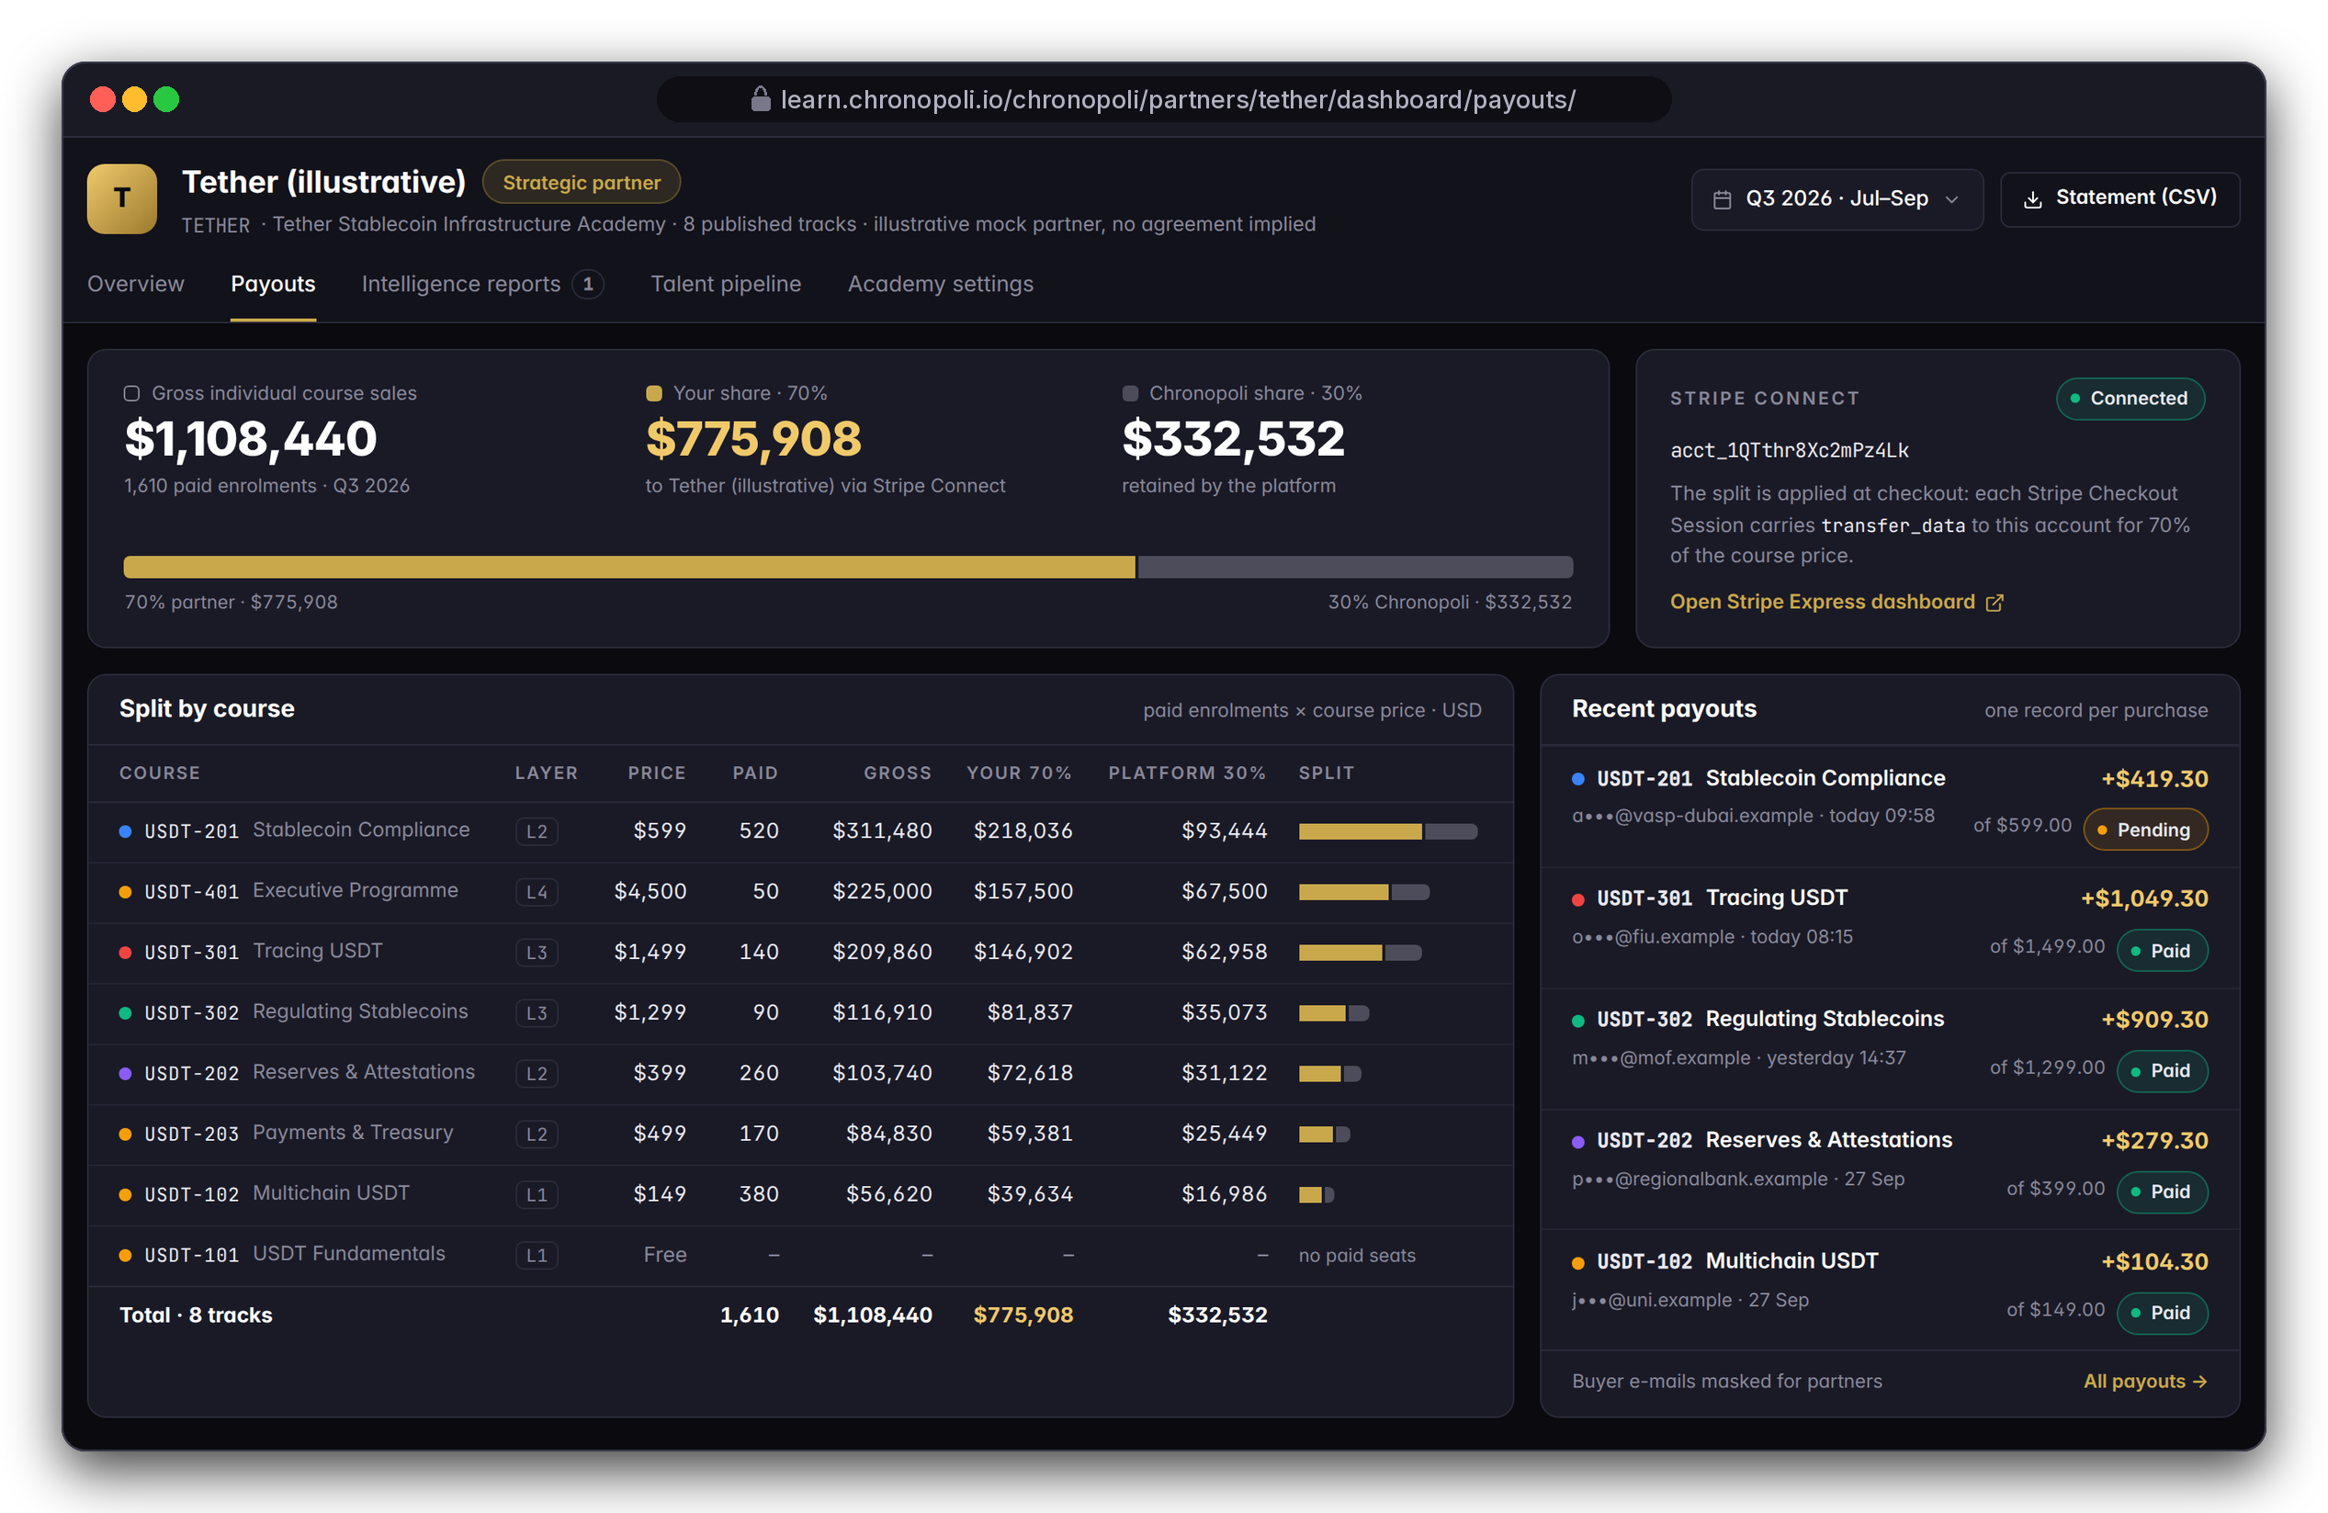
PARTNER SIDE · EARN
Persona: Nadia Karim · Illustrative mock data
70% of every partner-course sale goes to the partner, automatically
Stripe Connect splits each checkout at the moment of payment
Illustrative Q3: $1,108,440 gross from 1,610 paid enrolments
$775,908
$332,532
to the partner (70%)
to Chronopoli (30%)
One payout record per purchase, split by course; buyer emails are masked for partners
DESIGN PROTOTYPE
Partner payouts view (not yet built)
Illustrative mock data · Tether is a partner-roadmap target only; no agreement implied
26
Notes:
The split is in the checkout code: each Stripe Checkout Session carries a transfer of 70 percent to the partner's Connect account, and the webhook writes a payout record. The gross counts individual purchases only; team-licence revenue comes on top. Still open for the Commerce sprint: payout status is never set to 'paid' yet (R-13, partly fixed).

Slide 27
ILLUSTRATIVE SCENARIO · ONE ACADEMY
What one academy could look like (illustrative)
Fictitious Tether scenario, Q3 2026: demo numbers that show the mechanics, not traction
ENROLMENTS
COMPLETIONS
4,812
1,937
+18% QoQ
40.3% completion rate
Free · 2,140 enrolments · $0 revenue
BADGES ISSUED
PARTNER SHARE
1,244
$775,908
Gross: $1,108,440 individual sales · $775,908 partner (70%) · $332,532 platform (30%)
Depth pays: L3/L4 courses bring about 50% of gross from about 17% of paid enrolments
Not included: team-licence revenue
The free USDT-101 is the funnel: 2,140 of 4,812 enrolments (44%)
ILLUSTRATIVE MOCK DATA
Source: illustrative scenario, paid enrolments × list price · segments under $20k unlabelled
Fictitious Tether academy; no partnership or real traction implied
Illustrative mock data · Tether is a partner-roadmap target only; no agreement implied
27
Notes:
Say it plainly: this is a model of one academy, not reported revenue. Three things to take from it. First, the free USDT-101 is the funnel, with 2,140 enrolments or 44% of the total. Second, 50 live-cohort seats bring $225,000, about 72% of what 520 buyers of the flagship L2 course bring. Third, the platform keeps $332,532 without producing a single course.

Slide 28
FINANCIAL HIGHLIGHTS · PROJECTIONS
Projected profitable from month 5
Chronopoli Master Document projections: zero licensing, $374/mo AWS to start, companies fund everything
$1.72M
67.5%
$9.59M
$44.9M
$0
Year 1 revenue
EBITDA margin Y1
Year 3 revenue
Cash in Year 5
Licensing
9 partners + subscriptions
$1.09M net income Y1
Master Document estimate
Debt-free model
Full open-source stack
SERVER & API COSTS
AWS infrastructure Y1
$4,572 / yr
Claude API Y1
$3,300 / yr
ElevenLabs + HeyGen Y1
$612 / yr
Total cost of revenue Y1
< 1.5% of revenue
AWS as % of revenue Y5
0.53%
Source: Chronopoli Master Document projections (March 2026), not audited. Month 5 counts from the commercial launch, which follows the six-sprint go-live plan (slide 35).
28
Notes:
The infrastructure cost is almost embarrassingly low: about $4,600 a year for AWS in Year 1, zero licensing, because the whole stack is open source: Open edX, Discourse, Opencast, Presenton, all self-hosted. All figures are Master Document projections, not results. Month 5 counts from the commercial launch, and the launch follows the six-sprint go-live plan, so don’t present it as a calendar date. At the Year 3 projection of $9.59M, the $8M pre-money is below one times projected Year 3 revenue.

Slide 29






TRACTION & VALIDATION
Code-complete. First partners engaged.
Code-complete across 15 development phases: 90 requirements, 100% mapped; not yet deployed (slide 34)
PLATFORM STATUS
DONE
AWS DEPLOYMENT
NEXT
DBCC PARTNERSHIP
DONE
Code-complete
Terraform-ready
Confirmed
15 GSD phases · 90 requirements · 0 unmapped
17 Terraform files · me-central-1 (UAE) · go-live after the six-sprint plan (slide 35)
Anchor institutional partner · 500+ company network
BUiD ACADEMIC
IN PROGRESS
TARGET: RIPPLE
TARGET
TARGET: CHAINALYSIS
TARGET
MOU in progress
Pitching
Engaging
Maria Papadaki · 30 CPD credits/year recognition
$150K Founding Academy · talent pipeline
$150K Founding Academy · Investigation District
Statuses as in the master papers. Ripple and Chainalysis are targets in conversation; nothing is signed. The Tether academy in the product tour is illustrative (slide 9).
29
Notes:
Say the statuses exactly as they are. The platform is code-complete: 15 development phases, 90 requirements, none unmapped. It is Terraform-ready for me-central-1 but not deployed; slide 34 has the honest review. Dubai Blockchain Center is the confirmed anchor, with a network of more than 500 companies. The BUiD academic MOU is in progress, with 30 CPD credits a year as the recognition target. Ripple is being pitched and Chainalysis is engaging, each as a $150K Founding Academy target. Nothing with Ripple or Chainalysis is signed.

Slide 30


COMPETITIVE LANDSCAPE
We are not a better Coursera
A categorically different architecture: the first neutral Knowledge City for the digital economy
FEATURE
COURSERA / LINKEDIN
ACAMS / ICA
VENDOR ACADEMIES
CHRONOPOLI
SHOWN ON
AI-generated content pipeline
Slide 20
Live round tables + automatic opinion papers
Slides 19, 20
Digital Twin expert system
Slide 21
Seven cross-sector Knowledge Districts
Slide 3
Verified Open Badges 2.0 credentials
Slide 14
Automated talent pipeline
Slide 14
Partner Intelligence Reports
Slides 18, 20
Curriculum updates in under 48 h
Slides 17, 20
Neutral cross-sector positioning
Slide 4
yes
partial
no
Competitor ratings: Chronopoli Master Document. Chronopoli column: built in code, going live with the six-sprint plan; the 48-hour update is a design target.
30
Notes:
We are not a better Coursera: we are a different architecture. Coursera and LinkedIn Learning sell content; ACAMS and ICA sell certification; vendor academies teach their own product. None of them has the pipeline, the round tables, digital twins, cross-sector districts or neutral positioning. The ratings of the competitors are the Master Document’s. The Chronopoli column means built in code and shown in this deck; it goes live with the six-sprint plan. The last column points to the slide that shows each feature.

Slide 31



COMPETITIVE MOATS
Four self-reinforcing moats
Each moat strengthens the other three: the longer the platform runs, the harder it is to replicate
Proprietary Knowledge Moat
Partner Lock-in Moat
Every round table, opinion paper and masterclass feeds the AI Tutor. After 12 months, no external AI, not ChatGPT, not Gemini, has access to this knowledge base. It compounds like interest.
When a partner builds its academy inside Chronopoli, its credential history, talent pipeline and community are embedded. Leaving means giving up its own institutional knowledge base.
In this deck: slides 12, 20
In this deck: slides 9, 14
Network Effects Moat
Cost Structure Moat
More partners → more round tables → more knowledge → more users → more employer demand → more partners: a two-sided marketplace flywheel in a high-value niche.
$374 a month of AWS infrastructure to start, zero licensing, an open-source stack. VC-funded SaaS competitors cannot undercut this pricing without operating at a loss.
In this deck: slides 4, 19
In this deck: slides 28, 33
31
Notes:
Four moats, and each strengthens the other three. The knowledge moat: every round table, paper and masterclass feeds the AI tutor, and no external AI has that knowledge base. Partner lock-in: an academy’s credential history, talent pipeline and community live inside Chronopoli. Network effects: more partners, more round tables, more knowledge, more users, more employer demand, more partners. Cost structure: $374 a month of AWS to start and zero licensing, so SaaS competitors cannot undercut us without losing money.

Slide 32

TEAM
The right people at the right time
Compliance expertise + defence tech + blockchain infrastructure + UAE institutional access
Chris
CTO (to be confirmed)
Co-Founder & COO · Regulatory Client Manager, Bank Frick
Co-Founder · platform & infrastructure lead
BACKGROUND
BACKGROUND
KYC/AML/EDD expert · FMA Liechtenstein · FINMA Switzerland · UAE VARA · digital-assets compliance across 5+ jurisdictions
Open edX · AWS · Python/Django · AI-pipeline architecture. Search in progress for a world-class technical co-founder with MENA experience
VENTURES & CONTEXT
Co-Founder PHLX AG (Swiss defence tech) · WorldBitEnergy · Dubai Blockchain Center
VENTURES & CONTEXT
Platform code-complete via the GSD framework: 15 phases, 90 requirements. What go-live still needs: slide 34
ADVISORS Maria Papadaki (BUiD, academic partner) · DBCC leadership · Compliance advisor (TBC) · Regional investor (TBC)
32
Notes:
Chris brings compliance depth: KYC, AML and EDD across Liechtenstein, Switzerland and the UAE, plus the DBCC network. The CTO seat is open: we are looking for a senior Open edX and AWS engineer with MENA experience, and the platform code, the review and the six-sprint plan are the brief. Maria Papadaki of BUiD advises as academic partner; DBCC leadership supports the platform. We deliberately do not quote a line count: the codebase has grown past the old figure, and the review on slide 34 is the better measure.

Slide 33




TECHNOLOGY
Technology: Open edX at the core, AWS around it, no fork
Tutor 22 (Verawood), a Chronopoli Tutor plugin and 8 Django apps; upstream updates arrive with “tutor upgrade”
Edge
Route53 (5 subdomains + wildcard) · CloudFront · ACM/TLS · Amazon SES
AWS SERVICES
LMS core
Open edX LMS, Studio and MFEs on Tutor 22 · Celery workers · Caddy
UPSTREAM
Chronopoli apps
onboarding · partners · discourse_sso · ecommerce · symposia · academy · ai_tutor · masterclass
OUR CODE
AI & media
Bedrock (Claude Sonnet 4.6 + Knowledge Base) · Transcribe · Textract · IVS
AWS SERVICES
Pipeline
EventBridge, then Step Functions, 8 Python 3.13 Lambdas and an SQS approval queue
AWS SERVERLESS
Data
RDS MySQL 8.4 · Redis · MongoDB · S3 (media, static, backups, knowledge)
AWS MANAGED
Extensions
Discourse 3.5 · Opencast 20.4 · Presenton, behind nginx
SELF-HOSTED
Ops
Terraform · GitHub Actions · me-central-1 · EC2 from $374/mo to EKS $600–$2,000/mo
INFRA AS CODE
33
Notes:
Why the no-fork decision matters to an investor: we maintain only our plugin, apps and theme, and Open edX security fixes and features arrive through “tutor upgrade”. The real Open edX screens in this deck ran on a stock Tutor 22.0.2 install built from prebuilt images. Hosting in the UAE region keeps regulated learners' data close to home. Costs start small and scale with traffic: the master papers budget $374 a month for AWS at launch (the cost moat, slide 31), growing to an EKS cluster at $600–$2,000 a month.

Slide 34
STATUS · HONEST VIEW
Where we are: code complete, not yet live
A September 2026 technical review of the full codebase found 37 verified issues, and fixing has begun
37
8 + 3
15
16
verified findings
fixed + partly fixed
update commits
stack updates
Each one confirmed by reading the code or running a check
26 open: the six sprints close 22 of them and finish all 3 partly fixed
On the review branch, e.g. the Bedrock model swap, the AI-tutor chat-history fix and the Terraform stack refresh
Including:
Tutor 22 (Verawood)
MySQL 8.4 · Ubuntu 24.04
Python 3.13 Lambdas
Claude Sonnet 4.6
Pinned Opencast and Presenton
● 6 critical ● 18 high ● 13 medium
● 8 fixed ● 3 partly ● 26 open
Not live yet: all feature code is written; the platform isn't deployed
What the screens are: real Open edX that ran, real Chronopoli templates in a test harness, design prototypes for pages still to be built, real Opencast and Discourse
Biggest blocker: packaging the apps as edx-platform plugins (R-1, R-2)
34
Notes:
We would rather show this than have you find it in due diligence. Five critical items are open: packaging (R-1), routing (R-2), IVS event mapping (R-4), the approval hand-off (R-5), and a public media bucket that also holds learner grade files (R-6). One critical item (R-3) is fixed. Four open items still need a sprint: the auto-badge trigger (R-22), the Discourse SSO secret sync (R-28), onboarding answer validation (R-33) and the configure-tutor script (R-34). Three urgent upgrades are done: the retired Claude model is replaced, MySQL moved from 8.0 to 8.4 to avoid extended-support fees, and the plugin's cap on an end-of-life Tutor release is lifted.

Slide 35
GO-LIVE PLAN · ORDER OF WORK, NOT DATES
Chips: review findings · gold = partly fixed, finished in that sprint
Road to go-live: six sprints
Each sprint closes a named set of review findings, then terraform apply and the first partner academy
1
2
3
4
5
6
Boot
Secure
Commerce
Pipeline
AI & data
Launch
Package the apps as edx-platform plugins; fix routing, templates and init
Private media and exports, least-privilege IAM, partner access model, consent
Paid course modes, refunds, payout status, webhook hardening
IVS recording, event mapping, task tokens, container Lambda for PDFs
Knowledge-base index and access policy, embeddings region, quotas
CloudFront DNS origin, wildcard academies, CI migrations, AWS provider 6.x
R-1
R-2
R-9
R-6
R-17
R-25
R-12
R-13
R-14
R-4
R-5
R-20
R-18
R-30
R-32
R-19
R-23
R-35
R-10
R-31
R-26
R-29
R-37
R-24
R-36
After sprint 6: the first partner academy goes live
MILESTONES: M1 GOES LIVE, THEN THE FEATURE ROLL-OUT
M1
terraform apply + EC2
M2
CHRON-ET district
M3
E-commerce
M4
Symposia (commercial differentiator)
M5
Company academies
M6
AI tutor (platform moat)
M7
Digital twin + partner dashboard
35
Notes:
This is the technical base of the 90-day go-to-market plan on slide 36. The slide shows the order of work, not dates, because sprint length isn't fixed yet. Sprint 1 unlocks everything else: once the apps load inside Open edX, every template render in this deck becomes a live page. After M1, features roll out as milestones: e-commerce, round tables, company academies, the AI tutor, then digital twins with the partner dashboard. Two upgrades are held back to sprint 6 on purpose: AWS provider 6.x, which needs a reviewed terraform plan, and Claude Sonnet 5.5, which needs Lambda changes and a check that it is available in the region.

Slide 36
GO-TO-MARKET · TARGETS
90-day sprint to first revenue
Close two Founding Partners before public launch; the six-sprint plan (slide 35) is the technical base
NOW → MONTH 3
MONTH 3 → 6
MONTH 6 → 12
MONTH 12 → 24
Deploy & close
Launch & grow
Scale
Expand
Six sprints, then terraform apply and go-live
Public free-tier launch
400 paid subscribers
TOKEN2049 Dubai + Singapore
First opinion papers published on LinkedIn
4 corporate team licences
Annual summit (50–100 participants)
Ripple + Chainalysis pitch (1 slide, 1 demo)
2,000 registrations target
3 more strategic partners
Singapore market entry
3 beta round tables via DBCC
First Company Academy live
First Digital Twin masterclass
10,000+ registered users
BUiD MOU signed
Month counts are master-plan targets. Go-live comes after the six sprints, which are ordered but not yet dated; public launch follows the first two Founding Partners.
36
Notes:
The plan is to close two Founding Partners before the public launch, then let the product sell itself. The first 90 days: finish the six sprints, run terraform apply, pitch Ripple and Chainalysis with one slide and one demo, run three beta round tables through DBCC and sign the BUiD MOU. Months 3 to 6: public free tier, first opinion papers on LinkedIn, 2,000 registrations and the first company academy. Months 6 to 12: 400 paid subscribers, four corporate team licences, three more strategic partners and the first digital-twin masterclass. Then TOKEN2049, an annual summit and Singapore. Month counts are targets; the go-live date depends on the sprints, which are ordered but not yet dated.

Slide 37


PARTNER ROADMAP · TARGETS, NOT AGREEMENTS
Partner roadmap: who we want to build with
Target partners by tier. These are roadmap targets; no agreements are signed.
TIER
TARGET PARTNERS (NOT SIGNED)
WHAT THE TIER GETS
Founding
Ripple, Chainalysis, Cardano, Hedera
Flagship tracks or a Founding Academy, co-hosted symposia, a seat on the curriculum board
Strategic
Tether, Polygon, Chainlink, Fireblocks
Branded academy, pathways and badges, talent pipeline
Content / Investigation
TRM Labs, Elliptic
Specialist courses inside a district
AI
Microsoft AI, Google AI
AI District content
Institutional
Universities (BUiD MOU in progress), think tanks, banks
Co-certification and research round tables
Names are roadmap targets, not agreements. Status today (slide 29): DBCC confirmed anchor · BUiD MOU in progress · Ripple pitching · Chainalysis engaging
37
Notes:
Ripple and Chainalysis are the two target Founding Academies of the master plan ($150K a year each); both are in conversation, neither has signed. Sequence: founding partners come first, because they shape the curricula and co-host the first round tables. Strategic academies like the Tether example follow once company academies are live (milestone M5). Content and AI partners deepen individual districts. Institutions give the credentials weight with regulators and employers.

Slide 38



THE ASK · INVESTORS
Raising $2,000,000 seed round
Pre-money valuation $8,000,000 · Equity / SAFE · 18-month runway
$2,000,000
Code-complete
Companies pay us
SEED ROUND · $8M PRE-MONEY · EQUITY / SAFE
Not a prototype: the feature code is written. Not live yet; go-live follows the six-sprint plan (slides 34-35)
B2B-first: $150K academy deals fund the model before students pay a dollar
USE OF FUNDS
Sales & partnership team
$600K · 30%
Marketing & conferences
$400K · 20%
Platform scaling (AWS, EKS)
Zero licensing costs
UAE tax advantage
$400K · 20%
Open-source stack, $374/mo AWS baseline, gross margin >97% at scale (projection)
9% corporate tax on profits above $102K, no personal income tax for employees, DBCC as institutional anchor
G&A, legal, operations
$600K · 30%
38
Notes:
We are raising $2M in a seed round at an $8M pre-money valuation, as equity or a SAFE, for 18 months of runway. Use of funds: $600K for the sales and partnership team, $400K for marketing and conferences, $400K for platform scaling on AWS and EKS, and $600K for G&A, legal and operations. Four reasons: the code is complete and the go-live plan is concrete; companies pay us, not students; there are no licensing costs; and the UAE tax regime plus the DBCC anchor. Don’t say the platform is live: it goes live after the six sprints.

Slide 39


THE ASK · PARTNERS
Become a founding Knowledge Partner
Help build the place where the digital economy learns, hosted by Dubai Blockchain Center
Founding partners
Pilot institutions
Investors
Co-design a flagship track or an academy around the roles you hire for, co-host the first round tables, sit on the curriculum board
Regulators, FIUs, banks and VASPs for the first team-licence cohorts, with feedback on L2-L3 content
Fund the six-sprint go-live and the first partner academies: the $2M seed on slide 38
Next step: a working session to choose your district, first track and first round table
Contact: partners@chronopoli.io · chronopoli.io
39
Notes:
Close on the ask, not on features. The product exists as code and as the screens you've seen; what's missing is go-live engineering and the first founding partners. The investor terms are on slide 38: $2M seed at $8M pre-money. This slide is the partner version of the ask. Offer the user guide and technical review booklet as the leave-behind.

Slide 40
Chronopoli is not a better Coursera.
Not a smarter university.
It is a completely new architecture
where credentials are verifiable, content is AI-generated and regulation-linked, companies fund learning instead of students, and the degree is replaced by a dynamic professional record that follows you for life.
EMAIL
PLATFORM
HOSTED
ANCHOR
partners@chronopoli.io
learn.chronopoli.io (at go-live)
AWS UAE · me-central-1
Dubai Blockchain Center
Confidential · for authorised recipients only · September 2026 · © Chronopoli / Dubai Blockchain Center
40
Notes:
Chronopoli is not a better Coursera, and not a smarter university. It is a new architecture: credentials are verifiable, content is AI-generated and linked to regulation, companies fund learning instead of students, and the degree is replaced by a professional record that follows you for life. Pause, then hand over the contact details and the leave-behind.

