Slide 1

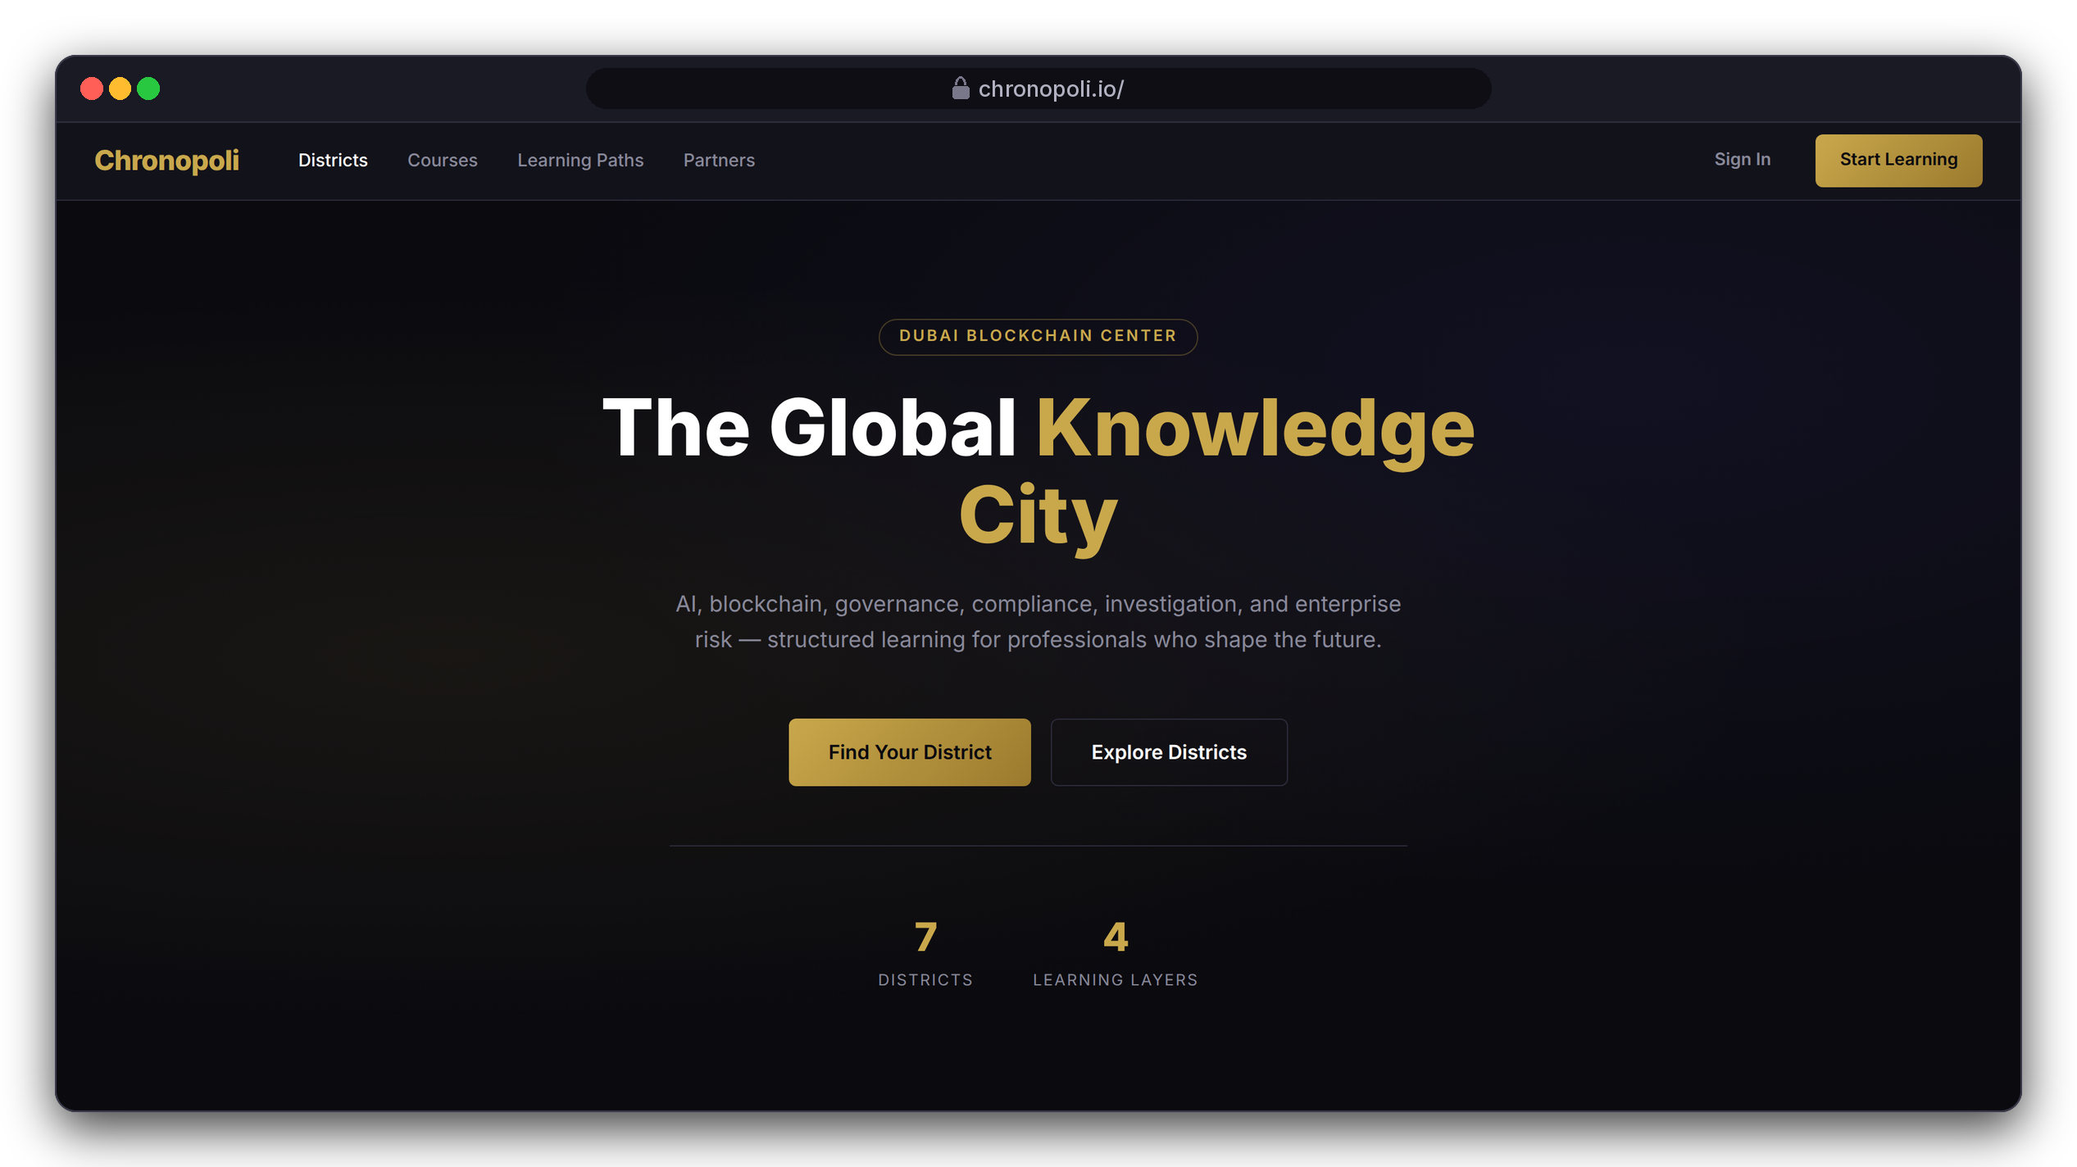

INVESTOR & PARTNER PRESENTATION
Chronopoli
The Global Knowledge City for the digital economy,
hosted by Dubai Blockchain Center
AI-Native Knowledge Infrastructure ·
Community Intelligence Engine · Verified Credentials
Digital assets · AI · Governance · Risk & trust ·
Financial-crime investigation · Compliance · Emerging tech
Hosted in the UAE · September 2026
DESIGN PROTOTYPE (NOT YET BUILT)
Landing page, not yet live
The product tour uses an illustrative Tether (USDT) academy: fictitious mock data, no partnership implied
Illustrative mock data · Tether is a partner-roadmap target only; no agreement implied
01
Notes:
Chronopoli is one platform where regulators, financial intelligence units, banks, exchanges, fintechs, enterprises, founders and students learn the digital economy, hosted by Dubai Blockchain Center. The platform is built but not live yet. Every screen in this deck is either a real platform screen or a clearly labelled design prototype. The running example, a Tether academy, is fictitious demo data: Tether is a target partner, not a signed one.

Slide 2





THE PROBLEM
The digital economy has a structural knowledge gap
No one connects digital assets, AI, governance, risk and investigation in one trusted, neutral place
Fragmentation
Speed Mismatch
Fake Credentials
No Neutral Convener
Stablecoin infrastructure, AI governance, regulation, risk and forensics sit in silos; no single platform connects them
MiCA and FATF change, DeFi exploits create new typologies. Universities take 18 months to update, training firms 6; the market moves daily
A certificate says you sat in a room. It tells no employer what you know today, in context, for your jurisdiction
Nobody puts an issuer, a UAE regulator, a forensics analyst and a researcher in one room and turns that into institutional knowledge
OUR ANSWER
OUR ANSWER
OUR ANSWER
OUR ANSWER
Seven districts, four layers, one onboarding
Updates in under 48 h: authoring + round tables
Open Badges 2.0 linked to partner roles
Symposia: round tables that publish
Slides 3, 7
Slides 16, 19
Slide 13
Slides 18, 19
02
Notes:
These are the four problems from the master investor deck. The speed mismatch is the killer fact: MiCA, FATF guidance and new crypto typologies change monthly, universities take 18 months to update a curriculum and the big certification bodies about 6. Every team in the room has felt this, from product and treasury to risk and compliance. Use one concrete picture: a stablecoin team that must understand multichain settlement, reserve attestations and new regulation within weeks, and today pieces that together from webinars and PDFs. Each problem has an answer that the product tour shows on real screens; the numbers under each answer are the slides. The update in under 48 hours is a design target for partner authoring plus the round-table pipeline, not a measured result yet.

Slide 3
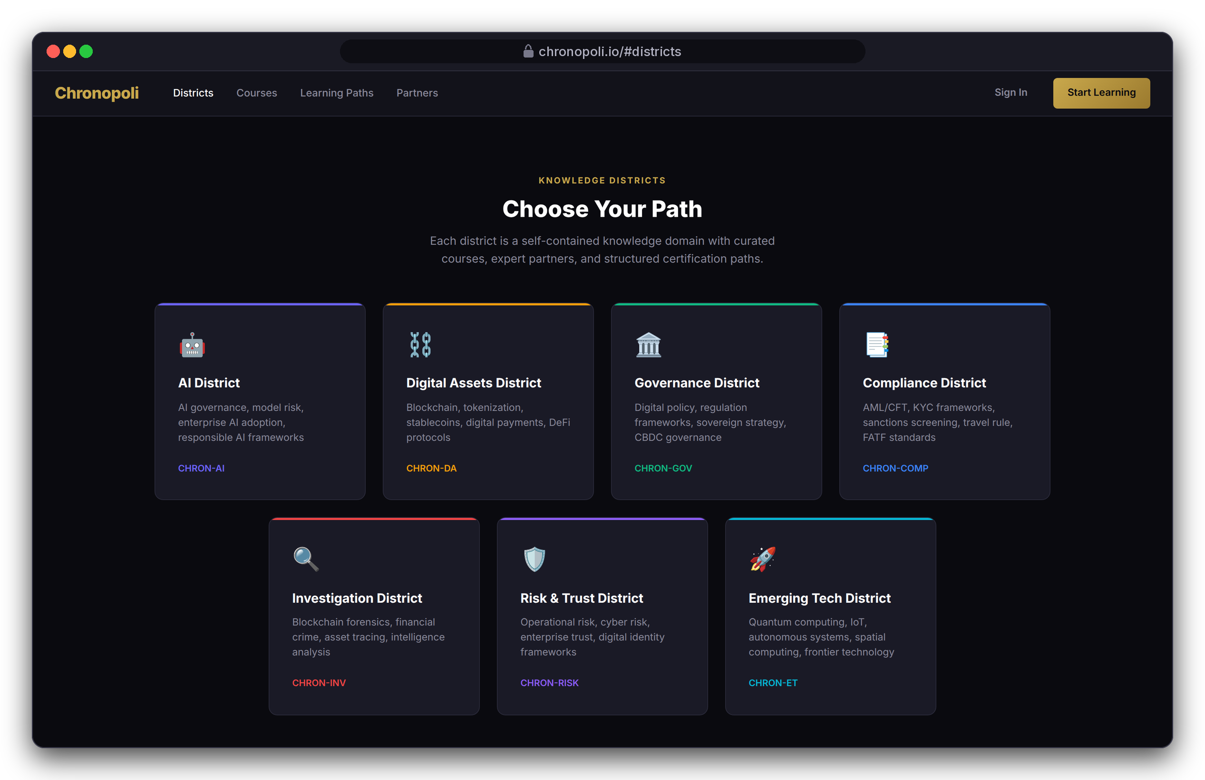
THE CITY
One city, seven districts, four layers
Every course sits in a Knowledge District and a learning layer, so every learner and partner knows where they belong
7 Knowledge Districts: AI, Digital Assets, Governance, Compliance, Investigation, Risk & Trust, Emerging Tech
4 learning layers set depth and price (below)
Partners publish tracks into several districts and can run their own branded academy
One account for courses and community
LEARNING LAYERS: DEPTH AND PRICE RISE TOGETHER
L3
L4
L2
Institutional
Influence
L1
Professional
$999–$2,499
$3,000–$8,000
Entry
$299–$799
$0–$149
DESIGN PROTOTYPE (NOT YET BUILT)
Landing page: the seven districts, not yet live
03
Notes:
Chronopoli isn't a course catalogue; it's a city map. A district is where a topic lives, and a layer is how deep you go. The districts are built into the platform itself, not just into the marketing, and the same grid organises the community forums on slide 14. Internal, not for the audience: the current landing-page draft still says six districts, shows a '50+ Partners' figure and a 'Trusted by' strip with roadmap names. This capture uses corrected copy, and the page must be fixed before anything goes public.

Slide 4

PRODUCT
Three pillars, one platform
Every feature serves the network effect: more partners → more content → smarter AI → more value
Symposia
Company Academies
Open Knowledge
Community Intelligence Engine
Branded partner academies
AI Tutor + Digital Twins
Live round tables under the Chatham House Rule, streamed live
Automated opinion papers in 3 hours
LinkedIn and Instagram content, one human approves (TikTok: roadmap)
Partner Intelligence Reports per session
Branded sub-academies at the partner’s own web address
Custom learning pathways and a badge system
Open Badges 2.0 verified credentials
Talent pipeline: badges matched to partner roles
AI Tutor grounded in all platform content
Digital Twin: an expert’s documents become an AI avatar, with consent
Open course marketplace, 70/30 revenue split
Compounds with every new piece of content
01
02
03
IN THE PRODUCT TOUR
IN THE PRODUCT TOUR
IN THE PRODUCT TOUR
Slides 18-19
Slides 8, 12-13, 17
Slides 6, 9, 11, 20
Shared platform core: onboarding, courseware and course authoring, district forums and lecture video (slides 7, 10, 14, 16)
04
Notes:
Three pillars, one platform. Symposia is the community intelligence engine: round tables that become papers, posts and partner reports. Company Academies are branded partner academies with pathways, verified badges and a talent pipeline. Open Knowledge is the AI tutor, digital twins and the open course marketplace. Every feature serves the network effect: more partners bring more content, which makes the AI smarter, which brings more value. Each product-tour slide carries its pillar in a label next to the step, so you can see every pillar on real screens. Be precise on two points: publishing needs one human approval, and TikTok is on the roadmap, not yet built.

Slide 5
PRODUCT TOUR
Product tour: one learner, end to end
One persona of several: Layla, MLRO at Gulf Digital Exchange (fictitious VASP), earns a stablecoin credential
1
2
3
4
5
6
7
8
9
Discover
Onboarding
Partner academy
Enrol & pay
Learn
AI tutor
Pass & pathway
Badge to job
Community & video
One catalogue, one sign-up
Routed in 5 questions
Pick a pathway
Secure hosted checkout
Lessons and graded checks
Cited answers inside the lesson
Grades roll up to the pathway
Open Badge, matched to a job
District forums and lecture video
Slide 6
Slide 7
Slide 8
Slide 9
Slide 10
Slide 11
Slide 12
Slide 13
Slide 14
Open Knowledge
Platform core
Company Academies
Open Knowledge
Platform core
Open Knowledge
Company Academies
Company Academies
Platform core
Then the partner side (slides 16-26)
Author 16
›
Measure 17
›
Convene 18
›
Publish 19
›
Masterclass 20
›
Earn 22-26
THE CAST (ALL FICTITIOUS)
WHAT EACH SCREEN IS
LA
Layla Al-Mansoori slides 7-14, 18, 20, 23-24
REAL PLATFORM SCREEN
Captured from the working platform on our demo system
MLRO, Gulf Digital Exchange (fictitious VASP)
NK
Nadia Karim slides 17, 24-25
DESIGN PROTOTYPE (NOT YET BUILT)
A page that is still to be built
Academy administrator, partner side (fictitious)
AH
Dr. Amira Haddad slides 18-20
All people, organisations and figures in the tour are illustrative mock data
Round-table moderator, Governance District (fictitious)
Illustrative mock data · Tether is a partner-roadmap target only; no agreement implied
05
Notes:
We follow one person, Layla, through every function, and then the partner behind her course. Three fictitious people carry the story: Layla the learner, Nadia who runs the partner academy, and Dr. Amira Haddad who moderates round tables. Two labels tell you what each screen is: a real platform screen was captured from the working platform on our demo system, and a design prototype shows a page that is still to be built. Layla is one persona of several, and USDT-201 is one of eight illustrative Tether courses: USDT-101 fundamentals, 102 multichain, 202 reserves and attestations, 203 payments and treasury, 301 investigations, 302 regulation and the 401 executive programme; four of the eight sit in the Digital Assets District. Every step also carries its pillar (slide 4): Symposia, Company Academies, Open Knowledge, or the shared platform core. Her course runs from 1 September 2026, and her badge is issued on 18 September.

Slide 6
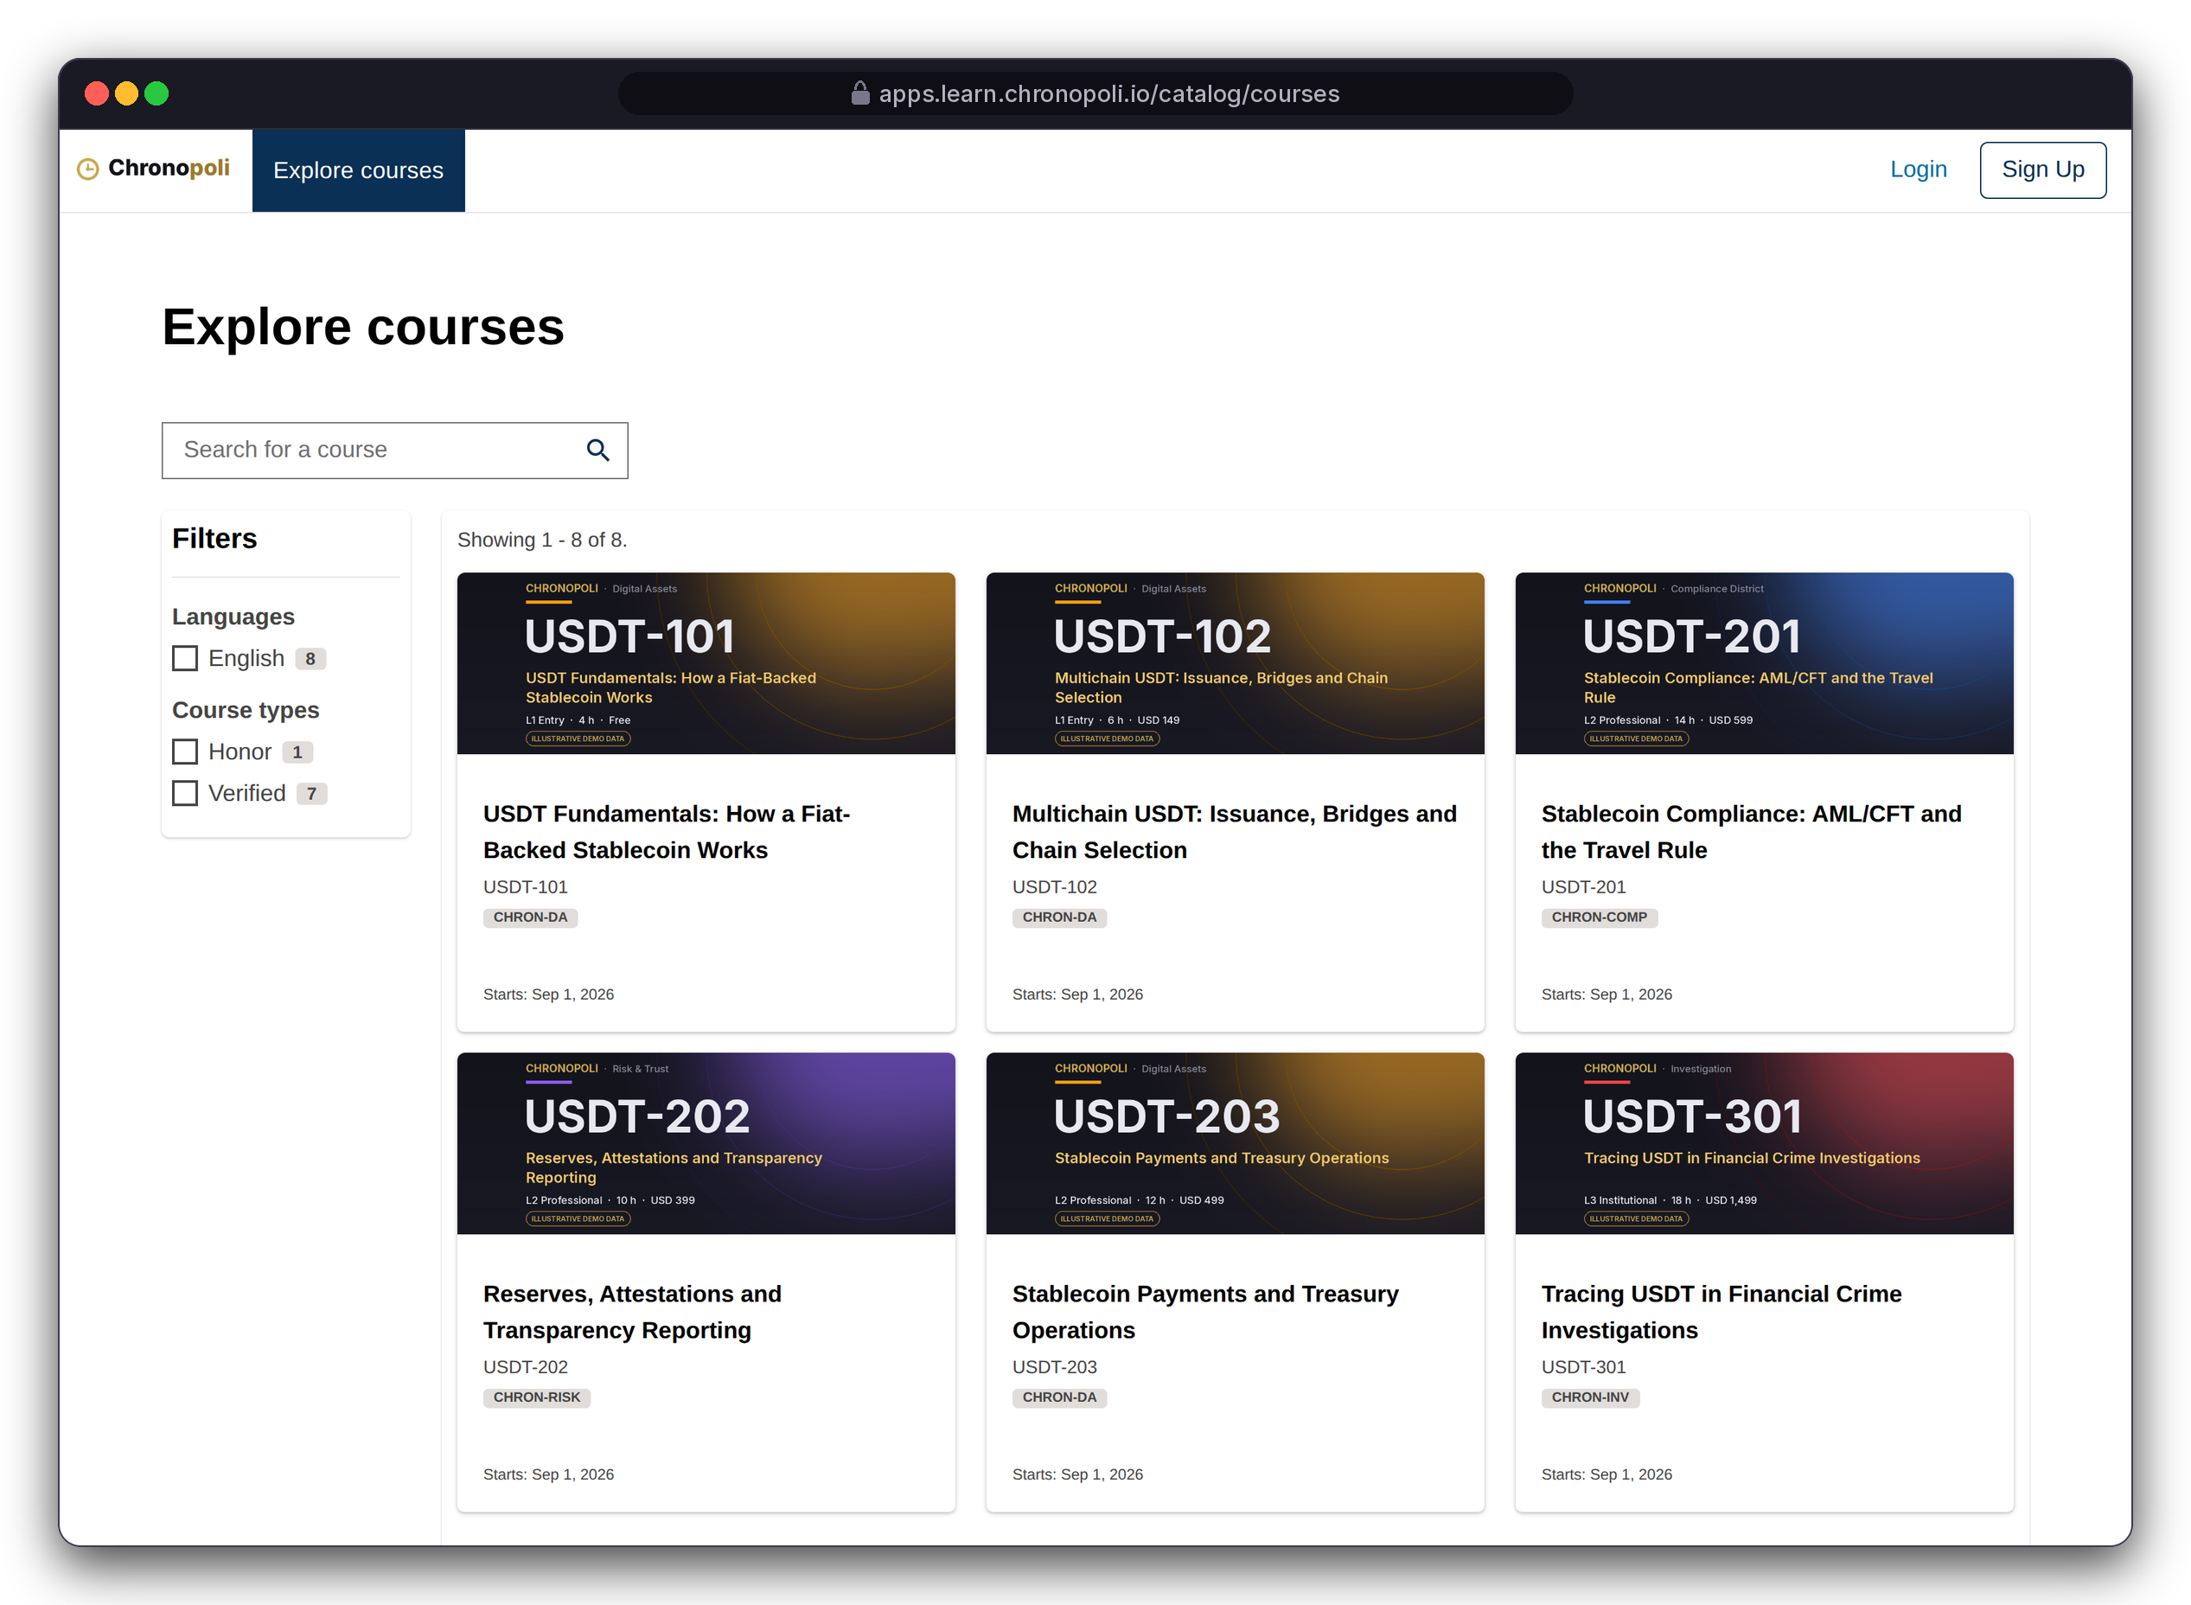
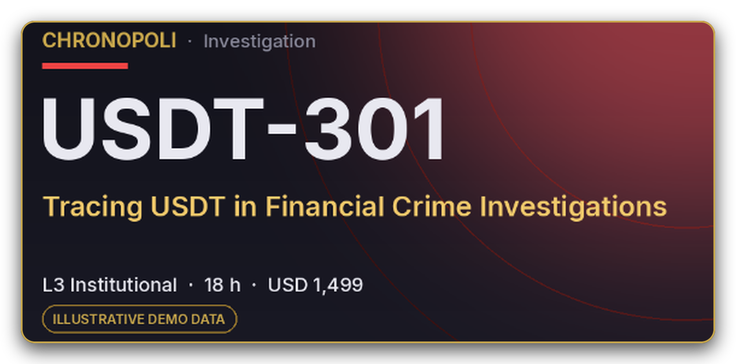
PRODUCT TOUR · STEP 1 OF 9 · DISCOVER
PILLAR 03 · OPEN KNOWLEDGE
Persona: a visitor before sign-up
Discover: one catalogue across every district
Search and filter every track; each card shows district, layer, effort and price
Search and filters: full-text search across every track and district
Sign up once: the same account also opens the district forums
ZOOM ON THE SAME SCREEN: ONE CARD IMAGE
On every card image: district, layer, effort and price
ALL EIGHT DEMO TRACKS (ILLUSTRATIVE)
USDT-101
USDT-102
USDT-201
USDT-202
L1 Free
L1 $149
L2 $599
L2 $399
USDT-203
USDT-301
USDT-302
USDT-401
REAL PLATFORM SCREEN
Course catalogue · first 6 of 8 demo courses
L2 $499
L3 $1,499
L3 $1,299
L4 $4,500
Illustrative mock data · Tether is a partner-roadmap target only; no agreement implied
06
Notes:
We didn't build a catalogue from scratch: the platform gives us one, with search, filters and course pages out of the box. These screens still use the platform's default look with the Chronopoli name and a demo wordmark, not yet the dark and gold design. The district filter is switched off in the demo because it still shows raw district codes; the district still appears on every card. The frame shows the first two rows; the zoom is the USDT-301 card from the same screen, and the list on the right gives all eight demo tracks: USDT-101 is free (L1), USDT-301 costs $1,499 (L3).

Slide 7
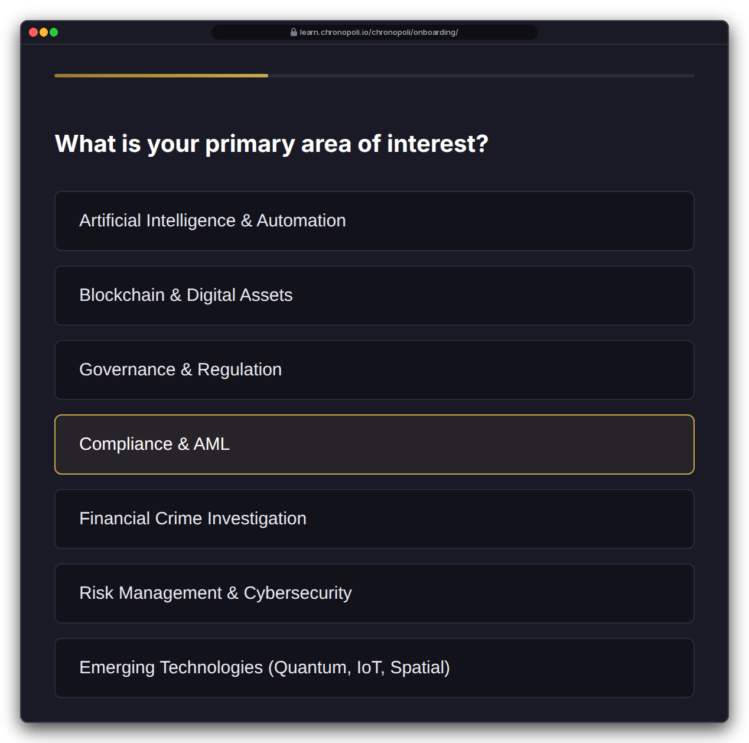
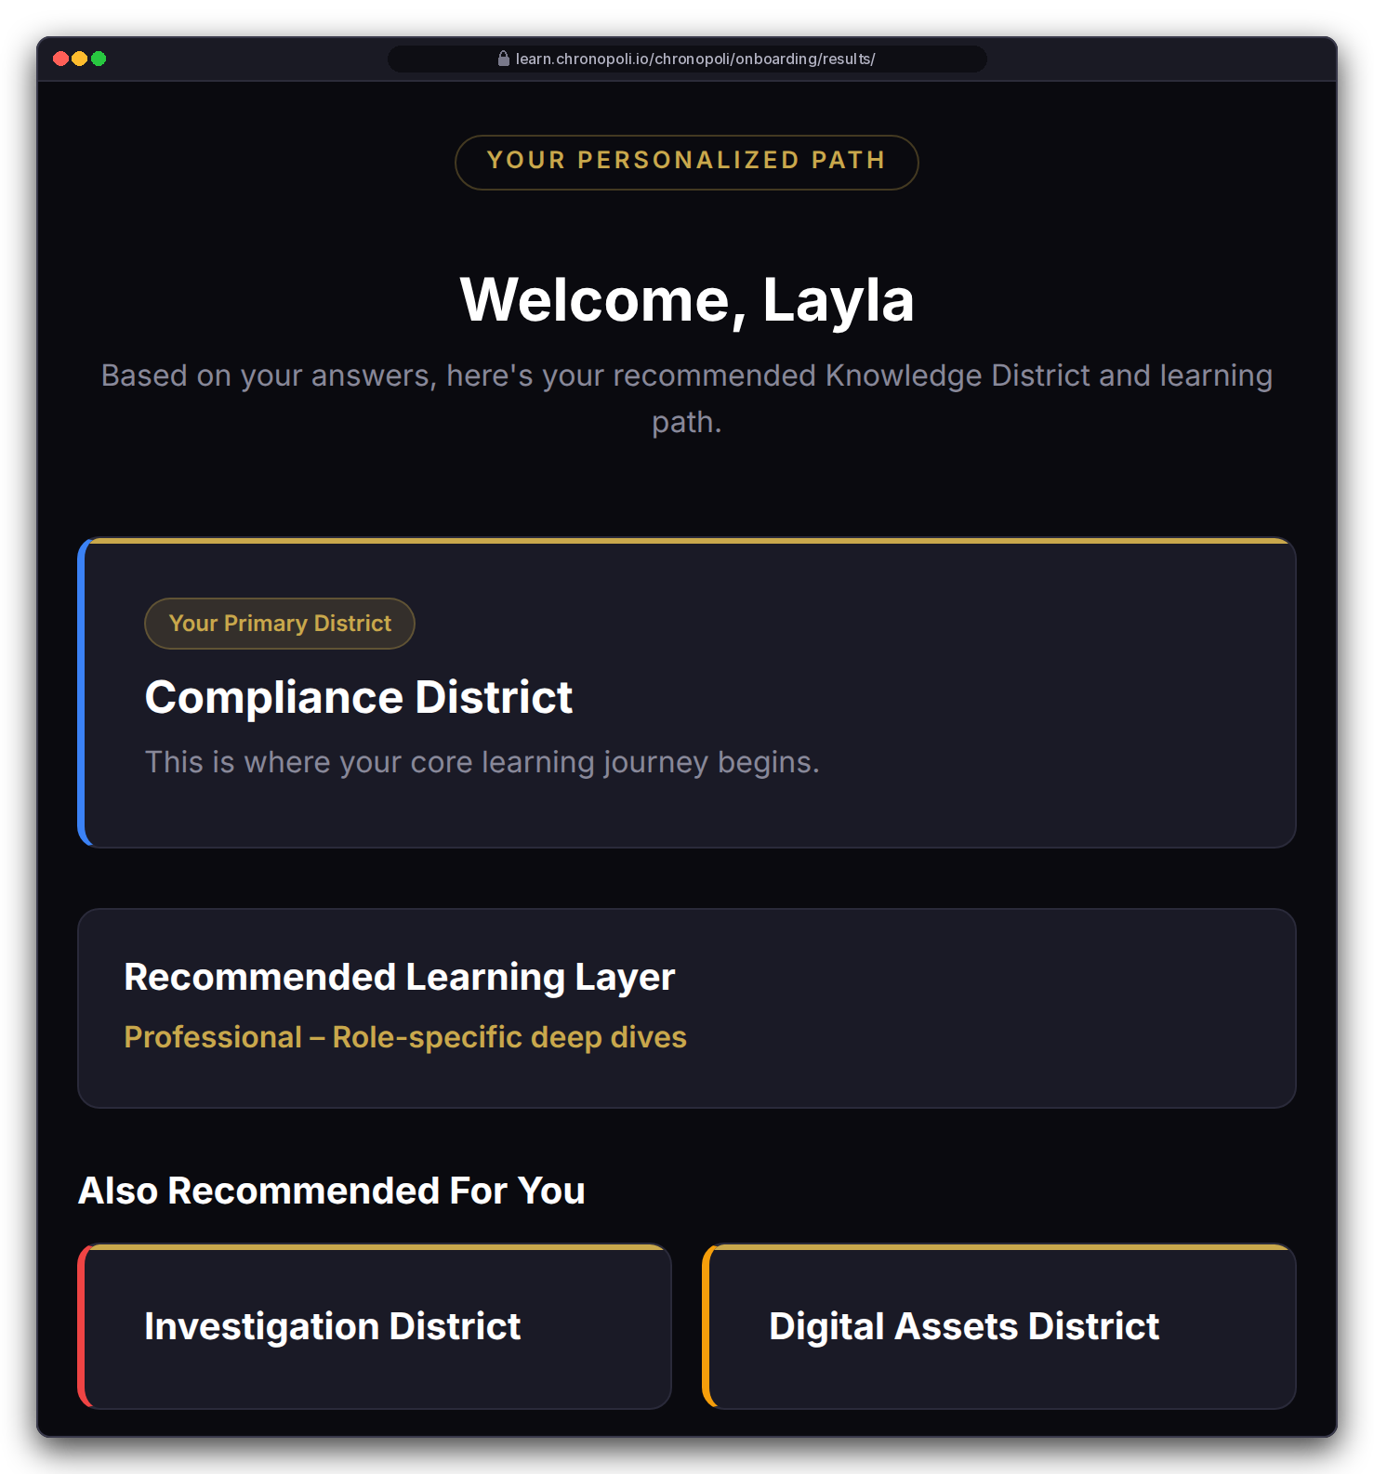
PRODUCT TOUR · STEP 2 OF 9 · ONBOARDING
PLATFORM CORE
Persona: Layla Al-Mansoori, MLRO (fictitious)
Onboarding: five questions, a personal map of the city
Focus picks the home district and its two neighbours; role and experience set the starting layer
Layla answers: crypto exchange · Compliance & AML · experienced · certificate · within weeks
Result: Compliance District at L2 Professional, with Investigation and Digital Assets as neighbours
Rule-based and explainable: the home district follows her own focus choice; role and experience set the layer
Reused by the AI tutor: stored in her profile to set depth and examples
REAL PLATFORM SCREEN
Question 2 of 5
REAL PLATFORM SCREEN
Routing result
Illustrative mock data · Tether is a partner-roadmap target only; no agreement implied
07
Notes:
The recommendation isn't mocked: Layla's answers went through the real routing rules. Call it onboarding, not AI: the routing follows clear rules, which also makes it easy to explain. The AI comes in on slide 11, where the tutor reuses this profile. Because the home district follows the learner's own focus choice, an FIU investigator who picks financial-crime investigation lands in Investigation, and a ministry adviser who picks governance lands in Governance. Before launch, these pages still need their final integration into the live platform, and the answers must be checked against the allowed options.

Slide 8
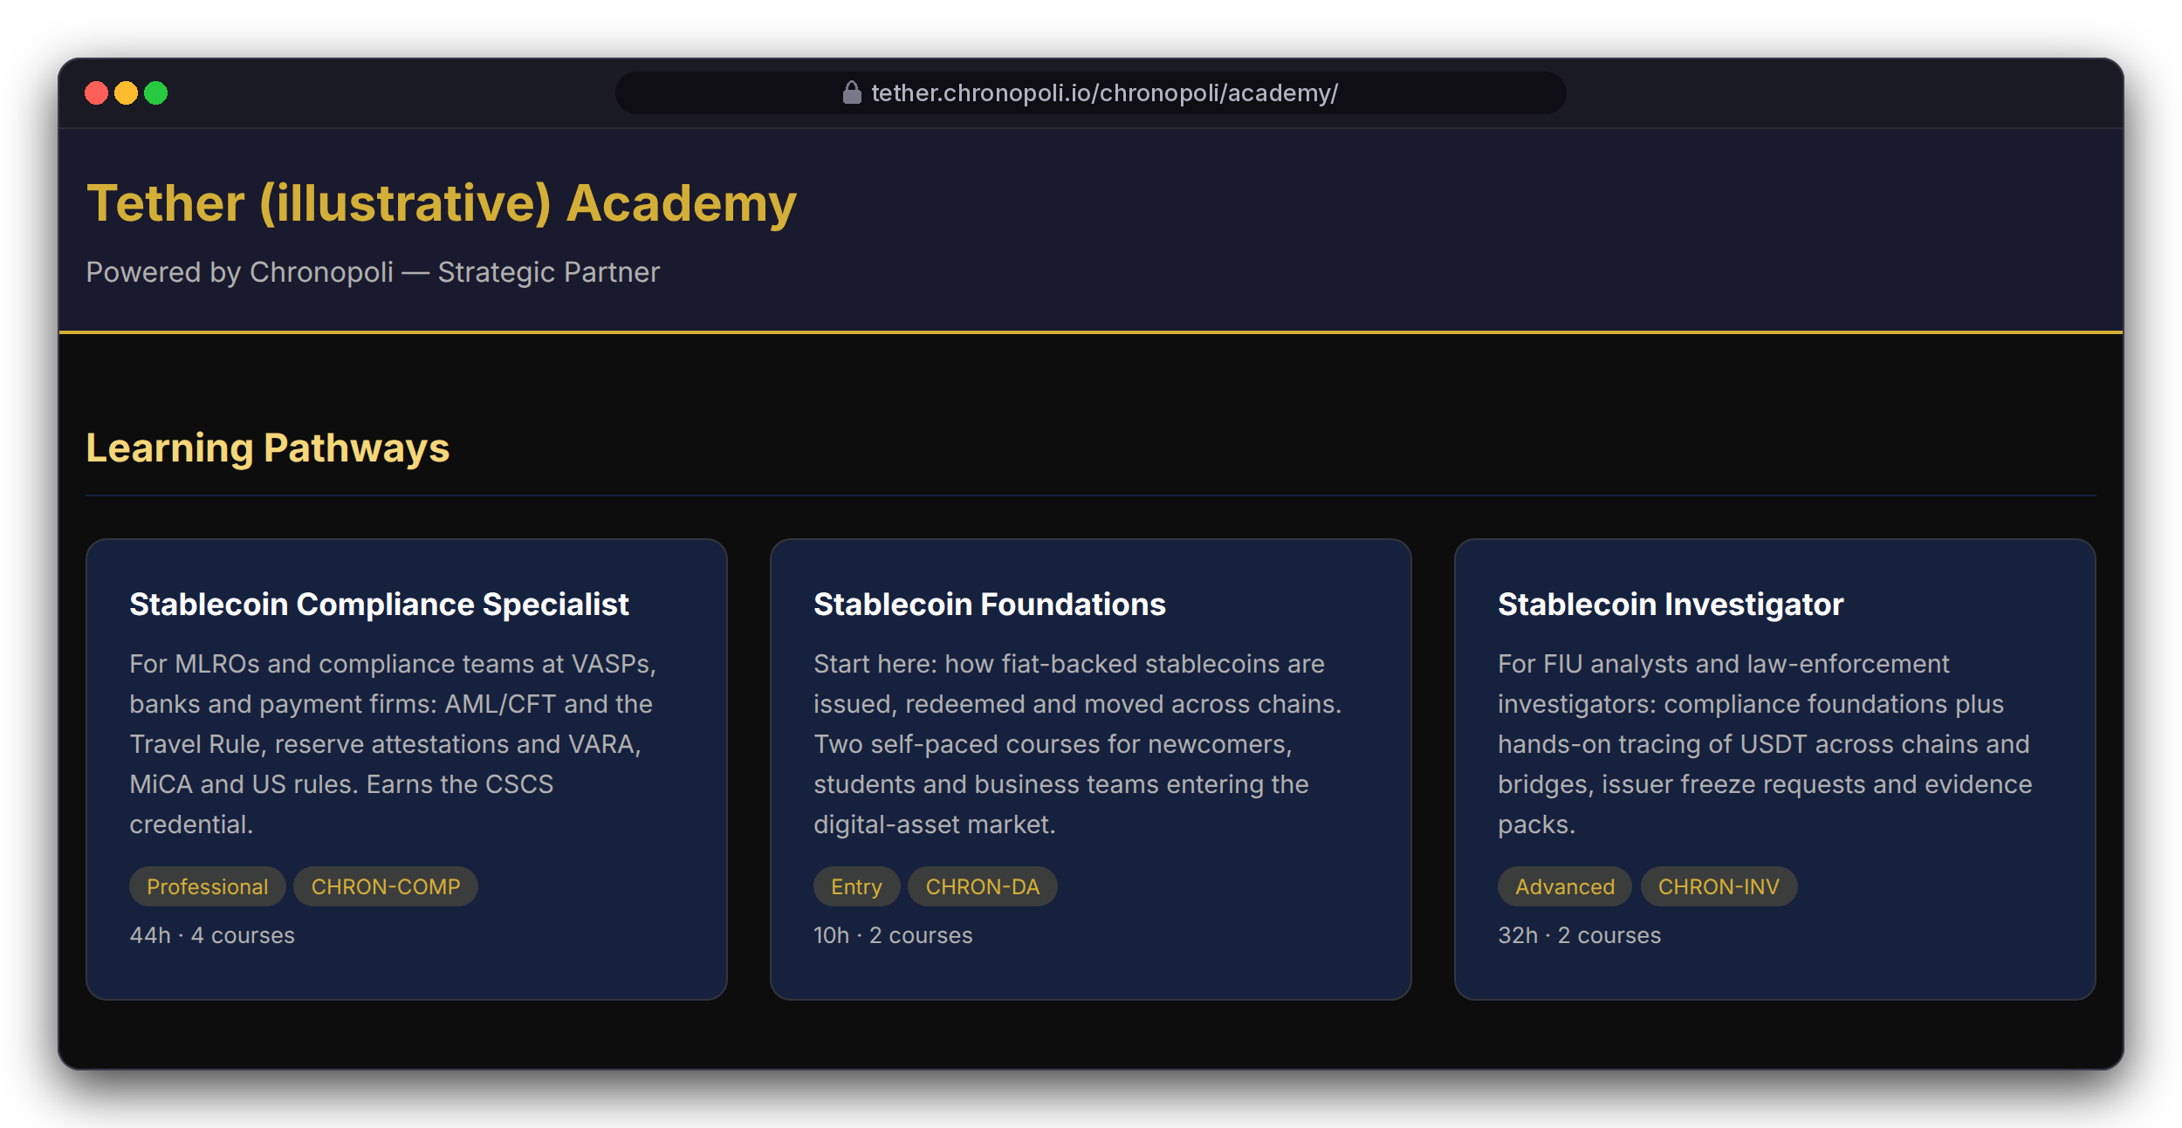
PRODUCT TOUR · STEP 3 OF 9 · PARTNER ACADEMY
PILLAR 02 · COMPANY ACADEMIES
Persona: Layla browsing
Partner academy: a partner's own school inside the city
Pathways that end in a co-branded badge, next to the partner's open roles, at the partner's own web address
3 pathways: Stablecoin Compliance Specialist (4 courses, 44 h), Foundations (2 courses, 10 h), Investigator (2 courses, 32 h)
District catalogues: courses stay in their districts, so a partner track also shows up there
Talent pipeline: the partner's open roles sit on the same page, below the pathways (slide 13)
REAL PLATFORM SCREEN
Academy home, top of the page (partner colour and logo not yet applied)
Illustrative mock data · Tether is a partner-roadmap target only; no agreement implied
08
Notes:
The partner admin, Nadia Karim (fictitious), sets this up in the back office: partner record, web address, pathways, badges and jobs. Two honest caveats. The page doesn't yet apply the partner's brand colour or logo. And the partner's own web address (tether.chronopoli.io) is not switched on yet; for the demo we opened the academy directly. The frame shows the top of the academy page; the open roles follow further down the same page, and slide 13 shows the job board. This is the Company Academies pillar: a branded partner academy (slide 4).

Slide 9
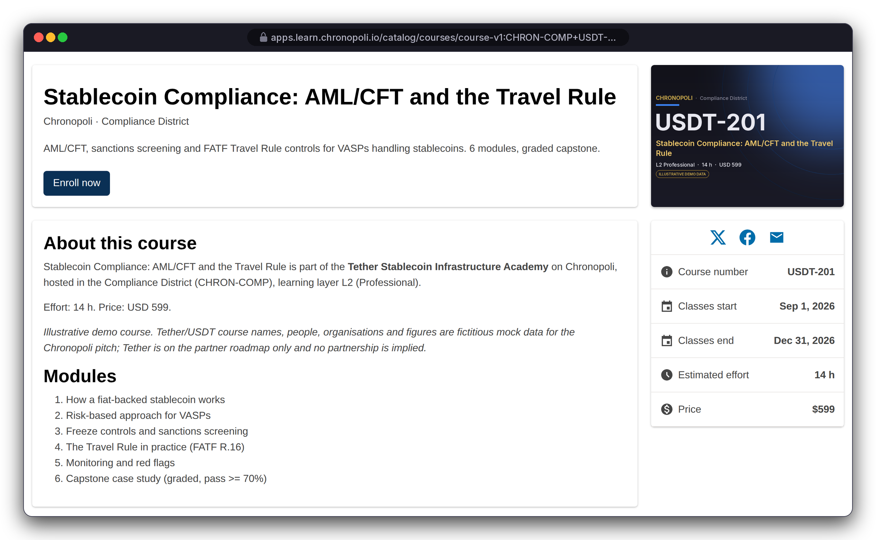
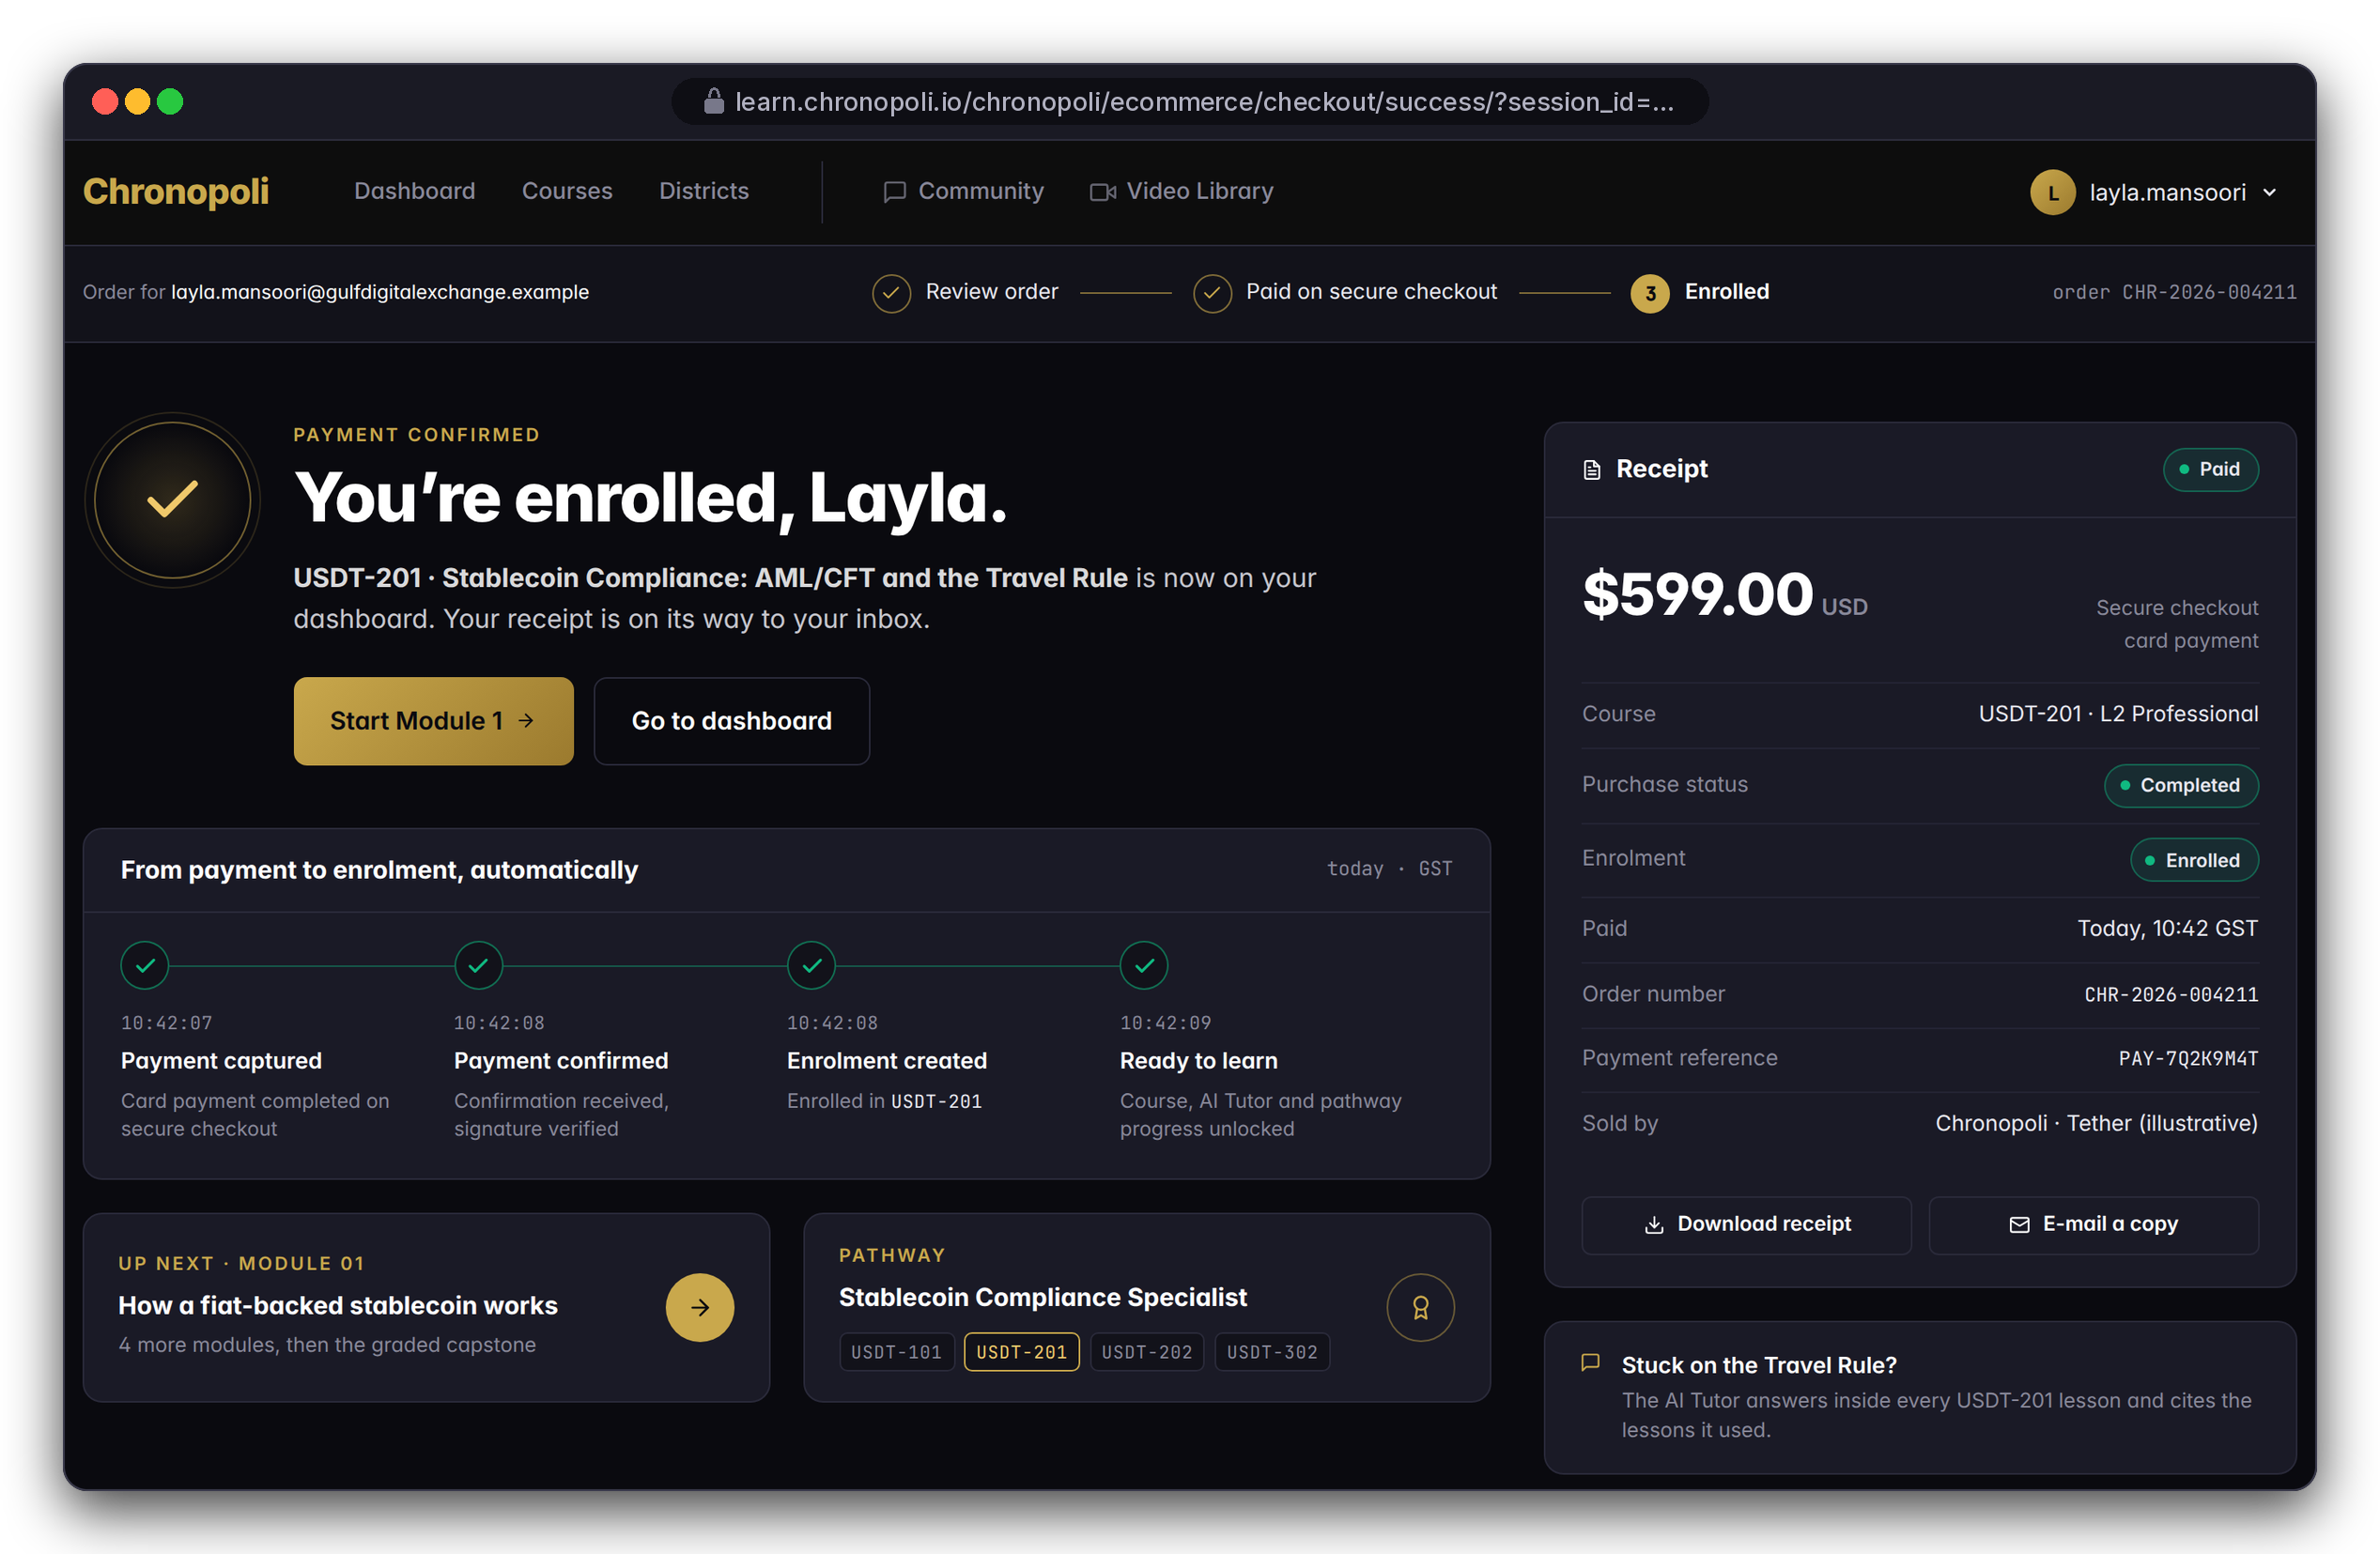
PRODUCT TOUR · STEP 4 OF 9 · ENROL & PAY
PILLAR 03 · OPEN KNOWLEDGE
Persona: Layla · Illustrative mock data
Enrol and pay in one checkout
The learning layer sets the price, a secure hosted checkout takes the payment, and the learner is enrolled automatically
REAL PLATFORM SCREEN
Course page with price
DESIGN PROTOTYPE (NOT YET BUILT)
Payment confirmed, auto-enrolled
Layer sets the price: L2 Professional, $599
Hosted checkout: card details never reach Chronopoli
Automatic enrolment: once she has paid, with the 70% partner share recorded
Illustrative mock data · Tether is a partner-roadmap target only; no agreement implied
09
Notes:
The course page and price are real: USDT-201, L2 Professional, $599. Chronopoli never sees card details, because payment runs on a secure hosted checkout from an established payment provider. Once she has paid, the platform enrols Layla automatically and records the partner’s 70% share, and a repeated payment notice cannot enrol her twice. The confirmation page is a design prototype, not yet built. Still to do before launch: making payment a condition of access inside the course itself, and handling refunds.

Slide 10
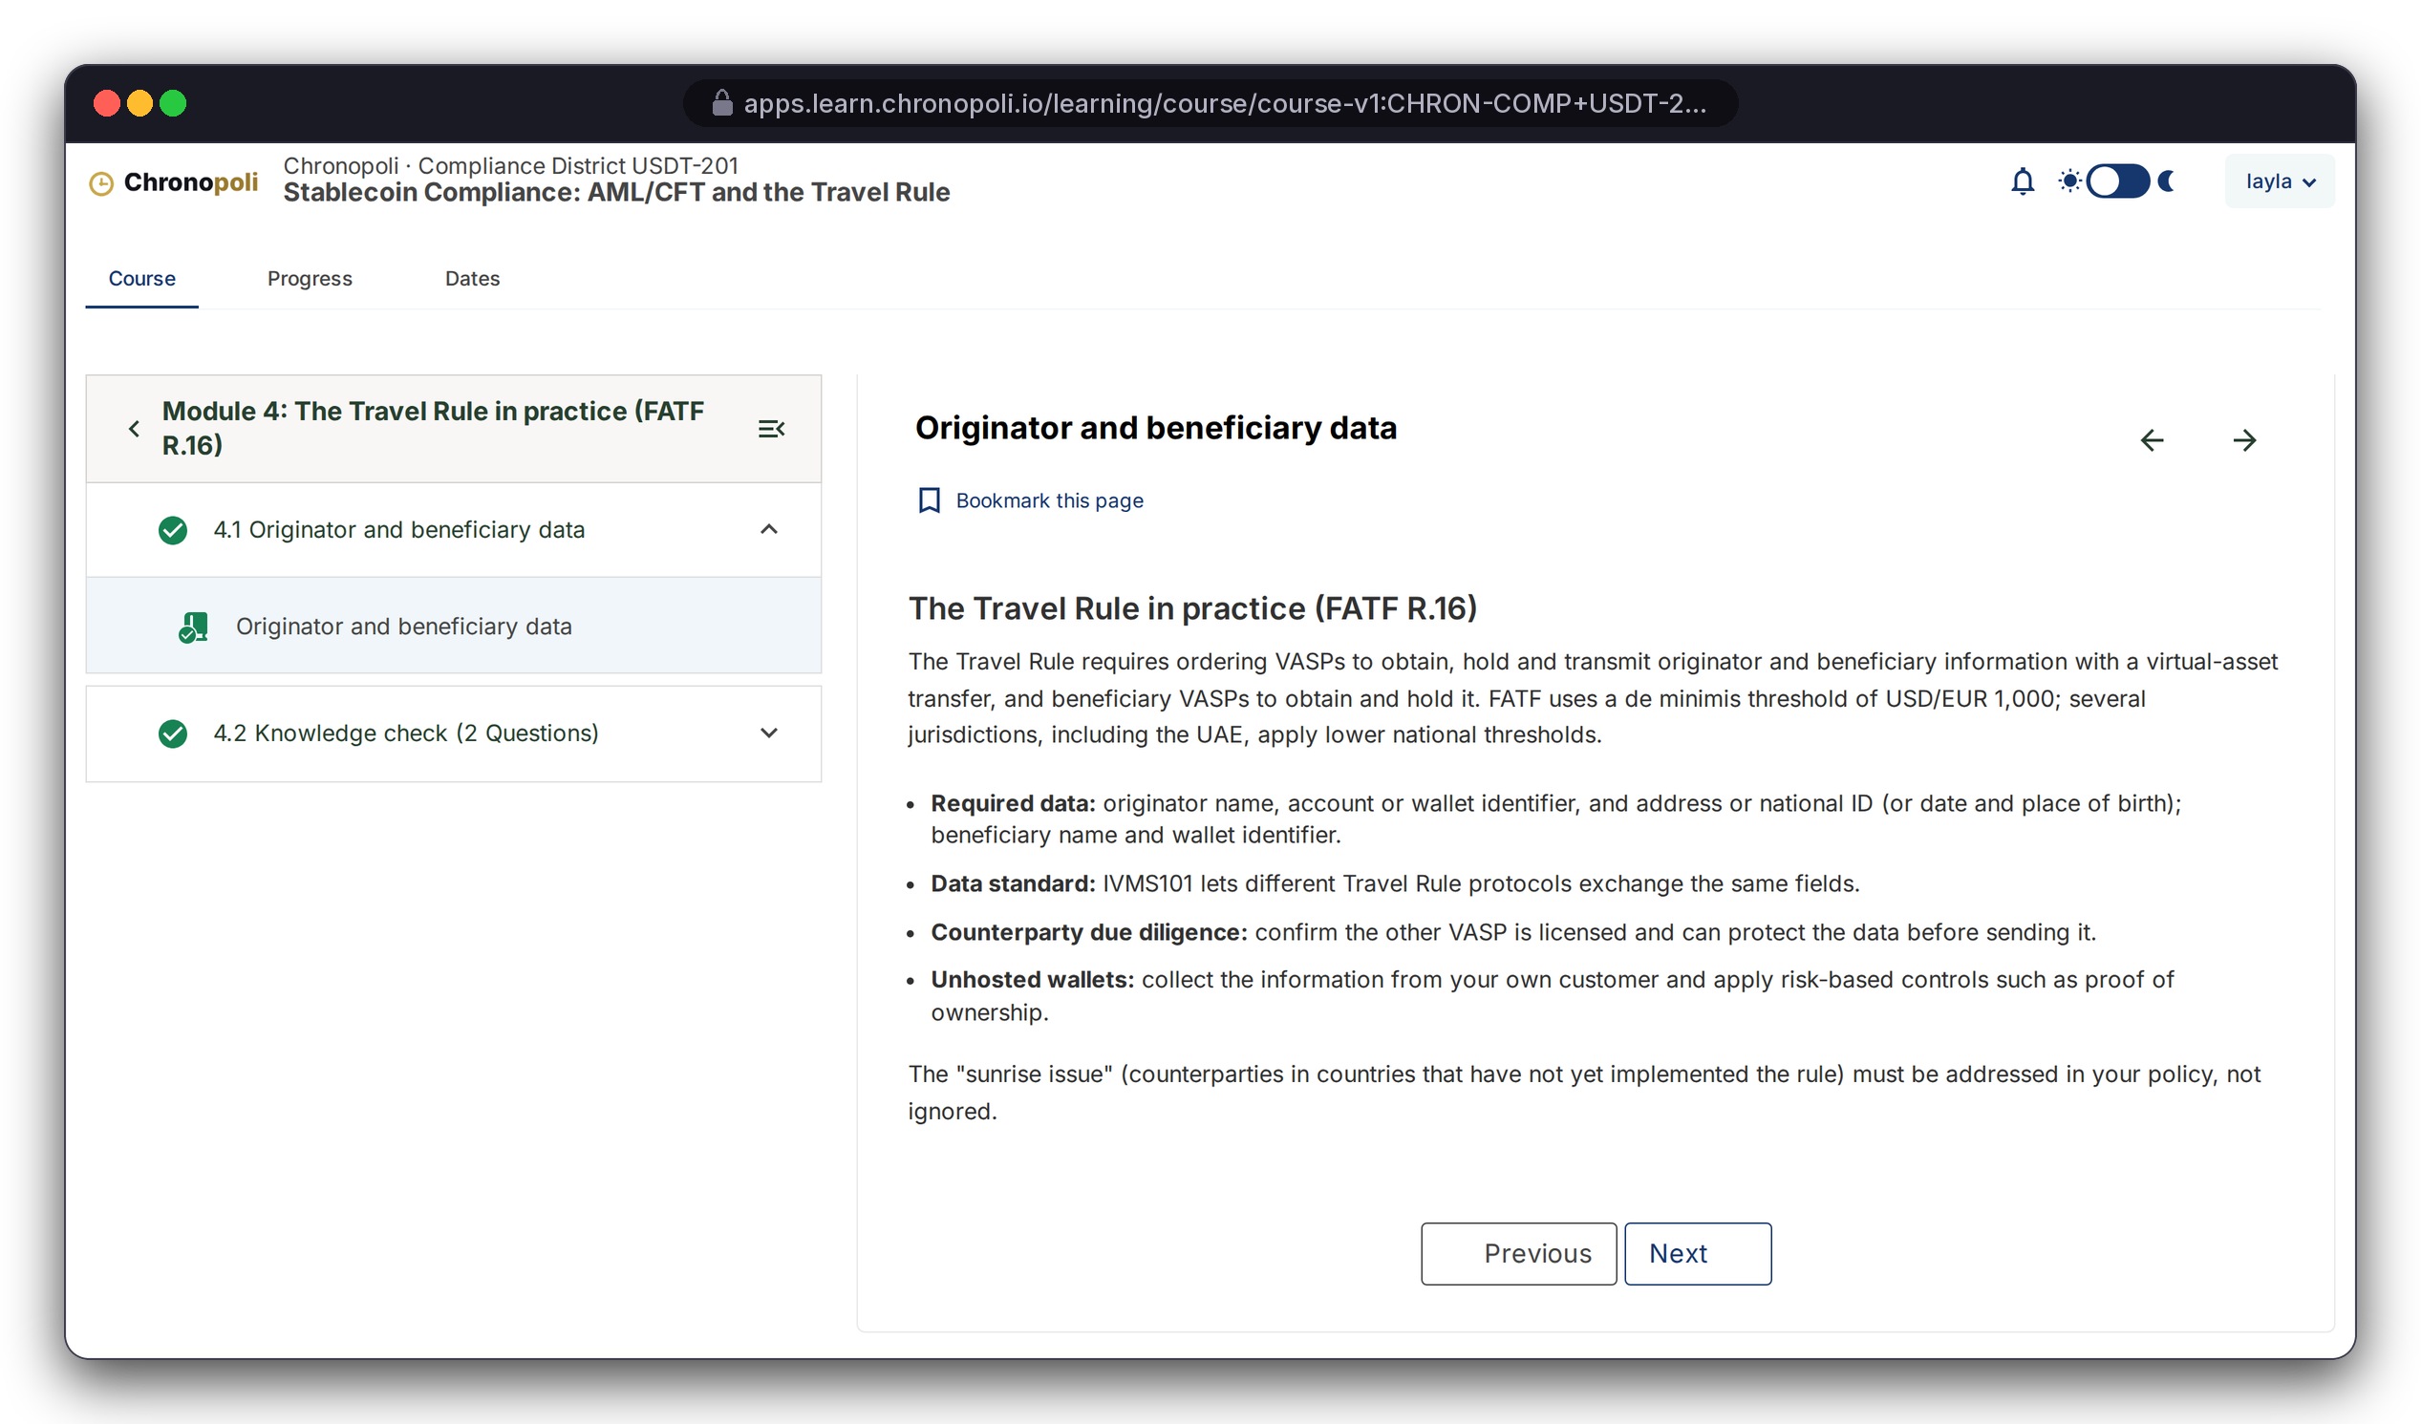
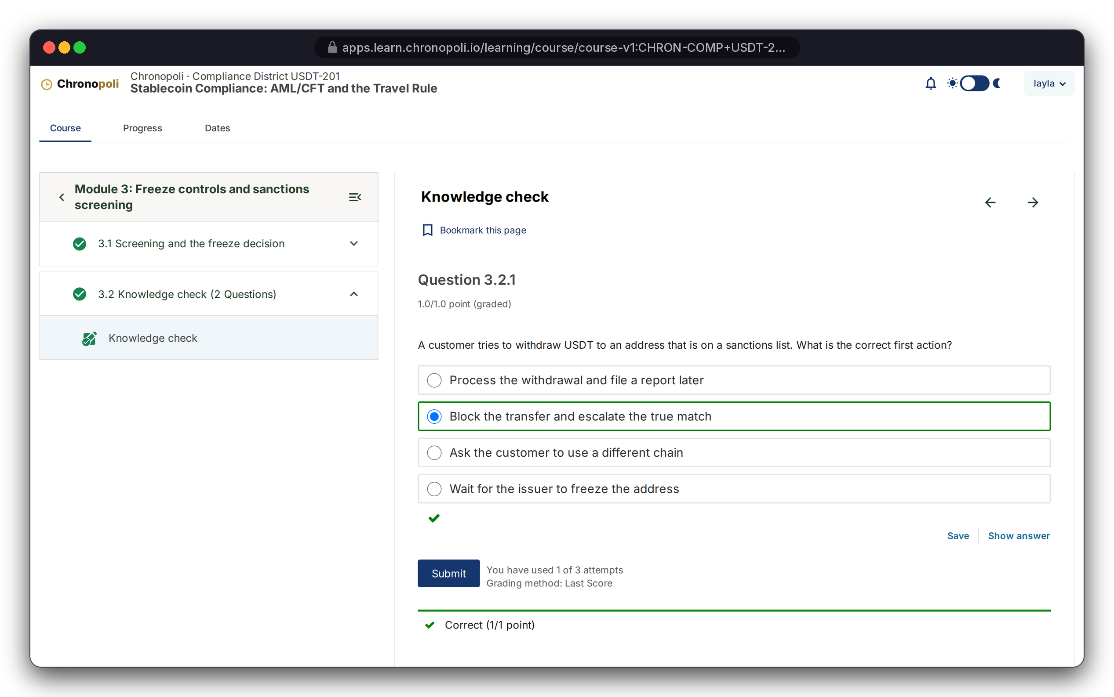
PRODUCT TOUR · STEP 5 OF 9 · LEARN
PLATFORM CORE
Persona: Layla · Illustrative mock course content
Learn on a proven LMS: lessons and auto-graded checks
Proven courseware: completion tracking, graded problems, attempts and feedback out of the box
REAL PLATFORM SCREEN
Lesson 4.1, the Travel Rule in practice
REAL PLATFORM SCREEN
Knowledge check 3.2 · correct on attempt 1 of 3
USDT-201: six modules, ending in a graded capstone
Instant grading: attempts are tracked (1 of 3 used)
Illustrative mock data · Tether is a partner-roadmap target only; no agreement implied
10
Notes:
Layla worked through the course in a real browser session; these aren't mock-ups. This is the advantage in practice: proven courseware, grading and progress tracking that we don't have to build or maintain ourselves. Our effort goes into what sits around it: districts, academies, credentials, round tables and the AI tutor. Partner faculty write this content themselves in course authoring (slide 16).

Slide 11
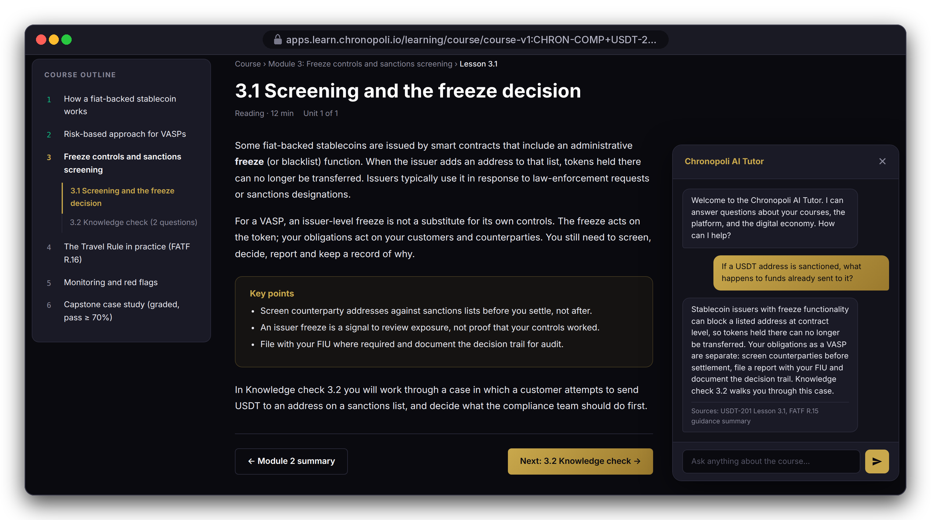
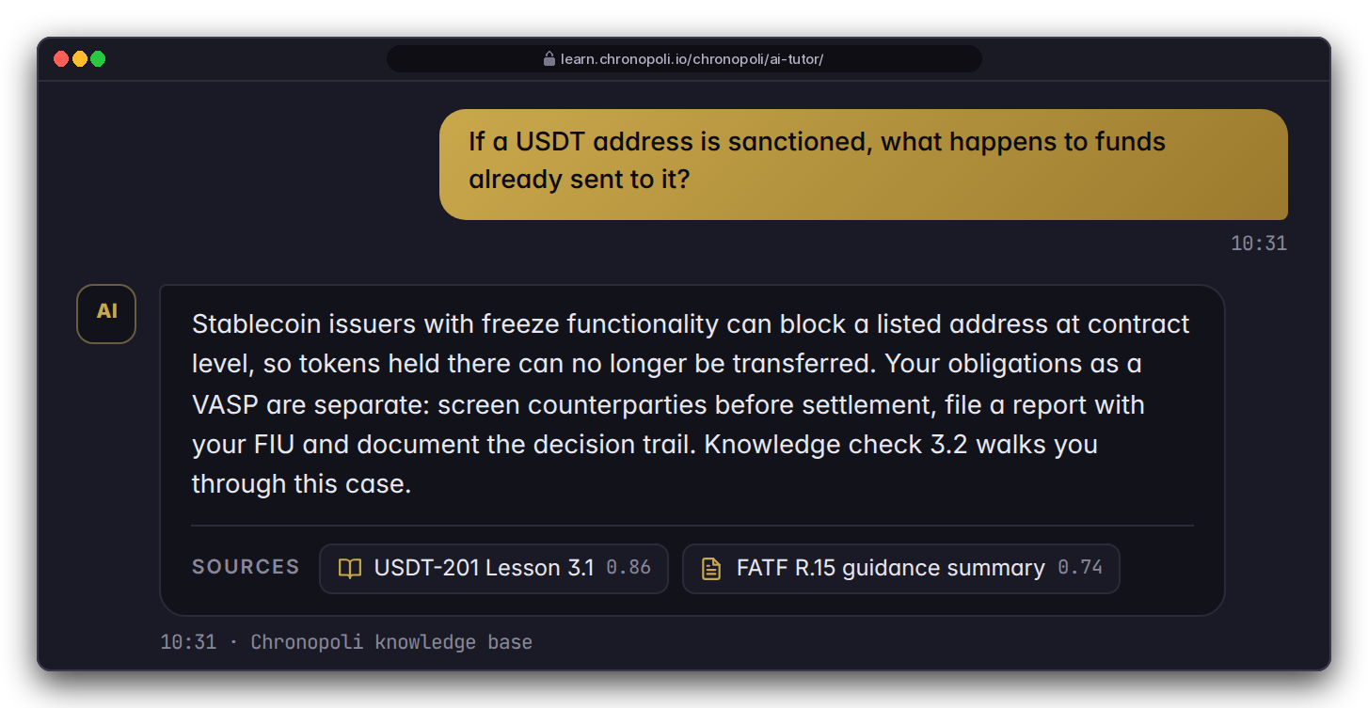
PRODUCT TOUR · STEP 6 OF 9 · AI TUTOR
PILLAR 03 · OPEN KNOWLEDGE
Persona: Layla, Module 3 · Mock lesson, target theme
An AI tutor that cites its sources
The AI tutor answers inside the lesson, from the Chronopoli knowledge base, and shows its sources
DESIGN PROTOTYPE (NOT YET BUILT)
Tutor history
In Module 3: Layla asks what happens to funds already sent to a sanctioned USDT address
Cited answer: grounded in USDT-201 Lesson 3.1 and the FATF Recommendation 15 summary, at her L2 depth
A learning aid: not legal or compliance advice
DESIGN PROTOTYPE (NOT YET BUILT)
AI tutor on a prototype lesson page · scripted demo answer
Illustrative mock data · Tether is a partner-roadmap target only; no agreement implied
11
Notes:
The tutor window and the Chronopoli header are our own product, and the tutor shapes its answer around Layla's onboarding profile: Compliance District, L2 depth, exchange examples. For this demo the answer text is scripted, not a live AI answer; say so if asked. This is the platform moat: tutoring grounded in partner courses and round-table papers, which no general-purpose AI has. A reliability fix for long conversations is already done. Still to do before launch: building the knowledge base from the course content, its access rules and per-user usage limits. The dark and gold look is the target Chronopoli design; the real platform screens on slide 10 still use the default look, and both show the same Module 3 outline. This is the AI Tutor of the Open Knowledge pillar.

Slide 12
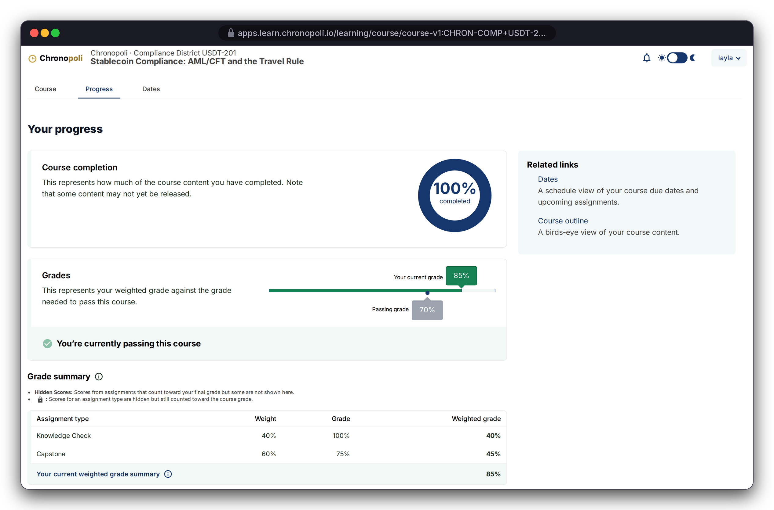

PRODUCT TOUR · STEP 7 OF 9 · PASS & PATHWAY
PILLAR 02 · COMPANY ACADEMIES
Persona: Layla · Illustrative mock data
Pass, then watch the pathway fill up
The platform grades each course; the academy reads those grades to track the whole pathway
REAL PLATFORM SCREEN
Progress page
REAL PLATFORM SCREEN
Pathway page
USDT-201 complete: 85% against a 70% pass mark (weights: knowledge checks 40%, capstone 60%)
Pathway: four required courses in four districts, all passed; no parallel grade book
Illustrative mock data · Tether is a partner-roadmap target only; no agreement implied
12
Notes:
Layla answered one capstone question wrong on purpose, so the 85% is a grade the platform computed from her submitted answers. The pathway spans Digital Assets, Compliance, Risk & Trust and Governance. That’s the city idea: one credential built from several districts. In the demo the pathway page uses sample progress data; at launch it reads the grades straight from the platform, so there is one grade record and no parallel grade book.

Slide 13

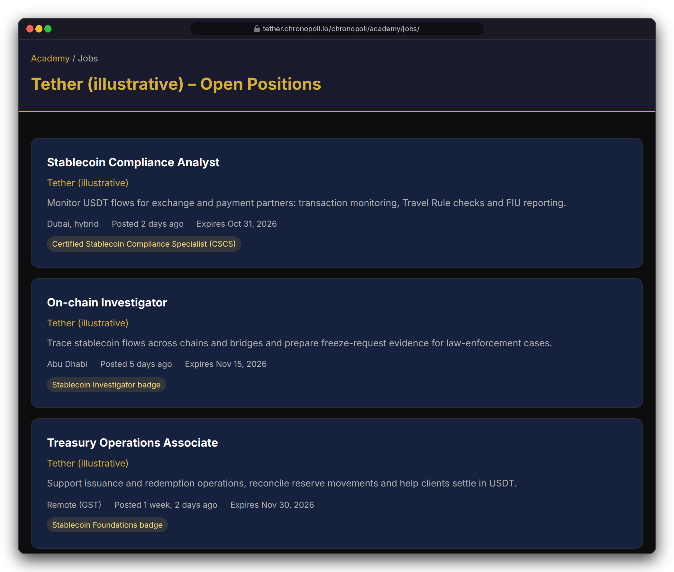
PRODUCT TOUR · STEP 8 OF 9 · BADGE TO JOB
PILLAR 02 · COMPANY ACADEMIES
Persona: Layla · Fictitious roles
From credential to career
Finishing a pathway issues a verifiable Open Badge, and partners can require that badge for open roles
CSCS badge: Open Badges 2.0, readable by badge wallets and HR systems
Roles can require a badge: the Stablecoin Compliance Analyst role (Dubai, hybrid) asks for CSCS
Consent first: learners opt in before partners see their badges (required before launch)
REAL PLATFORM SCREEN
CSCS badge
REAL PLATFORM SCREEN
Partner job board
Illustrative mock data · Tether is a partner-roadmap target only; no agreement implied
13
Notes:
The pitch to partners: you don't just educate the market, you hire from it. The badge was awarded by the platform's own badge logic. Two things must be in place before this runs automatically and compliantly: the badge has to be issued automatically when the certificate is created, and learners must explicitly opt in before they are put forward for jobs.

Slide 14
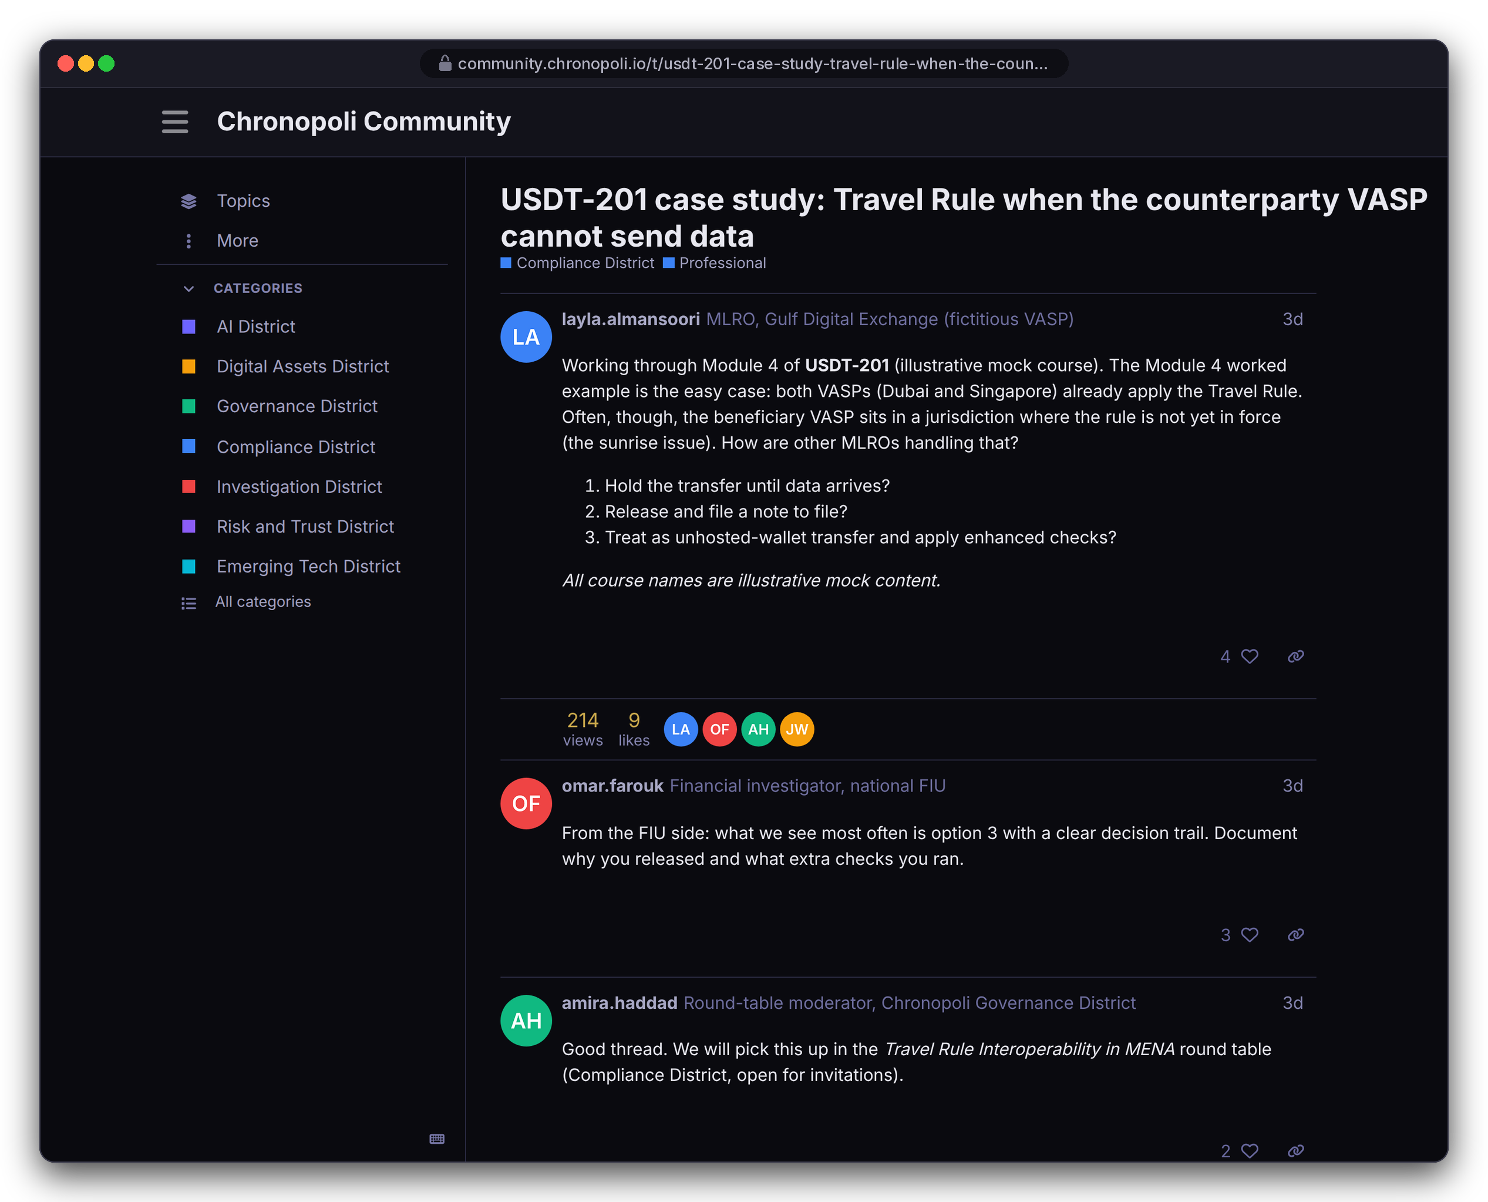
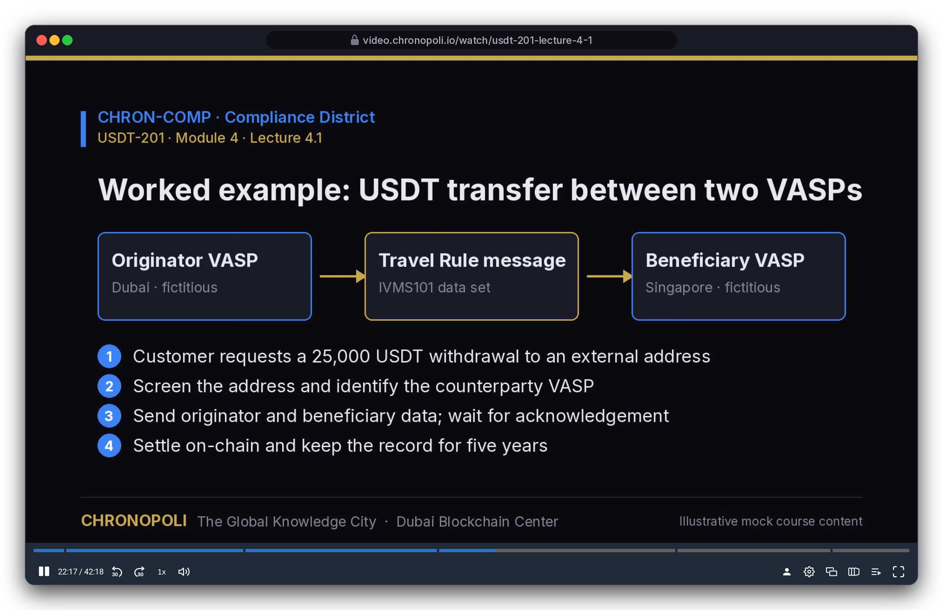
PRODUCT TOUR · STEP 9 OF 9 · COMMUNITY & VIDEO
PLATFORM CORE
Persona: Layla during USDT-201 · Illustrative mock content
Community and video, in district colours
District forums and recorded lectures: both real, both running on our demo system
REAL PLATFORM SCREEN
Forum · Travel Rule thread
REAL PLATFORM SCREEN
Lecture video · lecture 4.1
Community: a forum per district, same sign-in as the courses; an MLRO asks, an FIU investigator answers
Video: recorded lectures with a slide index, so learners can jump straight to any slide
Illustrative mock data · Tether is a partner-roadmap target only; no agreement implied
14
Notes:
Both ran for real on our demo system for these captures, with seeded content. The thread starts from the Module 4 worked example in the lecture, where both VASPs already apply the Travel Rule, and asks about the harder sunrise case, so course, video and community connect. The AI slide builder for staff is not shown, because we could not capture it for this deck. Before launch, the shared sign-in between courses and community still needs its final set-up.

Slide 15




PART 2
The partner side: why organisations pay
Author, run, measure and earn from an academy, plus round tables and expert masterclasses that no catalogue offers
Course authoring
Slide 16
NEW PERSONAS (FICTITIOUS)
Partner dashboard and weekly reports
Slide 17
NK
Nadia Karim
Academy administrator (fictitious)
Symposia: round tables and the five-output pipeline
Slides 18-19
Open Knowledge: Digital Twin masterclasses
Slide 20
AH
Dr. Amira Haddad
Round-table moderator (fictitious)
Market, business model, pricing and payouts
Slides 21-26
Financials, traction, team, plan and the ask
Slides 27-36
Illustrative mock data · Tether is a partner-roadmap target only; no agreement implied
15
Notes:
We switch personas here: Nadia Karim runs the partner academy, and Dr. Amira Haddad moderates round tables. Both are fictitious. From now on, the question is what a partner gets for its money.

Slide 16
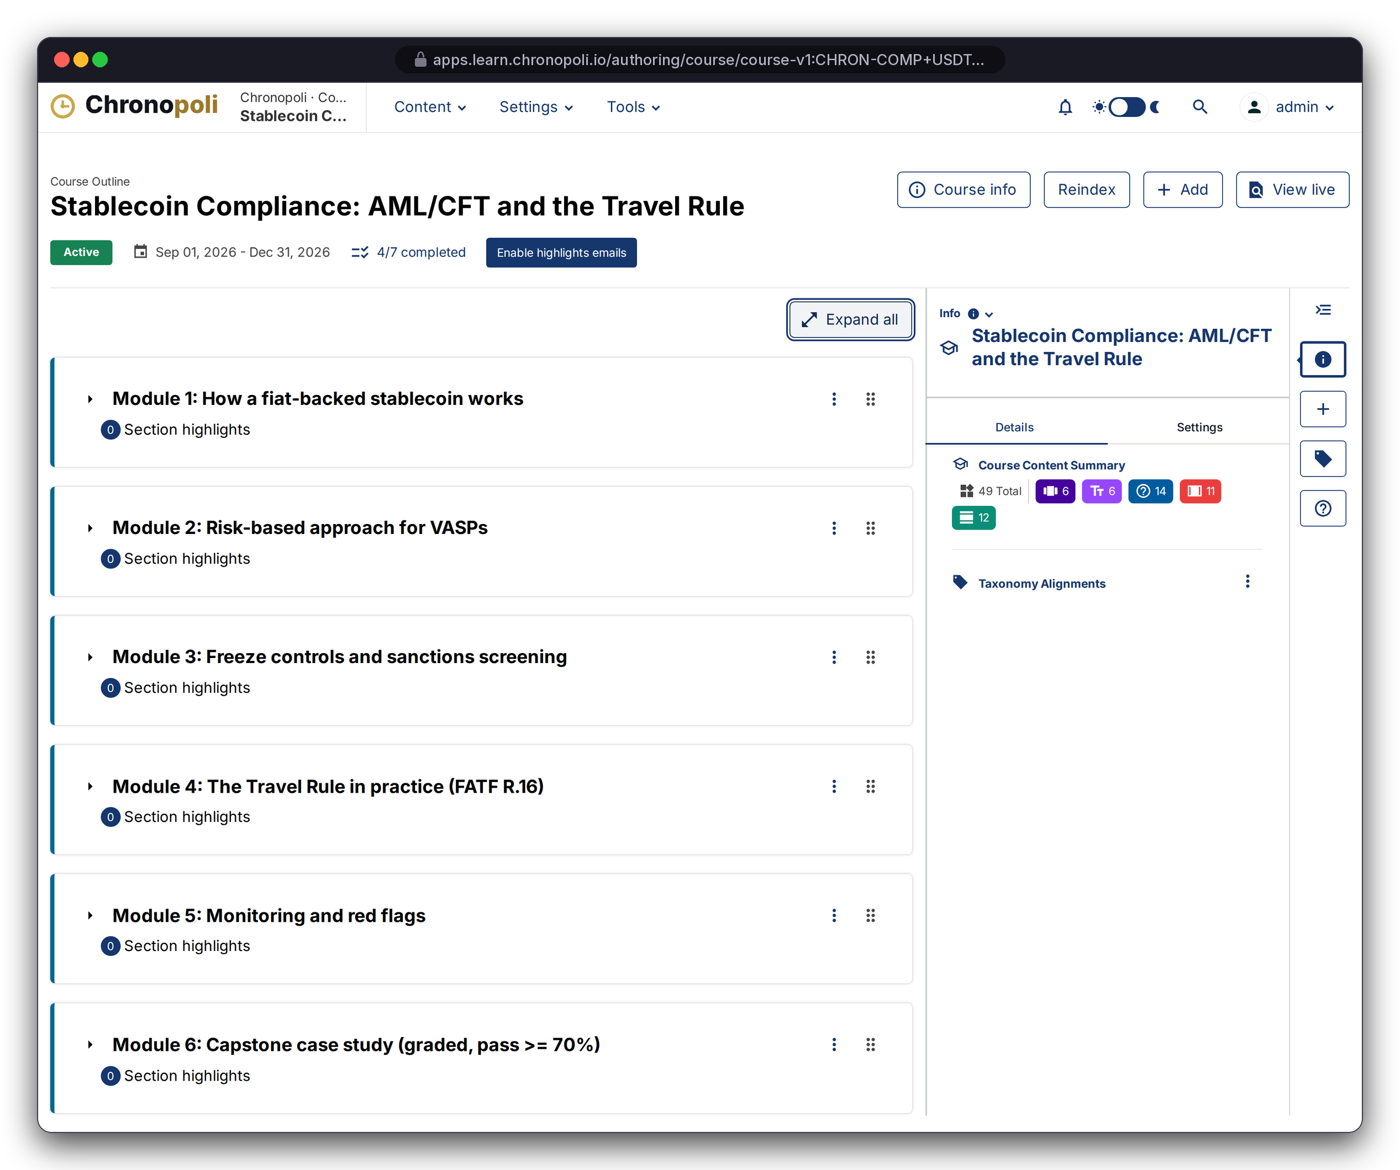
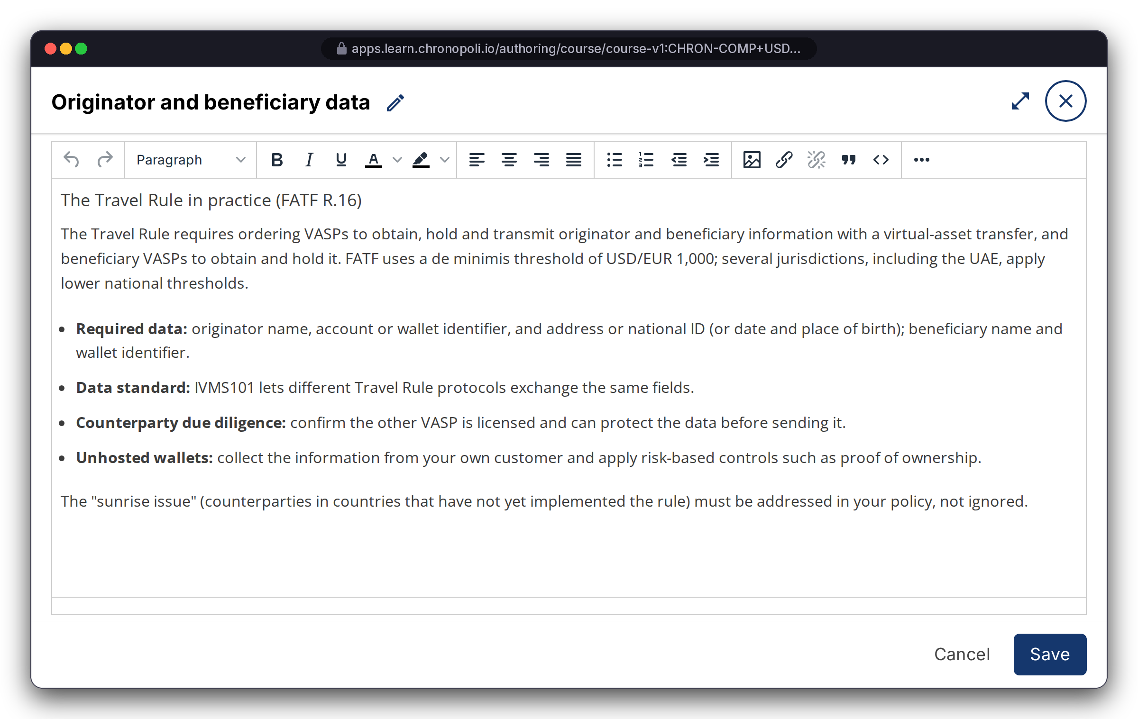
PARTNER SIDE · AUTHOR
PLATFORM CORE
Persona: course team (admin account)
Partners author on a proven tool: nothing to rebuild
Course outline, rich-text editing, scheduling and grading policies are standard platform features
REAL PLATFORM SCREEN
USDT-201 outline
REAL PLATFORM SCREEN
Rich-text editor, lesson 4.1
Districts: each course is built in its district (e.g. CHRON-COMP), then linked to an academy
Built-in authoring: outline, editor, dates and grading
Continuous upgrades: every platform release improves authoring at no extra cost
Illustrative mock data · Tether is a partner-roadmap target only; no agreement implied
16
Notes:
Partners already know this kind of tool: universities and companies use it worldwide. All eight demo courses were built and imported this way, so onboarding a partner’s content means importing a course, not starting a software project. Every platform release improves authoring at no extra cost to us. Pathways, badges and job postings are then set up in the academy back office.

Slide 17
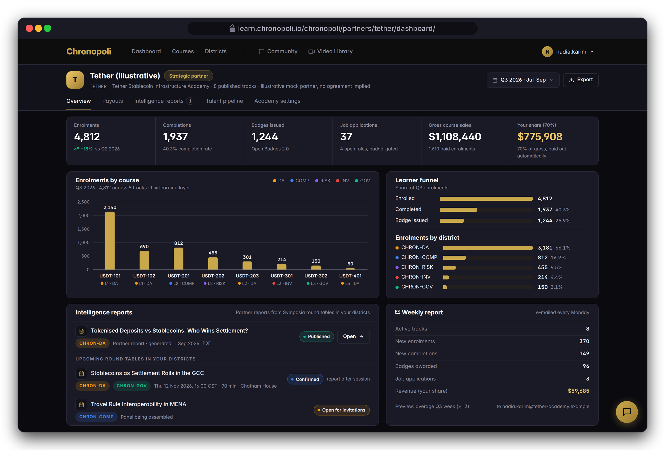
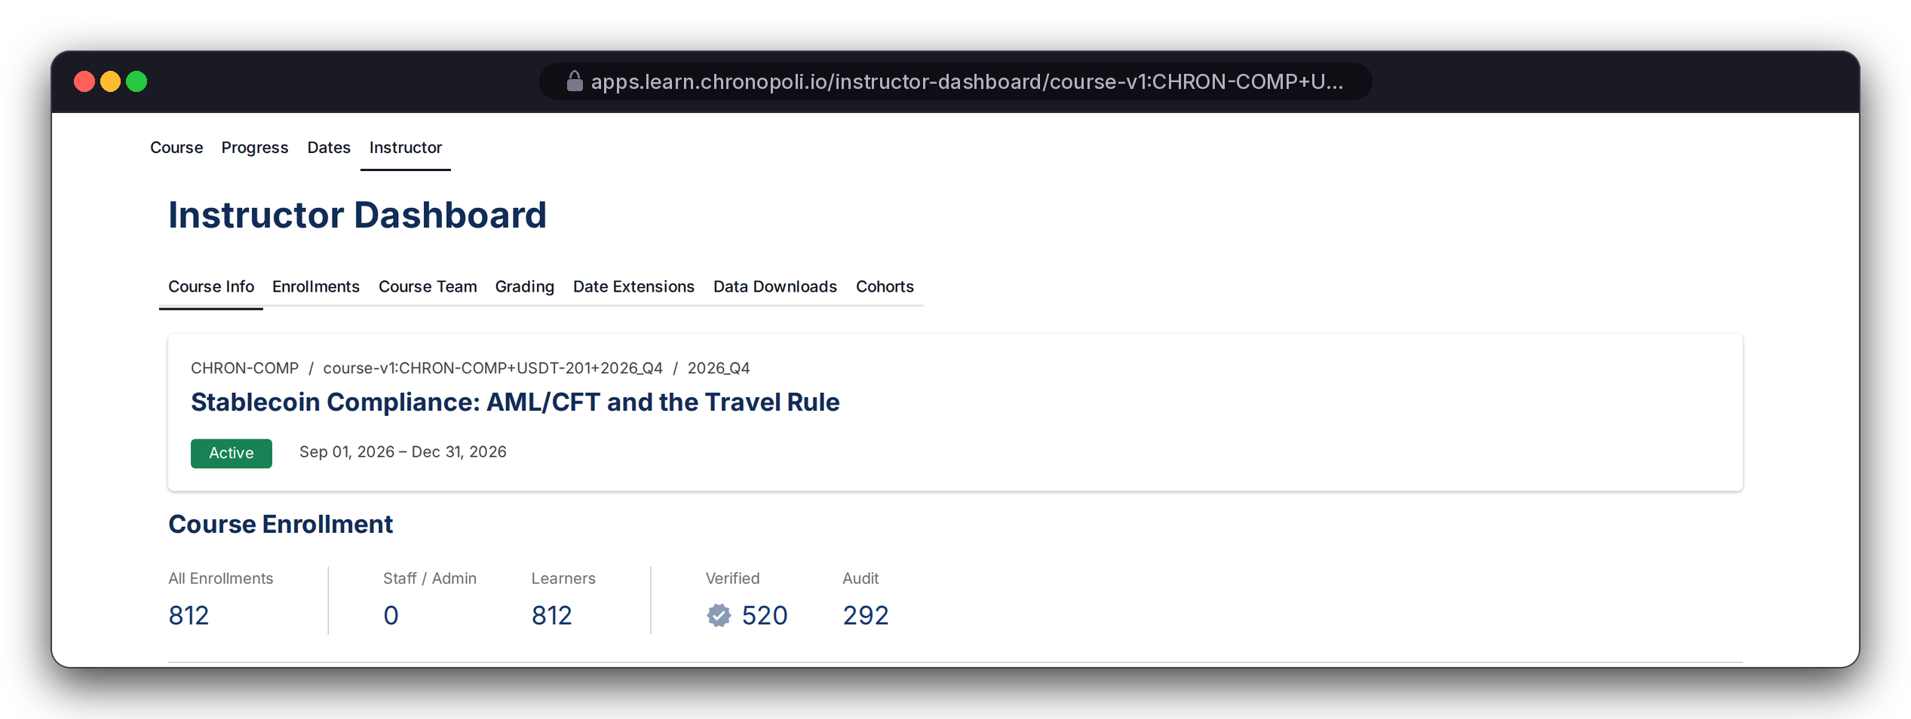
PARTNER SIDE · MEASURE
PILLAR 02 · COMPANY ACADEMIES
Persona: Nadia Karim, academy admin (fictitious)
A live cockpit for every partner
Enrolments, completions, badges, revenue and intelligence reports, plus a weekly e-mail summary
REAL PLATFORM SCREEN
Instructor dashboard
KPIs: enrolments by course and district, learner funnel
Partner Intelligence Reports: from its districts’ round tables
Weekly summary: by e-mail, plus a data feed
Course data: USDT-201 shows 812 enrolled, 520 verified (paid)
DESIGN PROTOTYPE (NOT YET BUILT)
Partner dashboard · illustrative KPIs
Illustrative mock data · Tether is a partner-roadmap target only; no agreement implied
17
Notes:
The counts on the right come from 811 demo accounts plus Layla, sized to match the scenario. If asked about the other 292: in the demo they are free (unpaid) enrolments, and the scenario counts only paid enrolments as sales. The weekly report is built. Still to do before launch: partner user accounts with the right access, reports limited to each partner’s own data, the dashboard page itself, and the completion-rate figure, which is not calculated yet.

Slide 18
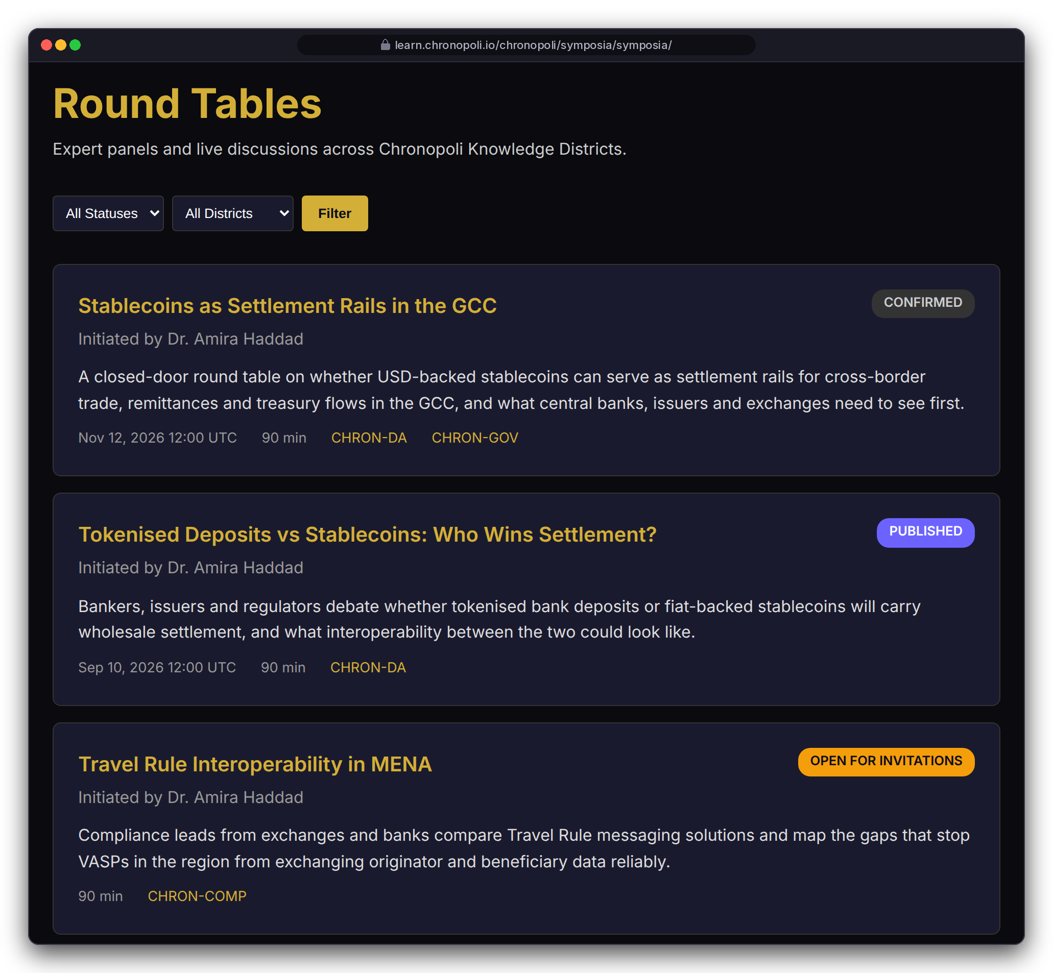
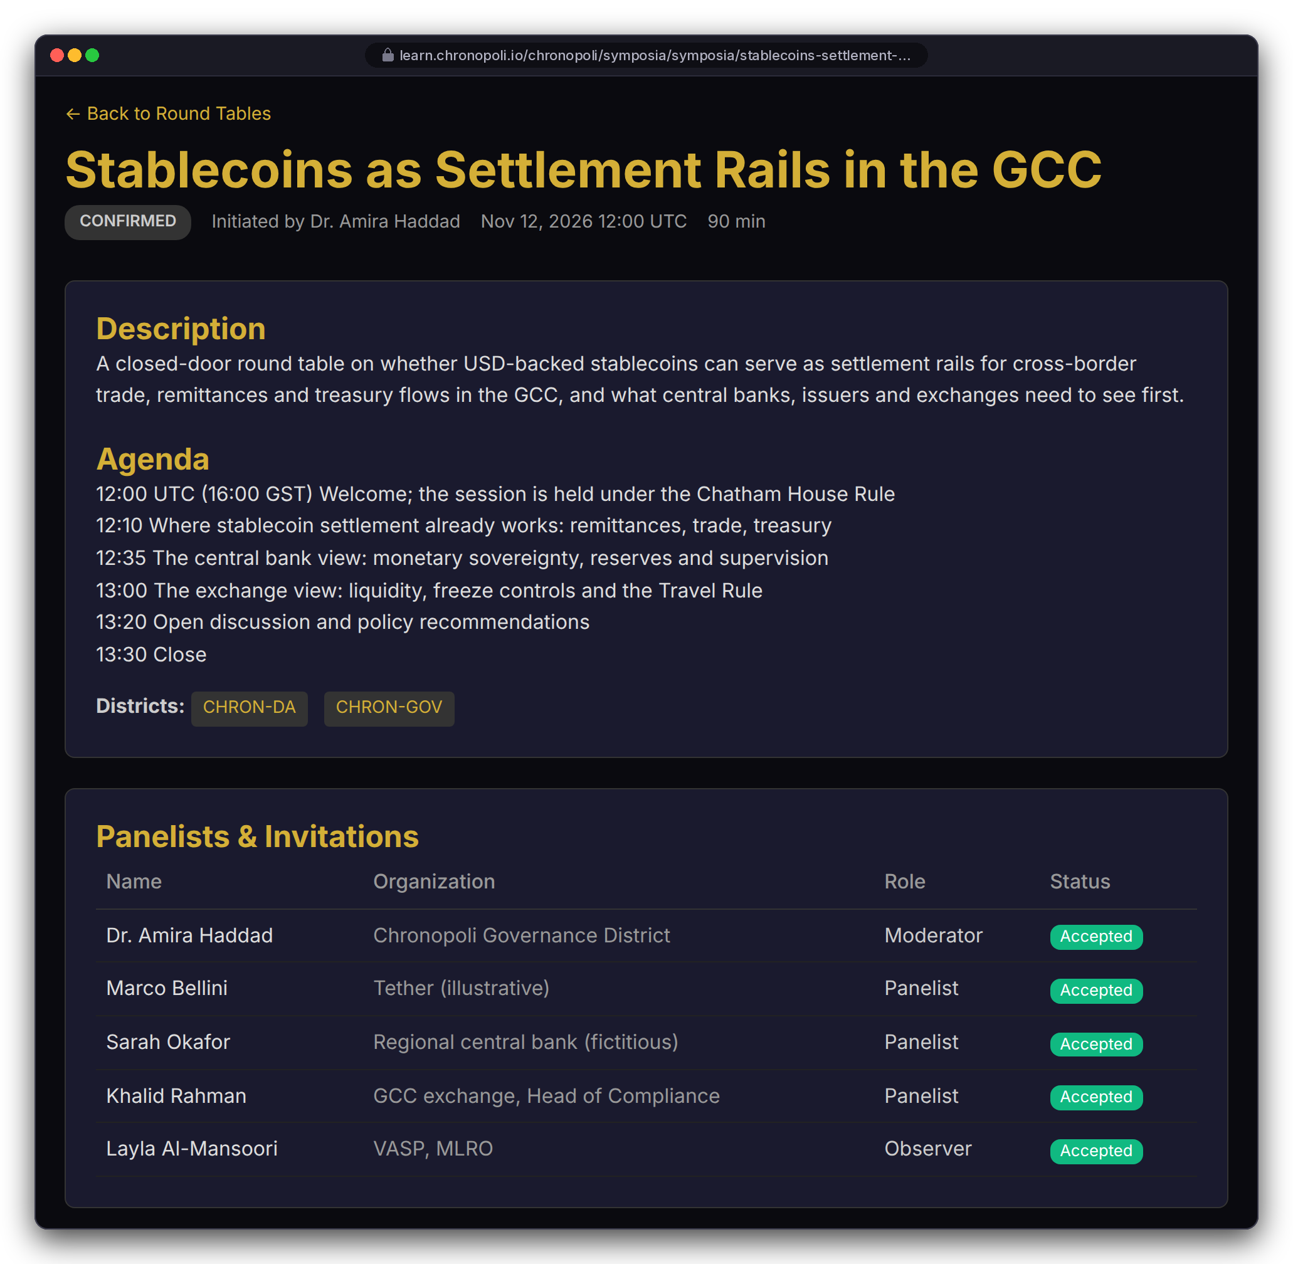
PARTNER SIDE · CONVENE
PILLAR 01 · SYMPOSIA
Persona: Layla as observer · 12 Nov 2026, 16:00 GST (12:00 UTC) · Fictitious panel
Symposia: closed-door round tables as a product
Curated expert panels under the Chatham House Rule, streamed live and tied to districts
Lifecycle: draft, open for invitations, confirmed, live, processing, published
Invitations: secure and expiring, with moderator, panelist and observer roles
Partner Intelligence Report: the sponsor receives one after every session
REAL PLATFORM SCREEN
Round-table list
REAL PLATFORM SCREEN
Agenda and panel
Illustrative mock data · Tether is a partner-roadmap target only; no agreement implied
18
Notes:
This is the commercial differentiator. Putting an issuer, a central bank, an exchange and a regulator-facing moderator in one room is something no online course platform can sell. The round-table pages print times in UTC, so the agenda is written in UTC too: 12:00 UTC is 16:00 in Dubai. Still to do before launch: recording the live stream and starting the content pipeline automatically after each session.

Slide 19
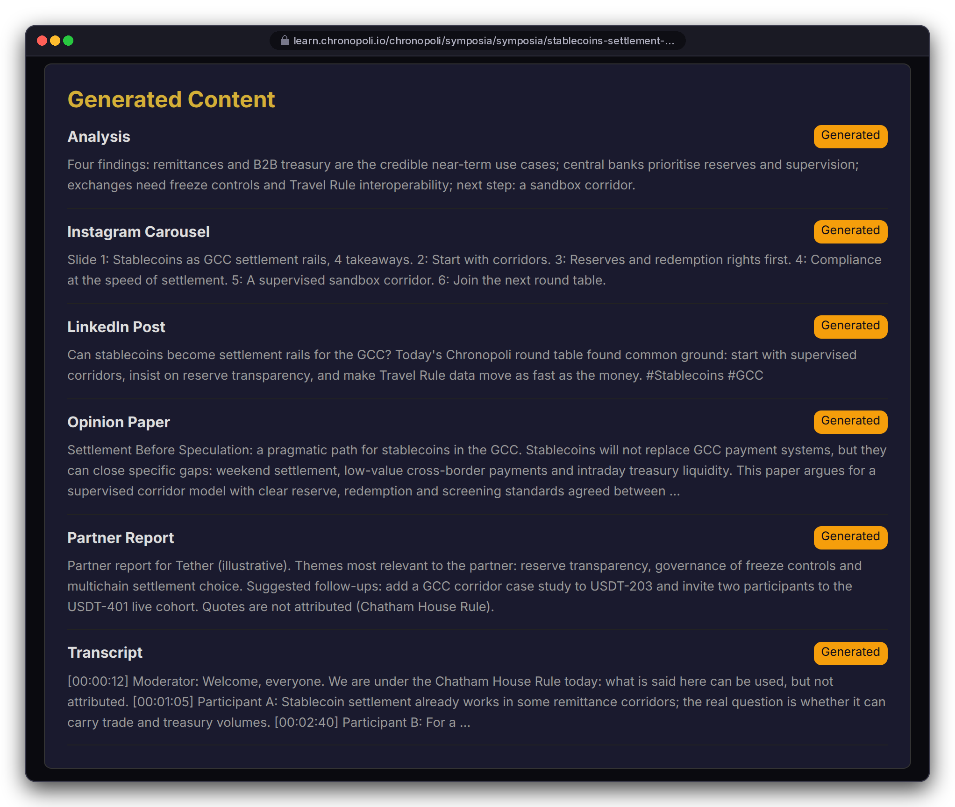
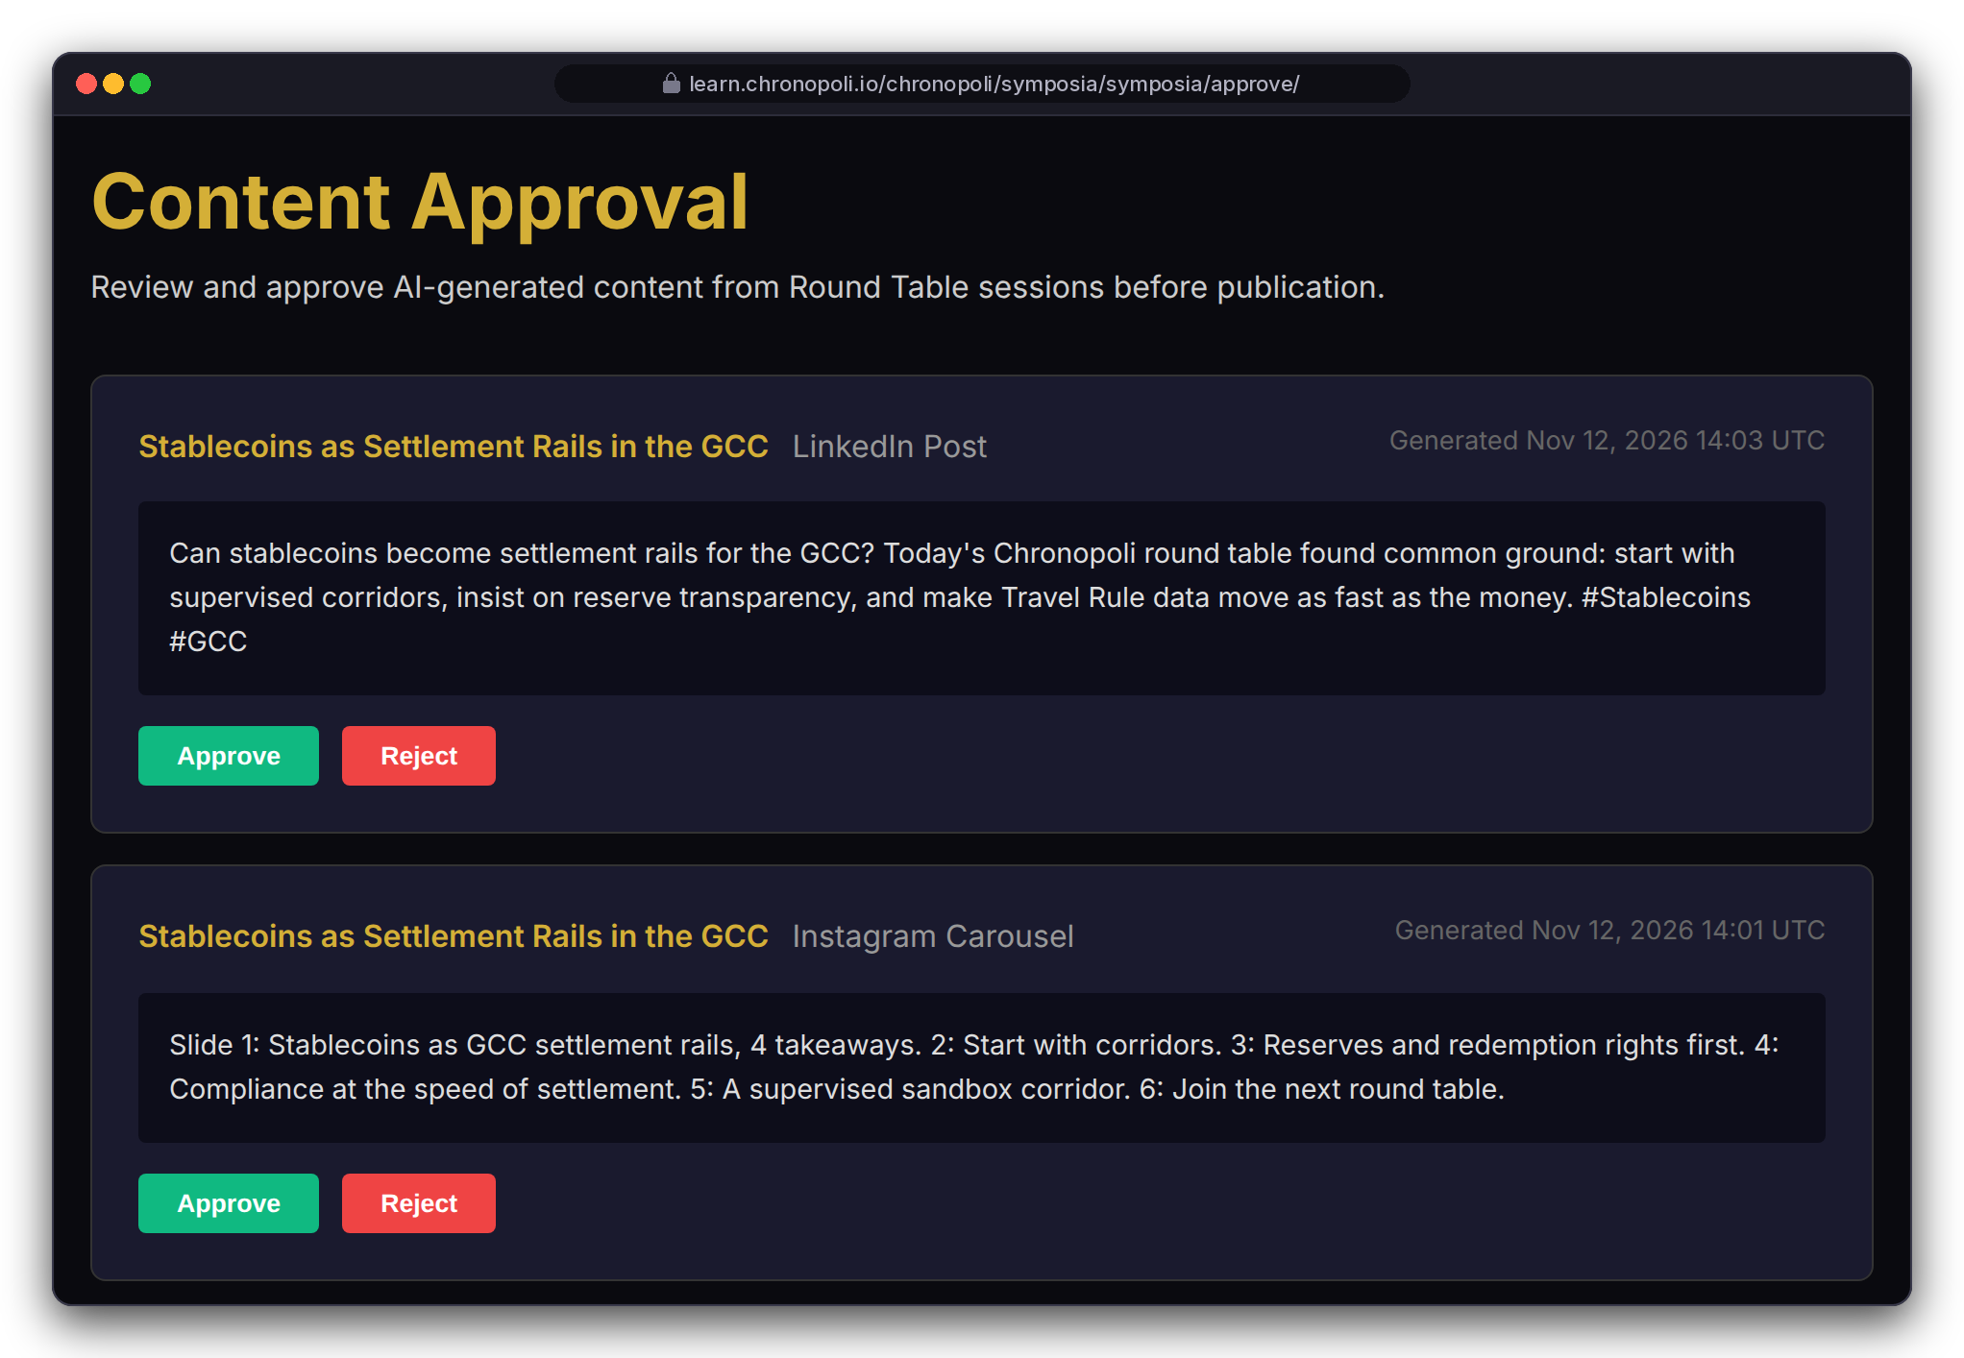
PARTNER SIDE · PUBLISH
PILLAR 01 · SYMPOSIA
Persona: Dr. Amira Haddad, moderator (fictitious) · Mock output texts
Five outputs in 3 hours, one human approves
From one round table: opinion paper, LinkedIn posts, Instagram carousel, partner report, AI-tutor update
PIPELINE STEPS
Session recorded
Recording stored
Pipeline starts
Transcript
AI analysis
4 drafts in parallel
Approval queue
One human approves
REAL PLATFORM SCREEN
Outputs
REAL PLATFORM SCREEN
Approvals
Automated: from the session recording to four drafts, with no manual step
Five outputs: these four, plus an AI-tutor update once approved
One human approves (~10 min): nothing auto-publishes; Chatham House anonymisation is required before launch
Illustrative mock data · Tether is a partner-roadmap target only; no agreement implied
19
Notes:
Be clear: these output texts are mock copy written for the demo and shown in the real pages. The pipeline has not processed a real session yet. One round table becomes five outputs: the opinion paper, a LinkedIn post per participant, an Instagram carousel, the Partner Intelligence Report for the sponsor and, once approved, an update to the AI tutor’s knowledge base. The screen also lists the transcript and the analysis, the two intermediate products. The master papers’ “3 hours” and “10 minutes” are design targets. TikTok is on the roadmap, not yet built. Don’t promise anonymity yet: today the analysis picks out named quotes and the paper prints them with a participant list, so Chatham House anonymisation must be built in before the first real session. Also still to do before launch: connecting the live recording to the pipeline, the hand-off to the approval queue and the PDF version of the paper. The approval queue prints UTC: 14:03 UTC is 18:03 in Dubai, about half an hour after the 16:00-17:30 GST session ends.

Slide 20
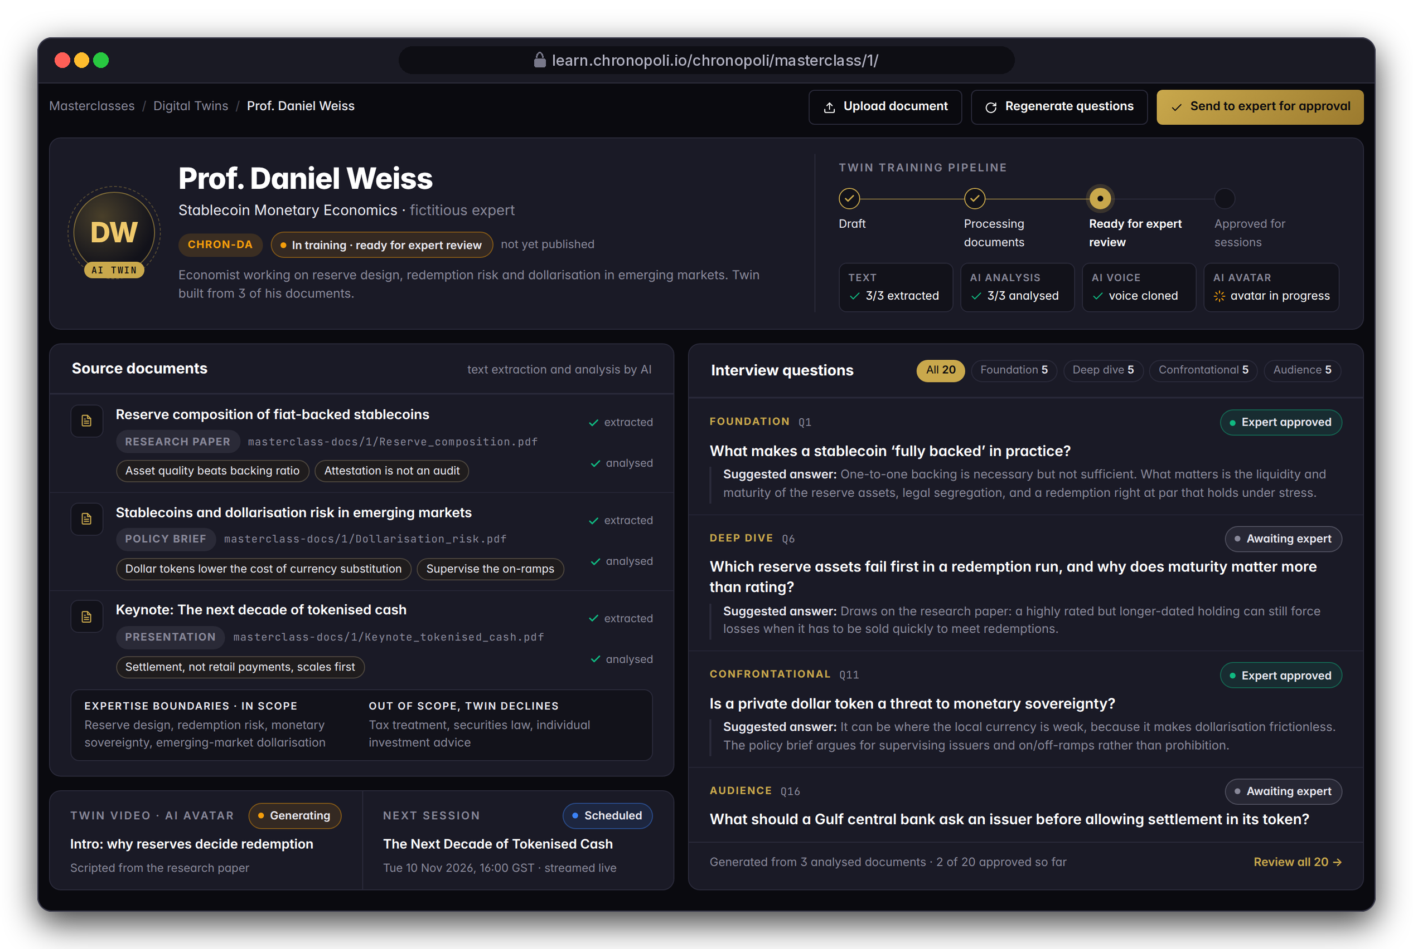
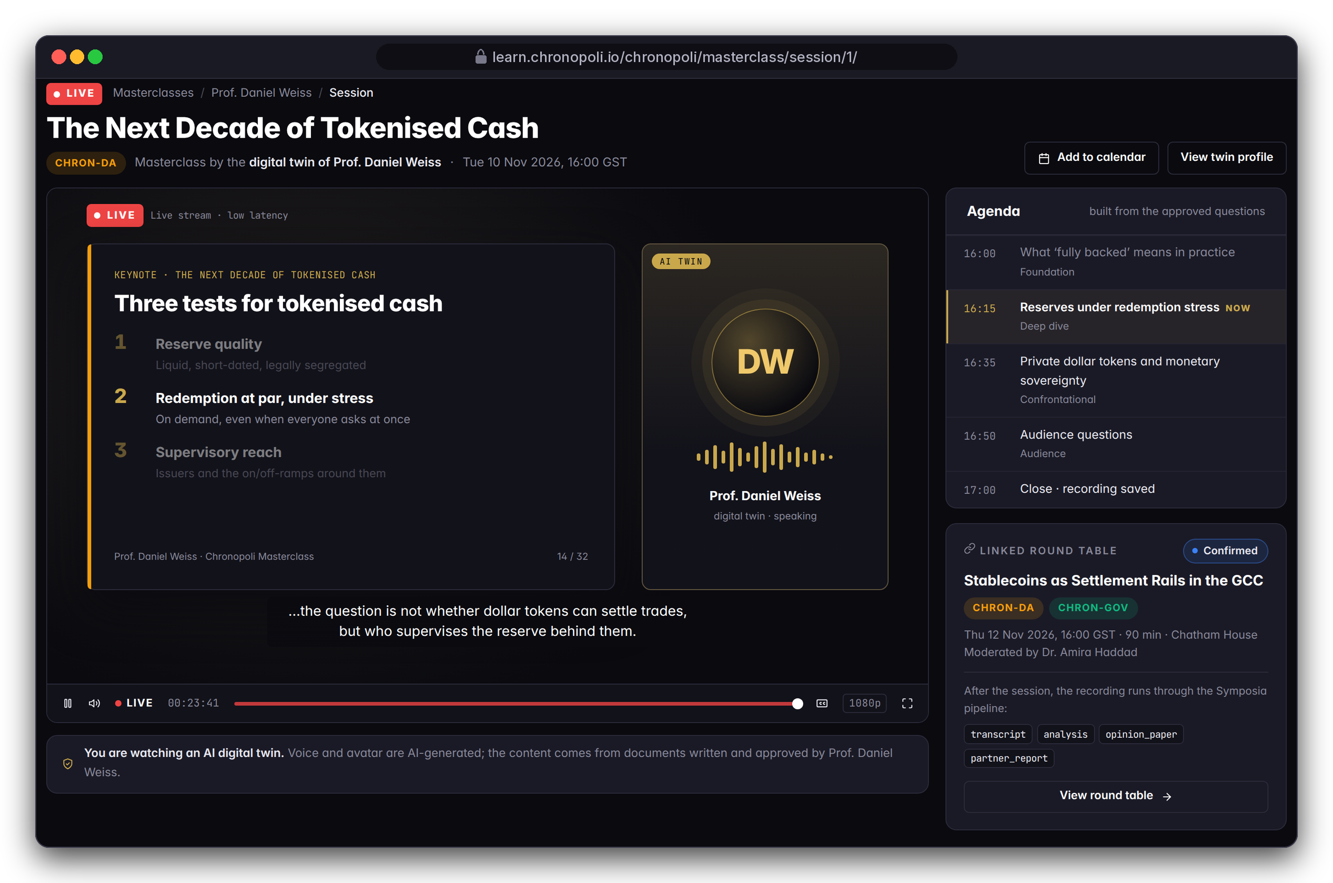
PARTNER SIDE · MASTERCLASS
PILLAR 03 · OPEN KNOWLEDGE
Personas: Dr. Amira Haddad (staff), Layla (viewer) · The expert is fictitious
Digital-twin masterclasses: scale an expert, with consent
An AI twin built from the expert's own published work, which prepares questions for the expert to approve and can teach live
DESIGN PROTOTYPE (NOT YET BUILT)
Twin staff view
DESIGN PROTOTYPE (NOT YET BUILT)
Live masterclass, 10 Nov 2026
Built from the expert's own work: AI maps the expert's positions; the expert approves every question
Live with consent: AI-disclosed voice and avatar; written expert consent (required before launch)
Illustrative mock data · Tether is a partner-roadmap target only; no agreement implied
20
Notes:
The document analysis and the question workflow, including expert approval of each question, are built. The two pages are design prototypes, not yet built. Consent is a design rule that still has to be built: before any voice is cloned we need a recorded written consent, and a publish check so that no twin goes live without the expert’s approval. The expert must be able to withdraw the twin at any time.

Slide 21
MARKET OPPORTUNITY · INVESTOR VIEW
$45B total addressable market
Five fast-growing markets, connected for the first time by one platform
TAM
$45B
Professional digital-economy training
SAM
$8.5B
MENA + Europe, enterprise
SOM
$9.6M
Year 3
Source: Chronopoli Master Document estimates (March 2026), not independently verified. The segments overlap, so the TAM is not their sum.
21
Notes:
The market numbers are the Chronopoli Master Document estimates; we have not had them independently verified, so say that if asked. The TAM is professional digital-economy training, $45B; the serviceable market is enterprise training in MENA and Europe, $8.5B; the obtainable share is $9.6M by Year 3, the same figure as the Year 3 revenue projection. The five segments overlap and are not additive, which is why corporate L&D alone is larger than the TAM. The point of the slide is growth: AI-governance training and digital-assets education grow at 42% and 35% a year, and nobody connects them.

Slide 22
BUSINESS MODEL
Companies pay. Students benefit.
B2B-first: Company Academy fees fund the ecosystem before a single student pays
REVENUE STREAM | YEAR 1 | YEAR 3 | PRICING
Company Academies | $825K | $2.4M | $25K–$150K / yr
Corporate Team Subs | $480K | $2.4M | $1,500 / seat / yr
Individual Subscriptions | $280K | $2.8M | $490–$1,490 / yr
Open Marketplace (30%) | $100K | $750K | Creator 70%
Certification Fees | $30K | $240K | $15 / cert
Summit + Research | — | $1.0M | From Year 2
TOTAL REVENUE | $1.72M | $9.59M | 67.5% EBITDA (Y1)
TWO PRICING VIEWS
Commercial model (left): annual academy fees and subscriptions, as counted in the projections.
In the product (slides 23-25): per-course layer prices from $0 to $8,000 for single purchases, seats at $125 a month (= $1,500 a year), 70/30 split at checkout.
A FOUNDING ACADEMY, PER YEAR
$150K
Trained staff and regulators, verified credentials, candidates sent to its hiring team, and Intelligence Reports. One recruiter placement costs about $20K.
Source: Chronopoli Master Document projections (March 2026).
22
Notes:
The business model is B2B-first: companies fund everything. A Founding Academy costs $150,000 a year. For that the partner gets trained staff and trained regulators, verified credentials, qualified candidates sent directly to its hiring team, and a Partner Intelligence Report every time its name comes up in a round table. Compare that with about $20,000 for a single recruiter placement. Before a single student pays, the Company Academies alone bring $825,000 in Year 1. These are Master Document projections. The next slides show the second pricing view, the one already built into the product: per-course layer prices, seats and the 70/30 split.

Slide 23
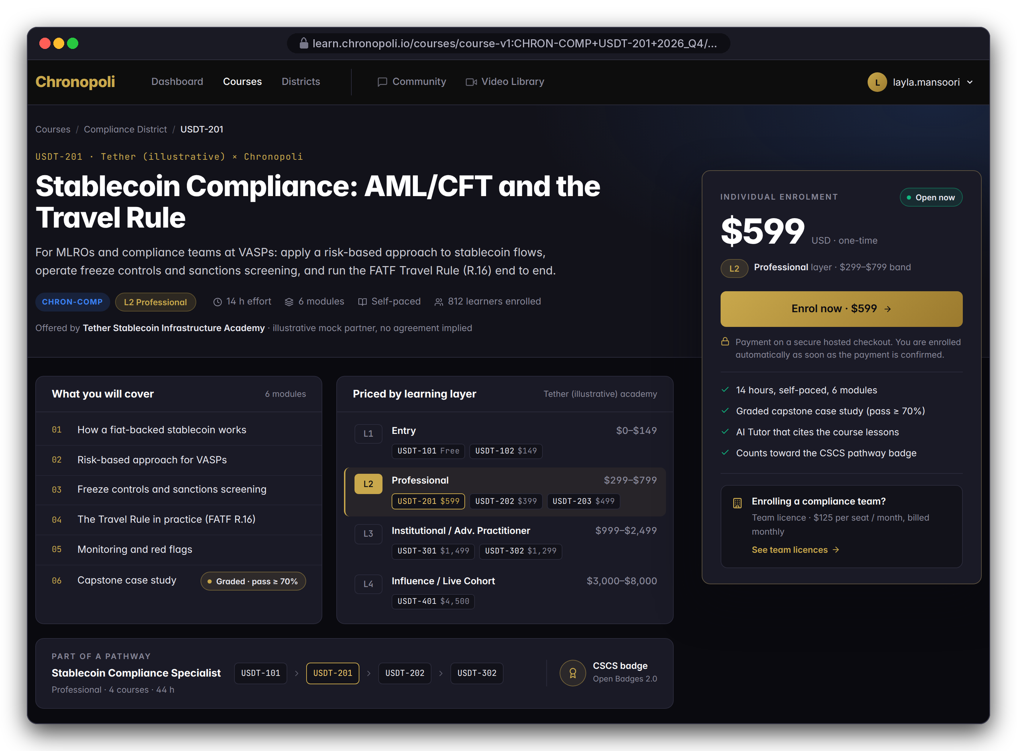
PARTNER SIDE · EARN
Persona: Layla Al-Mansoori · Illustrative mock data
In the product: how each price is charged
Layer prices for single purchases, seats for teams, 70/30 on partner courses; academy fees and subscriptions: slide 22
SINGLE-COURSE PURCHASE
CORPORATE TEAM SUBS
$0–$2,499
$1,500 / seat / yr
L1 Entry: $0–$149
L2 Professional: $299–$799
L3 Institutional: $999–$2,499
$125 per seat per month; employers buy seats for digital-asset, risk and compliance teams
MARKETPLACE SPLIT
L4 LIVE FORMATS & TIERS
70 / 30
$3,000–$8,000
Every partner-course sale splits at checkout: 70% to the creator, paid out automatically
Influence cohorts, round tables and masterclasses; the partner tier (slide 33) sets the benefits
DESIGN PROTOTYPE (NOT YET BUILT)
USDT-201 page with the L1-L4 price ladder
Illustrative mock data · Tether is a partner-roadmap target only; no agreement implied
23
Notes:
There are four mechanics, and the first three are already built into the product. The price ladder puts a whole academy on one screen, from a free USDT-101 to a $4,500 live cohort in Dubai. This is the second pricing view: the commercial model on slide 22 (academy fees, subscriptions) is what the master projections count; these are the mechanics that already exist in the product. The $1,500 per seat per year there is the $125 per seat per month here. Company Academy fees follow the master pricing ($25K–$150K a year); what each partner tier gets within that range isn't set yet, so don't quote tier fees. The model's strength is that partners bring content and audience, and Chronopoli takes 30% of every partner sale without producing the course. Internal: the L1 price label in the product still reads $49-$149 and must be aligned to the $0-149 band.

Slide 24
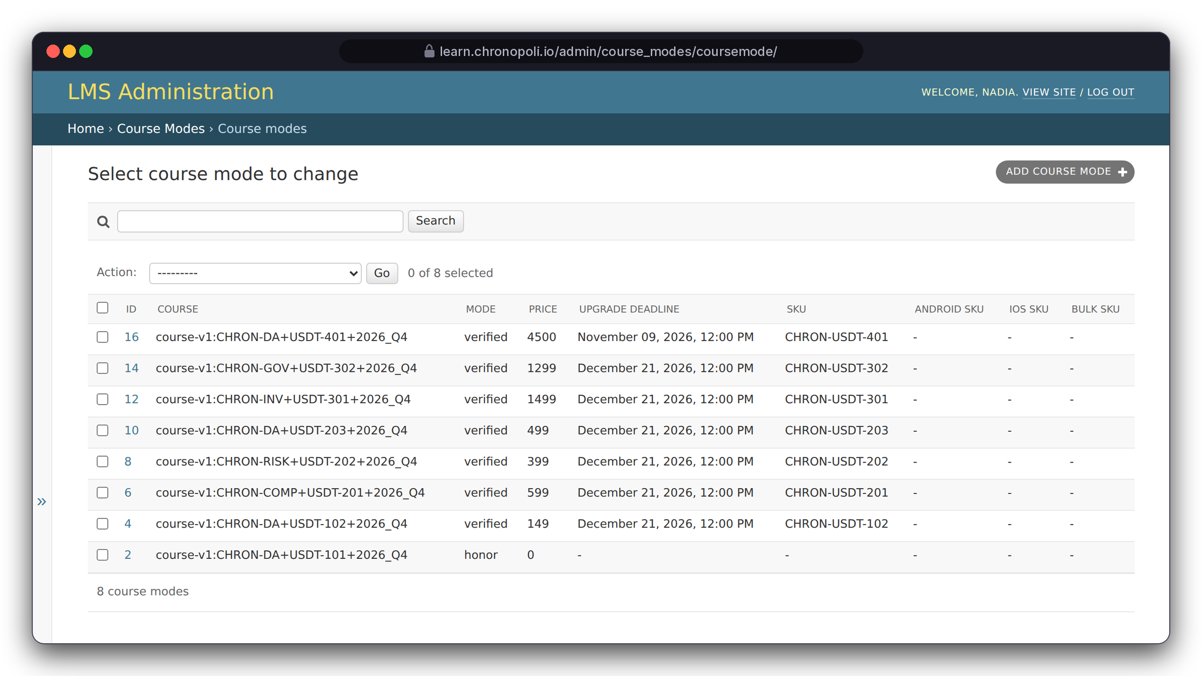
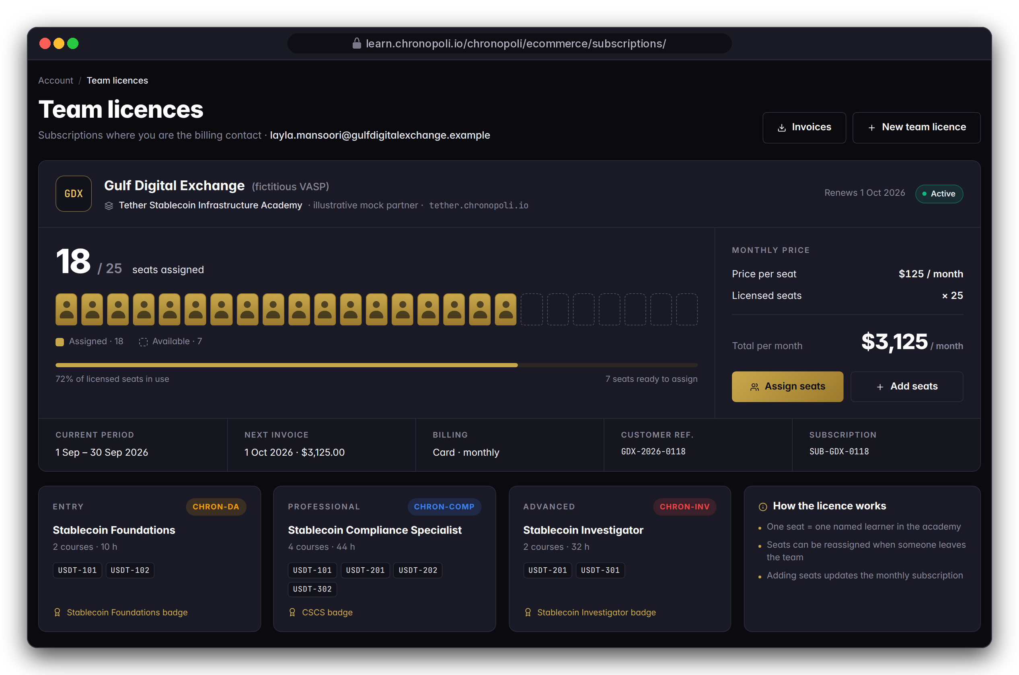
PARTNER SIDE · EARN
Personas: Nadia Karim in the admin (left), Layla as billing contact (right)
Prices sit in the platform; companies buy seats
Every course run carries its own price, and employers buy seats for whole teams
REAL PLATFORM SCREEN
Back-office course prices
DESIGN PROTOTYPE (NOT YET BUILT)
Team licence page
Course prices: from $0 (USDT-101) to $4,500 (USDT-401)
Next: the same price settings make payment a condition of access
Gulf Digital Exchange: 25 seats × $125 = $3,125 a month
Illustrative mock data · Tether is a partner-roadmap target only; no agreement implied
24
Notes:
Two ways to sell. Individuals buy course by course, and the prices on the left are the real platform settings, not a mock-up. Employers buy seats: Gulf Digital Exchange buys 25 seats and has assigned 18. The team licence page is a design prototype, not yet built. Two things to settle before launch: the subscription bills yearly while the price list is monthly, and seat assignment is only a counter today.

Slide 25
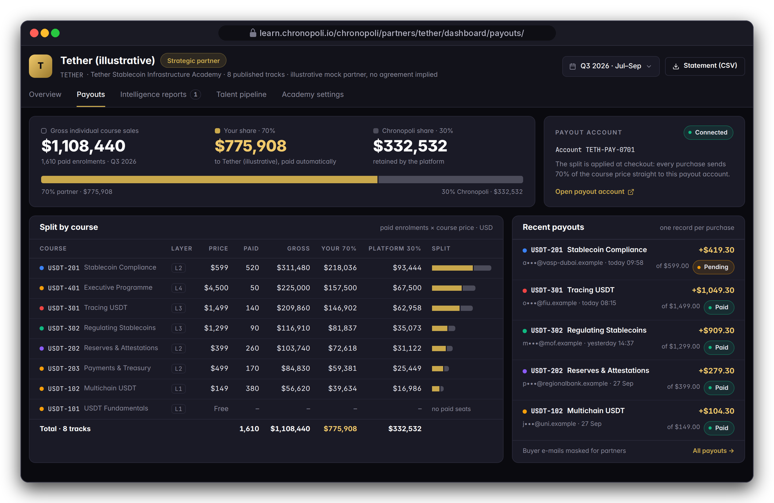
PARTNER SIDE · EARN
Persona: Nadia Karim · Illustrative mock data
70% of every partner-course sale goes to the partner, automatically
The checkout splits each payment at the moment it is made
Illustrative Q3: $1,108,440 gross from 1,610 paid enrolments
$775,908
$332,532
to the partner (70%)
to Chronopoli (30%)
One payout record per purchase, split by course; buyer e-mails are masked for partners
DESIGN PROTOTYPE (NOT YET BUILT)
Partner payouts view
Illustrative mock data · Tether is a partner-roadmap target only; no agreement implied
25
Notes:
The split is built into the checkout: each purchase carries a transfer of 70 percent to the partner’s payout account, and a payout record is written for every purchase. The gross counts individual purchases only; team-licence revenue comes on top. Still to do before launch: marking payouts as paid once the money has moved.

Slide 26
ILLUSTRATIVE SCENARIO · ONE ACADEMY
What one academy could look like (illustrative)
Fictitious Tether scenario, Q3 2026: demo numbers that show the mechanics, not traction
ENROLMENTS
COMPLETIONS
4,812
1,937
+18% QoQ
40.3% completion rate
Free · 2,140 enrolments · $0 revenue
BADGES ISSUED
PARTNER SHARE
1,244
$775,908
Gross: $1,108,440 individual sales · $775,908 partner (70%) · $332,532 platform (30%)
Depth pays: L3/L4 courses bring about 50% of gross from about 17% of paid enrolments
Not included: team-licence revenue
The free USDT-101 is the funnel: 2,140 of 4,812 enrolments (44%)
ILLUSTRATIVE MOCK DATA
Source: illustrative scenario, paid enrolments × list price · segments under $20k unlabelled
Fictitious Tether academy; no partnership or real traction implied
Illustrative mock data · Tether is a partner-roadmap target only; no agreement implied
26
Notes:
Say it plainly: this is a model of one academy, not reported revenue. Three things to take from it. First, the free USDT-101 is the funnel, with 2,140 enrolments or 44% of the total. Second, 50 live-cohort seats bring $225,000, about 72% of what 520 buyers of the flagship L2 course bring. Third, the platform keeps $332,532 without producing a single course.

Slide 27
FINANCIAL HIGHLIGHTS · PROJECTIONS
Projected profitable from month 5
Chronopoli Master Document projections: a lean cost base, and companies fund everything
$1.72M
67.5%
$9.59M
$44.9M
$1.09M
Year 1 revenue
EBITDA margin Y1
Year 3 revenue
Cash in Year 5
Net income Y1
9 partners + subscriptions
Projected, Year 1
Master Document estimate
Debt-free model
Master Document estimate
Source: Chronopoli Master Document projections (March 2026), not audited. Month 5 counts from the commercial launch, which follows the 90-day plan (slide 32).
27
Notes:
All figures are Master Document projections, not results. The model is B2B-first: Company Academies and team seats carry Year 1, and individual subscriptions become the largest stream by Year 3. Running costs are low, so the projected 67.5% EBITDA margin in Year 1 comes from the revenue model, not from cost cutting. Month 5 counts from the commercial launch, and the launch follows the 90-day plan on slide 32, so don't present it as a calendar date. At the Year 3 projection of $9.59M, the $8M pre-money is below one times projected Year 3 revenue.

Slide 28





TRACTION & VALIDATION
Platform built. Anchor confirmed.
Built, not yet live; launch plan in place. Anchor confirmed, MOU in progress, nothing signed yet
PLATFORM
BUILT
LAUNCH
NEXT
DBCC PARTNERSHIP
DONE
Built, not yet live
Plan in place
Confirmed
Real screens show the working product; prototypes are still to be built
Hosted in the UAE · going live is step one of the 90-day plan (slide 32)
Anchor institutional partner · 500+ company network
BUiD ACADEMIC
IN PROGRESS
TETHER
TARGET
FOUNDING PARTNERS
OPEN
MOU in progress
Target partner
Two seats open
Maria Papadaki · target: 30 CPD credits a year recognised
Strategic tier · illustrative demo academy (slide 8), no partnership
$150K Founding Academy each · to close before public launch (slide 32)
Statuses as in the master papers; nothing is signed. Tether is a target partner, and the Tether academy in the product tour is illustrative mock data (slide 8).
28
Notes:
Say the statuses exactly as they are. The platform is built but not live yet, and the launch plan is in place: going live is the first step of the 90-day plan on slide 32, with hosting in the UAE. Dubai Blockchain Center is the confirmed anchor, with a network of more than 500 companies. The BUiD academic MOU is in progress, with 30 CPD credits a year as the recognition target. Tether is the one named target partner, for the Strategic tier: the demo academy in the product tour is built around an illustrative Tether scenario with mock data, and no partnership is implied. The two Founding Partner seats, $150K a year each, are open; nothing is signed. If asked what "built" means: the real platform screens in this deck show the working product, and the pages labelled design prototype are still to be built.

Slide 29


COMPETITIVE LANDSCAPE
We are not a better Coursera
A categorically different architecture: the first neutral Knowledge City for the digital economy
FEATURE
COURSERA / LINKEDIN
ACAMS / ICA
VENDOR ACADEMIES
CHRONOPOLI
SHOWN ON
AI-generated content pipeline
Slide 19
Live round tables + automatic opinion papers
Slides 18, 19
Digital Twin expert system
Slide 20
Seven cross-sector Knowledge Districts
Slide 3
Verified Open Badges 2.0 credentials
Slide 13
Automated talent pipeline
Slide 13
Partner Intelligence Reports
Slides 17, 19
Curriculum updates in under 48 h
Slides 16, 19
Neutral cross-sector positioning
Slides 3, 33
yes
partial
no
Competitor ratings: Chronopoli Master Document. Chronopoli column: built, not yet live; goes live with the launch plan. The 48-hour update is a design target.
29
Notes:
We are not a better Coursera: we are a different architecture. Coursera and LinkedIn Learning sell content; ACAMS and ICA sell certification; vendor academies teach their own product. None of them has the pipeline, the round tables, digital twins, cross-sector districts or neutral positioning. The ratings of the competitors are the Master Document’s. The Chronopoli column means built and shown in this deck, but not live yet; it goes live with the launch plan. The last column points to the slide that shows each feature.

Slide 30



COMPETITIVE MOATS
Three self-reinforcing moats
Each moat strengthens the other two: the longer the platform runs, the harder it is to replicate
Proprietary Knowledge Moat
Partner Lock-in Moat
Network Effects Moat
Every round table, opinion paper and masterclass feeds the AI Tutor. After 12 months, no general-purpose AI has access to this knowledge base. It compounds like interest.
When a partner builds its academy inside Chronopoli, its credential history, talent pipeline and community are embedded. Leaving means giving up its own institutional knowledge base.
More partners → more round tables → more knowledge → more users → more employer demand → more partners: a two-sided marketplace flywheel in a high-value niche.
In this deck: slides 11, 19
In this deck: slides 8, 13
In this deck: slides 4, 18
Behind all three: a lean cost base, so SaaS competitors cannot undercut our prices without operating at a loss.
30
Notes:
Three moats, and each strengthens the other two. The knowledge moat: every round table, paper and masterclass feeds the AI tutor, and no general-purpose AI has that knowledge base. Partner lock-in: an academy’s credential history, talent pipeline and community live inside Chronopoli. Network effects: more partners, more round tables, more knowledge, more users, more employer demand, more partners. Behind all three sits a lean cost base, so SaaS competitors cannot undercut us without losing money.

Slide 31

TEAM
The right people at the right time
Compliance expertise + defence tech + blockchain infrastructure + UAE institutional access
Chris
CTO (to be confirmed)
Co-Founder & COO · Regulatory Client Manager, Bank Frick
Co-Founder · platform & infrastructure lead
BACKGROUND
BACKGROUND
KYC/AML/EDD expert · FMA Liechtenstein · FINMA Switzerland · UAE VARA · digital-assets compliance across 5+ jurisdictions
Learning-platform engineering · hosting and infrastructure · AI-pipeline architecture. Search in progress for a world-class technical co-founder with MENA experience
VENTURES & CONTEXT
Co-Founder PHLX AG (Swiss defence tech) · WorldBitEnergy · Dubai Blockchain Center
VENTURES & CONTEXT
Takes over a built platform and a concrete launch plan (slides 28 and 32)
ADVISORS Maria Papadaki (BUiD, academic partner) · DBCC leadership · Compliance advisor (TBC) · Regional investor (TBC)
31
Notes:
Chris brings compliance depth: KYC, AML and EDD across Liechtenstein, Switzerland and the UAE, plus the DBCC network. The CTO seat is open: we are looking for a senior platform and infrastructure engineer with MENA experience. The CTO takes over a built platform and a concrete launch plan (slides 28 and 32). Maria Papadaki of BUiD advises as academic partner; DBCC leadership supports the platform.

Slide 32
GO-TO-MARKET · TARGETS
90-day plan to first revenue
Go live in the UAE, close two Founding Partners, then launch publicly
NOW → MONTH 3
MONTH 3 → 6
MONTH 6 → 12
MONTH 12 → 24
Go live & close
Launch & grow
Scale
Expand
Finish launch preparation and go live
Public free-tier launch
400 paid subscribers
TOKEN2049 Dubai + Singapore
First opinion papers published on LinkedIn
4 corporate team licences
Tether academy pitch (1 slide, 1 demo)
Annual summit (50–100 participants)
2,000 registrations target
3 more strategic partners
3 beta round tables via DBCC
Singapore market entry
First Company Academy live
First Digital Twin masterclass
10,000+ registered users
BUiD MOU signed
Month counts are master-plan targets, not dated commitments. Public launch follows the first two Founding Partners.
32
Notes:
The plan is to go live, close two Founding Partners before the public launch, then let the product sell itself. The first 90 days: finish launch preparation and go live in the UAE, pitch the Tether academy with one slide and one demo, open the Founding Partner conversations, run three beta round tables through DBCC and sign the BUiD MOU. Months 3 to 6: public free tier, first opinion papers on LinkedIn, 2,000 registrations and the first company academy. Months 6 to 12: 400 paid subscribers, four corporate team licences, three more strategic partners and the first digital-twin masterclass. Then TOKEN2049, an annual summit and Singapore. Month counts are master-plan targets, not dated commitments.

Slide 33


PARTNER ROADMAP · TARGETS, NOT AGREEMENTS
Partner roadmap: four tiers, one named focus
What each tier gets. Tether is the one named target partner; no agreements are signed.
TIER
PARTNERS (NONE SIGNED)
WHAT THE TIER GETS
Founding
Two seats to fill before launch
Flagship tracks or a $150K Founding Academy, co-hosted symposia, a seat on the curriculum board
Strategic
Tether (target partner)
Branded academy, pathways and badges, talent pipeline, as in the tour’s illustrative academy
Content
Specialist course providers
Specialist courses inside a district, e.g. investigation, compliance or AI
Institutional
Universities (BUiD MOU in progress), think tanks, banks
Co-certification and research round tables
Tether is a roadmap target, not an agreement. Status today (slide 28): DBCC confirmed anchor · BUiD MOU in progress · Tether target Strategic partner
33
Notes:
The master plan fills two Founding Academy seats at $150K a year each; neither is filled, and we do not name candidates. Tether is the one named target, in the Strategic tier: the academy in the product tour is an illustrative Tether scenario with mock data, not a partnership. Sequence: founding partners come first, because they shape the curricula and co-host the first round tables. Strategic academies like the Tether scenario follow once company academies are live. Content partners deepen individual districts, including the AI District. Institutions give the credentials weight with regulators and employers.

Slide 34



THE ASK · INVESTORS
Raising $2,000,000 seed round
Pre-money valuation $8,000,000 · Equity / SAFE · 18-month runway
$2,000,000
Platform built
Companies pay us
SEED ROUND · $8M PRE-MONEY · EQUITY / SAFE
The product runs, as the screens show. Not live yet: going live starts the 90-day plan (slide 32)
B2B-first: $150K academy deals fund the model before students pay a dollar
USE OF FUNDS
Sales & partnership team
$600K · 30%
Marketing & conferences
$400K · 20%
Platform scaling
Lean operating model
UAE tax advantage
$400K · 20%
Projected 67.5% EBITDA margin in Year 1, profitable from month 5 (projection)
9% corporate tax on profits above $102K, no personal income tax for employees, DBCC as institutional anchor
G&A, legal, operations
$600K · 30%
34
Notes:
We are raising $2M in a seed round at an $8M pre-money valuation, as equity or a SAFE, for 18 months of runway. Use of funds: $600K for the sales and partnership team, $400K for marketing and conferences, $400K for platform scaling, and $600K for G&A, legal and operations. Four reasons: the platform is built and the launch plan is concrete; companies pay us, not students; the operating model is lean; and the UAE tax regime plus the DBCC anchor. Don't say the platform is live: going live is the first step of the 90-day plan on slide 32.

Slide 35


THE ASK · PARTNERS
Become a founding Knowledge Partner
Help build the place where the digital economy learns, hosted by Dubai Blockchain Center
Founding partners
Pilot institutions
Investors
Co-design a flagship track or an academy around the roles you hire for, co-host the first round tables, sit on the curriculum board
Regulators, FIUs, banks and VASPs for the first team-licence cohorts, with feedback on L2-L3 content
Fund the go-live and the first partner academies: the $2M seed on slide 34
Next step: a working session to choose your district, first track and first round table
Contact: partners@chronopoli.io · chronopoli.io
35
Notes:
Close on the ask, not on features. The product is built and you've seen it on real screens; what's missing is going live and the first founding partners. The investor terms are on slide 34: $2M seed at $8M pre-money. This slide is the partner version of the ask. Offer the product overview as the leave-behind.

Slide 36

Chronopoli is not a better Coursera.
Not a smarter university.
It is a completely new architecture
where credentials are verifiable, content is AI-generated and regulation-linked, companies fund learning instead of students, and the degree is replaced by a dynamic professional record that follows you for life.
EMAIL
PLATFORM
HOSTED
ANCHOR
partners@chronopoli.io
learn.chronopoli.io (at go-live)
In the UAE
Dubai Blockchain Center
Confidential · for authorised recipients only · September 2026 · © Chronopoli / Dubai Blockchain Center
36
Notes:
Chronopoli is not a better Coursera, and not a smarter university. It is a new architecture: credentials are verifiable, content is AI-generated and linked to regulation, companies fund learning instead of students, and the degree is replaced by a professional record that follows you for life. Pause, then hand over the contact details and the leave-behind.

