Slide 1


FOR KNOWLEDGE PARTNERS AND ENTERPRISE TEAMS
Your academy.
Your team's proof of competence.
Chronopoli, the Global Knowledge City for the digital economy, hosted by Dubai Blockchain Center
Digital assets
AI
Governance
Risk & trust
Financial-crime investigation
Compliance
Emerging tech
Founding Partner and pilot-cohort programme · Pre-launch · September 2026
Real grades and reports today; the team-admin console and evidence pack come with the pilot
DESIGN PROTOTYPE (NOT YET BUILT)
Backdrop: landing page
Illustrative mock data · Tether is a partner-roadmap target only; no agreement implied · all other organisations and people are fictitious
01
Notes:
TALK TRACK: Thank you for the time. In 20 minutes I'll show you two things. For a Knowledge Partner: how you get your own academy that educates your market and feeds you talent. For an enterprise team: how you train and certify digital-asset, risk and compliance staff, and show the evidence to management or a supervisor. Every screen is labelled either as a real platform screen or as a design prototype that is not yet built, and slide 5 shows the status of every deliverable on one page. The platform in one picture is the three pillars on slide 4: your academy is a branded partner academy inside the city. We're pre-launch and looking for Founding Partners and pilot teams. BEFORE ANY MEETING WITH A REAL STABLECOIN ISSUER OR ITS COMPETITOR: say up front that the Tether academy in this deck is an illustrative example built without Tether's involvement, and that no partnership exists. OBJECTION: 'Is this live?' ANSWER: Not yet. The platform is built and its core runs on our demo system; there's a launch plan, and that's why founding partners get to shape what launches first.

Slide 2



WHO IT IS FOR
Built for two buyers
The organisations that shape the digital economy, and the teams that have to operate inside it
For Knowledge Partners
ONE CITY
For Enterprise Teams
CHRON-AI
Protocols & stablecoin issuers · Analytics & investigation vendors
AI companies · Universities & think tanks · Banks
CHRON-DA
Banks · Fintechs · VASPs & exchanges · Law enforcement
Regulators' & FIU teams · Corporates & treasury
WHAT THEY WANT
CHRON-GOV
WHAT THEY WANT
Educate your market
Policy insight
Close competence gaps
Own the standard
Revenue from content
CHRON-COMP
One training record
Build a talent pool
Evidence for supervisors and audit
UNIVERSITIES AND THINK TANKS ALSO WANT
CHRON-INV
Grow people into roles
Co-certified executive education
CHRON-RISK
ALSO FOR REGULATORS' AND FIU TEAMS
Research round tables with practitioners and regulators
CHRON-INV: tracing for FIUs and law enforcement
A route to industry for graduates
CHRON-ET
CHRON-GOV: policy and supervision for regulators
Seven Knowledge Districts · four learning layers: L1 Entry · L2 Professional · L3 Institutional / Advanced Practitioner · L4 Influence / Live cohort
Partner roadmap (not signed): Founding: two seats open before launch · Strategic: Tether (target partner; the demo academy is an illustrative Tether scenario) · Content: specialist course providers by district · Institutional: BUiD (MOU in progress), universities, banks. Tether is a target only; no partnership, endorsement or agreement is implied.
02
Notes:
TALK TRACK: Two buyers, one platform. Partners bring the expertise and the brand; enterprises bring the learners and the budget. Both sit in the same seven districts and four layers, so the digital-asset team of a bank or a fintech and a stablecoin issuer's academy meet in the Digital Assets District, with risk, compliance and investigation one district away. Ask early which column the room is in and route the talk. PARTNER TALK: 1-12 and 17-28 (backup 29 on request). ENTERPRISE TALK: 1-5, 10, 13-22, 24-28 (skip 23; on 20 and 21 speak only to the team-subscription rows; on 22 use the data-access panel; on 24 use the enterprise lane). INSTITUTIONS (universities, think tanks): 1-9, 12, 17-22, 24-28 (skip 11 and 23; 29 only if asked). The roadmap line names one company, Tether, as a target partner; nothing is signed, and the Tether academy in this deck is an illustrative scenario with mock data. The traction slide (slide 19) gives the exact statuses. Before a meeting with a competitor of Tether, decide how to frame the Tether scenario and whether to show that slide. OBJECTION: 'Are these partners on board?' ANSWER: No. Dubai Blockchain Center is the confirmed anchor and the BUiD MOU is in progress; no partner is signed. The offer is about being a founder, not joining a crowd. OBJECTION: 'We already have an LMS.' ANSWER: For internal policy training, keep it. Chronopoli is for specialist digital-economy content and credentials, and the platform's standard reports export as CSV to whatever system you use.

Slide 3




THE PROBLEM
The digital economy has a structural knowledge gap
No one connects digital assets, AI, governance, risk and investigation in one trusted, neutral place
Fragmentation
Slides 6-8, 13
Speed mismatch
Slides 7, 12
Stablecoin infrastructure, AI governance, regulation, risk and forensics sit in silos: webinars, conference sessions and vendor decks, with no path by role and no single record.
MiCA changes, FATF updates, a new exploit creates a new typology. Universities take 18 months to update a curriculum, training firms 6; the market moves daily.
We deliver: seven districts, partner tracks and role-based pathways (P1–P3, E1)
We deliver: your experts author courses directly; round tables become drafts within hours (P2, P8)
Fake credentials
Slides 8-9, 15
No neutral convener
Slides 4, 12
A certificate says someone sat in a room; it tells no employer or regulator what they know today, and 'who was trained?' is answered with a spreadsheet.
Nobody puts a protocol, a regulator, an investigator and a researcher in one room and turns the conversation into institutional knowledge.
We deliver: badges on real grades (P3), grade reports (E3), badge-gated jobs (P4)
We deliver: closed-door round tables with a Partner Intelligence Report (P8)
Slide numbers show where each answer is proven
03
Notes:
TALK TRACK: The digital economy has a structural knowledge gap, and both buyers feel it in the same four ways. Fragmentation: stablecoin infrastructure, AI governance, regulation, risk and forensics live in silos, so nobody gets a path by role or a single record. Speed mismatch is the killer fact: universities take 18 months to update a curriculum and training firms 6, while MiCA, FATF guidance and crime typologies change every month. Fake credentials: a certificate proves attendance, not competence, and when a regulator or internal audit asks who was trained, the answer is a spreadsheet. No neutral convener: nobody puts a protocol, a regulator, an investigator and a researcher in one room and turns the conversation into institutional knowledge. Let the buyer pick the problem that hurts most, then jump to that proof slide. For partners it's usually the pipeline and owning the standard; for banks, VASPs and fintechs it's skills across product, treasury, risk and compliance, with proof for the supervisor; for universities it's reach into practice. Be precise on credentials: what exists today is the real platform grade report (slide 15); the one-click evidence pack is designed with pilot teams (slide 16). The 18- and 6-month figures come from our master papers; don't quote market sizes in a sales meeting. Instead ask: how long did your last evidence request take to answer? OBJECTION: 'Our vendor already gives us certificates.' ANSWER: A certificate from one course isn't a role-based pathway or a grade record. We show both, with the pass mark, per employee.

Slide 4


PRODUCT
Three pillars, one platform
Every feature serves the network effect: more partners → more content → smarter AI → more value
Symposia
Company Academies
Open Knowledge
Community Intelligence Engine
Branded partner academies
AI Tutor + Digital Twins
Live round tables, human-moderated, under the Chatham House Rule, streamed live
Opinion papers drafted in 3 hours
LinkedIn and Instagram content, one human approves (TikTok: roadmap)
Partner Intelligence Reports per session
Branded sub-academies at your own web address
Custom learning pathways and a badge system
Open Badges 2.0 credentials, co-issued with you
Talent pipeline: badges matched to your open roles
AI tutor grounded in platform content, citing its sources
Digital Twin: an expert’s documents become an AI avatar, with consent
Open course marketplace, 70/30 revenue split
Compounds with every new piece of content
01
02
03
SHOWN IN THIS DECK
SHOWN IN THIS DECK
SHOWN IN THIS DECK
Slide 12
Slides 6, 8-9, 11
Slides 10-11, 29
Shared platform core: courseware and course authoring, batch enrolment, gradebook and grade reports for enterprise teams (slides 7, 13-16)
04
Notes:
TALK TRACK: Three pillars, one platform. Symposia is the community intelligence engine: closed-door round tables that become papers, posts and a Partner Intelligence Report. Company Academies are branded partner academies: your academy with pathways, badges and a talent pipeline. Open Knowledge is the AI tutor, digital twins and the open course marketplace with its 70/30 split. Every feature serves the network effect: more partners bring more content, which makes the AI smarter, which brings more value to every academy. Each proof slide carries its pillar in a label next to the kicker. Be precise on two points: publishing needs one human approval, and TikTok is on the roadmap, not yet built. Enterprise teams mostly use the shared platform core: seats, cohorts, grades and reports. OBJECTION: 'So we become part of your brand?' ANSWER: Your academy carries your name, content and signatory; 'Powered by Chronopoli' and the co-issued badge are the link to the city.

Slide 5
THE OFFER · BUILD STATUS
What you get, and what is built today
Two tracks, one city · 5-question onboarding routes each learner to a home district and layer
FOR KNOWLEDGE PARTNERS
FOR ENTERPRISE TEAMS
P1
Your academy under your name
BUILT
BEFORE LAUNCH
E1
Batch enrolment + cohort
SHOWN WORKING
Name, pathways and jobs per academy built · before launch: your colours, logo and web address · slide 6
Standard platform feature, shown working on our demo system · slide 13
P2
Authoring and certificates in a proven tool
SHOWN WORKING
E2
Per-employee gradebook
SHOWN WORKING
Standard course authoring, shown working on our demo system · slide 7
Standard platform feature, shown working on our demo system · slide 14
P3
Pathways ending in a co-issued Open Badges 2.0 badge
BUILT
E3
Grade reports as CSV
SHOWN WORKING
Co-issued with your academy; your criteria; public online verification: before launch · slide 8
For your regulator or internal audit · slide 15
P4
Badge-gated job postings: your talent pipeline
BUILT
E4
Team-admin console, evidence pack
DESIGNED
Candidate consent step: before launch · slide 9
Coming with the pilot; seat records already built · slide 16
P5
AI tutor on your content, plus community
SHOWN WORKING
BUILT
District community shown working · AI tutor built; your course knowledge base is set up in the pilot · slide 10
BUILD STATUS CHIPS
P6
Partner analytics and weekly e-mail report
BUILT
BEFORE LAUNCH
SHOWN WORKING
Working today on our demo system; not live yet
Analytics and weekly report built · dashboard page: before launch · slide 11
BUILT
Built and shown on test data; not live yet
P7
70% of course sales, paid out automatically
BUILT
BEFORE LAUNCH
BEFORE LAUNCH
Still to be finished; scheduled before launch
Split built · payouts page and payout-account set-up: before launch · slide 11
DESIGNED
Page designed, not yet built
P8
Round tables with a Partner Intelligence Report
BUILT
Five outputs, one human approves · attribution removal: before launch · slide 12
SCREEN LABELS ON THE PROOF SLIDES
P9
Digital-twin masterclass, with expert consent
DESIGNED
REAL PLATFORM SCREEN
Roadmap: last milestone · backup slide 29
DESIGN PROTOTYPE (NOT YET BUILT)
Illustrative mock data · Tether is a partner-roadmap target only; no agreement implied · all other organisations and people are fictitious
05
Notes:
TALK TRACK: This is the whole offer on one page, and the status of each piece. Left is what a partner owns, right is what a team buys. The chip says what exists: green 'shown working' is running software you'll see on real screens; gold 'built' is our own product, demonstrated on test data but not live yet; grey means it is still to be finished before launch, or only designed so far. Say it before the buyer finds it: most of the partner experience is built but not yet live, and several manager-facing pages are still design. The parts that carry your data (course authoring, enrolment, grades and reports) are standard platform features that already work. Each tag is a proof slide, and the tag sits in the corner of that slide. OBJECTION: 'So most of this is vapour?' ANSWER: No. It's built, with a launch plan, and the chips show exactly which items are still design. That's what Founding Partners and pilot teams help shape. OBJECTION: 'What does it cost?' ANSWER: Slide 20: Company Academies $25K–$150K a year, team seats $1,500 a year ($125 a month), 70/30 on course sales; slide 21 shows the packages. The three pillars behind the P and E lines are on slide 4.

Slide 6
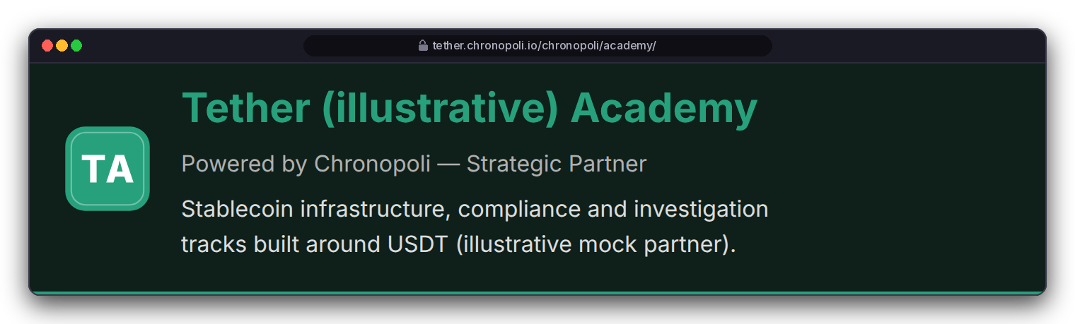
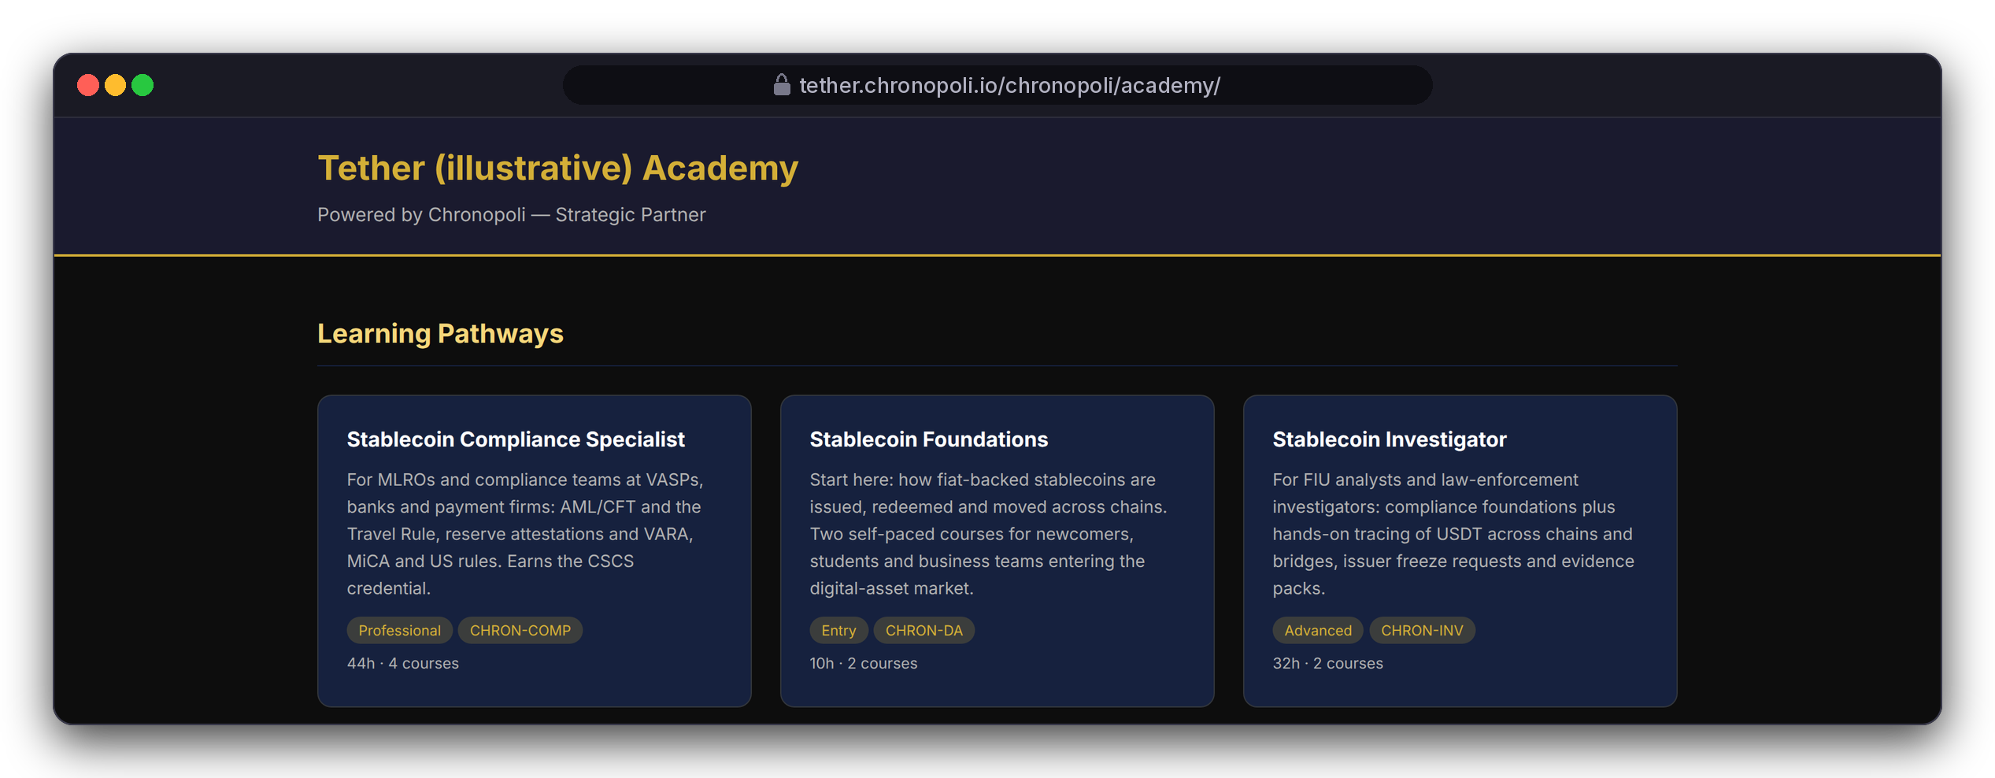

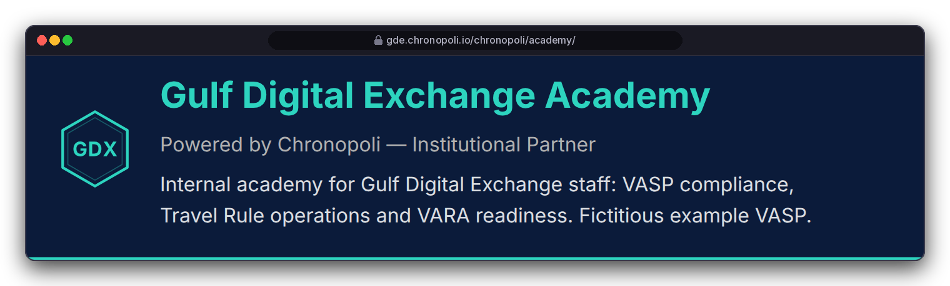
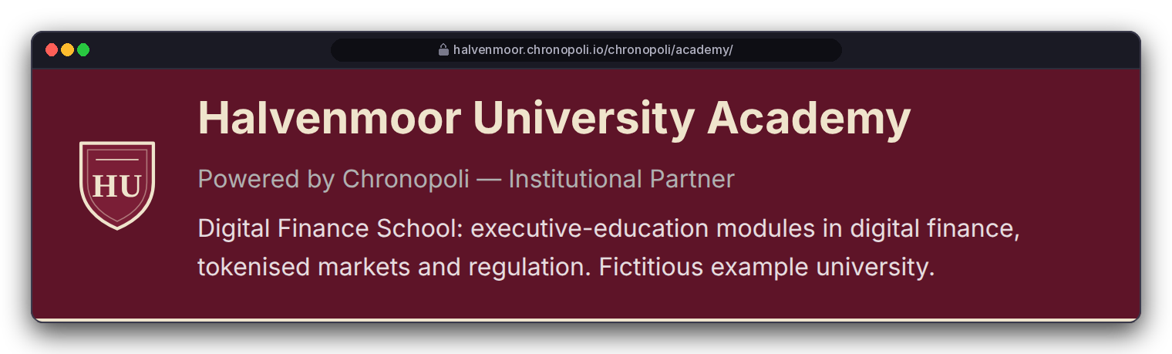
FOR KNOWLEDGE PARTNERS · PROOF
PILLAR 02 · COMPANY ACADEMIES
P1
Your academy, under your name, inside the city
One template, three tenants: a stablecoin academy, a VASP's internal academy and a university school
AT LAUNCH
Your brand
TODAY
One standard design in gold and navy
tether.chronopoli.io (planned)
gde.chronopoli.io (planned)
REAL PLATFORM SCREEN
Today: the standard academy page, Tether (illustrative)
halvenmoor.chronopoli.io (planned)
Today: each academy shows its own partner's name, pathways and jobs
At launch: your colours, logo and tagline, at your own address (<partner>.chronopoli.io); both are switched on before launch
Staff-only academies, such as a VASP's internal school: access model set in the partner agreement
DESIGN PROTOTYPE (NOT YET BUILT)
Your colours, logo and tagline on the academy page · placeholder marks, not real logos
Illustrative mock data · Tether is a partner-roadmap target only; no agreement implied · all other organisations and people are fictitious
06
Notes:
TALK TRACK: This is the outcome a partner buys: your own school, under your name, inside the city. Three very different academies on one design: a protocol educates its market, an exchange trains its own staff, a university runs executive-education modules. Point to the right-hand screen first: that's the academy page today, and the name, pathways and jobs already change per partner. The three tiles on the left show the same page with your colours, logo and tagline; that change is small and scheduled before launch, so it's labelled a prototype. Your own web address (<partner>.chronopoli.io) is also switched on before launch. OBJECTION: 'Can we use our own domain, like academy.ourbrand.com?' ANSWER: The model is <partner>.chronopoli.io. A custom domain isn't planned today, so treat it as a request for the partner agreement. OBJECTION: 'Is my internal academy private?' ANSWER: Access for staff-only academies is set in the partner agreement; don't promise a login gate beyond that. OBJECTION: 'Can we drop Chronopoli entirely?' ANSWER: The academy says 'Powered by Chronopoli' and the badge is co-issued; that's part of the model. This is the Company Academies pillar: your branded partner academy (slide 4).

Slide 7
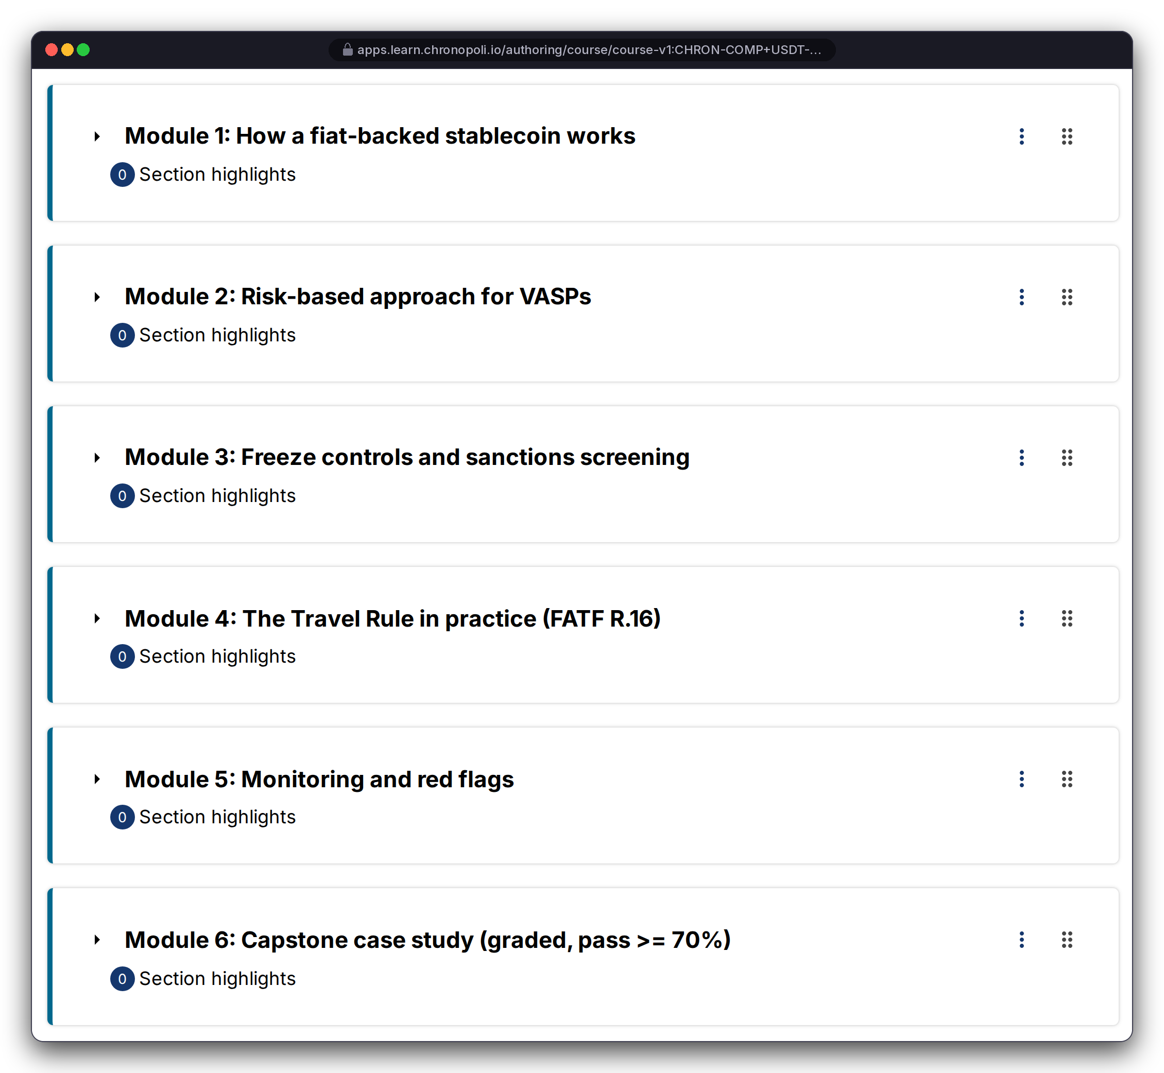
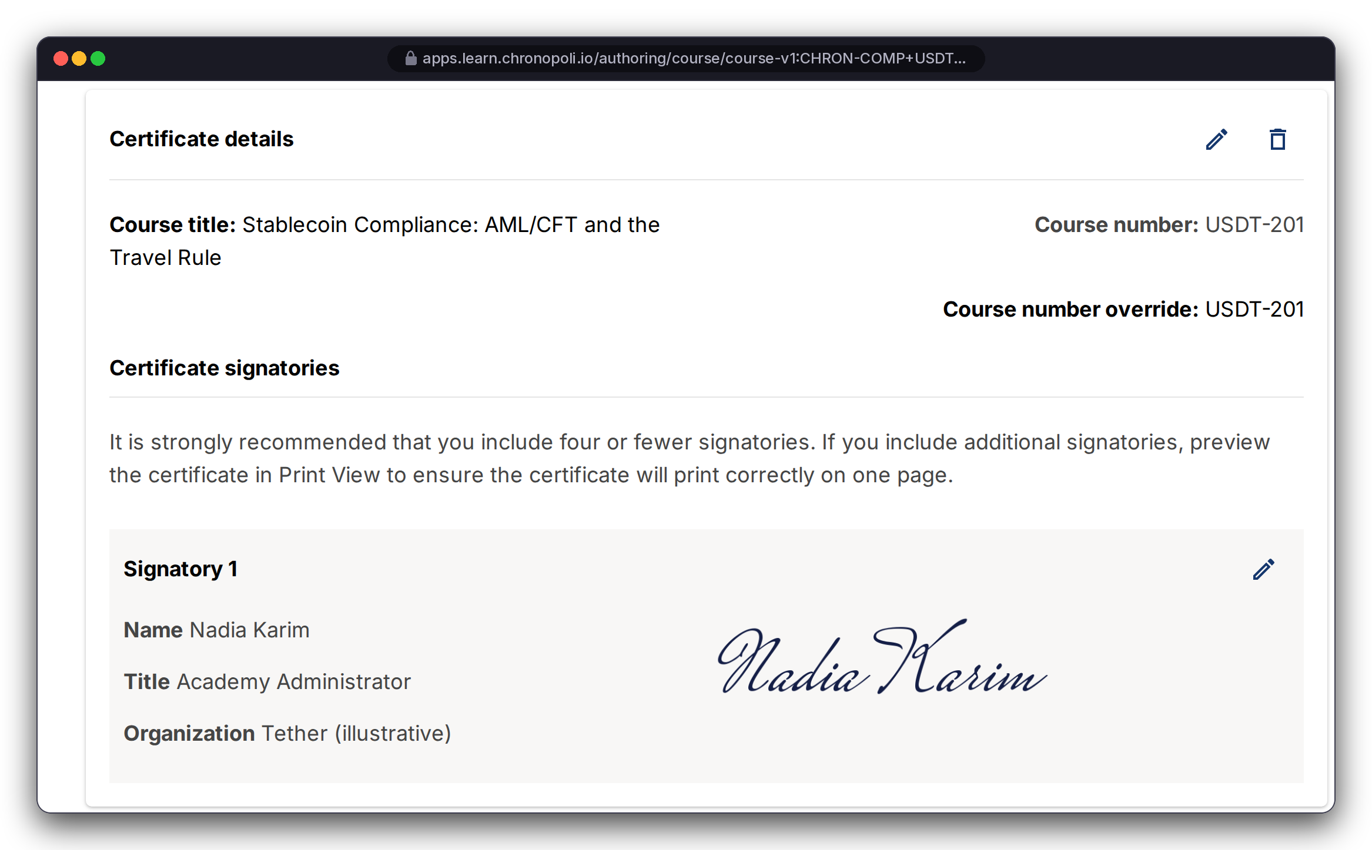
FOR KNOWLEDGE PARTNERS · PROOF
PLATFORM CORE
P2
Bring your content: author and certify in a proven authoring tool
Your course team uses the authoring tool universities use: nothing proprietary to learn, nothing to rebuild
Course authoring: outline, rich-text units, schedule and grading (USDT‑201: pass mark 70%; weighting: knowledge checks 40%, capstone 60%)
Certificate: configured on the verified track with your signatory; activated at launch
Your content stays yours: standard course export; rights, term and exit are set in the partner agreement
REAL PLATFORM SCREEN
REAL PLATFORM SCREEN
Left: USDT-201 outline, six modules
Right: certificate details; configured, not activated
Browser address shows the planned domain · signatory Nadia Karim, Academy Administrator, Tether (illustrative) · mock course, fictitious signatory
Illustrative mock data · Tether is a partner-roadmap target only; no agreement implied · all other organisations and people are fictitious
07
Notes:
TALK TRACK: Partners worry that content production is the expensive part. Here it's familiar tooling: the demo courses were built and imported this way. If you already have course material in a standard format, onboarding means import and quality review, not a software project. The outline shows the depth of one course: six modules down to a graded capstone. The certificate carries your signatory; it's configured but not activated, so on real screens we say 'certificate eligible', not 'issued'. OBJECTION: 'Who owns the content?' ANSWER: You author it; it exports in a standard course format; what rights Chronopoli gets, for how long and what happens on exit are set in the partner agreement. Don't promise a specific rights model. OBJECTION: 'We don't have instructional designers.' ANSWER: You bring subject-matter experts. Content QA with the Chronopoli team is a fixed step in the onboarding plan (slide 24). Don't promise a content-production service; its scope and price are set in the partner agreement.

Slide 8


FOR KNOWLEDGE PARTNERS · PROOF
PILLAR 02 · COMPANY ACADEMIES
P3
Credentials that carry your name
Pathways of ordered courses end in an Open Badges 2.0 badge co-issued by Chronopoli and your academy
Stablecoin Compliance Specialist: 4 courses, 44 h, ending in the Certified Stablecoin Compliance Specialist (CSCS) badge
Criteria you set: the courses, the 70% pass mark, the capstone; progress is read from the platform’s grades, so a pathway is complete only when its courses are passed
Open Badges 2.0 format, portable beyond Chronopoli; public online verification of each badge comes before launch
THREE PATHWAYS IN THE ILLUSTRATIVE ACADEMY
REAL PLATFORM SCREEN
REAL PLATFORM SCREEN
Stablecoin Foundations
2 courses · 10 h
Left: CSCS pathway, 100% complete (sample progress data)
Right: CSCS badge page as seen by the earner (fictitious learner)
Stablecoin Compliance Specialist
4 courses · 44 h
The on-screen 'verifiable' wording refers to public online verification, planned before launch · Tether (illustrative)
Stablecoin Investigator
2 courses · 32 h
Illustrative mock data · Tether is a partner-roadmap target only; no agreement implied · all other organisations and people are fictitious
08
Notes:
TALK TRACK: For a partner, this is standard-setting. You define what a competent stablecoin professional knows, here for compliance, and the same way for treasury, reserves or investigation pathways, and the credential carries your academy's name next to Chronopoli's. For enterprises, it's the same badge their people earn. Badges follow the Open Badges 2.0 standard, so they aren't locked to our platform. Public online verification of each badge comes before launch, so don't promise third-party verification yet. FOR UNIVERSITIES: co-issued means your academy's name is on the badge under criteria you set; academic credit, if any, is granted by your institution under your own quality assurance, not by the platform. OBJECTION: 'Will regulators recognise this badge?' ANSWER: We don't claim regulatory accreditation. The badge shows what it proves: the courses, the 70% pass mark and the capstone, and the underlying grade evidence is on slide 15. OBJECTION: 'Who sets the criteria?' ANSWER: You do, with our instructional team.

Slide 9
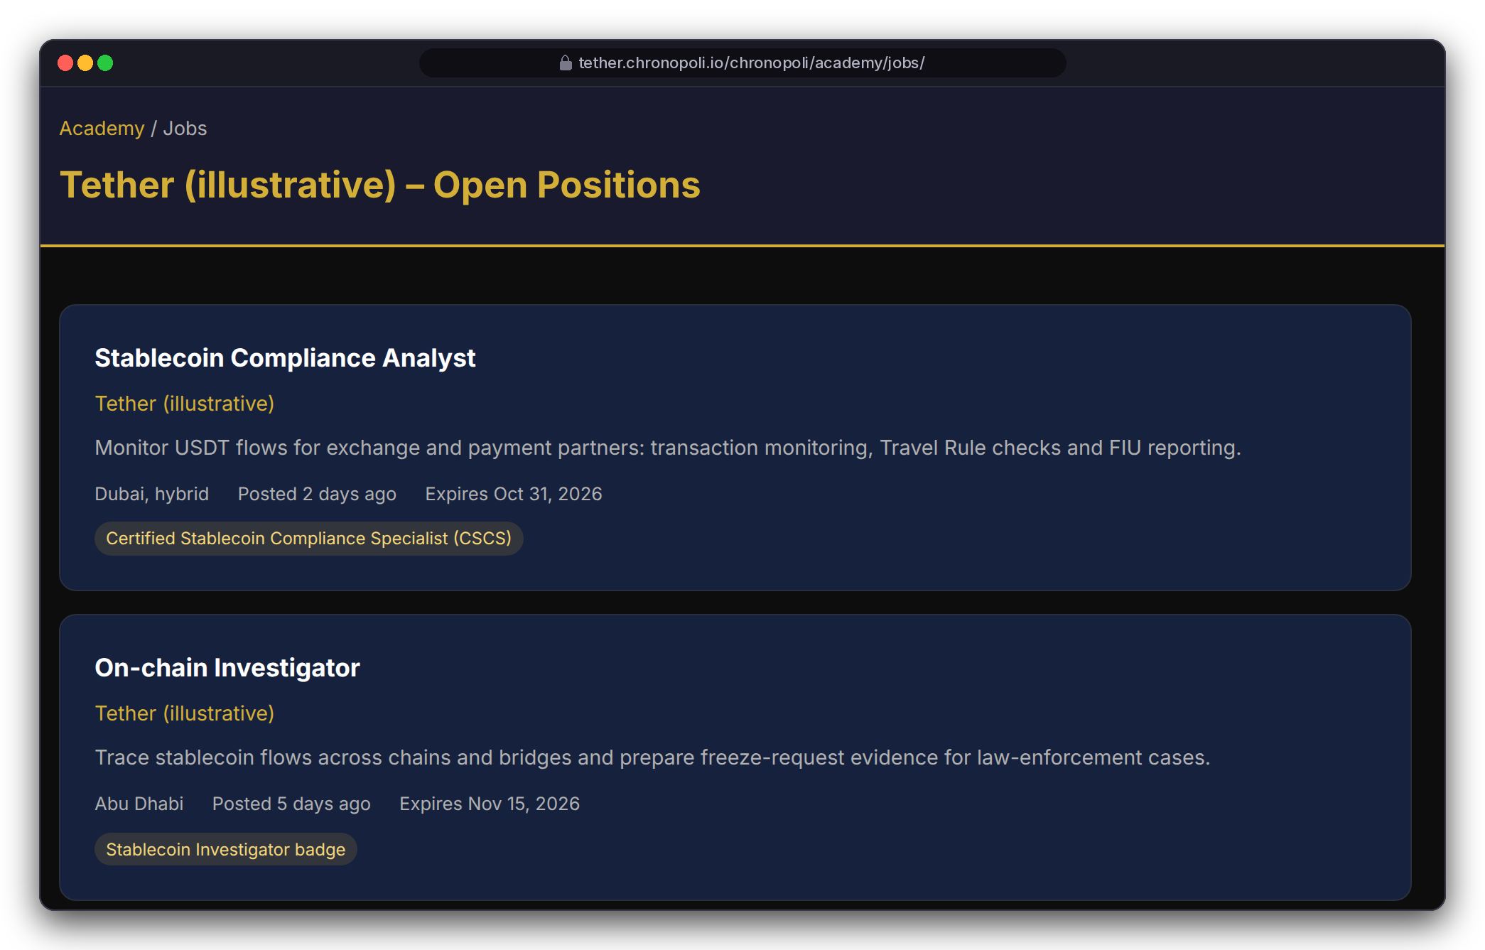
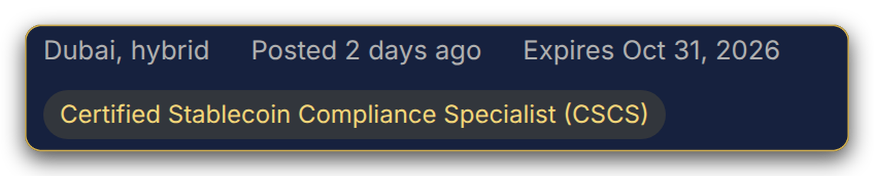




FOR KNOWLEDGE PARTNERS · PROOF
PILLAR 02 · COMPANY ACADEMIES
P4
From pathway to hire: a talent pipeline you own
Job postings in your academy require your badge, so applicants arrive pre-qualified on your curriculum
Each posting names the badge it requires (CSCS, Stablecoin Investigator, Stablecoin Foundations)
At launch: when a learner applies and gives explicit consent, a credential snapshot goes to your HR notification address. No consent, no data
Works for partners hiring into their ecosystem, universities placing graduates, and enterprises growing people internally
37
applications across the 4 postings, Q3 2026 (illustrative mock data)
THE PIPELINE, END TO END
REAL PLATFORM SCREEN
Pathway
Badge
Posting
Consent
Your HR
Academy job board, first 2 of 4 postings; gold frame: zoom of the first badge chip · Tether (illustrative), mock roles · consent step: required before launch, not yet built
before launch
Illustrative mock data · Tether is a partner-roadmap target only; no agreement implied · all other organisations and people are fictitious
09
Notes:
TALK TRACK: This is the slide partners remember. Education turns into recruiting: you stop paying to find people and start growing them to your own standard. The mock data shows 37 applications across four postings in one quarter; that's illustrative, showing the mechanics. Be clear on status: the job board and application flow are built; the explicit candidate consent step is required before launch, and the pipeline does not switch on without it. FOR UNIVERSITIES: present this as graduate placement. Who is data controller for applicant data is set in the partner agreement. OBJECTION: 'Privacy: we can't receive candidate data without consent.' ANSWER: Agreed. No consent, no data. The target hosting region is the UAE.

Slide 10
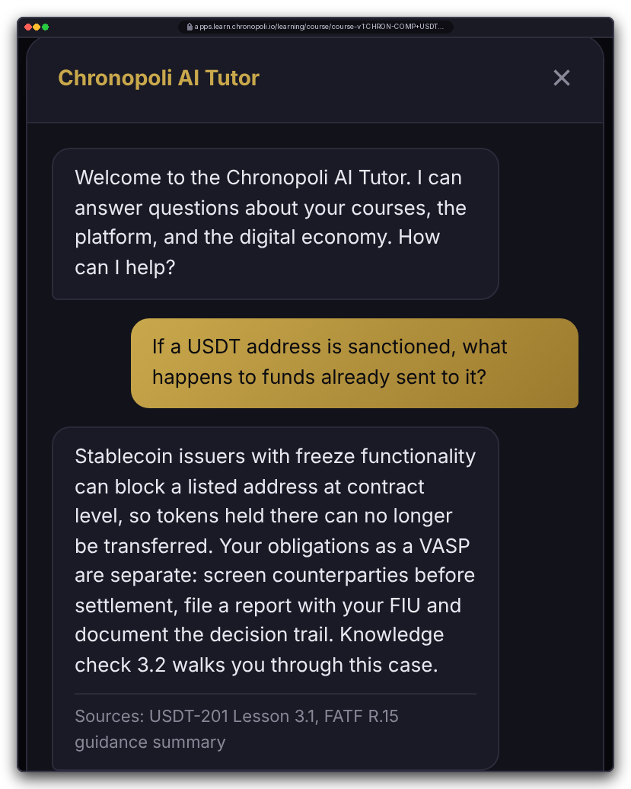
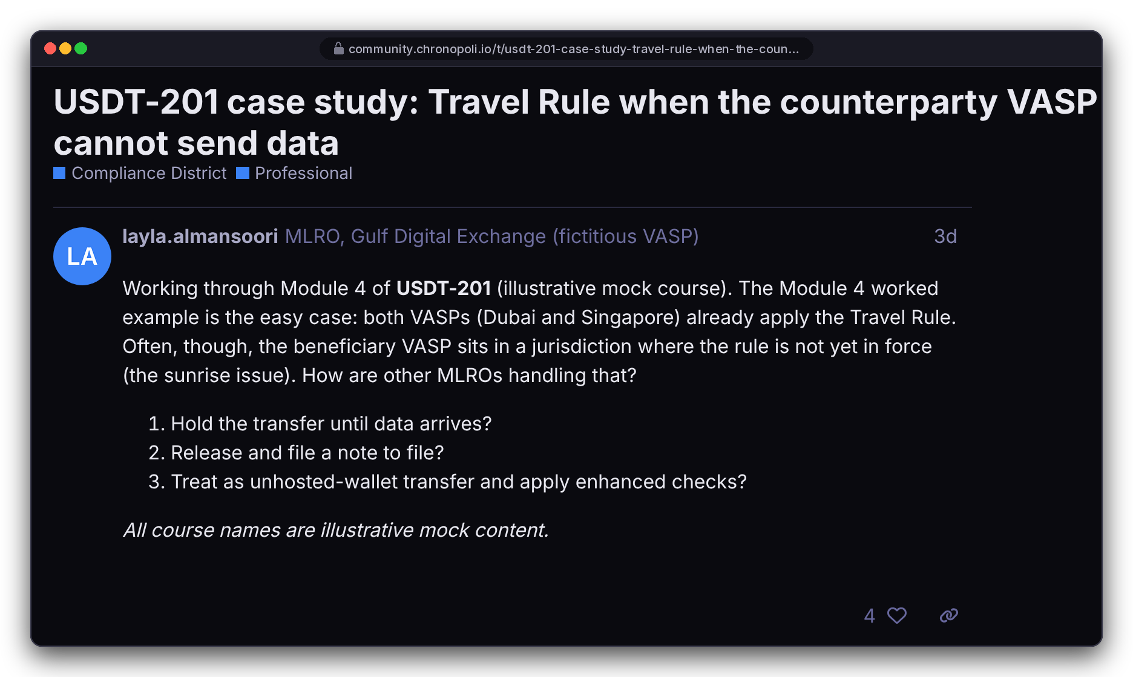
FOR KNOWLEDGE PARTNERS · PROOF
PILLAR 03 · OPEN KNOWLEDGE
P5
Learners stay engaged: an AI tutor on your content, and a community per district
Designed to answer from your course material and cite its sources; district forums connect practitioners, investigators and regulators
AI tutor: answers from a knowledge base built from your courses; it shows its sources and is a learning aid, not advice
Before launch: the knowledge base, its access rules and the handling of learner questions
Community: one forum category per district, the same sign-in as the courses, course-linked threads
For partners: questions and threads show what your market is struggling with
DESIGN PROTOTYPE (NOT YET BUILT)
REAL PLATFORM SCREEN
Left: the AI tutor on a mock lesson page; the answer is scripted demo copy
Right: the district forum in the Chronopoli design; a mock USDT-201 case-study thread, fictitious people
Illustrative mock data · Tether is a partner-roadmap target only; no agreement implied · all other organisations and people are fictitious
10
Notes:
TALK TRACK: Completion is where training programmes fail. Two things keep learners moving: an answer at the moment they're stuck, and peers doing the same job. The tutor is designed to answer from your course content and name its sources, here USDT-201 Lesson 3.1 and a FATF Recommendation 15 guidance summary. Say it clearly: the answer on screen is scripted demo copy, not a live AI answer. Building the knowledge base from your courses, its access rules and how learner questions are logged and kept are all finished before launch. The community on the right is real and ran on our demo system. In the enterprise talk, this slide shows what your staff get as learners. OBJECTION: 'Where do our staff's questions go? Are they used for training?' ANSWER: Data handling for tutor questions is settled before launch and written into the pilot order; we make no model-training guarantee beyond what's built. OBJECTION: 'What if the AI gives wrong advice in our name?' ANSWER: It's labelled a learning aid, not advice; it cites sources so the learner can check them, and it's scoped to course content. This is the AI Tutor of the Open Knowledge pillar; it compounds with every approved round-table output. If a partner asks whether its content feeds a tutor other academies use: which content enters the shared knowledge base is set per partner in the partner agreement (moats, slide 18).

Slide 11
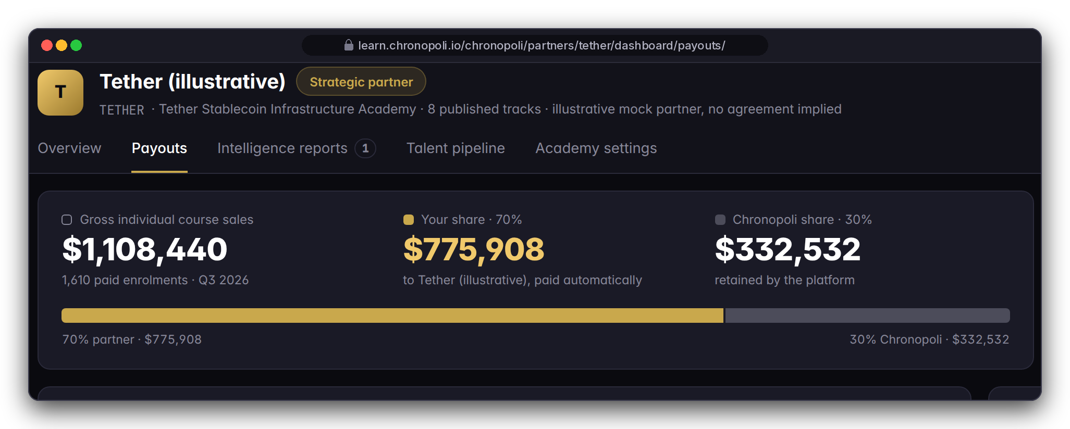
FOR KNOWLEDGE PARTNERS · PROOF
PILLAR 02 · COMPANY ACADEMIES
P6 · P7
Your dashboard and your 70% split
See what your academy does every week, and keep 70% of every partner-course sale
ENROLMENTS
COMPLETIONS
BADGES
JOB APPLICATIONS
OPERATING VIEW · ILLUSTRATIVE QUARTER
4,812
1,937
1,244
37
Tether (illustrative) demo data, Q3 2026, not real traction; the quarter's dollar figures are explained once, on slide 23
+18% QoQ
40.3% completion rate
Weekly e-mail report: new enrolments, completions, badges, job applications and revenue. Analytics and the weekly report are built; the dashboard page comes before launch
70/30 split at checkout: the split is built. Payout-account set-up, the payouts page, refunds and payout status come before launch. Tax treatment: set in the partner agreement
Same dashboard for an institutional academy; KPIs shown are an illustrative stablecoin scenario
DESIGN PROTOTYPE (NOT YET BUILT)
Partner dashboard, Payouts tab: the 70/30 split of the illustrative quarter · analytics, weekly e-mail and the 70/30 split are built; this page is not
Illustrative mock data · Tether is a partner-roadmap target only; no agreement implied · all other organisations and people are fictitious
11
Notes:
TALK TRACK: Partners fund education and rarely know what it achieved. The dashboard answers it: who enrolled, who finished, who earned your badge and who applied for your jobs, and the Monday e-mail means leadership sees it without logging in. The payouts page is the economic core: the split is applied at checkout, so there's no invoicing and no quarterly reconciliation argument. Status: the analytics, the weekly e-mail and the 70/30 split are built; the dashboard and payouts pages and the payout-account set-up come before launch. Every number is illustrative, a model of one academy; we'll walk through the money once, on slide 23. OBJECTION: 'Refunds, chargebacks, VAT, payout timing?' ANSWER: Refund handling and payout status are finished before launch; payout timing follows our payment provider's standard schedule; tax treatment is set in the partner agreement. OBJECTION: 'Does 70/30 also apply to team licences?' ANSWER: Team-licence revenue sharing isn't defined yet, so it's set in the partner agreement. OBJECTION: 'Can we get the raw data?' ANSWER: Course-level data comes from the platform's standard CSV reports (slide 15); learner-level sharing follows the access model on slide 22.

Slide 12
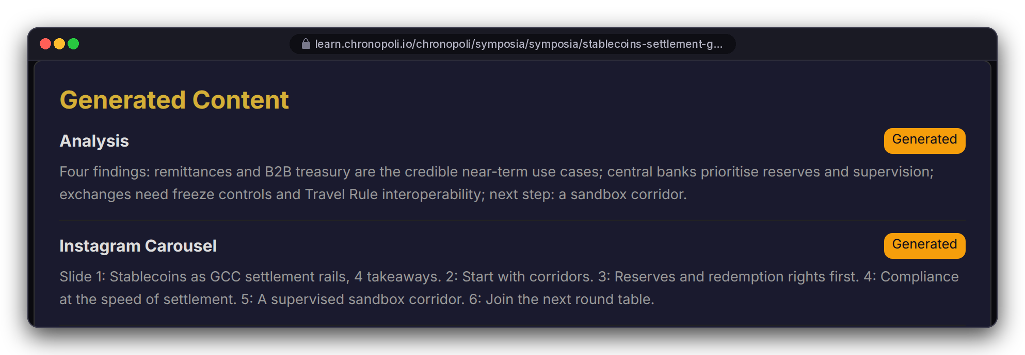
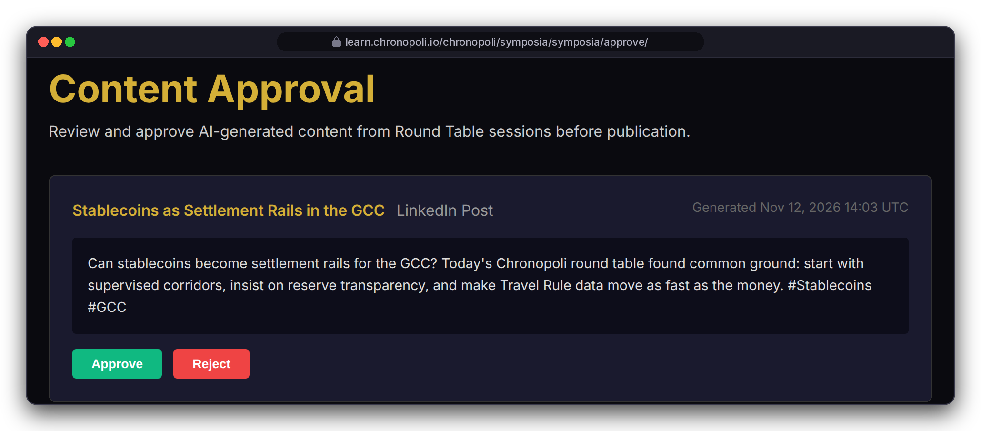

FOR KNOWLEDGE PARTNERS · PROOF
PILLAR 01 · SYMPOSIA
P8
Five outputs in 3 hours, one human approves
Sponsor or co-convene a closed-door round table: opinion paper, LinkedIn posts, Instagram carousel, Partner Intelligence Report and an AI-tutor update
Live stream (designed)
Transcript
AI analysis
4 drafts
One human approves
Publish + AI-tutor update
REAL PLATFORM SCREEN
Left: 2 of 6 generated items, mock output texts · live streaming designed, not yet run
REAL PLATFORM SCREEN
Right: staff approval queue, one card · session, people and sponsor illustrative
Sponsor sign-off on sponsor-branded outputs, and for institutions the rights to transcripts, faculty publication and ethics review: set in the partner agreement
The sponsoring partner receives the Partner Intelligence Report: themes relevant to you and suggested follow-ups for your tracks
Attribution: named quotes can print today; removal is fixed before launch, and until then one human (Chronopoli staff) approves every output
Illustrative mock data · Tether is a partner-roadmap target only; no agreement implied · all other organisations and people are fictitious
12
Notes:
TALK TRACK: For many partners this is worth more than courses. You convene regulators, banks and exchanges behind closed doors, and you leave with five outputs in about 3 hours: an opinion paper, LinkedIn posts, an Instagram carousel, a Partner Intelligence Report on what the market thinks, and, once approved, an update to the AI tutor's knowledge base. One human approves everything, in about 10 minutes. Say that 3 hours and 10 minutes are design targets, and that TikTok is on the roadmap, not yet built. This is the Symposia pillar, the community intelligence engine. The pipeline runs from the session recording to a transcript, an AI analysis and four drafts. The attribution caveat is on the slide on purpose: sessions run under the Chatham House Rule, but today the opinion paper can print attributed quotes and participant names, and the analysis picks out named key quotes. Removing attribution is fixed before launch; until then the one-human approve/reject step is the safeguard. The queue approves or rejects; it doesn't edit, and the approver is Chronopoli staff, not the partner, so sponsor sign-off is an agreement item. Live streaming is designed, but no session has been streamed yet. The session shown is 'Stablecoins as Settlement Rails in the GCC'. FOR UNIVERSITIES: position this as a research round table you co-convene; publication rights, ownership of transcripts and ethics review are set in the partner agreement. Don't claim co-moderator rights; the queue is staff-only. OBJECTION: 'What does sponsorship cost?' ANSWER: Set in the partner agreement. OBJECTION: 'Will AI misquote our panellists?' ANSWER: Every output waits in the approval queue, and one human can reject it.

Slide 13
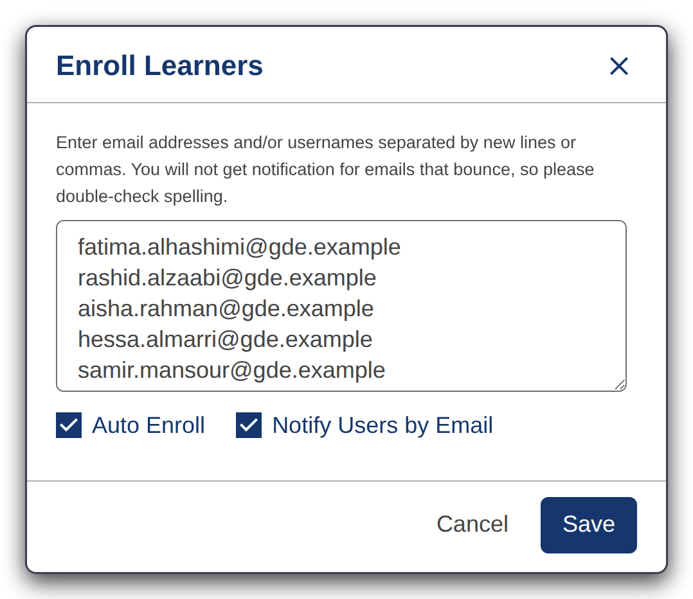
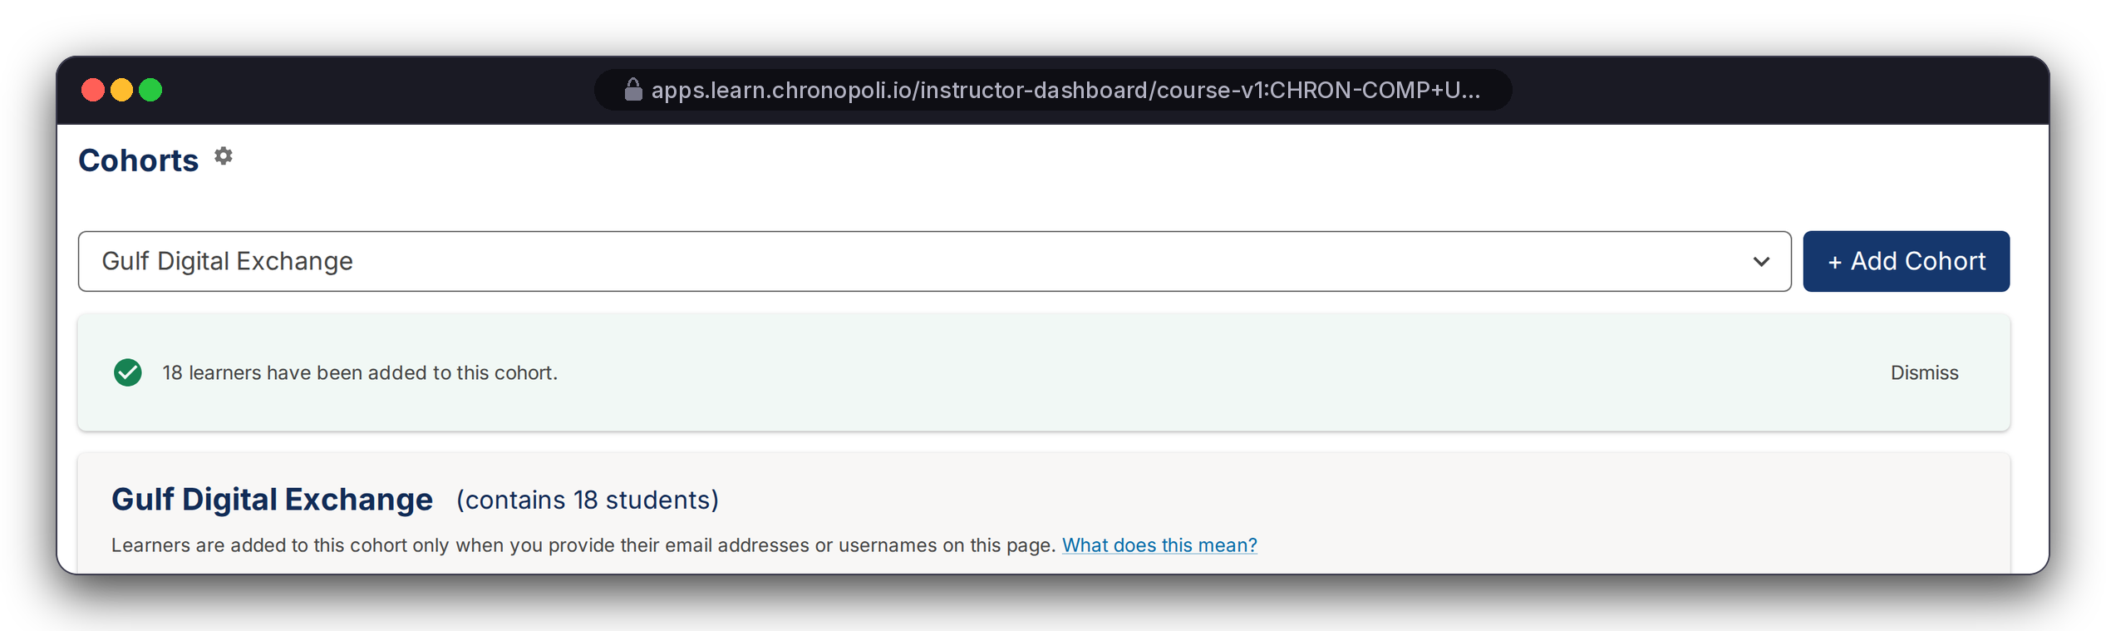
FOR ENTERPRISE TEAMS · PROOF
PLATFORM CORE
E1
Enrol a whole team in one paste, then group them as your company
Enterprise track, on the real platform: batch enrolment, then a company cohort for reporting
25
seats purchased
18
seats assigned
17
pasted in one go
18
in the cohort: the 17 + Layla (MLRO, alias domain)
REAL PLATFORM SCREEN
Right: Instructor Dashboard > Cohorts, cropped to the cohort panel
REAL PLATFORM SCREEN
Browser addresses show the planned domain · seeded test cohort; grades from test learners answering in the browser, no overrides (slides 13-15) · entry box enlarged for display · Gulf Digital Exchange and its staff are fictitious
Left: 'Enroll Learners' with the 17 @gde.example addresses, just before Save
Paste the e-mail addresses, tick Auto Enroll and Notify, save: 17 Gulf Digital Exchange employees enrolled in USDT-201; Layla, the MLRO, was already enrolled on her alias domain, making 18
One manual cohort, 'Gulf Digital Exchange', holds all 18 seat holders, so every report can filter to your company; a CSV upload also assigns cohorts
Standard enrolment uses the default track; our team moves your staff to the verified track in the pilot, automated in the team-admin console (E4)
Illustrative mock data · Tether is a partner-roadmap target only; no agreement implied · all other organisations and people are fictitious
13
Notes:
TALK TRACK: Now for the enterprise buyer. Everything on this and the next two slides is the real platform, running on our demo system. A 25-seat team licence has 18 people assigned: 17 new employees plus Layla, the MLRO, who was already enrolled. That's why the paste shows 17 and the cohort 18. The third line is deliberate: standard enrolment puts people on the default track, so for this demo we moved the 17 to the verified track in the back office. In the pilot our team does that step for you; the team-admin console automates it. OBJECTION: 'Do our staff need to create accounts first?' ANSWER: No. With Auto Enroll they're enrolled when they activate with that address. OBJECTION: 'How much admin work is this for us?' ANSWER: In the pilot you send a seat list; our team runs enrolment, track and cohort. In the master pricing this is a Corporate Team Subscription: $1,500 per seat per year, the same as the $125 per seat per month list price in the product (slide 20). Layla is one persona of several, and USDT-201 is one course of eight: the same seats cover the other Tether (illustrative) courses, from USDT-101 fundamentals and USDT-102 multichain to USDT-202 reserves and attestations, USDT-203 payments and treasury, USDT-301 investigations, USDT-302 regulation and the USDT-401 executive programme.

Slide 14
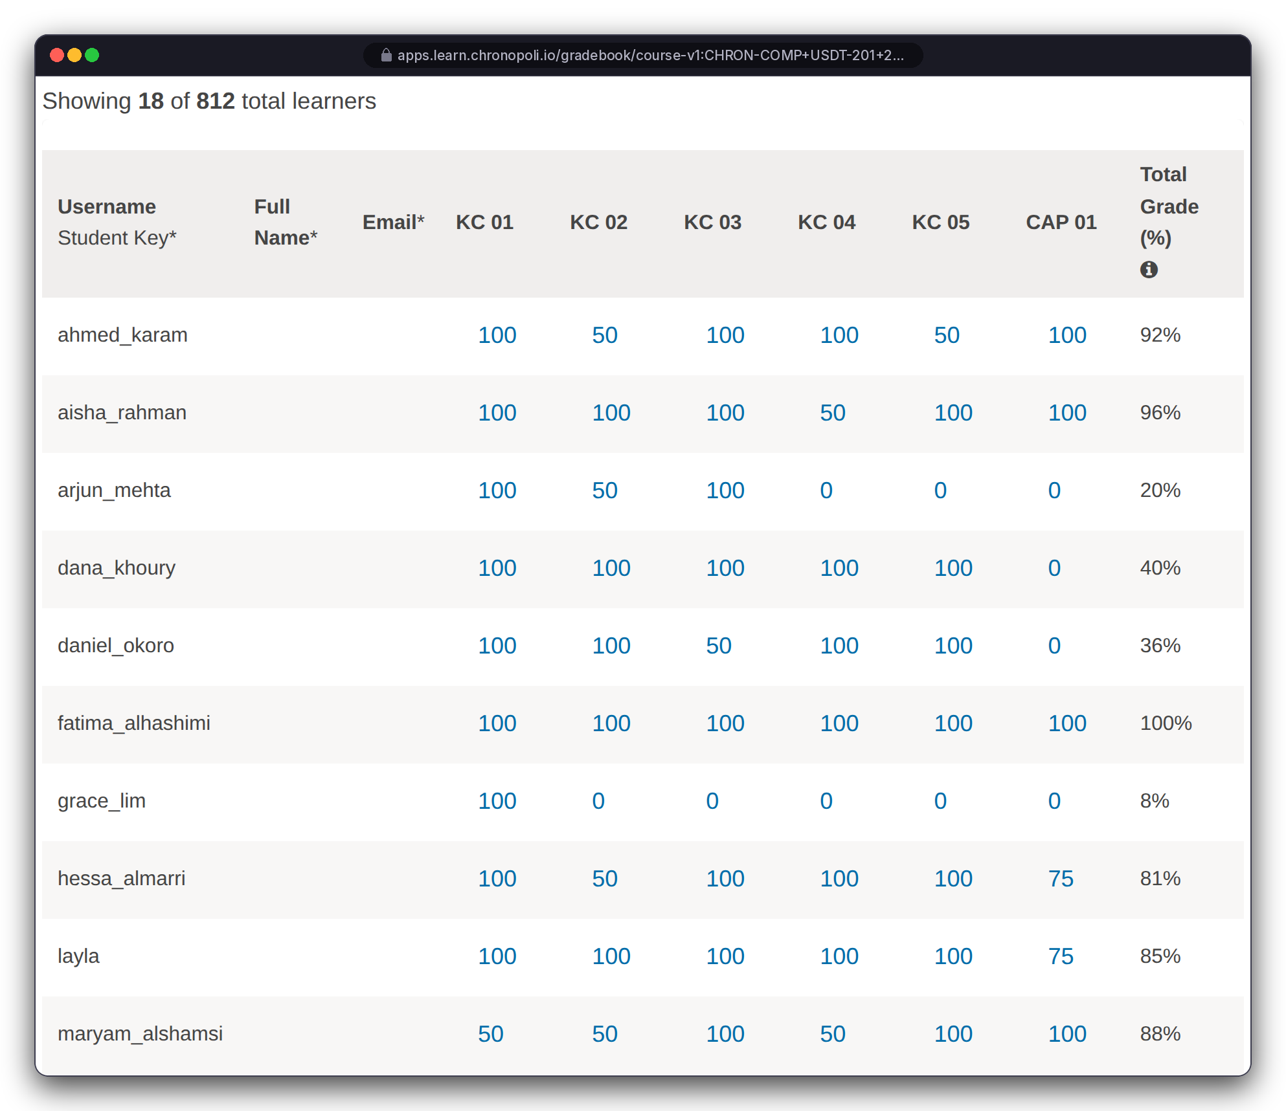
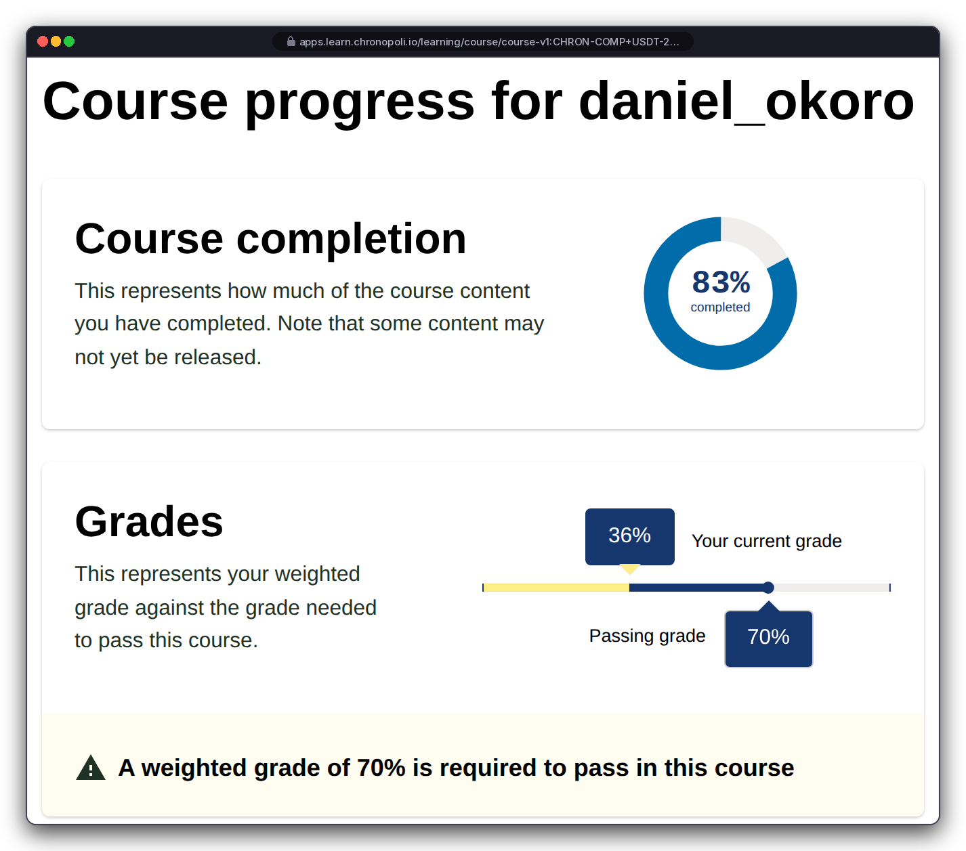

FOR ENTERPRISE TEAMS · PROOF
PLATFORM CORE
E2
See who is on track, and who needs help
Gradebook filtered to your cohort, and the staff view of any employee's progress against the 70% pass mark
Your cohort, 18 learners, with every knowledge check, the capstone and the total: from 100% down to 0% (not started); 9 of 18 at or above the 70% pass mark
Open one employee to see completion (83%) against grade (36%): capstone not yet attempted, so you know who to nudge
Who sees this: the gradebook is a course-staff view across all companies in the course. In the pilot only Chronopoli staff hold the course-staff role, and your team admin receives cohort-filtered views and reports; company-scoped admin access is part of the team-admin console (slide 16)
Demo system at a narrower browser width; addresses show the planned domain · scroll box expanded, tooltip colours restored (display only) · seeded cohort; grades from test learners, no overrides · fictitious people
REAL PLATFORM SCREEN
Left: gradebook, cohort 'Gulf Digital Exchange' (18 of 812 learners), first 10 of the 18 rows
REAL PLATFORM SCREEN
Right: staff view of daniel_okoro
Illustrative mock data · Tether is a partner-roadmap target only; no agreement implied · all other organisations and people are fictitious
14
Notes:
TALK TRACK: These grades are genuine. Each test learner worked through the course in a browser, one attempt per question, some wrong on purpose, with no overrides. The manager's question is 'who needs help?', and this answers it in one view. You set the pass mark and weights in course authoring: here 70%, knowledge checks 40%, capstone 60%. Address data access before they ask: '18 of 812' means this staff view covers everyone in the course, including other companies. That's why in the pilot only our staff hold that role and you get cohort-filtered views; slide 22 shows the full access model. OBJECTION: 'Can we trust auto-graded checks for regulatory training?' ANSWER: The report shows every component and the capstone, not just a completion tick, and you set the thresholds. OBJECTION: 'Our team leads won't log in to an instructor dashboard.' ANSWER: Fair. The simpler team-admin console on slide 16 comes with the pilot.

Slide 15
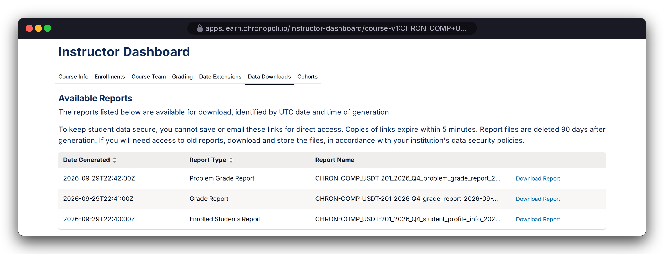
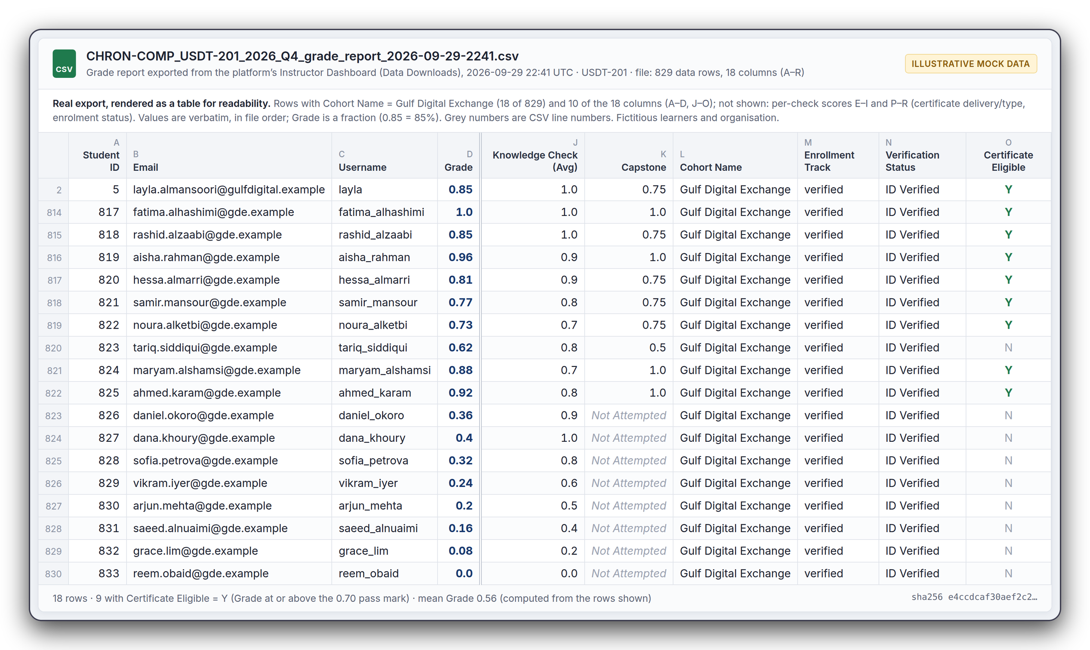
FOR ENTERPRISE TEAMS · PROOF
PLATFORM CORE
E3
Training evidence in a standard, system-generated format
The platform's standard Data Downloads produce a course-wide grade report; your cohort's rows (Cohort Name = Gulf Digital Exchange) are handed to you as a CSV
REAL PLATFORM SCREEN
Left: Instructor Dashboard > Data Downloads, reports generated on demand, timestamped in UTC
Per employee: grade, knowledge checks, capstone, cohort, track, verification status, certificate eligibility
Verification status column: 'ID Verified' is the platform's standard value, set manually by staff on the demo system; no ID check or proctoring performed
Before launch: report files sit in publicly reachable storage today; they are made private and access-controlled before launch, and pilot reports are delivered by the Chronopoli team, not by public link
REAL PLATFORM SCREEN
Right: the platform's grade-report CSV shown as a table: the 18 Gulf Digital Exchange rows of 829 · 10 of 18 columns, values verbatim · 9 certificate-eligible, mean grade 0.56 · certificates not activated · fictitious people
Illustrative mock data · Tether is a partner-roadmap target only; no agreement implied · all other organisations and people are fictitious
15
Notes:
TALK TRACK: This is the answer to 'show me who was trained'. It's a system-generated file from the platform itself: who, which course, what grade, against which pass mark. Be precise: the platform produces one file for the whole course; we filter it to your cohort's rows and hand those to you. Nine of eighteen are eligible; the other nine are visible too, which is what an auditor wants to see. The file has 829 rows: 812 enrolled learners plus 17 unenrolled test placeholders, and Layla's row uses her second demo address. Certificates are not activated, so the file says 'eligible', not 'issued'. Say the storage point yourself: today report files sit in publicly reachable storage, one of the open critical issues from our security review; it is fixed before launch, and until then we deliver pilot reports directly. OBJECTION: 'Is this accepted by VARA or our regulator?' ANSWER: We don't claim regulatory acceptance. We provide the underlying evidence in a standard format, and your compliance function decides how to present it. OBJECTION: 'Who actually sat the test?' ANSWER: Identity is the learner's own account; we don't claim proctoring or ID verification. The 'ID Verified' value here was set manually on the demo system. OBJECTION: 'Where is this data stored?' ANSWER: The target is hosting in the UAE.

Slide 16
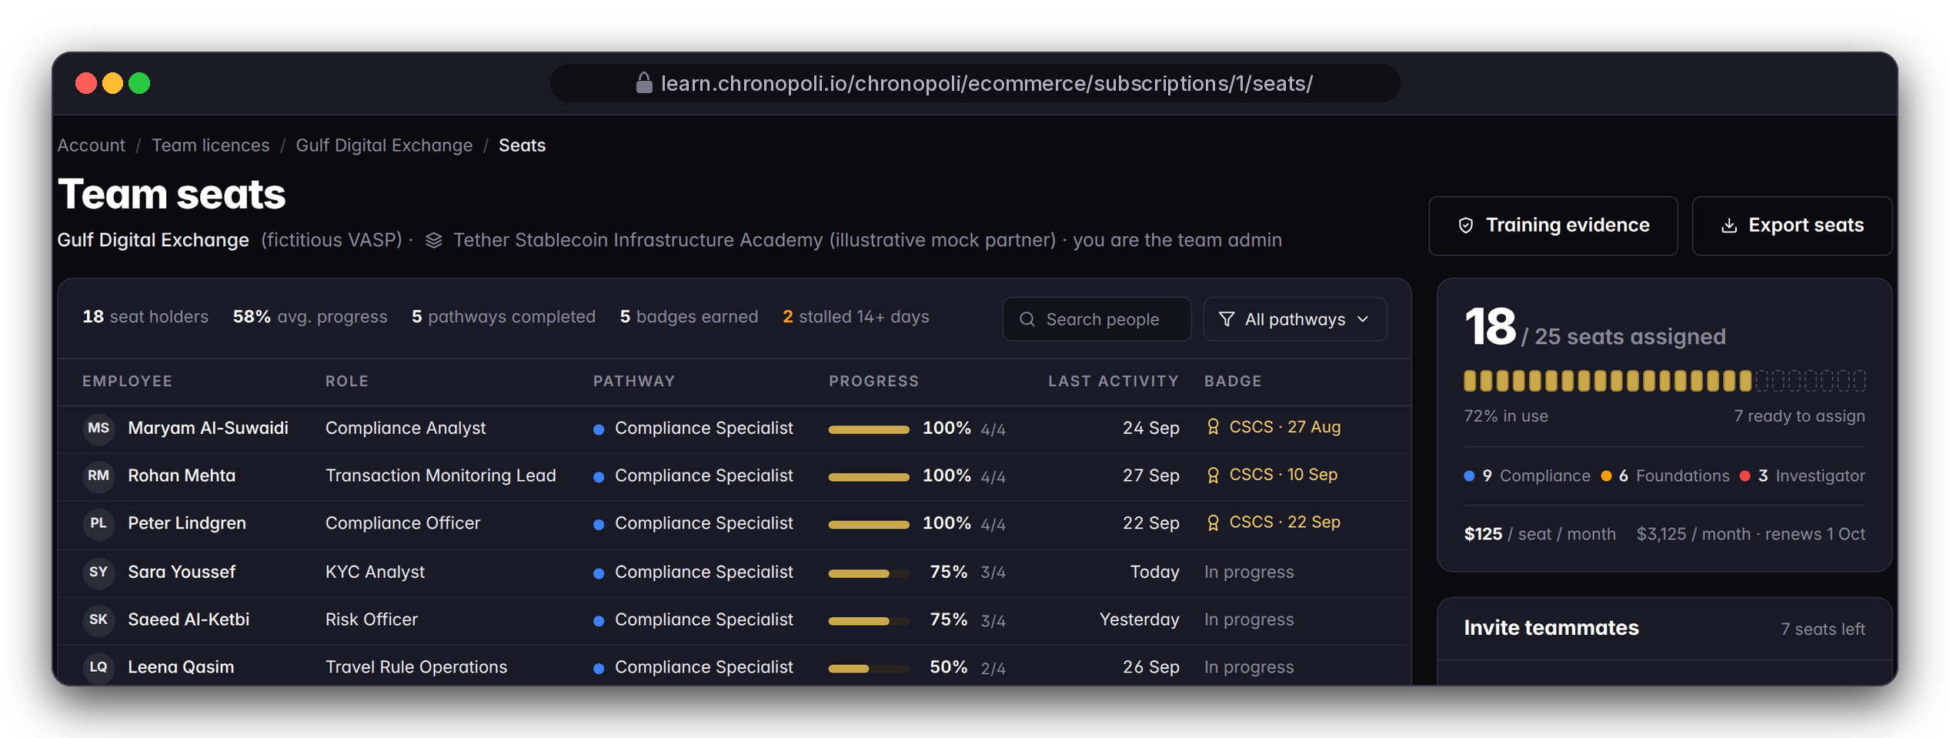
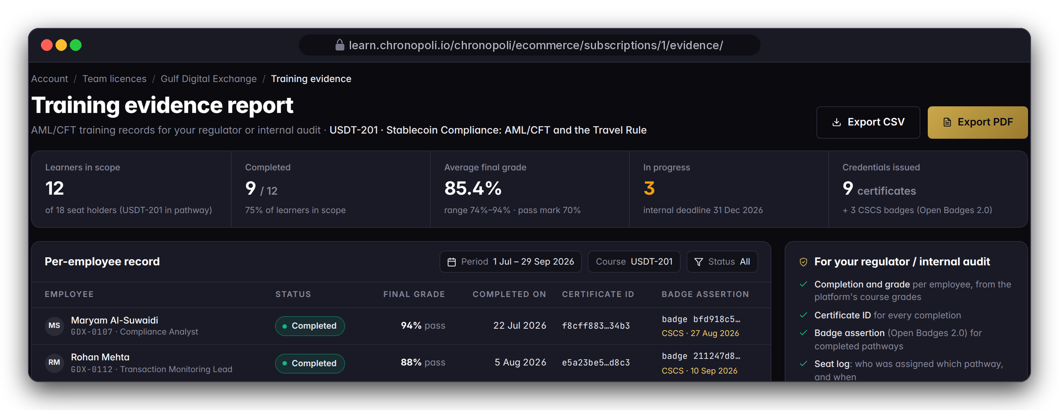
FOR ENTERPRISE TEAMS · COMING WITH THE PILOT
PLATFORM CORE
E4
Coming with the pilot: your team-admin console
Seats, invitations and a one-click evidence report, designed with our first pilot teams
DESIGN PROTOTYPE (NOT YET BUILT)
Left: team seats, Gulf Digital Exchange (fictitious)
DESIGN PROTOTYPE (NOT YET BUILT)
Right: training evidence report for USDT‑201
Not yet built: seat assignment, invites, domain join, CSV/PDF export; the team subscription and seat count exist · sample roster, not the slides 13-15 cohort
Team seats: 25 purchased seats × $125 = $3,125/month (18 assigned), with progress, last activity and badge per employee, and stalled learners flagged
Invite by e-mail, or let staff on your verified domain request a seat, with your approval
Training evidence report: USDT-201, 12 learners in scope (scope chosen by the team admin in this sample), 9 completed (75%), average grade 85.4%, with certificate and badge IDs and CSV/PDF export
Evidence-pack contents (fields, timestamps, sign-off) are co-designed with pilot teams
Illustrative mock data · Tether is a partner-roadmap target only; no agreement implied · all other organisations and people are fictitious
16
Notes:
TALK TRACK: Slides 13-15 are what exists. This is where it's going, and it's why we want pilot teams: you tell us what your team leads, risk and compliance officers and auditors need on this page. The team-licence records (seats and seats used) are already built, and billing is on purchased seats; these pages turn them into a console. Numbers here come from a separate sample roster, so they won't match the cohort on the previous slides; don't compare them. OBJECTION: 'Why are only 12 in scope?' ANSWER: In this sample the team admin scoped the report to the USDT-201 group; the rest of the seat holders are on other pathways or not assigned to this course. OBJECTION: 'Why buy before it exists?' ANSWER: A pilot team trains on the same standard platform shown on slides 13-15, with reports delivered by our team, and the console is designed with you. OBJECTION: 'Can we move seats when people leave?' ANSWER: That's the design: the team admin reassigns seats. OBJECTION: 'Can our regulator verify the badge ID online?' ANSWER: Not yet. Public online verification comes before launch.

Slide 17



COMPETITIVE LANDSCAPE
We are not a better Coursera
A categorically different architecture: the first neutral Knowledge City for the digital economy
FEATURE
COURSERA / LINKEDIN
ACAMS / ICA
VENDOR ACADEMIES
CHRONOPOLI
SHOWN ON
AI-generated content pipeline
Slide 12
Live round tables + automatic opinion papers
Slide 12
Digital Twin expert system
Slide 29
Seven cross-sector Knowledge Districts
Slide 2
Verified Open Badges 2.0 credentials
Slide 8
Automated talent pipeline
Slide 9
Partner Intelligence Reports
Slide 12
Curriculum updates in under 48 h
Slides 7, 12
Neutral cross-sector positioning
Slide 2
yes
partial
no
Competitor ratings: Chronopoli master papers. Chronopoli column: built, not yet live; goes live with the launch plan; status per item on slide 5. The 48-hour update and online badge verification are launch targets.
17
Notes:
TALK TRACK: We are not a better Coursera; we are a different architecture. Coursera and LinkedIn Learning sell content, ACAMS and ICA sell certification, vendor academies teach their own product. None of them has the pipeline, the round tables, digital twins, cross-sector districts or neutral positioning. For a buyer that means one place for your market, your staff and your regulator's view, rather than three vendors. The competitor ratings are from our master papers. The Chronopoli column means built and shown in this deck, but not live yet; it goes live with the launch plan, and the status of each item is on the offer slide (slide 5). The 48-hour update is a design target. OBJECTION: 'We already use ACAMS.' ANSWER: Keep it for the certification; Chronopoli adds the stablecoin, AI and on-chain depth, your own academy and the grade evidence per employee.

Slide 18




WHY IT COMPOUNDS
Four self-reinforcing moats
Each moat strengthens the other three, and each one works in your favour as a partner or a team
Proprietary Knowledge Moat
Partner Lock-in Moat
Every round table, opinion paper and masterclass feeds the AI tutor. After 12 months no general-purpose AI has access to this knowledge base. It compounds like interest.
When a partner builds its academy inside Chronopoli, its credential history, talent pipeline and community are embedded there and grow every year.
For you: Your learners get answers grounded in your district's sessions.
For you: Your academy gains value every year, and exit stays open.
In this deck: slides 10, 12
In this deck: slides 6, 9, 22
Network Effects Moat
Cost Structure Moat
More partners → more round tables → more knowledge → more users → more employer demand → more partners: a two-sided flywheel in a high-value niche.
About $374 a month of infrastructure to start, and a lean cost base as the city grows. SaaS competitors cannot undercut this without operating at a loss.
For you: Each new partner brings learners and employers to your district.
For you: Your fee pays for the academy, not for overhead.
In this deck: slides 2, 4
In this deck: slide 20
18
Notes:
TALK TRACK: Four moats, and each one works for you. The knowledge moat: every round table, paper and masterclass feeds the AI tutor, so your learners get answers grounded in your district's own sessions, which no general-purpose AI has. Partner lock-in, in your favour: your credential history, talent pipeline and community grow inside your academy every year, and the exit stays open with a standard course export and your badge records. Network effects: every new partner brings learners, experts and employers into your district. Cost structure: about $374 a month of infrastructure to start, so a lean cost base keeps overhead out of your price. Don't promise a price freeze; prices are set in the partner agreement or pilot order. OBJECTION: 'Does our content train a tutor that our competitors' learners use?' ANSWER: The master papers describe one tutor grounded in all platform content; which of your courses and round-table outputs enter the shared knowledge base, and which stay scoped to your academy, is set per partner in the partner agreement.

Slide 19




TRACTION & VALIDATION
Platform built. Anchor confirmed.
Built, not yet live; launch plan in place. Anchor confirmed, MOU in progress, nothing signed yet
PLATFORM
BUILT
LAUNCH
NEXT
DBCC PARTNERSHIP
DONE
Built, not yet live
Plan in place
Confirmed
Real screens show the working product; prototypes are still to be built
Hosted in the UAE · onboarding runs in parallel with launch preparation (slide 24)
Anchor institutional partner · 500+ company network
BUiD ACADEMIC
IN PROGRESS
TETHER
TARGET
FOUNDING PARTNERS
OPEN
MOU in progress
Target partner
Two seats open
Maria Papadaki · target: 30 CPD credits a year recognised
Strategic tier · illustrative demo academy (slide 6), no partnership
$150K Founding Academy each (slide 20) · to close before launch
Statuses as in the master papers; nothing is signed. What is built and what still comes before launch is listed item by item on slide 5. Tether is a target partner; the Tether academy in this deck is illustrative mock data.
19
Notes:
TALK TRACK: Say the statuses exactly as they are. The platform is built but not live yet, and the launch plan is in place; the pages marked as design prototypes are still to be built, as the offer slide (slide 5) shows item by item. Hosting is planned in the UAE. Dubai Blockchain Center is the confirmed anchor, with a network of more than 500 companies. The BUiD academic MOU is in progress, with 30 CPD credits a year as the recognition target. Tether is the one named target partner, for the Strategic tier: the demo academy in this deck is built around an illustrative Tether scenario with mock data, and no partnership is implied. The two Founding Partner seats, $150K a year each, are open. Nothing is signed. BEFORE A MEETING WITH A COMPETITOR OF TETHER: decide whether to show this slide; it names Tether. OBJECTION: 'Who else has signed?' ANSWER: Nobody yet; that's why the founding seats are open.

Slide 20
COMMERCIAL TERMS
Companies pay. Students benefit.
B2B-first: Company Academy fees and team seats fund the city; learners get the credentials
REVENUE STREAM | WHAT IT COVERS | PRICE
Company Academies | Your branded academy: pathways, badges, jobs, dashboard | $25K–$150K / yr
Corporate Team Subscriptions | Seats for an enterprise team | $1,500 / seat / yr
Individual Subscriptions | A single professional learner | $490–$1,490 / yr
Open Marketplace | Partner and creator course sales | 70% creator · 30% Chronopoli
Certification | Each certificate issued | $15 / certificate
TWO PRICING VIEWS
Commercial model (left): annual academy fees and subscriptions.
In the product (slides 11, 21, 23): per-course layer prices from $0 to $8,000 for single purchases, seats at $125 a month (= $1,500 a year), 70/30 split at checkout.
EXAMPLE: A FOUNDING ACADEMY, PER YEAR
$150K
Your academy, trained staff and regulators, co-issued credentials, candidates for your hiring team and a Partner Intelligence Report per round table. One recruiter placement: about $20K.
Source: Chronopoli master papers (March 2026). Where your academy sits in the range, term and exclusivity: partner agreement; seats: pilot order.
20
Notes:
TALK TRACK: Companies pay, students benefit. The model is B2B-first: Company Academy fees and team seats fund the city before a single student pays. A Company Academy costs $25K to $150K a year depending on scope; a Founding Academy, for example, is $150K a year. For that you get your academy, trained staff and regulators, co-issued credentials, qualified candidates sent to your hiring team and a Partner Intelligence Report per round table. Compare that with about $20,000 for a single recruiter placement. Enterprise teams pay $1,500 per seat per year, which is the $125 a month list price in the product. Individual subscriptions run from $490 to $1,490 a year, marketplace course sales split 70/30 in the creator's favour, and a certificate costs $15. Whether the $15 certificate fee is included in team seats or charged per certificate is set in the pilot order; don't promise either. The right-hand box shows the second pricing view, the one already built into the product: per-course layer prices, seats and the 70/30 split. Where your academy sits in the range, the term and any exclusivity are set in the partner agreement. Don't quote revenue projections in a sales meeting.

Slide 21




PACKAGES
Packages: four partner tiers and a team licence
Every partner tier runs on the same platform capabilities. The tier describes your role in the city and what we ask of you
PACKAGE | WHO IT IS FOR | WHAT YOU GET | WHAT WE ASK OF YOU
Founding Partner | First anchor partners who co-design the city | Academy + web address, flagship tracks, pathways + co-issued badges, badge-gated jobs, dashboard + weekly report, 70/30 payouts, first round tables, masterclass option | A Founding Academy fee (example: $150K/yr), co-design time in the pilot cohort, a flagship track, the first round table in your district
Strategic Partner | Protocols and issuers with multi-district curricula | Same capabilities, multi-district tracks, round-table sponsorship | An academy fee ($25K–$150K/yr), a multi-district curriculum
Content Partner | Analytics, investigation, AI and specialist training firms | Partner tracks and pathways in the relevant district, dashboard, 70/30 payouts, round-table sponsorship | An academy fee ($25K–$150K/yr), tracks in one district
Institutional Partner | Universities, think tanks, banks | Academy for students or staff, pathways + badges, course authoring, co-convened research round tables | An academy fee ($25K–$150K/yr), SMEs for one track, a research lead, a cohort
Enterprise team licence | Banks, fintechs, VASPs, regulators, FIUs, corporates | Seats, batch enrolment, cohort, gradebook, grade reports, verified-track certificates; team-admin console and evidence pack with the pilot | Seats at $1,500/seat/yr ($125/month), a team admin, a seat list, a pathway choice
Team licence: $1,500 per seat per year = $125 per seat per month (list price in the master pricing and in the product) · billed on purchased seats, not assigned seats · example: 25 seats = $3,125/month ($37,500/year at list) · catalogue scope per seat, minimum term and pilot length set in the pilot order
Fixed in the product: 70/30 split on partner-course sales; seat list price $125/seat/month.
Single-course price guidance by layer (partners set their own prices): L1 $0‑149 · L2 $299‑799 · L3 $999‑2,499 · L4 $3,000‑8,000.
Company Academy fee: $25K–$150K/yr by scope (Founding Academy example: $150K/yr, slide 20); tier placement in the range: partner agreement.
Illustrative mock data · Tether is a partner-roadmap target only; no agreement implied · all other organisations and people are fictitious
21
Notes:
TALK TRACK: Tiers describe the depth of partnership and what we ask of you, not a paywall on features. Everyone gets the academy, the credentials, the pipeline and the 70/30 split. Founding Partners give the most (co-design time, a flagship track, the first round table) and get the most influence. The prices follow the master commercial terms on slide 20: Company Academies $25K–$150K a year by scope, with a Founding Academy at $150K a year as the example, and team seats at $1,500 a year, which is the $125 a month list price fixed in the product together with the 70/30 split. Where a tier sits in the academy range, term, exclusivity and content rights are in one place: the partner agreement. Also agreed there: round-table sponsorship, district exclusivity, and whether an institutional MOU uses the fee or other terms. Team-licence access to partner-priced courses and any team-licence revenue share are set in the partner agreement or pilot order. The tier is a label on the partner record and does not restrict features; the emphasis per tier is our proposal. ENTERPRISE TALK: point only to the gold row. You pay for purchased seats, not assigned ones; the example is 25 seats at list, $3,125 a month. What a seat unlocks (catalogue scope), the minimum term and the pilot length go in the pilot order. OBJECTION: 'What does a Founding Partnership cost?' ANSWER: A Founding Academy is $150K a year in our master pricing; the exact scope is co-designed, and term and exclusivity are set in the partner agreement. OBJECTION: 'Why choose Founding over Content?' ANSWER: Influence: flagship tracks, the first round tables and a co-design seat. The ask is higher too. OBJECTION: 'Is $125 fixed?' ANSWER: It's the list price; volume and multi-year terms are on request.

Slide 22










GOVERNANCE · IP · DATA ACCESS
Who controls what: governance, IP and data access
Our proposed model. Each point is confirmed in the partner agreement or pilot order
Governance and IP
Who sees your employees' data
For partners and institutions
For enterprise teams
PROPOSED · CONFIRMED IN THE PARTNER AGREEMENT
PROPOSED · CONFIRMED IN THE PILOT ORDER
Contracting party: named in the partner agreement
Your team admin
Your cohort only (cohort-filtered reports in the pilot; company-scoped console in a later release)
You control your course content, badge criteria and certificate signatory; Chronopoli controls the platform and the approval of AI-generated outputs
A partner academy
Course-level aggregates; learner-level data only with candidate consent (required before launch)
Content IP stays with the author; the licence to Chronopoli (scope, term) is set in the partner agreement
Chronopoli staff
Operator access to all data; in the pilot they hold the course-staff role
Exit: a standard course export plus the badge records issued under your academy
Pilot environment, and the learner data allowed in it (for example pseudonymous usernames until data protection is hardened before launch), are set in the pilot order
Research outputs from round tables follow the agreement's publication and attribution clause
Illustrative mock data · Tether is a partner-roadmap target only; no agreement implied · all other organisations and people are fictitious
22
Notes:
TALK TRACK: This is the page legal, the academic senate and the data-protection officer ask for. Left, for partners and institutions: you control content, criteria and signatory; we run the platform and approve AI outputs; your IP stays yours, the rights you grant are in the agreement, and on exit you take a standard export and your badge records. Right, for enterprise teams: who can see your staff's grades. Your admin sees your cohort, a partner academy sees aggregates unless a learner consents, and Chronopoli staff operate the platform. The pilot environment and the kind of learner data allowed in it are written into the pilot order; until data protection is hardened before launch we recommend pseudonymous usernames. Every line here is a proposal, not a signed term. OBJECTION: 'Do you have an academic advisory board?' ANSWER: Not today, and we don't claim one. OBJECTION: 'Do you offer a DPA and a retention period?' ANSWER: Data-processing terms are set in the pilot order or partner agreement; we don't quote a retention period on a slide.

Slide 23
ILLUSTRATIVE ECONOMICS · A MODEL, NOT A FORECAST
Illustrative economics: per course, per quarter, per team licence
Fictitious Tether (illustrative) scenario showing the mechanics. Not a forecast, not traction.
PER 100 USDT-201
QUARTER GROSS
PARTNER 70%
TEAM LICENCE
$41,930
$1,108,440
$775,908
$3,125/mo
partner 70% of $59,900
8 courses, Q3 2026
of gross
25 seats × $125
Unit view: per 100 paid USDT-201 enrolments at $599 → $59,900 gross → $41,930 partner (70%) · $17,970 platform (30%)
Illustrative quarter (Q3 2026): 8 courses (USDT-101 to 401) · 4,812 enrolments · $1,108,440 gross individual sales → $775,908 partner (70%) · $332,532 platform (30%)
Depth pays: L3/L4 courses bring about 50% of gross from about 17% of paid enrolments; the free USDT-101 is the funnel (2,140 enrolments). Institutions may run L1 courses at $0; the model then works on reach, not revenue
Team licence, Gulf Digital Exchange (fictitious): 25 seats × $125 = $3,125/month ($37,500/year at list); not included in the partner figures, sharing set in the partner agreement
Not modelled: your expert time, content production and the annual Company Academy fee ($25K–$150K; slide 20)
Free · 2,140 enrolments · the funnel
$40k
$17k Chronopoli
$218k
$93k Chronopoli
$73k
$31k Chronopoli
$59k
$25k Chronopoli
$147k
$63k Chronopoli
$82k
$35k Chronopoli
$158k
$68k Chronopoli
ILLUSTRATIVE MOCK DATA
Fictitious Tether (USDT) academy, Gulf Digital Exchange licence · no partnership or traction implied · paid enrolments × list price
Illustrative mock data · Tether is a partner-roadmap target only; no agreement implied · all other organisations and people are fictitious
23
Notes:
TALK TRACK: Say it plainly: this is a model, not a result. We're pre-launch, and nobody has earned this money. Start with the unit line, because it's the one you can apply to your own funnel: every hundred paid seats on a $599 professional course is $41,930 to you. The quarter shows the lever: a free entry course fills the funnel, and professional and institutional courses carry the revenue. So a partner's best investment is one strong L3 course and a live L4 cohort, not ten entry videos. The last line matters: your expert time, content production and your annual Company Academy fee (slide 20) aren't in this model. OBJECTION: 'Where did 4,812 enrolments come from?' ANSWER: It's mock data built to demonstrate the dashboard and the split, not a forecast. In the workshop we run the same model with your own audience size and price points. OBJECTION: 'A 40% completion rate seems high.' ANSWER: It's an assumption in the mock, not a benchmark, and we don't promise a rate.

Slide 24
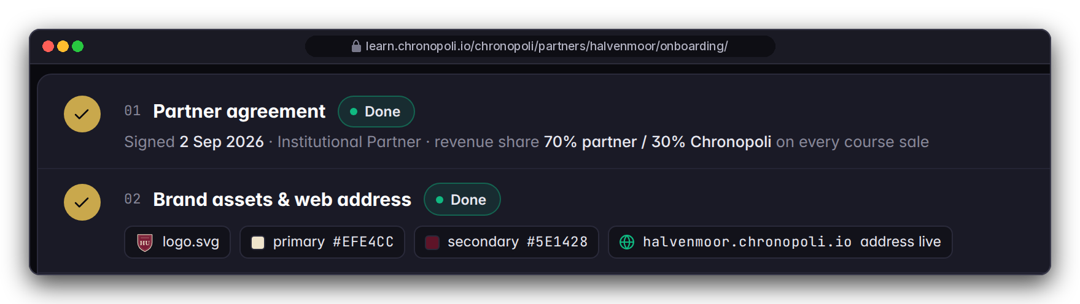
ONBOARDING · 90 DAYS FROM KICK-OFF
How onboarding works: your first 90 days
Day 0 = the kick-off date set in your partner agreement or pilot order. Content work runs in a preview while the platform completes its launch preparation
DAYS 0-30 · AGREE AND SET UP
DAYS 31-60 · BUILD
DAYS 61-90 · READY TO LAUNCH
Knowledge Partner
Agreement, tier and districts · brand assets and web address · payout account · HR notification e-mail · SMEs named
First track in course authoring · grading policy and certificate · pathway and badge criteria · content QA with the Chronopoli team · first round-table topic
Academy preview ready · job postings drafted · soft launch to your own audience
Enterprise team
Licence and seat list · roster and cohort · team admin named
Pathway choice · pilot cohort starts · first module completions tracked in the gradebook
First grade report reviewed with your team admin · environment and learner data: per pilot order
Platform go-live: after launch preparation; no calendar date committed
Where learners come from: your own channels first; in the city, the 5-question onboarding routes new learners to your district, plus community and round tables. No audience size is promised
Your effort: an executive sponsor, one academy admin (or team admin), SMEs to author or review each module, one content-QA cycle per track; time agreed in the workshop
DESIGN PROTOTYPE (NOT YET BUILT)
MOCK SCHEDULE · FICTITIOUS HALVENMOOR UNIVERSITY
Steps 01-02, not yet built · dates are a fictitious university's mock plan, not our commitment
Illustrative mock data · Tether is a partner-roadmap target only; no agreement implied · all other organisations and people are fictitious
24
Notes:
TALK TRACK: This is the project plan in one picture. Two lanes: partners on top, enterprise teams below, both counting from our kick-off. Answer reach before they ask: you bring your audience first; inside the city the 5-question onboarding sends new learners to your district, and the district community and round tables keep them. We don't promise audience numbers. Your effort: a sponsor, one admin, experts per module and one QA cycle; we estimate hours together in the workshop, not on a slide. The fictitious university on screen has two of six steps done, five of six experts confirmed and its first track 57% built. The dates on screen are that fictitious example's mock plan; we don't commit to a calendar go-live. ENTERPRISE: the pilot environment and what learner data may go into it are written into the pilot order; until data protection is hardened before launch we recommend pseudonymous usernames. OBJECTION: 'So when are we live?' ANSWER: After our launch preparation, and we'll give you a date as soon as it is fixed. Your content, brand and pathways will be ready in a preview, so you launch on day one of go-live.

Slide 25







TRUST BY DESIGN
Trust by design
Commitments built into the product and the launch plan. These are design commitments, not certifications
Human approval
IN THE PRODUCT
Chatham House
BY LAUNCH
Expert consent
BY LAUNCH
One human approves or rejects every AI-generated round-table output before it is published
Chatham House Rule sessions; removing attribution from outputs is fixed before launch
No voice or avatar twin without the expert's written consent (required before launch)
Candidate consent
BY LAUNCH
Open standards
IN THE PRODUCT
Always current
IN THE PRODUCT
No credential snapshot goes to partner HR without it (required before launch)
Open Badges 2.0 credentials; the platform’s standard grade reports as CSV
Platform improvements and security updates arrive with every release, at no extra cost
UAE hosting
BY LAUNCH
Private reports
BY LAUNCH
Scoped AI tutor
BY LAUNCH
Target: hosting in the UAE, with strict least-privilege access set up before launch
Learner grade files move from publicly reachable storage to private storage before launch
Answers cite sources, labelled a learning aid; per-partner scoping set up before launch
We hold no security certifications today. Our own security review logged 37 issues (6 critical, 18 high, 13 medium): 8 fixed, 3 partly fixed, 26 open, including 5 of the 6 critical items (one is the report storage above); 22 of the 26 are scheduled in the launch preparation. Summary available on request.
Every outside service (hosting, payments, AI; voice and avatar media only for consented twins) is listed in the data-processing terms.
Illustrative mock data · Tether is a partner-roadmap target only; no agreement implied · all other organisations and people are fictitious
25
Notes:
TALK TRACK: Regulators and banks buy trust first. Each tile is either in the product (the approval queue, Open Badges, standard reports, continuous upgrades) or a named commitment before launch (consent steps, attribution removal, private report storage, strict access rights, tutor scoping). We're open about status: our own security review logged 37 issues, 6 critical, 18 high and 13 medium. Eight are fixed and three partly fixed; 26 are open, including five critical ones, and one of those is learner grade files in publicly reachable storage. Of the 26 open, 22 are scheduled in the launch preparation and the rest are still being planned. We'd rather tell you than have you find it in due diligence. Every outside service we use is listed in the data-processing terms of the pilot order or partner agreement, so your procurement team gets the full list there. OBJECTION: 'Are you ISO 27001 or SOC 2 certified?' ANSWER: No, and we don't claim it; we're pre-launch. We can share the review summary and the security work planned before launch, and we'll answer your vendor due-diligence questionnaire against that plan.

Slide 26
OBJECTIONS
Questions buyers ask
Short answers; details in the partner agreement, the pilot order or on request
Is it live?
Will a regulator accept the evidence?
Support, SLA, term and exit?
Not yet: built, launch plan in place; join now as Founding Partner or pilot
Grade reports and Open Badges records as evidence; no regulator recognition claimed
Set in the pilot order / agreement; no SLA claimed; export + badge records on exit
What does it cost?
Can the partner see our staff's grades?
Academic credit? Language?
Academies $25K–$150K/yr; seats $1,500/yr ($125/month); 70/30 on course sales
Aggregates only; learner-level data needs consent (required before launch)
Granted by your institution, not the platform. English at launch; other languages on request
Who owns the content, and is it exclusive?
Learner data and contact?
Research use of round tables?
Standard, exportable course content; rights and exclusivity in the partner agreement
Consent + partner access model before launch; set in the agreement
Publication and attribution in the agreement; no automatic anonymity today
Can we use our brand?
Where does data live?
Who else is in?
Name, pathways, jobs today; colours, logo, web address before go-live
Hosted in the UAE (target); data protection hardened before launch
DBCC is the confirmed anchor; no partner signed (slide 19); Tether screens are illustrative
Illustrative mock data · Tether is a partner-roadmap target only; no agreement implied · all other organisations and people are fictitious
26
Notes:
TALK TRACK: Use this as the objection-handling slide. Invite the hardest question; if it isn't here, write it down and answer in writing. Never improvise a date, a fee, an SLA or a certification: the right answer is 'set in the partner agreement', 'set in the pilot order' or 'on request'. We don't list roadmap names on this slide: the exact statuses are on slide 19 (DBCC confirmed anchor, BUiD MOU in progress, Tether target partner). If asked, say no partner is signed. OBJECTION: 'Why commit before launch?' ANSWER: Founders set the first curricula and badge standards in their districts, host the first round tables and have their academy ready on launch day. The risk is bounded: a scoped agreement and a 90-day plan. OBJECTION: 'What happens if Chronopoli slips or doesn't launch?' ANSWER: Your content is standard course content that you authored and can export, badges follow an open standard, and go-live depends on the launch plan, not a marketing date.

Slide 27


NEXT STEP
Two ways to start
Hosted by Dubai Blockchain Center: help build the place where the digital economy learns
FOR KNOWLEDGE PARTNERS
FOR ENTERPRISE TEAMS
Founding Partner workshop
Pilot for 25 seats
Half a day, terms on request: choose your districts, first track and pathway, badge criteria and first round-table topic, and leave with your 90-day plan. Institutions: the workshop also drafts the governance, IP and research terms for your committee
Run one cohort on a pathway co-selected in the workshop from the courses available at pilot start, then review the first grade report together
25 seats at $1,500/seat/yr list
Term and catalogue in the pilot order
Districts + first track
Pathway + badge criteria
First round-table topic
Batch enrolment + cohort
Standard grade reports
Your 90-day plan
Institutions: governance, IP and research terms draft
Co-design the team-admin console
Next step: agree a workshop or pilot date, and name your sponsor and academy admin, or your team admin
Contact: partners@chronopoli.io · chronopoli.io/partners
Your account lead is named in the cover e-mail
Pre-launch · no go-live date committed · terms in the agreement or pilot order
Illustrative mock data · Tether is a partner-roadmap target only; no agreement implied · all other organisations and people are fictitious
27
Notes:
TALK TRACK: Close on one concrete next step, not on features. For a partner it's the workshop: it costs a morning and produces a plan they own; for a university it also produces the draft governance, IP and research terms the committee will ask for. For an enterprise team it's the 25-seat pilot, which matches the licence you've seen throughout; the term, the catalogue and the pathway go in the pilot order, and the pathway is chosen from what's available at pilot start. The pilot is priced at the list rate, $1,500 per seat per year ($125 a month). Which of the two fits you, and who else should be in the room? Then close on the statement on slide 28. Don't quote a discount or pilot price beyond the list price; workshop terms and anything else are on request. Leave behind the deck, the sample evidence CSV and, if asked, the security review summary. OBJECTION: 'We'll wait until you're live.' ANSWER: You can, but Founding Partners set the curriculum and badge standards for their district and host the first round tables, and those seats go to the partners who start now. OBJECTION: 'We need to take this internally first.' ANSWER: Of course. The workshop is the easiest way to give your stakeholders a concrete scope to decide on. RELEASE BLOCKER: partners@chronopoli.io and chronopoli.io/partners in the Contact box are placeholders; Dubai Blockchain Center confirms the live address before any external use of this deck. The account lead is named in the cover e-mail that sends this deck.

Slide 28
Chronopoli is not a better Coursera.
Not a smarter university.
It is a completely new architecture
where credentials are verifiable, content is AI-generated and regulation-linked, companies fund learning instead of students, and the degree is replaced by a dynamic professional record that follows you for life.
EMAIL
PLATFORM
HOSTED
ANCHOR
partners@chronopoli.io
learn.chronopoli.io (at go-live)
In the UAE
Dubai Blockchain Center
Pre-launch · September 2026 · © Chronopoli / Dubai Blockchain Center
28
Notes:
TALK TRACK: Chronopoli is not a better Coursera, and not a smarter university. It is a new architecture: credentials are verifiable, content is AI-generated and linked to regulation, companies fund learning instead of students, and the degree is replaced by a professional record that follows you for life. Pause, then hand over the contact details and the leave-behind. RELEASE BLOCKER: the e-mail and platform addresses are placeholders until Dubai Blockchain Center confirms them; learn.chronopoli.io is live only after go-live.

Slide 29
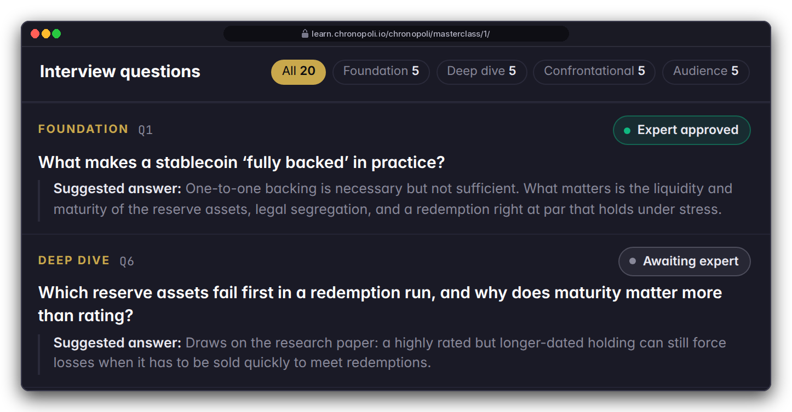
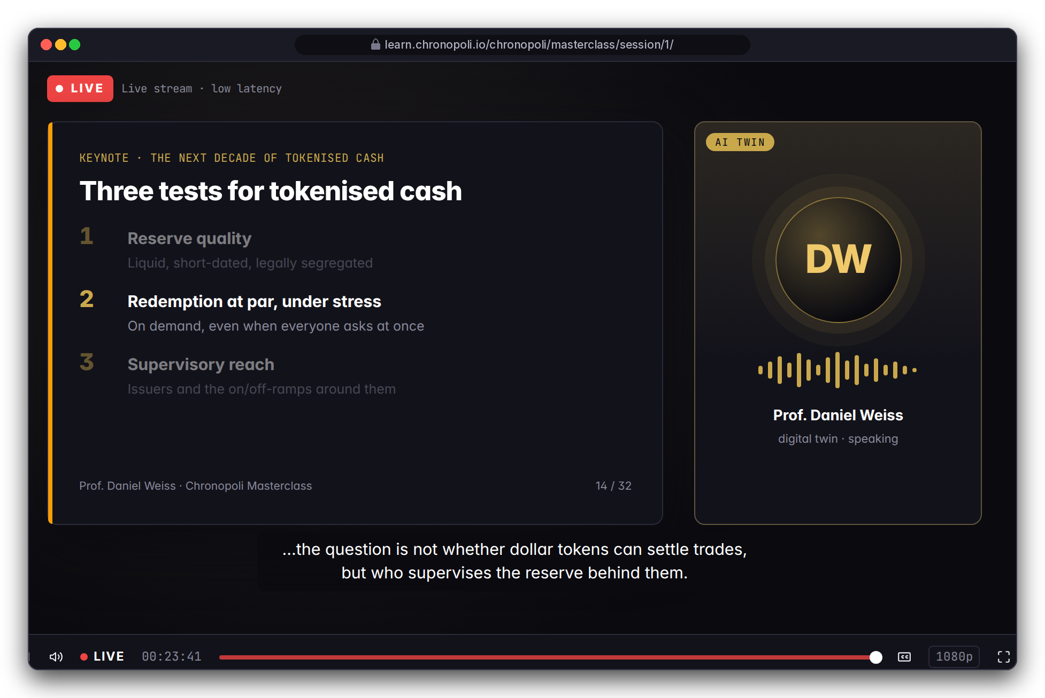
APPENDIX · LAST ROADMAP MILESTONE · ON REQUEST
PILLAR 03 · OPEN KNOWLEDGE
Scale your best expert with a digital-twin masterclass
Your expert's publications become an interview-style masterclass, only with the expert's written consent
DESIGN PROTOTYPE (NOT YET BUILT)
Right: live masterclass session design
Publications are analysed by AI, which drafts interview questions at four levels: foundation, deep dive, confrontational, audience
The expert reviews and approves the questions and suggested answers, and sets what's in and out of scope
AI voice and avatar only with written consent; consent, review and withdrawal are required before launch and not yet built; live sessions are designed
DESIGN PROTOTYPE (NOT YET BUILT)
Left: first 2 of 20 interview questions drafted for Prof. Daniel Weiss's twin, awaiting expert review
The expert is fictitious
Illustrative mock data · Tether is a partner-roadmap target only; no agreement implied · all other organisations and people are fictitious
29
Notes:
BACKUP SLIDE, show only if asked. TALK TRACK: Your best people can't be in every room. A twin lets a chief economist or head of investigations run an L4-style masterclass without flying in, and the expert stays in control of the content. Be precise about status: this is the last roadmap milestone; the pages are prototypes; consent, review and withdrawal are design rules required before launch, not features in the product today. Likeness and voice rights, and withdrawal when an expert leaves, are set in the expert's consent and the partner agreement. For a university audience treat this as optional; academic freedom and likeness rights make it the most sensitive item. OBJECTION: 'Our expert won't want a deepfake.' ANSWER: Then there's no voice or avatar. The same document analysis and question bank can support a live session with the real expert. OBJECTION: 'Reputation risk if the twin says something wrong?' ANSWER: It works from the expert's own documents, with approved questions and marked out-of-scope topics, and the expert signs off before it goes live.

