Slide 1
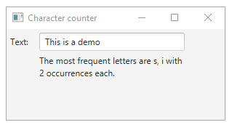
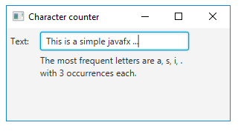

Slide 2
Details of your solution
Logic:
Count letters using HashMap<Character, Integer> (letter, count)
Find the letter with largest count
Filter entries from HashMap with counter less than max
Generate Output

Slide 3
Technical approaches you did
Used Java 8 to build this app
The Sceene Builder for GUI + manually removing unnecessary parts
Controller class that listen to GUI events and execute Model methods
Model where the the counting + output generating happens
Tests for Model classes created using Junit 5.4

Slide 4
Problems that you had
Java 11 does not include JavaFX
Sceene Builder does not work with JavaFX 11+ on Intellij 2019.2 (DIE)
Could not find Maven config for JavaFX which would correctly generate JAR

