Slide 1
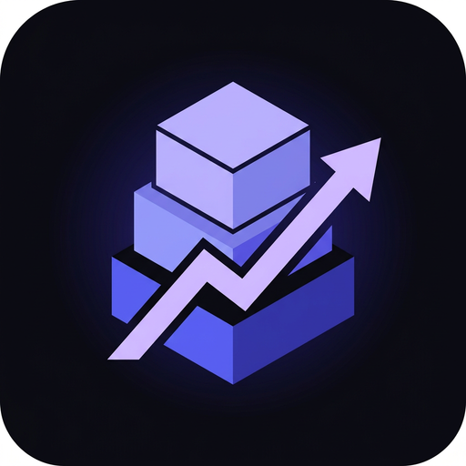
Logixia
STOCK MANAGEMENT · IN REAL TIME
Overview
All your store's
inventory
in one place.
128,450 RSD
34
128
Revenue +12.4%
Sales
Products
Track stock levels, receive goods, analyse movements and export reports — for you and your team.
Last 7 days
New sale
Store · +1,980 RSD
Free to start
No installation
Works on your phone
Interface preview
Start for free →
crm-inventory-chi.vercel.app

Slide 2
Everything your store needs
From the first product to clear reports.
01
02
03
Products and stock
Receiving goods
Sales and reversals
Categories, images, SKUs, prices, variants and custom fields — all in one place.
Search or scan barcodes; stock levels update immediately.
Sales by customer and channel, automatic stock and easy reversal.
04
05
06
Orders and customers
Public catalog
Analytics and reports
Order statuses, partial fulfilment and customer conversations.
Share the link on Instagram; customers pick variants and order or ask.
Stock, sales, revenue and top products; import, export and PDF reports.
ALSO INCLUDED
Barcode scanning · Audit log · Team and permissions · 6 languages · Dark and light theme
Logixia · crm-inventory-chi.vercel.app

Slide 3
How it works
From first setup to a clear view of your business — in three steps.
01
02
03
Create your store
Add your products
Track your results
Sign up with Google and get your Shop ID right away.
Enter products, receive stock and connect your team in a few clicks.
Sell, scan and follow revenue and stock through clear reports.
READY TO START
Open your store today.
Start for free →
Registration is free. No installation — it works on your phone.
crm-inventory-chi.vercel.app
Logixia · Stock management in real time
03 / 03

