Slide 1

On-ground phenomena study using Satellite Data
A. Crivcianschi
C. - I. Moisă
T. - H. Vâtcă

Slide 2

Research Problem
Problem: On-ground measurement is accurate, but expensive (expensive equipment, maitenance, etc.).
Solution: Analytical aproximation using remote satellite data and statistical correspondention.

Slide 3

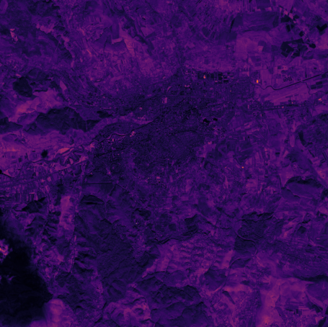
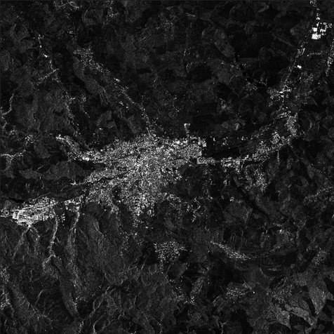
Architecture overview
Satellite Imagery source: Copernicus Data Space Ecosystem API
Used data set: Sentinel-2 L2A, etc.
Implementation using CV in Python

Slide 4
Current approach
Alternative
Methodology: Weekly site visits by a team of 3 engineers to manually take measurements.
Labor: 3 Engineers x 1 day/week x 52 weeks x €200/day = €20,800
Logistics: for 52 trips = €5,200
Equipment Maintenance: Calibration of sensors = €1,500
Total Annual Cost: €27,500
Methodology: Automated processing satellite images.
Labor (OPEX): 1 Data Analyst x 2 hours/week x 52 weeks = €2,600
Cloud Infrastructure: Storage for Historical Data Cubes + Computing Power = €1,200
Targeted Verification: Estimated 4 "Red Flag" deployments per year (instead of 52) = €1,600
Total Annual Cost: €5,400

Slide 5


Data Processing
improvements
Raw Data Acquisition
Gradient Analysis
Output Map
.tiff
| ∇ ∙ f |
011011010111...

Slide 6
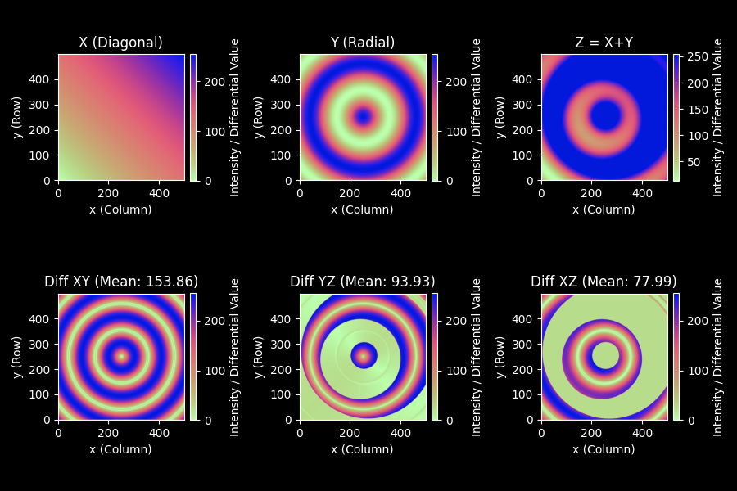
Proof of concept
Results using synthetic input bitmaps:

Slide 7
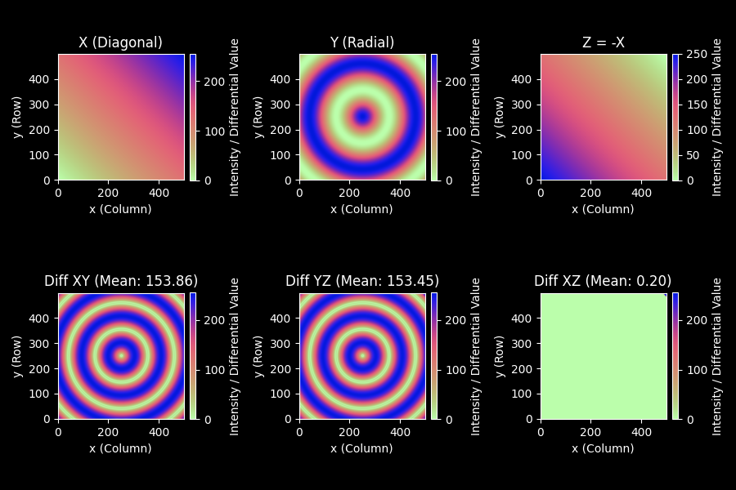

Slide 8
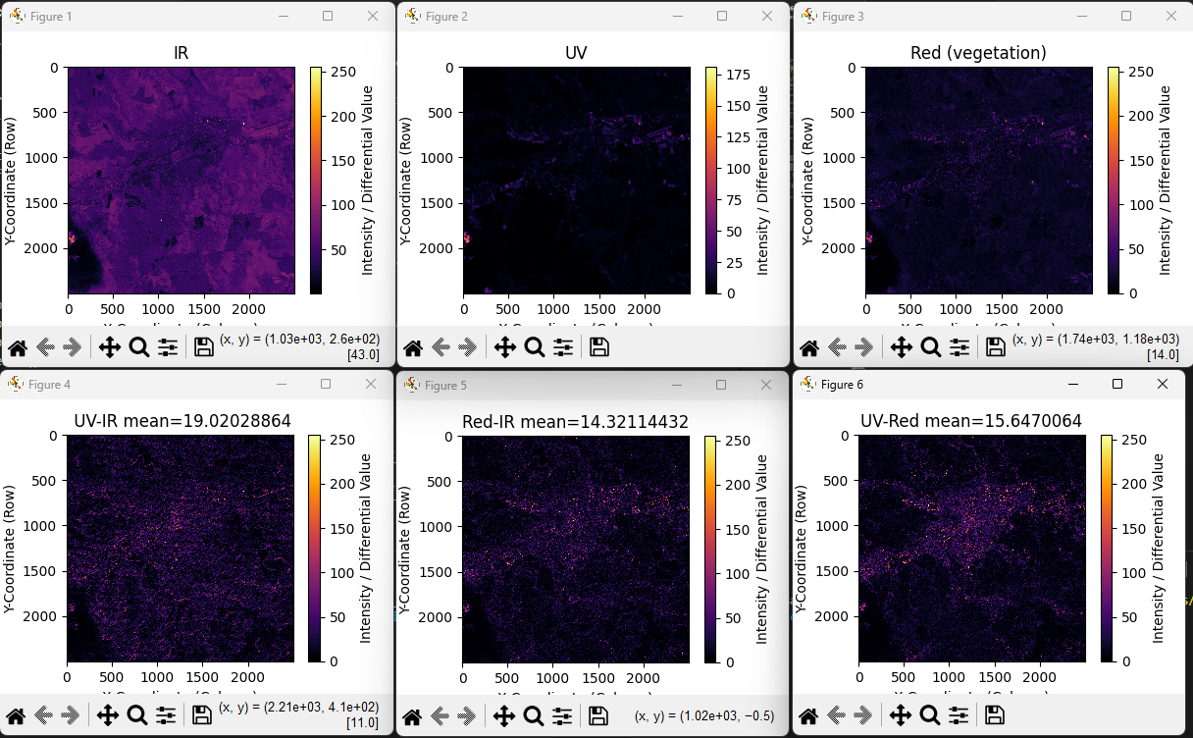

Slide 9
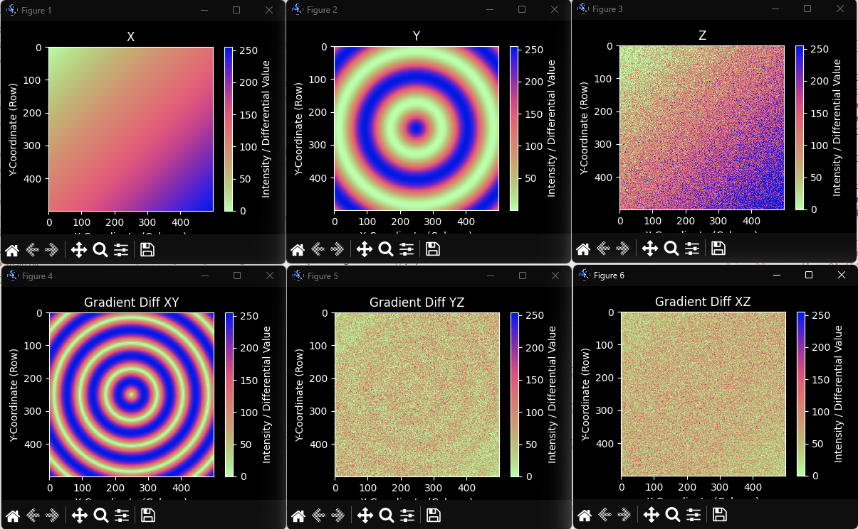
Limitations

Slide 10
SWOT analysis
S
Drastic Cost Reduction
Operational Scalability
Custom Dataset Flexibility
O
Request for cost-effective, low-computational-power solutions for Ecological Monitoring
W
High Noise Sensivity
T
API Dependency & Limits
Limited National Space Infrastructure

Slide 11
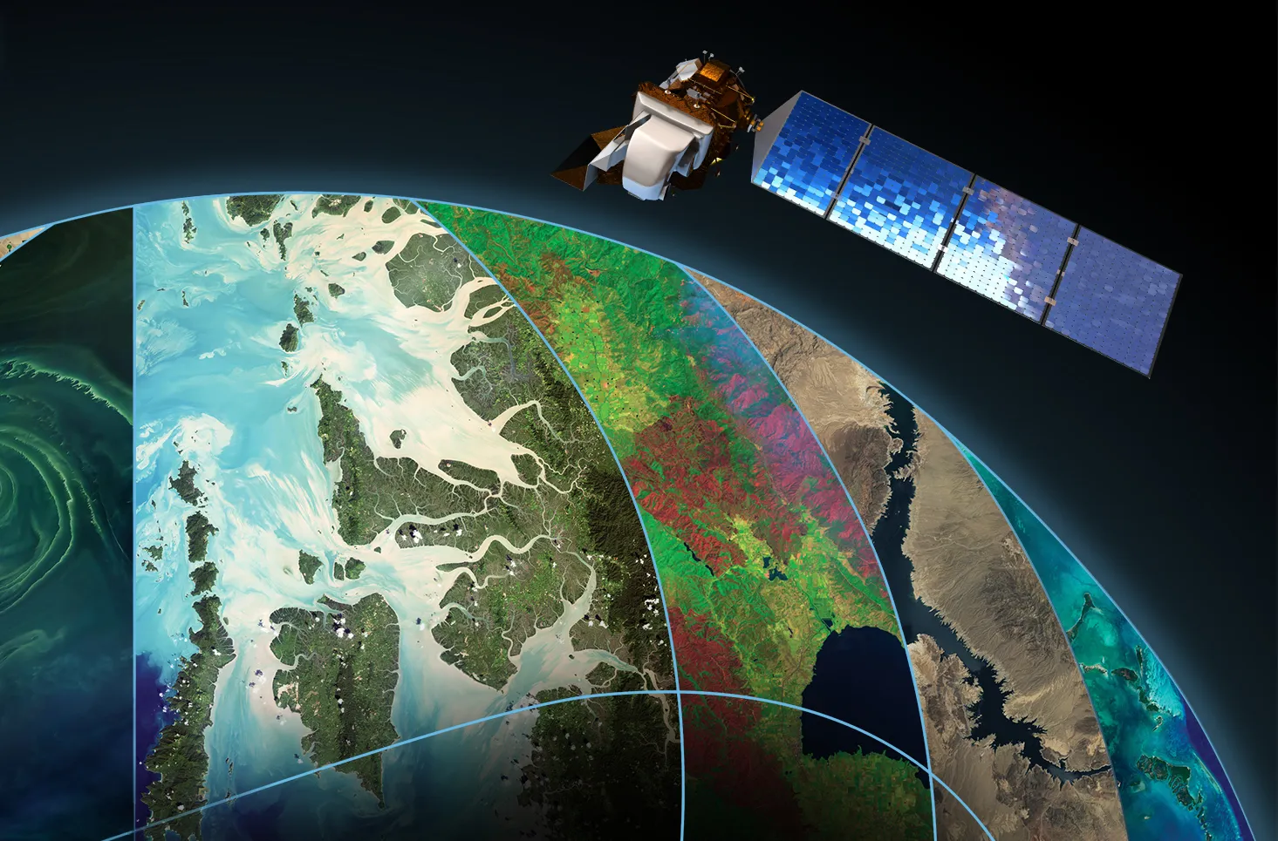
Conclusion
Statistical Validation
Cost Reduction: an ~80% reduction in annual operational costs
Scalability: One-time R&D investment
Efficiency: from spot checks to continuous monitoring.

Slide 12
References:
Koeppen et al. (2011): The Statistical Backbone
Methodology: Establishes the "Hybrid Time Series" approach, combining standard thresholding with robust statistical analysis of historical data.
Validation: Provides the mathematical framework (the ALICE Index) to validate our gradient analysis against a historical baseline.
Significance: Ensures that detected "edges" are statistically significant outliers rather than random sensor noise or cloud cover.
Zhou et al. (2016): Pattern Verification
Methodology: Utilizes "Seasonal Autocorrelation" to analyze the predictable rhythm of seasonal changes.
False Positive Reduction: Critical for distinguishing between "natural" gradients (like a seasonally warming coastline) and "disruptive" gradients (like industrial heat sources).
Pattern Breaking: Confirms that a detected signal is a true break in the established temporal pattern, rather than just a temporary intensity spike.
Project Repository:
https://github.com/SchnederIT/statistical_corr_on_sat_data/tree/dev

