Slide 1
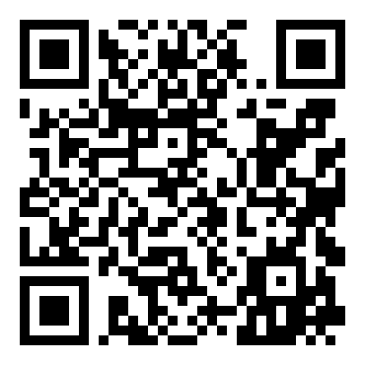
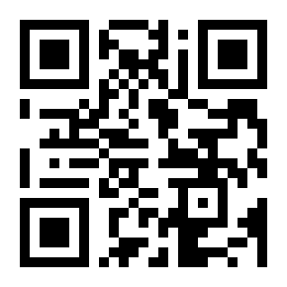
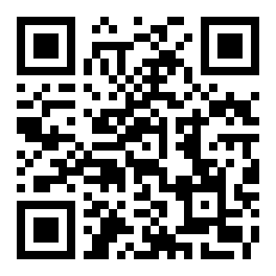
Poco — Preserve Originals, Conceal Only
Privacy-first PII anonymisation for LLM workflows, with a fully automated multi-environment DevOps pipeline
SWE40006 Software Deployment and Evolution | Group CL01_G01 | Tutorial: Wednesday 10:30 | Jamie Soo (104559690) · Timothy Schabel (105334128) · Sahil (105295665)
20 / 43
PII labels viable for training
8
labels with zero validation instances
2.4×
more tokens per character for Chinese
73:1
class imbalance (GIVENNAME : TIME)
99.99%
of annotations in viable labels
Repository
github.com/Schnitze1/SWE40006-Group-Project
Live Demo
littlepoco.me
Full EDA Report
Scan for full-corpus analysis
Poco — Preserve Originals, Conceal Only | SWE40006 Software Deployment and Evolution | Group CL01_G01 | October 2026

