Slide 1
VUEX
Christopher Praas
10.12.2018

Slide 2



Slide 3
Vuex = State Management Pattern + Library

Slide 4

State Managment
Props
Events

Slide 5
State Managment
Vuex
Props
Events

Slide 6
Vuex
Updates State
Receives new State

Slide 7
Vue components
Vuex store
const app = new Vue({
})
const store = new Vuex.store({
})
data: { … },
state: { … },
actions: { … },
methods: { … },
mutations: { … },
computed: { … }
getters: { … }
const store = new Vuex.store({
state: { … },
actions: { … },
getters: { … }
})
const app = new Vue({
data: { … },
methods: { … },
computed: { … }
})

Slide 8
const store = new Vuex.store({
state: {
todos: [
{ id: 1, text: “…“, done: false },
{ id: 2, text: “…“, done: true },
{ id: 3, text: “…“, done: true }
]
},
Getters: {
doneTodos(state) {
return state.todos.filter(todo => todo.done)
}
}
})

Slide 9
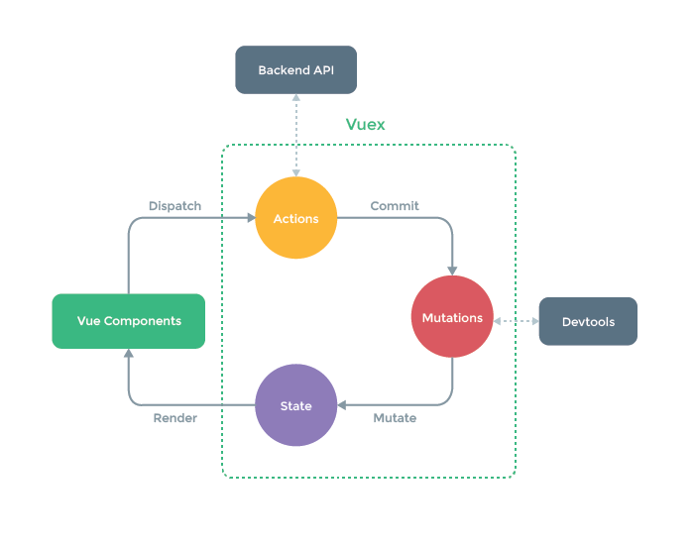
Getters

Slide 10
Wann sollte man es benutzen?
„Flux libraries are like glasses: you‘ll know when you need them.“

Slide 11
Live Beispiel
https://github.com/Schnitzel128/PBO-Vue

Slide 12
return this.$store.getters.doneVortrag
Vuehu²!

