Slide 1
MEMORY OPTIMIZATION
Christer Ericson
Sony Computer Entertainment, Santa Monica
(christer_ericson@playstation.sony.com)

Slide 2
Talk contents 1/2
Problem statement
  Why “memory optimization?”
Brief architecture overview
  The memory hierarchy
Optimizing for (code and) data cache
  General suggestions
  Data structures
    Prefetching and preloading
    Structure layout
    Tree structures
    Linearization caching
…

Slide 3
Talk contents 2/2
…
Aliasing
  Abstraction penalty problem
  Alias analysis (type-based)
  ‘restrict’ pointers
  Tips for reducing aliasing

Slide 4
Problem statement
For the last 20-something years…
  CPU speeds have increased ~60%/year
  Memory speeds only decreased ~10%/year
Gap covered by use of cache memory
Cache is under-exploited
  Diminishing returns for larger caches
Inefficient cache use = lower performance
  How increase cache utilization? Cache-awareness!

Slide 5
Need more justification? 1/3
Instruction parallelism:
SIMD instructions consume
data at 2-8 times the rate
of normal instructions!

Slide 6
Need more justification? 2/3
Proebsting’s law:
Improvements to
compiler technology
double program performance
every ~18 years!
Corollary: Don’t expect the compiler to do it for you!

Slide 7
Need more justification? 3/3
On Moore’s law:
Consoles don’t follow it (as such)
  Fixed hardware
  2nd/3rd generation titles must get improvements from somewhere

Slide 8
Brief cache review
Caches
  Code cache for instructions, data cache for data
  Forms a memory hierarchy
Cache lines
  Cache divided into cache lines of ~32/64 bytes each
  Correct unit in which to count memory accesses
Direct-mapped
  For n KB cache, bytes at k, k+n, k+2n, … map to same cache line
N-way set-associative
  Logical cache line corresponds to N physical lines
  Helps minimize cache line thrashing

Slide 9
The memory hierarchy
Roughly:
CPU
1 cycle
L1 cache
~1-5 cycles
L2 cache
~5-20 cycles
Main memory
~40-100 cycles

Slide 10
Some cache specs
 | L1 cache (I/D) | L2 cache
PS2 | 16K/8K† 2-way | N/A
GameCube | 32K/32K‡ 8-way | 256K 2-way unified
XBOX | 16K/16K 4-way | 128K 8-way unified
PC | ~32-64K | ~128-512K
†16K data scratchpad important part of design
‡configurable as 16K 4-way + 16K scratchpad

Slide 11
Foes: 3 C’s of cache misses
Compulsory misses
  Unavoidable misses when data read for first time
Capacity misses
  Not enough cache space to hold all active data
  Too much data accessed inbetween successive use
Conflict misses
  Cache thrashing due to data mapping to same cache lines

Slide 12
Friends: Introducing the 3 R’s
Rearrange (code, data)
  Change layout to increase spatial locality
Reduce (size, # cache lines read)
  Smaller/smarter formats, compression
Reuse (cache lines)
  Increase temporal (and spatial) locality
 | Compulsory | Capacity | Conflict
Rearrange | X | (x) | X
Reduce | X | X | (x)
Reuse | (x) | X

Slide 13
Measuring cache utilization
Profile
  CPU performance/event counters
    Give memory access statistics
    But not access patterns (e.g. stride)
  Commercial products
    SN Systems’ Tuner, Metrowerks’ CATS, Intel’s VTune
  Roll your own
    In gcc ‘-p’ option + define _mcount()
    Instrument code with calls to logging class
  Do back-of-the-envelope comparison
Study the generated code

Slide 14
Code cache optimization 1/2
Locality
  Reorder functions
    Manually within file
    Reorder object files during linking (order in makefile)
    __attribute__ ((section ("xxx"))) in gcc
  Adapt coding style
    Monolithic functions
    Encapsulation/OOP is less code cache friendly
  Moving target
  Beware various implicit functions (e.g. fptodp)

Slide 15
Code cache optimization 2/2
Size
  Beware: inlining, unrolling, large macros
  KISS
    Avoid featuritis
    Provide multiple copies (also helps locality)
  Loop splitting and loop fusion
  Compile for size (‘-Os’ in gcc)
  Rewrite in asm (where it counts)
Again, study generated code
  Build intuition about code generated

Slide 16
Data cache optimization
Lots and lots of stuff…
  “Compressing” data
  Blocking and strip mining
  Padding data to align to cache lines
  Plus other things I won’t go into
What I will talk about…
  Prefetching and preloading data into cache
  Cache-conscious structure layout
  Tree data structures
  Linearization caching
  Memory allocation
  Aliasing and “anti-aliasing”

Slide 17
Prefetching and preloading
Software prefetching
  Not too early – data may be evicted before use
  Not too late – data not fetched in time for use
  Greedy
Preloading (pseudo-prefetching)
  Hit-under-miss processing

Slide 18
Software prefetching
// Loop through and process all 4n elements for (int i = 0; i < 4 * n; i++) Process(elem[i]);
const int kLookAhead = 4; // Some elements ahead for (int i = 0; i < 4 * n; i += 4) { Prefetch(elem[i + kLookAhead]); Process(elem[i + 0]); Process(elem[i + 1]); Process(elem[i + 2]); Process(elem[i + 3]); }

Slide 19
Greedy prefetching
void PreorderTraversal(Node *pNode) { // Greedily prefetch left traversal path Prefetch(pNode->left); // Process the current node Process(pNode); // Greedily prefetch right traversal path Prefetch(pNode->right); // Recursively visit left then right subtree PreorderTraversal(pNode->left); PreorderTraversal(pNode->right); }

Slide 20
Preloading (pseudo-prefetch)
Elem a = elem[0]; for (int i = 0; i < 4 * n; i += 4) { Elem e = elem[i + 4]; // Cache miss, non-blocking Elem b = elem[i + 1]; // Cache hit Elem c = elem[i + 2]; // Cache hit Elem d = elem[i + 3]; // Cache hit Process(a); Process(b); Process(c); Process(d); a = e; }
(NB: This code reads one element beyond the end of the elem array.)

Slide 21
Structures
Cache-conscious layout
  Field reordering (usually grouped conceptually)
  Hot/cold splitting
Let use decide format
  Array of structures
  Structures of arrays
Little compiler support
  Easier for non-pointer languages (Java)
  C/C++: do it yourself

Slide 22
Field reordering
struct S { void *key; int count[20]; S *pNext; };
struct S { void *key; S *pNext; int count[20]; };
void Foo(S *p, void *key, int k) { while (p) { if (p->key == key) { p->count[k]++; break; } p = p->pNext; } }
Likely accessed together so store them together!

Slide 23
Hot/cold splitting
Hot fields:
Cold fields:
struct S { void *key; S *pNext; S2 *pCold; };
struct S2 { int count[10]; };
Allocate all ‘struct S’ from a memory pool
  Increases coherence
Prefer array-style allocation
  No need for actual pointer to cold fields

Slide 24
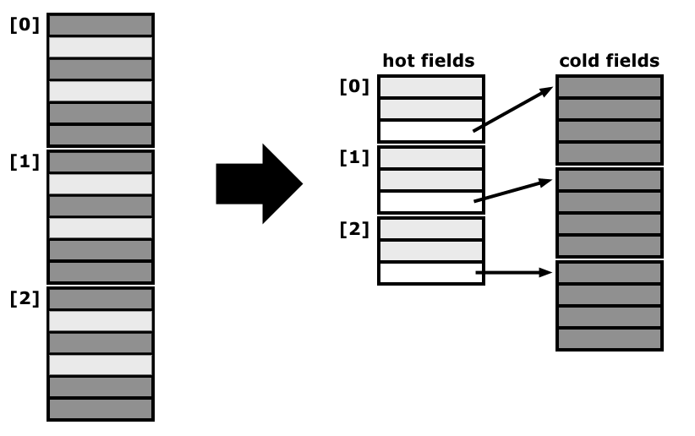
Hot/cold splitting

Slide 25
Beware compiler padding
struct X { int8 a; int64 b; int8 c; int16 d; int64 e; float f; };
struct Y { int8 a, pad_a[7]; int64 b; int8 c, pad_c[1]; int16 d, pad_d[2]; int64 e; float f, pad_f[1]; };
Decreasing size!
struct Z { int64 b; int64 e; float f; int16 d; int8 a; int8 c; };
Assuming 4-byte floats, for most compilers sizeof(X) == 40, sizeof(Y) == 40, and sizeof(Z) == 24.

Slide 26
Cache performance analysis
Usage patterns
  Activity – indicates hot or cold field
  Correlation – basis for field reordering
Logging tool
  Access all class members through accessor functions
  Manually instrument functions to call Log() function
  Log() function…
    takes object type + member field as arguments
    hash-maps current args to count field accesses
    hash-maps current + previous args to track pairwise accesses

Slide 27
Tree data structures
Rearrange nodes
  Increase spatial locality
  Cache-aware vs. cache-oblivious layouts
Reduce size
  Pointer elimination (using implicit pointers)
  “Compression”
    Quantize values
    Store data relative to parent node

Slide 28
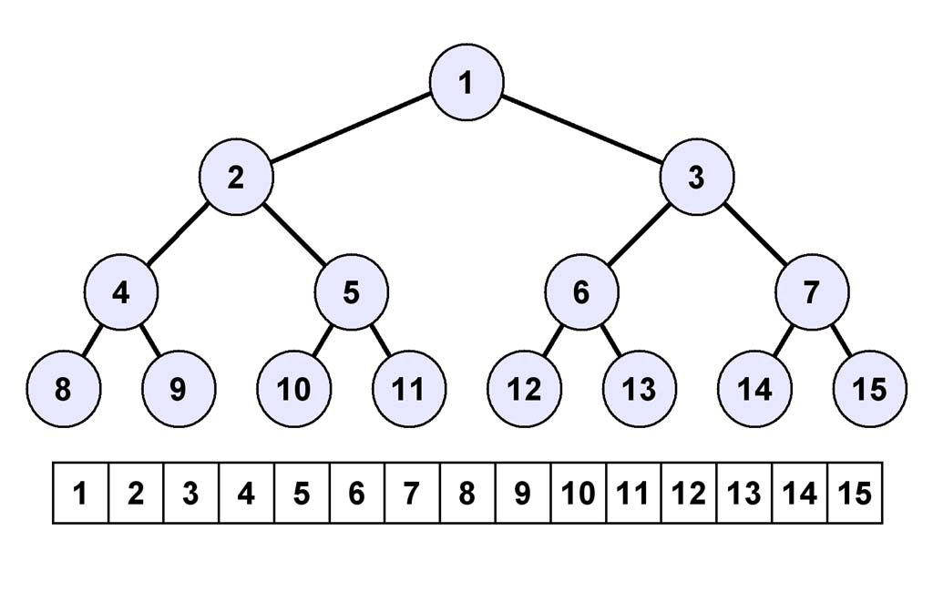
Breadth-first order
Pointer-less: Left(n)=2n, Right(n)=2n+1
Requires storage for complete tree of height H

Slide 29
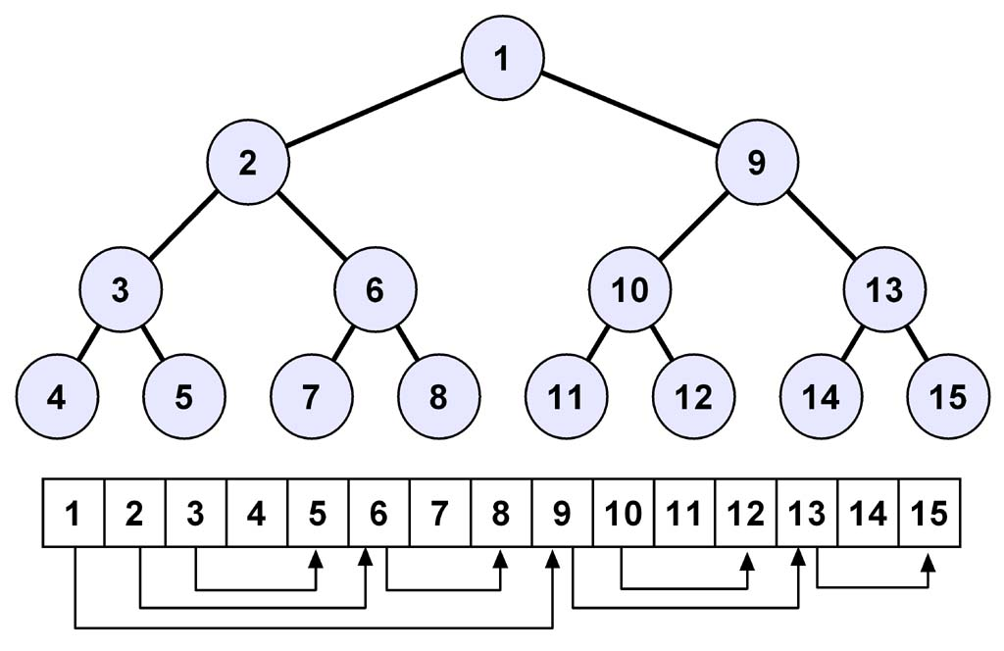
Depth-first order
Left(n) = n + 1, Right(n) = stored index
Only stores existing nodes

Slide 30
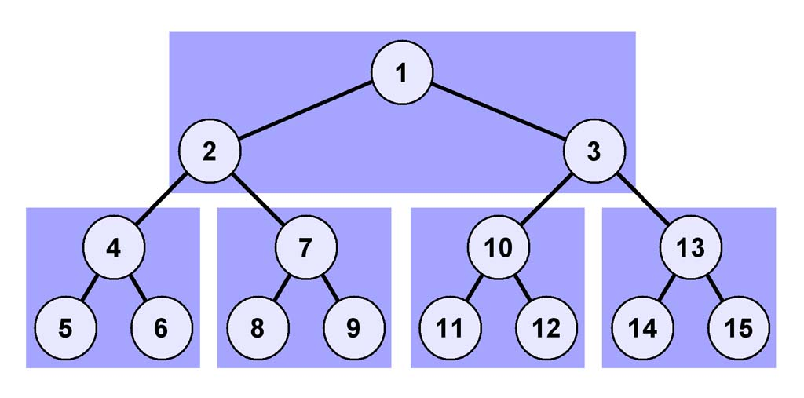
van Emde Boas layout
“Cache-oblivious”
Recursive construction

Slide 31
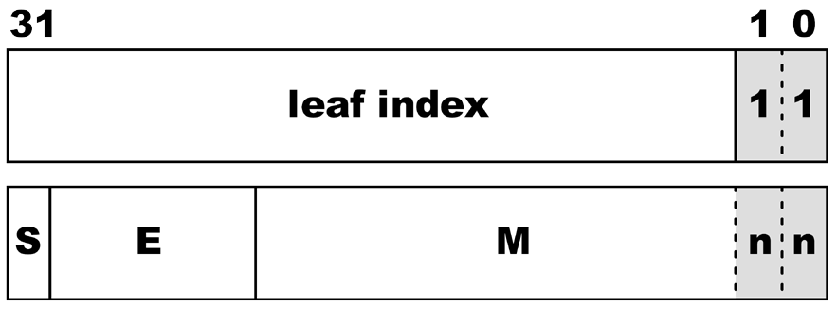
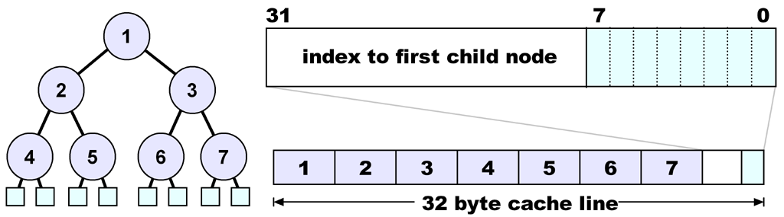
A compact static k-d tree
union KDNode {
// leaf, type 11
int32 leafIndex_type;
// non-leaf, type 00 = x,
// 01 = y, 10 = z-split
float splitVal_type;
};

Slide 32
Linearization caching
Nothing better than linear data
  Best possible spatial locality
  Easily prefetchable
So linearize data at runtime!
  Fetch data, store linearized in a custom cache
  Use it to linearize…
    hierarchy traversals
    indexed data
    other random-access stuff

Slide 33
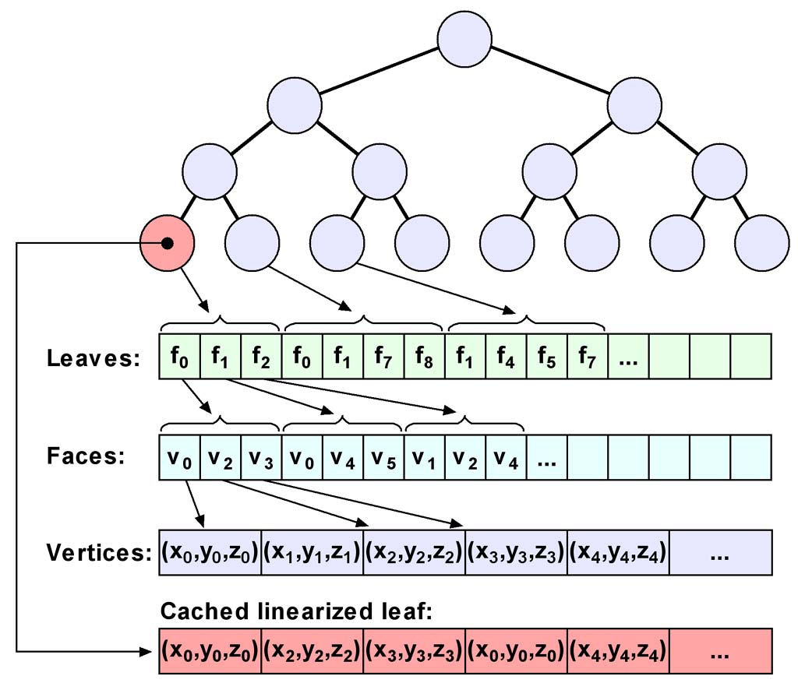

Slide 34
Memory allocation policy
Don’t allocate from heap, use pools
  No block overhead
  Keeps data together
  Faster too, and no fragmentation
Free ASAP, reuse immediately
  Block is likely in cache so reuse its cachelines
  First fit, using free list

Slide 35
The curse of aliasing
Aliasing is multiple
references to the
same storage location
What is aliasing?
int n; int *p1 = &n; int *p2 = &n;
Aliasing is also missed opportunities for optimization
What value is
returned here?
Who knows!
int Foo(int *a, int *b) { *a = 1; *b = 2; return *a; }

Slide 36
The curse of aliasing
What is causing aliasing?
  Pointers
  Global variables/class members make it worse
What is the problem with aliasing?
  Hinders reordering/elimination of loads/stores
    Poisoning data cache
    Negatively affects instruction scheduling
    Hinders common subexpression elimination (CSE), loop-invariant code motion, constant/copy propagation, etc.

Slide 37
How do we do ‘anti-aliasing’?
What can be done about aliasing?
  Better languages
    Less aliasing, lower abstraction penalty†
  Better compilers
    Alias analysis such as type-based alias analysis†
  Better programmers (aiding the compiler)
    That’s you, after the next 20 slides!
  Leap of faith
    -fno-aliasing
† To be defined

Slide 38
Matrix multiplication 1/3
Consider optimizing a 2x2 matrix multiplication:
Mat22mul(float a[2][2], float b[2][2], float c[2][2]){ for (int i = 0; i < 2; i++) { for (int j = 0; j < 2; j++) { a[i][j] = 0.0f; for (int k = 0; k < 2; k++) a[i][j] += b[i][k] * c[k][j]; } } }
How do we typically optimize it? Right, unrolling!

Slide 39
Matrix multiplication 2/3
Staightforward unrolling results in this:
// 16 memory reads, 4 writes Mat22mul(float a[2][2], float b[2][2], float c[2][2]){ a[0][0] = b[0][0]*c[0][0] + b[0][1]*c[1][0]; a[0][1] = b[0][0]*c[0][1] + b[0][1]*c[1][1]; //(1) a[1][0] = b[1][0]*c[0][0] + b[1][1]*c[1][0]; //(2) a[1][1] = b[1][0]*c[0][1] + b[1][1]*c[1][1]; //(3) }
But wait! There’s a hidden assumption! a is not b or c!
Compiler doesn’t (cannot) know this!
  (1) Must refetch b[0][0] and b[0][1]
  (2) Must refetch c[0][0] and c[1][0]
  (3) Must refetch b[0][0], b[0][1], c[0][0] and c[1][0]

Slide 40
Matrix multiplication 3/3
A correct approach is instead writing it as:
// 8 memory reads, 4 writes Mat22mul(float a[2][2], float b[2][2], float c[2][2]){ float b00 = b[0][0], b01 = b[0][1]; float b10 = b[1][0], b11 = b[1][1]; float c00 = c[0][0], c01 = c[0][1]; float c10 = c[1][0], c11 = c[1][1]; a[0][0] = b00*c00 + b01*c10; a[0][1] = b00*c01 + b01*c11; a[1][0] = b10*c00 + b11*c10; a[1][1] = b10*c01 + b11*c11; }
Consume
inputs…
…before
producing
outputs

Slide 41
Abstraction penalty problem
Higher levels of abstraction have a negative effect on optimization
  Code broken into smaller generic subunits
  Data and operation hiding
    Cannot make local copy of e.g. internal pointers
    Cannot hoist constant expressions out of loops
Especially because of aliasing issues

Slide 42
C++ abstraction penalty
Lots of (temporary) objects around
  Iterators
  Matrix/vector classes
Objects live in heap/stack
  Thus subject to aliasing
  Makes tracking of current member value very difficult
  But tracking required to keep values in registers!
Implicit aliasing through the this pointer
  Class members are virtually as bad as global variables

Slide 43
C++ abstraction penalty
Pointer members in classes may alias other members:
numVals not a
local variable!
class Buf { public: void Clear() { for (int i = 0; i < numVals; i++) pBuf[i] = 0; } private: int numVals, *pBuf; }
May be
aliased
by pBuf!
Code likely to refetch numVals each iteration!

Slide 44
C++ abstraction penalty
We know that aliasing won’t happen, and can
manually solve the aliasing issue by writing code as:
class Buf { public: void Clear() { for (int i = 0, n = numVals; i < n; i++) pBuf[i] = 0; } private: int numVals, *pBuf; }

Slide 45
C++ abstraction penalty
Since pBuf[i] can only alias numVals in the first
iteration, a quality compiler can fix this problem by
peeling the loop once, turning it into:
void Clear() { if (numVals >= 1) { pBuf[0] = 0; for (int i = 1, n = numVals; i < n; i++) pBuf[i] = 0; } }
Q: Does your compiler do this optimization?!

Slide 46

Type-based alias analysis
Some aliasing the compiler can catch
  A powerful tool is type-based alias analysis
Use language types to disambiguate memory references!

Slide 47
Type-based alias analysis
ANSI C/C++ states that…
  Each area of memory can only be associated with one type during its lifetime
  Aliasing may only occur between references of the same compatible type
Enables compiler to rule out aliasing between references of non-compatible type
  Turned on with –fstrict-aliasing in gcc

Slide 48
Compatibility of C/C++ types
In short…
  Types compatible if differing by signed, unsigned, const or volatile
  char and unsigned char compatible with any type
  Otherwise not compatible
(See standard for full details.)

Slide 49
What TBAA can do for you
It can turn this:
void Foo(float *v, int *n) { for (int i = 0; i < *n; i++) v[i] += 1.0f; }
Possible aliasing
between
v[i] and *n
into this:
void Foo(float *v, int *n) { int t = *n; for (int i = 0; i < t; i++) v[i] += 1.0f; }
No aliasing possible
so fetch *n once!

Slide 50
What TBAA can also do
Cause obscure bugs in non-conforming code!
  Beware especially so-called “type punning”
uint32 i; float f; i = *((uint32 *)&f);
uint32 i; union { float f; uint32 i; } u; u.f = f; i = u.i;
uint32 i; union { float f; uchar8 c[4]; } u; u.f = f; i = (u.c[3]<<24L)+ (u.c[2]<<16L)+ ...;
Illegal
C/C++ code!
Allowed
By gcc
Required
by standard

Slide 51
Restrict-qualified pointers
restrict keyword
  New to 1999 ANSI/ISO C standard
  Not in C++ standard yet, but supported by many C++ compilers
  A hint only, so may do nothing and still be conforming
A restrict-qualified pointer (or reference)…
  …is basically a promise to the compiler that for the scope of the pointer, the target of the pointer will only be accessed through that pointer (and pointers copied from it).
  (See standard for full details.)

Slide 52
Using the restrict keyword
Given this code:
void Foo(float v[], float *c, int n) { for (int i = 0; i < n; i++) v[i] = *c + 1.0f; }
You really want the compiler to treat it as if written:
void Foo(float v[], float *c, int n) { float tmp = *c + 1.0f; for (int i = 0; i < n; i++) v[i] = tmp; }
But because of possible aliasing it cannot!

Slide 53
Using the restrict keyword
For example, the code might be called as:
float a[10]; a[4] = 0.0f; Foo(a, &a[4], 10);
giving for the first version:
v[] = 1, 1, 1, 1, 1, 2, 2, 2, 2, 2
and for the second version:
v[] = 1, 1, 1, 1, 1, 1, 1, 1, 1, 1
The compiler must be conservative, and
cannot perform the optimization!

Slide 54
Solving the aliasing problem
The fix? Declaring the output as restrict:
void Foo(float * restrict v, float *c, int n) { for (int i = 0; i < n; i++) v[i] = *c + 1.0f; }
Alas, in practice may need to declare both pointers restrict!
  A restrict-qualified pointer can grant access to non-restrict pointer
  Full data-flow analysis required to detect this
  However, two restrict-qualified pointers are trivially non-aliasing!
  Also may work declaring second argument as “float * const c”

Slide 55
‘const’ doesn’t help
Some might think this would work:
void Foo(float v[], const float *c, int n) { for (int i = 0; i < n; i++) v[i] = *c + 1.0f; }
Since *c is const, v[i] cannot write to it, right?
Wrong! const promises almost nothing!
  Says *c is const through c, not that *c is const in general
  Can be cast away
  For detecting programming errors, not fixing aliasing

Slide 56
SIMD + restrict = TRUE
restrict enables SIMD optimizations
void VecAdd(int *a, int *b, int *c) { for (int i = 0; i < 4; i++) a[i] = b[i] + c[i]; }
Stores may alias loads.
Must perform operations
sequentially.
void VecAdd(int * restrict a, int *b, int *c) { for (int i = 0; i < 4; i++) a[i] = b[i] + c[i]; }
Independent loads and
stores. Operations can
be performed in parallel!

Slide 57
Restrict-qualified pointers
Important, especially with C++
  Helps combat abstraction penalty problem
But beware…
  Tricky semantics, easy to get wrong
  Compiler won’t tell you about incorrect use
  Incorrect use = slow painful death!

Slide 58
Tips for avoiding aliasing
Minimize use of globals, pointers, references
  Pass small variables by-value
  Inline small functions taking pointer or reference arguments
Use local variables as much as possible
  Make local copies of global and class member variables
Don’t take the address of variables (with &)
restrict pointers and references
Declare variables close to point of use
Declare side-effect free functions as const
Do manual CSE, especially of pointer expressions

Slide 59
That’s it! – Resources 1/2
Ericson, Christer. Real-time collision detection. Morgan-Kaufmann, 2005. (Chapter on memory optimization)
Mitchell, Mark. Type-based alias analysis. Dr. Dobb’s journal, October 2000.
Robison, Arch. Restricted pointers are coming. C/C++ Users Journal, July 1999. http://www.cuj.com/articles/1999/9907/9907d/9907d.htm
Chilimbi, Trishul. Cache-conscious data structures - design and implementation. PhD Thesis. University of Wisconsin, Madison, 1999.
Prokop, Harald. Cache-oblivious algorithms. Master’s Thesis. MIT, June, 1999.
…

Slide 60
Resources 2/2
…
Gavin, Andrew. Stephen White. Teaching an old dog new bits: How console developers are able to improve performance when the hardware hasn’t changed. Gamasutra. November 12, 1999 http://www.gamasutra.com/features/19991112/GavinWhite_01.htm
Handy, Jim. The cache memory book. Academic Press, 1998.
Macris, Alexandre. Pascal Urro. Leveraging the power of cache memory. Gamasutra. April 9, 1999 http://www.gamasutra.com/features/19990409/cache_01.htm
Gross, Ornit. Pentium III prefetch optimizations using the VTune performance analyzer. Gamasutra. July 30, 1999 http://www.gamasutra.com/features/19990730/sse_prefetch_01.htm
Truong, Dan. François Bodin. André Seznec. Improving cache behavior of dynamically allocated data structures.

