Slide 1

CSV Helper
By Fabien Léger & Samuel Dos Santos
Notes:
Click to add Notes

Slide 2
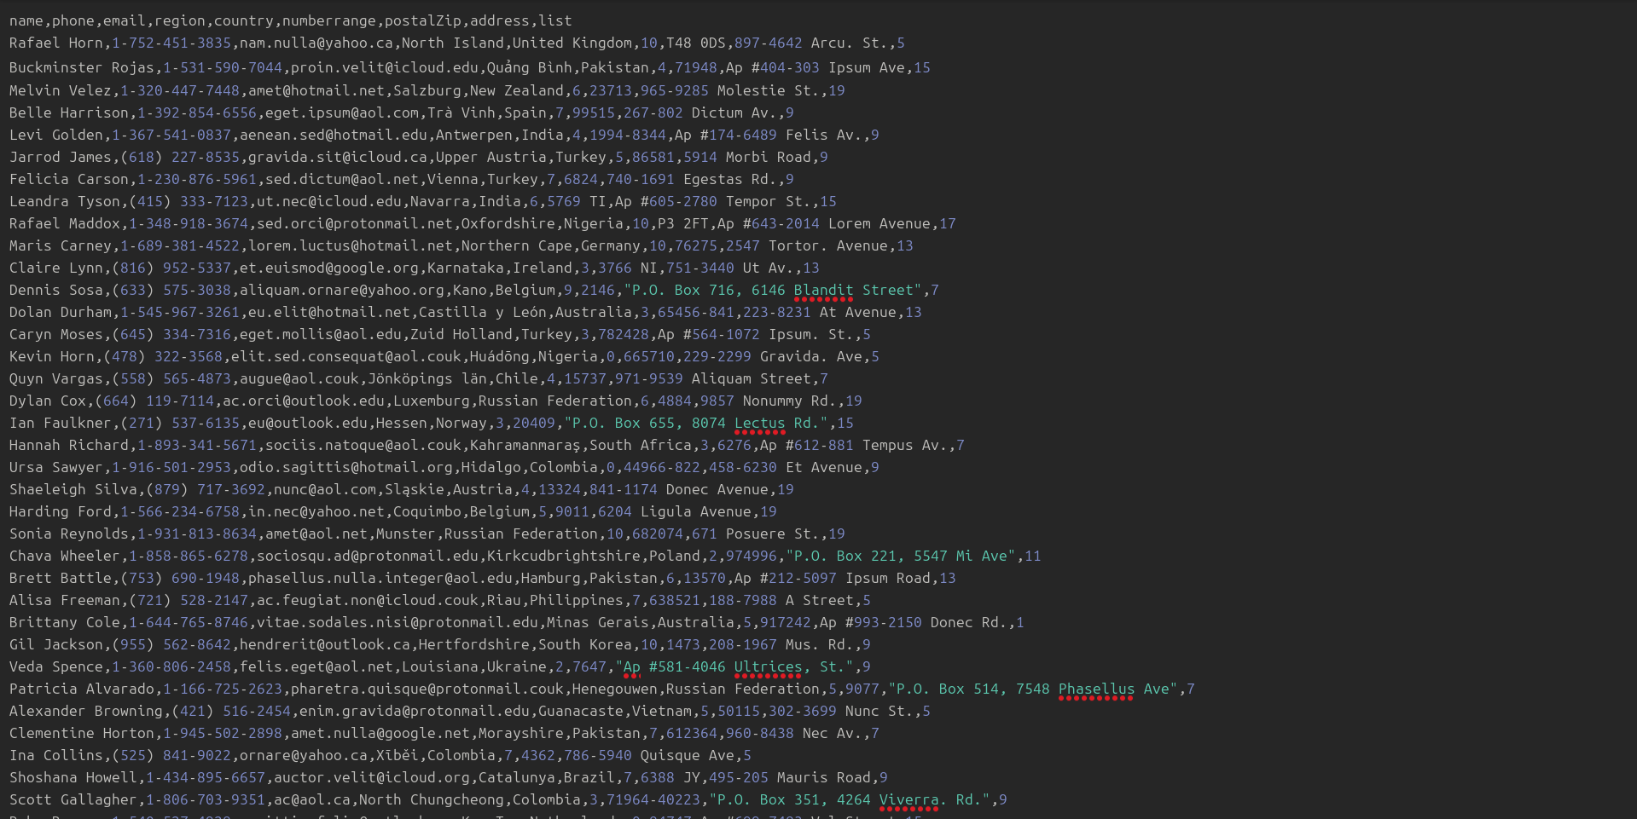
Problem
Notes:
Click to add Notes

Slide 3
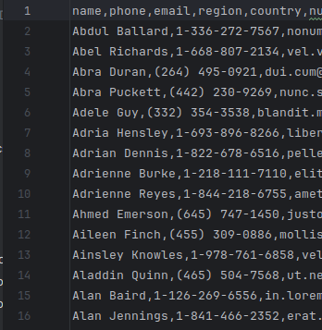
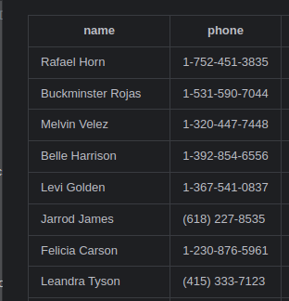
Project
Main
CsvSort
CsvToMd
Notes:
Click to add Notes

Slide 4

Showing the app in action
Notes:
Click to add Notes

Slide 5

Questions
Notes:
Click to add Notes

Slide 6
Links
Template [Ubuntu Caramel Mocha ] - License
CSV Image
Galaxy Image
Questions Image
Notes:
Click to add Notes

