Slide 1
Nokemon
By Fabien Léger
and Samuel Dos Santos

Slide 2
Goal
Make a Pokemon-like game
Players connect and chose a username
They can create or join a single game
Game is 1 vs. 1
They fight until one of the Nokemon is defeated

Slide 3
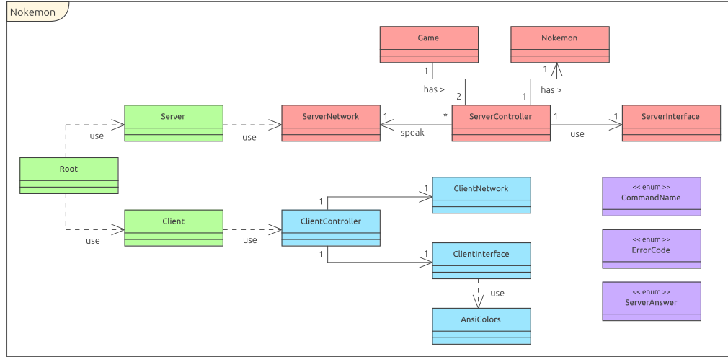
Diagramme de classe

Slide 4
Demonstration

