Slide 1
Cosmic Latte
API
A DAI project by Fabien Léger and Samuel Dos Santos

Slide 2
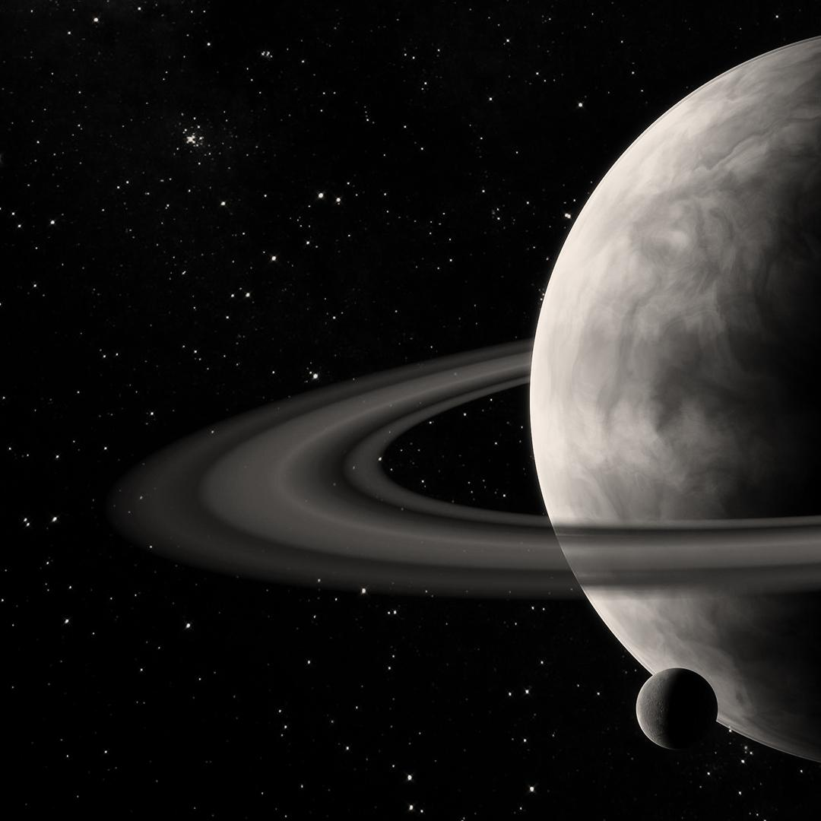
Problematic
Goal
Web application accessed through network
Two resources available
CRUD operations
Choice
Astronomical objects database
Users creating objects
Link between the two resources

Slide 3
Features
Astronomical Objects
Users
Data on each object
Multiple filters available
Saves which user created it
Simple information on a user
When deleted puts link to null

Slide 4
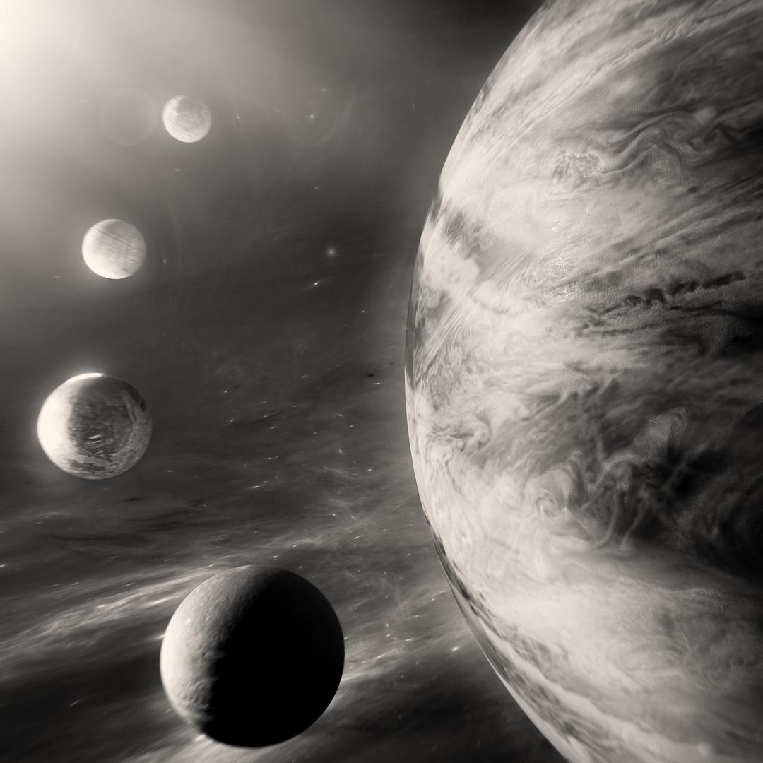
101
Demo
Showing Cosmic Latte in action

Slide 5
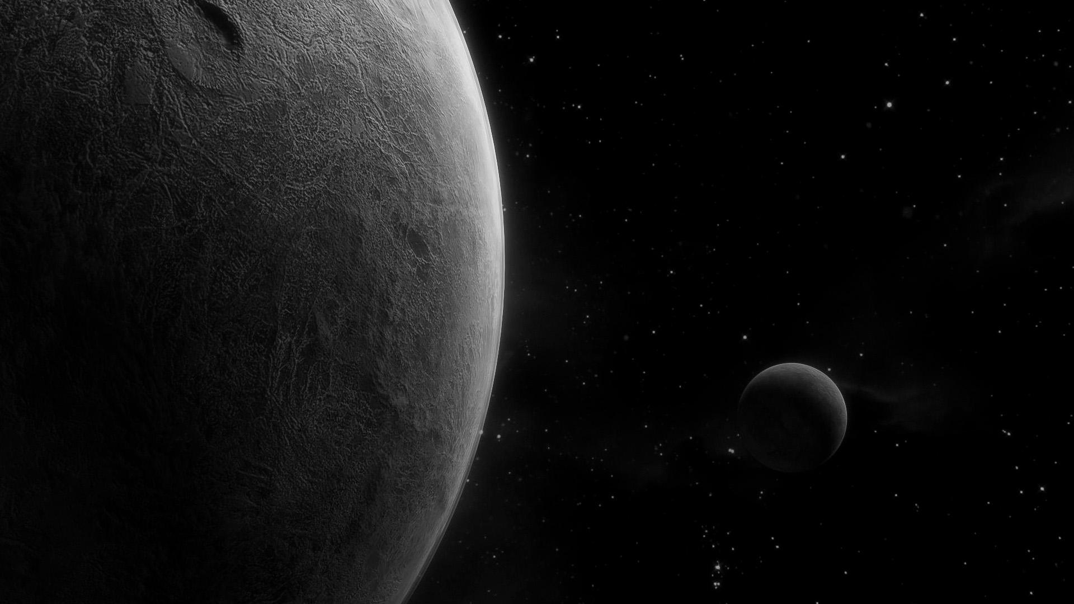
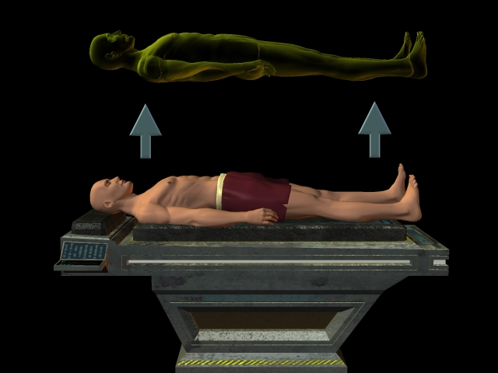
Do you have any questions?

Slide 6
Credits

