Slide 1
Fake News Project

Slide 2
Motivation For Project
Fake news detection is important for several industries.
Notably, regulatory agencies have begun to target websites with user-generated content (such as social media sites) for allowing the circulation of fake news on their platforms.
Automated fake news detection can be useful for major websites to identify potentially problematic content in advance.

Slide 3
Questions for Analysis
What can machine learning techniques tell us about fake news detection?
How do different styles of sampling data influence results?

Slide 4
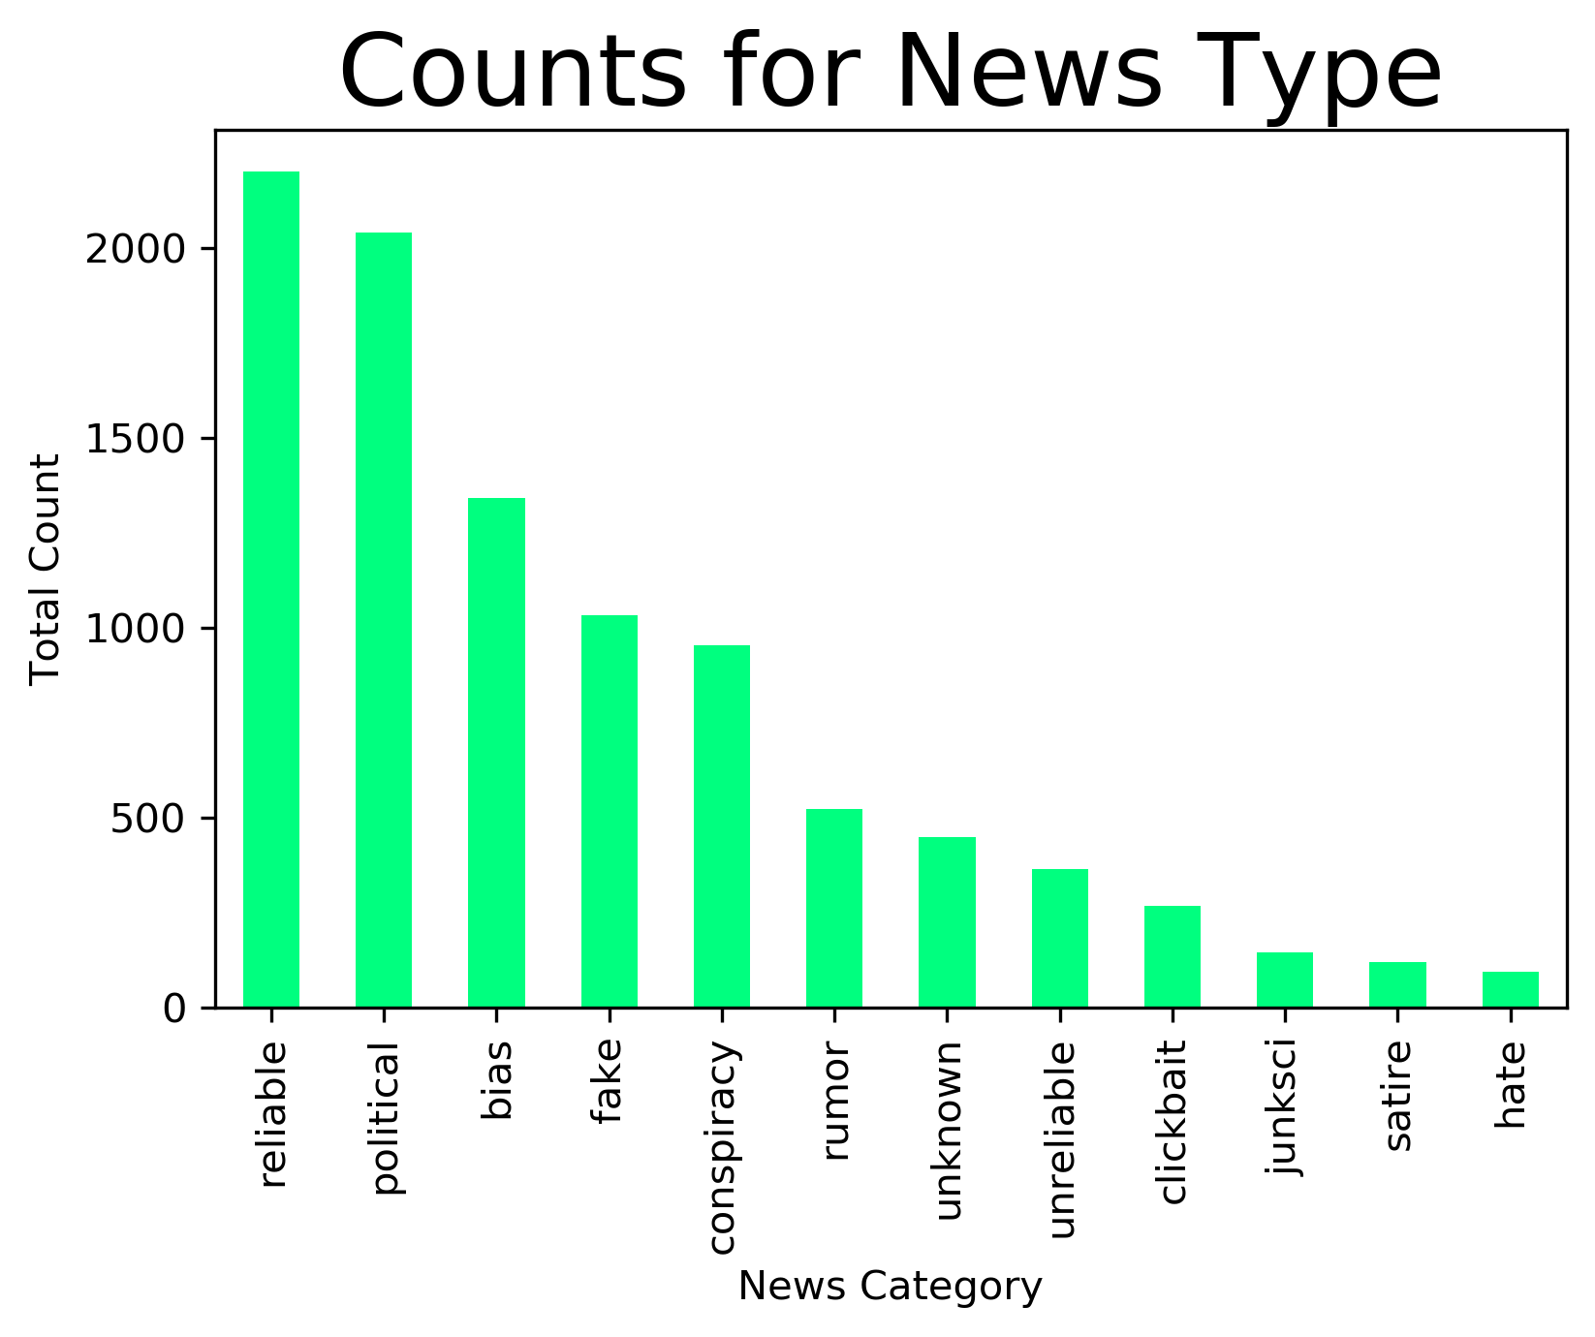
Category Counts

Slide 5
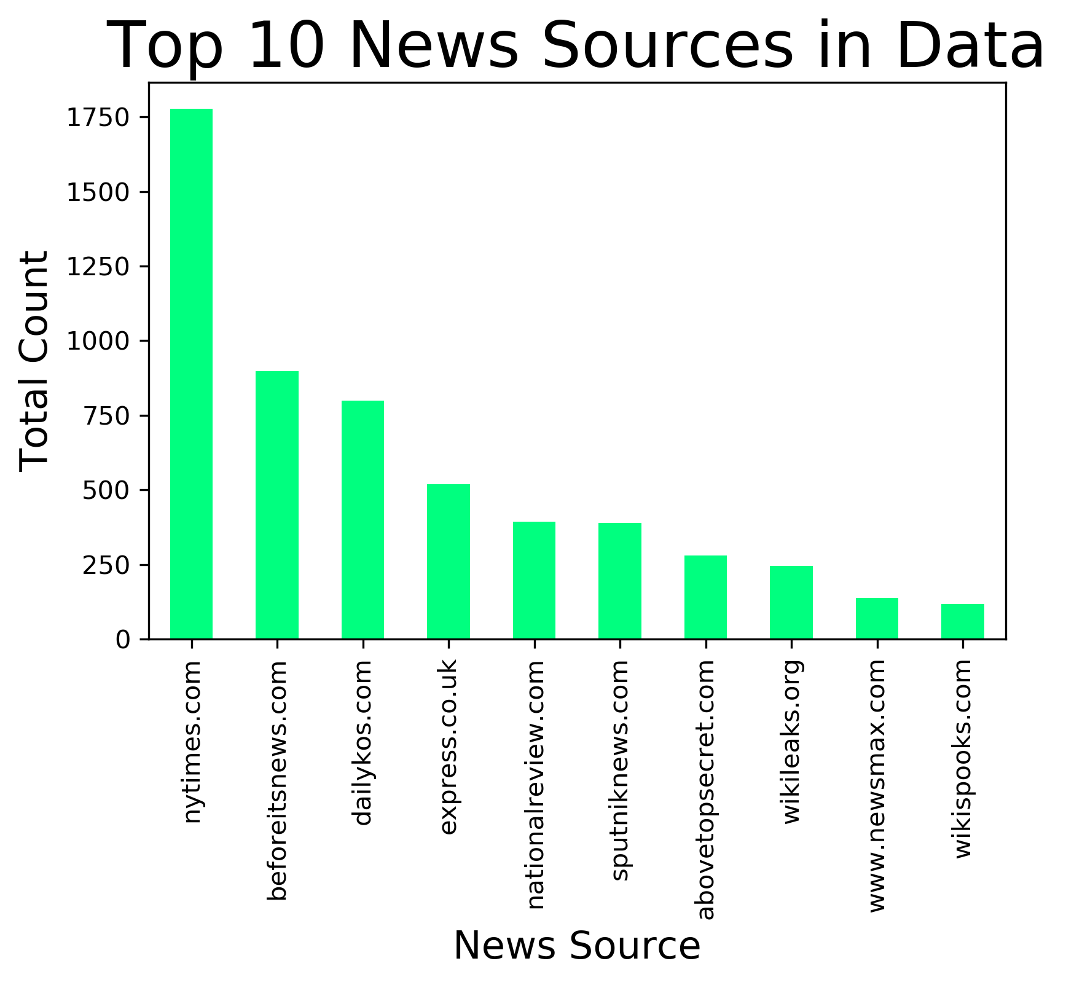
News Source Counts

Slide 6
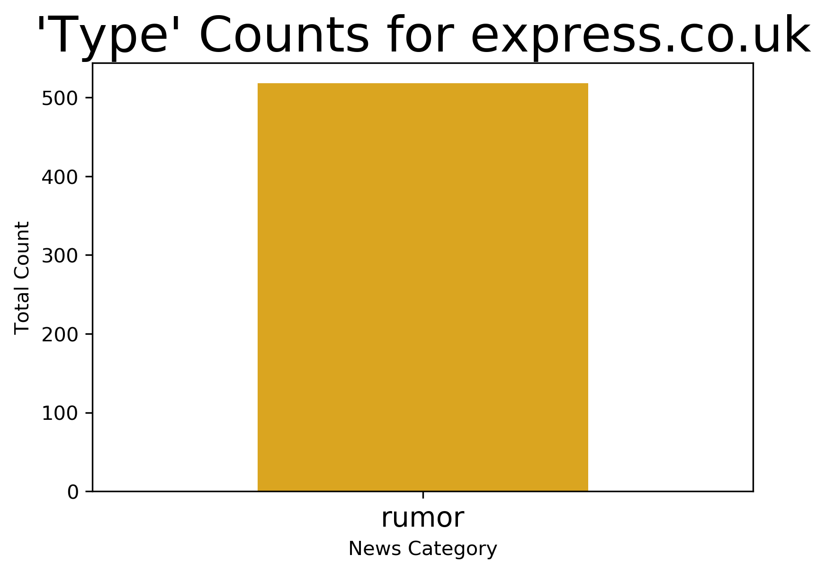
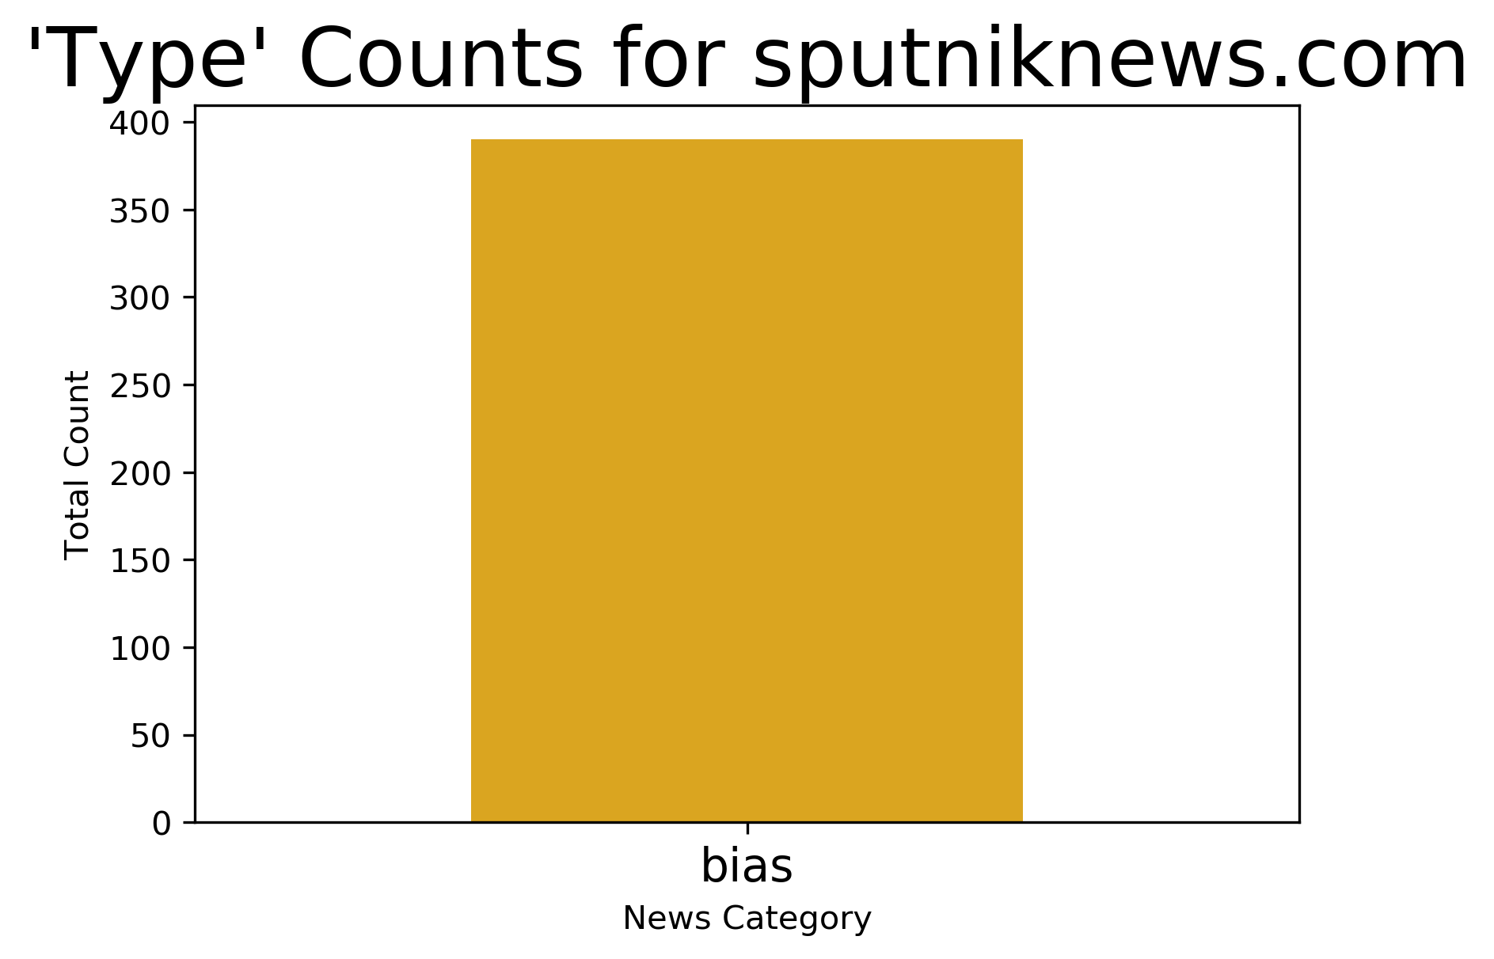
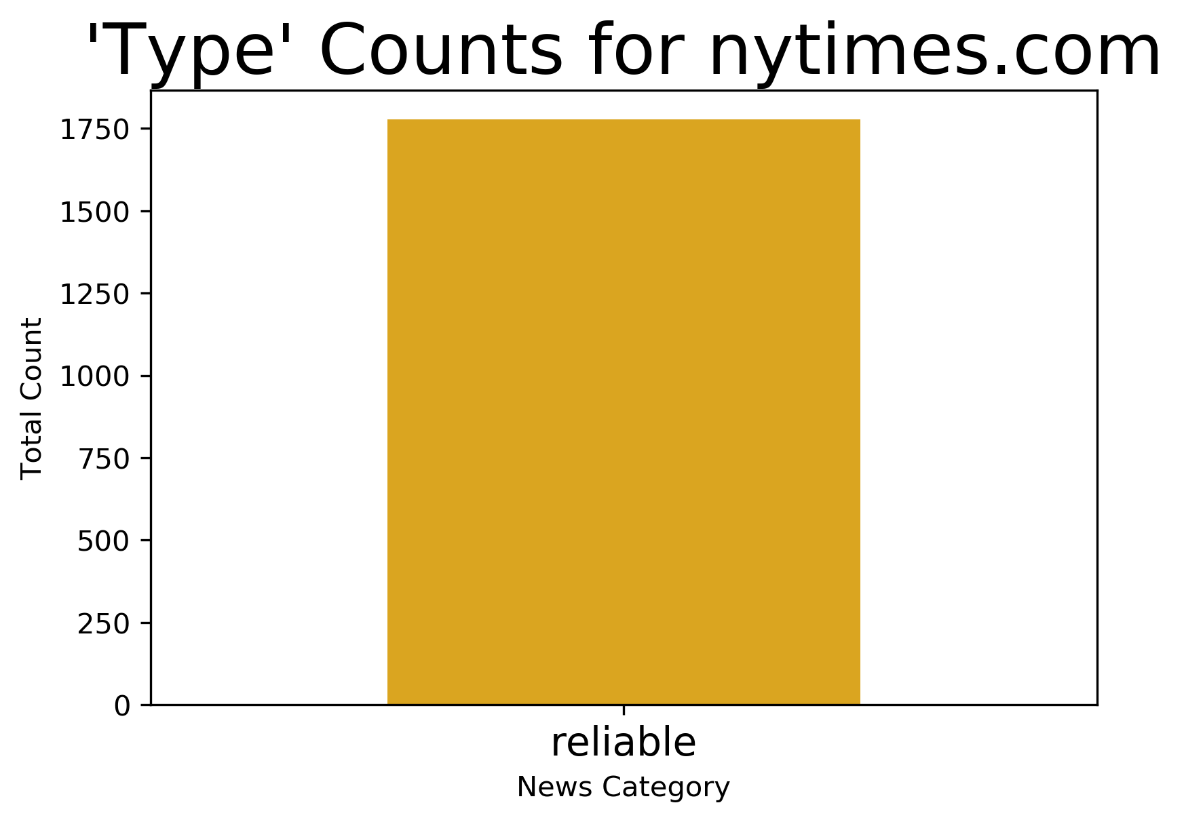
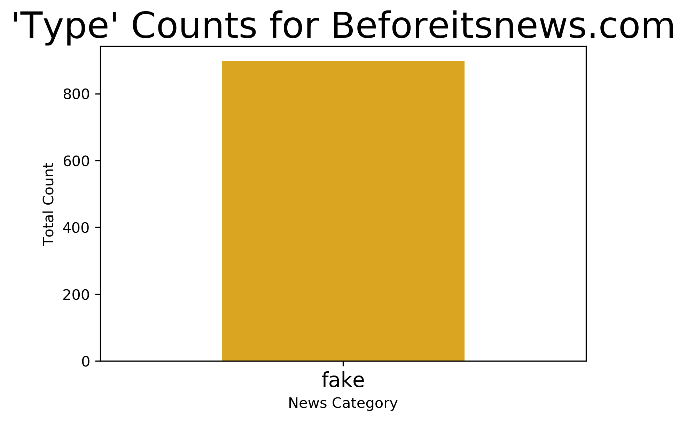
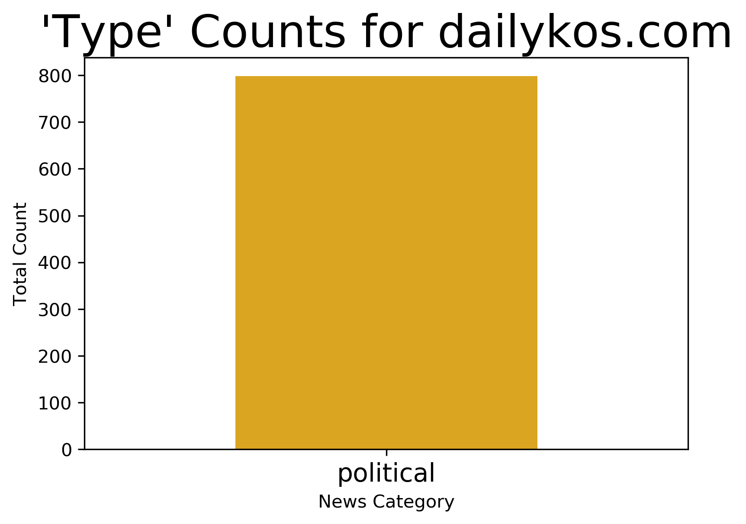
Every single article from a given source is in one category in the data
Is this problematic?

Slide 7
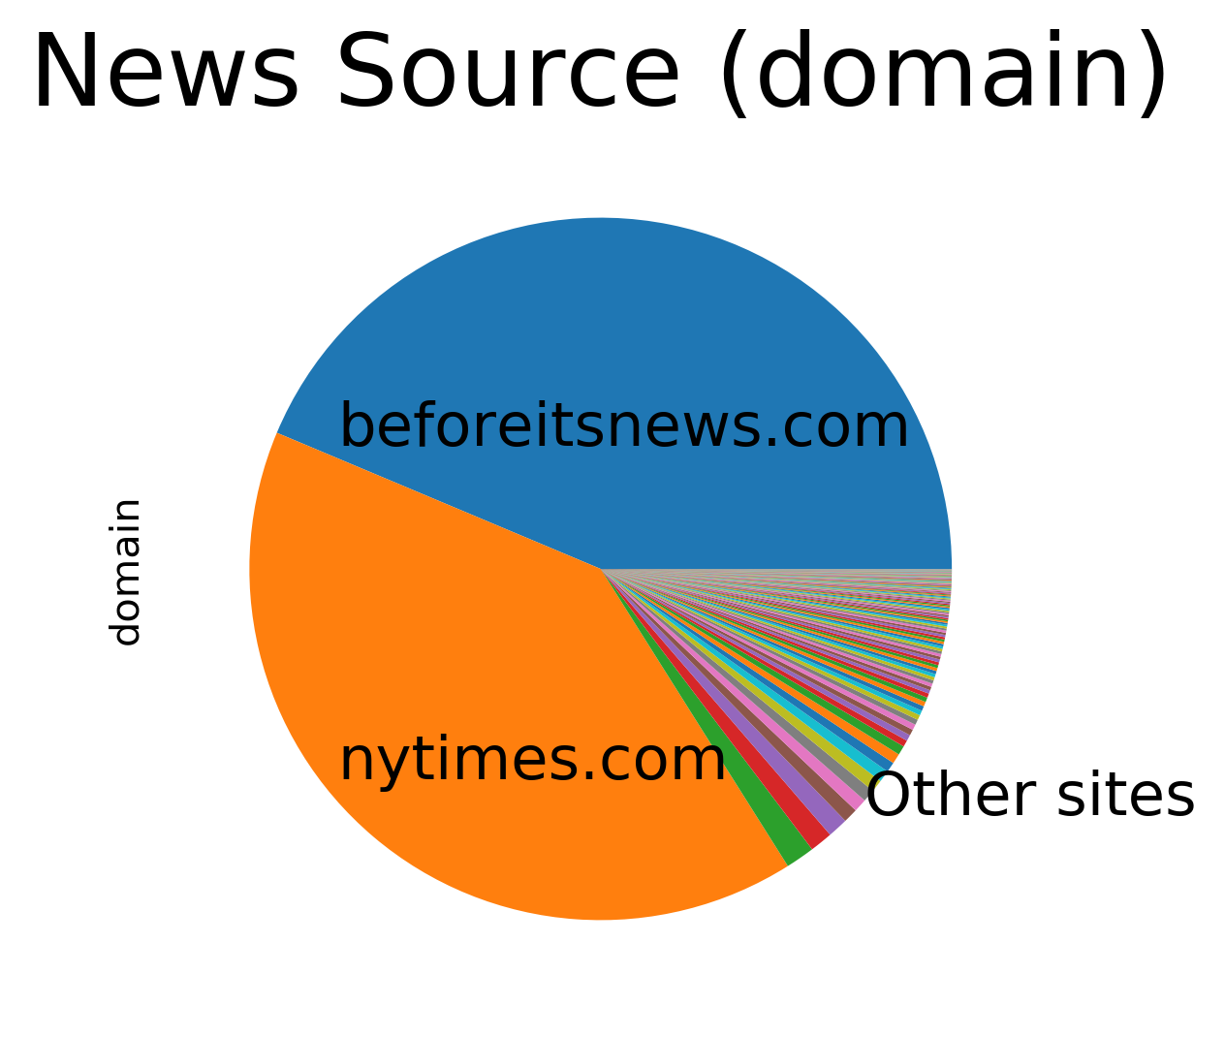
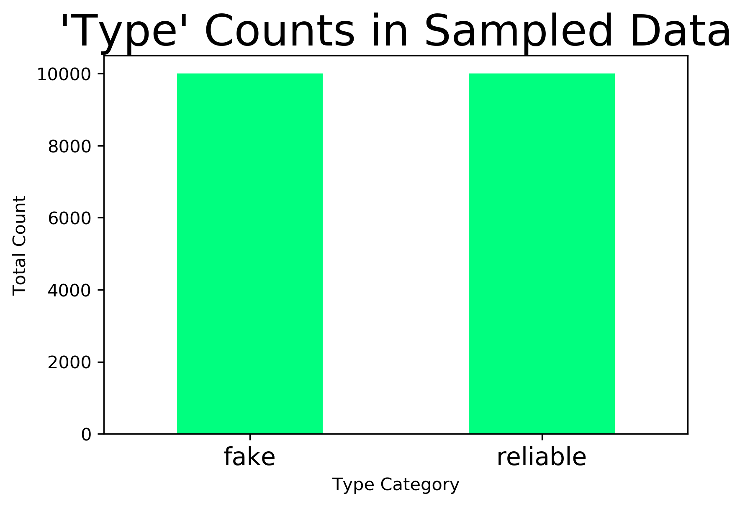
Initial Analysis – Reliable vs. Fake

Slide 8
Sentiment Analysis
 | Label | SIA Polarity Score | TextBlob Polarity Score | TextBlob Subjectivity
Fake News | 1 | 5468 | 983 | 1128
 | -1 | 3013 | 67 | 5784
 | 0 | 5013 | 7944 | 3088
Reliable News | 1 | 6721 | 1175 | 762
 | -1 | 2581 | 73 | 6800
 | 0 | 698 | 8752 | 2438

Slide 9
Predictive Modeling – Reliable vs. Fake
 |  | Vectorization Technique
 |  | Bag of Words | Tf-idf | Tf-idf with two bigrams
Classifier | MultinomialNB() | 86.7% | 87.2% | 90.4%
 | LinearSVC() | 87.0% | 90.8% | 91.7%
 | XGB Classifier() | 87.5% | 89.0% | 83.3%

Slide 10
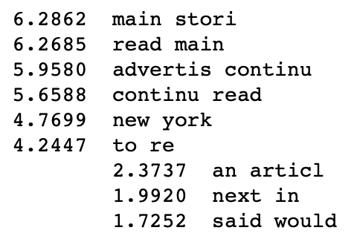
Most Predictive features for Initial Reliable vs. Fake Analysis
These results indicate that the fact that a given article is from the New York Times is more predictive than anything else in the data. Because of this, the data was resampled (see following slide)

Slide 11
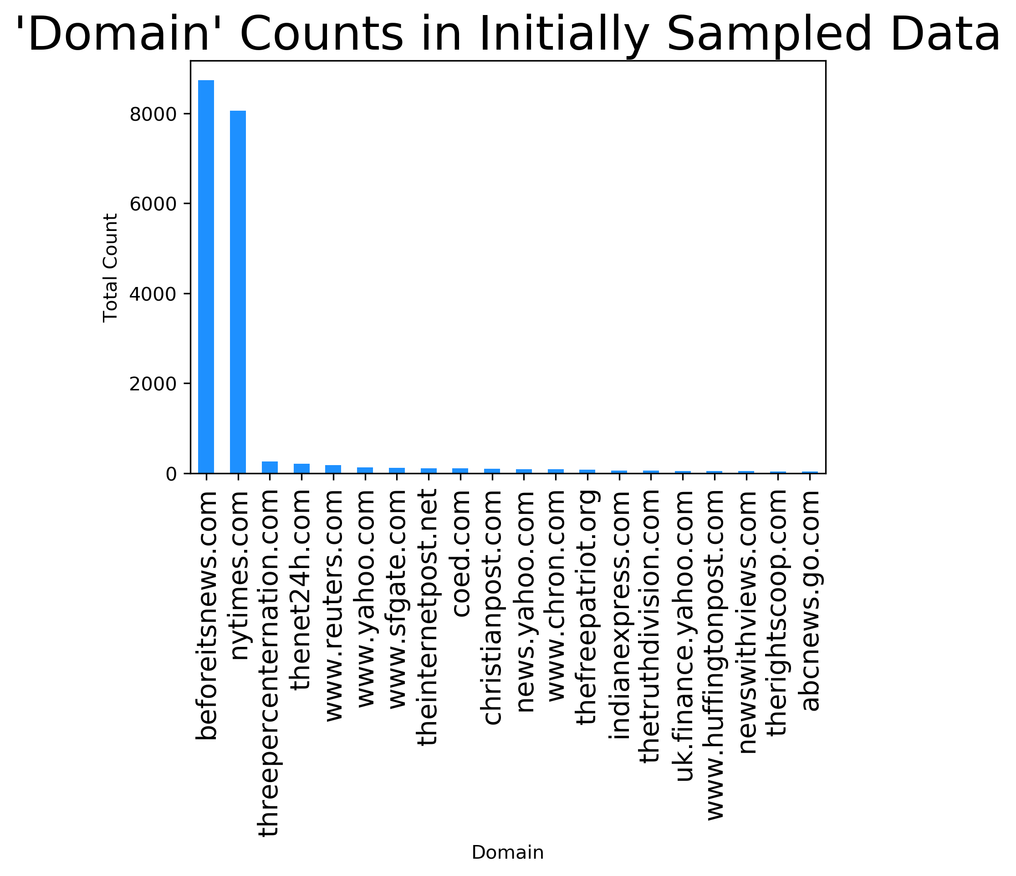
Resampling
The New York Times and beforeitsnews.com
were overrepresented
in the initial sample

Slide 12
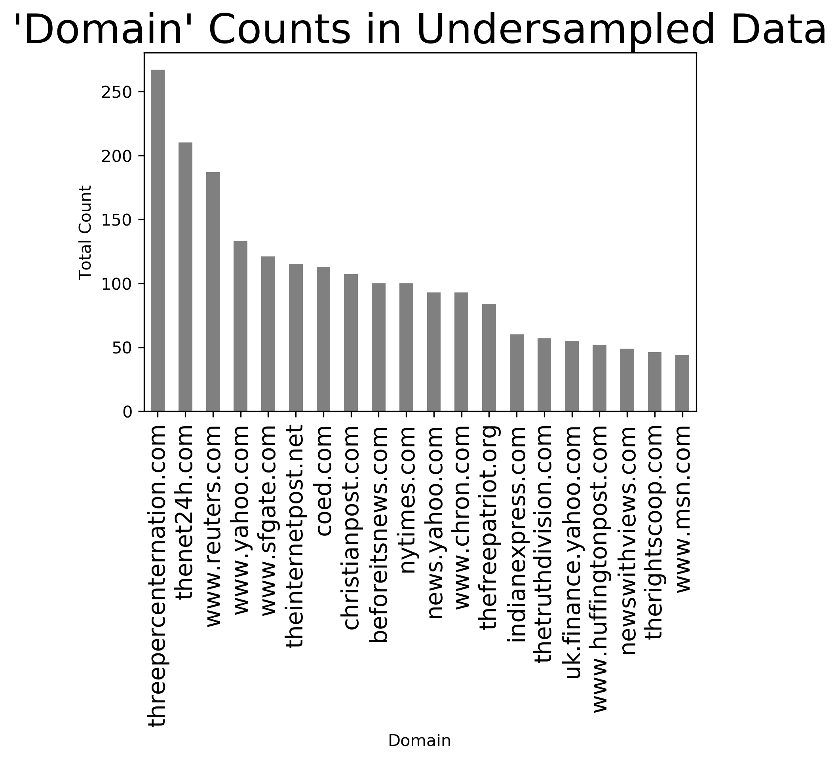
Data was resampled for better balance across domain

Slide 13
Predictive Accuracy – Resampled Data
 |  | Vectorization Technique
 |  | Bag of Words | Tf-idf | Tf-idf with two bigrams
Classifier | MultinomialNB() | 78.4% | 63.9% | 66.0%
 | LinearSVC() | 80.7% | 85.6% | 82.1%
 | XGB Classifier() | 79.8% | 84.6% | 78.7%

Slide 14
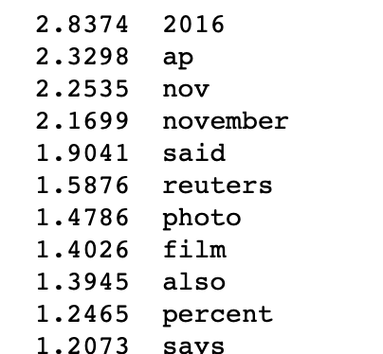
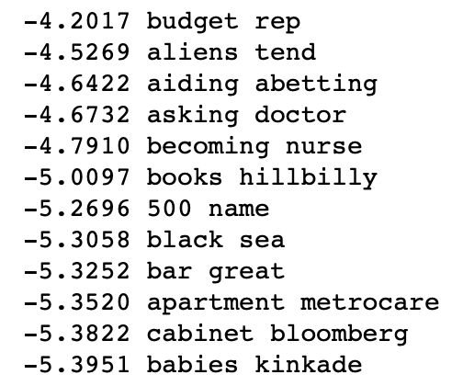
Predictive Features
Unigrams
Bigrams

Slide 15
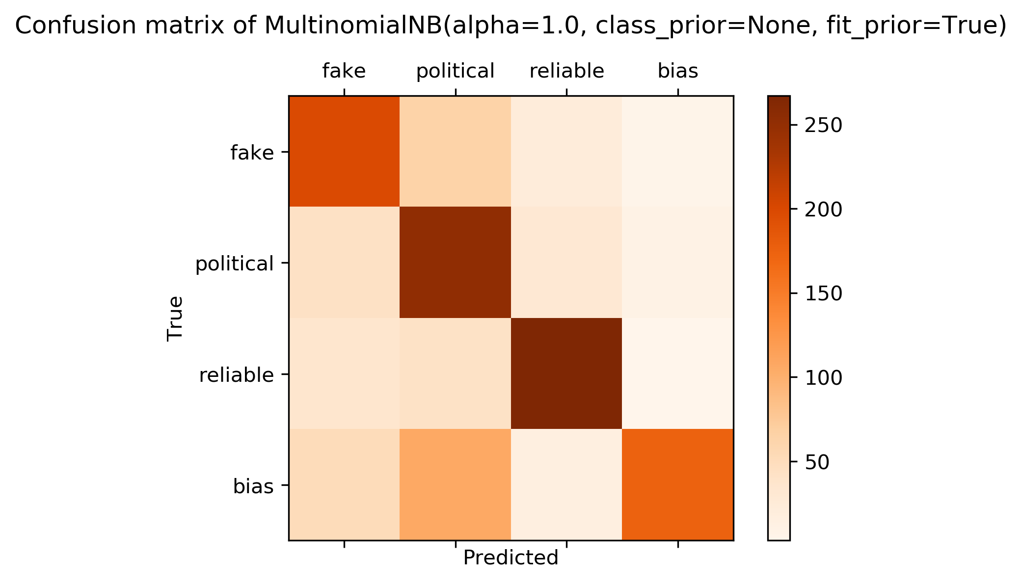
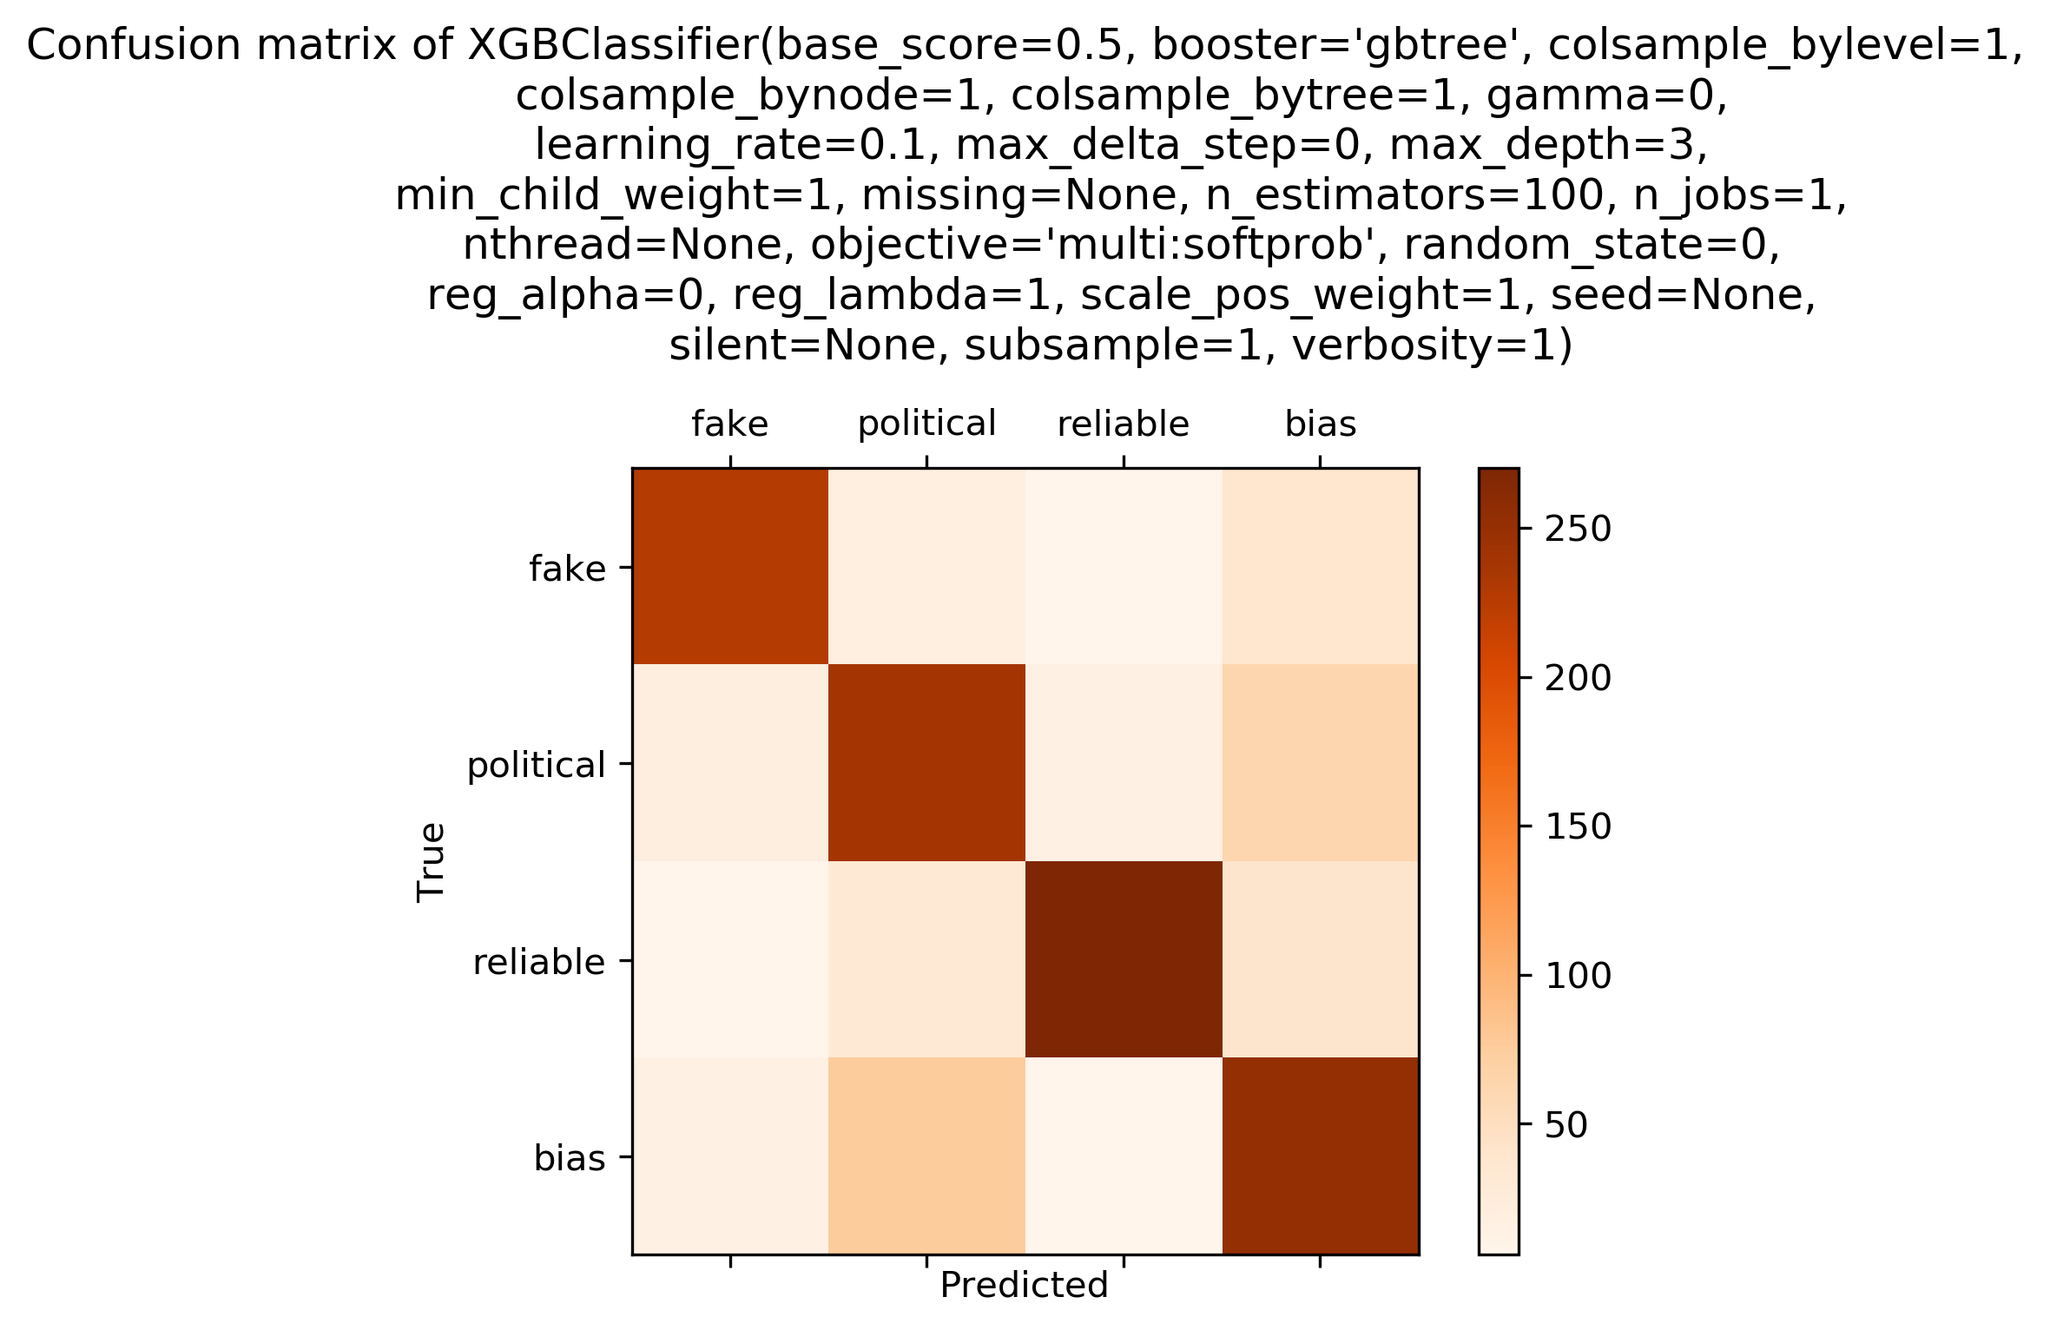
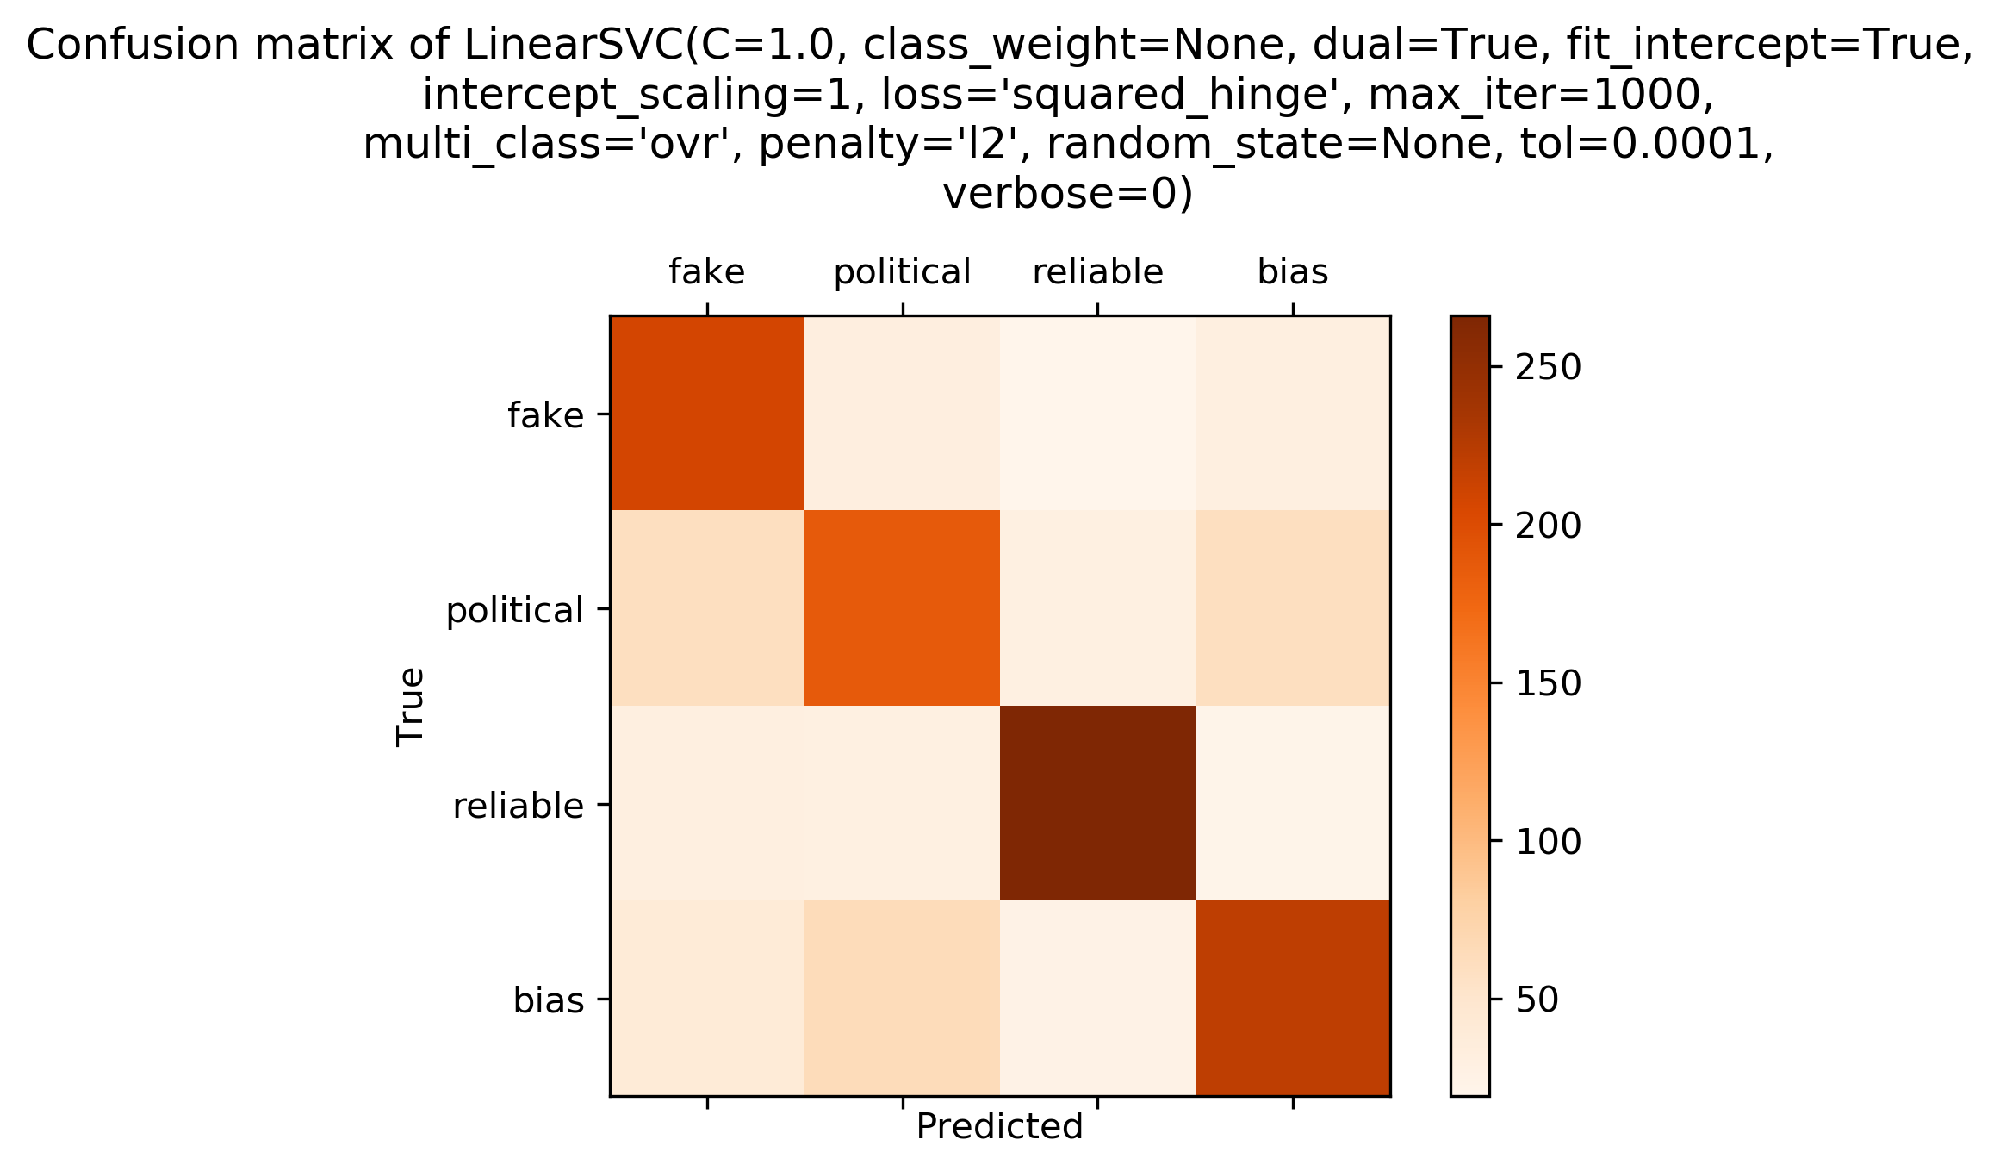
Multiclass Classification with count vectorization

Slide 16
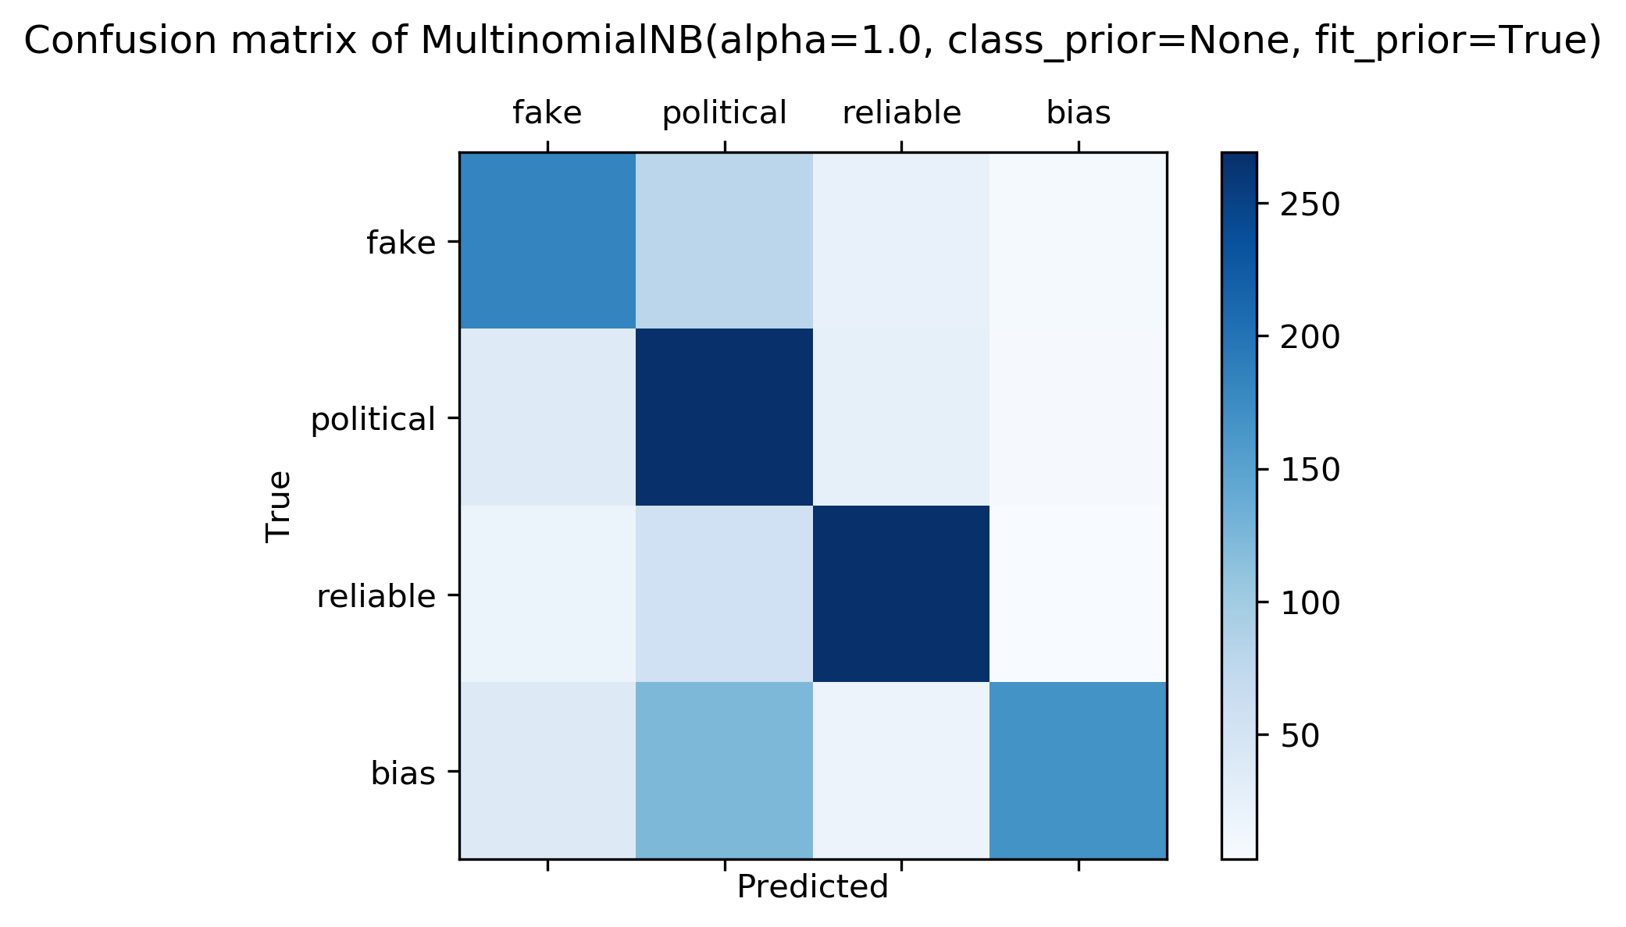
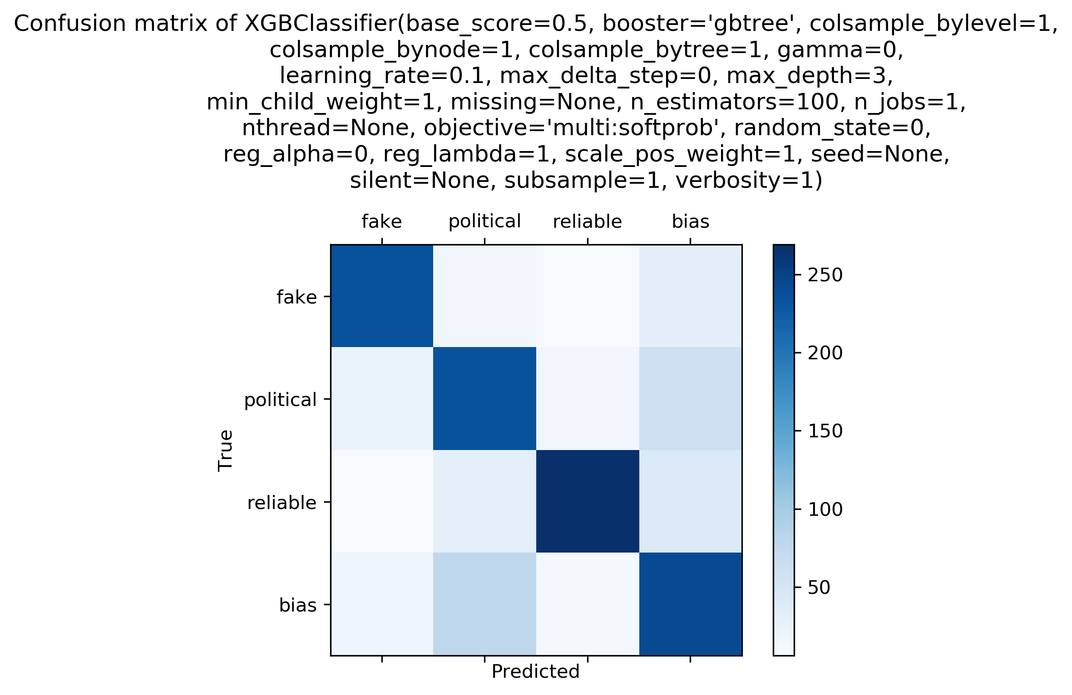
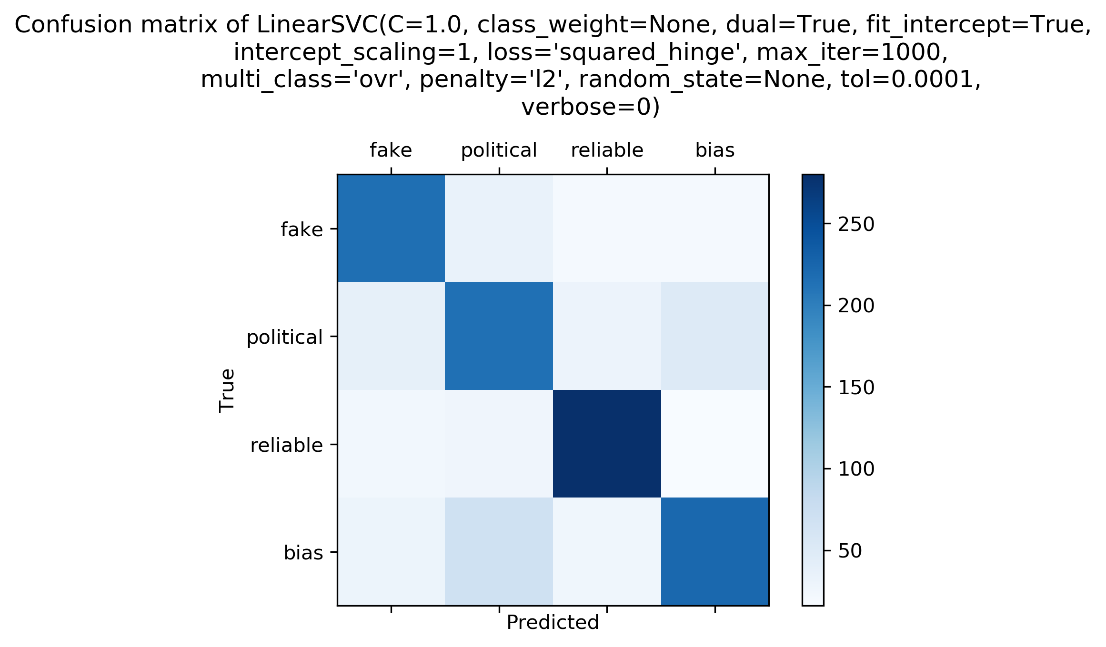
Multiclass Classification with tf-idf vectorization

Slide 17
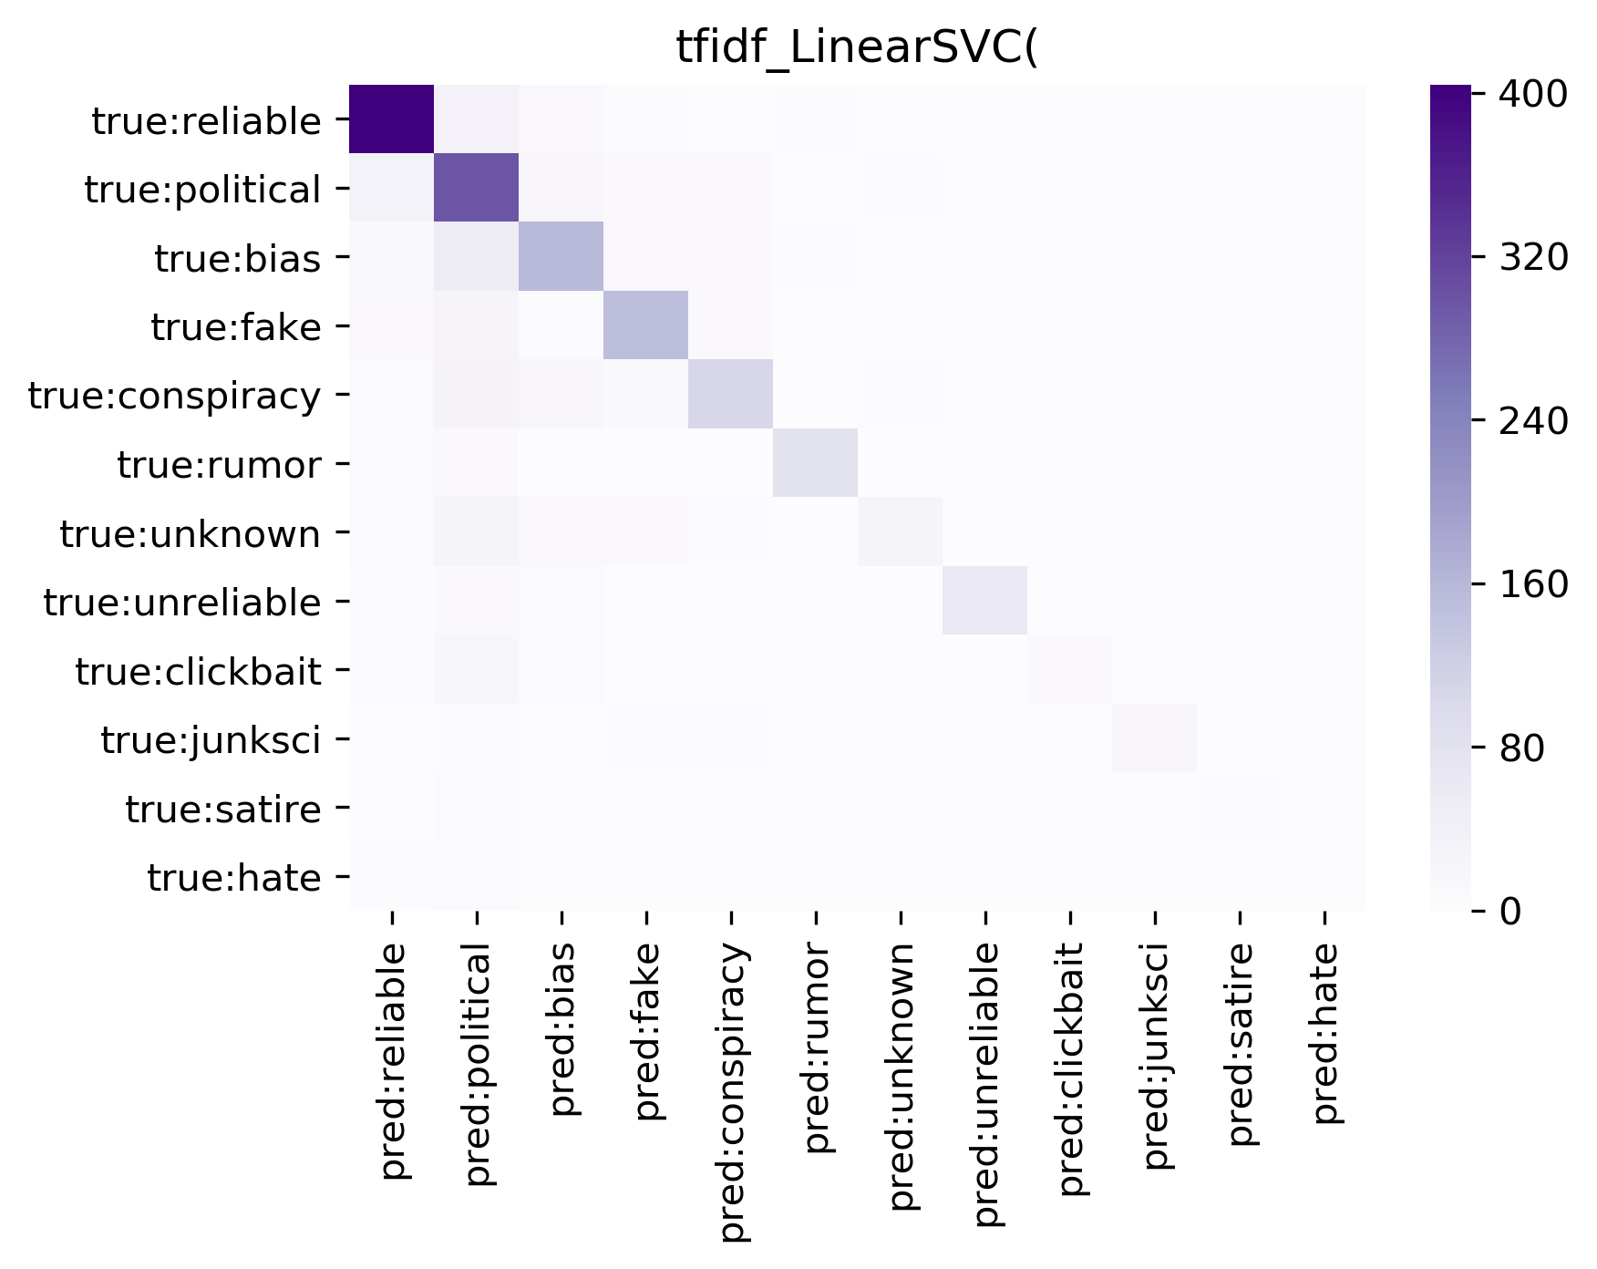
More Classes
The same six pairs of vectorization and classifiers were applied to the data, but for all of the classes (instead of just the four largest ones).

Slide 18
Concluding Points
Prediction accuracy seems to be inherently tied to source.
Some of the most informative features were direct references to the site or online newspaper that articles came from.
This analysis was conducted with a smaller subset of data from the very large dataset.
Conducting the analysis with a larger amount of data may yield more significant results.

