Slide 1
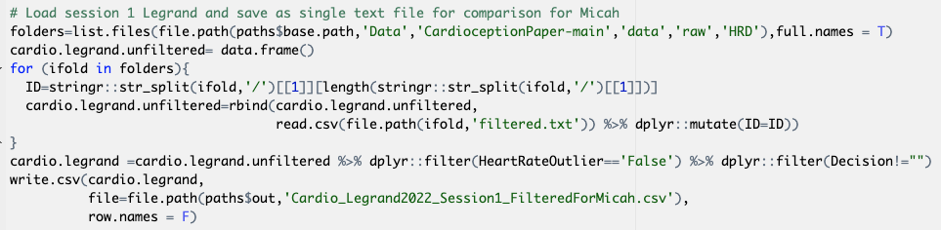
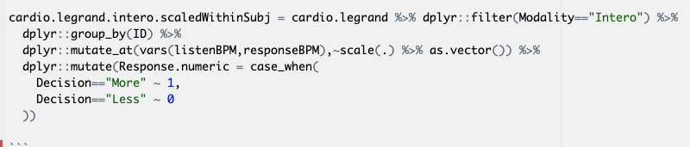
Data: Legrand et al. 2022 – session 1
Read the data
Filter by heart rate outliers supplied as mark up in the original data frame
Size:
Unique IDs: 218
Total rows: 31882
Rows in intero condition: 14485
Preprocessing:
Filter for Intero condition
Scale listenBPM and responseBPM within each person
Code ‘Decision’ as numeric

Slide 2
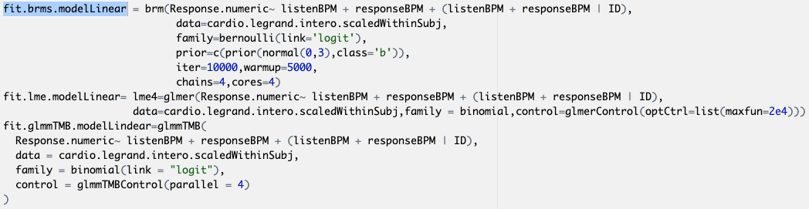
Model: Response.numeric ~ listenBPM + responseBPM + (listenBPM + responseBPM | ID)

Slide 3
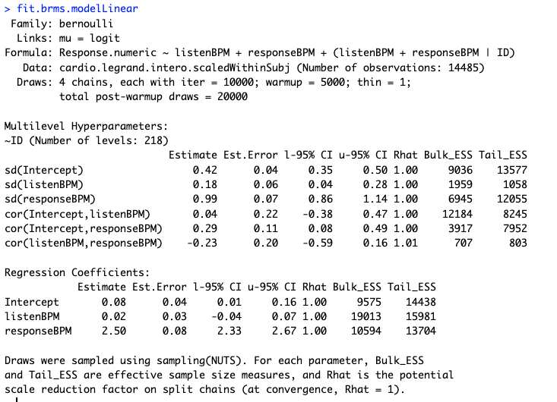
Model: Response.numeric ~ listenBPM + responseBPM + (listenBPM + responseBPM | ID)
brms

Slide 4
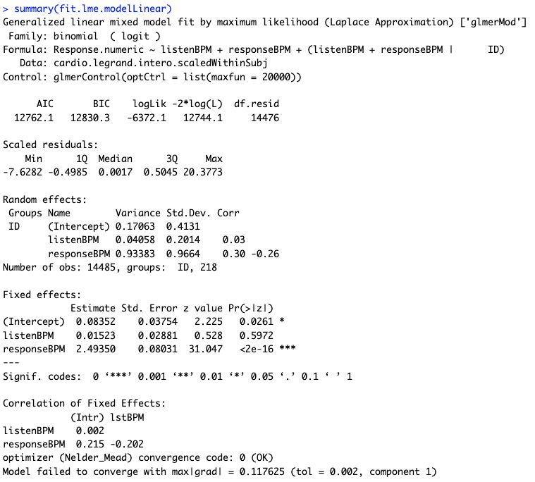
Model: Response.numeric ~ listenBPM + responseBPM + (listenBPM + responseBPM | ID)
Lme4:

Slide 5
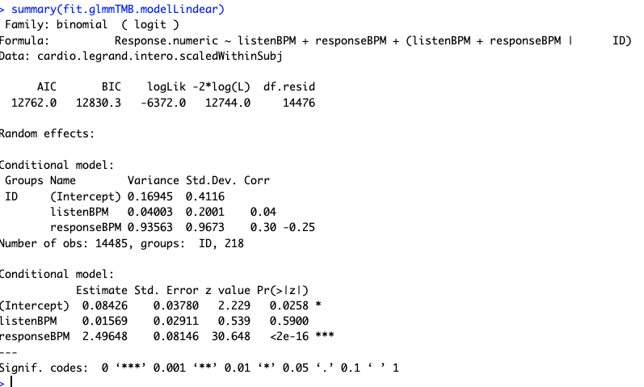
Model: Response.numeric ~ listenBPM + responseBPM + (listenBPM + responseBPM | ID)
glmmTMB

Slide 6
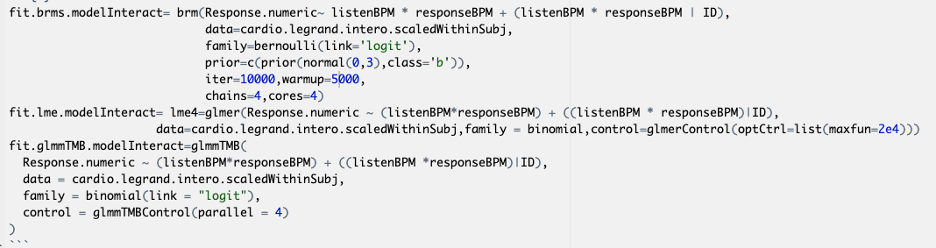
Model: Response.numeric ~ listenBPM *responseBPM + (listenBPM* responseBPM | ID)
For LME: Warning: Model failed to converge with max|grad| = 0.423474 (tol = 0.002, component 1)

Slide 7
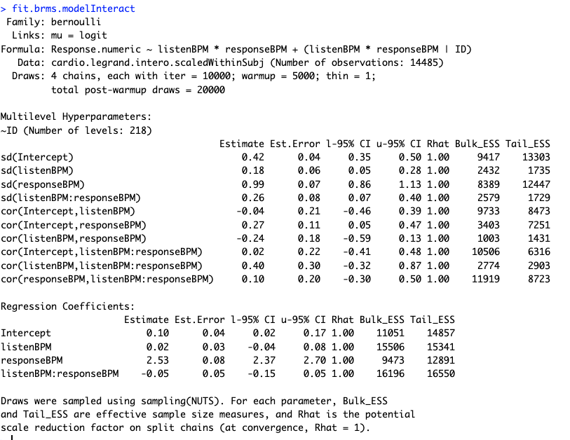
brms

Slide 8
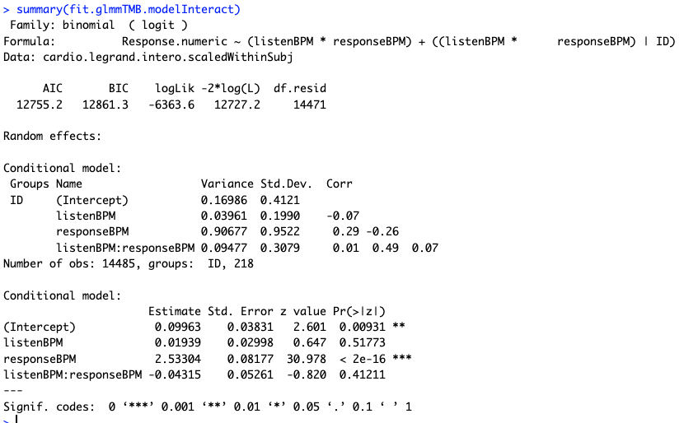
glmmTMB

