Slide 1

Mini Project User Stories & Acceptance Criteria
User Story | Acceptance Criteria | Completed | Partially Completed | Not Completed | Comments
User Story 1 | Clicking a column will place either a red or yellow disc in the lowest down unoccupied position in the clicked column
 | Colour of disc will alternate each turn (click)
 | No more than 42 turns can be played
 | Only one disc can occupy a single place in a position of the grid
 | Red goes first
 | Once a column is full (6 discs), no more discs can be place
User Story 2 | Winner message should be cleared
 | Red goes first after reset
 | After reset games should continue to meet acceptance criteria of user story 1
User Story 3 | A winner can be declared if a line occurs along any part of a row
 | A winner can be declared if a line occurs along any part of a column
 | A winner can be declared if a line fills any part of any diagonal
 | If all positions are occupied and no lines are achieved, then nobody is declared the winner |  |  |  | Show message “nobody wins”
 | If a winner is declared, then no further discs can be placed until the board is reset as per user story 2
User Story 4 | High scores shown after every game, no matter who wins
 | Score is calculated by subtracting the number of turns made before a winner is declared from 42
 | Players names are captured and associated with the winning score recorded for yellow or red after every game completes, unless nobody won
Functional
Requirement | Acceptance Criteria | Completed | Partially Completed | Not Completed | Comments
Code Check-In to Git | All code file should be checked in to git with appropriate comments
Pure Functions | All functions created within your code must be pure functions and meet the pure functions criterias
Resilience | High scores must be persisted even after server restart
README | Your code should contain a README, which informs how to clone, build and run your code as well as how to contirbute
ESLint | Your code should have no linting errors
Non-Functional

Slide 2
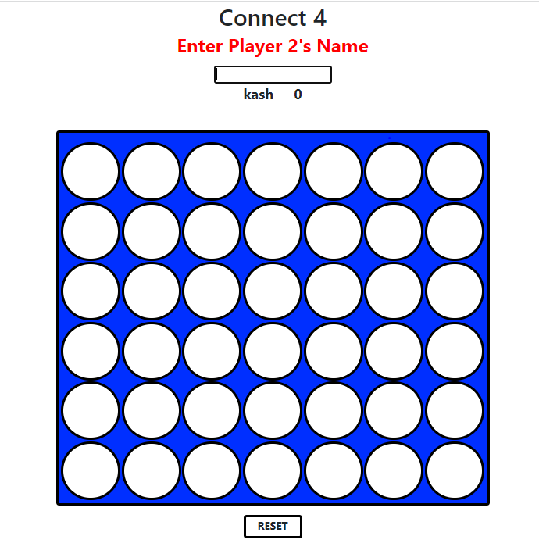
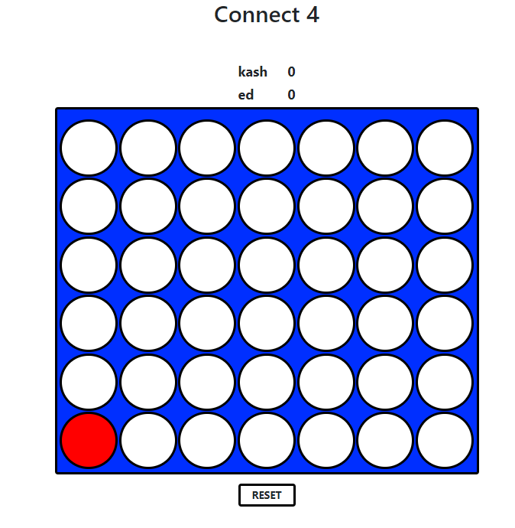
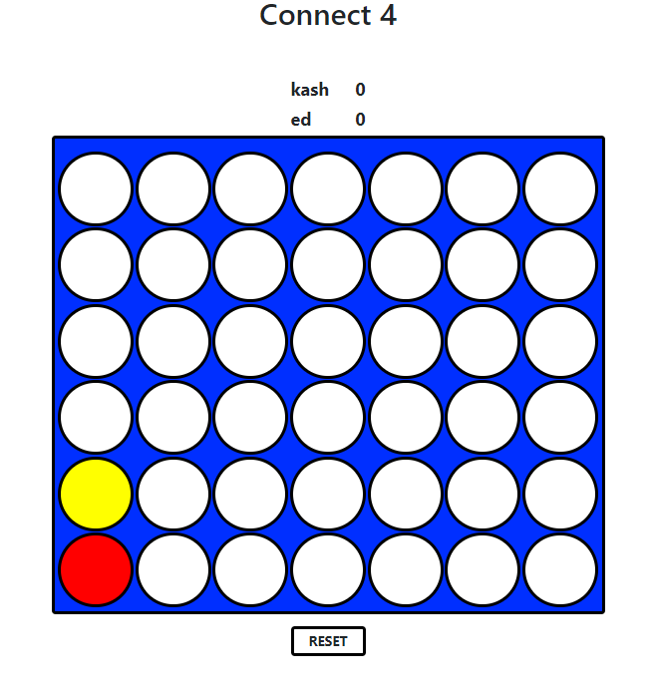
Enter Name, Alternating Turns Demo

Slide 3
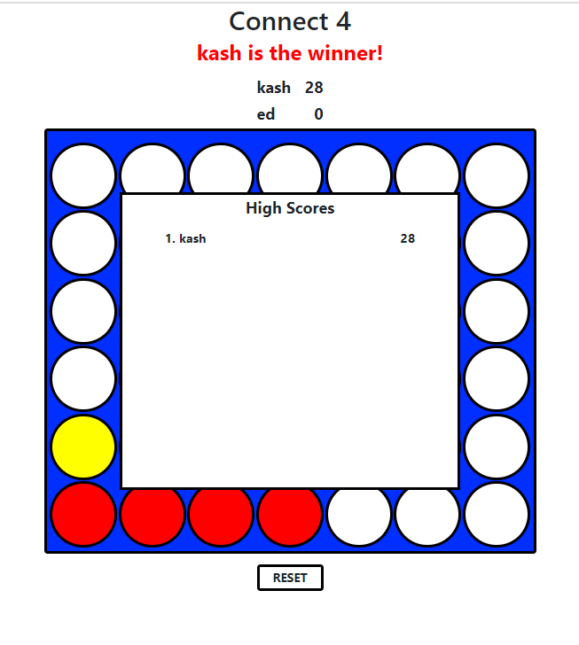
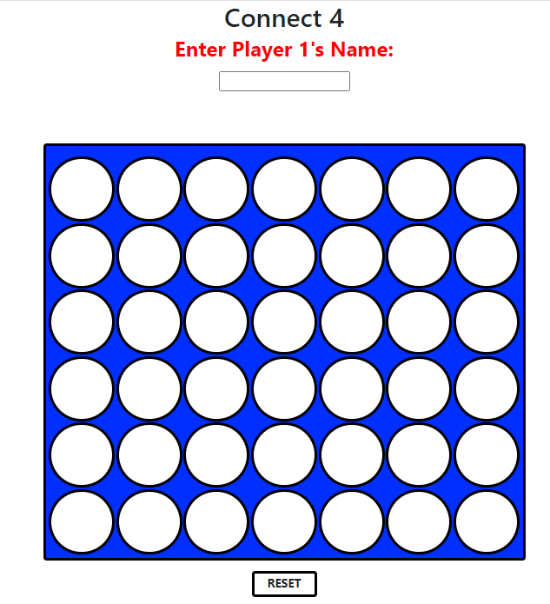
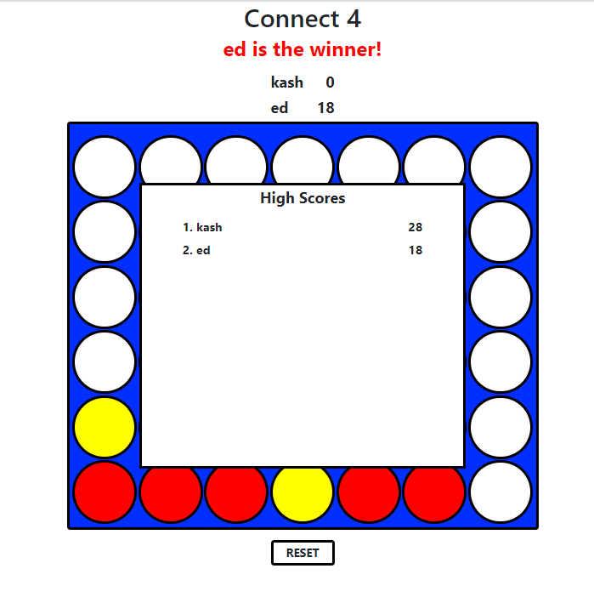
High Score Demo

