Slide 1
A Tutorial on Langauge Classification
Naam: Kaan Selcuk Gögcay
Datum: 16-01-2026

Slide 2
Table of content
Context
Methodology
  Exploratory Data Analysis (EDA)
  Modelling
  Evaluation (including results)
  Writing Tutorial
Ideas for Improvements
Discussions Points
A Tutorial on Langauge Classification

Slide 3
Context
Input: “24 es un número muy difícil
Input: “Io amo le ragazze italiane
Input: “I might secretly be a serial killer”
Language Classification Tutorial
Aimed at Software Engineers
Build your first NLP Model
Language Classifier
Language Classifier
Language Classifier
Output: Spanish
Output: Italian
Output: English
A Tutorial on Langauge Classification

Slide 4
Methodology
Exploratory Data Analysis (EDA)
Modelling
Evaluation (including results)
Writing Tutorial
A Tutorial on Langauge Classification

Slide 5
Methodology: EDA
Language Identification dataset by Papluca
Amazon reviews
20 languages
Limited to 5 languages (because basic review)
Arabic
Bulgarian
English
Arabic
Bulgarian
German
Greek
German
Greek
Spanish
French
French
Hindi
Italian
Japanese
Hindi
Japanese
Dutch
Portuguese
Russian
Dutch
Swahili
Polish
Swahili
Polish
Thai
Turkish
Urdu
Vietnamese
Chinese
Thai
Turkish
Urdu
Vietnamese
Chinese
A Tutorial on Langauge Classification

Slide 6
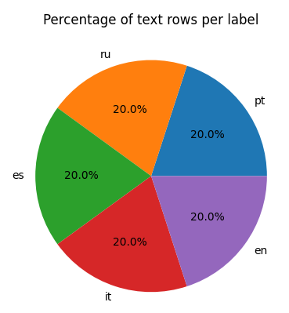
Methodology: EDA
5 Languages
3500 samples per language
17500 samples total
Evenly split
Sample: 'A little tight but ok..good quality’,
Sample: 'I cried, oh god it was ugly cries the likes of any I have ever had reading a book. Della and Ren will never be forgotten but their son...... absolutely devastated me. These books will forever be my favorites. They shall never be forgotten!',
A Tutorial on Langauge Classification

Slide 7

Methodology: Modelling
Deep Learning with Python Chapter 14 Text Classification
Bag-of-Words model
Word level tokenization (easiest to understand)
Vocabulary of 20000 words
A Tutorial on Langauge Classification

Slide 8
Methodology: Evaluation
Train accuracy: 99.94%
Validation accuracy: 98.78%
Test accuracy: 99.00%
Confusion Matrix
A Tutorial on Langauge Classification

Slide 9

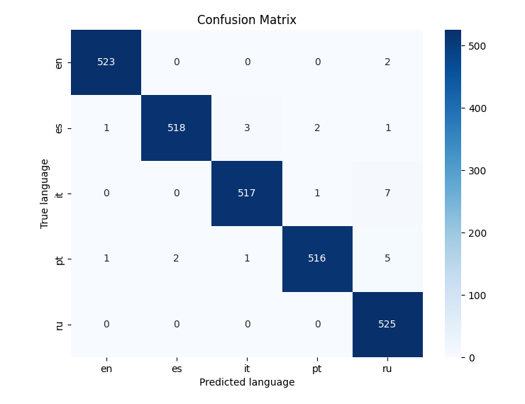


Slide 10
Methodology: Evaluation
Train accuracy: 99.94%
Validation accuracy: 98.78%
Test accuracy: 99.00%
Confusion Matrix
Classifying sentences
A Tutorial on Langauge Classification

Slide 11
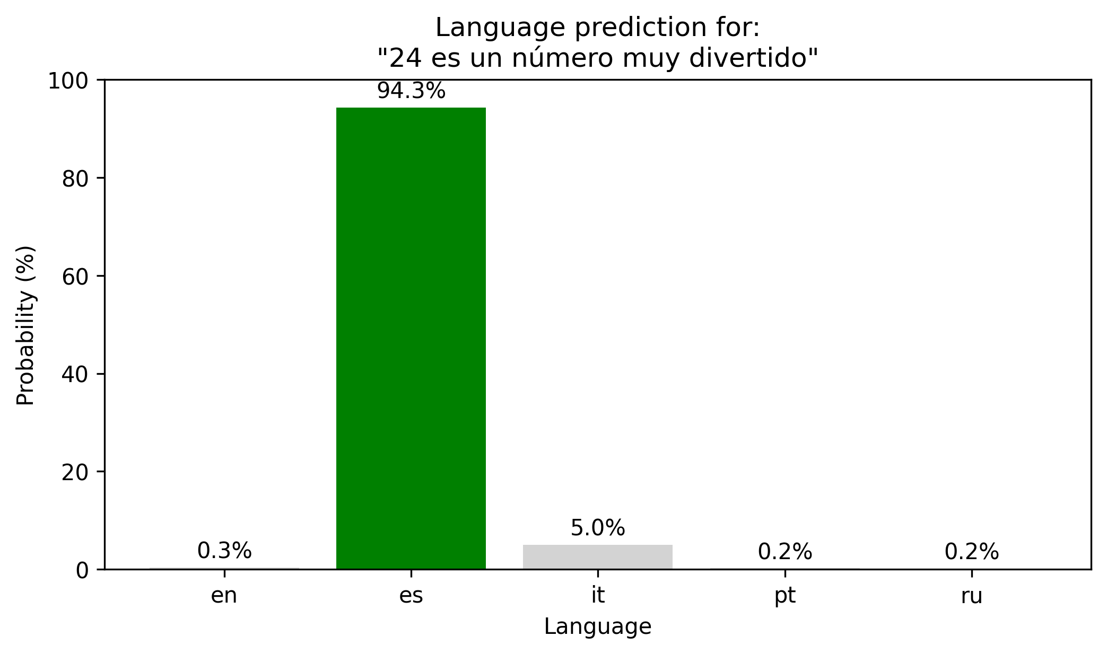

Slide 12
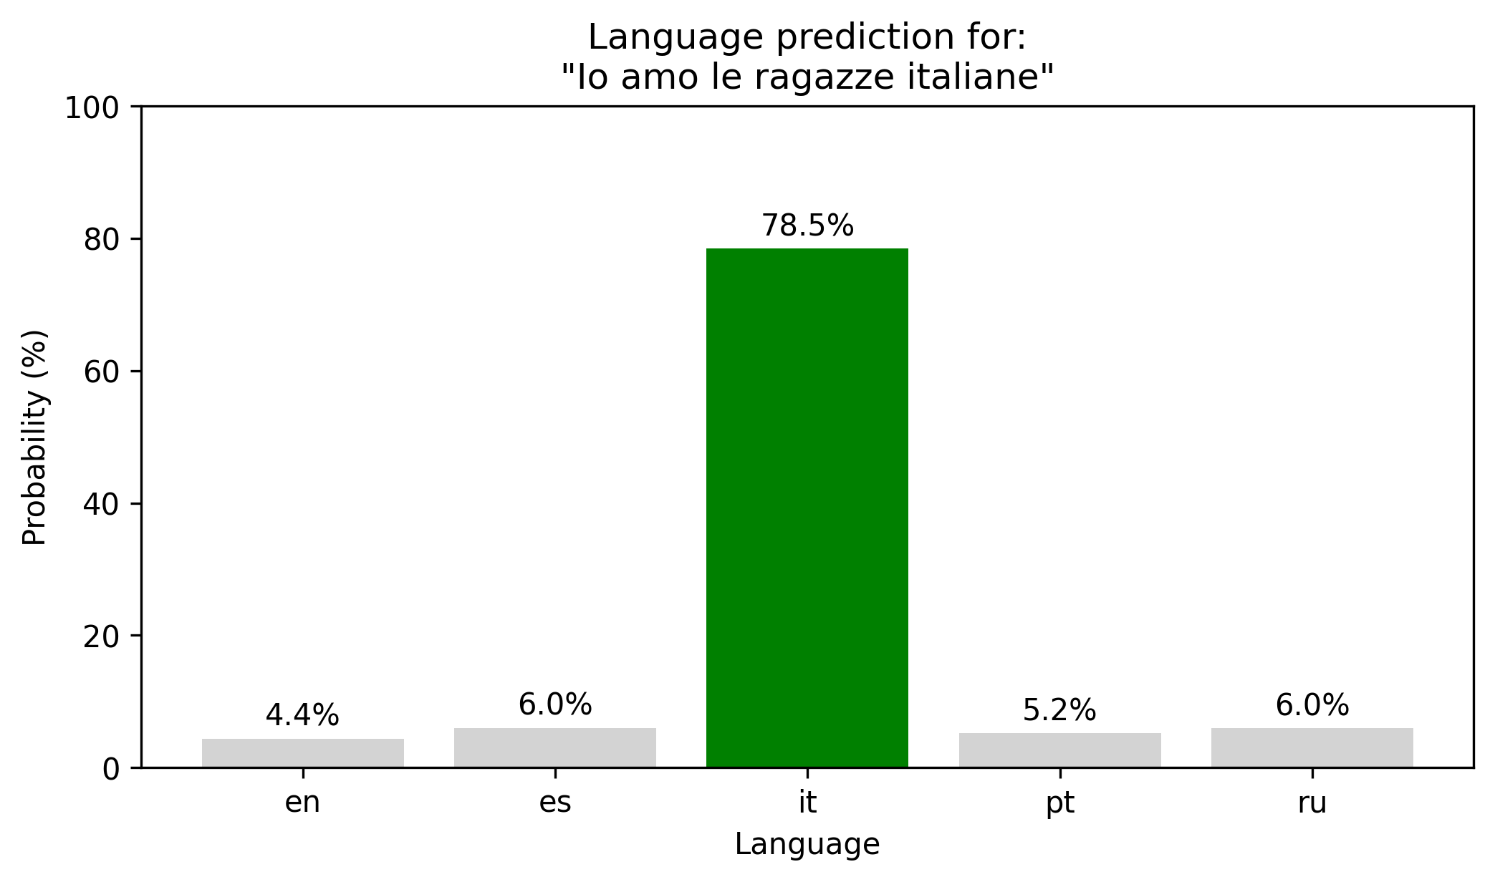

Slide 13
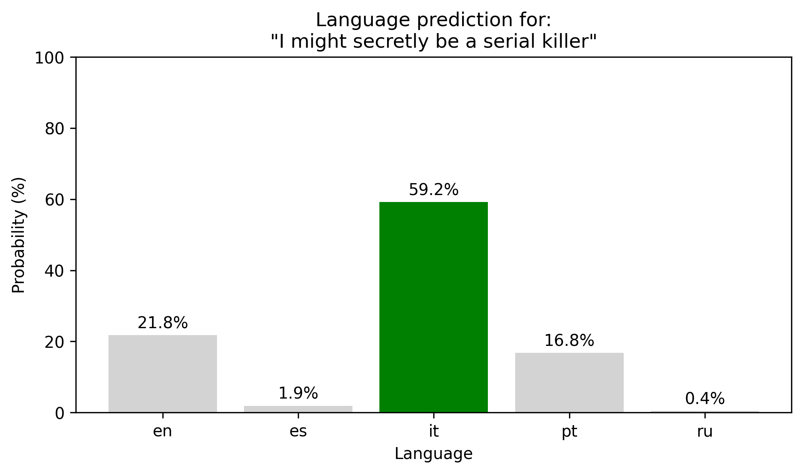

Slide 14
Methodology: Evaluation
Vocabulary
  i - 6
  might - 1223
  secretly - 0
  be - 77
  a - 3
  serial - 13297
  killer - 0
A Tutorial on Langauge Classification

Slide 15
Methodology: Writing Tutorial
  What you will learn
  Introduction
  Approach Overview
  Scope and Limitations
  Coding
    Step 1: Setting up the environment
    Step 2: Loading the data
    Step 3: Filtering languages
    Step 4: Data Preperation
    Step 5: Tokenization
    Step 6: Bag-of-Words model
    Step 7: Training the Classifier
    Step 8: Evaluating the model
A Tutorial on Langauge Classification

Slide 16
Methodology: Writing Tutorial
  What you will learn
  Introduction
  Approach Overview
  Scope and Limitations
  Coding
    Step 1: Setting up the environment
    Step 2: Loading the data
    Step 3: Filtering languages
    Step 4: Data Preperation
    Step 5: Tokenization
    Step 6: Bag-of-Words model
    Step 7: Training the Classifier
    Step 8: Evaluating the model
A Tutorial on Langauge Classification

Slide 17
Ideas for improvement
  Remove numbers from data
A Tutorial on Langauge Classification

Slide 18
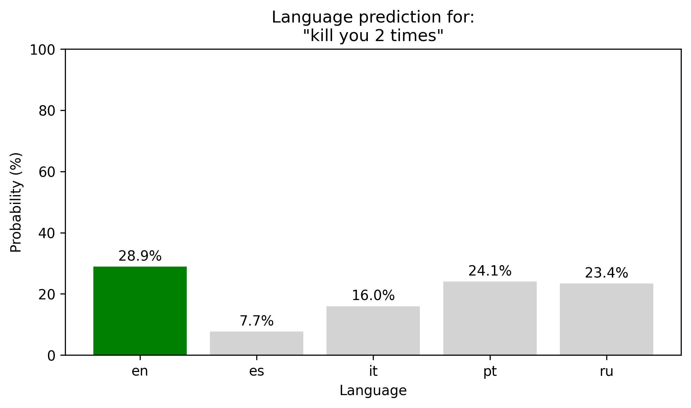
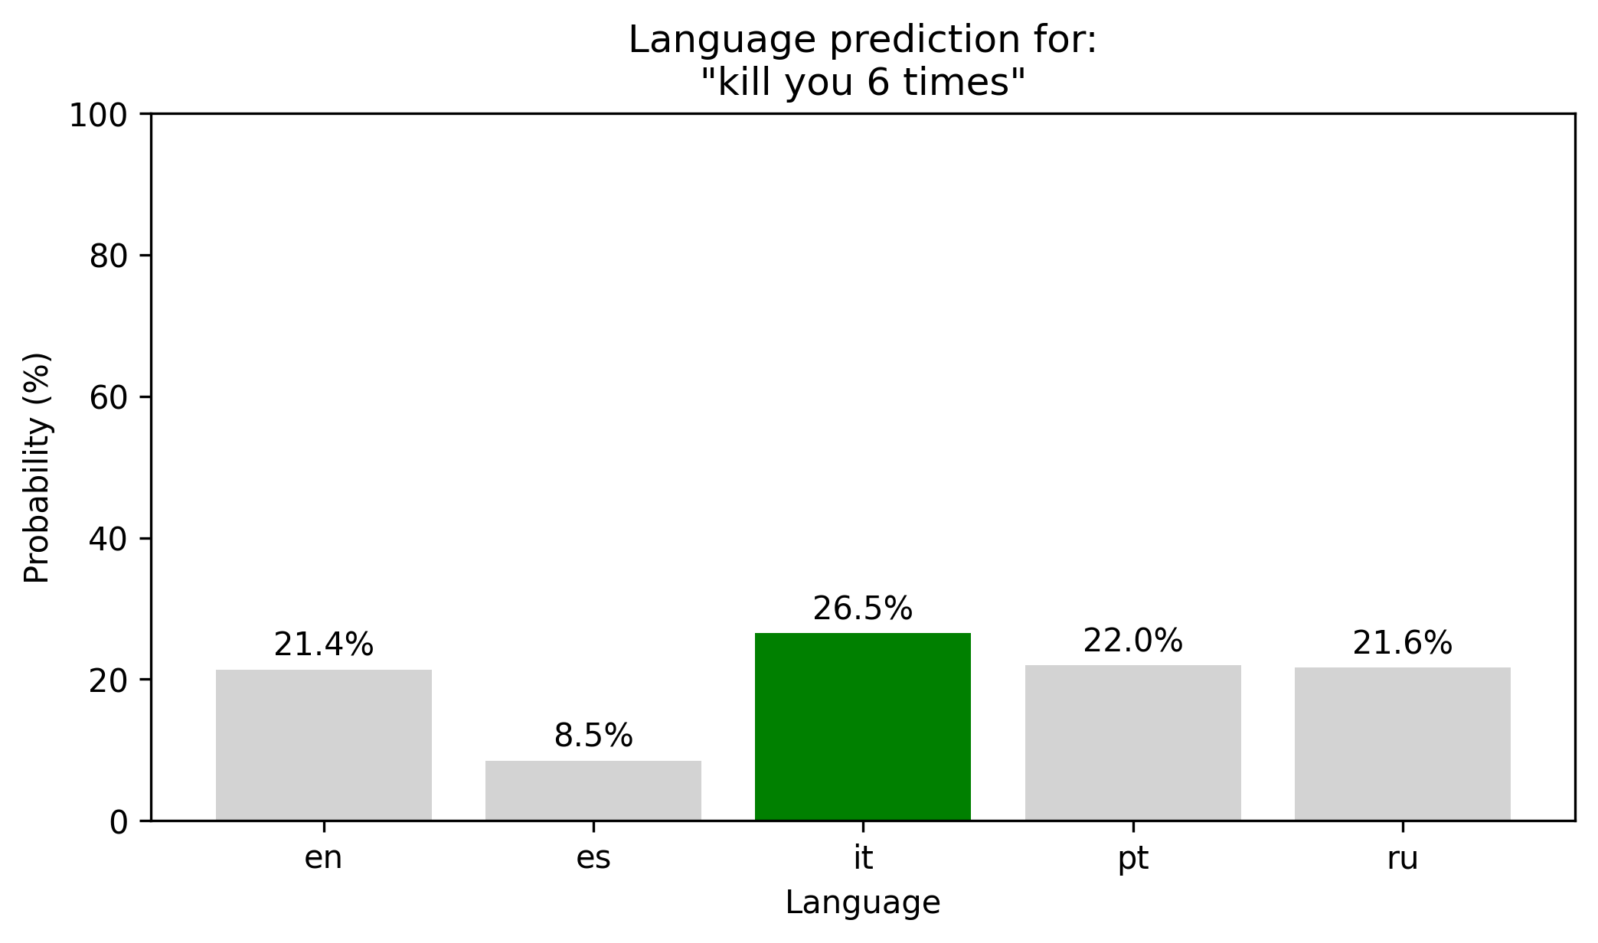
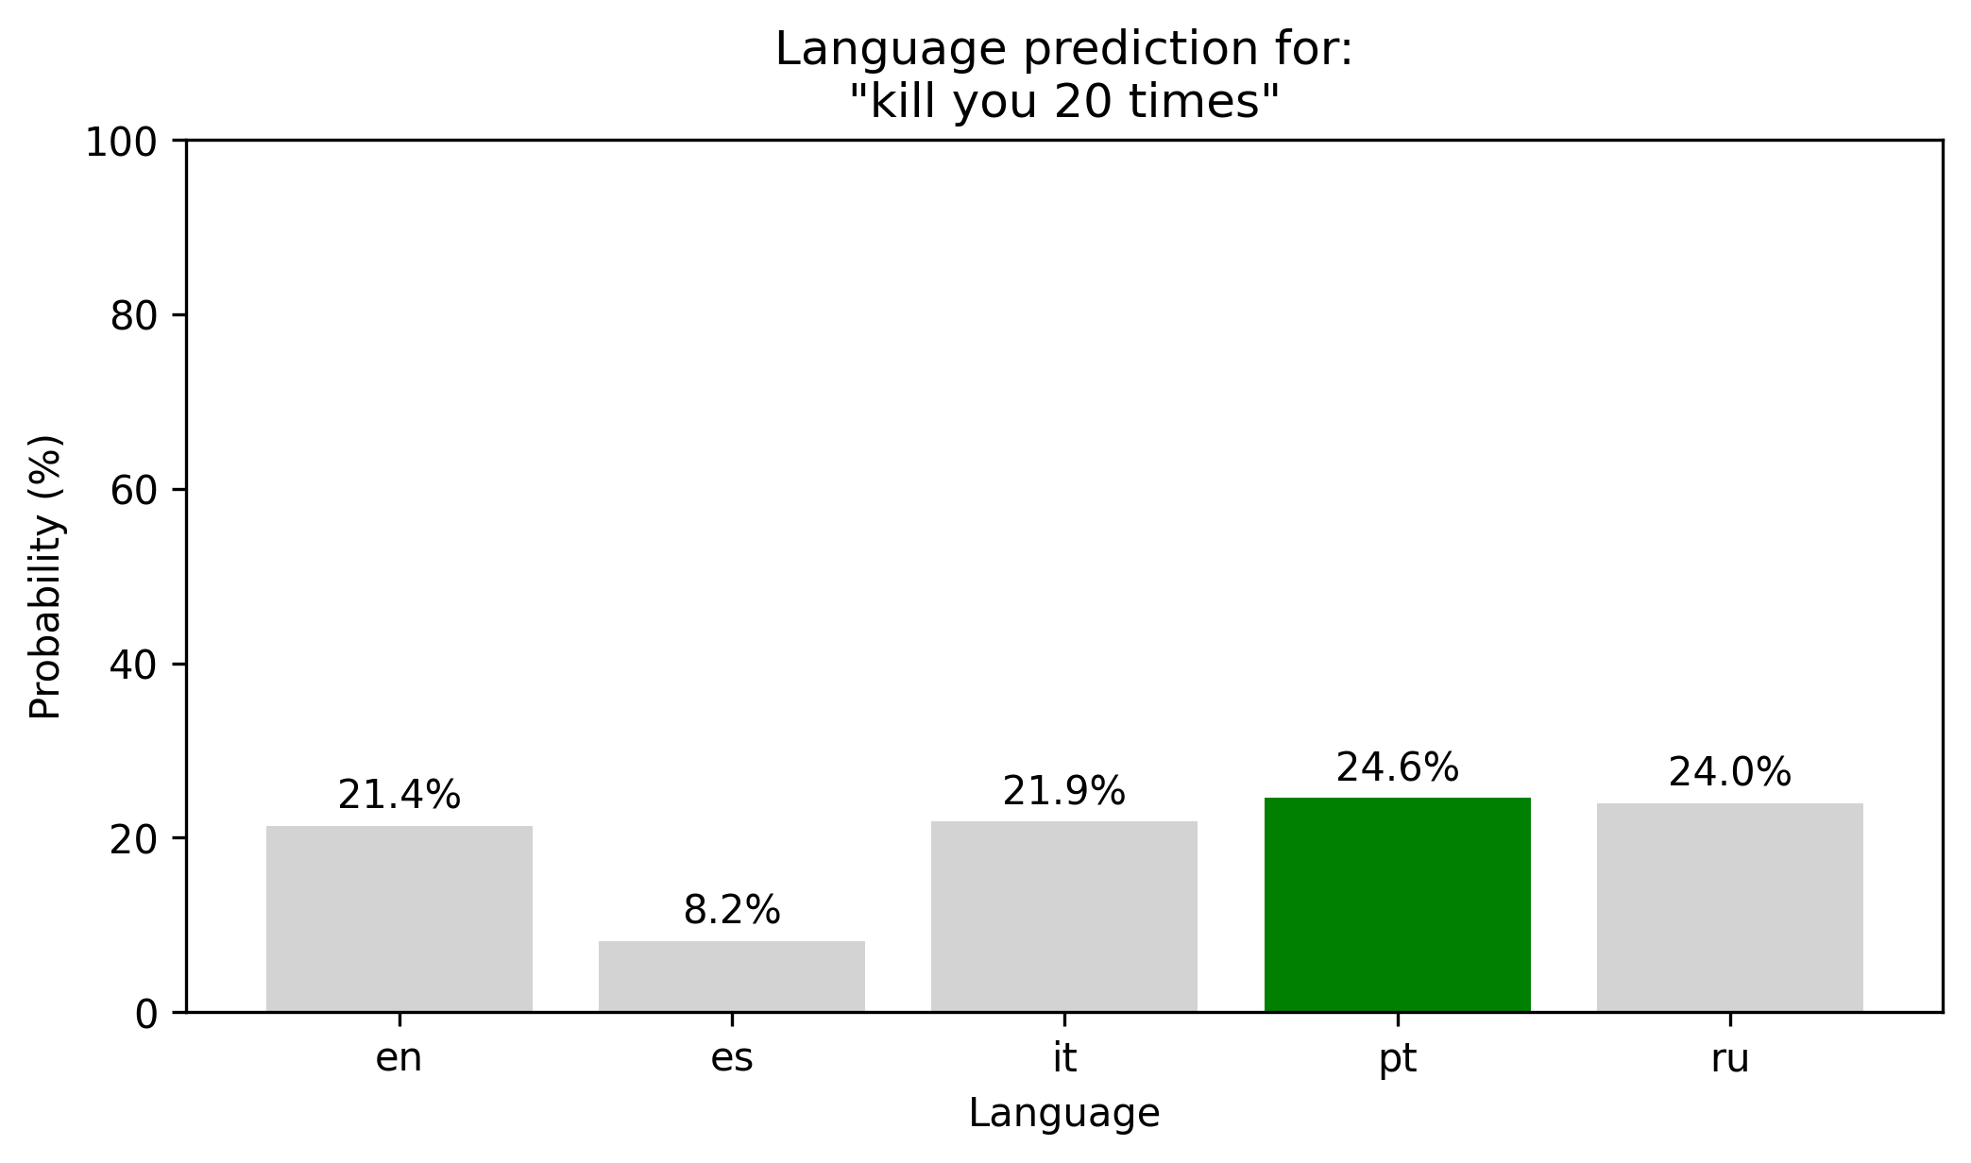
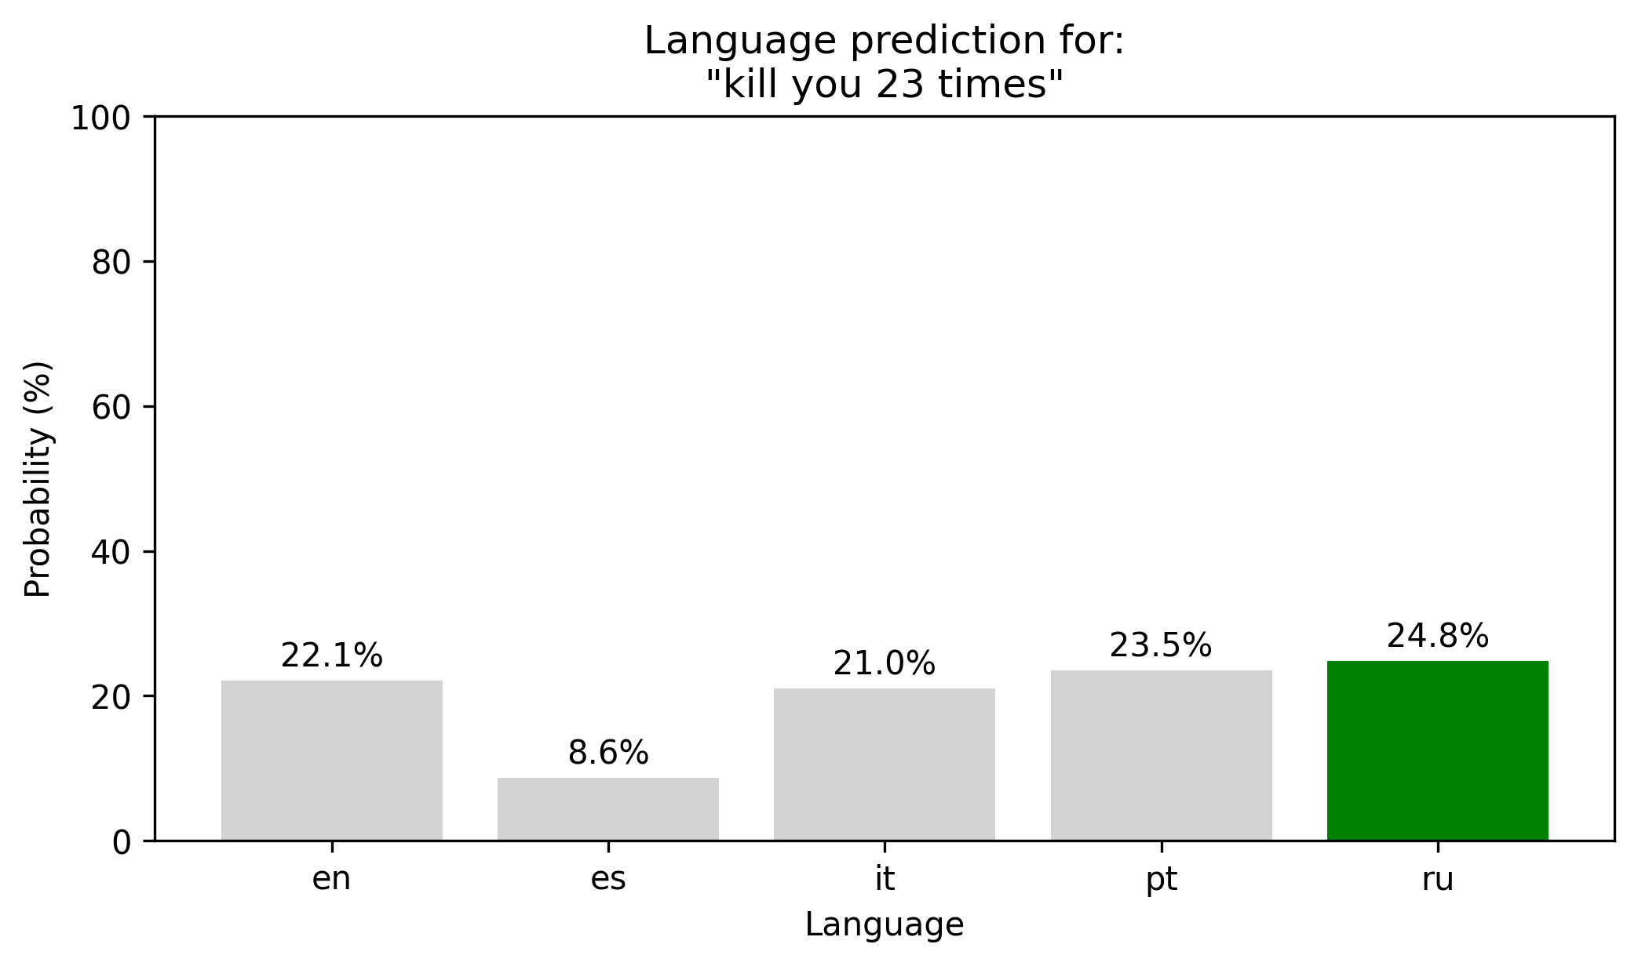

Slide 19
  Vocabulary
  kill - 10661
  you – 69
  2 - 100
  6 - 202
  20 - 439
  23 - 2142
  times - 464
A Tutorial on Langauge Classification

Slide 20
Ideas for improvement
  Remove numbers from data
  Consider removing punctuation
A Tutorial on Langauge Classification

Slide 21

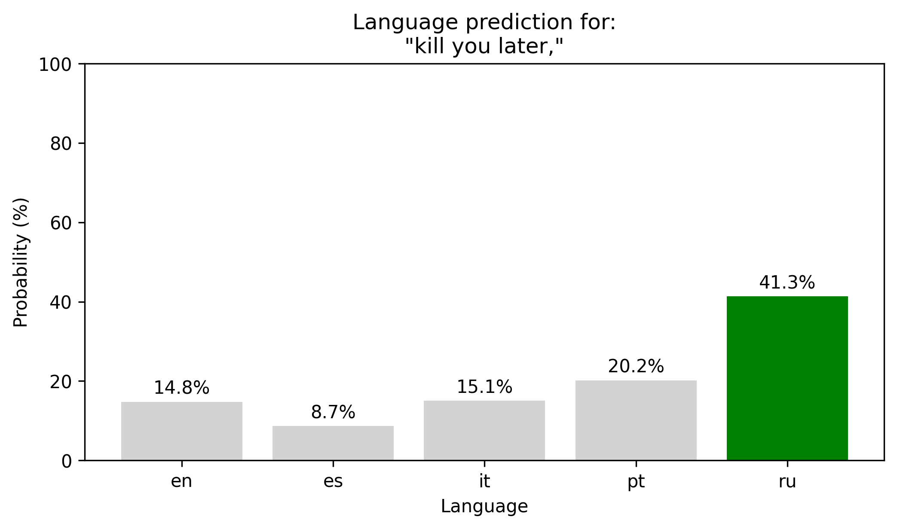
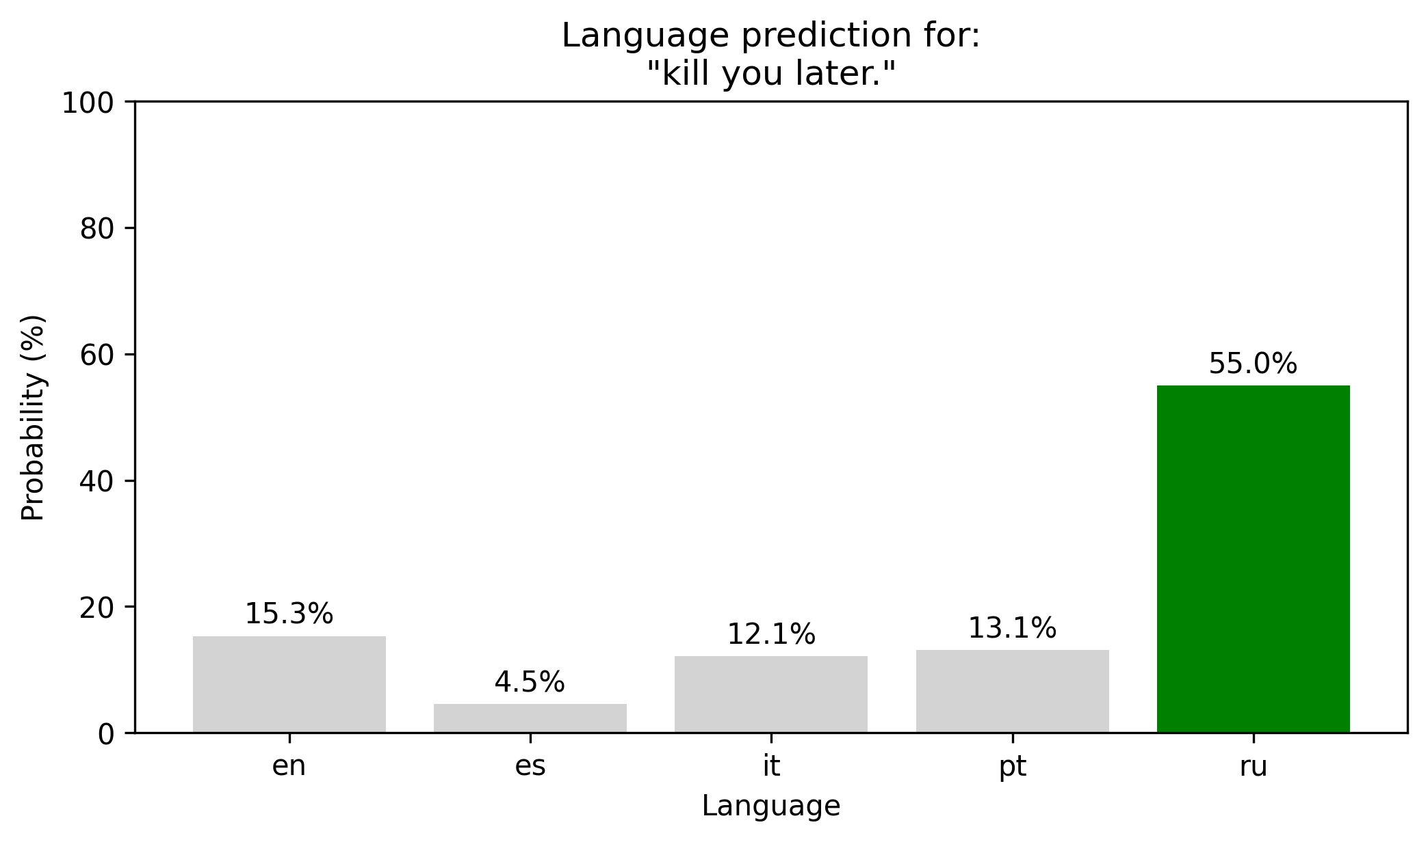
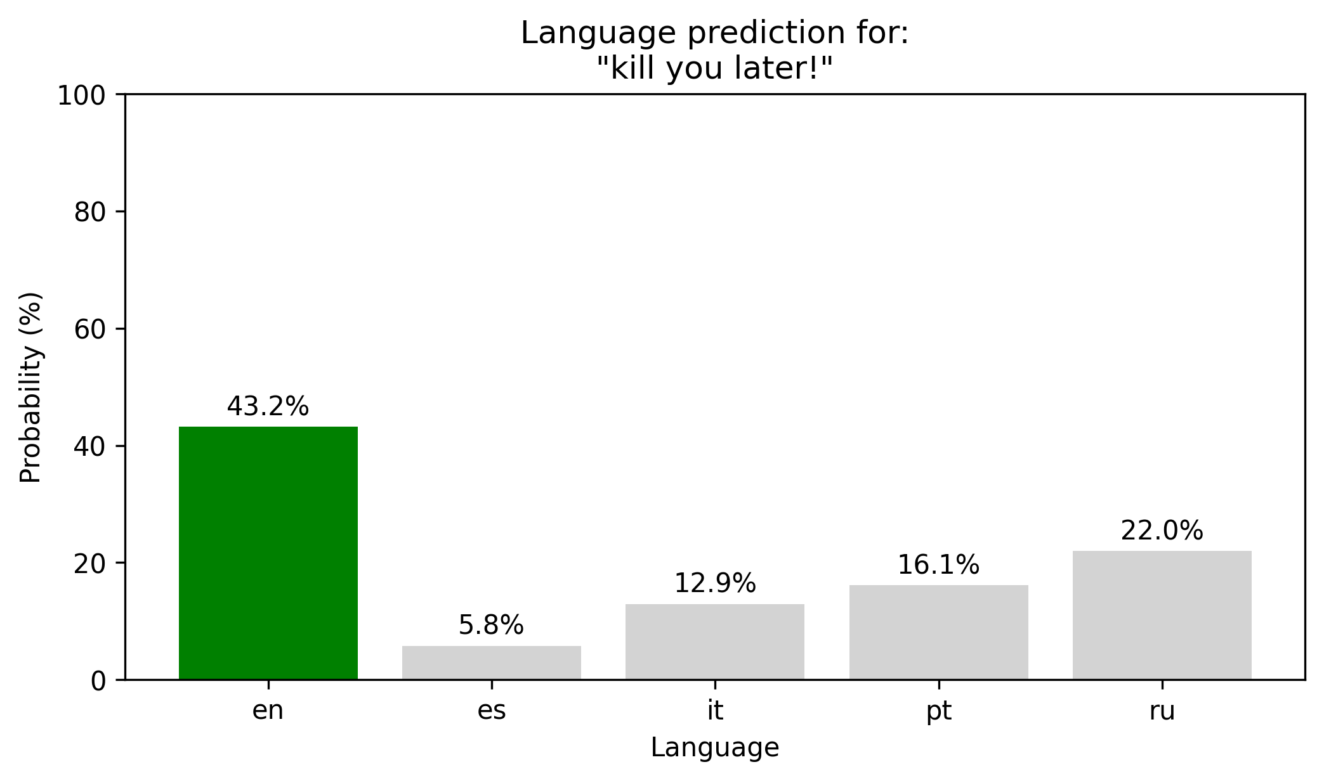

Slide 22
  Vocabulary
  kill - 10661
  you – 69
  later - 1056
  . - 1
  , - 2
  ! - 32

Slide 23
Ideas for improvement
  Remove numbers from data
  Consider removing punctuation
  Add more languages
A Tutorial on Langauge Classification

Slide 24
Discussion Points
  Punctuation. Keep? Remove? Partially?
  Every language contains some english words
    В блант резюме ( у меня мало времени ) , возможно , просить нас ( в массы ) Shell 20 баксов в год…
    На веб-сайте агентства по вопросам международного развития , на сайте " Care " или…
    Обсуждаем статью в журнале " The New York Times " в журнале " New York Times автор…
    Lo utilice con unos guantes de boxeo everlast de 12 onzas y también…
    Per l'anno in corso, si prevede un fatturato di 94 milioni di dollari e un utile di 26 centesimi per azione da operazioni continue.
A Tutorial on Langauge Classification

