Slide 1
Can Reinforcement Learning effectively detect money laundering?
Naam: Kaan Gögcay
Datum: July 1st 2026
and how does it compare to leading supervised learning methods on synthetic transaction data?

Slide 2
Probleem
Jaarlijks 16 Miljard euro
#8 Wereldwijd
Criminaliteit Loont
Banken zijn verplicht witwassen te bestrijden (wwft)

Slide 3
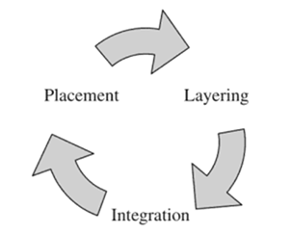
Maar wat is Witwassen?
Bron verbergen
Geld storten & investeren
Geld overmaken & assets kopen en verkopen
Luxieuze assets kopen

Slide 4



Hoe wordt Witwas gedetecteerd?
Rule-Based Rule-Based + Machine Learning

Slide 5
Hoe wordt Witwas gedetecteerd?
Bedrijf | ML Technieken
DLL | -
ING | Supervised Learning - XGBoost
ABN AMRO | Supervised Learning Unsupervised Learning XGBoost - Auto-Encoders Decision Trees - Clustering Random Forest - Isolation Forest

Slide 6
Literatuur Overview
Transformers (1)
Decision Regression Tree (1)
Naive Bayes (1)
K-Nearest Neighbors (1)
Feedforward Network (1)
AdaBoost (1)
Graph Deep Learning (1)
Graph Convolutional Network (1)
AML Survey Paper
Logistic Regression (6)
Random Forest (5)
XGBoost (4)
Decision Trees (3)
Support Vector Machines (3)
Artificial Neural Networks (1)
Gru (1)
LSTM (1)
Kaggle Fraud Detection Competition
XGBoost
CatBoost
LightGBM

Slide 7
Gat in de Literatuur
Reinforcement Learning
Toegepast op fraud detection
Niet toegepast op AML
Reinforcement Learning + Graph Based Approach
Toegepast op crypto AML datasets
Niet toegepast op synthetische banking data

Slide 8
Gat in de Literatuur
Reinforcement Learning
Toegepast op fraud detection
Niet toegepast op AML
Reinforcement Learning + Graph Based Approach
Toegepast op crypto AML datasets
Niet toegepast op synthetische banking data

Slide 9
Onderzoeksvragen
To what extent can Reinforcement Learning effectively detect money laundering, and how does it compare to leading supervised learning methods on transaction data?
1. How can Reinforcement Learning be applied to AML transaction monitoring?
2. How does Reinforcement Learning perform compared to leading supervised learning methods?
3. What are the benefits and limitations of Reinforcement Learning for AML?

Slide 10
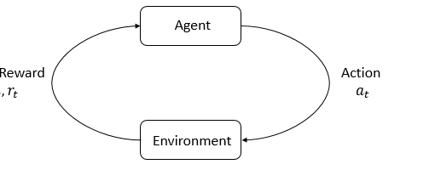
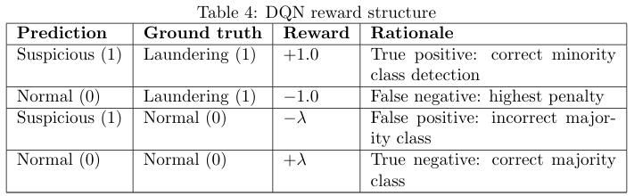
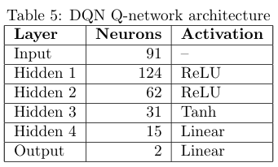
How can Reinforcement Learning be applied to AML transaction monitoring?
Dataset – SAML-D
Model – DQN
Markov Decision Process
  State: one-hot-encoded transactie
  Action: predict normal/laundering
  Reward Function:
  Episode Structure: één transactie
DQN Architectuur –

Slide 11
How does Reinforcement Learning perform compared to leading supervised learning methods?
Criteria | XGBoost | DQN
Performance | 0.9275 AUPRC | 0.6608 AUPRC
Explainability | Choices very clear | Choices unclear not able to utilize features
Robustness | Perfectly reproducable, not sensitive to hyperparameters | Run-to-run variability, subtle sensitivity to (hyper)parameters
Model Complexity | 27 features, decision trees | 91 features (one-hot-encoded), neural network
Resource Demand | ~30s training, <1s SHAP inference, <1s global SHAP feature importance | ~40m training, <1s SHAP inference, ~15 min global SHAP feature importance

Slide 12
What are the benefits and limitations of Reinforcement Learning for AML?
Criteria | XGBoost | DQN
Performance | 0.9275 AUPRC | 0.6608 AUPRC
Explainability | Choices very clear | Choices unclear not able to utilize features
Robustness | Perfectly reproducable, not sensitive to hyperparameters | Run-to-run variability, subtle sensitivity to (hyper)parameters
Model Complexity | 27 features, decision trees | 91 features (one-hot-encoded), neural network
Resource Demand | ~30s training, <1s SHAP inference, <1s global SHAP feature importance | ~40m training, <1s SHAP inference, ~15 min global SHAP feature importance

Slide 13
Vragen?

