Slide 1

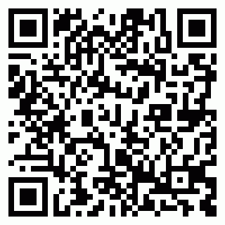
Certificate No: 202511HF67NBOD
Allenhouse Group of Institution
Certificate of Participation
This certificate is presented to
Pranav Shukla
of Allenhouse for participating in Exuberance during Exuberance – The Techno-Management, Cultural & Sports Fiesta

