Slide 1

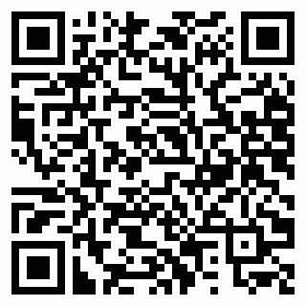
20256IOHK0P149
Mr. Ankur Tandon
ALLENHOUSE INSTITUTE OF TECNOLOGY

