Slide 1

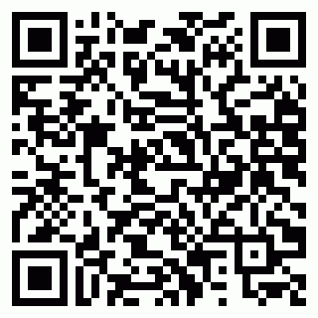
202594T79CZ4P5
Mr. Ankur Tandon
ALLENHOUSE INSTITUTE OF TECNOLOGY

