Slide 1

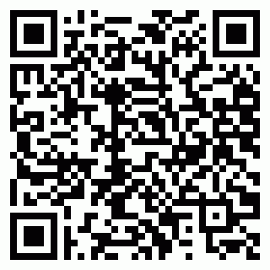
Certificate No: 2025MQAECV2LL7
Allenhouse Group of Institution
Certificate of Participation
This certificate is presented to
eshvi srivastava
of N/A for participating in Exuberance during Exuberance – The Techno-Management, Cultural & Sports Fiesta

