Slide 1

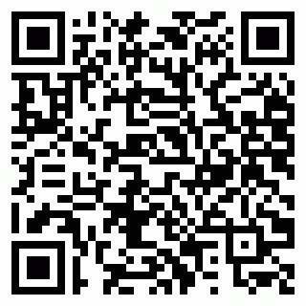
Certificate No: 2025PW50VVV1B8
Allenhouse Group of Institution
Certificate of Participation
This certificate is presented to
Pranav Shukla
of N/A for participating in Exuberance during Exuberance – The Techno-Management, Cultural & Sports Fiesta

