Slide 1

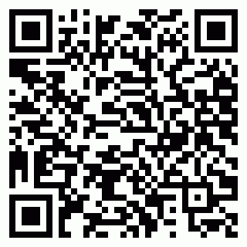
2025SZ3JHCZUZ5
Mr. Ankur Tandon
ALLENHOUSE INSTITUTE OF TECNOLOGY

