Slide 1

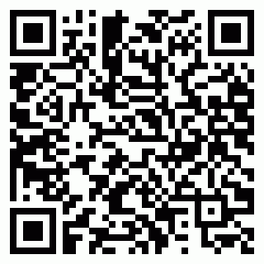

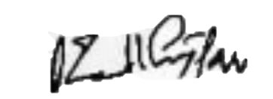
Vishlesan i-HUB IIT Patna
CERTIFICATE OF PARTICIPATION
2025ZV60EEVUT7
This is to certify that Mr. Ankur Tandon of ALLENHOUSE INSTITUTE OF TECNOLOGY has completed the Faculty Development Program AI Mastery for Educators From 15 May, 2025 to 7 June, 2025
Dr. Sai Kiran CEO, Vishlesan i-HUB IIT Patna

