Slide 1




Hackathon: REST API – Just Girls!
Team Members
Brisha Patel
Carmen Vieira
Clarissa Woodberry

Slide 2
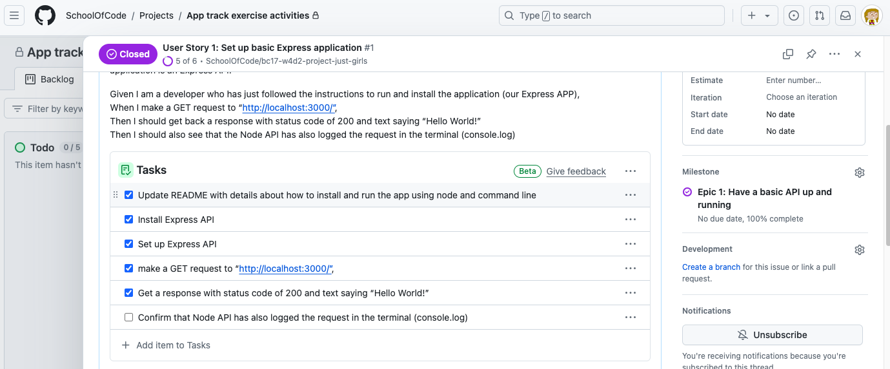
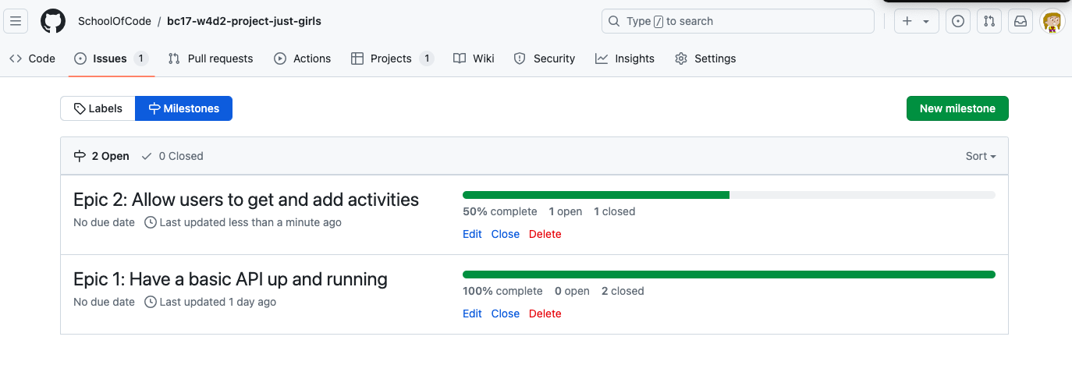
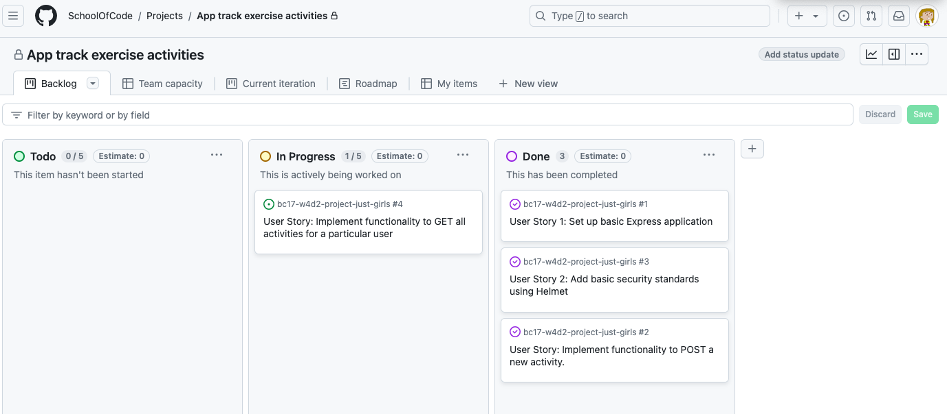
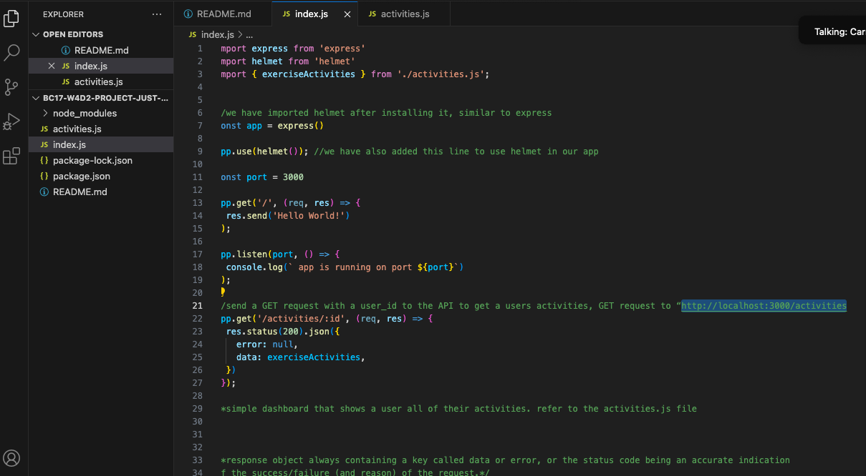
Hackathon: REST API
Planning – Time4Exercise

Slide 3
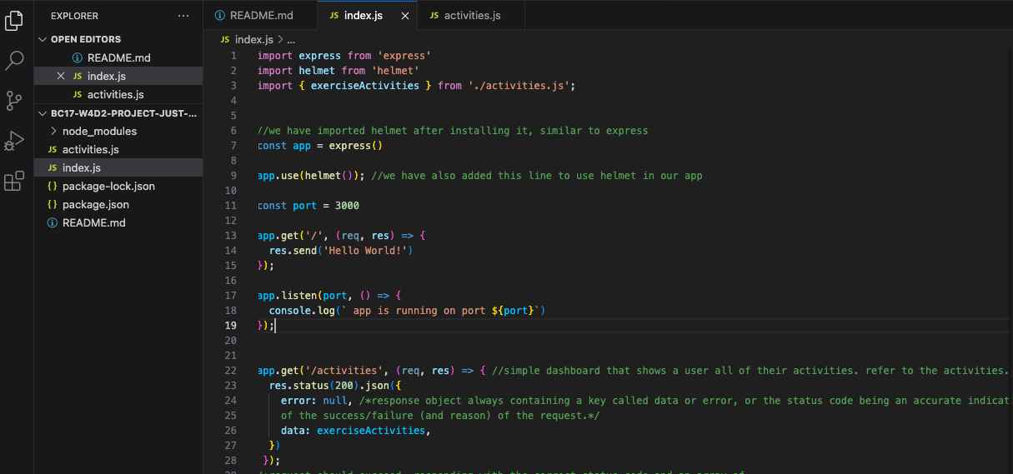
Hackathon: REST API
DEMO

Slide 4
Hackathon: REST API
Reflections
What Went Well
We tried to implement the learnings from the “listening types” to ensure we were better listeners.
We ensured all team members were comfortable with the concepts before we proceeded.
Team members felt heard and had opportunity to drive and navigate in a balanced way, allowing for a equal share of workload.
Room for Improvement
Sometimes to not “rush” and have a more systematic debugging approach.
To manage the duality of being on top of the technical side and be able to complete all the curriculum requirements, so the “struggle” is not so difficult.

