Slide 1
LBB7
Lana Mauge, ben maharjan, Ben Miller

Slide 2
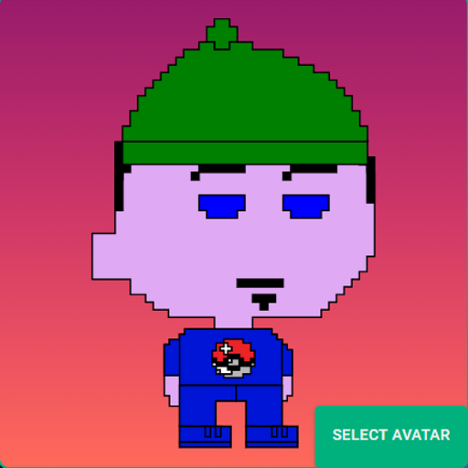
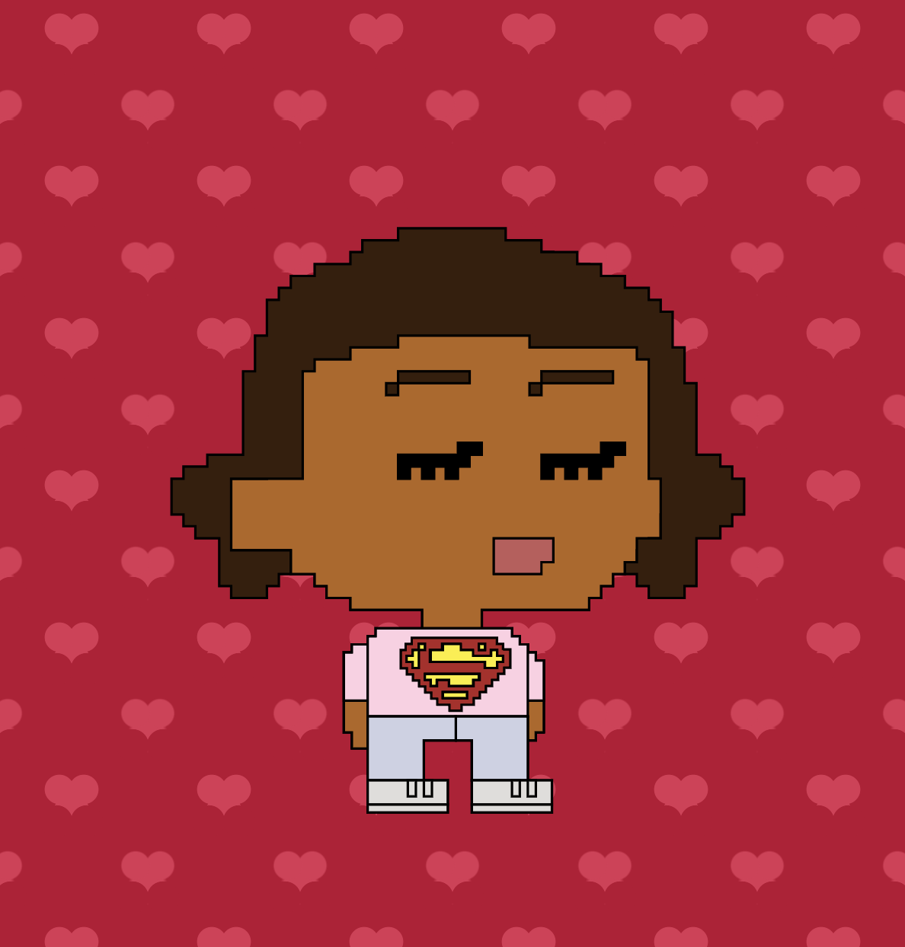

Ben Maharjan
Former business owner
Hobbies:
Fitness
Martial arts
Lana Mauge
Graphic designer
Based in Northwest London
Ben Miller
Former games design student
Hobbies:
Cooking
Game dev

Slide 3
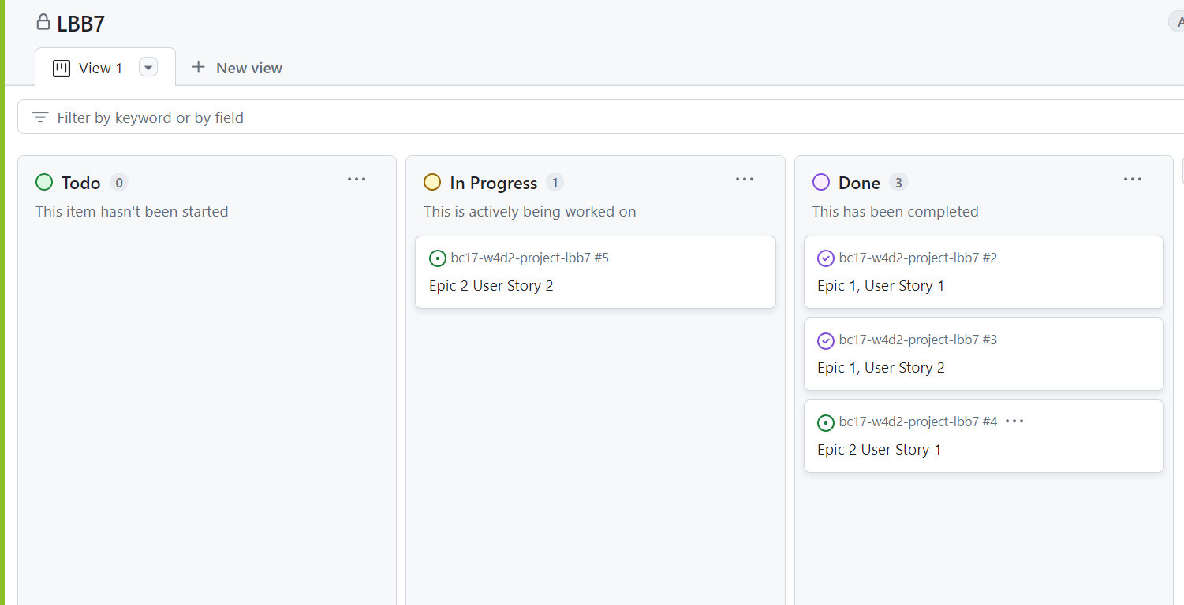
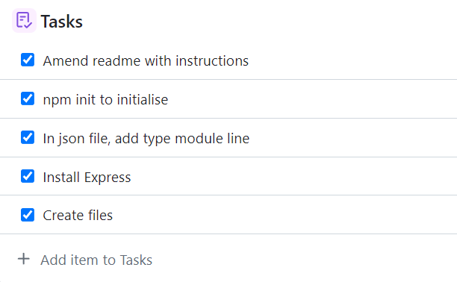
Preparation
GitHub to do board,
Shows what needs to be done, what is in progress, and what is done

Slide 4
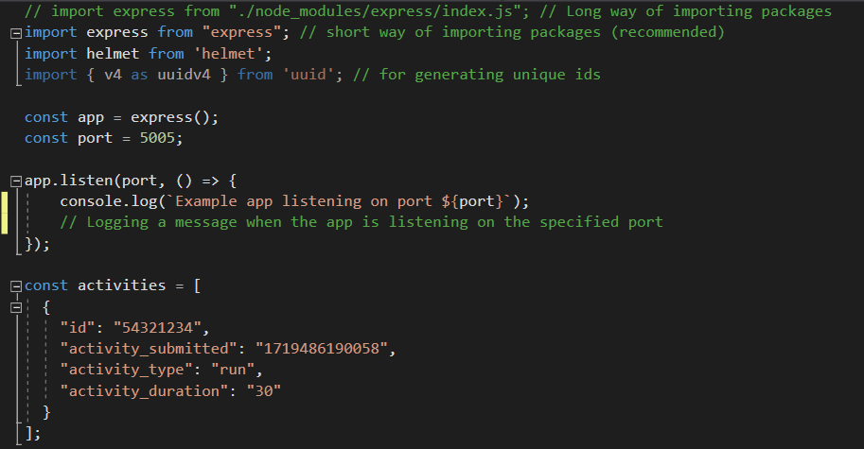
Code demo
Example of code used in project

Slide 5
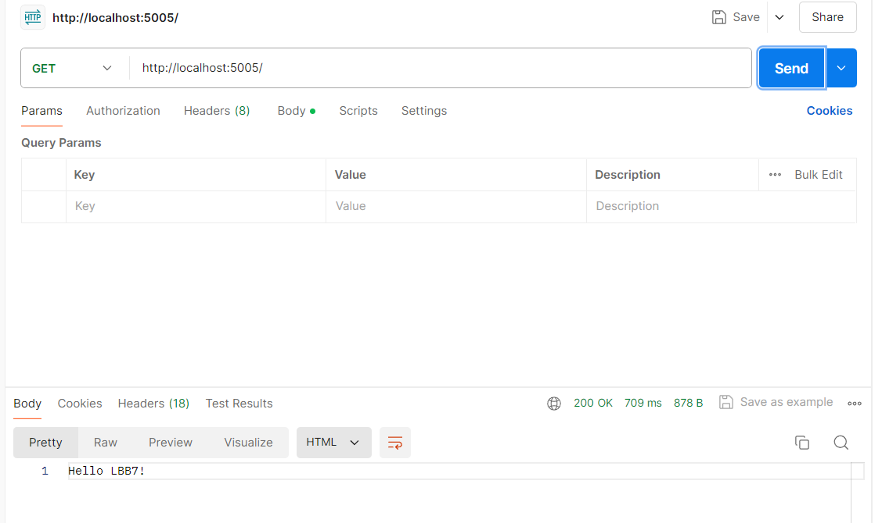
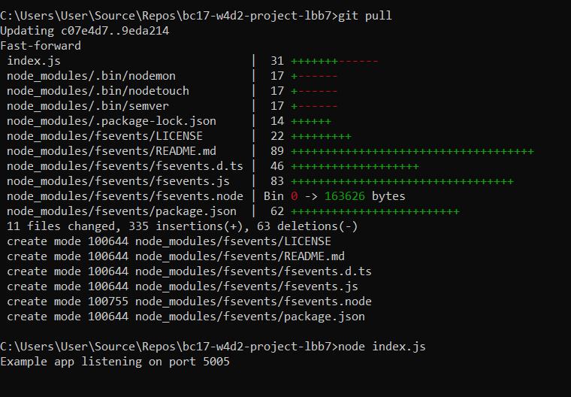
Postman
Use of Postman to test API

Slide 6
Reflections
What went well:
Planning through tasks
Completion of various stories
Teamwork and collaboration
Use of different resources to find solutions
What could have been done differently:
Time planning to complete further tasks
Alternate driving more frequently

Slide 7
Thanks! Any questions?

