Slide 1

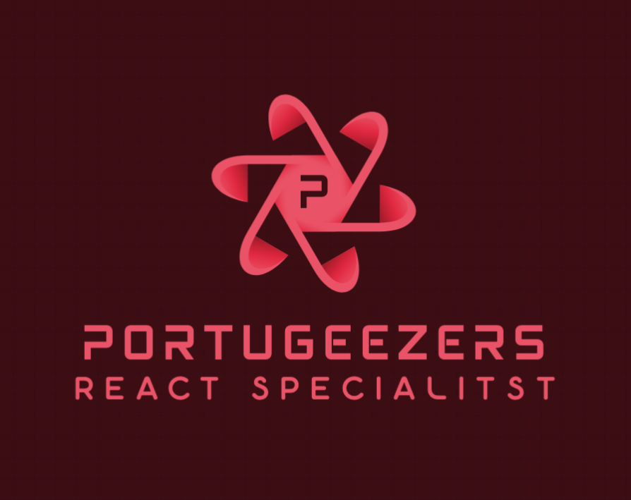
🔥Fireplace Palace Hackathon 🔥
Carmen Vieira
Dominic Maynard

Slide 2
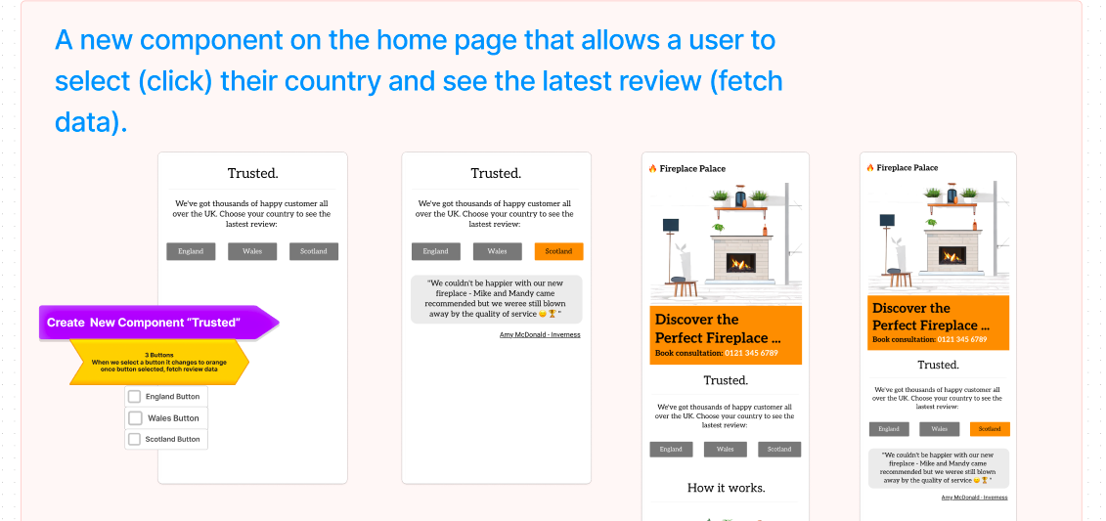
🔥Fireplace Palace Hackathon 🔥
Fireplace Palace Requirements/Planning

Slide 3
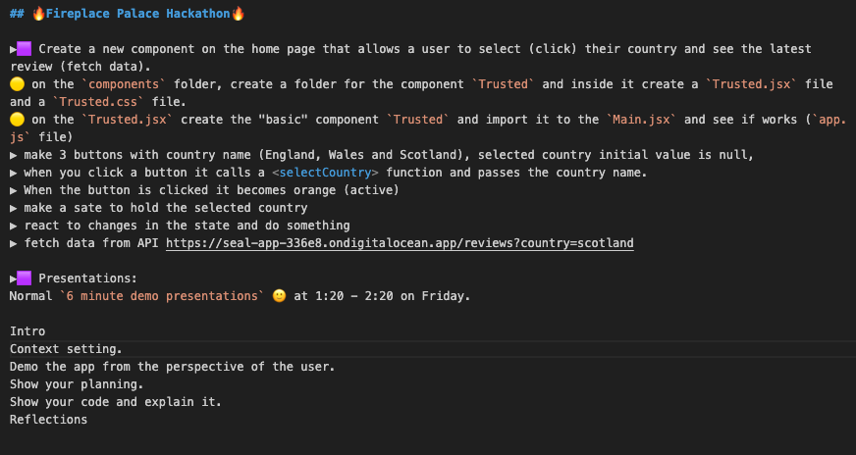
🔥Fireplace Palace Hackathon 🔥
Fireplace Palace Requirements/Planning

Slide 4
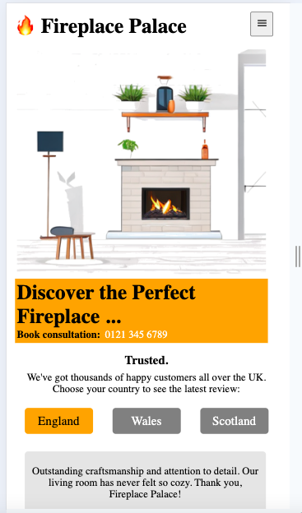
🔥Fireplace Palace Hackathon 🔥
User Interface Demo

Slide 5
🔥Fireplace Palace Hackathon 🔥
User Interface Demo

Slide 6
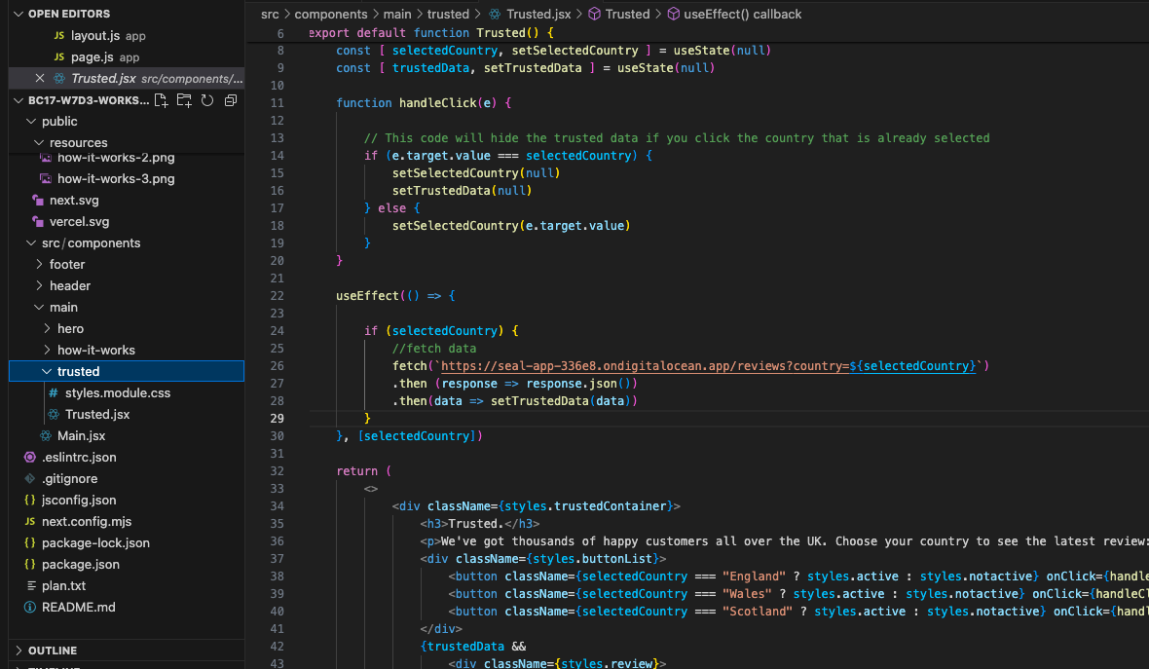
🔥Fireplace Palace Hackathon 🔥
Code Walkthrough

Slide 7
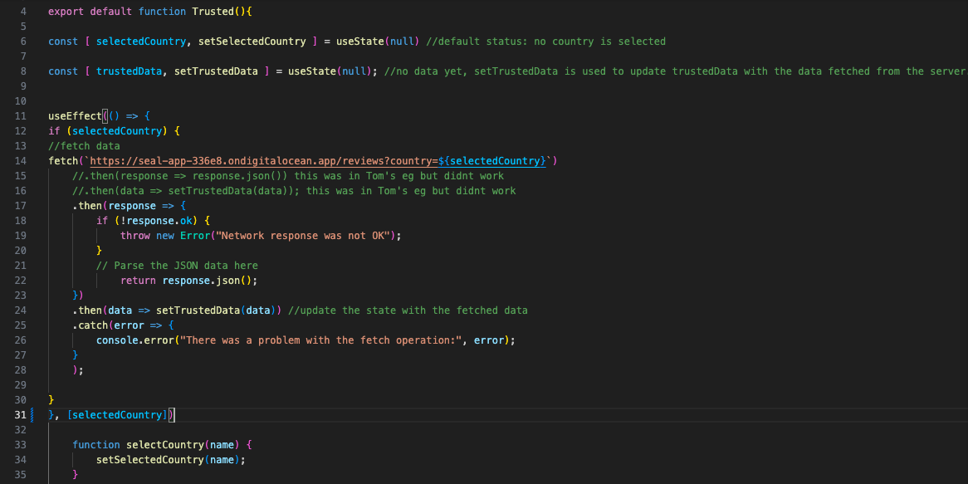
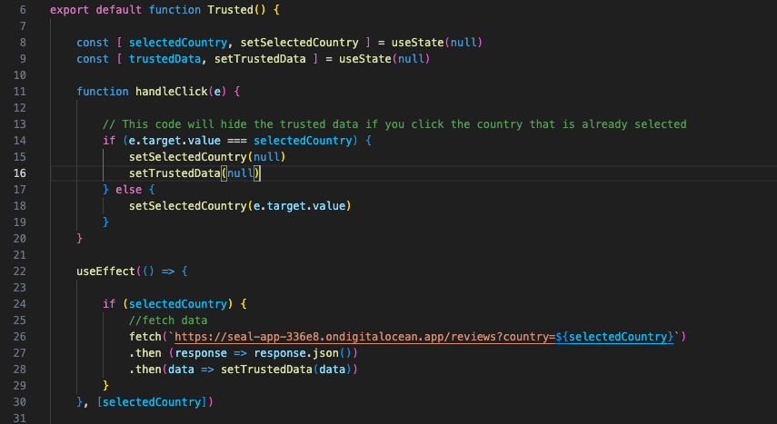
🔥Fireplace Palace Hackathon 🔥
Reflections

Slide 8
🔥Fireplace Palace Hackathon 🔥
Reflections
Room for Improvement
Sometimes to not “rush” and have a more systematic approach: more logical filing system and components organization.
To manage the duality of being on top of the technical side and be able to complete all the “tasks”, so the “struggle” is not so difficult.
What Went Well
We ensured all team members were comfortable with the concepts before we proceeded.
Team members were able to experiment with the project according to their cognitive/learning preferred style
Team had opportunity to drive and navigate in a balanced way.

