Slide 1

The Roll-A-Ball game

Slide 2

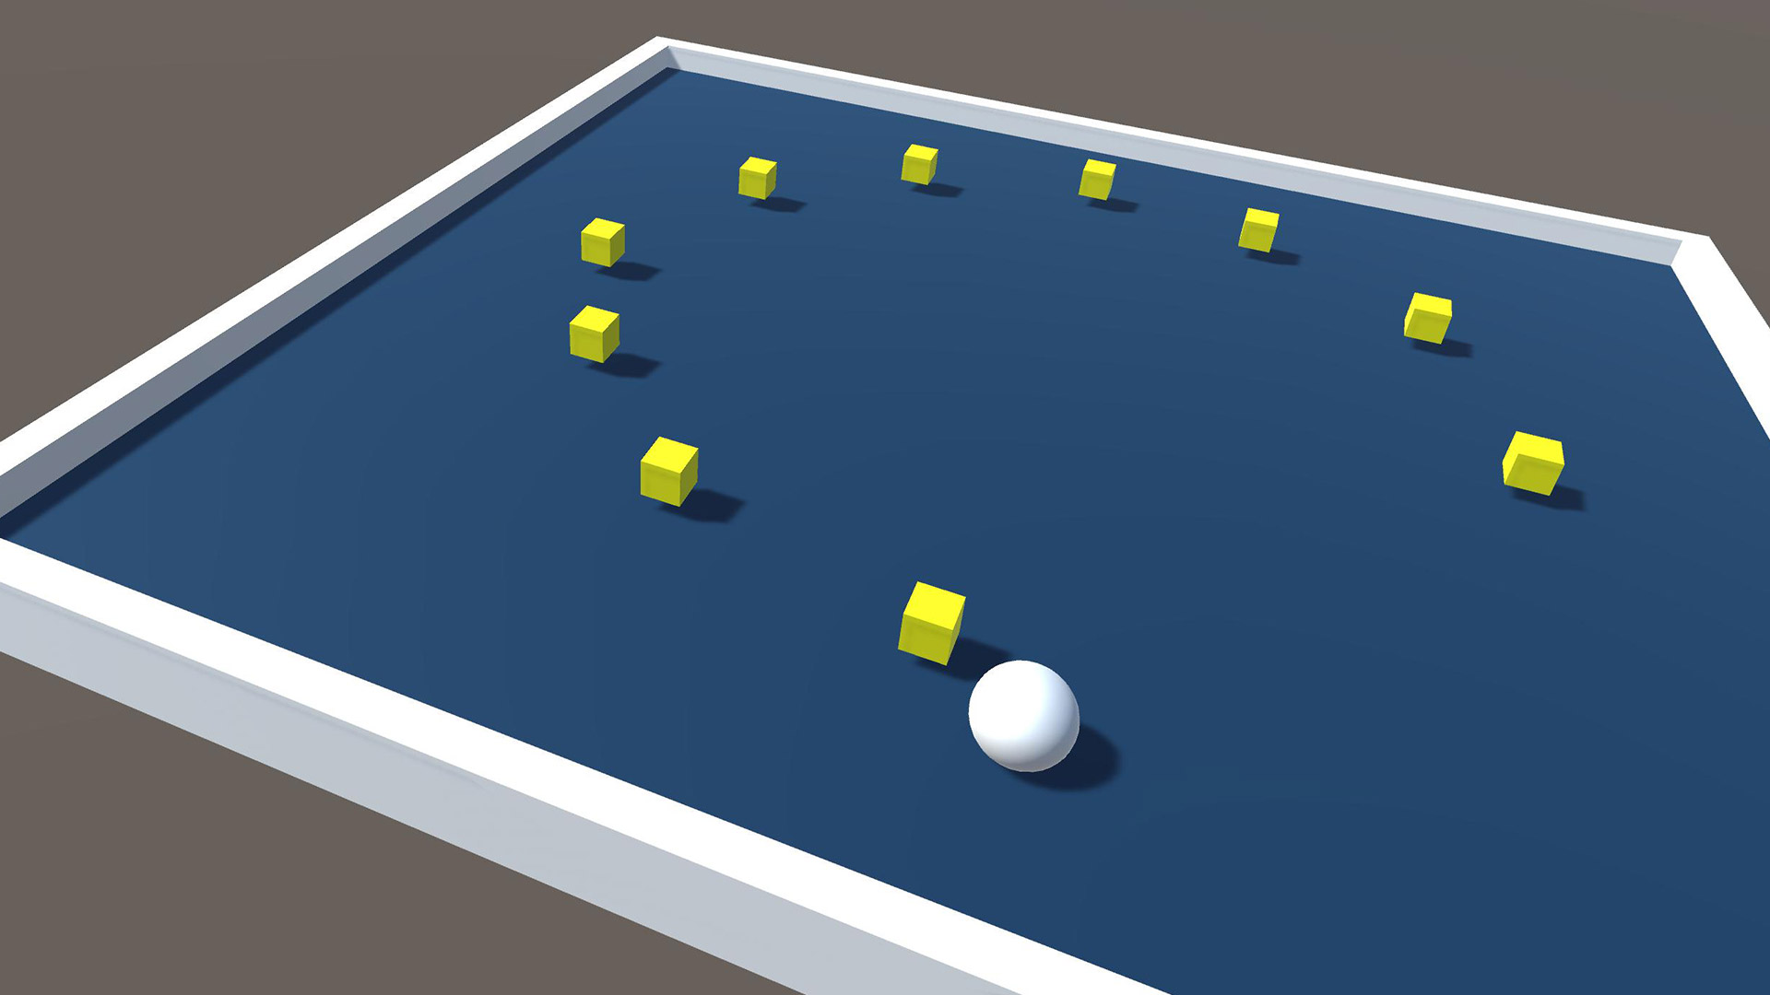
Building your first game in Unity
With the help of the Roll-a-ball tutorial
You will learn how to
Design a scene for your game
Use basic physics component to handle gravity and collisions
Create simple script to define the behavior of your game objects
Create simple text UI to provide information about the game’s state
Build your game to share it with other people

Slide 3
Building your first game in Unity
The tutorial is available here:
https://learn.unity.com/project/roll-a-ball-tutorial

Slide 4
Extending Roll-a-ball
Modify the roll-a-ball program to add new functionalities of your choice

Slide 5
Suggestions of game extensions
Add new types of pickup objects
Add pickups that affect the ball’s speed
Add multiple levels
Hint: changing levels will require you to use the Scene Manager
SceneManager.LoadScene()
To access the Scene Manager you will need to use the UnityEngine.SceneManagement namespace
You will also need to make sure all the scenes are added to the build settings
Keep track of the time required to beat the level
Add an AI opponent who chases the player

Slide 6
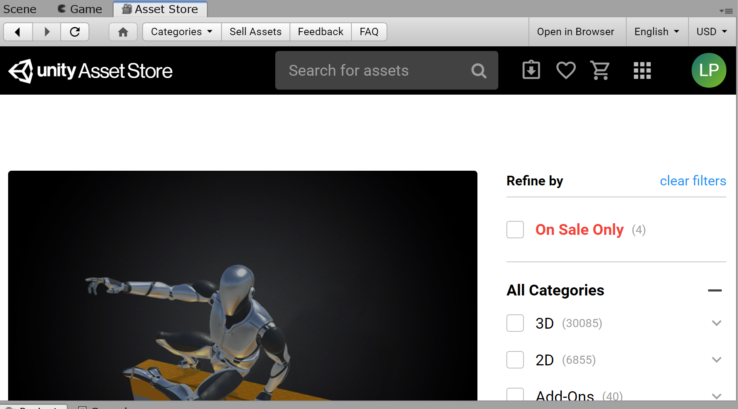
Unity asset store
Unity includes an asset store that can be used to find game objects that you can include in your game
For example, if you would like to find new 3D models
You can search for free downloads

Slide 7
How did it go?
What are challenges that you’ve encountered?
Did you have time to extend the game?
What extension did you do?
How did you approach it?

