Slide 1

The Roll-A-Ball game

Slide 2

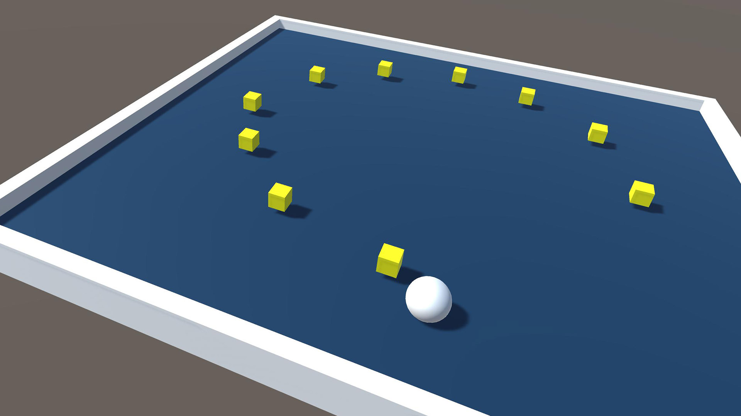
Building your first game in Unity
With the help of the Roll-a-ball tutorial
You will learn how to
Design a scene for your game
Use basic physics component to handle gravity and collisions
Create simple script to define the behavior of your game objects
Create simple text UI to provide information about the game’s state
Build your game to share it with other people

Slide 3
Building your first game in Unity
The tutorial is available here:
https://learn.unity.com/project/roll-a-ball-tutorial
Work in teams
Let us know if you need any assistance

Slide 4
How is it going so far?
Any challenges that you would like to discuss?
Anything that the tutorial asked you to do, but that you would like to better understand?
If you finish the tutorial early
Think about how you can extend this game by adding new functionalities

Slide 5
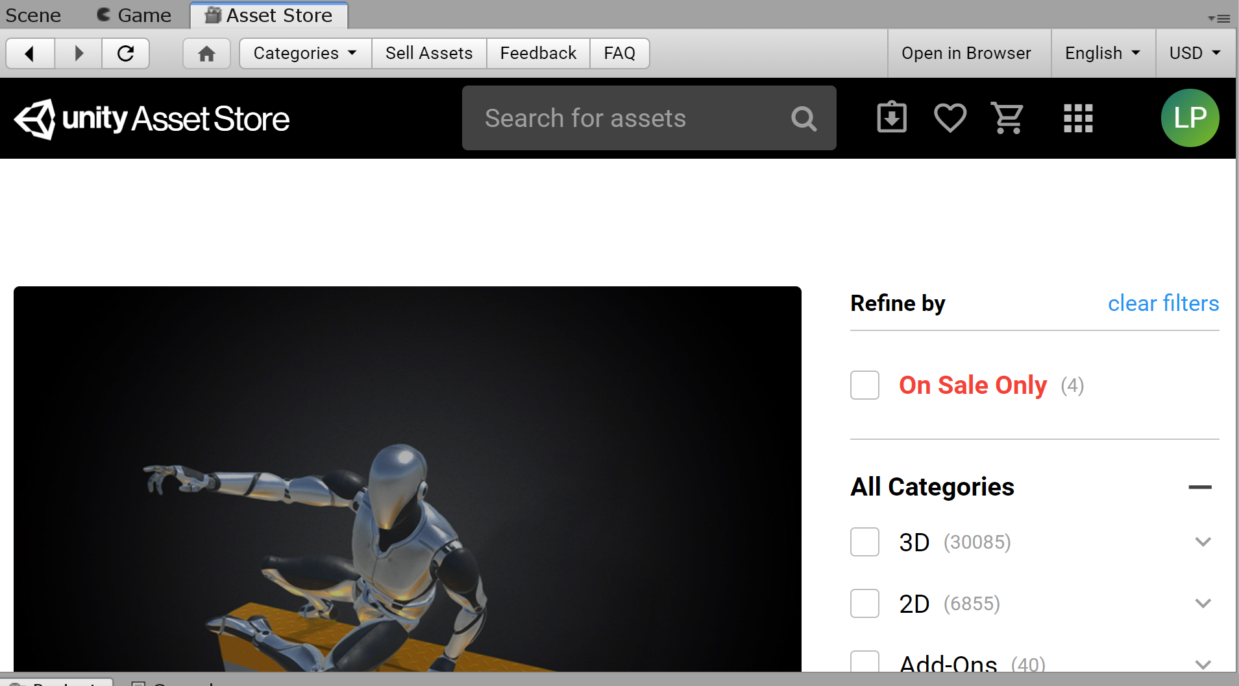
Unity asset store
Unity includes an asset store that can be used to find game objects that you can include in your game
For example, if you would like to find new 3D models
You can search for free downloads

Slide 6
Suggestions of game extensions
Add new types of pickup objects
Add multiple levels
Hint: changing levels will require you to use the Scene Manager
SceneManager.LoadScene()
To access the Scene Manager you will need to use the UnityEngine.SceneManagement namespace
You will also need to make sure all the scenes are added to the build settings
Add an AI opponent who chases the player
Keep track of the time required to beat the level

Slide 7
How did it go?
What are challenges that you’ve encountered?
Did you have time to extend the game?
What extension did you do?
How did you approach it?

