Slide 1

Introduction to VR and AR using the Unity platform

Slide 2

Welcome!

Slide 3
Introductions
Luc Paquette
Assistant professor, college of education
PI, I-STECS initiative
lpaq@illinois.edu
Eric Shaffer
Teaching assistant professor, computer science
Raya Hegemen-Davis
Program coordinator, I-STECS initiative
raya@illinois.edu
Liia Butler
PhD student, computer science

Slide 4

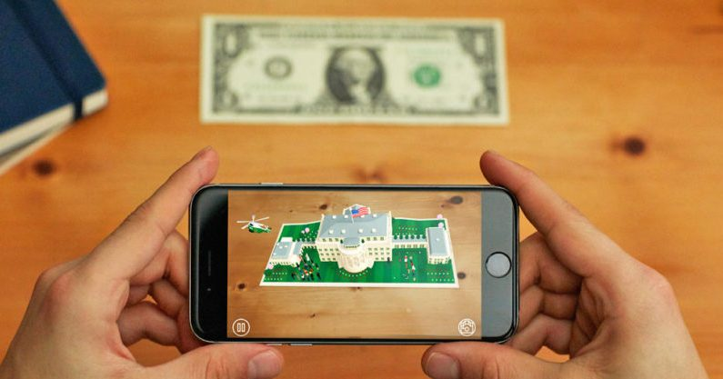

Goals
High level introduction to building virtual reality and augmented reality applications using the Unity platform
Learn how to setup the Unity tool to build VR/AR applications
Learn the basics of using the Google VR SDK and Vuforia
Notes:
Designed to be accessible for participants who do not already have extensive Unity or programming experience
But, not designed to become experts in Unity
Not directly teaching programming (but we will help with that)
Interesting aspect of the Unity tool is that it is possible to create projects with limited programming, but programming can become quite extensive for larger projects

Slide 5
Getting to know each others
What is your name?
What/where do you teach?
What is your experience with computer programming?
What is one interesting fact/anecdote about yourself?

Slide 6
VR and AR
How many have experienced virtual reality before?
Can you tell us about your experience?
How many have experienced augmented reality before?
Can you tell us about your experience?

Slide 7
VR and AR
Go on your phone’s app store
Find examples of VR and AR applications
What do you think of those applications?
Are they fun to use?
Are they easy to use?
How do those applications differ from “regular” applications?
What interaction methods are used in the applications?
Do the applications make any ingenious uses of VR/AR?
Would it be possible to create a similar application without VR/AR? Does the use of VR/AR enables something that wouldn’t be possible otherwise?

Slide 8
Why VR and AR?
There has been a growing interest in VR and AR
Why do you think this might be the case?
What do you think are the best applications of VR and AR?
What do you think is the interest of teaching VR and AR?
Create a poster to summarize your discussion
Notes:
Luc – comment: Are the questions too independent from each other? Or is there enough of a link to build a narrative?

