Slide 1

Natural Language Processing Workshop
Part I: Building a Chatbot

Slide 2
Natural Language Processing Workshop
Workshop Overview

Slide 3

Overview
What is a Chatbot?
Hi, My name is Alex how may I help you?
Project Overview
Hey, My laptop is not working.
May I know the model Number of your laptop

Slide 4
Overview
Training Data: Cornell Movie--Dialogs Corpus
DESCRIPTION:
This corpus contains a large metadata-rich collection of fictional conversations extracted from raw movie scripts:
- 220,579 conversational exchanges between 10,292 pairs of movie characters
- Involves 9,035 characters from 617 movies
- In total 304,713 utterances

Slide 5
Overview
Workshop PART I (July 30):
Data Preprocessing
Build the chatbot
Workshop PART II (Aug 13):
Deploy the model

Slide 6

Plan
Data preprocessing
Seq2Seq Concept
Q&A
Workshop!

Slide 7
Data Preprocessing

Slide 8
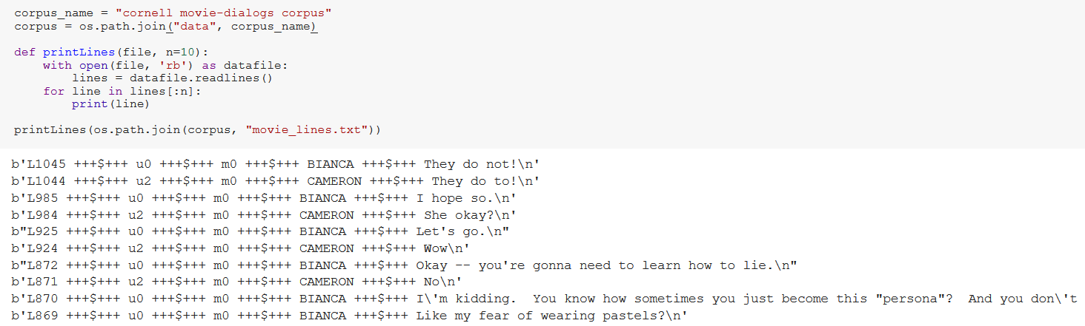
Data Preprocessing
File: movie_lines.txt
Line ID
Character
ID
Movie ID
Character Name
Text/Utterance
Separators

Slide 9
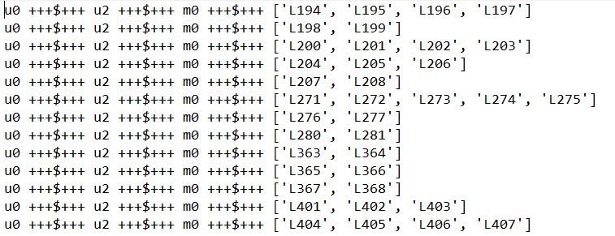
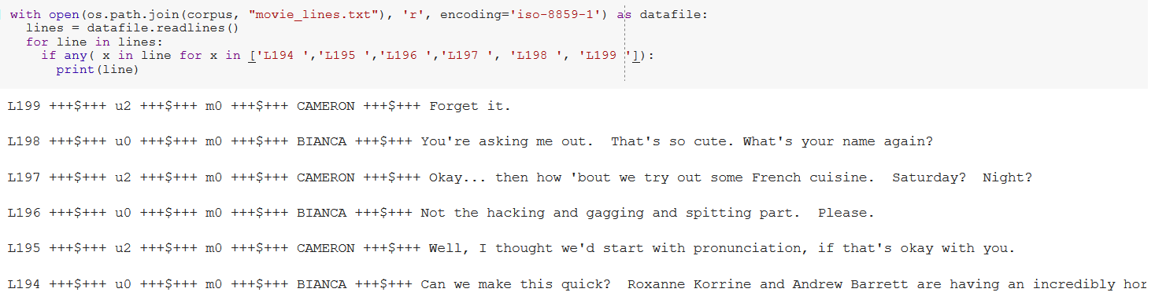
Data Preprocessing
File: movie_conversations.txt
Character
ID 1
Character
ID 2
Movie ID
Line IDs

Slide 10
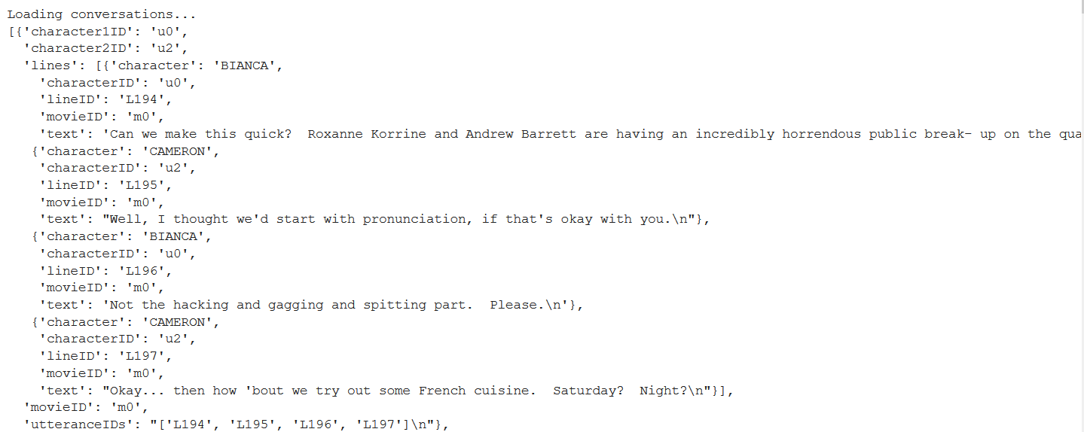
Data Preprocessing

Slide 11
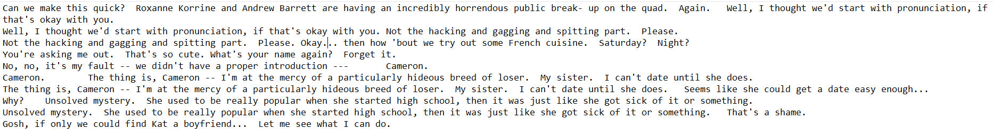
Data Preprocessing
194
195
194
195
Conversations Ordering:
195
196
196
197
198
199

Slide 12
Data Preprocessing
Create a vocabulary and load query/response sentence pairs into memory
Sequences of words to create mapping to a discrete numerical space.
Create mapping of each unique word encountered in our dataset to an index value
Define a mapping from words to indexes, a reverse mapping of indexes to words
Count of each word and a total word count
Add a word to the vocabulary (addWord)
Add all words in a sentence (addSentence)
Trim infrequently seen words (trim)
Max sentence length = 10, Start with ‘SOS’ , End with ‘EOS’, PAD short sentences

Slide 13
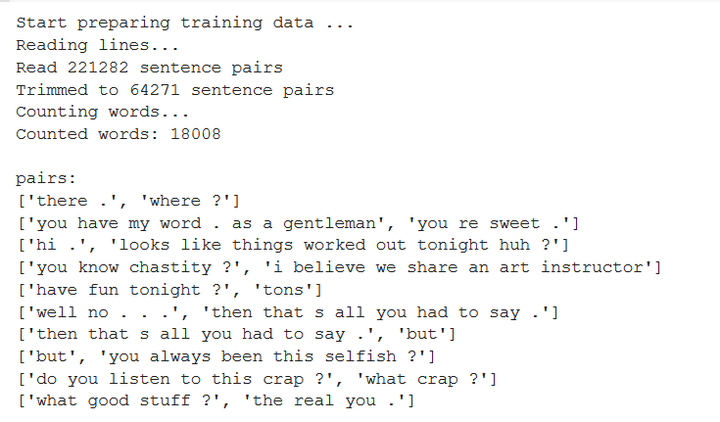
Data Preprocessing

Slide 14
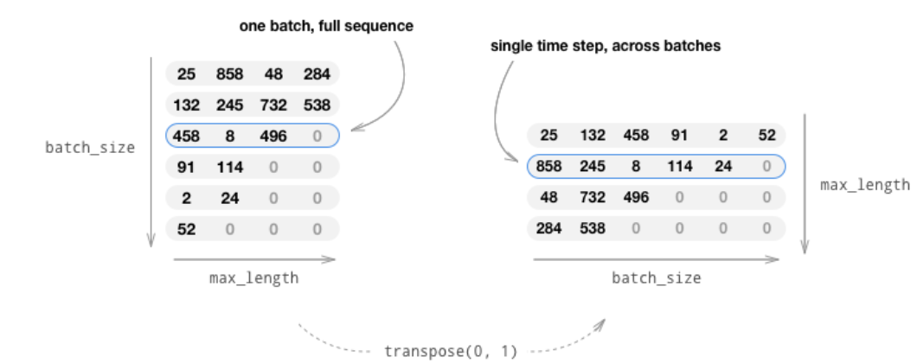
Data Preprocessing
The matrix is transposed so that indexing across the first dimension returns a time step across all sentences in the batch

Slide 15

Data Preprocessing
Seq2Seq Model

Slide 16
Seq2Seq Model
Contextual awareness
The clouds are in the Sky.
I grew up in France. I speak French
I am studying data science at UBC because I want to work as a data Scientist
I am from India, this summer I am planning to go back home. I am looking for cheap flights between Vancouver and Delhi
How will the Chatbot remember this ?

Slide 17
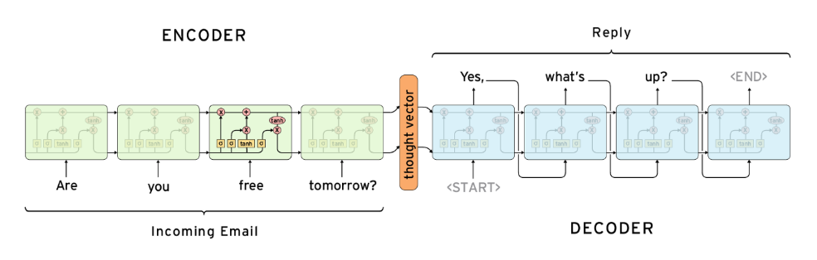
Seq2Seq Model

Slide 18
RNN Vs GRUs
Enhanced remembrance of the context.
Relation between the words far apart in the sentences remains intact
Gated Recurrent Unit (GRU) and both have the same goal of tracking long-term dependencies effectively while mitigating the vanishing/exploding gradient problems

Slide 19
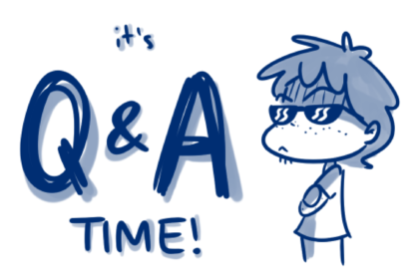
Q&A

Slide 20
Additional Resources
Chatbots (Wikipedia)
Chatbot Tutorial (Tutorial)
Cornell Movie--Dialogs Corpus (Data)
Understanding LSTM Networks
NLP | Seq2seq Model (Encoder Decoder Model)
Seq2Seq with Attention and Beam Search

Slide 21
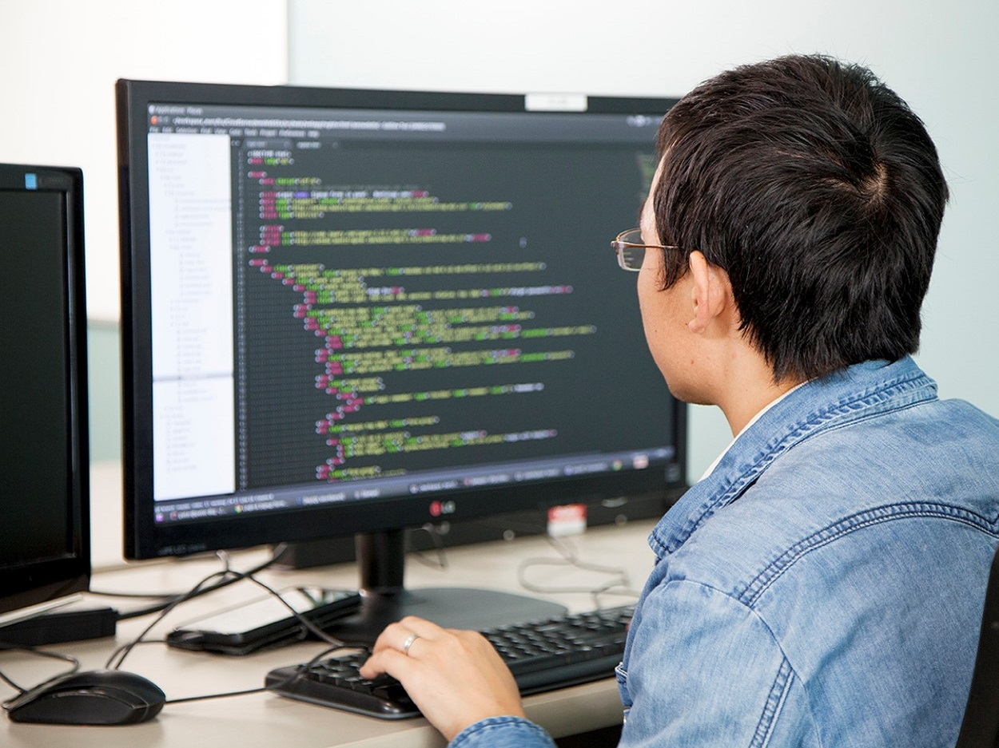
Activity Time!

Slide 22
Your Task
Fork the below Kaggle Kernel and follow along:
Link to be added once finalized

Slide 23

Venue Sponsor

Slide 24

The End

