Slide 1
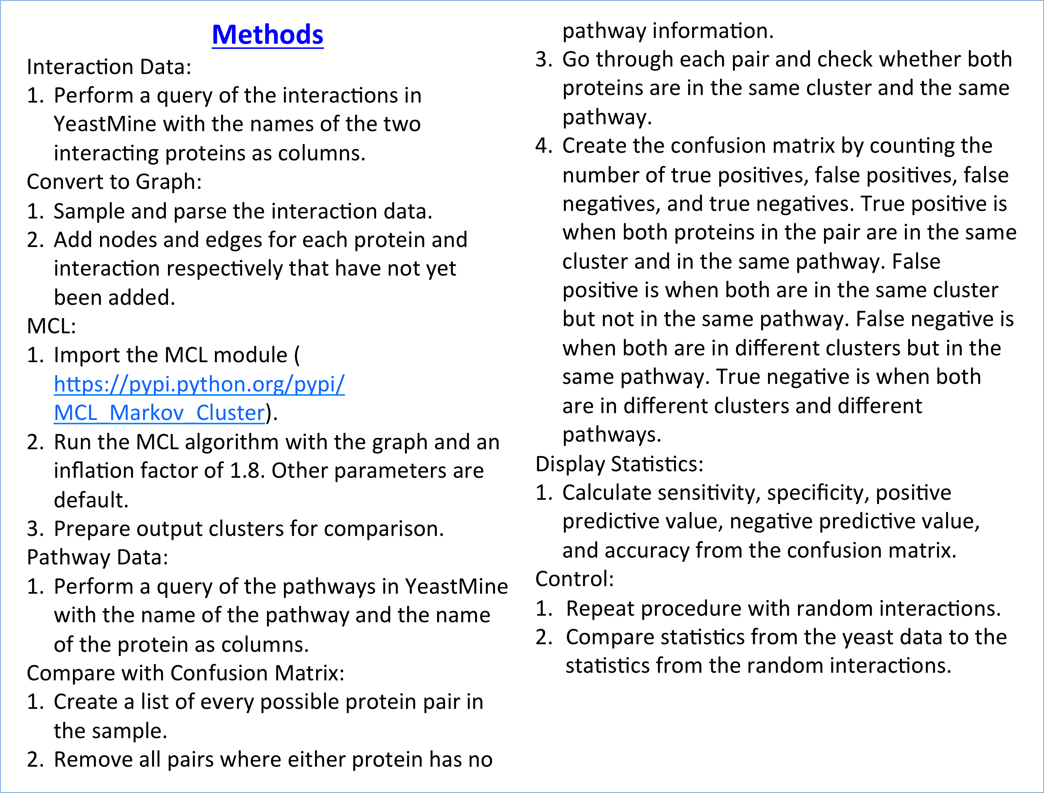
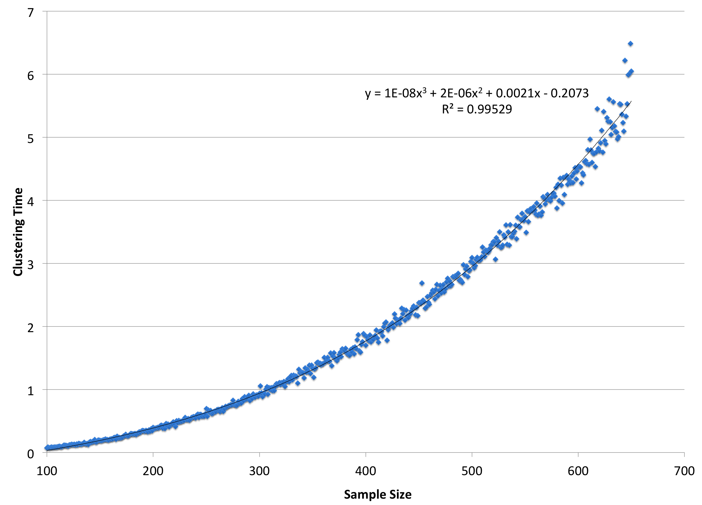


Predicting Biological Pathways Through the Clustering of Interaction Data
Jason Kuo^{1,2}, Jason Miller², Christopher Town²
¹Montgomery Blair High School, Silver Spring, MD ; ²J. Craig Venter Institute, Rockville, MD 20850
Abstract
Protein-protein interactions may be a predictor of pathways. Interaction data and pathway data was taken from YeastMine (SGD). For tractability, this study was run with a random sample of 1000 interactions out of 434,973. The interaction data was then clustered using the Markov Clustering Algorithm (MCL). A confusion matrix was used to measure the positive predictive value (ppv) of cluster co-occurrence as a predictor of pathway co-occurrence. The same methods were used on random interactions as a negative control. The ppv for the yeast interaction data was about 0.2308 compared to a ppv of 0.0 for the control. These results indicate that clustering interaction data is a good predictor of pathways. This study also provides insight into how sampling a biological data set can influence clusters as predictors of pathways. It also provides an open source program for the clustering of interaction data and comparison to pathways (https://github.com/1j4k7/mcl.git).
Introduction
Clustering is an excellent method for grouping together similar items in a collection. The algorithm we used is the Markov Clustering (MCL) Algorithm, an algorithm for clustering graphs based on the simulation of flow. This algorithm been shown to be the most fast and accurate for clustering biological data. By creating a graph using interaction data from YeastMine, the MCL algorithm can be applied to create clusters. These clusters are groups of proteins and represent predicted pathways from the interaction data. This can be compared to yeast pathway data using a confusion matrix to see how well clustering interaction data can predict pathways. Further, how well clustering interaction data predicts pathways can be compared to clustering random interactions to see if the results are influenced by bias. Being able to predict pathways is important for confirmation of existing pathway data and collection of more data.
Yeast Interactions | Condition Positive | Condition Negative
Test Positive | 6 | 20
Test Negative | 200 | 9785
Statistic | Value
Positive Predictive Value | 0.2308
Negative Predictive Value | 0.9800
Sensitivity | 0.0291
Specificity | 0.9980
Accuracy | 0.9780
Conclusions
The positive predictive value for clustering yeast interaction data is much greater compared to clustering random interactions.
We have evidence that the clustering algorithm is O(n³) with respect to time as indicated in figure 1. It is very likely that the runtime for the algorithm grows cubically as the sample size increases because the correlation coefficient for a cubic best fit curve is very close to 1.
Sampling does not seem to create a noticeable bias in the clusters. This is an observation that has not been analyzed in depth.
There is now an open source program for the clustering of interaction data and comparison to pathways (https://github.com/1j4k7/mcl.git).
Random Interactions | Condition Positive | Condition Negative
Test Positive | 0 | 9
Test Negative | 207 | 9795
Statistic | Value
Positive Predictive Value | 0.0000
Negative Predictive Value | 0.9793
Sensitivity | 0.0000
Specificity | 0.9991
Accuracy | 0.9784
Table 1: Two confusion matrices with output statistics on the right. The top matrix was used to score the clusters that came from the yeast interaction data from YeastMine. The bottom matrix was used to score the clusters that came from the random interaction data set.
Future Research
These methods have to be applied to other data sets. For example, interaction and pathway data can be obtained from other organisms from databases such as ThaleMine rather than YeastMine. A large limitation for this study was the processing power and runtime available. For this reason, sampling had to be used to obtain a smaller data set that could be clustered and analyzed in a reasonable amount of time. In the future, the act of sampling must be analyzed to determine how large of a sample must be required to have a good representation of all the interactions. An algorithm that can cluster more efficiently may also be implemented instead of the MCL algorithm. However, if these limitations can be surpasses, huge developments can be made in bioinformatics. Other types of data such as gene co-expression can be put into a graph. This allows the data to clustered using the same algorithm.
Funding
This project is funded by a grant from the National Science Foundation.
Figure 1: Scatter plot of the amount of time it takes to cluster the sample against the size of the sample. It was created by iterating through every integer sample size from 100 to 650 and timing how long it takes to cluster the sample. The vertical axis is in units of seconds and the horizontal axis does not have units. This plot shows the time complexity of the MCL algorithm to be cubic with a very high correlation coefficient. This is great because it confirms the claim on the MCL page (http://micans.org/mcl/). However, cubic growth is not good because the whole yeast interactions data set (size of 434,973) would take an intractable amount of time to cluster.

